Slide 1
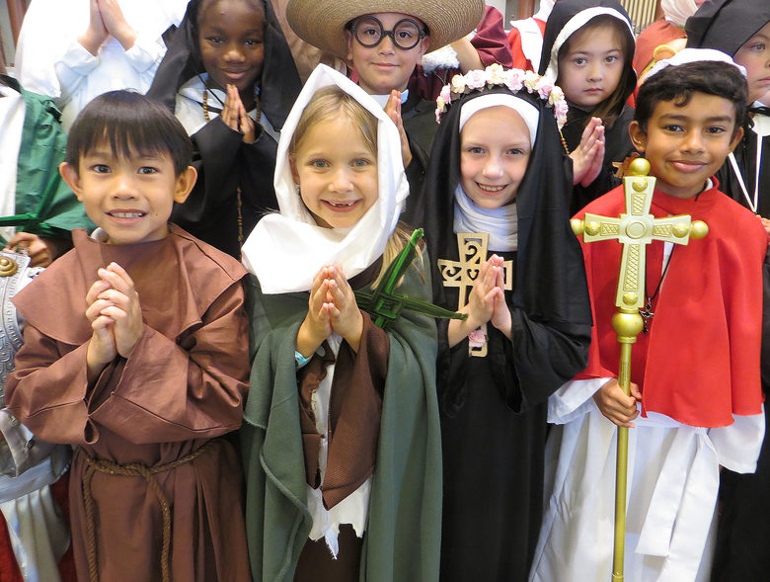
The Feast of All Saints
R-1
S-01
Notes:
Slide 1 The Feast of All Saints
Invite children to bring images, statues and books about saints to create interest in the Saints and add them to the prayer focus this week. Discuss the image and talk about how these children are celebrating ALL SAINTS Day. Create an ALL SAINTS space in the classroom for Saints books etc. and read Saints’ stories in prayer and during the day this month. This will provide a suitable context for All Souls Day on November 2 and the Communion of Saints Strand work.
The last slide in this resource is about Halloween. You can choose to use this or not but children of this age enjoy Halloween. It is at the end so it won’t distract children from LIs of the resource.

Slide 2
Learning Intentions
The children will:
1)
identify that the Feast of ALL SAINTS includes everyone who is with God in heaven
2)
name people who are honoured on the Feast of ALL SAINTS
R-1
S-02
Click the borders to reveal text
Notes:
Slide 2 Learning Intentions
Read through the Learning Intentions with the class and identify some ideas/questions that might be explored in the lesson.
Invite children to share what they know about Saints.
Show children the Columban Calendar and point out the Saints’ names on different feast days. Note the feast in the calendar of some Saints they know.

Slide 3
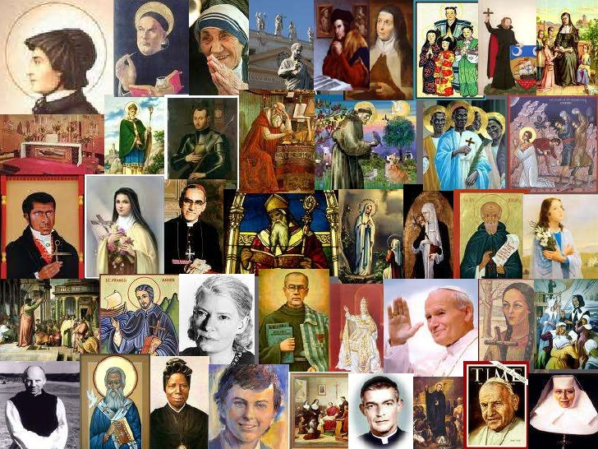
When do we celebrate ALL SAINTS Day?
Look at the collage – all of the people in the collage are saints
They all live in heaven with God because they were loving people on earth
What special day do we celebrate the feast of all the Saints in heaven?
Click the collage to find out and shout out the name and date.
Think about what could you do to celebrate ALL SAINTS Day at home and at school?
R-1
S-03
Click on an image to reveal a text line
Notes:
Slide 3 When do we celebrate ALL SAINTS Day?
Look at the collage of Saints. Explain to children that Saints are ordinary people who lived on earth and loved God and people and cared for creation like Jesus did. When their lives came to an end their souls went to be with God in heaven. Show children some Saints books and plan to read stories about them this week.
Reveal and read each text line and talk about what they mean. Explain we celebrate All Saints Day on November 1 on earth by remembering all the Saints in heaven.
Ask children to share what they think might happen in heaven with God and Jesus and all the Saints on this special feast day.

Slide 4
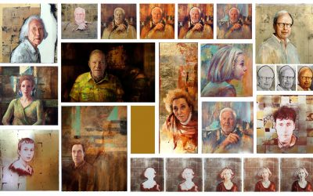
Who are the Saints?
1.
Saints are ordinary people like you and me who
become holy because they love
God very much.
2.
The Holy Spirit helps people to become
holy by loving God and leading people to God.
3.
People become saints by being loving people and caring
for creation and this helps
them to become holy.
4.
People who live good lives become Saints
because their love makes them holy like God.
5.
When they die God takes Saints
to live in heaven forever.
a. become holy because they love God very much.
b. because their love makes them holy like God.
c. to live in heaven forever.
d. holy by loving God and leading people to God
e. for creation and this helps them to become holy.
R-1
S-04
Click a sentence ending from the list to correctly complete sentences.
Notes:
Slide 4 Who are the Saints?
Look at the images of the Saints. What do you notice about them?
Read and talk about each sentence and choose how it can be completed.
Check each one out with the floater.
Invite children to take time to wonder about the Saints and ask questions.

Slide 5
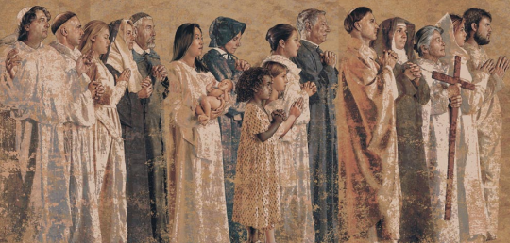
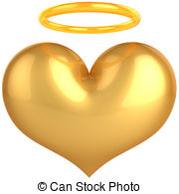
On ALL SAINTS Day we celebrate everyone who is in heaven with God
1
2
3
4
5
Everyone in heaven is a saint because they are with God.
Some saints are well known and some are not.
Some have been made Saints by a pope so they are well known.
On ALL SAINTS Day we celebrate and give God thanks for all the Saints in heaven.
The people who are part of our families and are with God in heaven are saints.
NAME PEOPLE IN YOUR FAMILY WHĀNAU WHO ARE SAINTS IN HEAVEN
R-1
S-05
Click the panels in sequence to reveal the image
Notes:
Slide 5 On ALL SAINTS Day we celebrate everyone who is in heaven with God
Read each panel of the Saints mural. Some of the saints who are not well known to everyone are our friends and family members who lived like Jesus on earth and now they are dead they live in heaven with him.
Capital S is used to denote a Saint who has been canonised - that is officially made a Saint by the Church. People who have not been canonised and are with God are saints.
When we write the name of a Saint who is well known we write St Catherine or St John. Explain some Saints have their own feast day but All Saints Day is the feast of all the Saints.
Note the image is part of an All Saints mural on the walls of the Catholic Cathedral in Los Angeles – Our Lady of the Angels. Mary is the Queen of all the Saints.

Slide 6
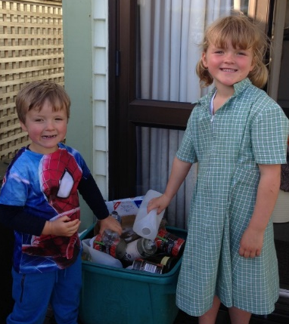
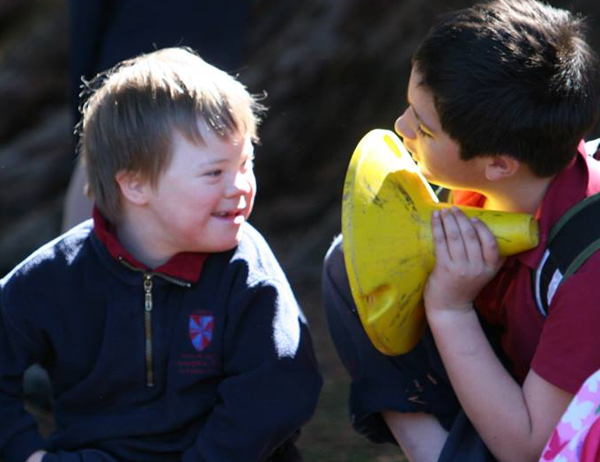
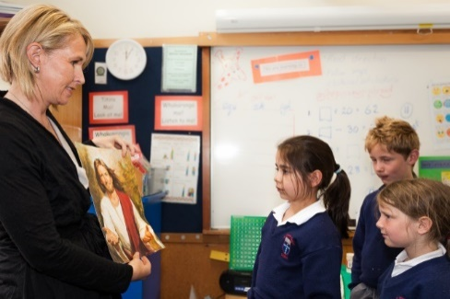
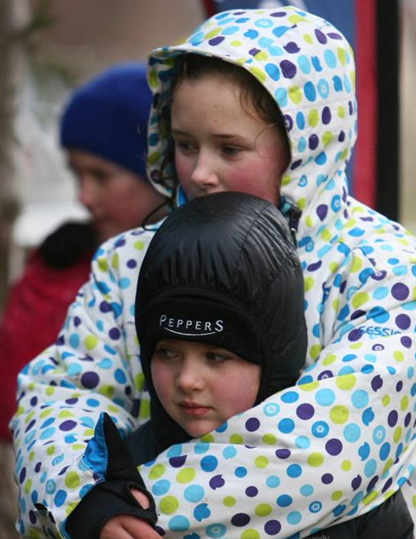
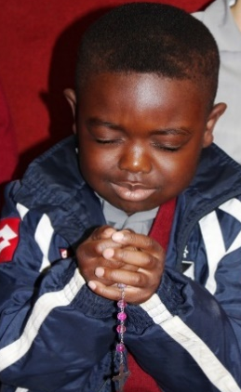
How do people become saints?
People become saints by CARING FOR OTHERS
People become saints by PRAYING TO GOD
People become saints by being KIND
People become saints by LEADING OTHERS TO GOD
People become saints by CARING FOR CREATION
When people are kind, caring and prayerful they become holy.
God is holy. Saints are holy. God wants all people to be holy.
God wants all people to become saints in heaven when their life is ended.
R-1
S-06
Notes:
Slide 6 How do people become saints?
Look at the images and read the text – explain all of these children are becoming saints by doing what Jesus did while he lived on earth. The Saints in heaven are our models – they show us how to live like Jesus and when our lives come to an end we will be saints in heaven with him forever.
Children suggest other ways we can follow Jesus and grow to become saints.

Slide 7
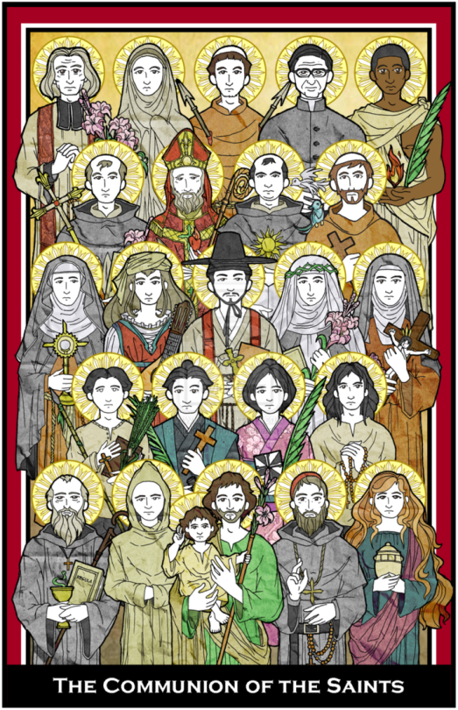
Honouring the Saints
On ALL SAINTS Day the people on earth celebrate all the good things the people in heaven did while they lived on earth. They remember them and thank God for all the people they loved and helped and cared for. There will be a huge party for God and all the holy people who are with God in heaven.
Can you imagine what the celebration of ALL SAINTS Day will be like in heaven!
The Saints who are well known have been recognised by the Church because they have lived their lives being very close to God, very brave, very kind and very loving. These people are our models to follow. Many of these people were priests and religious sisters and brothers.
Read the stories about the lives of these Saints and you will be amazed by how they
lived on earth.
The saints tried their best to be like Jesus and live like him. They helped people in need, they listened to what God wanted them to do and they did it. They never gave up.
They helped others to know Jesus.
Some Saints are well known, others are not.
Name your favourite saint and tell a story about him or her and why he or she is your favourite saint.
What would you say to them if you met them?
During their lives the saints did what God wanted them to do very well.
They cared for God’s creation and encouraged others to do it too.
Do you know the name of the saint who loved and cared for animals and creation – he even talked to them? Here is a clue – he had the same name as our pope!
There are millions of Saints in heaven
with God.
They were once ordinary people who loved God and people while they lived on earth.
It was living like this that helped them to become saints after they died.
Name 3 people you know who are
saints in heaven.
R-1
S-07
Click top card to discard it
Notes:
Slide 7 Honouring the Saints
Read the flip cards and answer the questions.
Explain that some Saints have a feast day of their own during the year and some don’t. ALL SAINTS DAY celebrates ALL people who are saints because they are now with God.

Slide 8
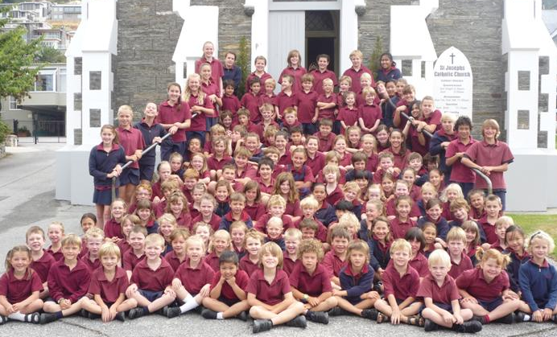
What can children of your age do to become saints?
R-1
S-08
Click in the white box to type. Click the worksheet button to get to worksheet.
Notes:
Slide 8 What can children of your age do to become saints?
Copy a worksheet for each child to colour and complete.
Its purpose is to help children recognise images of well-known Saints and find out something about them. Explain to children what a missionary is.
Add worksheet to children’s RE Learning Journals and send it home to be shared with families.
M Make copies of the 2 worksheets – see below for children to refer to and complete.
Names of Saints starting with Mary on the left and go down around the page
Mary Mother of Jesus, Queen of all the Saints of God.
Saint Mother Teresa of Calcutta, missionary to the poor of India.
Venerable Suzanne Aubert who will be Aotearoa New Zealand’s first Saint.*
St Francis of Assisi, cared for animals as part of God’s creation.
St Patrick, missionary and patron saint of Ireland.
St Joseph, foster father and teacher of Jesus, carpenter.
The apostles and followers and friends of Jesus who loved him very much.
Mary MacKillop, first Australian saint, missionary, teacher.
Saint Thérèse of Lisieux, loved God very much and led others to do the same.
All the saints in heaven whose names are not known, who brought others to God.
*Venerable is the first step to becoming a Saint. Blessed is next and then Saint.

Slide 9
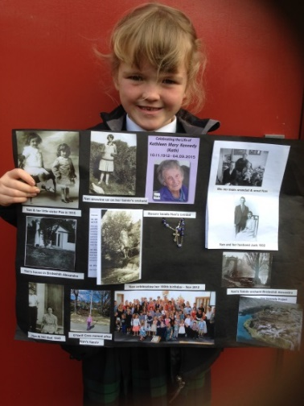
The Saints in heaven can talk to God for us
When people we have known and loved on earth die, they go to heaven to be with God.
Can you name someone you have known and loved who has died?
Although they have gone to heaven they never stop loving us.
What could you do to remember those you love who are in heaven – like your grandmother or grandfather? Look closely at the picture for an idea.
When these people go to heaven they become saints and they can talk to God for us.
What would you ask them to talk to God about for you?
God’s dream is that everyone will come and live in heaven at the end of their life.
What does God want people to do to get ready to be with God while they are living on earth?
R-1
S-09
Click the pins on the right to reveal post-it notes.
Notes:
Slide 9 The Saints in heaven can talk to God for us
Read each post it and share your responses to the questions.
Note the little girl with the poster she made to remember and honour her great grandmother. What ways could you honour people you have loved who have died?

Slide 10
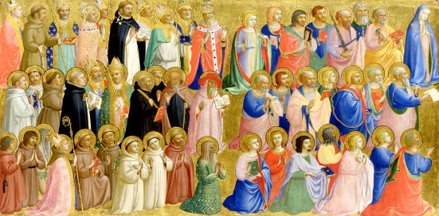
Preparing to celebrate on the eve of All Saints Day – Halloween
Who are the people in this image?
How do you know they are Saints?
Who can you see in the top corner on the right and why would this person be in a Saints picture?
What do you think about this All Saints art work?
R-1
S-10
Click the audio button to play ‘We are all Saints’
Click the audio button to stop ‘We are all Saints’
Notes:
Slide 10 Preparing to celebrate on the eve of All Saints Day – Halloween
Look closely at the image and talk about the people, who they are, how you know they are Saints, note who is on the top right of the image and explain why Mary is there. (Refer to Assumption resource). Explain that artists today may not include halos on saints in their art works. See Slide 11.
Notice the different images artists make of the Saints.
Make an artwork of what you imagine it is like in heaven on All Saints Day. Label them and display them where they can be admired.

Slide 11
What do you know about Halloween?
1.
Halloween is the eve or evening before ALL SAINTS Day
so the date would be the last day of the month - October 31.
2.
A halo is a gold circle of light around a Saint’s head to
show they are very holy and close to God – notice the halos in the picture.
3.
Halloween helps us to get ready to celebrate and honour
the goodness of the ordinary people who are now saints in heaven.
4.
ALL SAINTS Day used to be called All Hallows Day because that was
the feast that all the saints in heaven and earth celebrate.
5.
Halloween was a very old festival when people dressed up to scare
away evil spirits, now it is just time for children to have fun.
a. the goodness of the ordinary people who are now saints in heaven.
b. the feast that all the saints in heaven and earth celebrate.
c. so the date would be the last day of the month - October 31.
d. away evil spirits, now it is just time for children to have fun.
e. show they are very holy and close to God – notice the halos in the picture.
R-1
S-11
Click a sentence ending from the list to correctly position it in the sentence.
Notes:
Slide 11 What do you know about Halloween?
Read and talk about each sentence and choose how it can be completed.
Check each one out with the floater.
Explain the word Halloween (‘hallow’ – holy, ‘een’ – evening) means ‘the evening before the holy day of all the holy Saints’. All hallows – saints wear halos because halos are for people who are very holy like God and that is why the Saints are in heaven with God.

Slide 12
Check Up
1)
Who do we celebrate on ALL SAINTS Day?
2)
What do Saints teach us about how to live with each other on earth?
3)
Draw a picture and tell a story about a Saint you like.
4)
Ask a family member to tell you about someone in your family whānau
who has died and is now a saint in heaven with God.
5)
Which activity do you think helped you to learn best in this resource?
6)
Questions I would like to ask about the topics in this resource are …
R-1
S-12
Click the borders to reveal text
Notes:
Slide 12 Check Up
This formative assessment strategy will help teachers to identify how well children have achieved the Learning Intentions of the lesson.
Teachers can choose how they use the slide in their range of assessment options.
A worksheet of this slide is available for children in Years 5-8 to complete.
The last two items are feed forward for the teacher.
Recording the children’s responses to these items is recommended as it will enable teachers to adjust their learning strategies for future lessons and target the areas that need further attention.

Slide 13
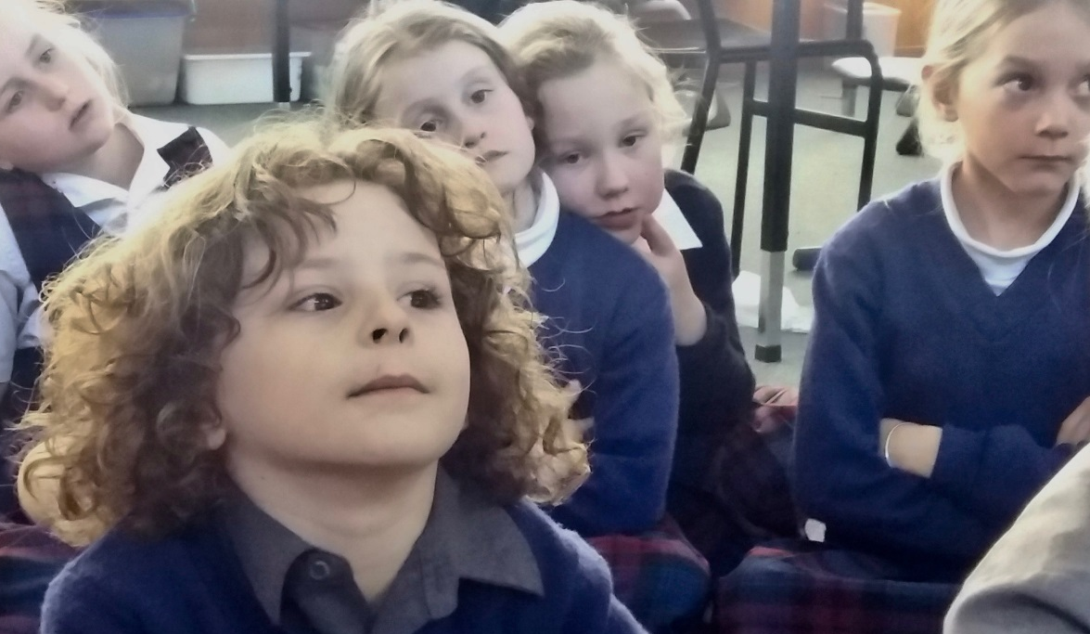
Time for Reflection
R-1
S-13
Click the audio button to stop reflective music
Click the audio button to play reflective music
Notes:
Slide 13 Time for Reflection
The MP3 is played to help create a reflective atmosphere and bring the children to stillness and silence as the teacher invites them to imagine God and all the Saints and people you know who are in heaven celebrating ALL SAINTS Day. Talk to one of them in your heart and ask them to ask God to help you to be a kind and loving person like they were on earth.

Slide 14
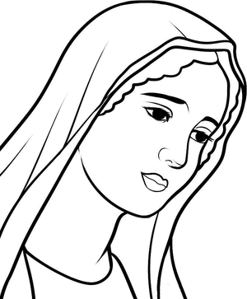
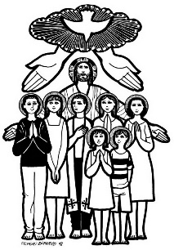
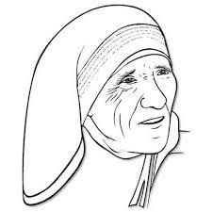
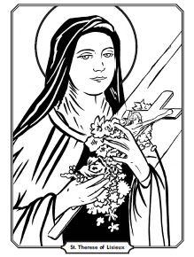
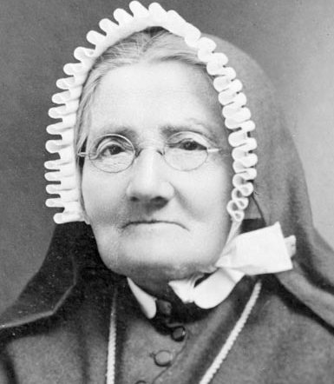
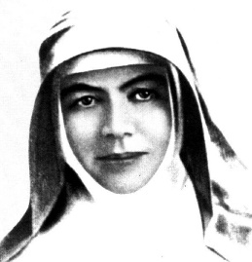
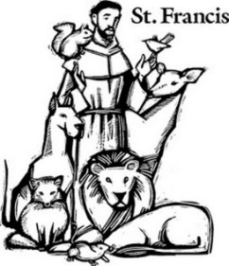
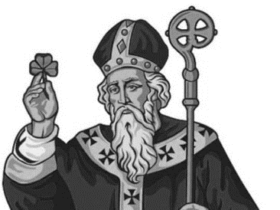
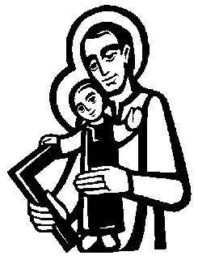
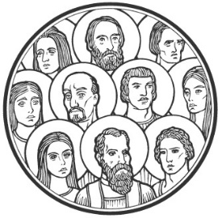
Match the SAINTS with their NAMES
Saints are ordinary people who love God very much.
Saints are holy people who live in heaven with God.
Saints love God and people very much.
Saints care for God’s creation.
Saints pray to God for us.
Saints are our role models who
show us how to follow Jesus.
How can we celebrate and honour
ALL SAINTS on their special day?
How many Saints can you name?
Add some saints of your own.
R-1
S-08A
Worksheet
Click the forward arrow to go to the next worksheet. Click the up arrow to return to the lesson
Notes:
Slide 8A Match the SAINTS with their NAMES - WORKSHEET
This worksheet relates to slide 8

Slide 15
Match the SAINTS with their NAMES
CAN YOU READ THE NAMES OF THE SAINTS AND MATCH THEM WITH THEIR PICTURE
PUT THEIR NUMBER IN THE BOX BESIDE THEM
Names of Saints starting with Mary going left and down around the page
Mary Mother of Jesus, Queen of all the Saints of God.
Saint Mother Teresa of Calcutta, missionary to the poor of India.
Venerable Suzanne Aubert who will be Aotearoa New Zealand’s first Saint.
St Francis of Assisi, cared for animals as part of God’s creation.
St Patrick, missionary and patron saint of Ireland.
St Joseph, foster father and teacher of Jesus, carpenter.
The apostles and followers and friends of Jesus who loved him very much.
Mary MacKillop, first Australian saint, missionary, teacher.
Saint Thérèse of Lisieux, loved God very much and led others to do the same.
10) All the saints in heaven whose names are not known, who brought others to God.
R-1
S-08B
Worksheet
Click the back arrow to go to the next worksheet. Click the up arrow to return to the lesson
Notes:
Slide 8B Match the SAINTS with their NAMES - WORKSHEET
This worksheet relates to slide 8

