Slide 1
The Feast of All Saints
R-1
S-01
Notes:
Slide 1 The Feast of All Saints
Use this slide as a focussing strategy to introduce the resource topic. Read the title together and invite children to share something they know about what Saints are and why there is a feast to celebrate them. Invite children to bring images, statues and books about saints to create interest in the Saints and add them to the prayer focus this week. Create an ALL SAINTS space in the classroom for Saints books etc. and read Saints stories in prayer and during the day this month. This will provide a suitable context for All Souls Day on November 2 and the Communion of Saints Strand work.
The last slide in this resource is about Halloween. You can choose to use this or not but children of this age enjoy Halloween. It is at the end so it won’t distract children from LIs of the resource.

Slide 2
Learning Intentions
The children will:
1)
explain the meaning of the celebrations of All Saints
R-1
S-02
Click the white box to reveal text
Notes:
Slide 2 Learning Intentions
During the week leading up to the feast of All Saints invite children to bring images, statues and books about saints to create interest in the Saints and add them to the prayer focus this week. Create an ALL SAINTS space in the classroom for Saints books etc. and read Saints stories in prayer and during the day this month. This will provide a suitable context for learning about All Souls Day on November 2 and the Communion of Saints Strand work and will encourage children to develop an interest in these models of faith.
When All Saints Day has past then with the children incorporate some of the All Saints prayer focus into an All Souls focus which will last for all of November. Explain to children that some of the saints who are in heaven were once Holy Souls and with the help of people’s prayer they are now saints in heaven with God.
Adapt Teaching and Learning Experience 1.

Slide 3
What is a Saint?
Someone who is very holy and close to
G
od
Men and women who show us how to be
H
oly
Saints follow Jesus and grow more like him
E
veryday
Saints are our holy
M
odels
We can ask Saints to pray to God for
U
s
People become Saints by living with kindness and
G
oodness
Saints live with God in
H
eaven
Saints keep on trying and do not give up in hard
T
imes
Some Saints become famous because of their great love for
O
thers
We can be Saints by following Jesus all through our
L
ives
Click on a letter to reveal a word
R-1
S-03
Click the worksheet button to go to the worksheet
Notes:
Slide 3 What is a Saint?
ANSWERS
1) God 2) holy 3) everyday 4) models 5) us 6) goodness 7) heaven 8) times 9) others 10) lives
Make a copy of the worksheet for each child to complete and add to their RE Learning Journal. Work with the children using the text on the screen and give children a chance to say what the missing word is before revealing it. Give children the worksheet and help them to connect the question in the title with the ideas in the answers with the missing words.

Slide 4
All Saints Day is the day we celebrate the lives of ALL the SAINTS in heaven
1.On ALL SAINTS Day we remember all the Saints
in heaven with God even if we don’t know their names.
2.On November 1 we celebrate the lives of
all the people we call Saints and their holy lives on earth.
3.God wants us all to be holy and good
like God so we can be in heaven when we die.
4.A Saint is a person who lived a very kind and good life on earth
just the way God wants us to live as well.
5.If we are loving and good people we are
on the way to becoming a saint too.
a)all the people we call Saints and their holy lives on earth.
b)on the way to becoming a saint too.
c)like God so we can be in heaven when we die.
d)just the way God wants us to live as well.
e)in heaven with God even if we don’t know their names.
R-1
S-04
Select the correct statement from the list to complete the sentence
Notes:
Slide 4 All Saints Day is the day we celebrate the lives of ALL the SAINTS in heaven
Children read through sentences and find which statement will complete them correctly. Read all the sentences through. Check them with the floaters. ANSWERS 1) e, 2) a, 3) c, 4) d, 5) b Adapt Teaching and Learning Experience 2.

Slide 5
Some saints are living on earth right now – how would you recognise them?
Our grandparents
love us very much – SAINTS ARE LOVING PEOPLE
Our uncles and aunts like to spend time with us - – SAINTS ARE KIND PEOPLE
Our cousins come over to play for the day – SAINTS ARE FUN PEOPLE
R-1
S-5A
Click an image to reveal a text line
Notes:
Slide 5A Some saints are living on earth right now – how would you recognise them?
Adapt Teaching and Learning Experiences 2 & 3.
Children read each revealed text and share about an experience you have had of ways the people mentioned show they are saints living on earth today.

Slide 6
Some saints are living on earth right now – how would you recognise them?
Our aunties like to bake with us – SAINTS ARE PATIENT PEOPLE
Our uncles are interested in us and what we are doing – SAINTS ARE CARING PEOPLE
Our godmothers make us feel special – SAINTS ARE SPECIAL PEOPLE IN OUR LIVES
R-1
S-5B
Click an image to reveal a text line
Notes:
Slide 5B Some saints are living on earth right now – how would you recognise them?
Adapt Teaching and Learning Experiences 2 & 3.
Children read each revealed text and share about an experience they have had of ways the people mentioned show they are saints living on earth today.

Slide 7
Some saints are living on earth right now – how would you recognise them?
Our grandads laugh a lot and cuddle us – SAINTS ARE HAPPY PEOPLE
Our grans are gentle and always have time to spend with us – SAINTS ARE GENTLE, GENEROUS PEOPLE
Our parents guide us and protect us – SAINTS LISTEN TO OUR PRAYER AND TAKE IT TO GOD
Click an image to reveal a text line
R-1
S-5C
Click the audio button to stop ‘We are all Saints’
Click the audio button to play ‘We are all Saints’
Notes:
Slide 5C Some saints are living on earth right now – how would you recognise them?
Adapt Teaching and Learning Experiences 2 & 3.
Children read each revealed text and share about an experience they have had of ways the people mentioned show they are saints living on earth today.

Slide 8
Heaven is full of Saints –
what Saints can you name?
St Mother Teresa of Calcutta
St Patrick
St Therese of Lisieux
St Peter
Mary Queen of All Saints
St Francis of
Assisi
St Mary
MacKillop
St Joseph
St Joan
of Arc
St Patrick
St Mother Teresa of Calcutta
Mary Queen of All Saints
St Therese of Lisieux
St Francis of Assisi
St Joseph
St Mary MacKillop
St Joan of Arc
St Peter
R-1
S-06
Click a name from the list and match it with the saint.
Notes:
Slide 6 Heaven is full of Saints - what Saints can you name?
ANSWERS
1) Mother Teresa of Calcutta 2) St Patrick 3) Saint Thérèse of Lisieux 4) St Peter 5) Mary Queen of All Saints 6) St Francis of Assisi 7) St Mary MacKillop 8) St Joseph 9) St Joan of Arc Children can use this slide to identify well known Saints. They could guess the names and then match them with the name floats. They could find their stories in a book of saints and share them with the class.

Slide 9
Celebrating the Saints
Some Saints have a special feast day of their own each year when their life is celebrated.
Can you name a Saint and the date of their feast day?
Look at the month of your birthday on the ‘I spy’ Saints calendar and try to spy a Saint you know whose feast day is in that month.
What do we call the day when the lives of all the Saints is celebrated?
How could you celebrate ALL SAINTS Day with your class and your family whānau?
X
Click the I-button to reveal information
R-1
S-07
Click the worksheet button to go to the worksheet
Notes:
Slide 7 Celebrating the Saints
Children can make a SAINTS CALENDAR using the blank template page for each month to use in the following year. You may prefer to use A3 size pages as this will allow more space and they could be laminated. Children could mark their birthdays and feast day and note the feast day that shares the date.
Children can work in small groups to add the name of the month and the year and the numbers for each day. They can refer to the Columban Calendar or use other resources to research the feast days assigned to the Saints and add their names to the correct date and month. They could also add a small symbol or image that could help people to remember the Saint’s name and story. Don’t forget to mark ALL SAINTS and ALL SOULS days in November.
The SAINTS Calendar can be referred to during the year and the Saint of the Day can be included in class prayer on their feast day. Children could choose a favourite Saint and research his/her life. They could create an image and a one-page profile of the Saint and these could be put in a clear file in the order of days and the months. It could be referred to and used in prayer time when the Saint of the Day story could be shared with the class as a way of helping children to get to know the Saints and celebrate their feast days.
Suggest to parents a Book of Saints stories is a good present for a child.
Adapt Teaching and Learning Experiences 6 & 7.

Slide 10
Catholics celebrate All Saints Day when they come together for Eucharist
At Eucharist on All Saints Day people give praise and thanks to God for all the good people who are with God who have not been named Saints by the Church.
There are many saints in heaven whose names we do not know and their names will not appear on calendars so that is why we celebrate the goodness of these people’s lives on All Saints Day at Eucharist.
At Eucharist on All Saints Day people thank God for their family members who have died and who they believe are now with God in heaven. There is great rejoicing and happiness in heaven on All Saints Day and we share in it through the Eucharist.
In the gospel that is read at Eucharist on All Saints Day St Matthew writes about the people who are blessed in life and filled with God’s grace. Because they were peacemakers and were filled with kindness and mercy on earth now they live with God.
R-1
S-08
Click the Icons to reveal text and an image.
Notes:
Slide 8 Catholics celebrate All Saints Day when they come together for Eucharist Share the revealed text with the children. Give them a chance to make a comment or ask a question. Explain that some people are recognised as Saints by the Church because they did great things that many people know about. Other people are saints because of the ways they lived their lives on earth and some are still living in loving ways as Jesus did. These people are people we know, our teachers, our friends, our aunties, our cousins, our coaches, our grans and grandads, our friends and priests. Next time we see their loving, kind ways we can try to remind ourselves that these people are ‘living’ saints here and now who are models for us to copy and who can lead us to God.

Slide 11
Celebrating All Saints Day at school
Here are some ideas to get you started:
Play the CELEBRATING ALL SAINTS
board game
Dress up as a saint like the children in the
picture and have an All Saints parade and
invite other classes to join in
Make an All Saints bunting – Saint’s name
on one side ‘Pray for us’ on the other –
hang it in the school and church foyer
Have an All Saints party and play party
games
Make an art work of your favourite saint
and create an All Saints Art Exhibition to
share with your families and parish.
Click the worksheet button to go to the game
Click the audio button to stop ‘We are all Saints’
R-1
S-09
Click the audio button to play ‘We are all Saints’
Click the video button to play ‘When the Saints go Marching in’
Notes:
Slide 9 Celebrating All Saints Day at school Work through the ideas with the children and decide how you could celebrate All Saints Day. The Celebrating All Saints board game is also available to print in the Lesson Notes in the resource section on the front screen. Make copies for children to share in pairs or small groups – dice and counters are needed.

Slide 12
Check Up
1)
Why do we call people Saints? (Slides 3&4)
Name 3 named Saints and 3 Saints that you knew on earth and who are in heaven now with God. (Slide 5A,B,C)
2)
3)
How can Saints help people like us on earth? (Slide 6)
Who do we celebrate on All Saints Day and name 2 ways to celebrate? (Slides 8&9)
4)
5)
What do we praise and thank God for at the All Saints Day Eucharist? (Slide 8)
6)
Which activity do you think helped you to learn best in this resource?
7)
Questions I would like to ask about the topics in this resource are …
R-1
S-10
Click the white box to reveal text
Notes:
Slide 10 Check Up
This formative assessment strategy will help teachers to identify how well children have achieved the Learning Intentions of the resource. Teachers can choose how they use the slide in their range of assessment options. A worksheet of this slide is available for children in Years 5-8 to complete. The last two items are feed forward for the teacher. Recording the children’s responses to these items is recommended as it will enable teachers to adjust their learning strategies for future resources and target the areas that need further attention.

Slide 13
Time for Reflection
Click the audio button to stop reflective music
R-1
S-11
Click the audio button to play reflective music
Notes:
Slide 11 Time for Reflection
The MP3 is played to help create a reflective atmosphere and bring the children to stillness and silence as the teacher invites them to imagine all the Saints in heaven praising and giving thanks to God. Think about them as their models who can help and guide them to be kind and good to everyone. Plan a kind action they could do every day to help them to become a saint.

Slide 14
What is a Saint?
Name: Date:
Someone who is very holy and close to
G
Men and women who show us how to be
H
Saints follow Jesus and grow more like him
E
Saints are our holy
M
We can ask Saints to pray to God for
U
People become Saints by living with kindness and
G
Saints live with God in
H
Saints keep on trying and do not give up in hard
T
Some Saints become famous because of their great love for
O
We can be Saints by following Jesus all through our
L
Worksheet
R-1
S-03
Click the up arrow to return to the lesson
Notes:
Slide 3 What is a Saint? WORKSHEET
This worksheet relates to slide 3

Slide 15
Celebrating the Saints
R-1
S-07
Click the up arrow to return to the lesson
Notes:
Slide 7 Celebrating the Saints WORKSHEET
This worksheet relates to slide 7

Slide 16
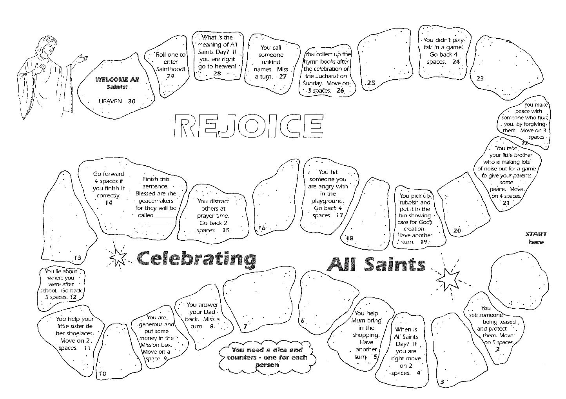
Celebrating All Saints Day at school
Game
R-1
S-09
Click the up arrow to return to the lesson
Notes:
Slide 9 Celebrating All Saints Day at school GAME
This worksheet relates to slide 9

