Slide 1
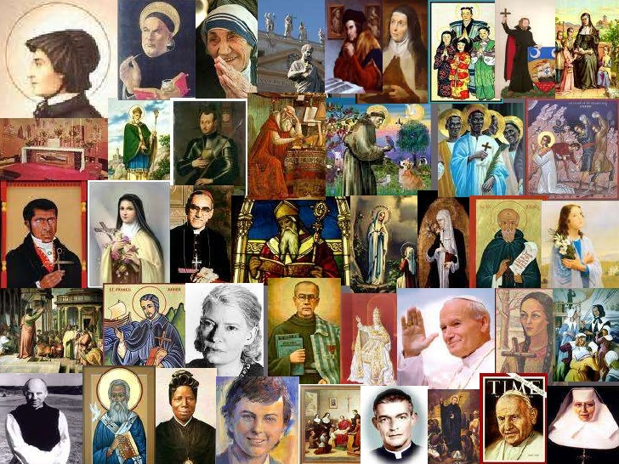
The Feast of All Saints
R-1
S-01
Notes:
Invite the children to look closely at the collage of Saints.
Share the names of those you recognise.
Can you identify some who have been canonised in the 21st century?
As you look at the collage make a summary statement about Saints.

Slide 2
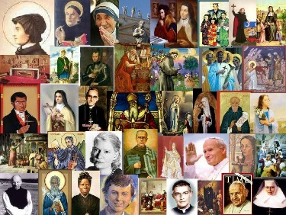
Learning Intentions
The children will:
1)
identify the saints as members of the Church who are in heaven
2)
recognise that the saints in heaven are united to the members of the Church who are on earth and pray for them.
R-1
S-02
Click in each caption space to reveal text.
Notes:
Read through the Learning Intentions with the class and identify some ideas/questions that might be explored in the resource.
Make a prayer focus for this month with images and symbols of Saints in heaven and on earth. Create a litany to pray during class prayer and sing ‘We are all Saints’. Read the life story of a Saint each day in class prayer.

Slide 3


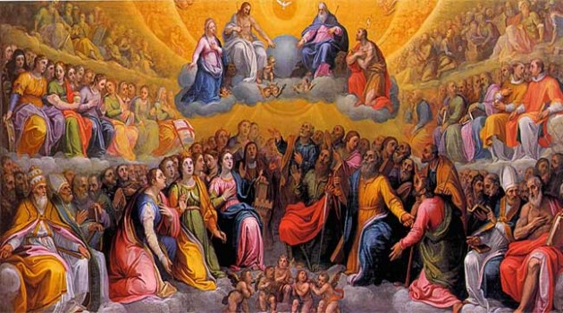
The Feast of All Saints celebrates the lives
of all the members of the Church in heaven and on earth
There are thousands of canonised saints in heaven and billions who are not. All through these holy people’s ordinary lives they have taken part in the life of God as they loved and cared for others: mums and dads, grandmothers and grandfathers, aunties and uncles and faithful friends and neighbours.
Can you name some?
There are saints in heaven who were children when they died and who lived their lives as loving daughters and sons and as good friends, team members, classmates, dancers, singers, artists, runners, magicians, sports people and they followed God’s call to be holy people in their families and communities in the world. Can you name some?
Click the pins on the right to reveal post-it notes.
Click the video button to play the clip ‘How Do You Become A Saint’.
R-1
S-03A
Notes:
Adapt Teaching and Learning Experience 1
Look at the image – name the groups of people in it and say something you know about them. How would you describe this style of art work?
Read the 1st post it – then watch the clip https://www.youtube.com/watch?v=o5JA1LTWc7M
How Do You Become A Saint? 2:47 minutes
Have a conversation with the person next to you about what you learned about how Saints are canonised.
Read the 2nd post it and respond.

Slide 4
The Feast of All Saints celebrates the lives
of all the members of the Church in heaven and on earth
There are Saints living on earth too. They are people who share their energy, their gifts and their time to benefit others. They spread happiness and joy and kindness and love wherever they go. They are generous, compassionate friends of Jesus who help others to get to know him. These people are in our family whānau, our parish, our country and our world.
Can you name some?
There are saints in heaven from every culture and period of history in the world, whose names are no longer known by people on earth and are known only to God. Some are from different religions and ways of living and God has brought them to heaven to be included forever in God’s glorious kingdom.
Can you name some?
R-1
S-03B
Click the pins on the right to reveal post-it notes.
Notes:
Read, discuss and respond to the post it notes.
In pairs create some questions to encourage deeper thinking about Saints and their lives on earth. Use the questions to start a class discussion.
Name some children in your class who know a lot about Saints and ask them to share what they know.

Slide 5
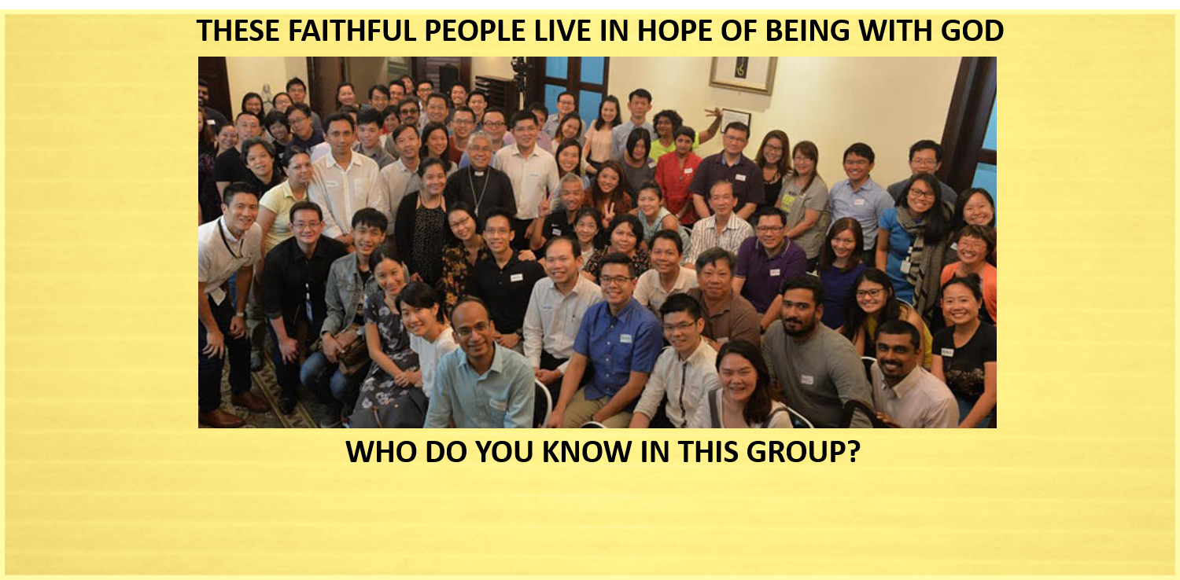
The People of God
who are part of the Church on earth
They are people who are baptised faithful followers of Jesus who live holy lives
They try to live as he did and they love and care for others
They serve people who are poor
They continue to love their family members who have died and they pray that they are with God
They live in hope that one day they will be with God in heaven.
R-1
S-04
Click the down-button to move the blind down, click the up-button (appears at bottom) to move the blind to the top.
Notes:
Read the title and the text reveals then talk about what they mean.
Invite children to name some people they know who talk to them about hoping one day they will be in heaven with God.
Take time to reflect on what living in hope means to them and say why it is important for Christians to have hope in their hearts.
Note that the people spoken about on Slides 4,5,6 are all part of the Communion of Saints

Slide 6
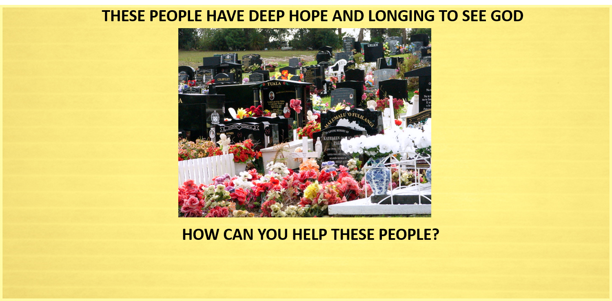
The People whose souls are in Purgatory
They are the people who have died and remain united by the bonds of friendship with God through their baptism
They are not with God yet because they need to make up for their sins and failures to love others while they lived on earth
They wait in purgatory preparing and longing to be with God in heaven
They long to be with those they knew and loved on earth who are in heaven
They cannot help themselves so they rely on the prayer and good works of people on earth to help them reach their heavenly goal
R-1
S-05
Click the down-button to move the blind down, click the up-button (appears at bottom) to move the blind to the top.
Notes:
Read the title and the text reveals then talk about what they mean.
Invite children to bring to mind someone they know who may be waiting to go to God and needs their prayer. Spend a few minutes silently naming people and asking God to take them to heaven. Encourage them to share this idea with their family and suggest they pray together at home for their family members who have died during the month of November. After dinner is a good time for family prayer.

Slide 7
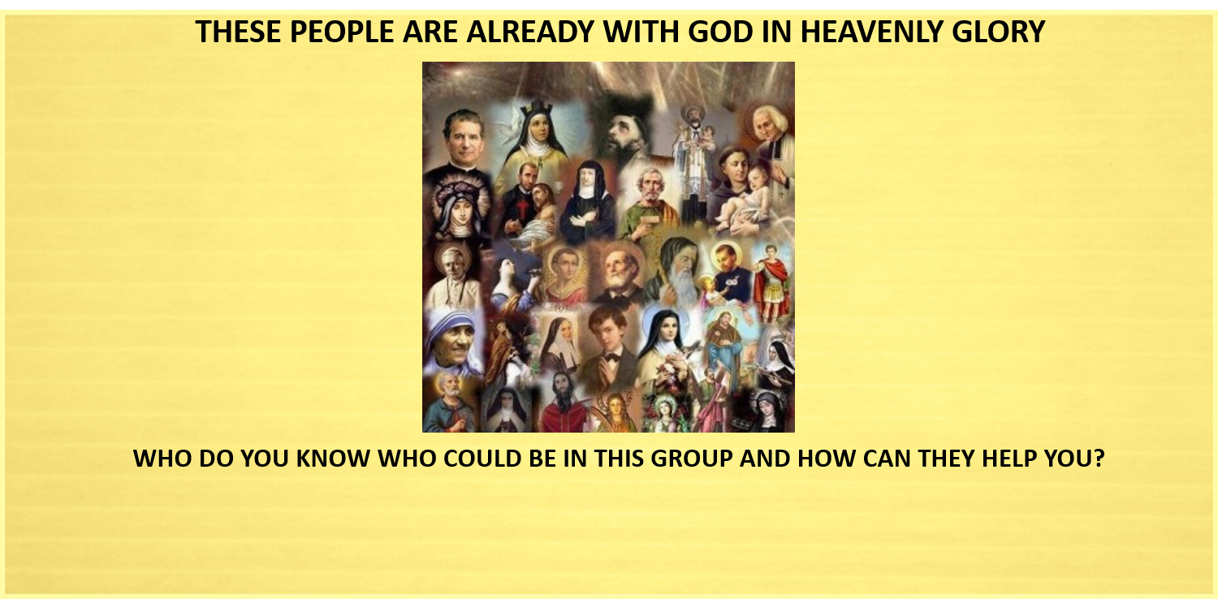
The People who are Saints in Heaven
They are the people in heaven who have loved God and followed Jesus faithfully during their lives on earth.
Some of them have lived very closely to God and been recognised as very holy people and they are canonised Saints.
Others are ordinary people like members of our family whānau who tried hard to live as God wanted them to and sometimes they forgot to.
All of these people are saints and they are all giving God praise and thanks now and will go on doing this forever.
They can help people on earth because they still love and care for them by taking their prayers to God, Jesus and Mary.
Through the power of the Holy Spirit Te Wairua Tapu all members of the Church on earth and all the saints in heaven join in praise and thanks to God
during the Eucharist.
R-1
S-06
Click the down-button to move the blind down, click the up-button (appears at bottom) to move the blind to the top.
Notes:
Adapt Teaching and Learning Experience 2
Read the title and the text reveals then talk about what they mean.
Set up a Saints’ Books Basket for children to read saints stories during this month.
Children can make up a quiz for the class or play 20 questions to identify a saint. They could research stories on the web and share them each morning during class prayer.
Talk to children about how they will all be saints one day because through their baptism the Holy Spirit will guide them along the path to sainthood. Remind them to listen to the Holy Spirit prompting them each day to follow Jesus by serving others, encouraging others and doing their best at home and at school.

Slide 8

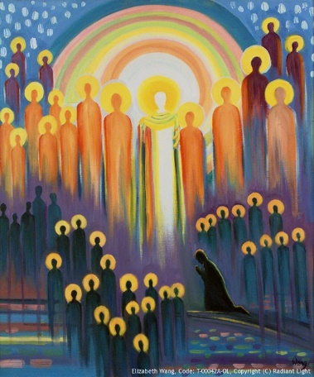

The Saints in heaven, the people on earth and the souls
in purgatory are all part of the Communion of Saints
What is the Communion of Saints?
The Communion of Saints is a Catholic belief that describes the Church as a gathering of all those who are saints because of their faith in Jesus Christ.
What do Catholics do to share in the family of the Communion of Saints?
Catholics share their gifts in the service of others in the Church and in the world, they care for people in need, they participate in the sacraments especially the Eucharist
– all of these practices tie the followers of Jesus together in a special bond.
Who belongs to the Communion of Saints?
Catholic believe that the Holy Spirit unites all people who believe in Jesus, those who are alive right now, those who have died and are being prepared to enter heaven and the Saints who are in heaven right now are all members of the Communion of Saints.
Why do Catholics pray for people who have died?
Catholics believe that the bonds of love people have while they are on earth do not break when they die. People who love one another hold one another up before God in prayer. We pray for God’s mercy on our dead family and friends asking that their journey to heaven be swift.
R-1
S-07
Click the audio button to stop ‘We are all Saints’
Click an image on the left to reveal text.
Click the audio button to play ‘We are all Saints’
Notes:
Invite children to look closely at the image.
With a partner discuss where you can see each group that is part of the Communion of Saints.
Who is the dark figure kneeling in the centre of the image?
Debate how well in your opinion this artist has expressed the Catholic belief of the Communion of Saints.
Adapt Teaching and Learning Experience 3.
Read and discuss the text reveals. Sing using the MP3 ‘We are all Saints’.

Slide 9
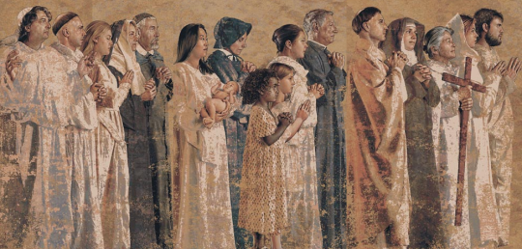
How are the living followers of Jesus on earth connected with the Saints in heaven?
People on earth are connected to the Saints in heaven
through the bond given at baptism by the Holy Spirit that will never break.
Even after death people are still brothers and sisters of Christ and
members of the Church and the Communion of Saints.
Just as people on earth pray for one another the saints in heaven
pray for people on earth because they continue to love and care for them.
members of the Church and the Communion of Saints.
through the bond given at baptism by the Holy Spirit that will never break.
pray for people on earth because they continue to love and care for them.
R-1
S-08A
Click on a sentence from the list at the bottom or click an empty text box to complete the sentences.
Notes:
Adapt Teaching and Learning Experience 3
Children suggest the statement that will complete each sentence – check them with the floater and discuss their meaning.
This image hangs in the St Mary of the Angels Catholic Cathedral in Los Angeles. It is part of a mural of the Communion of Saints which surrounds the people as they pray at mass. You can see more of this mural and learn more about it if look on the website. What might the people who pray looking at the mural feel as living members of the Communion of Saints?

Slide 10
How are the living followers of Jesus on earth connected with the Saints in heaven?
People living on earth believe all the saints in heaven
including their
family whānau members hear their prayers and bring them to God.
The saints in heaven have achieved their sainthood and are now cheering on
people on earth who are still on the way to sainthood in the holy life of God.
All people who are in heaven are saints even if they have not been canonised
because they have lived their lives in keeping with the holy life of God.
because they have lived their lives in keeping with the holy life of God.
family whānau members hear their prayers and bring them to God.
people on earth who are still on the way to sainthood in the holy life of God.
R-1
S-08B
Click on a sentence from the list at the bottom or click an empty text box to complete the sentences.
Notes:
Children suggest the statement that will complete each sentence – check them with the floater and discuss their meaning.
This image hangs in the St Mary of the Angels Catholic Cathedral in Los Angeles. It is part of a mural of the Communion of Saints which surrounds the people as they pray at mass. You can see more of this mural and learn more about it if look on the website. What might the people who pray looking at the mural feel as living members of the Communion of Saints?

Slide 11
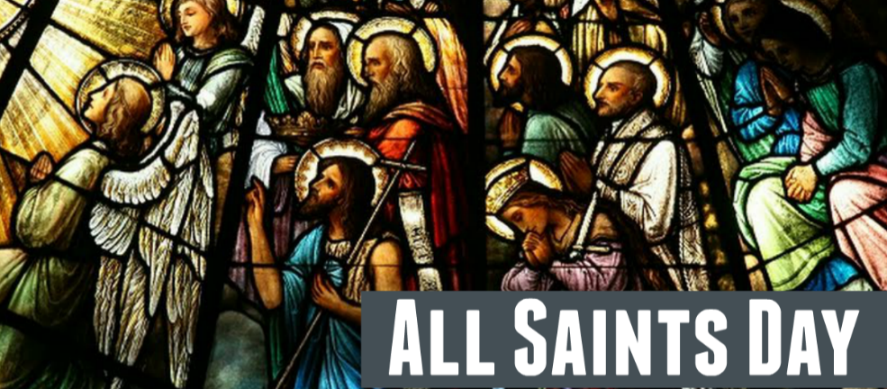
The Feast of All Saints
Some DIY ideas for the Feast of All Saints:
Name 3 saints in heaven who are canonised
and 3 saints who are not canonised.
Guess how many saints there are in heaven.
Make and share a Post it board with the names of all
the saints you know – CELEBRATING ALL SAINTS.
Make the names into a Litany of the Saints to pray and share in November.
SHARE A SAINT’S STORY IN A MINIUTE - Choose a saint, research their story and share it with your class
in one minute.
SAINT’S SYMBOL GUESSING GAME - draw or make a symbol of a saint you know about.
Let your class guess which saint it symbolises – explain why this symbol is appropriate.
Make up an ALL SAINTS DAY RAP – teach it to younger classes, record it and put the clip on the school website.
Plan a class celebration for ALL SAINTS DAY and invite people to come.
R-1
S-09
Click the worksheet button to go to the worksheet.
Notes:
This slide will give the children some scope for their own activities to share with their school, family and parish in their All Saints day celebration.
Print of some worksheets for children to refer to and choose some of the ideas to celebrate All Saints day.

Slide 12

Check Up
1)
What are the benefits of having ALL SAINTS DAY in the Liturgical Calendar?
2)
How can people on earth honour the saints and make use of them?
3)
Create an image or symbol of the Communion of Saints and put yourself in it.
R-1
S-10A
Notes:
This formative assessment strategy will help teachers to identify how well children have achieved the Learning Intentions of the resource.
Teachers can choose how they use the slide in their range of assessment options.
A worksheet of this slide is available for children in Years 5-8 to complete.
The last two items are feed forward for the teacher.
Recording the children’s responses to these items is recommended as it will enable teachers to adjust their learning strategies for future resources and target the areas that need further attention.

Slide 13
Check Up
4)
Make SAINTS ARE … posters to help others to understand how lucky we are to have Saints in our Church.
5)
Which activity do you think helped you to learn best in this resource?
6)
Questions I would like to ask about the topics in this resource are …
R-1
S-10B
Click the worksheet button to go to the worksheet
Notes:
Children complete the Check Up worksheet and add it to their Re Learning Journal.

Slide 14
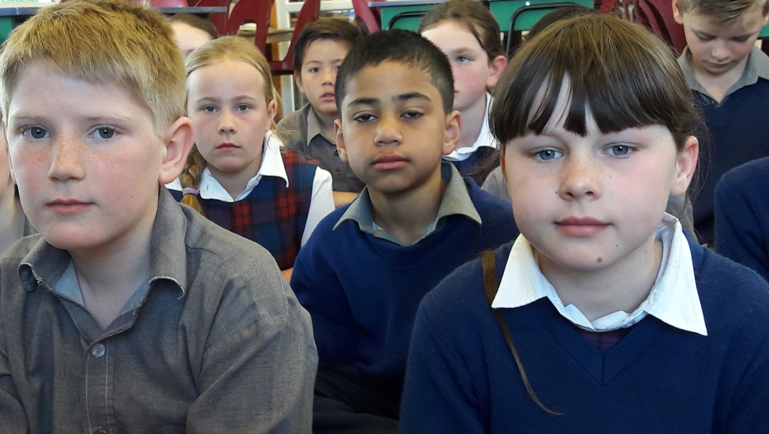

Time for Reflection
R-1
S-11
Click the audio button to stop reflective music
Click the audio button to play reflective music
Notes:
The MP3 is played to help create a reflective atmosphere and bring the children to stillness and silence as the teacher invites them to think about one simple thing they can make a habit of each day to help them grow in holiness and become a saint in heaven one day.

Slide 15
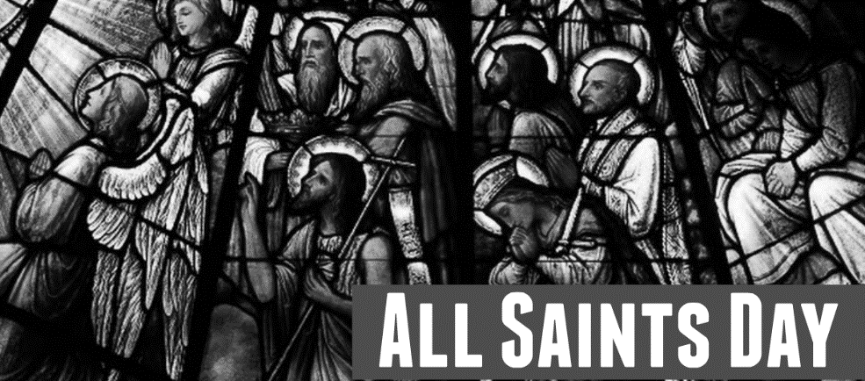
The Feast of All Saints
Some DIY ideas for the Feast of All Saints:
Name 3 saints in heaven who are canonised
and 3 saints who are not canonised.
Guess how many saints there are in heaven.
Make and share a Post it board with the names of all
the saints you know – CELEBRATING ALL SAINTS.
Make the names into a Litany of the Saints to pray and share in November.
SHARE A SAINT’S STORY IN A MINIUTE - Choose a saint, research their story and share it with your class
in one minute.
SAINT’S SYMBOL GUESSING GAME - draw or make a symbol of a saint you know about.
Let your class guess which saint it symbolises – explain why this symbol is appropriate.
Make up an ALL SAINTS DAY RAP – teach it to younger classes, record it and put the clip on the school website.
Plan a class celebration for ALL SAINTS DAY and invite people to come.
Name:___________________________
Date:____________
R-1
S-09
Worksheet
Click the up arrow to return to the presentation
Notes:
This Worksheet relates to Slide 9.

Slide 16
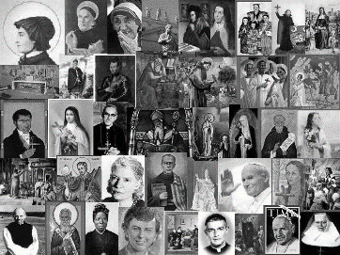
Check Up
Name:____________________________
Date:____________
1) What are the benefits of having ALL SAINTS DAY in the Liturgical Calendar?
2) How can people on earth honour the saints and make use of them?
3) Create an image or symbol of the Communion of Saints and put yourself in it.
4) Make SAINTS ARE … posters to help others to understand how lucky we are to have Saints in our Church.
5) Which activity do you think helped you to learn best in this resource?
6) Questions I would like to ask about the topics in this resource are …
R-1
S-10
Worksheet
Click the up arrow to return to the presentation
Notes:
This Worksheet relates to Slide 10.

