Slide 1
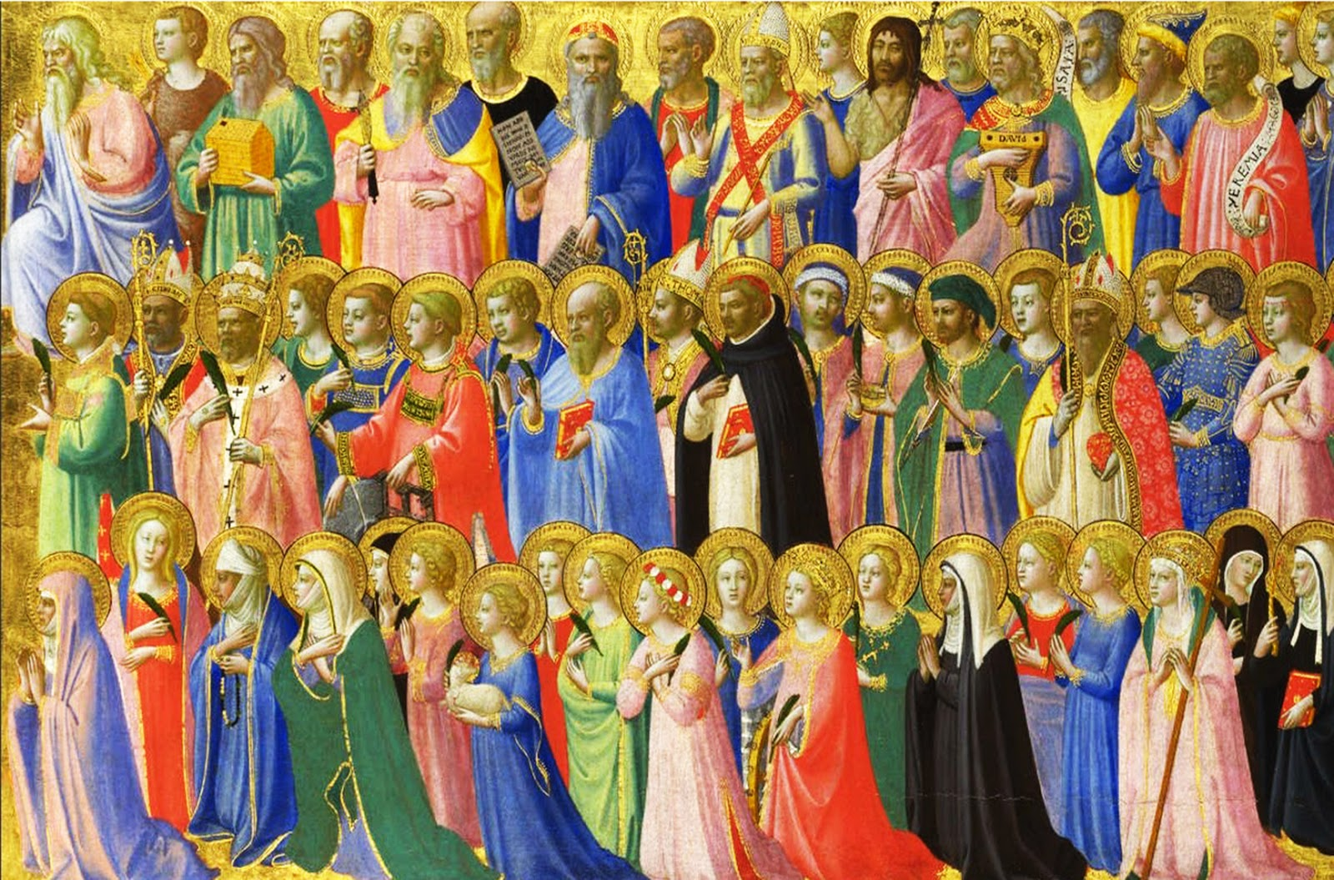
The Feast of All Saints
R-1
S-01
Notes:
Slide 1 The Feast of All Saints Use this slide as a focussing strategy to introduce the resource topic. Read the title together and invite students to share something they know about Saints and the way the Church celebrates the great feast of All Saints.

Slide 2
Learning Intentions
The students will:
1)
explain who the Church honours and celebrates on All Saints Day
2)
explain the relationship between the saints in heaven and the people on earth continuing the journey as the pilgrim people of God on earth
R-1
S-02
Click the borders to reveal text
Notes:
Slide 2 Learning Intentions
During the week leading up to the feast of All Saints invite children to bring images, statues and books about saints to create interest in the Saints and add them to the prayer focus this week. Create an ALL SAINTS space in the classroom for Saints books etc. and read Saint’s stories in prayer and during the day this month. This will provide a suitable context for All Souls day on November 2 and the Communion of Saints Strand work and will encourage children to develop an interest in these models of faith.
When All Saints day has past then with the children incorporate some of the All Saints prayer focus into an All Souls focus which could last for all of November until Advent. Explain to children that some of the saints who are in heaven were once holy souls and with the help of people’s prayer they are now saints in heaven with God.

Slide 3
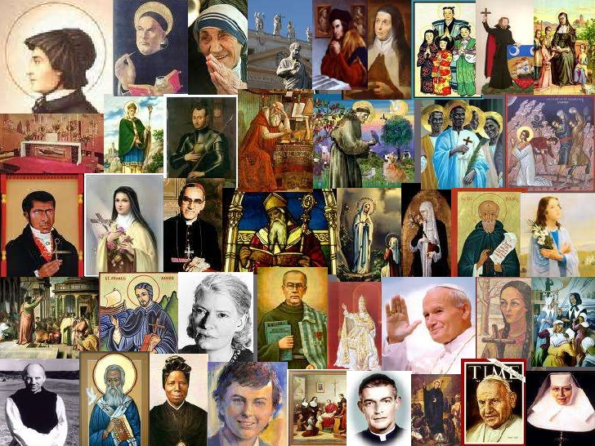
Saints – what do you know about them?
R-1
S-03
Notes:
Slide 3 Saints – what do you know about them?
Invite students to describe in as many ways they can think of where the feast of All Saints occurs in the Liturgical Year. Refer to Slide 7 for image of Liturgical Calendar.
Look closely at the image and see if you can recognise any of the Saints? Share an observation about who Saints are.
Complete the sentences There are lots of ….. There are not many … There are very few … Can you give reasons to explain why this might be?
On the whiteboard make a bill board headed: What we know about the Saints
Using post-it notes students write what they know and put these ideas on the left side of the board. Repeat this on the right side with questions they have about Saints.
Read out the statements on the post its and put them into categories – e.g.
Descriptions of what a saint is, Names of well-known saints, Facts about Saints, How people become saints, etc.
Read the questions on the post its. Check if some can be answered with the statements. Keep the questions in view as you work through the resource. These can be returned to recap on Slide 10.

Slide 4
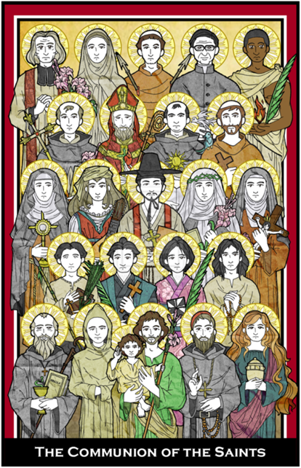
The Catholic Tradition and History of Honouring the Saints
Over time the early burial places of the Saints became places of pilgrimage and prayer for Christians to visit. Some had tombs and churches built over them and they became popular places to celebrate Mass in honour of the Saints and give thanks to God for their lives.
TASK 7
Research where some of these places are and make a plan to use when you visit them on your OE when you are older!
The canonisation of Saint Udalric, by
Pope John XV in 993 was the first example of
a Saint canonised by a pope. Later Bishops helped
to oversee the more formal process of making people Saints which we call ‘canonisation’.
The ceremony was led by the pope of the time. Prior to this the Church did not have a formal canonisation process for making people Saints.
TASK 6
Why do you think it would be necessary to have a formal canonisation process?
Make a flow chart to explain the process.
Following the canonising of some unsuitable people, the church saw the need to tighten the canonisation process to prevent this from happening. From then on when seeking approval for a person to be canonised, their suitability would be carefully scrutinized during the long process before they could become ‘added to the list of official Saints’.
TASK 5
Make a list of all the official Saints you know – don’t forget those mentioned in Task 3. From your list create a litany to pray during prayer time e.g. St Patrick early missionary in Ireland - Pray for us.
With the criteria for canonisation not as strict as it is today, the number of saints had increased greatly by the sixth and seventh centuries.
TASK 4
Find out who some of these saints were in this period and dramatise some highlights of the life of one or make a comic strip of the story of one of them to share.
Over the next few centuries, sainthood was extended to those who had defended the faith and led holy lives such as Mary and Joseph, Elizabeth, Ann and Joachim.
TASK 3
Can you name other holy people of this period, make a collage of them and write 5 fast facts about each of them?
In early Christian times the meaning of the word ‘martyr’ changed to refer to a believer who was called to witness for their religious belief, and on account of this witness, endured suffering or death. St John was the only apostle of Jesus who was not martyred. The first martyrs were honoured as saints almost immediately after their deaths.
TASK 2 Make memorial cards for 3 of the apostles. Include details of their lives and death. Use a present day memorial card as a model to share. When sharing your work explain why people have memorial cards and show some recent examples.
The first people to be revered as Catholic saints were martyrs who died under the Roman persecution in the first centuries after Jesus Christ. Martyrs are people who give up their lives in the name of God and their religious beliefs. Originally the word ‘martyr’ meant ‘witness’ but it was not intended that witnessing would lead to death.
TASK 1
Who was the first Christian Martyr?
Present his story to be shared with others.
R-1
S-04
Click the top card to discard it. Click the worksheet button for printable flip cards
Notes:
Slide 4 The Catholic Tradition and History of Honouring the Saints
The activities that follow on the flip cards can be worked on individually or in pairs as home or classroom tasks and shared with others when completed during November to keep the focus on the Saints.
Note that printable flip cards, for the students to work with, are available as a PDF file from the Teachers’ Resources on the web-site.

Slide 5
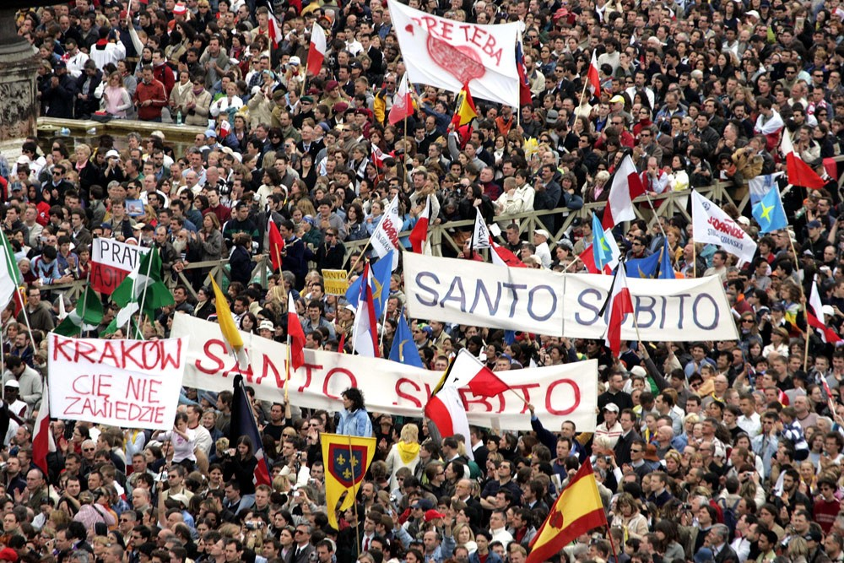
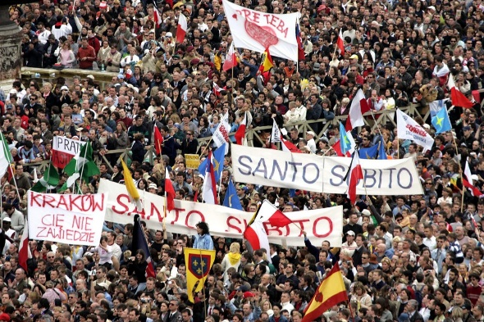
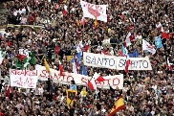
Pope Francis canonises Saints in the Vatican in Rome
Throughout Catholic history, the saints have been a central part of Catholic belief and spirituality. They are like ‘elder brothers and sisters who cheer us along’. St Paul calls them a ‘cloud of witnesses’ surrounding us. (Hebrews 12)
TASK 11
Read Hebrews 11 and make a collage of the names and images of the ’witnesses’ Paul is talking about to share. Put a symbol of their lives beside their name and image.
The ‘Venerable’ Suzanne Aubert has made the first step on her journey towards Sainthood. The next step she will pass through is beatification when she will be called ‘Blessed’ and then through to ‘Saint’ hood. Suzanne Aubert will be Aotearoa New Zealand’s first Saint.
TASK 10
Make a timeline of Suzanne Aubert’s life, illustrate it and include her path to Sainthood. Prepare and share an ‘íntervïew’ with her and record and keep it to use when she is canonised.
In the 21st century there has been an emphasis on canonising a greater mix of people. These include young people, people from non-European countries and cultures such as South America, China, indigenous people and lay people - married and single. These are ordinary people like us. They come from countries all over the world. They are our models of faith.
TASK 9 Research some of the more recently canonised Saints and note which of these categories mentioned they represent. Include thumbnail descriptions of their lives with images of them to share.
In the 20th century, Popes John Paul II and Benedict XVI revised the canonisation process and Pope Francis has continued to do this more recently. When Pope John Paul II died in 2005, people in the crowd in St. Peter’s Square chanted, “Santo subito” meaning “Sainthood now.” Research if this would be possible? Pope Francis canonised him in April 2014.
TASK 8 Watch a you tube clip of a canonisation event and include it in a presentation to share, see example below. Note when selecting the clip the language it is in and how long it runs for.
Click the top card to discard it. Click the video button to play ‘Saint Teresa’ Click the worksheet button for printable flip cards
R-1
S-05
Notes:
Slide 5 Pope Francis canonises Saints in the Vatican in Rome
Watch the clip and share what students know about the process of canonisation. Share ideas about how the clip shows Mother Teresa’s journey to Sainthood. Assign the tasks to students and set aside some time to work on them and a time to share their work with others.
Note that printable flip cards, for the students to work with, are available as a PDF file from the Teachers Resources on the web-site.

Slide 6
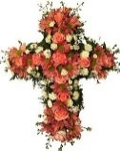
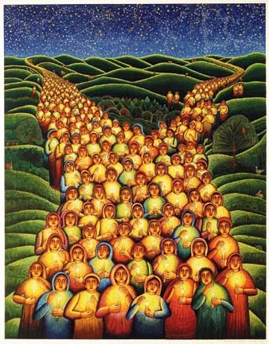
Who are the Saints?
Saints are ordinary people who have lived and are still living lives of great love for God and people and have been and still are faithful followers of Jesus.
Some Saints have been recognised by the Church and have been through the process of canonisation and are officially named and known as ‘Saint’. We use an ‘S’ when we write their names because we know they are in heaven with God.
There are many people on earth who are filled with the fruit of the Holy Spirit. They follow God’s call to be holy and listen to God and live as God wants them to. These people will be in heaven when they die because God knows of their goodness and loves them very much. They will be saints in heaven with us.
R-1
S-06A
Click on the icons to reveal text and the image on the right
Notes:
Slide 6A Who are the Saints?
Look closely at the slide image and share how it depicts people as Saints. Read the text boxes and make a question or a comment about the ideas in them. Imagine what it will be like to be a saint in heaven with God.
https://www.youtube.com/watch?v=nMSLj3x9DPo
Emphasise the idea that comes out in the clip that the Saints are our friends who are with us every day. We can call on them to talk to God on our behalf. Remember to include the ‘Saint of the Day’ in morning prayer. You will find these on the Columban Calendar. Not every day has a Saint dedicated to it – that is why we celebrate them all on all Saints Day. See Slide 7.
Sing and dance to ‘When the Saints Go Marching In’ 2:50 Minutes.
Explain that this style of singing is known as a barbershop quartet which is four singers singing in four-part harmony without accompaniment. They can be male or female but are not usually mixed. The female version is known as ‘Sweet Adelines’. Students could research and report on the history of this singing style. Take time to imagine all the saints marching in – make a mural or a bunting for the classroom and add to it throughout the month. Share it at assembly.

Slide 7
Who are the Saints?
There are saints on their journey as God’s pilgrim people, living among us here on earth – in our family whānau, in our school, in our parish and in the world. You can recognise these people by their unselfishness, their kindness, their compassion, their courage, their enthusiasm, their fortitude but most of all by their LOVE.
The Saints are our models to follow, our guides to show us the right way. They are our teachers and parents, our grans and grandads, our friends and our priests because all of them love us and want us to lead good and happy lives so that when we die God will say, ‘Welcome, come to be with me in heaven and be one of my saints forever’.
Click on the icons to reveal text and the image on the right.
Click the Video button to play ‘When The Saints Go Marching In’
R-1
S-06B
Notes:
Slide 6B Who are the Saints?
Look closely at the slide image and share how it depicts people as Saints.
https://www.youtube.com/watch?v=nMSLj3x9DPo
Sing and dance to ‘When the Saints Go Marching In’ 2:50 Minutes
Emphasise the idea that comes out in the clip that the Saints are our friends and we can call on them to talk to God on our behalf. Remember to include the ‘Saint of the Day’ in morning prayer. You will find these on the Columban Calendar. Not every day has a Saint dedicated to it – that is why we celebrate them all on all Saints Day. See Slide 7.

Slide 8
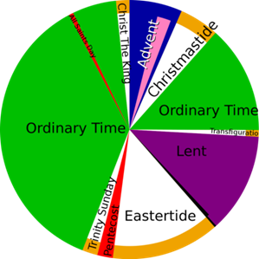
Why do we have the Feast of All Saints in the Liturgical Calendar?
When the martyrs in the first century were recognised as Saints they each had a day dedicated to them as their feast day on which they were honoured and remembered.
Catholic belief is that these holy people are part of the heavenly family who are connected in love with the people in their earthly family. They continue to watch over them and care for them and cheer them along their way to heaven.
It was not long before the number of martyrs exceeded the number of days on the calendar so one day was set aside which was to be known as the feast of All Martyrs.
This feast soon came to include all people who have lived holy lives but were unknown and uncelebrated and the day became known as All Saints Day.
Describe where All Saints Day occurs in the Liturgical Year, how it is celebrated on earth, imagine what happens in heaven and suggest some ways your class and your family could celebrate it.
R-1
S-07
Click the pins on the right to reveal post-it notes. Click the video button to play ‘All Saints Pep Talk’
Notes:
Slide 7 Why do we have the Feast of All Saints in the Liturgical Calendar?
Continue the discussion on Slide 3 when students identified the place of the Feast of All Saints in the Liturgical Year. Recall how they described when All Saints Day occurs in as many ways as possible e.g. coming close to … towards the end of… the day before Read the post its and let them generate questions and comments about the topic. Watch ‘All Saints Pep Talk’ 7:15 minutes
https://www.youtube.com/watch?v=Mad1Jgf0jow
Adapt Teaching and Learning Experiences 1, 2 Explain the relationship between the Feast of All Saints with the Feast of All Souls which is celebrated tomorrow.

Slide 9
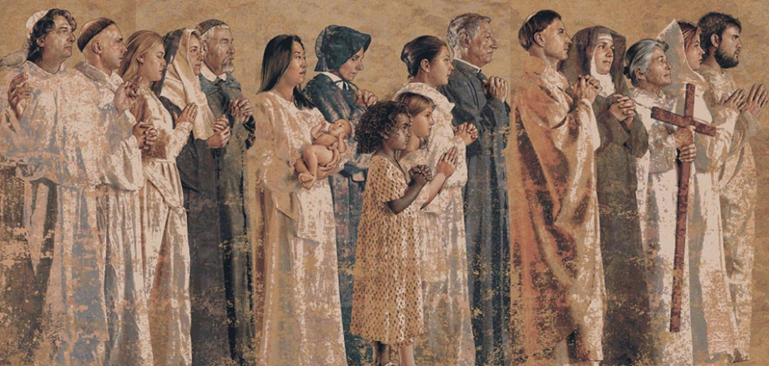
The Saints are our models who encourage us in our life journey towards God
We no longer see those we have loved on earth
Those of us who are still pilgrims on our journey
We are all part of the Communion of Saints
God created us all to know, love and serve God and
All Saints Day is the celebration of all the saints
Read the Book of Daniel 12:3 and find out what God
when they die, but we can still feel their encouragement and love.
can pray for those who are waiting and are almost ready to see God.
and we all care that when our lives are over we can go to God.
to be with God forever in the joy of heaven when we die.
on earth, in heaven and those who are waiting.
promises those who are wise and lead others to righteousness.
can pray for those who are waiting and are almost ready to see God.
to be with God forever in the joy of heaven when we die.
when they die, but we can still feel their encouragement and love.
promises those who are wise and lead others to righteousness.
and we all care that when our lives are over we can go to God.
on earth, in heaven and those who are waiting.
R-1
S-08
Click a sentence part from the list to complete the sentences above.
Notes:
Slide 8 The Saints are our models who encourage us in our life journey towards God
ANSWERS 1) C, 2) A, 3) E, 4) B, 5) F, 6) D
Read the starter statements and find the correct ending for each sentence. Click to check it with the floater tool. Ask a student to find and read Daniel 12:3. “Those who are wise will shine like the brightness of the sky, and those who lead many to righteousness, like the stars forever and ever.” Discuss the images Daniel uses to describe God’s promise. Adapt Teaching and Learning Experiences 5&6 Return to the Post its on the bill board from Slide 3 and answer any unanswered questions. Note the slide image is part of a magnificent All Saints mural adorning the walls of the Catholic Cathedral of our Lady of the Angels in Los Angeles. Notice how it includes a mixture of people who are Saints as was referred to on Slide 4 Flip card /Task 9. Look at the Cathedral website for more images and information.

Slide 10
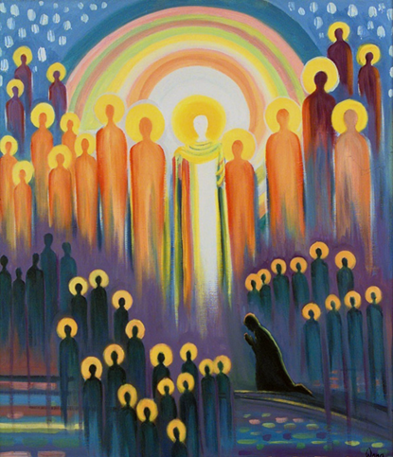
Celebrating All Saints Day with the Communion of Saints
WE ARE ALL PART OF THE COMMUNION OF SAINTS CELEBRATING ALL SAINTS DAY WITH OUR FRIENDS
Arrange an All Saints Day celebration for your class.
Make strips of bunting with Saints’ names on one side and Pray to God for us on the other to decorate your classroom.
Make All Saints cupcakes.
Make halos for everyone from tinsel to wear.
Pray together the Litany of the Saints created in Task 5 on Slide 5.
Sing ‘We are All Saints’.
Make a ‘My Favourite Saint’ wall and display it on a wall that can be seen by everyone.
Create a ‘Cheering us on’ rap and teach it to other classes.
Click the worksheet button to go to the worksheet.
R-1
S-09
Click the audio button to stop ‘We Are All Saints’
Click the audio button to play ‘We Are All Saints’
Notes:
Slide 9 Celebrating All Saints Day with the Communion of Saints Look at the image and describe what you see. How would you say it represents the Communion of Saints? Work through the items and use some of the ideas to plan ab All Saints Day celebration to share with other people in your school and parish community.

Slide 11
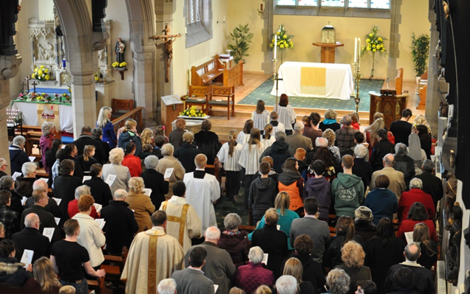
How the Church honours and celebrates on All Saints Day
The Church honours All the Saints on their special day by celebrating the .
People honour All the Saints by remembering them and giving God thanks for their to following Christ.
All Saints Day is a day to recall the example they set for us as we try to them in our lives.
On this special Saints day we can ask them to speak to God for us about the concerns we have in our .
All Saints Day is a perfect day to thank the Saints for being our and us and cheering us on till the end of our journey.
Eucharist
faithfulness
pono
imitate
models
faithfulness
lives
lives
imitate
encouraging
models
encouraging
Eucharist
pono
R-1
S-10
Chose words from the list on the right to complete the sentences.
Notes:
Slide 10 How the Church honours and celebrates on All Saints Day Read and complete the statements and check using the floaters. Go back to the Post it notes on Slide 3 and answer any questions that may not have been dealt with yet.

Slide 12
Check up
1)
Write a paragraph about who the Saints are and how the Church honours them. (Slides 4, 5 & 6)
2)
Make a flow chart to illustrate the three steps to Sainthood and identify 2 new learnings about the history of canonisation you found interesting. (Slide 5)
3)
Explain who is in the Communion of Saints and how the three groups who are part of it relate to each other. (Slides 7 & 9)
4)
Write 3 reasons why the Saints are important to people who are still on their life journey. (Slide 8)
5)
Which activity do you think helped you to learn best in this resource?
6)
Questions I would like to ask about the topics in this resource are …
Click in each caption space to reveal text
Click on the worksheet button to go to the worksheet.
R-1
S-11
Notes:
Slide 11 Check Up
This formative assessment strategy will help teachers to identify how well students have achieved the Learning Intentions of the resource. Teachers can choose how they use the slide in their range of assessment options. A worksheet of this slide is available for students in Years 5-8 to complete. The last two items are feed forward for the teacher. Recording the students’ responses to these items is recommended as it will enable teachers to adjust their learning strategies for future resources and target the areas that need further attention.

Slide 13
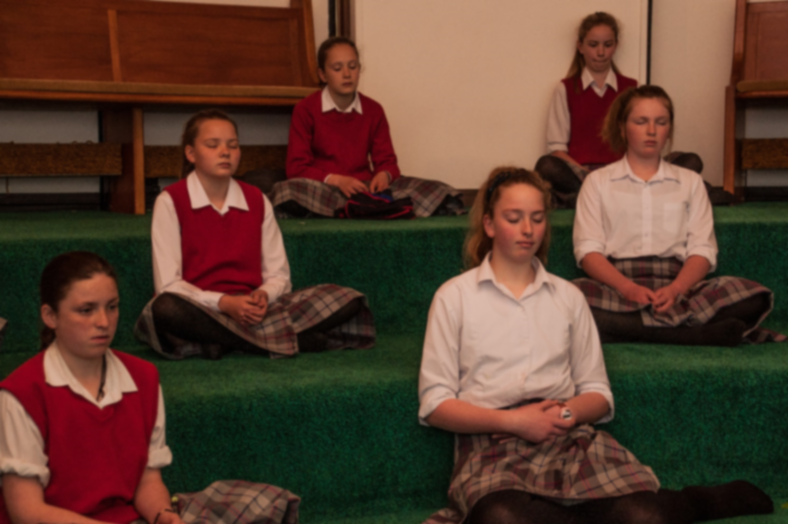
Time for Reflection
R-1
S-12
Click the audio button to play reflective music
Click the audio button to stop reflective music
Notes:
Slide 12 Time for Reflection
The MP3 is played to help create a reflective atmosphere and bring the young people to stillness and silence as they reflect on the saints they have known in their lives and the saints and martyrs they have learned about. Imagine them listening and cheering them on. Remember to ask the Saints to help them through their life journey towards sainthood.

Slide 14
The Catholic Tradition and History of Honouring the Saints
The first people to be revered as Catholic saints were martyrs who died under the Roman persecution in the first centuries after Jesus Christ. Martyrs are people who give up their lives in the name of God and their religious beliefs. Originally the word ‘martyr’ meant ‘witness’ but it was not intended that witnessing would lead to death.
TASK 1
Who was the first Christian Martyr? Present his story to be shared with others.
In early Christian times the meaning of the word ‘martyr’ changed to refer to a believer who was called to witness for their religious belief, and on account of this witness, endured suffering or death. St John was the only apostle of Jesus who was not martyred. The first martyrs were honoured as saints almost immediately after their deaths.
TASK 2 Make memorial cards for 3 of the apostles. Include details of their lives and deaths. Use a present day memorial card as a model to share. When sharing your work explain why people have memorial cards and show some recent examples.
R-1
S-04A
More flip cards are on the next slide. Click the up arrow to return to the lesson
Notes:
Slide 4A The Catholic Tradition and History of Honouring the Saints
This worksheet relates to slide 4.

Slide 15
The Catholic Tradition and History of Honouring the Saints
Over the next few centuries, sainthood was extended to those who had defended the faith and led holy lives such as Mary and Joseph, Elizabeth, Ann and Joachim.
TASK 3
Can you name other holy people of this period, make a collage of them and write 5 fast facts about each of them?
With the criteria for canonisation not as strict as it is today, the number of saints had increased greatly by
the sixth and seventh centuries.
TASK 4
Find out who some of these saints were in this period and dramatise some highlights of the life of one or make a comic strip of the story of one of them to share.
R-1
S-04B
More flip cards are on the previous/next slide. Click the up arrow to return to the lesson
Notes:
Slide 4B The Catholic Tradition and History of Honouring the Saints
This worksheet relates to slide 4.

Slide 16
The Catholic Tradition and History of Honouring the Saints
Following the canonising of some unsuitable people, the church saw the need to tighten the canonisation process to prevent this from happening. From then on when seeking approval for a person to be canonised, their suitability would be carefully scrutinized during the long process before they could become ‘added to the list of official Saints’.
TASK 5
Make a list of all the official Saints you know – don’t forget those mentioned in Task 3. From your list create a litany to pray during prayer time e.g. St Patrick early missionary in Ireland - Pray for us.
The canonisation of Saint Udalric, by
Pope John XV in 993 was the first example of
a Saint canonised by a pope. Later Bishops helped
to oversee the more formal process of making people Saints which we call ‘canonisation’.
The ceremony was led by the pope of the time. Prior to this the Church did not have a formal canonisation process for making people Saints.
TASK 6
Why do you think it would be necessary to have a formal canonisation process?
Make a flow chart to explain the process.
R-1
S-04C
More flip cards are on the previous/next slide. Click the up arrow to return to the lesson
Notes:
Slide 4C The Catholic Tradition and History of Honouring the Saints
This worksheet relates to slide 4.

Slide 17
The Catholic Tradition and History of Honouring the Saints
Over time the early burial places of the Saints became places of pilgrimage and prayer for Christians to visit. Some had tombs and churches built over them and they became popular places to celebrate Mass in honour of the Saints and give thanks to God for their lives.
TASK 7
Research where some of these places are and make a plan to use when you visit them on your OE when you are older!
R-1
S-04D
More flip cards are on the previous slide. Click the up arrow to return to the lesson
Notes:
Slide 4D The Catholic Tradition and History of Honouring the Saints
This worksheet relates to slide 4.

Slide 18
Pope Francis canonises Saints in the Vatican in Rome
In the 20th century, Popes John Paul II and Benedict XVI revised the canonisation process and Pope Francis has continued to do this more recently. When Pope John Paul II died in 2005, people in the crowd in St. Peter’s Square chanted, “Santo subito” meaning “Sainthood now.” Research if this would be possible? Pope Francis canonised him in April 2014.
TASK 8 Watch a you tube clip of a canonisation event and include it in a presentation to share, see example below. Note when selecting the clip the language it is in and how long it runs for.
In the 21st century there has been an emphasis on canonising a greater mix of people. These include young people, people from non-European countries and cultures such as South America, China, indigenous people and lay people - married and single.
These are ordinary people like us.
They come from countries all over the world. They are our models of faith.
TASK 9 Research some of the more recently canonised Saints and note which of these categories mentioned they represent. Include thumbnail descriptions of their lives with images of them to share.
R-1
S-05A
More flip cards are on the next slide. Click the up arrow to return to the lesson
Notes:
Slide 5A Pope Francis canonises Saints in the Vatican in Rome
This worksheet relates to slide 5.

Slide 19
Pope Francis canonises Saints in the Vatican in Rome
The ‘Venerable’ Suzanne Aubert has made the first step on her journey towards Sainthood. The next step she will pass through is beatification when she will be called ‘Blessed’ and then through to ‘Saint’ hood. Suzanne Aubert will be Aotearoa New Zealand’s first Saint.
TASK 10
Make a timeline of Suzanne Aubert’s life, illustrate it and include her path to Sainthood. Prepare and share an ‘íntervïew’ with her and record and keep it to use when she is canonised.
Throughout Catholic history, the saints have been a central part of Catholic belief and spirituality. They are like ‘elder brothers and sisters who cheer us along’. St Paul calls them a ‘cloud of witnesses’ surrounding us. (Hebrews 12)
TASK 11
Read Hebrews 11 and make a collage of the names and images of the ’witnesses’ Paul is talking about to share. Put a symbol of their lives beside their name and image.
R-1
S-05B
More flip cards are on the previous slide. Click the up arrow to return to the lesson
Notes:
Slide 5B Pope Francis canonises Saints in the Vatican in Rome
This worksheet relates to slide 5.

Slide 20
AT EVERY STAGE OF OUR JOURNEY TO GOD WE TRAVEL WITH OUR FRIENDS IN THE COMMUNION OF SAINTS
saints living on earth
people preparing to be Saints
SAINTS in heaven with GOD forever
Name: _______________
Date: _________
R-1
S-09
Worksheet
Click the up arrow to return to the lesson
Notes:
Slide 9 Celebrating All Saints Day with the Communion of Saints WORKSHEET
This worksheet relates to slide 9

Slide 21
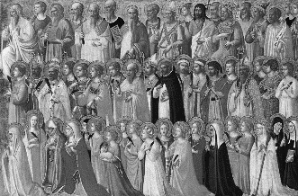
Check up
Name:____________________________
Date:____________
Write a paragraph about who the Saints are and how the Church honours them. (Slides 4, 5 & 6)
2. Make a flow chart to illustrate the three steps to Sainthood and identify 2 new learnings about the history of canonisation you found interesting. (Slide 5)
3. Explain who is in the Communion of Saints and how the three groups who are part of it relate to each other. (Slides 7 & 9)
Write 3 reasons why the Saints are important to people who are still on their life journey. (Slide 8)
5. Which activity do you think helped you to learn best in this resource?
6. Questions I would like to ask about the topics in this resource are …
R-1
S-11
Worksheet
Click the up arrow to return to the lesson
Notes:
Slide 11 Check up WORKSHEET
This worksheet relates to slide 11

