Slide 1
Remembering and Praying for
those who have died
R-1
S-01
Notes:
Slide 1 Remembering and Praying for those who have died
Set up a prayer focus for All Souls beside the All Saints focus.
Take time to explain the difference between the feasts and how we celebrate them.

Slide 2
Learning Intentions
The children will:
1)
name ways in which people remember those who have died
2)
recognise that God’s family pray on All Souls Day for people who have died
3)
compose a Litany for people who have died
R-1
S-02
Click the borders to reveal text
Notes:
Slide 2 Learning Intentions
Read through the Learning Intentions with the class and identify some ideas/questions that might be explored in the lesson.
Create a focus for All Souls Day that can be used all through the month of November for the Holy Souls and explain who they are. You could include photographs, memorial cards and funeral handouts and explain why people use these to help them remember the holy souls especially the ones they have known. Remember to use class prayer time every day to pray for the holy souls this month.

Slide 3
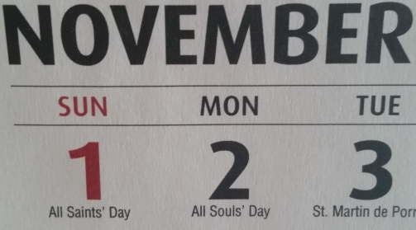
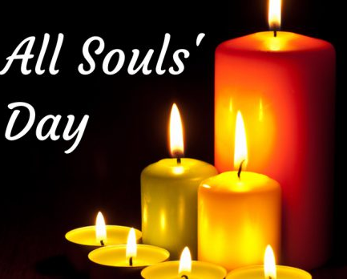
All Souls Day is a special day in God’s family on earth and in heaven
What is a soul?
The soul is created by God and is the part of a person you cannot see. Every person has a soul.
Why do people need a soul?
People need a soul because with their body and soul together they make a person.
What happens to people’s souls when they die?
People’s souls live forever and ever in heaven with God. Their bodies die and are buried in the earth.
What does God’s family on earth do on All Souls Day?
On All Souls Day all of God’s family on earth pray for all the souls who have died that they will be with God, Jesus, Mary and all the Saints in heaven.
What does God’s family in heaven do on All Souls Day?
On All Souls Day all of God’s family welcome each new soul as they come to heaven.
R-1
S-03
Click each heart to reveal answers
Notes:
Slide 3 All Souls Day is a special day in God’s family on earth and in heaven
Explain how every person has a body and he or she needs a soul to make them a person. Take time to read each question and read and talk about the answer.
Invite children to ask questions about their own souls.
Children could draw themselves with their body and their soul.

Slide 4
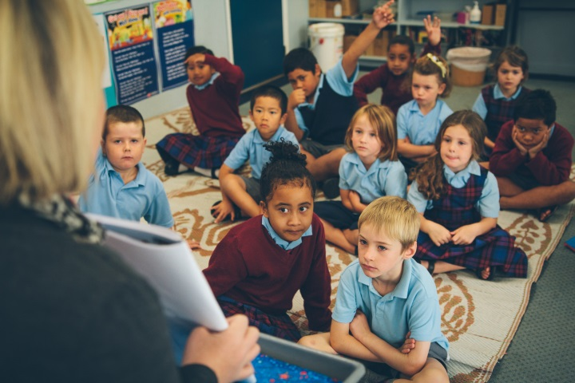
All Souls Day is a day to remember and pray for
people who have died
Here are the names of people who have died…
R-1
S-04
Click in the white box to type
Notes:
Slide 4 All Souls Day is a day to remember and pray for people who have died
Adapt Teaching and Learning Experiences 1 & 2. Type names in the white box.
Children can share stories about the people they have named.
Keep the names so they can be included in Litany for people who have died.

Slide 5
People remember in different ways
those who have died
Some have pictures of them near to see and tell stories about them so they always remember them.
Some make candles with their names on and light them when they pray that they are resting in peace with God.
Others make a memory basket with some of their precious things in it to help them feel close to them. Sometimes they talk to them or sing to them.
Others visit their grave and put flowers on it to show they still love them and miss them.
R-1
S-05
Click on each picture to reveal text
Notes:
Slide 5 People remember in different ways those who have died
Adapt Teaching and Learning Experience 2.
Children look closely at each image and talk about them.
They may have other ways their families remember people who have died to share.

Slide 6
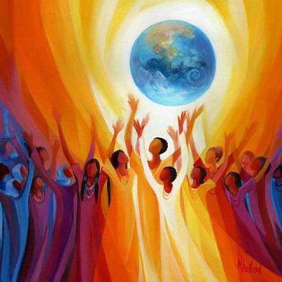
The souls of people who have died are with God
People who have died belong to God’s family in a different way from people living on earth.
The souls of people who have died are with God even though their bodies are buried on earth.
This place where God, Jesus, Mary and all the Saints are is called heaven. Heaven is a very happy place and it lasts forever.
Jesus promised he would prepare a place for people who loved God on earth to go to when they died.
R-1
S-06
Click the pins on the right to reveal post-it notes.
Notes:
Slide 6 The souls of people who have died are with God
Read each post it and invite children to comment.

Slide 7
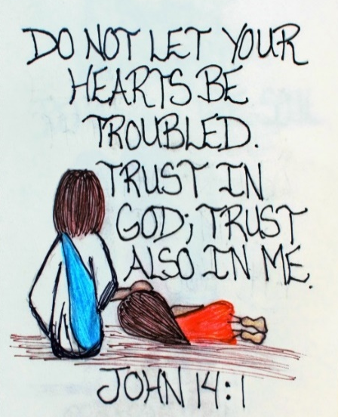
Jesus told his followers what to do when they
were troubled and unhappy
Trusting in God and Jesus
Looks like
Sounds like
Look at the sketch of Jesus and talk about what he is doing and who he is talking to.
Read his words and talk about what they mean.
Tell a story about when someone you know was troubled and upset.
What does Jesus want us to do when we are troubled?
Talk about what trusting in God and Jesus looks and sounds like.
R-1
S-07
Click the worksheet button to go to the worksheet
Notes:
Slide 7 Jesus told his followers what to do when they were
troubled and unhappy
Look closely at the image and read words and read and respond to each bullet point.
Print a copy of the worksheet for each child. Add to RE Learning Journals when completed.
Refer to and record ideas related to last bullet point – children record them on their T chart and add others.

Slide 8
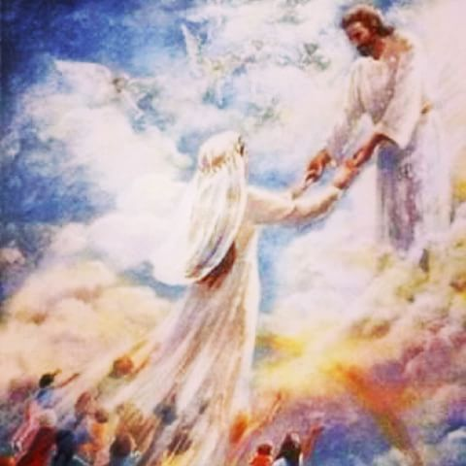
Jesus told his followers he would prepare a place in
God his Father’s house for them
1) Jesus said “Trust in God and trust in
me”
2) In my Father’s house there are many
rooms
3) Some people need to wait to become their best
selves
4) There are rooms for people who need to wait to get into
heaven
5) Praying for people who have died helps them to get into heaven
quickly
rooms
me
selves
quickly
heaven
R-1
S-08
Click a word from the list to correctly complete the sentence.
Click the audio button to stop ‘Come and go with me’
Click the audio button to play ‘Come and go with me’
Notes:
Slide 8 Jesus told his followers he would prepare a place in God his Father’s house for them
Adapt Teaching and Learning Experiences 4 &5.
Match the statements and talk about what they mean.
Sing together ‘Come and go with me’.

Slide 9
God wants everyone to come and live in
his house with many rooms we call heaven
People who have been kind and loving people on earth will be with God in heaven.
Some people are not quite ready to be with God when they die.
These people need to become their best selves before meeting God because God is so good.
The prayers of the people on earth help them to become their best selves.
When this happens they go to be in heaven with God, Jesus and all the Saints to be happy forever.
R-1
S-09
Click the picture to reveal each line (5 times). Click the worksheet button to go to worksheet
Notes:
Slide 9 God wants everyone to come and live in his house with many rooms
See Children’s Activity at the end of the resource and make a copy for children to complete and add to their RE Learning Journals.
Talk about what heaven might be like and who else might be there.
Explain that we can help people to go to heaven by asking God to take them.

Slide 10
We can pray in different ways on All Souls Day
for people who have died
R-1
S-10
Notes:
Slide 10 We can pray in different ways on All Souls Day for people who have died.
Read and explain what the words of the prayer mean.
Tell children this is a very old prayer for people who have died.
Remind them to pray for people whom we call the Holy Souls all through this month.

Slide 11
Check Up
1)
Tell a partner 2 ways you remember people you loved who have died. (Slide 5)
2)
What date is All Souls Day - make a small poster to remind people to pray for All Souls on their special feast day. (Slide 3)
3)
Make a class Litany for All Souls to pray this week in class prayer for all those who have died. Include the names of people in your family whānau who have died.
4)
Where are the souls of all the people who have died? (Slides 6 &9)
5)
Can you finish the sentence – A soul is … (Slide 3)
6)
Which activity do you think helped you to learn best in this resource?
7)
Questions I would like to ask about this resource are……
R-1
S-11
Click the borders to reveal text
Notes:
Slide 11 Check Up
This formative assessment strategy will help teachers to identify how well children have achieved the Learning Intentions of the lesson.
Teachers can choose how they use the slide in their range of assessment options.
A worksheet of this slide is available for children in Years 5-8 to complete.
The last two items are feed forward for the teacher.
Recording the children’s responses to these items is recommended as it will enable teachers to adjust their learning strategies for future lessons and target the areas that need further attention.

Slide 12
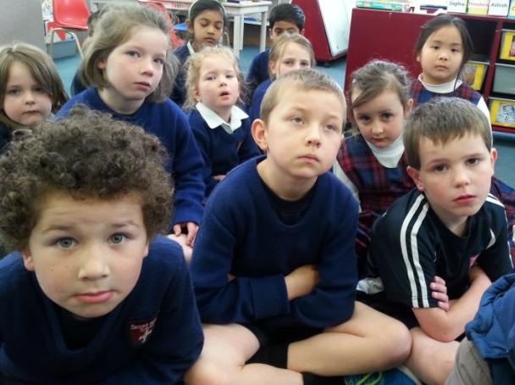
Time for Reflection
R-1
S-12
Click the audio button to stop reflective music
Click the audio button to play reflective music
Notes:
Slide 12 Time for Reflection
The MP3 is played to help create a reflective atmosphere and bring the children to stillness and silence as the teacher invites them to say the names of the people that you know who have died and are now in heaven with God. Tell them you love them and miss them and ask them to tell God about you and your family.

Slide 13
Jesus told his followers what to do when they
were troubled and unhappy
Name….…….. Date……..
Trusting in God and Jesus
Looks like
Sounds like
R-1
S-07
Worksheet
Click the up arrow to return to the lesson
Notes:
Slide 7 Jesus told his followers what to do when they were troubled and unhappy - WORKSHEET
This worksheet relates to slide 7.
Print a copy of the worksheet for each child. Add to RE Learning Journals when completed.
Refer to and record ideas related to last bullet point
– children record them on their worksheet.

Slide 14
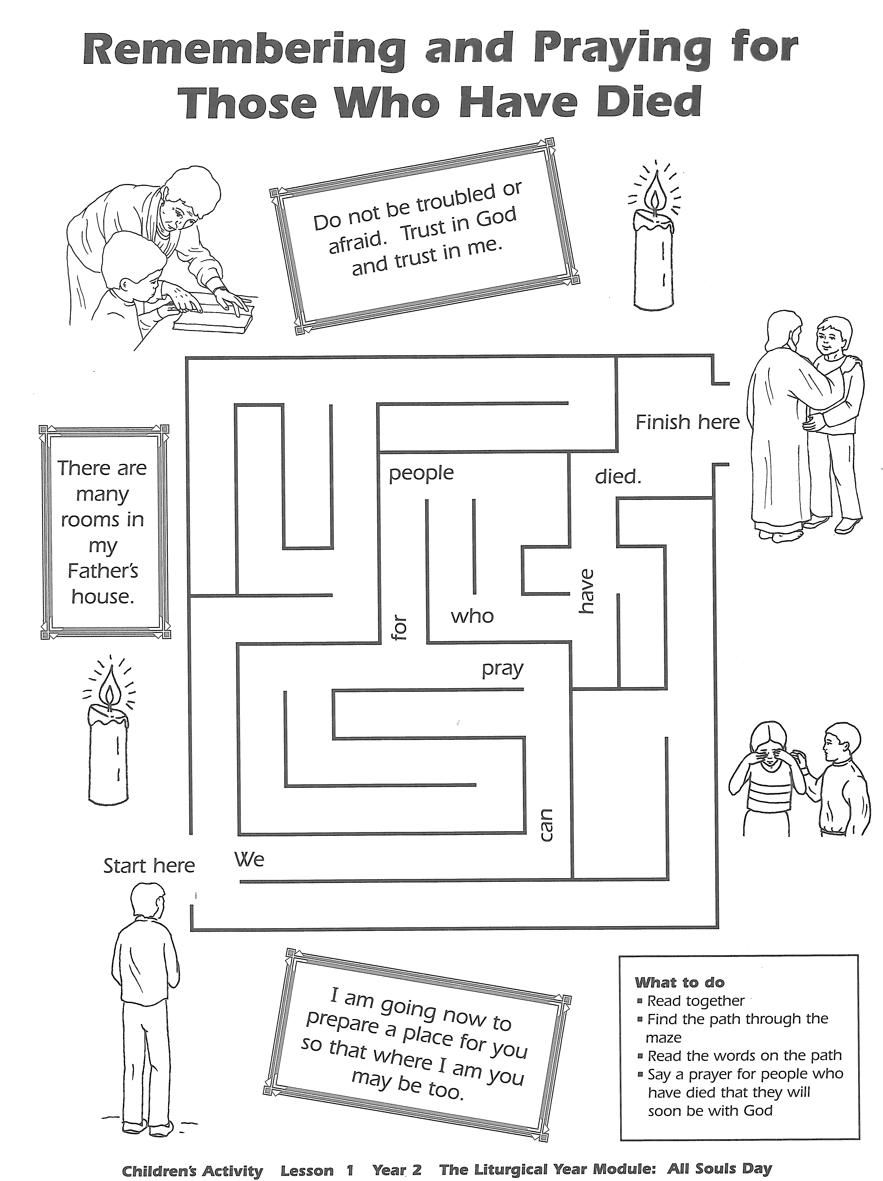
Name….…….. Date……..
R-1
S-09
Worksheet
Click the up arrow to return to the lesson
Notes:
Slide 9 God wants everyone to come and live in his house with many rooms - WORKSHEET
This worksheet relates to slide 9.
See Children’s Activity at the end of the resource and make a copy for children to complete and add to their RE learning Journals.

