Slide 1





All Souls Day
R-1
S-01
Notes:
Slide 1 All Souls Day
Use this slide as a focussing strategy to introduce the resource topic. Read the title together and invite children to share something they know about the feast of All Souls and what it means. Point out that purple is the colour that is used on All Souls Day.

Slide 2
Learning Intentions
The children will:
name the feast and the date when Catholics pray for the Holy Souls
1)
recognise that Catholics believe their prayers help the Holy Souls in Purgatory
2)
R-1
S-02
Click the white box to reveal text
Notes:
Slide 2 Learning Intentions
Read through the Learning Intentions with the class and identify some ideas/questions that might be explored in the resource.
Create a focus for All Souls Day that can be used all through the month of November for the Holy Souls. You could include photographs, memorial cards and funeral handouts and explain how people use these to help them remember the Holy Souls especially the ones they have known. Remember to use class prayer time every day this month to pray for the Holy Souls.

Slide 3

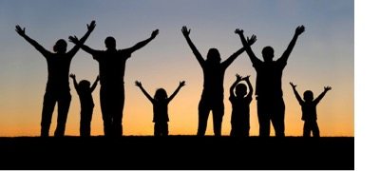
God creates each person with a body and soul
People need to change their lives, say they are sorry to those they have hurt and be reconciled with them. When people die they will not be with God if they are not reconciled and they will need to wait in purgatory to do this then God will call them to heaven.
We can recognise what people’s souls or spirits are like by the way they act. If they are kind and caring as God wants them to be, they will grow towards God and become holy like God who is kind and caring. Because of this as soon as they die God will take them to heaven.
Their body is their outer part that can be seen and their soul is their inner part that cannot be seen. Each person’s body dies at the end of their life but their soul is different because it lives on forever in heaven with God.
Each person has a body and a soul that God creates. Every person needs a soul in their body to make them a complete person.
When people are selfish and hurtful towards others and living as God does not want them to, they will grow away from God. They need to turn back to God, to ask for forgiveness and make up for what they have done wrong.
People’s souls influence the way they act and respond to people and to God. How they show their feelings and their spirit is unique to each person and this makes them who they are.
People need to take care of their bodies and their souls to keep themselves healthy. Our bodies and our souls need food to help them grow. They both need rest, care and love throughout our lives.
R-1
S-03
Click top card to discard it
Notes:
Slide 3 God creates each person with a body and soul
Explore what the title means.
Read each flip card and talk about what it means with the children. Encourage children to ask questions and make comments.

Slide 4
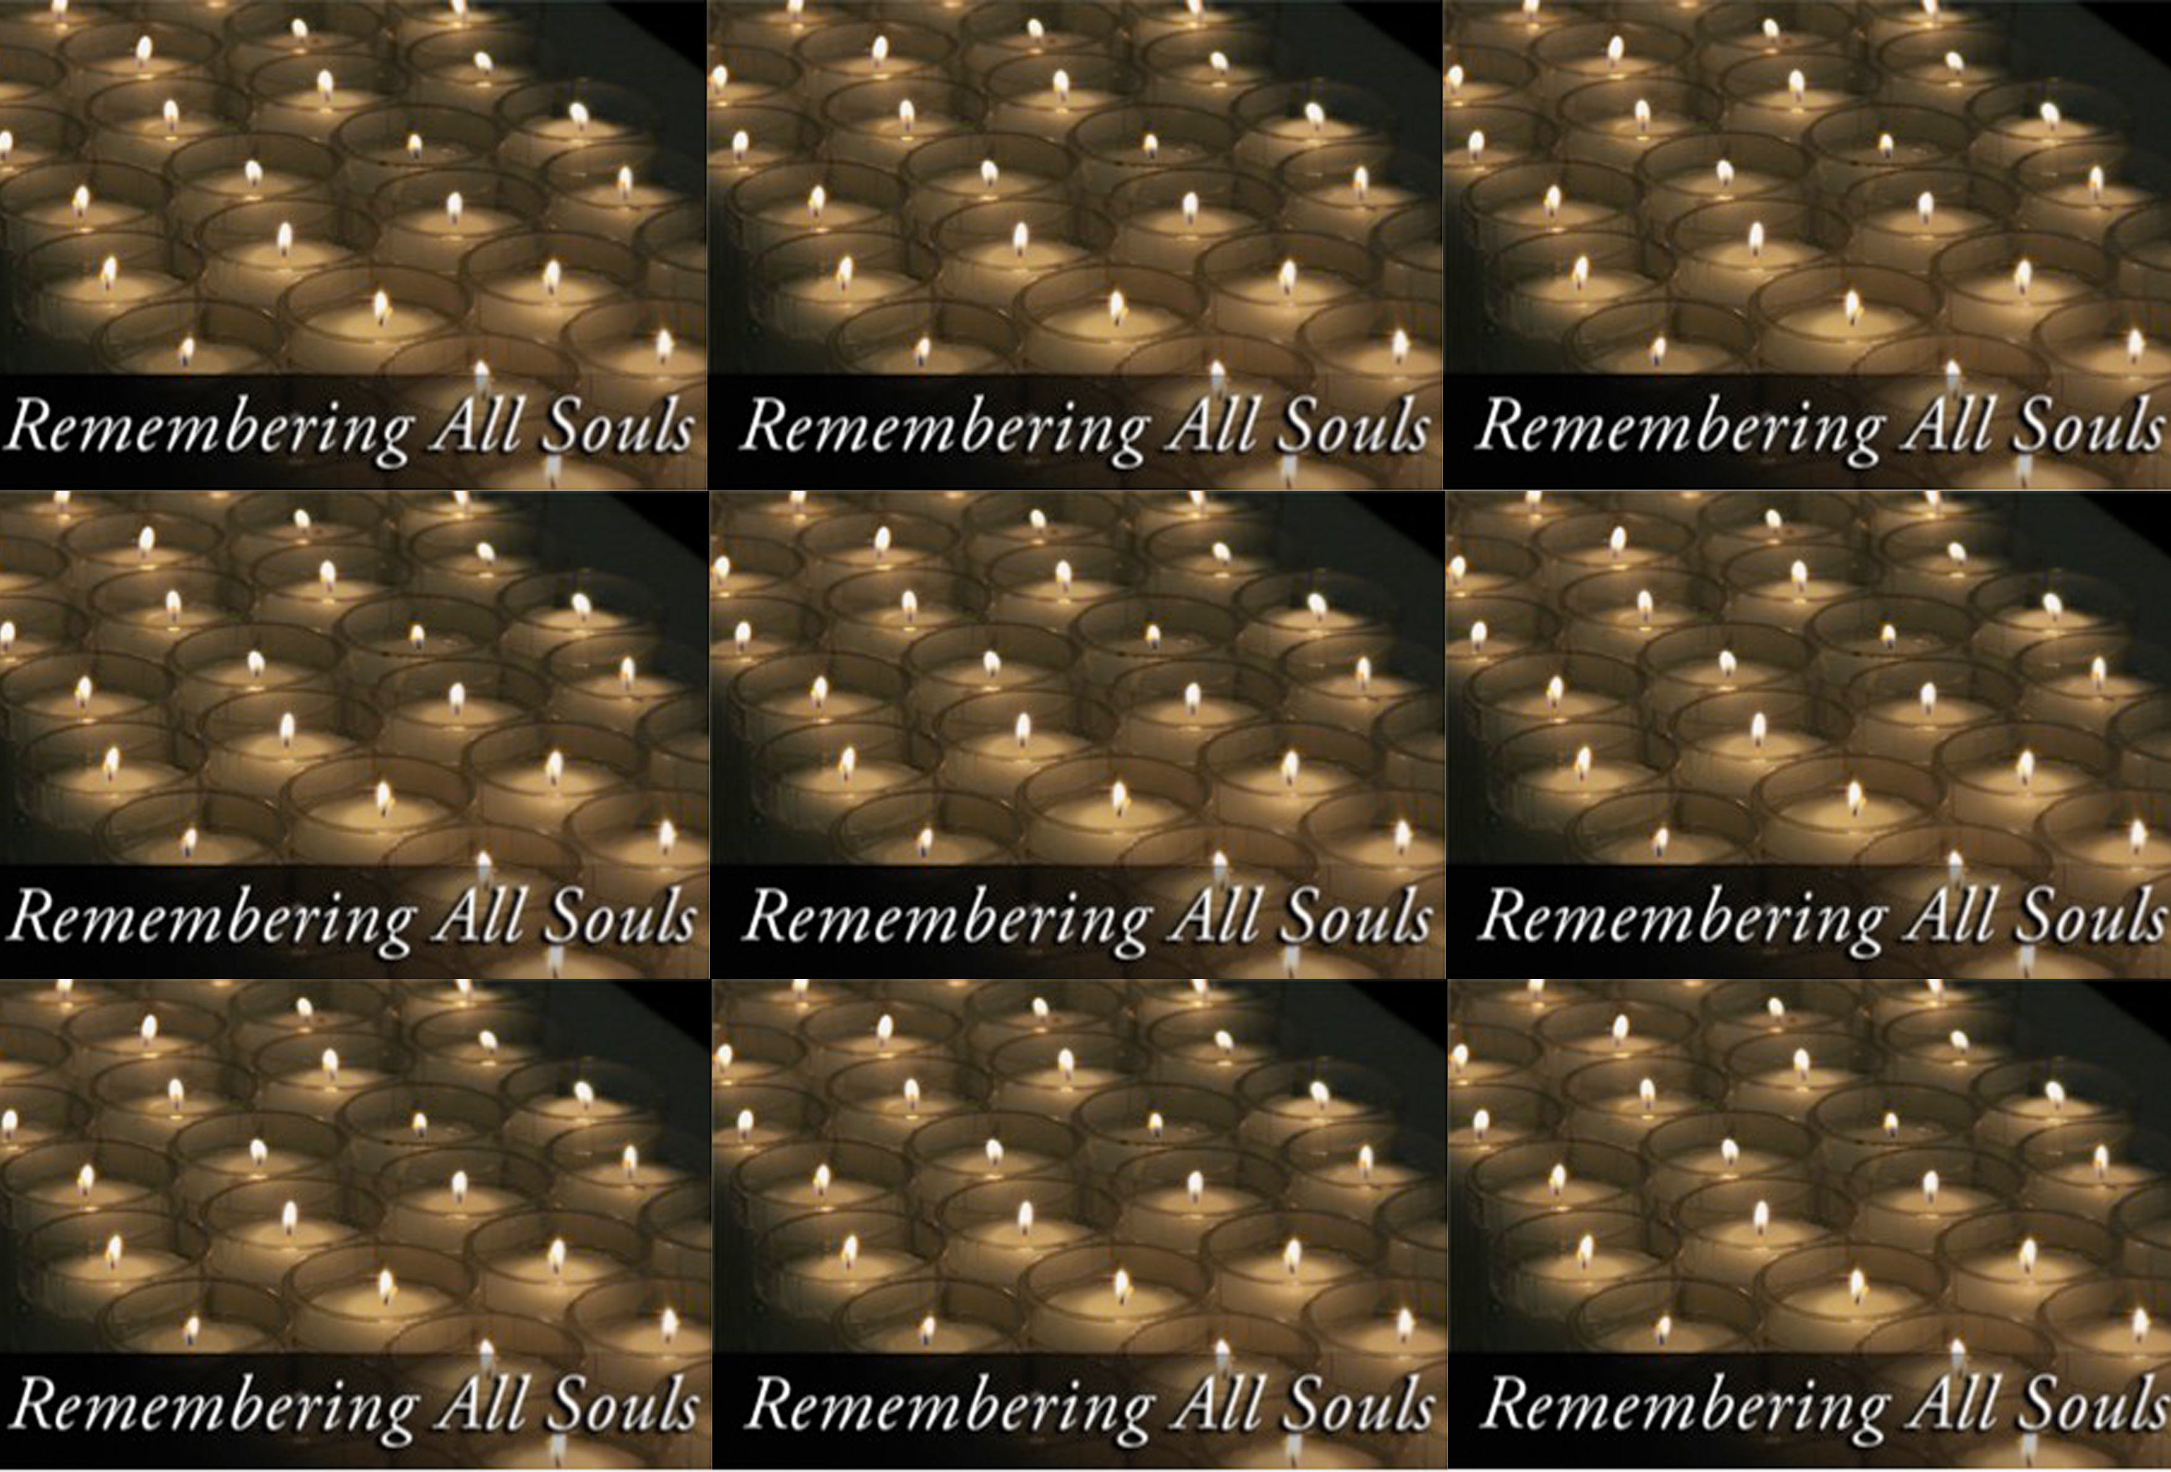
What happens to people’s souls when they die?
When they die, God takes the souls of the holy people who have lived with kindness and goodness to heaven, to live there forever with God who makes everything holy.
Do you know someone who is with God in heaven?
The souls of the people who have tried to live as God wanted them to but who at times didn’t, have to wait in purgatory until they have become holy and are ready to be with God. Heaven is full of holiness, because God is there so everyone who goes to heaven needs to be holy.
How can you tell a person is holy?
Click the down-button to move the blind down,
R-1
S-4A
Click the up-button (appears at bottom) to move the blind to the top.
Notes:
Slide 4A What happens to people’s souls when they die?
Give children time to respond to the title question.
Read each revealed text block and respond to the question.
Adapt Teaching and Learning Experience 1

Slide 5
What happens to people’s souls when they die?
We call the people who are waiting to go to heaven the ‘holy souls’. We call them ‘holy’ because they have tried hard to live good lives and the waiting time in purgatory and the prayers of people on earth helps to make up for their sins and be ready to be with God who is waiting for them to come to heaven.
What do you think God would say to a person when they come in to heaven?
In purgatory the holy souls prepare to be with God in heaven forever. No one knows where purgatory is or how long people are there. We do know that the holy souls yearn to be with God and wait patiently to go to heaven.
What can we do to help the holy souls in purgatory?
Click the down-button to move the blind down,
R-1
S-4B
Click the up-button (appears at bottom) to move the blind to the top.
Notes:
Slide 4B What happens to people’s souls when they die?
Read each revealed text block and respond to the question.
Use what is in the text to help children understand what happens when people die.

Slide 6
What happens to people’s souls when they die?
What we do know is that because we still love people even when they have died we can pray for them and this helps them to be ready to be with God in heaven. There is a great celebration when each soul enters heaven.
Can you name who would be at the All Saints Day celebration
in heaven?
Click the down-button to move the blind down,
R-1
S-4C
Click the up-button (appears at bottom) to move the blind to the top.
Notes:
Slide 4C What happens to people’s souls when they die?
Read each revealed text block and respond to the question and invite children to ask some of their own.
Invite children to share their experiences of what happened when someone they know died. (Be sensitive to children who may be grieving.)

Slide 7
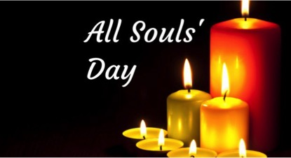
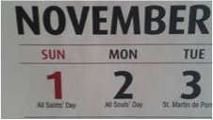
All Souls Day is a special day
November 2 is ALL SOULS Day because it is the day
when we remember and pray for all those who have died.
Prayer is the way the people on earth
help the Holy Souls in purgatory prepare to enter heaven.
The feast of All Souls is a special day
of remembrance and prayer for those who have died.
Catholics believe that God wants
all people to be part of the joy of heaven after they die.
Purgatory helps people become holy like
God who is full of holiness and goodness.
help the Holy Souls in purgatory prepare to enter heaven.
when we remember and pray for all those who have died.
of remembrance and prayer for those who have died.
God who is full of holiness and goodness.
all people to be part of the joy of heaven after they die.
R-1
S-05
Select the correct statement from the list to complete the sentence
Notes:
Slide 5 All Souls Day is a special day
Read the title and explain why All Souls Day is a special day. Read the sentence and find the statement to complete it on the list. Check it with the floater. What do you think the joy of heaven would be like?
What date is All Souls Day?
What is the best thing we can do for the Holy Souls who are waiting to go to heaven?

Slide 8
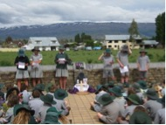

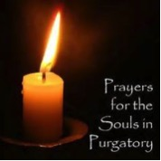
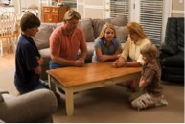

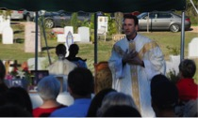
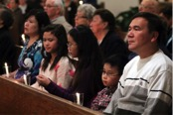
Ways we can pray for
the Holy Souls
1
5
2
We can have a liturgy at the cemetery for all those who have died in our community.
We can pray with our family for the souls of members of our family who have died.
We can go to Mass with our families and pray that the souls of our family members are in heaven with God.
4
3
Sometimes we can go to Mass at the cemetery where many holy souls are buried and pray they will be in heaven with God today.
Click the panels in sequence to reveal images and text
R-1
S-06
Click the audio button to stop ‘Eternal Rest’
Click the audio button to play ‘Eternal Rest’
Notes:
Slide 6 Ways we can pray for the Holy Souls
Explain that there are different ways we can pray for the Holy Souls. Ask the children to look closely at each image and predict what the text that matches it might say then click to reveal it.
Ask the children to make up some text that matches the last image of the candle.
Print off a copy of the worksheet for each child to complete and add to their RE Learning Journal. Sing together the special song for people who have died, ‘Eternal Rest’.
Explain what this means to the children.

Slide 9



Things to do with your family whānau to celebrate All Souls Day
The feast of All Souls Day is a good time to talk with your family about people who have died who have been important in your lives.
The most important thing you could do for them is ask God to take them to heaven forever. All Souls Day is a special day to do this. There is great happiness in heaven on All Souls Day.
It’s good to share stories and memories about them – what they were like as people and what they liked to do. You could find some photographs of them and make a special memory place to help you keep them close to you.
Remember November is called the month of the Holy Souls so you can pray for them especially all through this month. You can also pray for people who may have no one to pray for them so they can go to heaven. too.
R-1
S-07
Click the pins on the right to reveal post-it notes.
Notes:
Slide 7 Things to do with your family whānau to celebrate All Souls Day
Look closely at the image and invite children to describe what is happening in it.
Read each post it and make a list of what children would like to do to celebrate All Souls Day with their family whānau.
Make a fridge magnet to remind families of the date All Souls Day is – November 2.
Give children some opportunities to practise explaining to their families why All Souls Day is a special day and how they could make it a ‘holy’ day to pray for the Holy Souls of their family members such as their grans, grandads, aunties, uncles, friends who have died.
Remind them to explain that our prayers can help them get into heaven and be with God.
Plan some special things to do at home on All Souls Day. Refer to the post its on the slide.
Adapt Teaching and Learning Experience 3.

Slide 10
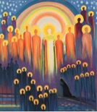
Heaven is a wonderful place and one day it will be our home with God
Look closely at the image – share your ideas about what you can see
Think about heaven and talk to a partner about what you think it is like
Type on the slide all your ideas about heaven and who is there
Create an art work of heaven and include all the saints, angels and people you know – don’t forget God, Jesus, Mary and the Holy Spirit. Display your work where it can be admired.
R-1
S-08
Click in the white box and write your text
Notes:
Slide 8 Heaven is a wonderful place and one day it will be our home with God
Read the slide title and talk about what it means. Look closely at the image and share different interpretations of what it is.
Work through the activities listed on the slide and type children’s suggestions in the white text box.
Decide what to do and prepare to do it in time for All Souls Day.
Children could share their art works at assembly and discuss the different ways people imagine what heaven is like. Display the art works for all to see in the school and parish.

Slide 11
Check Up
1)
What do you know about a person’s soul? (Slide 3)
2)
What happens to people’s souls when they die? (Slide 4A & B)
3)
What date do we celebrate the feast of All Souls? (Slide 5)
4)
Why do we pray for the Holy Souls and why are they holy? (Slide 6)
5)
Share 3 things you have learnt about the Holy Souls?
6)
Why is purgatory a good place?(Slides 4&5)
7)
Which activity do you think helped you to learn best in this resource?
8)
Questions I would like to ask about the topics in
this resource are …
R-1
S-09
Click the white box to reveal text
Notes:
Slide 9 Check Up
This formative assessment strategy will help teachers to identify how well children have achieved the Learning Intentions of the resource.
Teachers can choose how they use the slide in their range of assessment options.
A worksheet of this slide is available for children in Years 5-8 to complete.
The last two items are feed forward for the teacher.
Recording the children’s responses to these items is recommended as it will enable teachers to adjust their learning strategies for future resources and target the areas that need further attention.

Slide 12
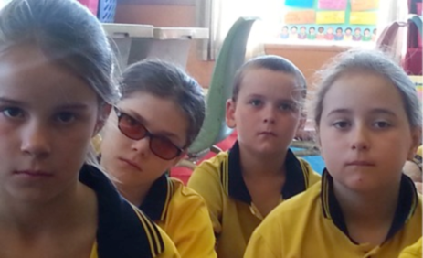

Time for Reflection
R-1
S-10
Click the audio button to stop reflective music
Click the audio button to play reflective music
Notes:
Slide 10 Time for Reflection
The MP3 is played to help create a reflective atmosphere and bring the children to stillness and silence as the teacher invites them to imagine God and all the Saints and holy people in heaven waiting to welcome someone into heaven. Think about someone going to heaven on All Souls Day because you remembered to pray for the Holy Souls on their special feast day.
Children could share their art works at assembly and discuss the different ways people imagine what heaven is like.

Slide 13

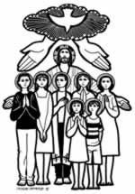
ALL SOULS DAY
A DAY FOR REMEMBERING PEOPLE IN
OUR FAMILY WHĀNAU WHO HAVE DIED
November 2, the Feast of All Souls, is the day Catholics pray for people who have died.
The names in the hearts are people we have known and loved who have died.
Ask someone to tell you a story about them.
Let us remember these people as we pray together
Eternal rest grant to them
O Lord
and may perpetual light shine upon them.
May they rest in peace. AMEN
Write your own prayer in the cloud
Name: Date:
R-1
S-06
Worksheet
Click the up arrow to return to the lesson
Notes:
Slide 6 Ways we can pray for the Holy Souls WORKSHEET
This worksheet relates to slide 6

