Slide 1
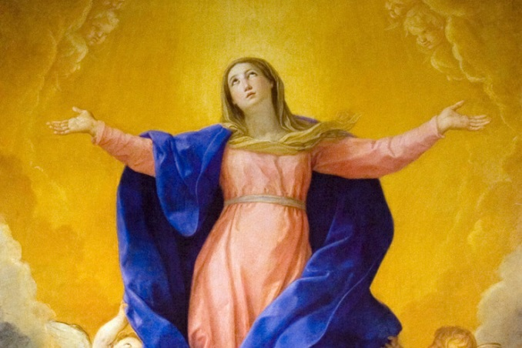
Mary is taken into Heaven
R-1
S-01
Notes:
Use this slide as a focussing strategy to introduce the resource topic. Read the title together and invite children to share something they know about what happened when Mary died and God took her to heaven.
Sing Mary songs this week during class prayer.

Slide 2
Learning Intentions
The children will…
1)
recognise that the Assumption is a special day to celebrate Mary
2)
recognise that Mary was taken body and soul to heaven.
R-1
S-02
Click in each box to reveal text.
Notes:
Read through the Learning Intentions with the class and identify some ideas/questions that might be explored in the resource.

Slide 3
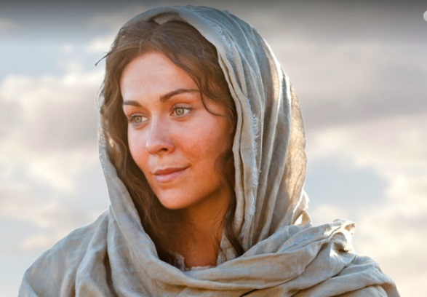
What happened to Mary after Jesus died?
Later Mary grew older and her life on earth came to an end.
She showed them how to listen to God as she and Jesus did.
Mary reminded the apostles of all the things Jesus had taught them.
She was with them when the Holy Spirit came to them in tongues of fire at Pentecost.
Mary stayed friends with the apostles who were followers of Jesus and prayed with them.
John took Mary to his house and looked after her as Jesus had asked.
Jesus asked his friend John to look after Mary when he died.
RESET
R-1
S-03
Click each card to move through (7) and “Reset” to start over.
Notes:
Adapt Teaching and Learning Experience 1
Talk about Mary’s life – God chose her to be Jesus’ mother, she married Joseph and they lived with Jesus as a family beside Joseph’s carpenter’s shop. Jesus grew to be a man and showed people how to live with love and kindness. Jesus died and rose again and then when back to heaven. Mary grew older and her life on earth came to an end.
Use the Flip cards to continue the story. Read them through and talk about what they mean.

Slide 4
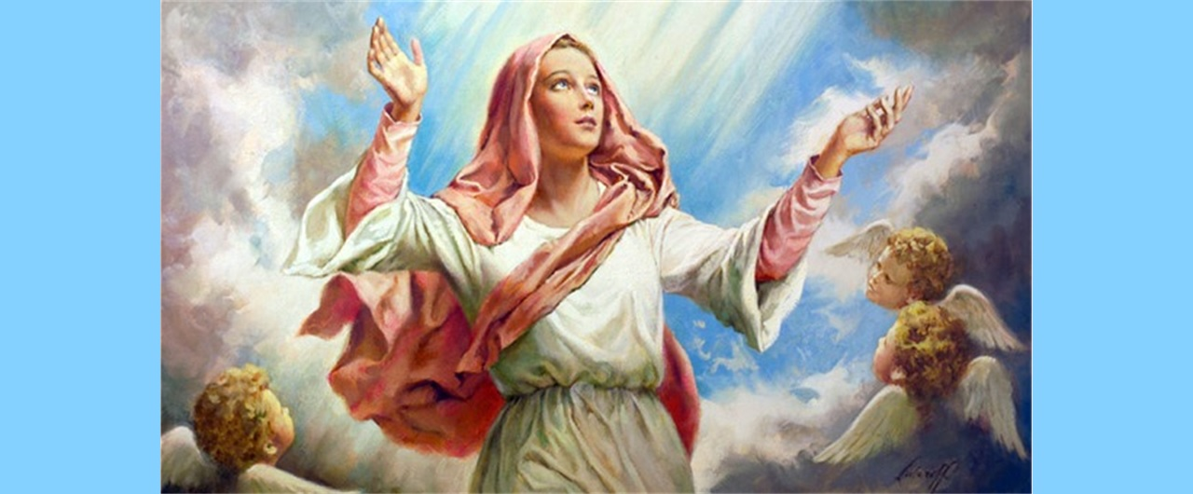
What happened when Mary died?
After Mary died God took her to heaven and Jesus was waiting to welcome her.
We call this Mary’s Assumption into heaven.
Now Mary is in heaven with God, Jesus and all the Saints and angels.
Mary is with people we know who have died and are now in heaven too.
What do you think Jesus said to Mary when she came to heaven?
Click the down-button to move the picture down,
click the up-button (appears at bottom) to move the picture to the top.
R-1
S-04
Notes:
Explain to the children that we find stories about Mary in the Bible. But the story about Mary’s death is not written in the Bible. We know Mary died because people told the story to each other and then they told their children and they told their children and that is how it was passed down to others over many years and that is how we know the story today.
Read the blind reveals and discuss what Mary Assumption means. Invite children to name people they know who are now in heaven and to suggest what Jesus said to Mary when she came to heaven.

Slide 5
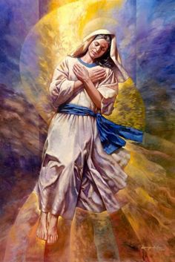
God took Mary’s body and soul to Heaven
When people die their soul goes to be with God
When Mary died God took her body and her soul
God loved Mary very much because she had
We call Mary’s body and soul being
Mary’s Assumption reminds us that at the end of the world
and their body is buried in the earth.
to heaven because she had loved God very much.
loved and cared for God’s son, Jesus on earth.
taken up to heaven Mary’s Assumption.
our bodies will be raised up like Mary’s
to be in heaven with God.
loved and cared for God’s son, Jesus on earth.
our bodies will be raised up like Mary’s to be in heaven with God.
to heaven because she had loved God very much.
taken up to heaven Mary’s Assumption.
and their body is buried in the earth.
Click an item on the list or the end of a sentence to correctly position second half of the sentence.
R-1
S-05
Notes:
Read through the sentences and find the correct statement to complete them. Explain what happened to Mary when she died is different from what happens to other people. Check out the sentences by reading them through.
ANSWERS 1)E, 2)C, 3)A, 4)D, 5)B

Slide 6
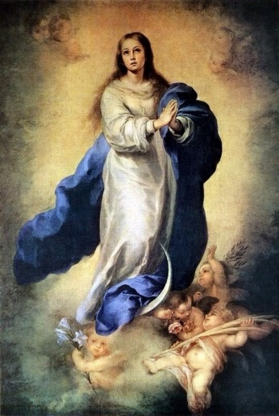
We celebrate the Feast of Mary’s Assumption Day on August 15
We think about Mary being taken body and soul to heaven where she lives now with God and Jesus.
Every year we remember and celebrate Mary’s Assumption Day together at Mass.
At Mass we pray and give thanks to God for Mary and the ways she taught us to love God and each other.
We know that at the end of our lives we will be happy in heaven with Mary, Jesus and God.
R-1
S-06
Click the pins on the right to reveal post-it notes.
Notes:
Adapt Teaching and Learning Experience 2
Read through the Post it notes and let them generate children’s comment and questions. Talk about going to mass on Mary’s Assumption to celebrate Mary’s feast. Explain that going to mass on her feast day is a great way to give honour to Mary because she was Jesus’ mother.

Slide 7
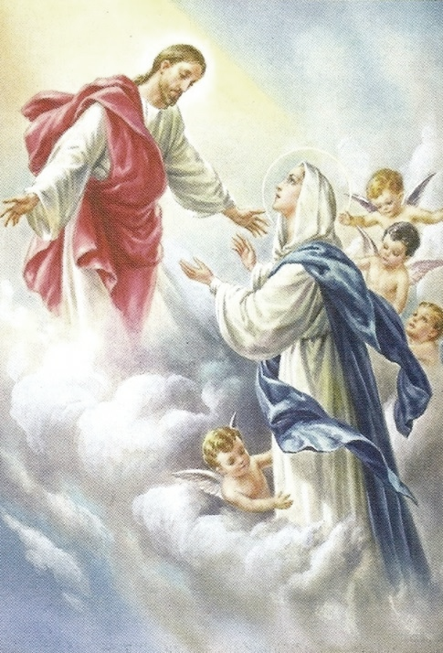
Imagining Mary’s welcome into Heaven
Jesus said …
The Angels said …
Mary said …
R-1
S-07
Click the worksheet icon for worksheet.
Notes:
Adapt Teaching and Learning Experience 3
Talk about what children could write in the word balloons before they write in them.
Add the worksheets to children RE Learning Journal.

Slide 8
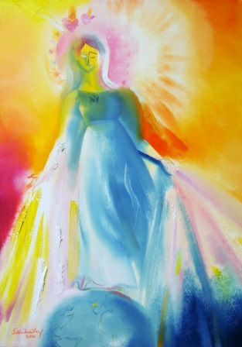
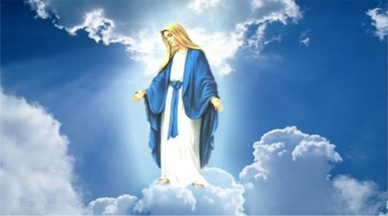
Making an Art Work of Mary’s Assumption
Lots of artists have made art works about Mary’s Assumption.
Look closely at the examples and name some things that you notice about all of them.
Think about what you would like to include in your art work of Mary’s Assumption and what colours you would use for it.
Create your beautiful art work and include it in a Mary’s Assumption Exhibition to share with lots of other people to celebrate Mary’s special feast day.
X
R-1
S-08
Click the i-button to reveal information.
Notes:
Adapt Teaching and Learning Experience 4
Point out that long ago blue was the colour used for the clothes of special people like queens. It was also used for peace, and nature (sea and sky). So it makes sense that artists used blue in their pictures of Mary as she is the Queen of Heaven and Earth and the Queen of Peace.
When the children have completed their art works display them to share with other classes, families and parishes. You could make a clip of them and children could talk about their art work to share what they have learned about the feast of Mary’s Assumption. This could be used as a teaching resource in the future. Add the link to the school website so family whānau can enjoy it.

Slide 9
Check up
1)
The Assumption is when Mary…
2)
What day do we celebrate Mary’s Assumption?
3)
Who welcomed Mary into heaven?
4)
Explain your art work to someone in your class.
5)
Which activity do you think helped you to learn best in this resource?
6)
Questions I would like to ask about the topics in this resource are…
R-1
S-09
Click in each box to reveal text.
Notes:
This formative assessment strategy will help teachers to identify how well the children have achieved the Learning Intentions of the resource.
Teachers can choose how they use the slide in their range of assessment options.
A worksheet of this slide is available for children in Years 5-8 to complete.
The last two items are feed forward for the teacher.
Recording the children’s responses to these items is recommended as it will enable teachers to adjust their learning strategies for future resources and target the areas that need further attention.

Slide 10
Time for Reflection
Click the audio button to stop reflective music
R-1
S-10
Click the audio button to play reflective music
Notes:
The MP3 is played to help create a reflective atmosphere and bring the children to stillness and silence as the teacher invites them to think about Mary going up to heaven and Jesus and God waiting to welcome her and remember that one day Jesus and God will welcome them into heaven too.

Slide 11
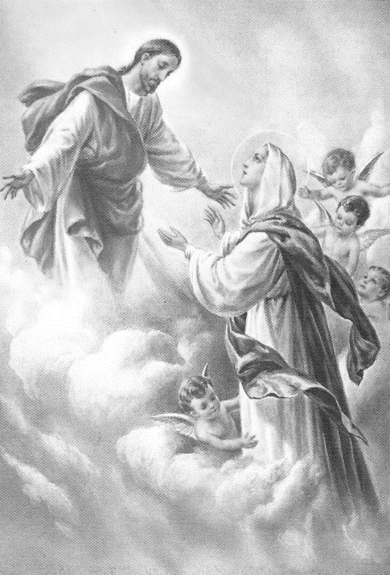
Imagining Mary’s welcome into Heaven
Name__________________________________ Date_______________
Jesus said …
The Angels said …
Mary said …
Worksheet
R-1
S-7
Click the up arrow to return to the presentation

