Slide 1
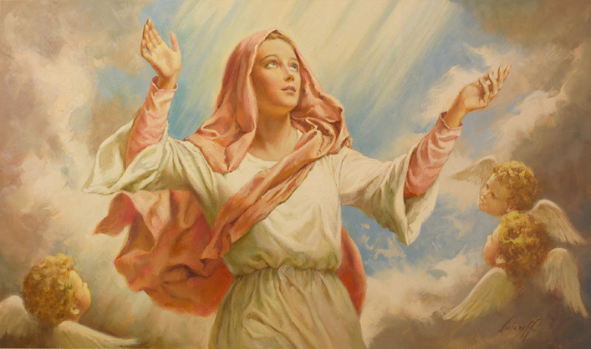
Mary, like Jesus, is taken into heaven
R-1
S-01
Notes:
Read the stories about Mary’s life mentioned in Slides 4, 5, 6 during class prayer this week.

Slide 2
Learning Intentions
The children will:
1)
recall that Jesus was raised from death and ascended into heaven
2)
recall that God took Mary body and soul into heaven
3)
identify ways in which Mary was like Jesus.
R-1
S-02
Click the borders to reveal text

Slide 3
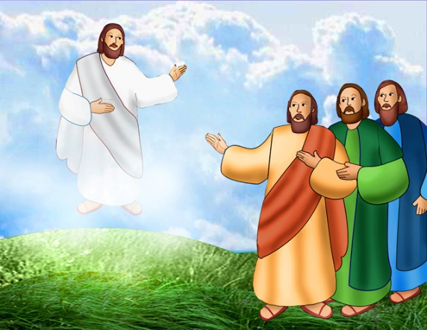
Jesus went back to God his Father in heaven
on Ascension Day
Jesus was taken up in a cloud by God to heaven and that is why we think heaven is in the clouds in the sky.
After Jesus said good bye to his friends he asked them to carry on his work of caring for people.
Jesus was sad to leave his friends but he was very happy to be with God in heaven.
Then Jesus ascended to God his Father in heaven. We call this the Ascension.
R-1
S-03
Click the pins on the right to reveal post-it notes.
Notes:
Adapt Teaching and Learning Experience 2

Slide 4
Remembering what happened as Mary began
her life as a young woman
What is the angel saying to Mary?
The angel Gabriel came to Mary and asked her to be the mother of God’s son, Jesus.
What was Mary’s answer?
Read the story about this in the Bible in the Gospel written by
Saint Luke 1:26-38.
Who are the people in the picture?
Joseph and Mary were going to get married.
Mary was going to have a baby and Joseph looked after her.
R-1
S-04A
Click each image to reveal answers.
Notes:
Adapt Teaching and Learning Experience 4
Use the images and text in Slides 4, 5 & 6 to remind children of the special events in Mary’s life.
Encourage them to say what they know about the stories and the images of these events.
Read the blue text and answer the questions before clicking the image and revealing the black text.

Slide 5
Remembering what happened as Mary began
her life as a young woman
Who was the baby Mary would have?
Mary’s baby was Jesus and we celebrate his birth because he is God’s son.
What do we call the feast that celebrates Jesus’ birthday?
Read the story about this in the Bible in the Gospel written by Saint Luke 2:1-20.
Where were Mary and Joseph taking Jesus?
Mary and Joseph took Jesus to be presented at the temple for a special ceremony that is like baptism.
Read the story about this in the Bible in the Gospel written by Saint Luke 2:22-40.
Who did Mary and Joseph meet in the temple?
R-1
S-04B
Click each image to reveal answers.
Notes:
Adapt Teaching and Learning Experience 4
Use the images and text in Slides 4, 5 & 6 to remind children of the special events in Mary’s life.
Encourage them to say what they know about the stories and the images of these events.
Read the blue text and answer the questions before clicking the image and revealing the black text.

Slide 6
Learning about what Mary and Joseph’s life was
like with Jesus as he grew older
What is Mary doing here?
Mary is making clothes for Jesus to wear.
Mary loved Jesus very much and looked after him.
What other ways did Mary care for Jesus?
What is Mary doing in the picture?
Jesus was a Jewish boy and Mary taught him Jewish prayers.
Who taught you prayers when you were little?
R-1
S-05A
Click each image to reveal text
Notes:
Adapt Teaching and Learning Experience 4
Use the images and text in Slides 4, 5 & 6 to remind children of the special events in Mary’s life.
Encourage them to say what they know about the stories and the images.
Read the blue text and answer the questions before clicking the image and revealing the black text.

Slide 7
Learning about what Mary and Joseph’s life was
like with Jesus as he grew older
What is happening that made Mary and Jesus look so worried?
Read the story about this in the Bible in Gospel written by Saint Luke 2:41-52
Have you ever been lost?
– share your story about this.
Mary and Joseph taught Jesus many things as he grew up
– what is happening here?
What do you call someone who makes things from wood?
Mary continued to look after the holy family in their home in Nazareth.
Can you say the names of the people who were in the holy family?
R-1
S-05B
Click each image to reveal text
Notes:
Adapt Teaching and Learning Experience 4
Use the images and text in Slides 4, 5 & 6 to remind children of the special events in Mary’s life.
Encourage them to say what they know about the stories and the images.
Read the blue text and answer the questions before clicking the image and revealing the black text.

Slide 8
Remembering what happened in Mary and Joseph’s life when Jesus became a man
What do you think Jesus was getting ready to do?
Mary listened to him and encouraged him. She knew God had sent him to do his work to build God’s Kingdom on earth.
What do you think Mary is saying to Jesus?
Who are the people in the picture with Jesus?
Can you name any of Jesus’ friends who were his apostles?
Who is the woman next to Jesus? Was she an apostle of Jesus?
What was Jesus’ work as he travelled around the country?
R-1
S-06A
Click each image to reveal text
Notes:
Adapt Teaching and Learning Experience 4
Use the images and text in Slides 4, 5 & 6 to remind children of the special events in Mary’s life.
Encourage them to say what they know about the stories the images.
Read the blue text and answer the questions before clicking the image and revealing the black text.

Slide 9
Remembering what happened in Mary and Joseph’s life when Jesus became a man
Where did Jesus perform his first miracle?
Read the story about this in the Bible in the Gospel written by Saint John 2:1-20.
Jesus continued his work but it led him to his death on the cross.
What is happening in the picture?
Mary did not leave Jesus she stood beside him at the foot of the cross.
Mary’s friends cared for her after Jesus died.
She was very sad. Later her sadness turned to joy when Jesus rose on Easter Sunday.
R-1
S-06B
Click each image to reveal text
Notes:
Adapt Teaching and Learning Experience 4
Use the images and text in Slides 4, 5 & 6 to remind children of the special events in Mary’s life.
Encourage them to say what they know about the stories the images.
Read the blue text and answer the questions before clicking the image and revealing the black text.

Slide 10
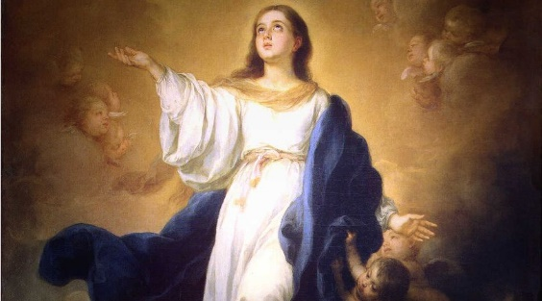
When it was time for Mary’s life to come to an end, God took her body and her soul up to heaven
1) At the end of Mary’s life God took her to heaven - body and s___.
oul
2) We call this Mary’s A _________.
ssumption
od
3) Mary was taken up to heaven because she loved G __.
4) Now Mary lives with God and Jesus in h_____.
eaven
5) Mary is our heavenly mother and she loves us very m___.
uch
R-1
S-07
Click on sentence to reveal ending.
Notes:
Explain to children that when people die their souls go to God in heaven but their bodies stay in the earth. But with Mary, God took her body and soul to heaven because he loved her so much. This is why Mary’s Assumption is so special and this has only happened to Mary.

Slide 11
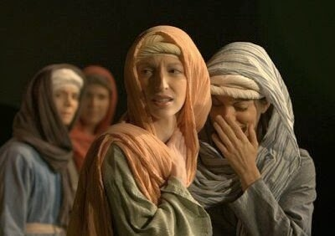
Mary’s friends were very sad when she died
We can ask Mary to help us to be loving and kind to the people around us.
We call this Mary’s Assumption. God did this because Mary had loved God and Jesus so much during her life.
That means God lifted up Mary’s body and soul from her grave and Jesus received her into heaven.
The story about Mary’s death is not written in the Bible but we know that she was assumed into heaven.
She had showed them how God wants people to love and care for each other.
They had loved and cared for her on earth and she had been a wise and loving friend to them.
Mary died peacefully just as if she fell asleep and her friends and the apostles took her body to be buried.
R-1
S-08
Click top card to discard it

Slide 12
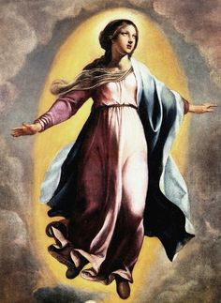
We celebrate the Feast of Mary’s Assumption on August 15
H | E | A | R | T | H | V | E | R | Y
E | H | E | A | V | E | N | D | A | Y
R | I | S | P | E | C | I | A | L | D
A | S | S | U | M | P | T | I | O | N
A | G | K | C | O | U | N | T | R | Y
F | O | R | H | U | A | N | D | N | M
O | U | R | S | J | W | E | O | N | A
A | U | G | U | S | T | 1 | 5 | P | R
I | N | T | O | N | L | I | F | E | Y
C | E | L | E | B | R | A | T | E | S
We celebrate Mary’s life on earth and her assumption into heaven on August 15 it is a very special day for our country.
R-1
S-09
Click the words in the sentence to reveal its position in the Word Find.
Notes:
Children find each word in the sentence below on the matrix and highlight it in the sentence and in the Word Find
The feast of the Assumption is the national feast day of Aotearoa New Zealand. Mary loves and cares for our people and protects our country and we honour her on her feast day.

Slide 13
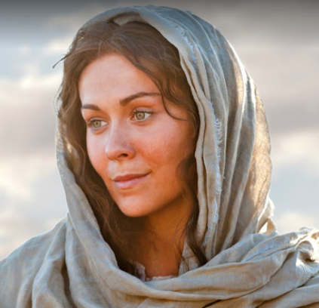
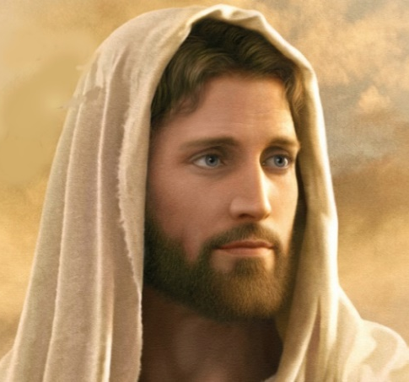
What ways was Mary like Jesus?
Mary said “Yes God I will be the mother of Jesus
Mary said “I will help …
Mary said “I will teach …
God said “This is my beloved …
Mary was assumed into …
Jesus said “Yes God I will be born on earth”
Jesus said “I will help …
Jesus said “I will teach …
God said “This is my beloved …
Jesus ascended in to ….
R-1
S-10
Click the audio button to play ‘Mary said Yes’
Click the audio button to stop ‘Mary said Yes’
Notes:
Sing using the MP3 ‘Mary said “Yes”’
ANSWERS - examples
I will help the poor, people who are sick and lovely, people who are in need
I will teach people about God’s great love for people, how to love one another
This is my beloved son/daughter
Jesus ascended/ Mary was assumed into heaven

Slide 14
Check Up
1)
Retell the story about Jesus’ Ascension into heaven.
2)
Talk about 3 special events in Mary’s life.
3)
What happened when Mary died?
4)
What does it mean that Mary was assumed into heaven?
5)
Which activity do you think helped you to learn best in this resource?
6)
Questions I would like to ask about the topics in this resource are …
R-1
S-11
Click the borders to reveal text

Slide 15
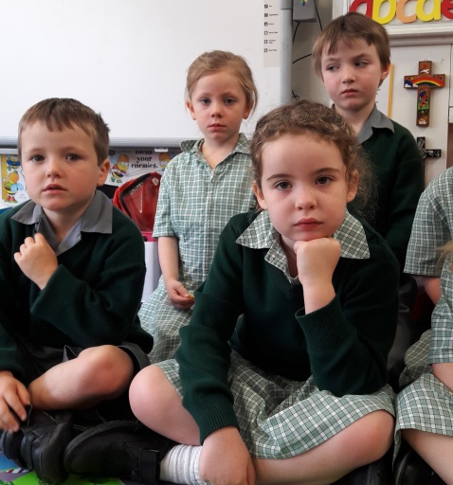
Time for Reflection
R-1
S-12
Click the audio button to stop reflective music
Click the audio button to play reflective music
Click audio button to play reflective music
Notes:
The MP3 is played to help create a reflective atmosphere and bring the children to stillness and silence as the teacher invites them to think about how they can be kind and loving to people in their family just as Mary was.

Slide 16
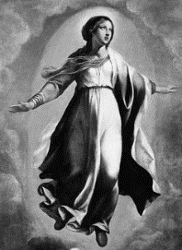
The Holy Spirit helps people to love and care for others as Jesus did
H | E | A | R | T | H | V | E | R | Y
E | H | E | A | V | E | N | D | A | Y
R | I | S | P | E | C | I | A | L | D
A | S | S | U | M | P | T | I | O | N
A | G | K | C | O | U | N | T | R | Y
F | O | R | H | U | A | N | D | N | M
O | U | R | S | J | W | E | O | N | A
A | U | G | U | S | T | 1 | 5 | P | R
I | N | T | O | N | L | I | F | E | Y
C | E | L | E | B | R | A | T | E | S
Name_______ Date_______
We celebrate Mary’s life on earth and her assumption into heaven on August 15 it is a very special day for our country.
R-1
S-09
Worksheet
Click the up arrow to return to the lesson

