Slide 1
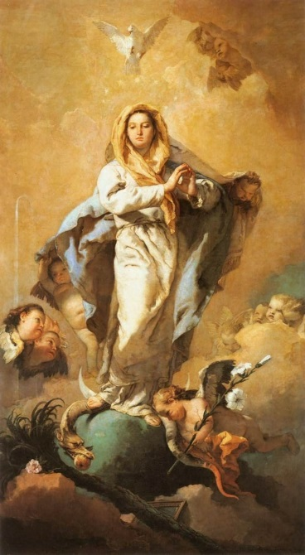
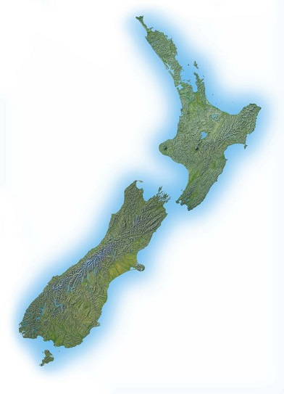
Mary of the Assumption is the Patron of Aotearoa
New Zealand
R-1
S-01
Notes:
Use this slide as a focussing strategy to introduce the resource topic. Read the title together and invite children to share something they know about Mary’s Assumption and this feast celebrates that Mary is the Patron and protector of Aotearoa New Zealand.

Slide 2

Learning Intentions
The children will…
1)
recognise that after her Assumption, Mary is present to all people everywhere
2)
recognise that Mary of the Assumption is the patron or protector of Aotearoa New Zealand
3)
recognise that the feast of the Assumption is a Holy Day of Obligation.
R-1
S-02
Click in each box to reveal text.
Notes:
Read through the Learning Intentions with the class and identify some ideas/questions that might be explored in the resource.
Sing ‘O Queen of all’ in class prayer this week and pray for people from different cultures in your class and your school and parish.

Slide 3
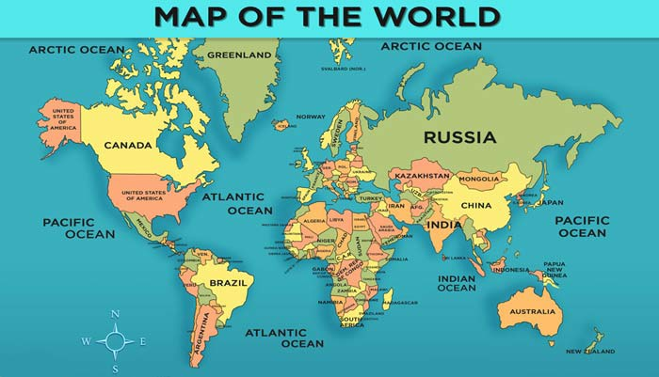
Mary looks after our land and the lands of our birth
Can children find:
the country of their birth.
the country where they live now.
the country where Mary lived.
the countries in the world where Mary is known now.
Mary lived here
We live here
Pointer/pen
Click red buttons to display on the map where we live and where Mary lived.
Click worksheet icon for worksheet.
The pen or pointer can be used to show where children were born (to remove pointer click on it and “pointer” again or use pointer options in right click).
R-1
S-03
Notes:
Adapt Teaching and Learning Experiences 1, 2.
Ask children from other cultures to find out how Mary’s Assumption is celebrated in their country and share it with their class. This could be recorded and share with the school on Assumption day.
Children could ask grandparents to tell them about how Mary’s Assumption was celebrated when they were children and share it with their class.
Adapt Teaching and Learning Experience 6.
Note: Assumption Day in India is very important as it coincides with the National Independence Day.
India had been taken over and governed as a colony by the English for 200 years. On August 15 1947 a man called Mahatma Gandhi restored the independence of India through the path of non-violence and self-sacrifice. This great man drew inspiration from the Gospel. Every Indian Christian has reason to celebrate Mother Mary and their Motherland India on this day.

Slide 4
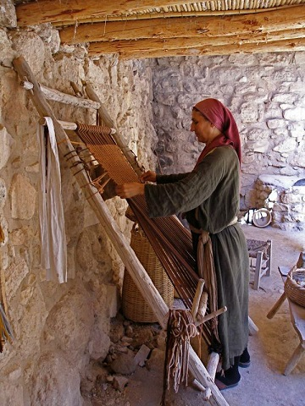
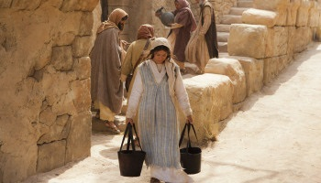
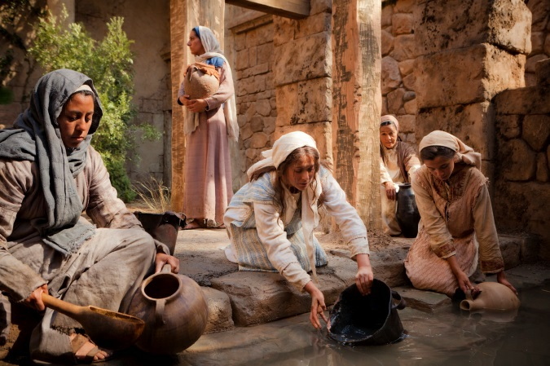
Mary’s life in Nazareth was like the other women in the town
Mary spent time weaving cloth for clothing and mats for her home and family.
Caring for Joseph and Jesus was how Mary showed her love for them.
Getting food from the market was a good time for Mary to meet her friends.
She enjoyed their company. Mary was a good friend and she would visit anyone who needed her help.
The well was a gathering place for the village women to catch up and support each other.
The women listened to Mary because they knew she was a wise and loving woman.
This is what Mary’s life was like when she lived on earth
R-1
S-04a
Click images to reveal text.
Notes:
Use the revealed text to generate discussion and questions about Mary’s life.
Children can create their own collage of images of Mary’s life to be part of an Assumption Art Display in the church or school foyer to celebrate the feast. Add a map and flag of Aotearoa New Zealand with a caption to remind people that the feast of the Assumption is our National feast day. Children could do some research about how this feast was chosen. This could be shared and added to the art display.

Slide 5
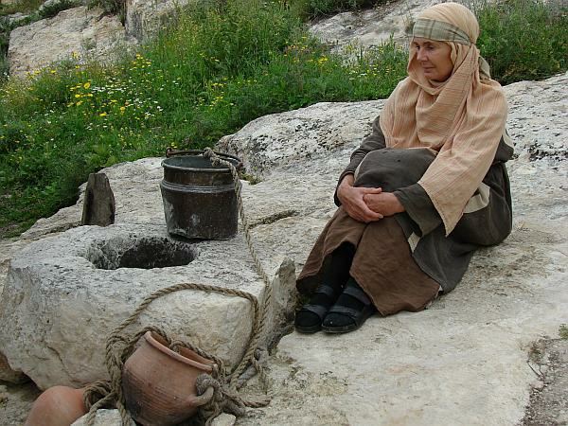
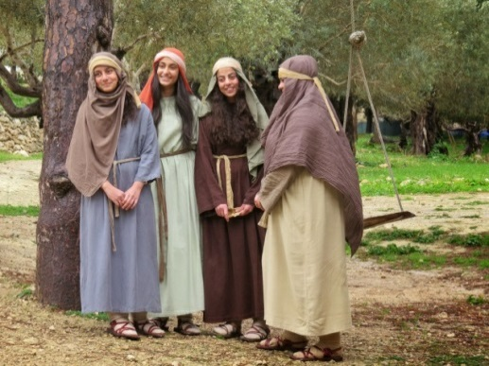
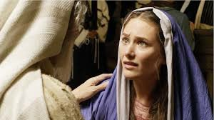
Mary’s life in Nazareth was like the other women in the town
Sometimes Mary would spend time alone in quiet prayer with God.
God would let Mary know what his plan was for her life in these times.
Mary supported Jesus with his work. Mary listened to the stories he told her and Joseph about people he met.
She was always there to advise him and care for him. Sometimes Jesus worked in the shop with Joseph.
Mary enjoyed the company of the other women in Nazareth.
She listened to their problems and helped them when she could.
They recognised Mary as someone who always stood up for people in need and protected them.
This is what Mary’s life was like when she lived on earth
R-1
S-04b
Click images to reveal text.
Notes:
Use the revealed text to generate discussion and questions about Mary’s life.
Children can create their own collage of images of Mary’s life to be part of an Assumption Art Display in the church or school foyer to celebrate the feast. Add a map and flag of Aotearoa New Zealand with a caption to remind people that the feast of the Assumption is our National feast day. Children could do some research about how this feast was chosen. This could be shared and added to the art display.

Slide 6

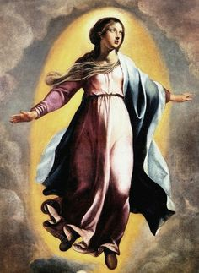

Since Mary’s Assumption into heaven she is present to people everywhere
What God did for Mary because of her good and faithful life, God promises to do for everyone else who believes in God and follows Jesus. They too will be raised up on the last day and death will have no power over them. God promised this and proved he keeps his promise because we have seen it in Mary. This is why we have hope in what God promises.
While Mary lived on earth she was limited to contact with people in her own village and the areas surrounding it. Now after her Assumption into heaven, Mary’s presence is no longer limited - she is available to help all people in need anywhere in the world.
When ordinary people die their bodies are buried in the earth and their souls go to heaven. Their souls will be reunited with their bodies on the last day of the world when Jesus comes again to bring his Kingdom of mercy, love and justice to its fullness.
God loved Mary so much he took her, body and soul, to heaven because she was without sin and completely faithful to God’s plan for her life. Her body like most other humans would not decay because it was her body that carried Jesus into the world so God raised her in her body to eternal life.
God wants people everywhere to try to become like Mary. Mary lived her life completely in tune with what God was asking of her. God wants people everywhere to do this. Mary is the model for all people who follow Jesus. Christians are called to love Jesus as Mary did, care for those in need as Mary did, lead others to God as Mary did.
R-1
S-05
Click the pins on the right to reveal post-it notes.
Notes:
Refer to the images of the previous 2 slides and emphasise how Mary helped people in her community. Now she is in heaven she can help people everywhere. Read through each post it note and take time to clarify the meaning of the text and invite children to ask a question or make a comment to generate discussion.

Slide 7
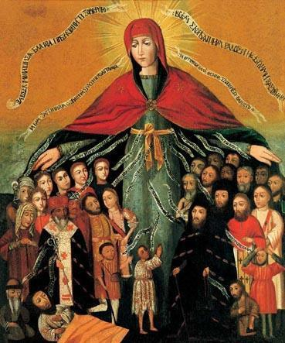
Mary is the protector of all people
1) The Catholic bishops of Aotearoa chose Mary to be the special
2) This means we place special importance
3) The bishops chose the feast of Mary’s Assumption
4) The feast of the Assumption is such an important
5) On Holy Days of Obligation the whole community
protector or patron of our land and
our people.
on Mary - on her feasts, in our liturgies and schools and
parishes.
into heaven to celebrate our national feast day
on August 15.
feast it is a Holy Day of Obligation.
gathers to celebrate Eucharist together in their
parish church.
feast it is a Holy Day of Obligation.
into heaven to celebrate our national feast day on August 15.
on Mary - on her feasts, in our liturgies and schools and parishes.
gathers to celebrate Eucharist together in their parish church.
protector or patron of our land and our people.
R-1
S-06
Click an item on the list or the end of a sentence to correctly position second half of the sentence.
Notes:
This art work was created by a Ukrainian painter.
The writing is in Ukrainian - Can you read what it says?
If you could, what do you think it would say?
What are the people doing in the picture? Why?
Mary is shown as a protector, like all mothers she protects her children from harm and is concerned for them. This is why Mary was chosen to be the protector of our country.
You could research who chose Mary to be the patron and protector of our country.
In class prayer this week name all the things Mary could protect our country from and ask her to take your prayers to God and speak to God on your behalf. How does having Mary as your protector make you feel?
Remember to ask Mary’s help in class prayer when there are storms, accidents and sad things that happen.
ANSWERS 1) E, 2) C, 3) B, 4) A, 5)

Slide 8
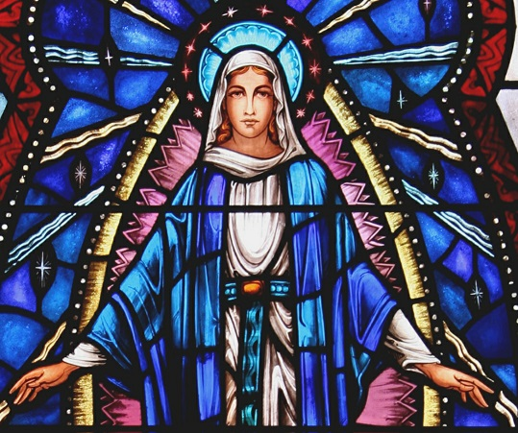
Celebrating the feast of Mary’s Assumption
N | A | E | S | E | J | M | A | R | Y
T | O | V | N | C | M | F | O | R | E
K | T | I | S | A | O | D | E | H | P
Y | E | L | T | E | R | H | A | H | A
Y | A | R | P | P | T | R | S | Y | R
Y | R | D | D | E | M | A | L | L | H
C | O | N | G | O | H | U | T | O | P
T | A | O | N | P | E | S | S | H | E
O | T | Y | N | L | L | T | E | S | L
L | A | I | C | E | P | S | P | H | A
Assumption Day is a special Holy Day for all people in Aotearoa to pray to Mary to help us live together in peace and harmony.
R-1
S-07
Click the words in the sentence to reveal their position in the puzzle.
Notes:
Read the sentence in the word find under the image.
Find each word in the sentence below on the matrix and highlight it in the sentence and in the Word-Find. Add to RE Learning Journals.
Ask Mary in class prayer to help our people live together in peace and harmony with no violence.

Slide 9

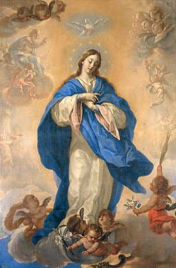
Mary is living her heavenly life with God
Mary’s Assumption made it possible for her to be present to all people everywhere as she is enjoying her heavenly life with God, Jesus all the Saints all people who have died.
What do you imagine heavenly life is like?
Assumption Day is a Holy Day of Obligation and on this special feast day Catholics honour Mary by celebrating Eucharist together. All Sundays are also Holy Days of Obligation because they celebrate the day Jesus rose from the dead. They are like Easter Sunday every week.
There is another Holy Day of Obligation in Aotearoa New Zealand – do you know when it is?
Our national feast day on August 15 that celebrates Mary’s Assumption into heaven recognises Mary’s complete faithfulness, love and care for Jesus and all people. God rewarded her for this by taking her up – ‘assuming’ her to heaven by God’s power.
How is Mary’s life and death a model for people today and for what will happen after death?
Mary is the mother of the whole human family and she cares for all people just as mothers on earth do. Mothers care for their children and protect them and that is why Bishop Pompallier, the first bishop of New Zealand, chose Mary to be our patron and protector.
Can you think of times we might need to ask Mary to keep us safe and protect us from harm?
Mary wants to continue in heaven to do what God wants her to do. She speaks to God when people ask her for help and because of her special relationship with God, God considers her requests generously.
Remembering Mary is your heavenly mother what could children of your age ask Mary to help you with?
Mary is still the person she was when she lived on earth and while she is now in heaven she wants to continue to help people as she did on earth.
What can people do to ask Mary for help?
RESET
Click each card to move through (6) and “Reset” to start over.
R-1
S-08
Click the audio button to stop ‘O Queen of All’
Click the audio button to play ‘O Queen of All’
Notes:
Read through each flip card – think about what the text means and respond to the question.
Sing using the MP3 ‘O Queen of All’ This hymn could be sung at mass on Assumption Day.
Clarify the difference for the children between Christ’s Ascension which was by his own power as the second person of the Holy Trinity and Mary’s Assumption which Mary did not do for herself but was done for her by the power of God because of Christ’s love for her as his mother.
Christmas Day is the other Holy Day of Obligation.

Slide 10

Check up
1)
How did Mary’s Assumption make it possible for her to be present to all the people of the world?
2)
Why was the feast of Mary’s Assumption chosen as the national feast for Aotearoa New Zealand?
3)
How can Catholics celebrate the feast of Mary’s Assumption?
4)
What does Mary’s Assumption teach us about our life on earth and what happens when we die?
5)
Which activity do you think helped you to learn best in this resource?
6)
Questions I would like to ask about the topics in this resource are…
R-1
S-09
Click in each box to reveal text.
Notes:
This formative assessment strategy will help teachers to identify how well the children have achieved the Learning Intentions of the resource.
Teachers can choose how they use the slide in their range of assessment options.
A worksheet of this slide is available for children in Years 5-8 to complete.
The last two items are feed forward for the teacher.
Recording the children’s responses to these items is recommended as it will enable teachers to adjust their learning strategies for future resources and target the areas that need further attention.

Slide 11

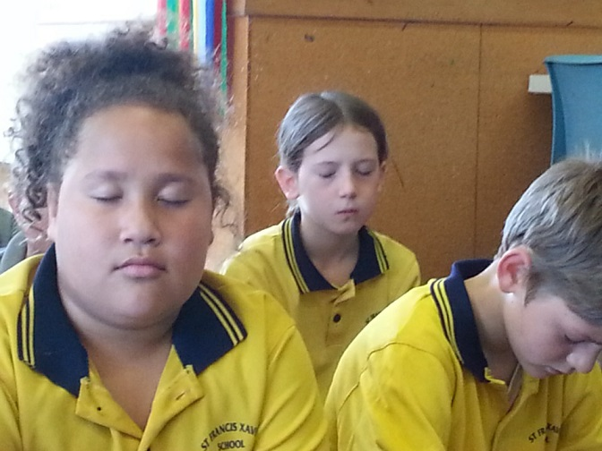

Time for Reflection
Click the audio button to stop reflective music
R-1
S-10
Click the audio button to play reflective music
Click the audio icon for reflective music.
Notes:
The MP3 is played to help create a reflective atmosphere and bring the children to stillness and silence as the teacher invites them to recall how willingly Mary responded to God’s call to be the mother of his Son, Jesus. Reflect on times God has called you, through someone you know to do something special for someone else and how you have responded. Talk to Mary about this.

Slide 12
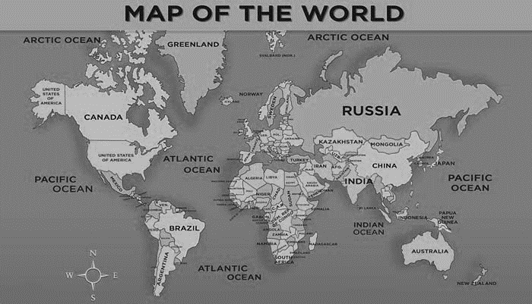
Mary looks after our land and the lands of our birth
Name__________________________________ Date_______________
Please mark on the map where –
Mary lived
You were born
You live now
Worksheet
R-1
S-3
Click the up arrow to return to the presentation.

Slide 13
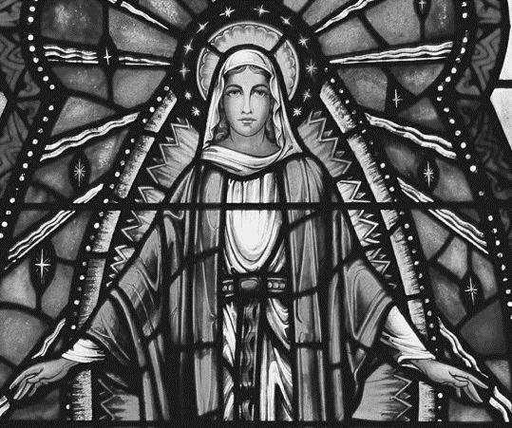
Celebrating the feast of Mary’s Assumption
Name__________________________________ Date_______________
N | A | E | S | E | J | M | A | R | Y
T | O | V | N | C | M | F | O | R | E
K | T | I | S | A | O | D | E | H | P
Y | E | L | T | E | R | H | A | H | A
Y | A | R | P | P | T | R | S | Y | R
Y | R | D | D | E | M | A | L | L | H
C | O | N | G | O | H | U | T | O | P
T | A | O | N | P | E | S | S | H | E
O | T | Y | N | L | L | T | E | S | L
L | A | I | C | E | P | S | P | H | A
Assumption Day is a special Holy Day for all people in Aotearoa to pray to Mary to help us live together in peace and harmony.
Highlight the words in the sentence when you mark them in the word-find.
Worksheet
R-1
S-7
Click the up arrow to return to the presentation.
Notes:
Find each word in the sentence below on the matrix and highlight it in the sentence and in the Word-Find. Add to RE Learning Journals.

