Slide 1
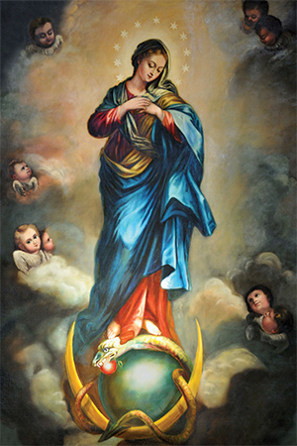
The Feast of the Assumption
R-1
S-01
Notes:
Use this slide as a focussing strategy to introduce the resource topic. Read the title together and invite children to share something they know about Mary’s
Assumption into heaven body and soul. Create a Mary prayer focus and sing Mary songs this week during class prayer to honour Mary on her feast day.
Print off copies of the worksheet on Slide 6 with the works of the traditional Mary Hymn ‘Hail Queen of Heaven’ for children to sing with on the next slide. Before you start read the Overview Notes on Slide 6.
Look closely at the image on this slide and note what Mary is standing on and what surrounds her head.

Slide 2
Learning Intentions
The children will:
1)
recognise that the Feast of the Assumption is a Holy Day of Obligation
2)
recognise that in her Assumption to heaven Mary Maria shares in the resurrection of her Son.
R-1
S-02
Click in each caption space to reveal text. Click the video button to play a video
Notes:
Read through the Learning Intentions with the class and identify some ideas/questions that might be explored in the resource.
In class prayer use the readings for the feast of the Assumption during class prayer this week -
The Book of Revelation 12: 1-3. Luke 1:39-56 and play the clip with the traditional hymn to Mary ‘Hail Queen of Heaven’ on slide 6.
https://www.youtube.com/watch?v=miMm7BUHARQ
Hail Queen of Heaven 2:49 Minutes

Slide 3
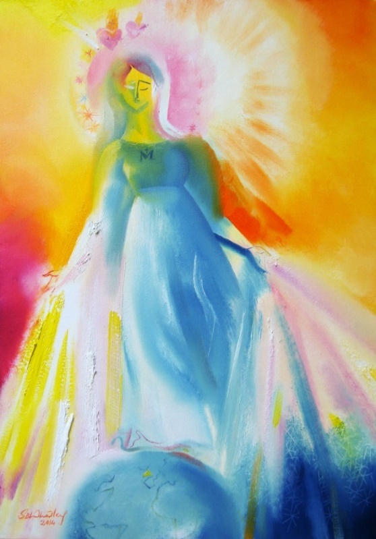
What do you know about the Feast of Mary’s Assumption?
What do I know about the Feast of Mary’s Assumption?
R-1
S-03
Use the pen tool in left hand corner to write an example .Click the worksheet button to go to the worksheet
Notes:
Adapt Teaching and Learning Experience 1.
Print off the Mind Map worksheet for children to record what they know already about Mary’s Assumption. Give children time to add to their mind map as they work through and complete the resource.
Take time to share what children have written on their mind map and note any questions they have.

Slide 4
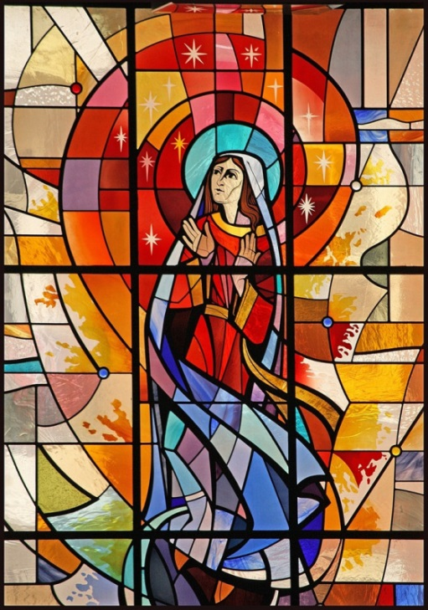
Why is the Assumption of Mary such an important Feast in the Church?
Understanding Mary’s Assumption helps us to understand more about God’s plan for us and our salvation. When we honour Mary we honour God who created her and Jesus whose life, death and resurrection saved her and all of us from sin and death.
Mary’s Assumption shows us how closely connected Jesus’ life was to Mary’s and how what happened to her will happen to us – we too will be raised up body and soul on the last day to live in heaven forever.
God did not want Mary’s body that gave birth to his son, cared for him and supported him throughout his life to decay after death in her grave. God raised Mary’s body and soul immediately to be in heaven with God. Through this, God did for Mary what he did for Jesus so Mary could share in Jesus’ resurrection.
Jesus died because of his love for all people and he saved them from death. By Jesus’ resurrection to new life he made it possible for all people to enjoy a new eternal life in heaven. People can make this possible by being living examples of God’s love in the world.
Mary was a human like us but she lived in complete faithfulness to God and her Assumption teaches us that there is hope of eternal life for all after death, death is not the end. Mary is the living proof for all Christians of the promise Jesus made of this.
R-1
S-04
Click the pins on the right to reveal post-it notes.
Notes:
Read through each post it note and talk what the text means and let children have time to think about what it means. Children respond to the title question.

Slide 5
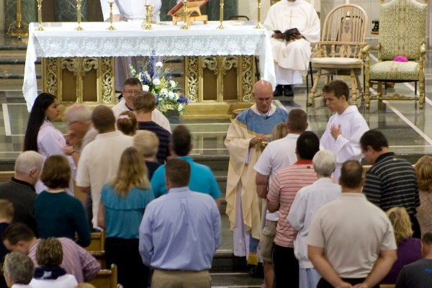
Celebrating the Feast of Mary’s Assumption
Mary’s Assumption is a major feast
that is celebrated in the life of the Church community.
Assumption Day is one of two days in the Church’s
life in New Zealand when people are expected to participate in the Eucharist.
Mary’s Assumption is a model for Christians of what God
has planned for them when they die.
has planned for them when they die.
that is celebrated in the life of the Church community.
life in New Zealand when people are expected to participate in the Eucharist.
R-1
S-05A
Click on a sentence from the list at the bottom or click an empty text box to complete the sentences.
Notes:
Children share their own answers and check them with the floaters.
Remind children that every Sunday is a Holy Day of Obligation when the parish community gathers together to celebrate and give praise, glory and thanks to God for all God has given them. In Aotearoa New Zealand the other Holy Day of Obligation besides the feast of the Assumption on August 15 is Christmas Day, December 25.

Slide 6
Celebrating the Feast of Mary’s Assumption
Mary’s life was lived entirely for
God, doing everything that God had planned for her.
By raising Mary’s body and soul to heaven
God enabled Mary to share in Jesus’ resurrection.
Catholics celebrate Mary’s Assumption by
singing special hymns, saying special prayers to honour her.
singing special hymns, saying special prayers to honour her.
God enabled Mary to share in Jesus’ resurrection.
God, doing everything that God had planned for her.
R-1
S-05B
Click on a sentence from the list at the bottom or click an empty text box to complete the sentences.
Notes:
Children share their own answers as above then check them with the floaters.
Remind children that every Sunday is a Holy Day of Obligation when the parish community gathers together to celebrate and give praise, glory and thanks to God for all God has given them. In Aotearoa New Zealand the other Holy Day of Obligation besides the feast of the Assumption on August 15 is Christmas Day, December 25

Slide 7
The 1st Scripture Reading from the book of Revelation 12:1
There are many traditional hymns and prayers directed to Mary Queen of Heaven that are used in the Church especially on special feast days that honour Mary. Her assumption is the 4th Glorious Mystery of the Rosary and her Crowning as Queen of Heaven is the 5th Glorious Mystery. Watch and listen to the example of a traditional hymn to honour Mary’s Queen of Heaven.
As time passed, the image of Mary with a crown accepted her as the Queen of Heaven. Pope Pius XII declared her the Queen of Heaven because of her relationship with Jesus who is the King and because of the perfect life she lived and how she continues to take the prayer offered to God by people who honour her in their special devotions and liturgy on her feast days.
Over time this image has been used to portray in art and statues Mary as she was assumed into heaven. In the 1950s Mary’s Assumption became a ‘dogma’ which is an official belief of the Catholic Church.
Generally speaking, Catholics view Mary (as shown in the image) as the woman clothed with the sun in the book of Revelation 12:1-3: "A great and wondrous sign appeared in heaven: a woman clothed with the sun, with the moon under her feet and a crown of twelve stars on her head.”
Revelation is also known as The Apocalypse and has come to be associated with cataclysmic disaster, judgement day or the end of the world. However, its true meaning is an unveiling or revelation of things known only to God.
The book of Revelation is also a prophecy (Revelation 1:1-3). We often think of prophecy as a prediction of the future, but originally it meant "speaking the mind of God.”
John used this style of writing so his Roman captors would not understand the description of his vision. It would have made sense to other Christians.
The book of Revelation is an example of "apocalyptic" writing that uses symbols, images and numbers to convey its message. It is also used in the book of Daniel in the Old Testament. The messages it conveys are often about persecution.
Tradition says John the apostle (Mark 3:14-19) was the author of both the book of Revelation and the Gospel of John, but that is not certain. The author does not identify himself as an apostle.
In about the year 95 A.D, a man named John had a vision from heaven. The book of Revelation is John's record of that vision. John was a Christian leader and was in exile on the Roman prison island of Patmos.
A great and wondrous sign appeared in heaven: a woman clothed with the sun, with the moon under her feet and a crown of twelve stars on her head. -Book of Revelation 12:1-3
R-1
S-06A
Click top card to discard it.
Notes:
Explain that the 1st Reading comes from the Book of Revelation. The style of writing in this book is different from all other writing in the Bible. Find out about this as you read through the flip cards.
Children make notes of new learning on post it notes and share what they have noted when the flip cards are finished. Revelation is the last book in the Bible – give children time to find it in their Bible. They can record the last verse Revelation 21:21 and share the last word and its meaning: Amen, so be it, in their RE Learning Journal and memorise. Children can make a Book of Revelation Poster Board and add their post it notes. Encourage them to do further research about the Book of Revelation and add it to the poster board.
There are parts of this book that are more suitable for adults so it may be wise for this age group just to focus on the passage in this resource.

Slide 8
The 1st Scripture Reading from the book of Revelation 12:1
Hail Queen of Heaven:
Hail Queen of Heaven
Hail Queen of Heav’n the ocean star
Guide of the wand’rer here below.
Thrown on life’s surge we claim their care
Save us from peril and from woe.
Mother of Christ Star of the Sea
Prayer for the wanderer, pray for me.
O gentle chaste and spotless maid
We sinners make our prayers through thee.
Remind they Son that he has paid
The price of our iniquity.
Virgin most pure, Star of the sea
Pray for thy children, Pray for me.
A great and wondrous sign appeared in heaven: a woman clothed with the sun, with the moon under her feet and a crown of twelve stars on her head. -Book of Revelation 12:1-3
R-1
S-06B
Click the video button to play a video .Click the worksheet button to go to the worksheet.
Notes:
Explain that a characteristic of the Catholic Church has always been
devotional practices that give honour to Mary, the Saints, the Sacred Heart etc.
Devotions are personal expressions of love, faith and spiritual attachment to a holy person or feast. They usually include prayer and hymns and they can be practiced individually or with groups in homes, churches, schools or other gathering places.
Devotions can be used at any time or to mark a special feast, event or season in the Liturgical calendar. Examples are the Stations of the Cross, the Rosary, pilgrimages and novenas.
Devotions are not part of the Liturgy of the Church but people are encouraged to use them to sustain their prayer and faith. Devotions sometimes include traditional cultural practises, images and language.
The hymn ‘Hail Queen of Heaven’ was a popular hymn that was part of many devotions to Mary. Mary was called by many titles some of which were similes and metaphors such as Star of the Sea, Seat of Wisdom, Queen of All Saints. Many of these titles are prayed in Litanies to honour Mary.
While many forms of devotion continue today they were probably more popular in the past and were a very important part of older people’s faith and life. Read through words of the hymn (See Slide 6B) and highlight the words that recognise Mary as a caring protector and relate this to why the Assumption was chosen as our national feast day. Using the clip and the words sing the hymn and discuss the meaning of the words.
https://tinyurl.com/Faith-Alive-Hail-Holy-Queen Hail Queen of Heaven 2:49 Minutes
Give children the link to share with an older family member and encourage them to talk to their older family whānau about their favorite devotions
Note it is a tinyURL which makes is much easier for children to copy - https://tinyurl.com/Faith-Alive-Hail-Holy-Queen
Many older people grew up with these hymns and have sung them all their lives. They often request that they are sung at their funerals. Even though the language of hymns such as these is somewhat dated now, they are still used to honour Mary and to bring back memories for older people in the parish community. Encourage children to talk to older people about the devotions they use/d and to show and share some examples with them.
Children could compile a Litany using all Mary’s names and titles to honour her that can be prayed and shared with others on Assumption Day. Adapt Teaching and Learning Experience 4.
Children create an art work of Mary Queen of Heaven and display them in an exhibition to be share with the school and parish community to celebrate Assumption Day. Work through the bullet points on the I pop up

Slide 9
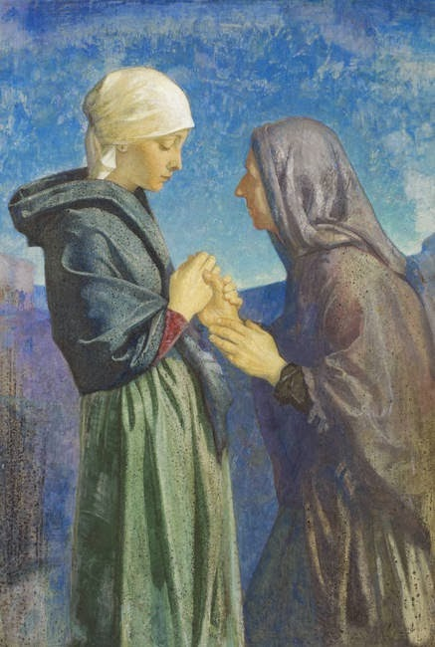
The Gospel Reading for the
Feast of the Assumption
Read Luke 1:39-56
What is this incident in Mary’s life referring to?
What is the name of the prayer of praise to God that Mary prays in this reading?
How did Elizabeth describe Mary in the story and what did she mean by it?
What are some of God’s mighty deeds that Mary acknowledges?
Why do you think Mary prayed this prayer?
Reflect on the fact that Mary’s greatness does not come from her position in society, or how much money she had but from her response to what God asked her to do in her life.
X
R-1
S-07
Click the audio button to stop ‘You are blessed among women’
Click the I-button to reveal information.
Click the audio button to play ‘You are blessed among women’
Notes:
As Assumption is a Holy Day of Obligation, children will be celebrating it by going to mass. Being familiar with the 1st reading and the gospel will increase their participation. You may like to include in the mass the song below which ties in well with the gospel.
Sing using the MP3 ‘You are blessed among women’
ANSWERS:
What is this incident in Mary’s life referred to? The Visitation – Mary visits Elizabeth.
What is the name of the prayer of praise to God that Mary prays in this reading? The Magnificat
How did Elizabeth describe Mary in the story and what did she mean by it?
Of all women you are the most blessed, and blessed is the fruit of your womb.
She meant Mary was to be the mother of Jesus, the Messiah and Saviour of the world.
What are some of God’s mighty deeds that Mary acknowledges?
God has chosen Mary and done great things for her. God is powerful, holy and God has pulled down the mighty and lifted up those with no power. God has fed the hungry and sent away the rich empty. God is full of mercy and keeps his promises.
Why do you think Mary prayed this prayer?
Mary wanted to acknowledge how great God is and all God has done for her by asking her to be the mother of his son, Jesus.

Slide 10
What does Mary’s Assumption mean for us?
Mary’s Assumption helps us to:
remember that God gives each of us a purpose and a vocation to follow in our life and the gifts we need to carry it out well
First sentence that wraps at the end of the textbox and thus spreads out over two lines
Second sentence that wraps at the end of the textbox and thus spreads out over two lines
Third sentence covering one line only
Fourth sentence that wraps at the end of the textbox and thus spreads out over two lines
realise that we have the gift of free will to follow our vocation or call from God just as Mary did
be aware of the Holy Spirit in our hearts who prompts us to listen to God’s call and leads us to use our gifts as we follow it
be strong when we have hard times in our lives and gives us hope that we can get through it
R-1
S08A
Click the down-button to move the blind down.
Notes:
Read the title and suggest ideas about what Mary’s Assumption means for us in our lives today.
Read each item and respond to each one with a partner.
Use the highlighted verbs as a starter to make your own statement about the Assumption.

Slide 11
What does Mary’s Assumption mean for us?
Mary’s Assumption helps us to:
trust that Mary will intercede for us with God
First sentence that wraps at the end of the textbox and thus spreads out over two lines
Second sentence that wraps at the end of the textbox and thus spreads out over two lines
Third sentence covering one line only
Fourth sentence that wraps at the end of the textbox and thus spreads out over two lines
believe in the promises Jesus made to us about going to prepare a place for us
anticipate sharing in our own glorious resurrection with Jesus
recognise that God enabled Mary to share in the resurrection of Jesus her son by taking her body and soul to heaven
R-1
S08B
Click the down-button to move the blind down.
Notes:
Read the title and suggest ideas about what Mary’s Assumption means for us in our lives today.
Read each item and respond to each one with a partner.
Use the highlighted verbs as a starter to make your own statement about the Assumption eg I believe … I realise … I trust …
Review the Mind Maps from Slide 3 and add any new learning. Add worksheet to RE Learning Journal.

Slide 12
Check Up
1)
Explain what a Holy Day of Obligation is, how the community celebrates it and give 3 examples.
2)
Give 3 reasons why Mary’s Assumption is such an important feast.
3)
Write a paragraph about the Scripture Readings for the feast of the Assumption.
R-1
S-09A
Notes:
This formative assessment strategy will help teachers to identify how well children have achieved the Learning Intentions of the resource.
Teachers can choose how they use the slide in their range of assessment options.
A worksheet of this slide is available for children in Years 5-8 to complete.
The last two items are feed forward for the teacher.
Recording the children’s responses to these items is recommended as it will enable teachers to adjust their learning strategies for future resources and target the areas that need further attention.

Slide 13
Check Up
4)
Look at your mind map related to Slide 3 and add new things you have learned about it in this lesson.
5)
Which activity do you think helped you to learn best in this resource?
6)
Questions I would like to ask about the topics in this resource are …
R-1
S-09B
Click the worksheet button to go to the worksheet
Notes:
This formative assessment strategy will help teachers to identify how well children have achieved the Learning Intentions of the resource.
Teachers can choose how they use the slide in their range of assessment options.
A worksheet of this slide is available for children in Years 5-8 to complete.
The last two items are feed forward for the teacher.
Recording the children’s responses to these items is recommended as it will enable teachers to adjust their learning strategies for future resources and target the areas that need further attention

Slide 14
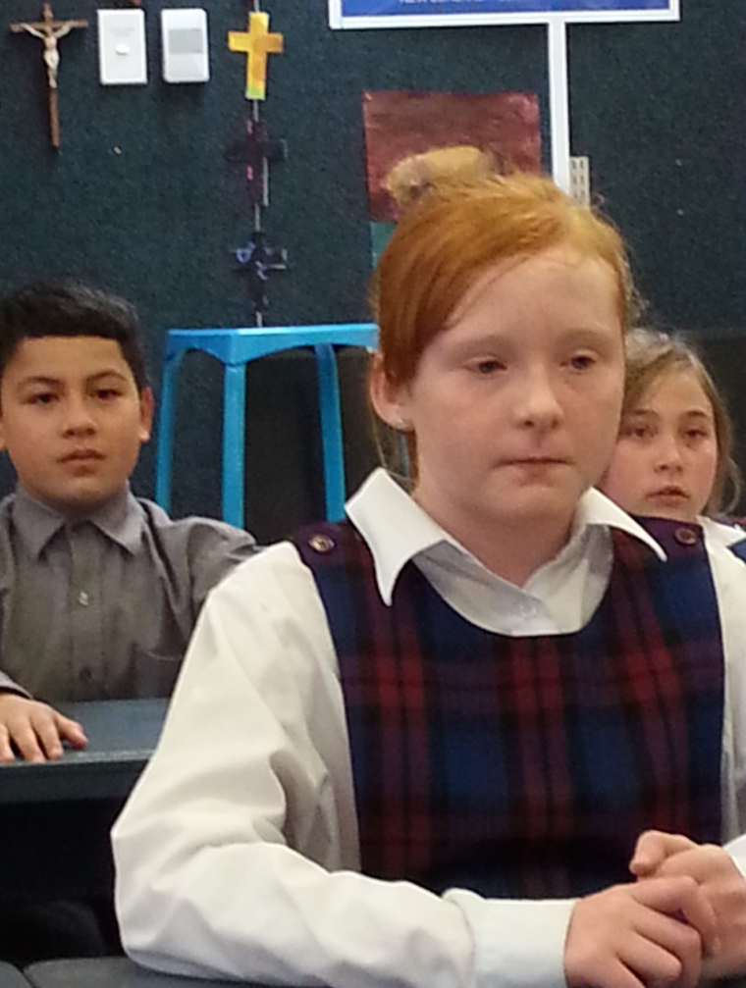
Time for Reflection
R-1
S-10
Click the audio button to stop reflective music
Click the audio button to play reflective music
Notes:
The MP3 is played to help create a reflective atmosphere and bring the children to stillness and silence as the teacher invites them to reflect on Mary’s Assumption and think about how she shows them what is in store for them when their life on earth has come to an end. Talk to Mary about how they are following God’s call to them to grow each day in holiness through their relationships with God and with people at home and at school.

Slide 15
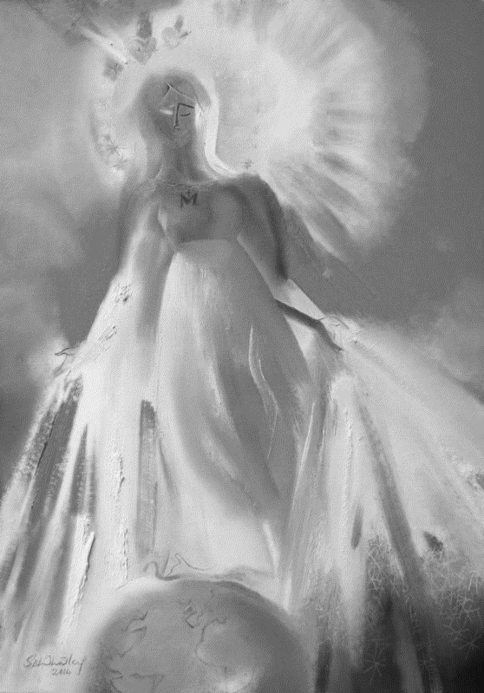
What do you know about the Feast of Mary’s Assumption?
What do I know about the Feast of Mary’s Assumption?
Name:____________________________
Date:____________
R-1
S-03
Worksheet
Click the up arrow to return to the presentation
Notes:
This worksheet relates to slide 3.

Slide 16
The 1st Scripture Reading from the book of Revelation 12:1
Hail Queen of Heaven:
Hail Queen of Heaven
Hail Queen of Heav’n the ocean star
Guide of the wand’rer here below.
Thrown on life’s surge we claim their care
Save us from peril and from woe.
Mother of Christ Star of the Sea
Prayer for the wanderer, pray for me.
O gentle chaste and spotless maid
We sinners make our prayers through thee.
Remind they Son that he has paid
The price of our iniquity.
Virgin most pure, Star of the sea
Pray for thy children, Pray for me.
A great and wondrous sign appeared in heaven: a woman clothed with the sun, with the moon under her feet and a crown of twelve stars on her head. -Book of Revelation 12:1-3
Name:____________________________
Date:____________
R-1
S-06B
Worksheet
Click the up arrow to return to the presentation
Notes:
This worksheet relates to slide 6B.

Slide 17
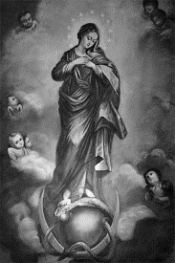
Check Up
Name:____________________________
Date:____________
1) Explain what a Holy Day of Obligation is, how the community celebrates it and give 3 examples.
2) Give 3 reasons why Mary’s Assumption is such an important feast.
3) Write a paragraph about the Scripture Readings for the feast of the Assumption.
4) Look at your mind map related to Slide 3 and add new things you have learned about it in this lesson.
5) Which activity do you think helped you to learn best in this resource?
6) Questions I would like to ask about the topics in this resource are …
R-1
S-09
Worksheet
Click the up arrow to return to the presentation
Notes:
This worksheet relates to slide 9.

