Slide 1
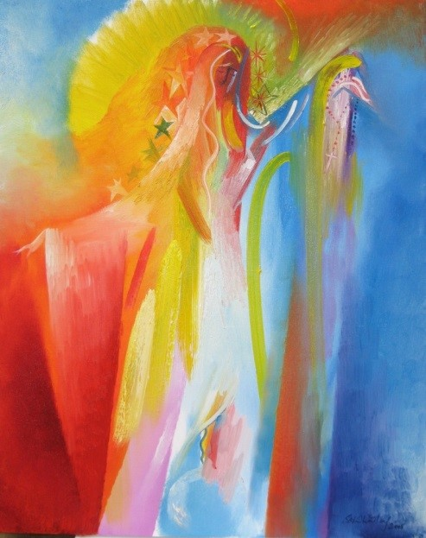
The Feast of the Assumption
R-1
S-01

Slide 2
Learning Intentions
The children will:
recognise the Feast of the Assumption celebrates that Mary Maria was taken body and soul into heaven
1)
recognise how Mary’s Assumption gives Christians hope – tūmanako that they too will be raised body and soul and enter the glory of heaven.
2)
R-1
S-02
Click the box to reveal the Learning Intention

Slide 3
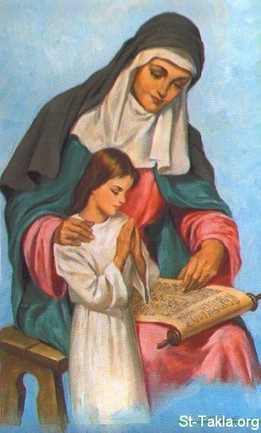
What do I know about the life of Mary, Mother of Jesus?
TRUE FALSE
TRUE FALSE
Mary was born in Bethlehem in 18 BC.
Mary’s parents were Anne and Joachim.
Mary’s name in Hebrew is Miriam.
Mary had many brothers and sisters.
The first mention of Mary in the Scriptures is the story of the Annunciation.
Mary is mentioned most in the Gospel written by St Matthew.
Mary is mentioned as Maryam in the Quran, the holy book for Muslim people.
Mary lived the life of a young Greek woman as she grew up in her village.
Mary was a teenager when she agreed to God’s request to be the mother of his Son.
This action began Mary’s life which she live completely doing what God asked her to do.
Most of what we know about Mary’s life we learn from the Old Testament.
Mary visited her elderly cousin Elizabeth when they were both pregnant.
Elizabeth greeted Mary saying “Blessed are you among all women!”
Joseph married Mary and their baby was born in a hospital in Jerusalem.
Jesus was presented at the Temple as was the Christian custom.
TRUE FALSE
TRUE FALSE
TRUE FALSE
TRUE FALSE
TRUE FALSE
TRUE FALSE
TRUE FALSE
TRUE FALSE
TRUE FALSE
TRUE FALSE
TRUE FALSE
TRUE FALSE
TRUE FALSE
TRUE FALSE
TRUE FALSE
TRUE FALSE
TRUE FALSE
TRUE FALSE
TRUE FALSE
TRUE FALSE
TRUE FALSE
TRUE FALSE
TRUE FALSE
TRUE FALSE
TRUE FALSE
TRUE FALSE
TRUE FALSE
TRUE FALSE
R-1
S-03a
Click True or false to reveal answer
Notes:
Note the woman in the image with Mary as a little girl is her mother St Ann, who was Jesus’ grandmother.
Children could include prayer this week for their grandparents.
The worksheet can be used as an indicator of children’s knowledge about the life of Mary.
Some ideas to use if their scores are low –
Review the worksheet and work through the items and discuss them with the class. Repeat worksheet.
Read Scripture stories about Mary in class prayer to reflect on and discuss.
Set up a research project on Mary and get children to present their findings in different ways to classes.
Use your priest, parents or parishioners to share what they know about Mary.
Make a ‘What we know about Mary’ board and ask children, staff, parents and grandparents to contribute to it.

Slide 4
What do I know about the life of Mary, Mother of Jesus?
TRUE FALSE
16) Jesus was educated at the temple school and Jesus taught him gardening skills.
17) Jesus was lost in Peru for weeks and Mary and Joseph found him playing with his friends
18) When Jesus began his teaching work Mary supported him and became one of his disciples.
19) Once at a wedding Mary asked Jesus to turn the wine into water to stop people drinking.
20) Jesus went about curing people and Mary could see he truly was God’s Son.
21) Mary knew Jesus was saying things the Jewish leaders didn’t like and she worried about him.
22) Mary was present when Jesus had his Last Supper the night before he died.
23) As Jesus carried his cross up Calvary hill Mary didn’t see him because there was such a crowd.
24) Mary stayed with Jesus by the cross and Jesus asked his friend Peter to look after her.
25) Mary stayed with the apostles until after Jesus rose from the dead.
26) When the Holy Spirit came Mary was present in the upper room in Jerusalem.
27) Mary died and the apostles were very sad but God took her body and soul to heaven.
28) The Assumption is the feast that celebrates Mary becoming the mother of Jesus.
29) The Church celebrates Mary’s Assumption by gathering for Eucharist in parish churches.
30) Mary is now in heaven and has been crowned Queen of Heaven.
TRUE FALSE
TRUE FALSE
TRUE FALSE
TRUE FALSE
TRUE FALSE
TRUE FALSE
TRUE FALSE
TRUE FALSE
TRUE FALSE
TRUE FALSE
TRUE FALSE
TRUE FALSE
TRUE FALSE
TRUE FALSE
TRUE FALSE
TRUE FALSE
TRUE FALSE
TRUE FALSE
TRUE FALSE
TRUE FALSE
TRUE FALSE
TRUE FALSE
TRUE FALSE
TRUE FALSE
TRUE FALSE
TRUE FALSE
TRUE FALSE
TRUE FALSE
TRUE FALSE
R-1
S-03b
Click True or false to reveal answer
Notes:
Note the woman in the image with Mary as a little girl is her mother St Ann, who was Jesus’ grandmother.
Children could include prayer this week for their grandparents.
The worksheet can be used as an indicator of children’s knowledge about the life of Mary.
Some ideas to use if their scores are low –
Review the worksheet and work through the items and discuss them with the class. Repeat worksheet.
Read Scripture stories about Mary in class prayer to reflect on and discuss.
Set up a research project on Mary and get children to present their findings in different ways to classes.
Use your priest, parents or parishioners to share what they know about Mary.
Make a ‘What we know about Mary’ board and ask children, staff, parents and grandparents to contribute to it.

Slide 5
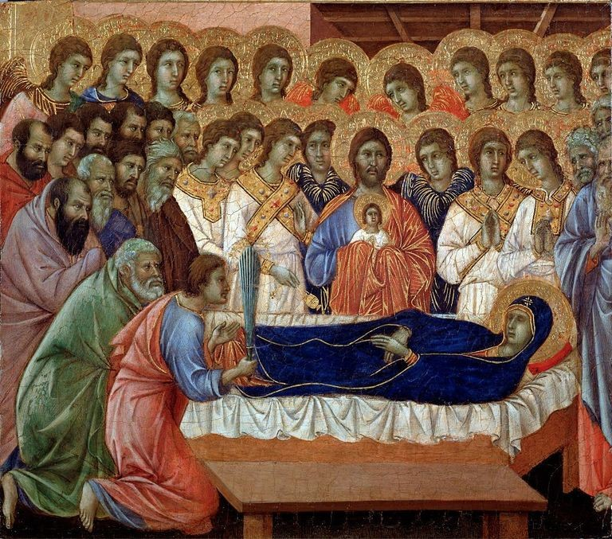
What happened at the end of Mary’s life?
For Mary this did not happen. Her body and soul were not separated. God honoured her and brought her to heaven because she was God’s favoured one who was full of grace. Just as Jesus was raised up by God and is enjoying his life in heaven Mary too is enjoying her final resurrection in heaven before everyone else.
God rewarded Mary’s love and faithfulness by ‘assuming’ her – body and soul to heaven to be reunited with Jesus. At death people’s bodies and souls are separated. Their bodies are buried and their souls go to heaven. Catholics believe that at the end of time people’s bodies will be reunited with their souls.
Mary lived her life completely according to what God asked of her. She carried God’s only son into the world, she cared for him and raised him to adulthood. She became his first disciple as he began to do what God had sent him to do on earth – to make God known to all people and to build God’s kingdom of justice, love and peace.
Look at the image again – this is what one artist thought Mary’s death might have been like. Think about what had been happening in her life before she died. Where was Jesus? Who was caring for her at this stage of her life? Can you identify anyone in the image? What do you think happened next?
Mary’s death is not recorded in the Scripture but it is generally accepted that she died at the end of her life like other humans.
The Feast of the Assumption was not celebrated until the 6th century and then it was called the Dormition of Mary which means ‘the falling asleep’ Mary. We do not know the place or date of her death although there are legends about it that may or may not be true.
Look closely at the image and describe what you see is happening, who is present, who is the focus of attention and why. What do you think the image of the small child represents?
R-1
S-04
Click top card to reveal others
Click the reset button to restart
Notes:
Draw children’s attention to the art work in the slide images in this Assumption resource.
The image on this slide is titled ‘Death of the Virgin’ by an Italian artist, Duccio di Buoninsegna. It is painted in tempura paint on wood and was painted between the years 1308-1311 in Siena. It shows Mary’s dead body surrounded by angels and saints. Christ can be seen in the centre holding a small image of Mary’s soul. The painting is hanging in the Museum of Opera in Siena.
Note that many of the images of the Assumption were painted by artists from older times and they are what are called ‘traditional’ images of Mary. Their value is that they give an image for us to think about as we try to understand the event they depict. It is good for the children to note different artistic styles and eras of art and children will enjoy deciding on their favourite styles and explaining the reasons for their choice.

Slide 6
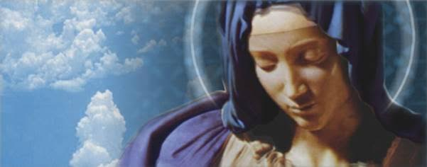
What does the Assumption mean for us?
Even though Mary is in heaven now she continues to love all her children, on earth. She listens to our prayers and needs and takes them to God and intercedes for us – just as our earthly mothers do.
Therefore for us the Assumption means Mary will …
Mary lived a perfect life as a human woman and was like us in every way but sin. Jesus has promised all who have faith in him will have a new resurrected life in heaven and Mary is proof that Jesus keeps his promise.
Therefore for us we can be confident that Mary’s Assumption is proof that we …
As Christians we believe that what God has done for Mary, God will do for us.
Therefore for us Mary’s Assumption gives us hope tūmanako that after living faithful lives God will receive our souls into the glory of heaven.
The Feast of the Assumption is a Holy Day of Obligation when the community celebrates by gathering for the Eucharist to honour Mary and recall her Assumption and the reason why God assumed her to heaven body and soul.
Therefore this feast provides us with a perfect opportunity to reflect and celebrate Mary’s perfect life and encourage each other to place our trust in her as she intercedes for us with God.
R-1
S-05
Click the down-button to move the blind down,
click the up-button (appears at bottom) to move the blind to the top.

Slide 7
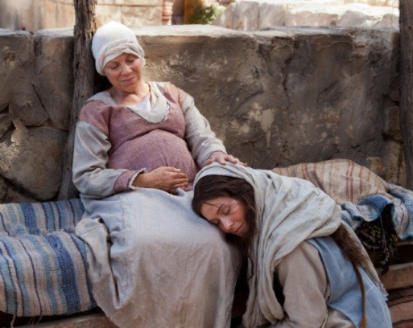
The Gospel Reading on Assumption Day
Read Luke 1:39 – 45
What had Mary done that Elizabeth would greet her with these words “of all women you are most blessed”?
Read Mary’s response to Elizabeth in Luke 1:46-55 – put into your own words what Mary is saying?
Can you share how Mary’s visitation to Elizabeth is connected with Mary’s Assumption?
Discuss the point – It is not the gifts we receive but how we use them that matters.
X
Click the I-button to reveal information
R-1
S-06
Notes:
Use this reading in prayer this week to help children become very familiar with it.
Adapt Teaching and Learning Experience 3.
Children could make a fridge magnet or a bunting flag of an important verse in this reading.
ANSWERS
What has Mary done that Elizabeth would greet her with these words “of all women you are most blessed”? God has chosen Mary to be the mother of Jesus the saviour of the world and she trusted completely in what God promised and by her Assumption she is the fulfilment of God’s promise of eternal life in heaven. What God did for Mary, God will do for us.
Read Mary’s response to Elizabeth in Luke 1:46-55 – how would you describe what Mary says? Mary’s response shows her gratitude and her humility and is full of praise to God for God’s power and justice.
Can you share how Mary’s visitation to Elizabeth is connected to Mary’s Assumption?
Elizabeth’s words remind us of the unique woman Mary is and by accepting God’s request to be the mother of his son, Jesus she made it possible for God’s plan for the world to be achieved. See also 1st item above.
Discuss the point – Our greatness depends not on the gifts we receive but on how we use them.
Everything we have and are comes to us from God. Our talents, our personal qualities and everything good in our lives are God’s gift and grace to us. God has given us these gifts to use for the benefit not just of ourselves but for others also. To whom much is given, much is expected. Mary’s greatness came because she chose to use the gifts and opportunities God gave her for the benefit of others. Mary was full of grace tapu and mana and she used her these not to boost her own importance but to proclaim God’s greatness in her prayer we call the Magnificat (Luke 1:46-55).
Adapt Teaching and Learning Experience 4

Slide 8
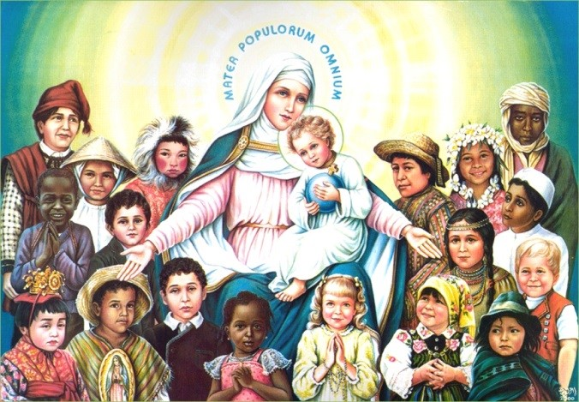
Why Mary is called holy and blessed by all nations and
all generations of people
1) God called Mary to be the Mother of the
God’s son Jesus who was sent to save all people.
2) Because Mary was filled with the power
of the Holy Spirit her life was lived completely for God.
3) Mary used all the gifts God gave her
to give glory, praise and thanks to God.
4) Mary is the loving mother of Jesus and the mother of
all the people in the world Jesus came to save.
5) God took Mary to heaven because she was the perfect
human and she believed and trusted in God’s promises.
6) God promised that all people who had faith in God
would live with God in the glory of heaven after their death.
A) to give glory, praise and thanks to God.
B) human and she believed and trusted in God’s promises.
C) God’s son Jesus who was sent to save all people.
D) would live with God in the glory of heaven after their death.
E) all the people in the world Jesus came to save.
F) of the Holy Spirit her life was lived completely for God.
R-1
S-07
Click lower statements to match upper statements
Notes:
ANSWERS 1) C, 2) F, 3) A, 4) E, 5) B, 6) D
Look at the image on this slide - children could create art works or photo collages (using images of children of different cultures from your school) of Mary Queen of Heaven and Earth and all People. These could be shared in an Assumption Exhibition in the school or church to celebrate Mary’s special feast.

Slide 9
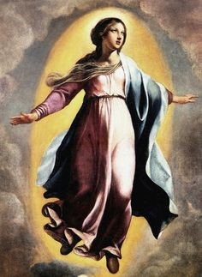
What God did for Mary gives all Christians hope tūmanako of eternal happiness
Mary was a human person created by God and what God has done for her God has promised to do for all humans.
What does this say about God and why is this important for us?
Mary is the model human being, she is the only human who has not sinned, she thinks only of others and always acted the way she knew God would want her to.
Why would Mary be a good model for all people to follow?
When people die their body dies but their souls live forever. Their bodies are buried and their souls go to heaven with God. God promised this would be the destiny of all people who have faith in him.
Can you give 3 examples of what people have to do so that their souls go to be with God?
Click the small pictures to reveal text
R-1
S-08a
Click the audio button to stop ‘O Queen of All’
Click the audio button to play ‘O Queen of All’
Notes:
Sing using the MP3 ‘O Queen of All”. This song could be sung during mass on Assumption Day

Slide 10
What God did for Mary gives all Christians hope tūmanako of eternal happiness
It is God’s plan that all people will live forever in heaven where Mary is already. She shows us what our eternal life will be like because she is experiencing it already. Her body and soul were assumed to heaven when she died and will not need to be reunited on the last day as all other humans will.
What do you think eternal life will be like and who will be sharing it with you?
When people are in heaven they can intercede for us, this means we can ask them to talk to God on our behalf. We believe Mary is the best person to intercede for us because of her special relationship with God as the mother of his son.
What sort of things could we ask Mary to help us with?
Click the small pictures to reveal text
R-1
S-08b
Click the audio button to stop ‘O Queen of All’
Click the audio button to play ‘O Queen of All’
Notes:
Sing using the MP3 ‘O Queen of All”. This song could be sung during mass on Assumption Day

Slide 11
Check up
1)
Name 3 things the Assumption means for us.(Slide 5)
2)
Explain what happened when Mary died. (Slide 4)
In the Gospel that is read on Assumption Day Elizabeth recognises something about Mary and Mary responds – write about this in your own words. (Slide 6)
3)
4)
Why does the Feast of the Assumption give Christians hope of eternal life? (Slide 8)
5)
Which activity do you think helped you to learn best in this resource?
6)
Questions I would like to ask about the topics in this resource are …
R-1
S-09
Click the worksheet button to go to the worksheet
Notes:
This formative assessment strategy will help teachers to identify how well children have achieved the Learning Intentions of the resource.
Teachers can choose how they use the slide to assess each item.
A worksheet of this slide is available as an option for children to complete.
The last two items are feed forward for the teacher.
Recording the children’s responses to these items is recommended as it will enable teachers to adjust their learning strategies for future resources and target the areas that need further attention.
You could repeat the TRUE FALSE Activity on Slide 3

Slide 12
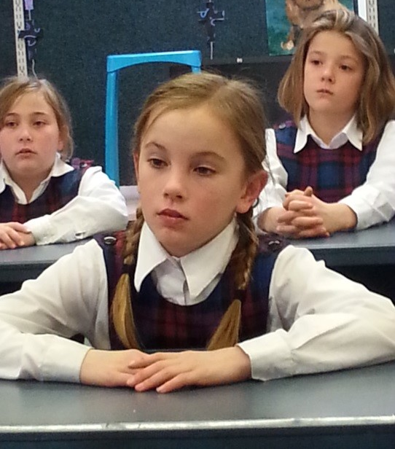
Time for Reflection
R-1
S-10
Click the audio button to stop reflective music
Click the audio button to play reflective music
Notes:
The MP3 is played to help create a reflective atmosphere and bring the children to stillness and silence as the teacher invites them to imagine Mary as mother and queen of all people listening to their needs. Imagine her taking them to God - what do they think God would say to Mary. Make a silent prayer for their own needs and ask Mary as their mother in heaven to help them deal with the things they find difficult in their lives.

Slide 13
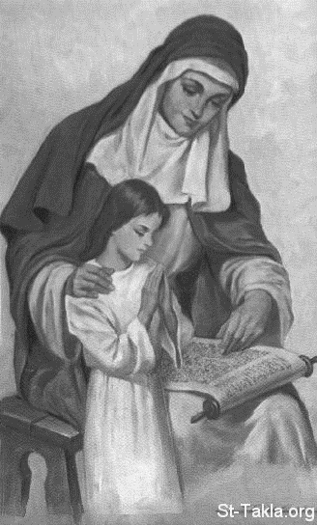
What do I know about the life of Mary, Mother of Jesus?
Name:____________________________
Highlight TRUE or FALSE
Date:____________
TRUE FALSE
Mary was born in Bethlehem in 18 BC.
Mary’s parents were Anne and Joachim.
Mary’s name in Hebrew is Miriam.
Mary had many brothers and sisters.
The first mention of Mary in the Scriptures is the story of the Annunciation.
Mary is mentioned most in the Gospel written by St Matthew.
Mary is mentioned as Maryam in the Quran, the holy book for Muslim people.
Mary lived the life of a young Greek woman as she grew up in her village.
Mary was a teenager when she agreed to God’s request to be the mother of his Son.
This action began Mary’s life which she live completely doing what God asked her to do.
Most of what we know about Mary’s life we learn from the Old Testament.
Mary visited her elderly cousin Elizabeth when they were both pregnant.
Elizabeth greeted Mary saying “Blessed are you among all women!”
Joseph married Mary and their baby was born in a hospital in Jerusalem.
Jesus was presented at the Temple as was the Christian custom.
TRUE FALSE
TRUE FALSE
TRUE FALSE
TRUE FALSE
TRUE FALSE
TRUE FALSE
TRUE FALSE
TRUE FALSE
TRUE FALSE
TRUE FALSE
TRUE FALSE
TRUE FALSE
TRUE FALSE
TRUE FALSE
R-1
S-03a
Worksheet
Click the up arrow to return to the presentation
Notes:
Note the woman in the image with Mary as a little girl is her mother St Ann, who was Jesus’ grandmother.
Children could include prayer this week for their grandparents.
The worksheet can be used as an indicator of children’s knowledge about the life of Mary.
Some ideas to use if their scores are low –
Review the worksheet and work through the items and discuss them with the class. Repeat worksheet.
Read Scripture stories about Mary in class prayer to reflect on and discuss.
Set up a research project on Mary and get children to present their findings in different ways to classes.
Use your priest, parents or parishioners to share what they know about Mary.
Make a ‘What we know about Mary’ board and ask children, staff, parents and grandparents to contribute to it.

Slide 14
What do I know about the life of Mary, Mother of Jesus?
Name:____________________________
Highlight TRUE or FALSE
Date:____________
16) Jesus was educated at the temple school and Jesus taught him gardening skills.
17) Jesus was lost in Peru for weeks and Mary and Joseph found him playing with his friends
18) When Jesus began his teaching work Mary supported him and became one of his disciples.
19) Once at a wedding Mary asked Jesus to turn the wine into water to stop people drinking.
20) Jesus went about curing people and Mary could see he truly was God’s Son.
21) Mary knew Jesus was saying things the Jewish leaders didn’t like and she worried about him.
22) Mary was present when Jesus had his Last Supper the night before he died.
23) As Jesus carried his cross up Calvary hill Mary didn’t see him because there was such a crowd.
24) Mary stayed with Jesus by the cross and Jesus asked his friend Peter to look after her.
25) Mary stayed with the apostles until after Jesus rose from the dead.
26) When the Holy Spirit came Mary was present in the upper room in Jerusalem.
27) Mary died and the apostles were very sad but God took her body and soul to heaven.
28) The Assumption is the feast that celebrates Mary becoming the mother of Jesus.
29) The Church celebrates Mary’s Assumption by gathering for Eucharist in parish churches.
30) Mary is now in heaven and has been crowned Queen of Heaven.
TRUE FALSE
TRUE FALSE
TRUE FALSE
TRUE FALSE
TRUE FALSE
TRUE FALSE
TRUE FALSE
TRUE FALSE
TRUE FALSE
TRUE FALSE
TRUE FALSE
TRUE FALSE
TRUE FALSE
TRUE FALSE
TRUE FALSE
R-1
S-03b
Worksheet
Click the up arrow to return to the presentation
Notes:
Note the woman in the image with Mary as a little girl is her mother St Ann, who was Jesus’ grandmother.
Children could include prayer this week for their grandparents.
The worksheet can be used as an indicator of children’s knowledge about the life of Mary.
Some ideas to use if their scores are low –
Review the worksheet and work through the items and discuss them with the class. Repeat worksheet.
Read Scripture stories about Mary in class prayer to reflect on and discuss.
Set up a research project on Mary and get children to present their findings in different ways to classes.
Use your priest, parents or parishioners to share what they know about Mary.
Make a ‘What we know about Mary’ board and ask children, staff, parents and grandparents to contribute to it.

Slide 15
Check up
Name:____________________________
Date:____________
1) Name 3 things the Assumption means for us.(Slide 5)
2) Explain what happened when Mary died. (Slide 4)
3) In the Gospel that is read on Assumption Day Elizabeth recognises something about Mary and Mary responds – write about this in your own words. (Slide 6)
4) Why does the Feast of the Assumption give Christians hope of eternal life? (Slide 8)
5) Which activity do you think helped you to learn best in this resource?
6) Questions I would like to ask about the topics in this resource are …
R-1
S-09
Worksheet
Click the up arrow to return to the presentation

