Slide 1
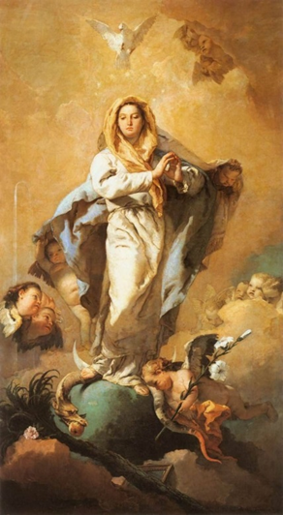
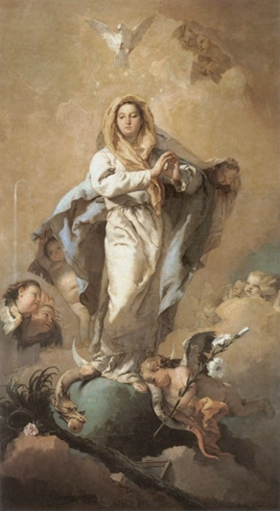
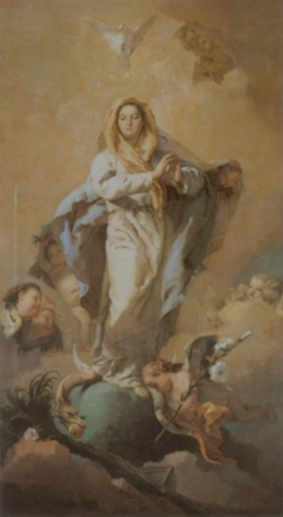
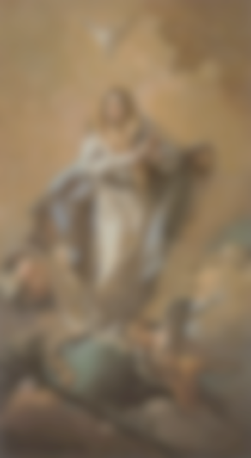
The Feast of the Assumption
R-1
S-01
Notes:
Slide 1 The Feast of the Assumption
Use this slide as a focussing strategy to introduce the resource topic.
Invite the students to read the title and look closely at the image and define the meaning of the word ‘Assumption’. Invite students to share something they know about Mary’s Assumption into heaven and how through this she shares in the resurrection of her son Jesus.
Read background notes for teachers and children on overview for Slide 4A before starting to use the resource. Create a Mary prayer focus and use the Mary songs in class prayer this week – see
Left "lesson" as this refers to the lesson in class.

Slide 2
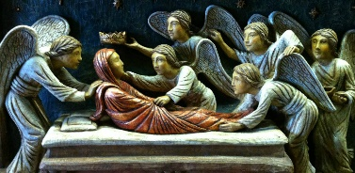
Learning Intentions
The students will:
1)
Explain that Mary’s Assumption means that she was taken to heaven body and soul to share in the Resurrection of her son
2)
Recognise how Mary’s Assumption gives Christians hope that they too will be raised body and soul and enter the glory of heaven
3)
Explain what it means that the feast of the Assumption is
a holy day of Obligation.
R-1
S-02
Click the borders to reveal text
Notes:
Slide 2 Learning Intentions
Look closely at the image of the Assumption and share an observation.
Note that many of the images of Mary’s Assumption are painted in a traditional style. This style reflects the ways artists in the past imagined what Mary’s Assumption was like. This event is not recorded in the Scripture and has been passed down through the tradition of the Church.

Slide 3
What do we know already about Mary’s Assumption into heaven?
What I know about Mary’s Assumption
R-1
S-03
Click the worksheet button to go to the worksheet
Notes:
Slide 3 What do we know already about Mary’s Assumption into heaven?
Make a copy of the Mind map for each student to complete.
Suggest to students they can add further ideas to the Mind Map after the next slide and Slide 5.
Read background notes for teachers on overview for Slide 4A before continuing with the resource.

Slide 4
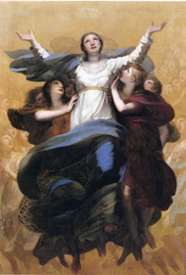
What does the Assumption of Mary mean?
The Assumption of Mary means that Mary was taken to heaven, body and soul, by God. How this happened is a mystery of faith but has been believed by Christians from the earliest days of the Church. In 1950 Mary’s Assumption was declared a dogma of the Church by the Pope.. Can you name any other mysteries of the Catholic faith?
A dogma is a truth that has been revealed by God which Catholics have long accepted and believed in by faith and grace. At the Council of Ephesus in 431, the first dogma that was declared about Mary was that she is Mary, the Mother of God.. Why are dogmas important in the Catholic Church?
Originally the belief in the Assumption was celebrated on August 15 and was called the Dormition or Memorial of Mary. Many people had been petitioning Pope Pius XII to have the belief declared a dogma. The Vatican II documents refer to Mary’s Assumption as “a sign of certain hope and comfort to the pilgrim People of God”. Why does Mary’s Assumption give people hope and comfort?
R-1
S-04A
Click on the icons to reveal text and the image on the right
Notes:
Slide 4A What does the Assumption of Mary mean?
After reading the notes below read each block of revealed text and respond to the questions. Use them to generate discussion about the dogma of the Assumption and watch the clip on Slide 4B
The Assumption Declaration 1:41 Minutes https://www.youtube.com/watch?v=PJcSyaRU0kc
Background information for teachers to share –
The Assumption of Mary means that Mary was taken to heaven, body and soul, by God. How this happened is a mystery of faith but has been believed by Christians from the earliest days of the Church. In 1950 Mary’s Assumption was declared a dogma of the Church by the Pope. A dogma is a faith belief revealed by God that is set down by the Magisterium of the Church for Catholics to believe.
A dogma is defined formally when there is a controversy that needs to be clarified or when the Church thinks that the faithful can be helped by a particular emphasis being drawn to an already existing belief. This was the case in defining the dogma of the Assumption of Mary in an Apostolic Constitution declared by Pope Pius XII on Nov 1st. 1950.
The title of the dogma was ‘Munificentissimus Deus’ which is Latin for the ‘most bountiful God’. Dogmas of Mary always clarify, highlight and safeguard the integrity and qualities of Jesus. Jesus, who is the Son of God, had been carried within Mary’s body, therefore her ‘sacred body’ could not be left in a tomb to be ‘reduced to dust and ashes’. (M D no. 14)
We bring to mind the Assumption of Our Lady when we pray the 4th decade of the Glorious Mysteries of Mary’s prayer, the Rosary, which has been prayed by Catholics for many centuries. Prayer to Mary unites us more closely to her son, Jesus.

Slide 5
What does the Assumption of Mary mean?
When a dogma is declared by the Pope it has come from an accepted faith belief of the faithful people, and will be celebrated and expressed by them in their faith community prayer and liturgical celebrations. How is the Assumption of Mary celebrated in your faith community now?
During Bishop Pompallier’s first Mass at Totara Point on 13th January 1838, he placed the whole country under the patronage of Our Lady of the Assumption making this feast our national feast day and a Holy Day of Obligation in Aotearoa New Zealand. Watch the clip of the celebrations in Rome when the Pope declared Mary’s Assumption a dogma.
Click on the icons to reveal text and the image on the right
Click the video icon to play ‘The Assumption Declaration’
R-1
S-04B
Notes:
Slide 4B What does the Assumption of Mary mean?
Read each block of revealed text and respond to the questions. Use them to generate discussion about the dogma of the Assumption and watch the clip, then talk about what life was like in 1950 and encourage students to comment on what they saw.
The Assumption Declaration 1:41 Minutes https://www.youtube.com/watch?v=PJcSyaRU0kc
Background information for teachers to share –
The Assumption of Mary means that Mary was taken to heaven, body and soul, by God. How this happened is a mystery of faith but has been believed by Christians from the earliest days of the Church. In 1950 Mary’s Assumption was declared a dogma of the Church by the Pope. A dogma is a faith belief revealed by God that is set down by the Magisterium of the Church for Catholics to believe.
A dogma is defined formally when there is a controversy that needs to be clarified or when the Church thinks that the faithful can be helped by a particular emphasis being drawn to an already existing belief. This was the case in defining the dogma of the Assumption of Mary in an Apostolic Constitution declared by Pope Pius XII on Nov 1st. 1950.
The title of the dogma was ‘Munificentissimus Deus’ which is Latin for the ‘most bountiful God’. Dogmas of Mary always clarify, highlight and safeguard the integrity and qualities of Jesus. Jesus, who is the Son of God, had been carried within Mary’s body, therefore her ‘sacred body’ could not be left in a tomb to be ‘reduced to dust and ashes’. (M D no. 14)
We bring to mind the Assumption of Our Lady when we pray the 4th decade of the Glorious Mysteries of Mary’s prayer, the Rosary, which has been prayed by Catholics for many centuries. Prayer to Mary unites us more closely to her son, Jesus.

Slide 6
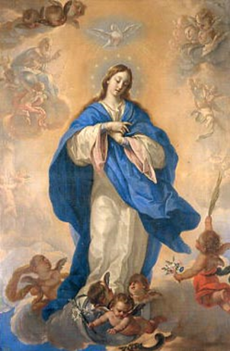
What Mary’s Assumption means for us?
to heaven when her life on earth had ended.
God took Mary body and soul
Mary’s Assumption gives hope to all Christians that
Mary shares in the resurrection of her son Jesus and this makes it
Mary’s Assumption celebrates the dignity of the body
Mary’s life is a model of faithfulness, kindness and courage
Mary continues to be our heavenly mother who takes our
they too will share in the resurrection of their body and soul.
possible for us to hope that what happened to her will happen to us.
and soul that God has given to each person.
for each of us to follow in our lives.
needs to God and speaks up for us as our earthly mothers do.
A.
B.
C.
D.
E.
F.
possible for us to hope that what happened to her will happen to us.
for each of us to follow in our lives.
needs to God and speaks up for us as our earthly mothers do.
they too will share in the resurrection of their body and soul.
and soul that God has given to each person.
to heaven when her life on earth had ended.
Click a sentence part from the list to complete the sentences above
Click the video button play ‘About the Assumption’
R-1
S-05
Notes:
Slide 5 What Mary’s Assumption means for us?
ANSWERS
1) F, 2) D, 3) A, 4) E, 5) B, 6) C
Watch the clip https://www.youtube.com/watch?v=i3cm45ki1m0
Mary: The Assumption 4:52 minutes – give students time to comment and question what they saw and heard in the clip.
Students read each item and identify which statement completes the sentence correctly and checks it with the floater.
When students have completed this activity and have watched the clip give them time to add new ideas in their own words to their Assumption Mind Map on the Slide 3 worksheet.

Slide 7
Some background information to increase our understanding of the importance of Mary’s Assumption as a feast
We expect Mary died before she was assumed by the power of God into heaven. Death is the natural process that ends all human life. Death was not part of God’s plan but it came into the world because people turned away from God.
God has promised to raise
all people on the last day
to be happy in heaven forever.
By his death and resurrection Jesus restored God’s original plan for our resurrection. Mary was the first person to show us what God has planned for us
after we die.
This is why Mary’s Assumption is a feast of great importance
for all people.
Mary’s body and soul were never separated because God brought them to heaven together.
Mary did not have to wait for Jesus to come again.
God wanted Mary to enjoy her final resurrection from the moment of her death and Assumption.
On the last day of the world Jesus will come again.
The dead will be raised up and their bodies and souls will be reunited.
This is when God will establish the Kingdom of justice, peace and mercy for those who have been faithful to God.
Jesus began his Kingdom while he was on earth and we as his followers have helped to carry it on.
When people’s lives come to an end their bodies die and decay but their souls are immortal – they never die. God’s plan is that the souls of all people will come to heaven to be with God to share eternal happiness.
By sacrificing his life Jesus restored God’s plan and God’s relationship
with people. By Jesus’ life and death all people were saved and became God’s favoured people again. This is why we call Jesus our Saviour.
God loved all of creation very much and did not want to be separated from any part of it especially the people. God sent his son Jesus into the world to restore the relationship they had broken.
Jesus gave his life as a sacrifice to save people from the consequences of their actions that had brought pain, sin and death into the world.
God’s plan was that people and all creation would live in perfect harmony with God and there would be no pain, no sin and no death. But people used their free will to turn away for God and the plan was damaged. The story in the bible of Adam and Eve is a way of explaining how this might have happened.
R-1
S-06
Click on the top right card to flip the page.
Notes:
Slide 6 Some background information to increase our understanding of the importance of Mary’s Assumption as a feast
Let students take turns at reading through the flip book pages and after each page invite them to make a comment or raise a question. Keep note of these and respond to them after the next slide.

Slide 8
Mary’s Assumption is such an important feast because …
Mary’s body and soul were taken to heaven at her Assumption, Mary already shares in the fullness of the new life promised to people through the resurrection of her son, Jesus
Mary shares in Jesus’ resurrection through her Assumption and this makes it possible for us to share in it also. What happened to Jesus through his resurrection has also happened to Mary
the Church understands Mary’s Assumption as a feast that gives people great hope because it means that all people will share in the resurrection of their bodies and their souls
the feast of the Assumption also celebrates the dignity of the body and soul of each person as gifts given by God to be respected not only during life but also after death
Mary’s Assumption gives people hope and faith to believe that heaven is their final goal where they will share in the fullness of God’s tapu forever.
Click the down-button to move the blind down.
Click the Worksheet button to go to the worksheet.
R-1
S-07
Notes:
Slide 7 Mary’s Assumption is a very important feast because …
Students read each statement in pairs and share what it means in their own words to clarify their thinking.
Invite students to respond to one of the statements that helps them to understand why Mary’s Assumption is an important feast in the Liturgical Year.

Slide 9
Through her Assumption into heaven Mary shares in the resurrection of her son
Write a question for the answer
Q1 _____________________________________________________________________________________________________
A1
Because Mary’s body and soul were taken to heaven at her Assumption, Mary already shares in the fullness of the new life promised to people through the resurrection of her son, Jesus.
Q2 _____________________________________________________________________________________________________
A2
Mary shares in Jesus’ resurrection through her Assumption and this makes it possible for us to share in it also. What happened to Jesus through his resurrection has also happened to Mary and will happen to us after our death.
Q3 _____________________________________________________________________________________________________
A3
The Church understands Mary’s Assumption offers Christians hope tūmanako that they too will be raised body and soul to enter the glory of heaven.
Q4 _____________________________________________________________________________________________________
A4
The feast of the Assumption also celebrates the dignity of the body and soul of each person as gifts given by God to be respected not only during life but also after death.
Q5 _____________________________________________________________________________________________________
A5
Mary’s Assumption gives people hope and faith to believe that heaven is their final goal where they will share in the fullness of God’s tapu forever.
R-1
S-08
Click the worksheet button to go to the worksheet
Notes:
Slide 8 Through her Assumption into heaven Mary shares in the resurrection of her son
Print off a worksheet for each student to complete.
Students could work on this activity in pairs and record their questions.
Add worksheet to their RE Learning Journal.

Slide 10
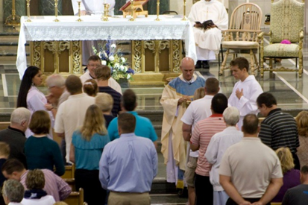
We honour Mary’ Assumption day as a Holy Day of Obligation
What does a Holy Day of Obligation mean?
What day every week is a Holy Day of Obligation and why?
What are the two feast days that are Holy Days of Obligation in Aotearoa New Zealand?
What does the Church celebrate on Mary’s Assumption day?
How does the Church celebrate Holy Days of Obligation?
Why is participating in the Eucharist a good way to celebrate Holy Days of Obligation?
X
Click the I-button to reveal information
R-1
S-09
Click the audio button to play ‘O Queen of All’
Click the audio button to stop ‘O Queen of All’
Notes:
Slide 9 We honour Mary’ Assumption day as a Holy Day of Obligation
Discuss how some of the ideas from this resource could be used in the parish celebration of the Eucharist to celebrate this Holy Day of Obligation.
Adapt Teaching and Learning Experience 2
Bring up the I pop up
ANSWERS IN BRACKETS
- What does a Holy Day of Obligation mean? (These are special feast days in the Liturgical Year on which Catholics are expected to gather and celebrate Eucharist.)
- What day every week is a Holy Day of Obligation and why? (Every Sunday.)
- What are the two feast days that are Holy Days of Obligation in Aotearoa New Zealand? (Christmas Day, December 25, and the feast of the Assumption on August 15)
- What does the Church celebrate on Mary’s Assumption day? (The Church celebrates that God took Mary to heaven body and soul and God has promised that the same will be done for faithful people like Mary and this is what Christians hope for.)
- How does the Church celebrate Holy Days of Obligation? By community celebrations of the Eucharist.
- Why is participating in the Eucharist a good way to celebrate Holy Days of Obligation? (It reminds the community:
of Mary’s faithfulness to God and encourages everyone to be like Mary,
that Mary is proof that God keeps his promises to bring people to heaven.
to give honour to Mary as our heavenly Mother and model of faith.)
Sing ‘O Queen of All ’using MP3.

Slide 11
Because of her Assumption into heaven Mary lives now in glory with God so all faithful people can …
have great hope that Mary will ask God to protect people who are homeless, hungry and helpless
listen to what God is asking them to do with their lives and do it faithfully as Mary did
be filled with hope that God will keep his promise and they will see heaven as their final goal
recognise, respect and restore the dignity of all human life of people who are lost and helpless
share their needs with Mary and ask her to speak to God on their behalf as their advocate
follow Mary as a model of faithful love and through her come closer to God and her son Jesus.
R-1
S-10
Click the down-button to move the blind down.
Notes:
Slide 10 Because of her Assumption into heaven Mary lives now in glory with God so all faithful people can …
Use the blind tool arrow to reveal the ways we benefit from Mary’s Assumption. Take time to discuss them and then remove the text and ask students to repeat the ideas in their own words and encourage questions.

Slide 12
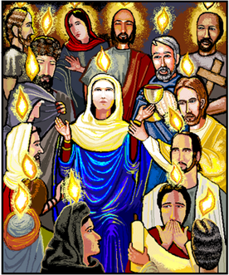
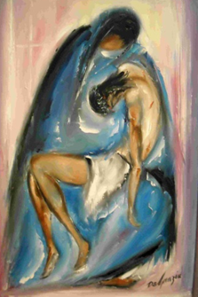
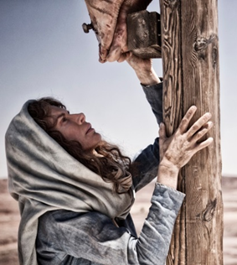
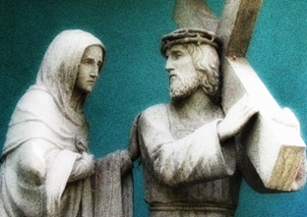
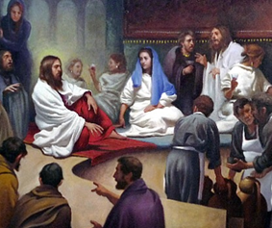
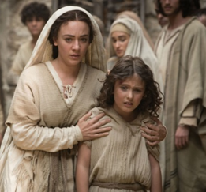
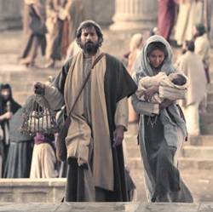
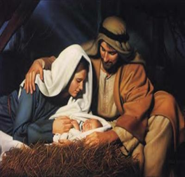
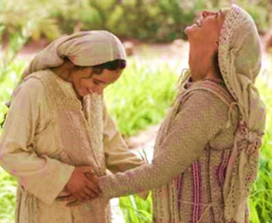
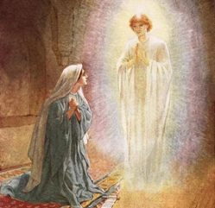
Important Events in Mary’s Life
Class select an event in Mary’s life and make a bunting to record their learning about important events in Mary’s life and Assumption.
Put the image on one side and text to match on the other side.
Hang them in chronological order to share with other classes or in the church.
Sing Mary songs ‘O Queen of All’ and ‘Kia Waiata Kia Maria’ to celebrate Mary’s Assumption.
The Annunciation
The Visitation
Jesus is found in the temple
Mary at the cross
The Marriage at Cana
Mary holds Jesus
Mary gives birth to Jesus
The Presentation
Pentecost
Mary meets Jesus
The Assumption
Click any Image for more information, click again to return. Click the Worksheet button to go to the worksheet
R-1
S-11
Click the audio button to play ‘Te Waiata a Maria & O Queen of All’
Click the audio button to stop ‘Te Waiata a Maria & O Queen of All’
Notes:
Slide 11 Important Events in Mary’s Life
Make a copy of the worksheet for each student to complete.
Follow the prompts on the slide and bring this work to a conclusion by praying the ‘Hail Mary’ and singing the Mary songs.
Students will need to find, check and record on line under image each reference in their bible.
Class make a bunting to record their learning about important events in Mary’s life and her Assumption.
Create the image on one side and text to match on the other side.
Hang the bunting shapes in chronological order in the classroom to share with other classes or in the church to share with the parish.
You could add prayer ideas for people to ask Mary to take to God for them.
Answers (number refers to the list / (position) refers to image on worksheets left to right, top to bottom)
Num. Title (position) Reference
1 Pentecost (10) Acts 2:1-12
2 Mary holds Jesus (9) No reference
3 The Annunciation (1) Luke 1:26-38
4 Mary at the cross (8) John 2:1-11
5 The Marriage at Cana (6) Luke 2:41-50
6 Jesus is found in the temple (5) No reference
7 Mary meets Jesus (7) No reference
8 The Visitation (2) Luke 1:39-56
9 The Assumption (11) No reference
10 The Presentation (4) Luke 2;22-38
11 Mary gives birth to Jesus (3) Luke 2:1-20

Slide 13
Check up
1)
Write an explanation for your parish bulletin explaining why the Assumption is an important feast and what a Holy Day of Obligation means. Include the times of the parish Mass. (Slides 6,7,9)
2)
How does Mary share in the resurrection of her son and what does that mean for us? (Slide 8)
3)
Write 3 facts about dogmas and the declaration of the dogma of Mary’s Assumption (Slide 4)
4)
How does Mary’s Assumption benefit all faithful followers of Jesus? (Slide 5, 8)
5)
Send an older family member or friend the link to the clip ‘About the Assumption’, (http://tinyurl.com/y9oru8tw).Have a conversation with them about this feast and share what you have learned about it (Worksheet, Slide 11)
6)
Which activity do you think helped you to learn best in this resource?
7)
Questions I would like to ask about the topics in this resource are …
Click in each caption space to reveal text
Click on the worksheet button to go to the worksheet.
R-1
S-12
Notes:
Slide 12 Check Up
This formative assessment strategy will help teachers to identify how well students have achieved the Learning Intentions of the resource .
Teachers can choose how they use the slide in their range of assessment options.
A worksheet of this slide is available for students in Years 5-8 to complete.
The last two items are feed forward for the teacher.
Recording the students’ responses to these items is recommended as it will enable teachers to adjust their learning strategies for future resources and target the areas that need further attention. Changed to "resource" as the learning intentions refer to the resource.

Slide 14
Time for Reflection
R-1
S-13
Click the audio button to play reflective music
Click the audio button to stop reflective music
Notes:
Slide 13 Time for Reflection
The MP3 is played to help create a reflective atmosphere and bring the young people to stillness and silence as the teacher invites them to bring into their minds and visualise Mary’s Assumption into heaven with Jesus and God waiting to welcome her. Think about the promise God made to Jesus’ faithful followers that their final goal will be in heaven. Mary is the proof God will keep his promise and they also will share in God’s glory forever when they die.

Slide 15
What do we know already about Mary’s Assumption into heaven?
What I know about Mary’s Assumption
Name: _______________
Date: _________
R-1
S-03
Worksheet
Click the up arrow to return to the lesson

Slide 16
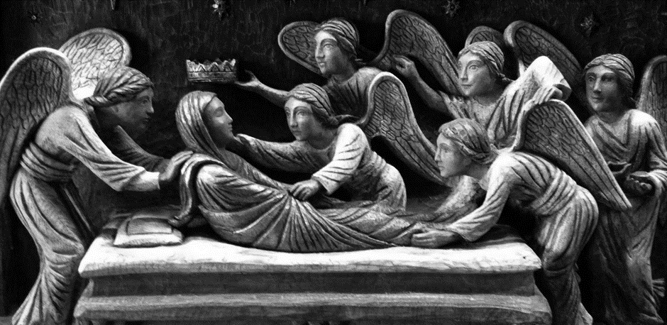
Through her Assumption into heaven Mary shares in the resurrection of her son
Write a question for the answer
Q1 _____________________________________________________________________________________________________
A1
Because Mary’s body and soul were taken to heaven at her Assumption, Mary already shares in the fullness of the new life promised to people through the resurrection of her son, Jesus.
Q2 _____________________________________________________________________________________________________
A2
Mary shares in Jesus’ resurrection through her Assumption and this makes it possible for us to share in it also. What happened to Jesus through his resurrection has also happened to Mary and will happen to us after our death.
Q3 _____________________________________________________________________________________________________
A3
The Church understands Mary’s Assumption offers Christians hope tūmanako that they too will be raised body and soul to enter the glory of heaven.
Q4 _____________________________________________________________________________________________________
A4
The feast of the Assumption also celebrates the dignity of the body and soul of each person as gifts given by God to be respected not only during life but also after death.
Q5 _____________________________________________________________________________________________________
A5
Mary’s Assumption gives people hope and faith to believe that heaven is their final goal where they will share in the fullness of God’s tapu forever.
Name: _______________
Date: _________
R-1
S-08
Worksheet
Click the up arrow to return to the lesson

Slide 17
Important Events in Mary’s Life
From the list below select and copy the correct number and title to match the appropriate Mary image. Locate in your bible the Scripture Reference for the stories that do not have an * and write it under the title
1)
2)
3)
4)
5)
6)
7)
8)
9)
10)
11)
Pentecost
Mary holds Jesus*
The Annunciation
Mary at the cross*
The Marriage at Cana
Jesus is found in the temple
Mary meets Jesus*
The Visitation
The Assumption*
The Presentation
Mary gives birth to Jesus
Share this link to the clip ‘About the Assumption’, (https://tinyurl.com/yacvd6z5) with a family member or friend and share what you have learned about this great feast of Mary.
Name: _______________
Date: _________
R-1
S-11
Worksheet
Click any Image for more information, click again to return. Click the worksheet button to go to the worksheet and the Video button to play ‘Lady in Blue’
Click the up arrow to return to the lesson

Slide 18
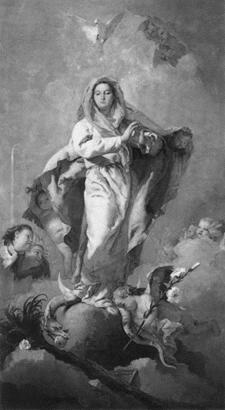
Check up
Name:____________________________
Date:____________
Write an explanation for your parish bulletin explaining why the Assumption is an important feast and what a Holy Day of Obligation means. Include the times of the parish Mass.(Slides 6,7,9)
How does Mary share in the resurrection of her son and what does that mean for us? (Slide 8)
Write 3 facts about dogmas and the declaration of the dogma of Mary’s Assumption (Slide 4)
How does Mary’s Assumption benefit all faithful followers of Jesus?(Slide 5, 8)
R-1
S-12A
Worksheet
Click the forward arrow to go to the next worksheet or up arrow to return to the lesson

Slide 19
Check up
Name:____________________________
Date:____________
Send an older family member or friend the link to the clip ‘About the Assumption’, http://tinyurl.com/y9oru8tw Have a conversation with them about this feast and share what you have learned about it (Worksheet, Slide 11)
Which activity do you think helped you to learn best in this resource?
Questions I would like to ask about the topics in this resource are …
R-1
S-12B
Worksheet
Click the up arrow to return to the lesson

