Slide 1
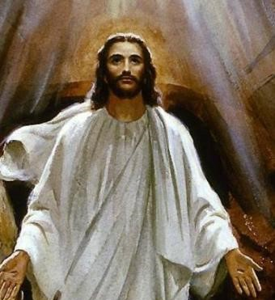
Easter Time is when Jesus rose from Death
R-1
S-01
Notes:
Slide 1 Easter Time is when Jesus rose from Death
Use this slide as a focussing strategy to introduce the resource topic. Read the title together and invite children to share something they know about when Jesus rose from the dead – we call this his Resurrection.

Slide 2
Learning Intentions
The children will:
1)
recognise Easter Sunday as the day Jesus rose from death
2)
recall the story of Jesus rising from death
3)
recognise that Easter Sunday is the happiest day for God’s people.
R-1
S-02
Click the boxes to reveal text.
Notes:
Slide 2 Learning Outcomes
Create a place in the room as an Easter area, maybe a (blanket) cave with a big (pillow) stone and a white towel. Gather for children to explore Easter images, books, songs, you tube clips, art and craft materials and paper etc. Have some simple props and costumes children can use to create their own Easter story drama. Have a selection of articles suitable for an Easter prayer focus and let them set up a new one each day. Have poems, books and bibles with the Easter story with a simple text that children can read to each other.
Set up a lovely prayer focus with the children with some pictures of the Resurrection and some bright yellow cloths because Easter is a very bright and happy time because Jesus is risen. Ask teachers from other classes to let your class visit to share their learning about Easter together. If possible take the children to the church to see the Paschal Candle and the bright joyful yellow and white flowers, candles and altar cloths. Children can pick up a lot about the feast and season of Easter from exploring their local church. Make children aware that this is the greatest feast in the Liturgical Year and it the event and belief that our faith is based on. This may be the first time children experience the Christian meaning of Easter. You are their spiritual guide and faith witness for your children so this is a good week to let them see how important celebrating Easter is for you and them together.

Slide 3
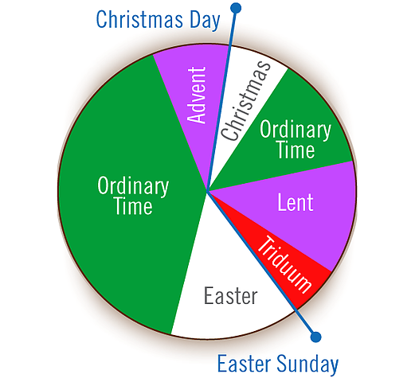
What do you know about the Liturgical Calendar?
This is the calendar that tells us the seasons and feast we have in the Church.
We call it the Liturgical Calendar. It tells us the story of Jesus’ life, when he died and when he rose.
It shows us the colours we have for each season
The Liturgical Year starts in Advent.
Point to Advent and say the names of the seasons as we move around the Liturgical Year.
Now say the name and point to the season that we celebrate next.
R-1
S-03
Click the crosses to reveal text, the fourth cross can be clicked to move the arrow around the calendar (8 clicks).
Notes:
Slide 3 What do you know about the Liturgical Calendar?
Explain simply to children what the calendar is and how it tells the stories of Jesus’ life, death and when he rose from death. We celebrate all these events in our school and our Church. Children can name the feasts and seasons on the calendar as you move the pointer around. Highlight that we have just learned about HOLY WEEK and now we are learning about EASTER. Repeat the names of the seasons to help children to become familiar with them and see the connections between them. You could repeat this each day until children are familiar with it. Adapt Teaching and Learning Experience 1.
Note: Lilies are often part of Easter images. This is because it is told that lilies grew in the garden where Jesus went when he was very sad after he had had his Last Supper with his friends.

Slide 4
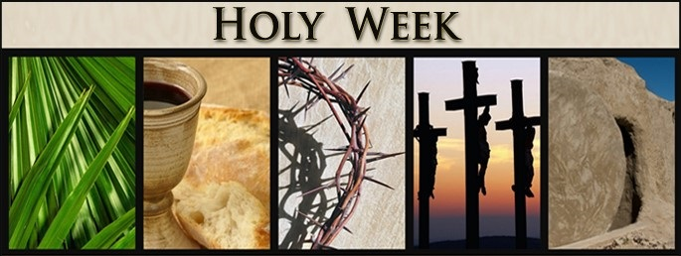
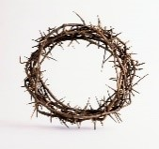
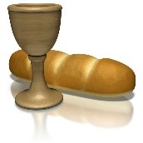
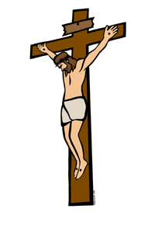
What can you remember about Holy Week?
Look at each picture and get a clue about which Holy Week story it is about?
Clue 1 is a palm like the people waved to welcome Jesus.
Can you share the story about Palm Sunday when…when …
Clue 3 is is the thorns in the crown the soldiers put on Jesus’ head
Can you share the story about what happened on Good Friday when…
a palm like the people waved to
the thorns in the crown the
welcome Jesus.
soldiers put on Jesus’ head
Palm
Sunday
Good Friday
Clue 2 is is the bread and wine Jesus shared with his friends at the Last Supper
Can you share the story about Holy Thursday when…
the bread and wine Jesus shared
Clue 4 is
Can you share the story about what happened on Good Friday when…
Jesus dies on the cross
with his friends at the Last Supper
Holy
Thursday
Good Friday
Clue 5 is … WHAT DO YOU THINK HAPPENED NEXT?
R-1
S-04
Click the symbols to reveal hidden text.
Notes:
Slide 4 What can you remember about Holy Week?
Use this slide to help children recall the HOLY WEEK stories and symbols – the clip, on Slide 5 will also help children to do this. Explain how symbols (objects with special meaning) on the slide – the palm, the bread and wine, the crown of thorns, and Jesus on the cross that we call the crucifix are helpful. They remind us of stories we know that are important to people like us who follow Jesus. Remind children that Jesus is a very important person for us and this time of the year is very special because we remember when Jesus died and rose from death. We thank Jesus for loving us so much. Explain to the children that Holy Week comes right before Easter. We are sad because Jesus died but when he rises from the dead we are filled with joy. Adapt Teaching and Learning Experience 2

Slide 5
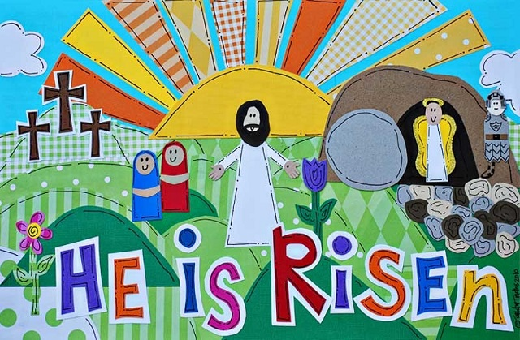
JESUS ROSE FROM THE DEAD – THAT’S WHY WE CELEBRATE EASTER
The women hurried to tell Jesus’ friends, the disciples, that he had risen as he said he would. They felt frightened and joyful at the same time.
The story of Jesus’ Resurrection began early on the first Easter Sunday morning when the women went to the tomb where Jesus was buried.
Suddenly Jesus was right there in front of them. He said, “Greetings, don’t be frightened. Go and tell my friends to go to Galilee and they will see me.” That is how the news of Jesus’ Resurrection began to spread throughout the world.
The angel at the tomb told them Jesus was not in the tomb because he had been raised to life. They could see that the tomb was empty.
R-1
S-05
Click the pins on the right to reveal post-it notes.
Click the video icon to play the clip – “Why Celebrate Easter?”
Notes:
Slide 5 JESUS ROSE FROM THE DEAD – THAT’S WHY WE CELEBRATE EASTER
Read the post it notes that tell the story of the Resurrection. Encourage children to discuss the story. Explain that this story comes from the Bible and show them where it is in the Bible. The clip is useful to connect the story of Holy Week and the story of Easter told by children. Give children a chance to respond to it and name their favourite part.
https://www.youtube.com/watch?v=gxbB0XCeulw
Why celebrate Easter? (3.09 minutes)
Read or tell the Easter story – Matthew 28:1-10 in class prayer this week.
Adapt Teaching and Learning Experiences 3 & 4. Recall the Easter story during class prayer tomorrow using images from a simple version of the story.

Slide 6
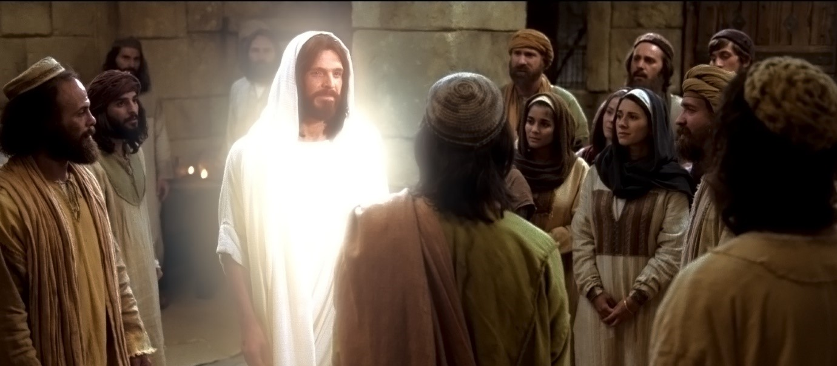
Jesus shows himself to his friends
No one saw Jesus rise from the dead because it happened during the night when the guards of the tomb were asleep.
When he rose Jesus had a new life and a new resurrected body which made him a bit hard for his friends to recognise him.
His friends knew he had risen because they had seen the empty tomb and they had seen him even though he looked a bit different.
We call the day Jesus began his wonderful new life after death, Easter Sunday. It is the most joyful day of the whole year and did you know that no one else has ever risen before.
Our Church celebrates Easter Day with special songs, prayers, candles. and symbols. Everyone is very happy that Jesus is alive in their hearts.
R-1
S-06
Click the green arrow to move the blind down and the red arrow to return to the top.
Click the audio button to stop ‘Jesus Lives!’
Click the audio button to play ‘Jesus Lives!’
Notes:
Slide 6 Jesus shows himself to his friends
Draw children’s attention to the people in the image, what they look like and what they are wearing and explain that this is what Jesus’ friends might have looked like when Jesus lived on the earth. Jesus is white and shiny because that is what he looked like in his risen body after his Resurrection, ready for his new life. Jesus went to see his friends after his Resurrection and after 40 days he went back to live with God in heaven and that is where he lives now.
Read the revealed text to explain ideas children wonder about and encourage them to ask questions about the Resurrection. Explain that we can’t really understand it well because it is a mystery but we still believe it happened because Jesus told his followers it would.
Watch the clip and ask children to share one thing they learned from it. How do you think Jesus’ friends felt when he appeared to them in his risen body?
Remember that the children are being introduced to this major belief of our faith – they will have other opportunities to increase their understanding as they grow. Giving children different ways of expressing their understanding of the Resurrection will help them to process what they have learned. It is through these early experiences of learning about Jesus that the children will come to know him and encounter him as a person in their lives. They could create a Resurrection art work which could be part of an Easter exhibition/festival to celebrate and share their faith and their learning with their family whānau and their parish community. Refer to Sharing our Learning Slide? R3.
Sing using the MP3 ‘Jesus Lives’

Slide 7
Things we can do to make Easter the Happiest Day of the Year
ALLELUIA is a special word we sing and say at Easter – it means PRAISE GOD. It is a very old word that followers of Jesus have been saying for hundreds of years. It is a joyful happy word to celebrate that Jesus is risen ALLELUIA. Remember to add it to your class prayer in the Easter season right up to Pentecost
People go to celebrate Easter Mass with people in their community. They light candles to show that they believe that Jesus is the light of their life and they pass the light on to each other. Talk with your family about going to Mass at Easter and notice the Easter Candle near the altar.
Eggs are a symbol of the new life that comes out of eggs. Jesus’ new life began when he came out of the tomb. Easter eggs remind us of that and that’s why we eat them at Easter. What new life do you know that comes out of an egg?
We have the Easter Candle to remind us that Jesus is the Light of the World. It is a very special candle that is kept in the church for a whole year. It is lit when people get baptised or buried. Easter is a feast of light and joy. Look for the Easter Candle when you go to the church next.
Butterflies are symbols of the Resurrection because just as Jesus went into the tomb and came out alive to begin his new life in his new body, caterpillars disappear into a cocoon and like Jesus they come out changed with a new life to live as beautiful butterflies. Did you know Jesus promised that all his followers will rise up after death as he did with new bodies and they will live with him forever in heaven?
Click YES or NO for the correct answer.
Click worksheet icon for worksheet.
R-1
S-07
Click the text to move through (5 total). Click the arrow to restart.
Click the worksheet icon to go to the worksheet.
Click the audio button to stop ‘Kua mate a Hehu’
Click the audio button to play ‘Kua mate a Hehu’
Notes:
Slide 7 Things we can do to make Easter the Happiest Day of the Year Read each flip card and respond to the yellow text. Look closely at the images and think and talk about what they mean. Children share their ideas about what they can do to make Easter Sunday the happiest day of the year because this is the day we remember that Jesus rose from the dead. Adapt Teaching and Learning Experience 6.
Sing using the MP3 ‘Kua mate a Hehu’
Make a copy of the worksheet for all children to complete and add to their RE Learning Journal. Read the text and talk about why Easter is the happiest day. Explain how we call the day Jesus rose Easter.

Slide 8
Easter Quiz
Easter comes at the end of ____ ______.
After he died on the cross Jesus was buried in the ____.
Jesus’ friends felt sad without him and very ________.
Jesus lay dead in the tomb for _____ ____.
The women were the first to know that Jesus had ____.
On Easter Sunday Jesus rose from the ____.
Jesus kept his promise to all his ________.
After he rose Jesus had a new body and a ____ ___.
Easter is a feast that makes everyone happy and ____.
Easter Sunday is the happiest day in the ____.
Holy
Week
dead
followers
tomb
new
life
frightened
three
days
joyful
year
risen
R-1
S-08
Click the blank spaces to reveal answers.
Notes:
Slide 8 Easter Quiz Children share their responses and check them with the floaters tool. Complete the Easter Quiz – you could repeat it during the week. Note what items need more attention.
ANSWERS 1) Holy Week, 2) tomb, 3) frightened, 4) three days, 5) risen, 6) dead, 7) followers, 8) new life, 9) joyful, 10) year

Slide 9
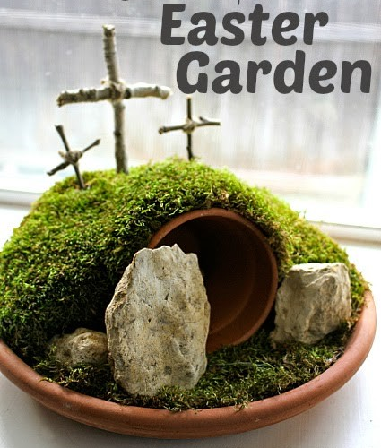
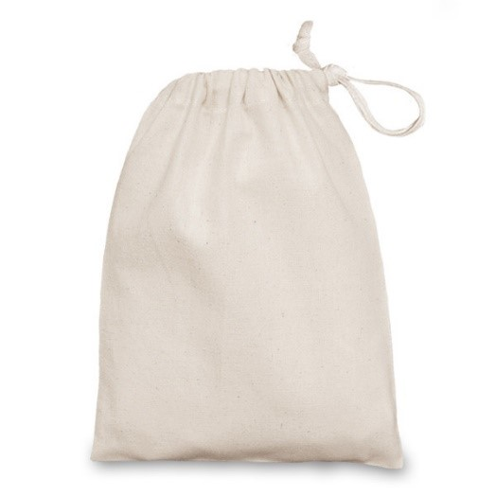
Ideas to make and celebrate Easter
R-1
S-09
Notes:
Slide 9 Ideas to make and celebrate Easter
Make an Easter Garden for the classroom or to share at home
For your own Easter garden you will need:
A tray or pot plant drip tray
Soil.
Grass seeds or moss.
Small stones for a path to the tomb
A large stone that covers the top of the flower pot
A piece of small white cloth.
A small flower pot for the tomb
6 sticks to make into 3 crosses.
Make an Easter Mystery Bag with a drawstring top. Put it objects that relate to Easter in it for example Easter eggs, a big round stone, an angel, a butterfly, and Easter card, a fridge magnet with ALLELUIA on it, a little Bible, a laminated image of the Jesus talking to the women, a candle, a little fluffy chicken and a bunny, some captions with words like He is risen, he is not here, Jesus is alive, Jesus is the Light of the World.
Children put their hand in and choose one object by feeling and identify it without seeing it – 3 guesses.
They take it out, identify it and share something they know about it with the class. Add new objects to the bag. Children can make a game of it to play with a partner or a group.
Make an Easter Candle or bookmark to laminate and share with a family member.

Slide 10
Check Up
1)
Tell the story of Easter Sunday around a group or with a partner.
2)
What day did Jesus rise from the dead?
3)
Who was the first to find the empty tomb?
4)
Why do we have Easter candles?
5)
Name 2 Easter symbols and explain what they mean.
6)
Which activity do you think helped you to learn best in this resource?
7)
Questions I would like to ask about the topics in this resource are …
R-1
S-10
Click the boxes to reveal text.
Notes:
Slide 10 Check Up
This formative assessment strategy will help teachers to identify how well the children have achieved the Learning Intentions of the resource.
Teachers can choose how they use the slide in their range of assessment options.
A worksheet of this slide is available for children in Years 5-8 to complete.
The last two items are feed forward for the teacher.
Recording the children’s responses to these items is recommended as it will enable teachers to adjust their learning strategies for future resources and target the areas that need further attention.

Slide 11
Time for Reflection
R-1
S-11
Click the audio button to stop Reflective Music
Click the audio button to play Reflective Music
Notes:
Slide 11 Time for Reflection
The MP3 is played to help create a reflective atmosphere and bring the children to stillness and silence as the teacher invites them to imagine Jesus coming out of the tomb. Wonder about what his friends said when they saw him again. Whisper to Jesus and thank him for rising from the dead and keeping his promise.

Slide 12
Worksheet
R-1
S-07
Click the up arrow to return to the presentation.
Notes:
Slide 7 Things we can do to make Easter the Happiest Day of the Year Read each flip card and respond to the yellow text. Look closely at the images and think and talk about what they mean. Children share their ideas about what they can do to make Easter Sunday the happiest day of the year because this is the day we remember that Jesus rose from the dead. Adapt Teaching and Learning Experience 6.
Sing using the MP3 ‘Kua mate a Hehu’
Make a copy of the worksheet for all children to complete and add to their RE Learning Journal. Read the text and talk about why Easter is the happiest day. Explain how we call the day Jesus rose Easter.

