Slide 1
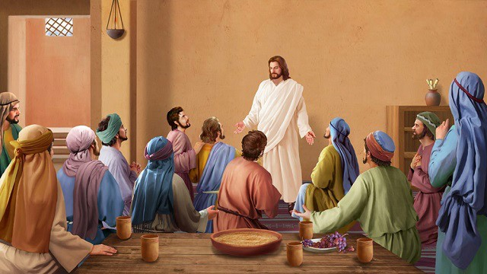
Jesus showed himself to his friends after he had risen
R-2
S-01
Notes:
Slide 1 Jesus showed himself to his friends after he had risen
Use this slide as a focussing strategy to introduce the resource topic. Read the title together and invite children to share something they know about how Jesus showed himself to his friends after he had risen from the tomb.

Slide 2
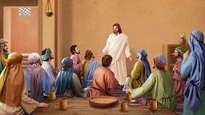
Learning Intentions
The Children will…
1)
name the people Jesus showed himself to after he had risen
2)
recognise words the risen Jesus spoke to his friends, the disciples.
R-2
S-02
Click the boxes to reveal text.
Notes:
Slide 2 Learning Outcomes
Look at the image and talk about why Jesus is all in white – this was to show he had risen and he looked different in his resurrected body. Notice this in the images on the other slides.
Read the Resurrection and after Easter stories during class prayer so children can become familiar with them. Collect some simple props and costumes children can use to create their own Easter story through drama. Have a selection of articles suitable for an Easter prayer focus and let them set up a new one each day. Remember to add ‘Alleluia, Alleluia’ to prayer during the 50 days of the Easter season. Have poems, books and bibles with a simple text of the Easter story that children can read to each other. Ask teachers from other classes to let your class visit to share their learning together. If possible take the children to the church to see the Paschal Candle and the bright joyful yellow and white flowers, candles and altar cloths. Children can pick up a lot about the feast and season of Easter from exploring their local church. Make children aware that this is the greatest feast in the Liturgical Year and it is the event and belief that our faith is based on. Be mindful that this is one of children’s early experiences to learn about the meaning of Easter. You are their spiritual guide and faith witness for your children so this is a good week to let them see how important celebrating Easter is for you and them together.

Slide 3
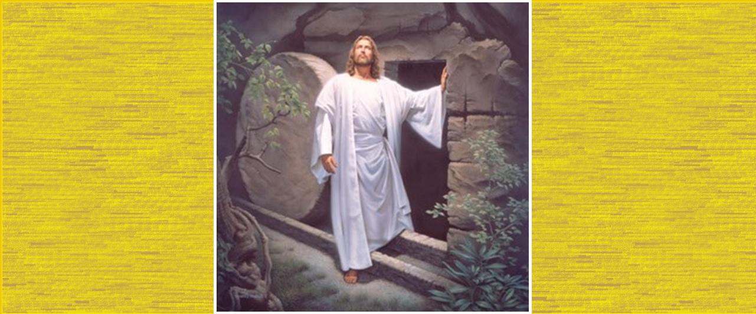
What happened when Jesus rose from the dead?
Jesus rose up from the tomb in his new resurrected body that looked different.
Early in the morning the women who were friends of Jesus came to the tomb.
There was a great earthquake and an angel came and rolled back the stone.
The guards shook with fright then they fainted from shock.
The angel spoke to the women and told them not to be afraid that Jesus was not there because he had been raised. They showed them where he had laid.
The women went quickly to tell the disciples that Jesus had been raised and was going to Galilee.
Jesus met them on the way and greeted them and told them not to be afraid.
Click the green arrow to move the blind down and the red arrow to return it to the top.
Click the video icon for resurrection of Jesus clip.
R-2
S-03
Notes:
Slide 3 What happened when Jesus rose from the dead Read each blind revealed sentence and talk about what it means and encourage the children to ask questions. Explain that a tomb is a bit like a cave where, in Jesus’ time, they used to put people when they died.
Watch the animated clip
https://www.youtube.com/watch?v=dgadn9EXMdk
Resurrection of Jesus (5:21 minutes)
Talk about the clip and ask children to share somethings they learned from it.
You may like to show it again as there is a lot in it. Explain that the first part is about what led up to the Resurrection of Jesus. Ask children for their responses.

Slide 4
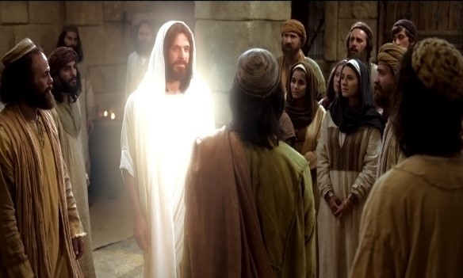
Who did Jesus show himself to after his Resurrection?
were the women who were his friends.
The first people Jesus showed himself to
Jesus showed himself to Mary Magdalene because she was crying near the tomb because Jesus was not there
The stories about Jesus meeting people after
Jesus had 10 meetings with his friends and he showed them his hands and his feet so they knew it was him.
Jesus could appear to his followers anywhere – on a beach, on a mountain and in the Last Supper room.
was crying near the tomb because Jesus
was not there.
the Resurrection we can read in the Bible.
them his hands and his feet so they knew it
was him.
on a beach, on a mountain and in the Last Supper
room.
the Resurrection we can read in the Bible.
them his hands and his feet so they knew it was him.
were the women who were his friends.
on a beach, on a mountain and in the Last Supper room.
was crying near the tomb because Jesus was not there.
R-2
S-04
Click the options a-e to correctly complete the sentences.
Notes:
Slide 4 Who did Jesus show himself to after his Resurrection? ANSWERS 1) C, 2) E, 3) A, 4) B, 5) D Read the first part of the sentences together and then choose from the A to E list to complete the sentences correctly. Read them over and talk about who his friends were and try to remember their names. Use the floater tool to check.

Slide 5
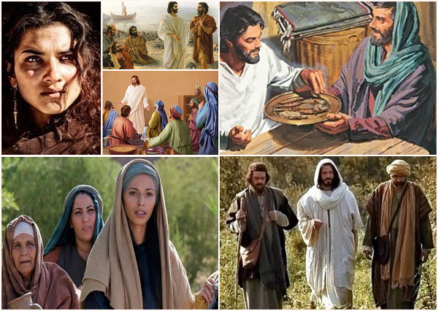
Can you name the people Jesus showed himself to after his Resurrection and say where they met?
Mary Magdalene near the tomb.
The disciples who were fishermen by the beach at daybreak.
With the disciples when Jesus was hungry.
The disciples in the Last Supper room with Jesus.
The women hurrying to Galilee.
Jesus with two of the disciples on the road to Emmaus.
R-2
S-05
Click the pictures to reveal text. Click worksheet icon for worksheet.
Notes:
Slide 5 Can you name the people Jesus showed himself to after his Resurrection and say where they met? Look at the pictures and name the people and where they are. Click the pictures to check your answers.
Read Luke 24:36-43 – see text in Teacher’s book or bible. Discuss the story and talk about how the disciples felt when Jesus showed himself to them – frightened, surprised, pleased. How would you have felt if you had been there? Make enough copies for each child to complete the worksheet ‘Jesus Showed Himself to His Friends’ (Teacher’s book, p.39) and add it to their RE Learning Journal.
Make a copy of the worksheet for all children to complete and add to their RE Learning Journal. Talk about what is happening in the picture and read what Jesus is saying. Colour the picture.

Slide 6
Why do you think Jesus showed himself to his friends after his Resurrection?
He wanted them to see he truly was alive.
He wanted to help them to not be frightened.
He was going to leave them soon and go back to heaven to be with God his Father.
They were his friends and he wanted to be with them.
What do you think they talked about when they were together?
What questions do you think they asked Jesus?
Click the picture to reveal captions (6 total)
R-2
S-06
Click the audio button to stop ‘Jesus Lives’ and ‘Kua mate a Hehu!’
Click the audio button to play ‘Jesus Lives’ and ‘Kua mate a Hehu!’
Notes:
Slide 6 Why do you think Jesus showed himself to his friends after his Resurrection?
Sing using the MP3 ‘Jesus Lives’ and ‘Kua mate a Hehu‘.
Read each item and encourage children to make a comment or ask a question about it. Explain to children that the disciples were frightened because that saw what the soldiers did to Jesus and because they were his friends they thought it might happen to them too. Jesus was their leader and they missed him when he died.
Children can create an art work of Jesus with his friends after the Resurrection to share with their family. They could make sure Jesus stands out and name the friends. Refer to Sharing our Learning Slide 12, R3.

Slide 7
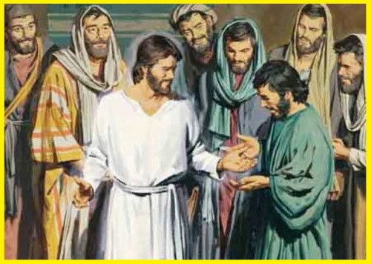
How did the Disciples recognise it was Jesus?
Jesus looked different after he had risen for the dead. When he showed himself to the disciples they didn’t recognise him.
When Jesus showed the disciples the marks in his hands, his feet and his side they knew it was truly Jesus who was alive and risen from the dead.
They knew he had risen but they didn’t expect to see him so they were surprised when he just appeared beside them.
You can go to Mass at Easter and give Jesus’ greeting of peace to people around you.
It was when he said, “Peace be with you.” that they recognised him and they were not frightened any more.
R-2
S-07
Click the pins on the right to reveal post-it notes.
Notes:
Slide 7 How did the Disciples recognise it was Jesus?
Read through each post it note and talk about what it means. Introduce Jesus’ greeting of peace at prayer time and at the end of the day as the children leave. It is important that they learn to share this by looking at people’s eyes as they say the words clearly and shake their hand respectfully. Include the greeting in languages from other cultures in your class as well – ask parents to provide you with text.
Adapt Teaching and Learning Experiences 5&6.
Note that if the Māori greeting is given to a group say koutou not koe.
Māori - Kia tau te rangimarie ki a koe
Samoan – La tumau pea le filemu ia te Oe
Tagalog (Philippines) - Sumaiyo ang Kapayapaan
Children could use other languages when they share the sign of peace once they are confident using English. Use native speakers to teach them the correct pronunciation. They could make posters of the greetings in different languages and share them with other classes.

Slide 8
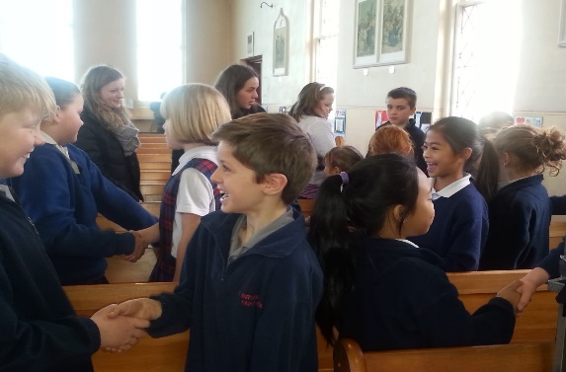
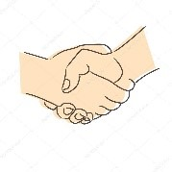
What does it mean when we say, “Peace be with you.”?
When we say “Peace be with you”
“Kia tau te rangimaire ki a koe”
we shake people’s hand and look into their eyes as we give them the message Jesus gave his friends
we want people to have peace in their lives
we want people to know when someone gives them peace they will not be afraid
we are passing on love to someone
Now you can give the sign of peace to your teacher and children in your class.
we let people know words can help them to feel peaceful in their heart
R-2
S-08
Click the handshakes to reveal text.
Notes:
Slide 8 What does it mean when we say “Peace be with you” Ask children to describe what peace in their hearts feels like. Remind them about sharing the Sign of Peace with reverence and take their time to look at the person and keep looking as they say the words clearly and shake their hand respectfully.

Slide 9
Check Up
1)
Name 3 people Jesus showed himself to after his Resurrection. (Slide 5)
2)
Why did Jesus show himself to his friends? (Slide 6)
3)
How did the disciples recognise it was Jesus? (Slide 7)
4)
What does it mean when you say, “Peace be with you, Kia tau te rangimarie ki a koe.” to someone? (Slide 8)
5)
Which activity do you think helped you to learn best in this resource?
6)
Questions I would like to ask about the topics in this resource are …
R-2
S-09
Click the boxes to reveal text.
Notes:
Slide 9 Check Up
This formative assessment strategy will help teachers to identify how well the children have achieved the Learning Intentions of the resource.
Teachers can choose how they use the slide in their range of assessment options.
A worksheet of this slide is available for children in Years 5-8 to complete.
The last two items are feed forward for the teacher.
Recording the children’s responses to these items is recommended as it will enable teachers to adjust their learning strategies for future resources and target the areas that need further attention.

Slide 10
Time for Reflection
R-2
S-10
Click the audio button to stop Reflective Music
Click the audio button to play Reflective Music
Notes:
Slide 10 Time for Reflection
The MP3 is played to help create a reflective atmosphere and bring the children to stillness and silence as the teacher invites them to remember the greeting Jesus gave his friends to help them feel better. Think about what they could do to help people feel better when they are anxious. Share the greeting

Slide 11
Worksheet
R-2
S-05
Click the up arrow to return to the presentation.
Notes:
Slide 5 Can you name the people Jesus showed himself to after his Resurrection and say where they met? Look at the pictures and name the people and where they are. Click the pictures to check your answers.
Read Luke 24:36-43 – see text in Teacher’s book or bible. Discuss the story and talk about how the disciples felt when Jesus showed himself to them – frightened, surprised, pleased. How would you have felt if you had been there? Make enough copies for each child to complete the worksheet ‘Jesus Showed Himself to His Friends’ (Teacher’s book, p.39) and add it to their RE Learning Journal.
Worksheet – Jesus Showed Himself to His Friends – refer to slide after Time for Reflection.

