Slide 1
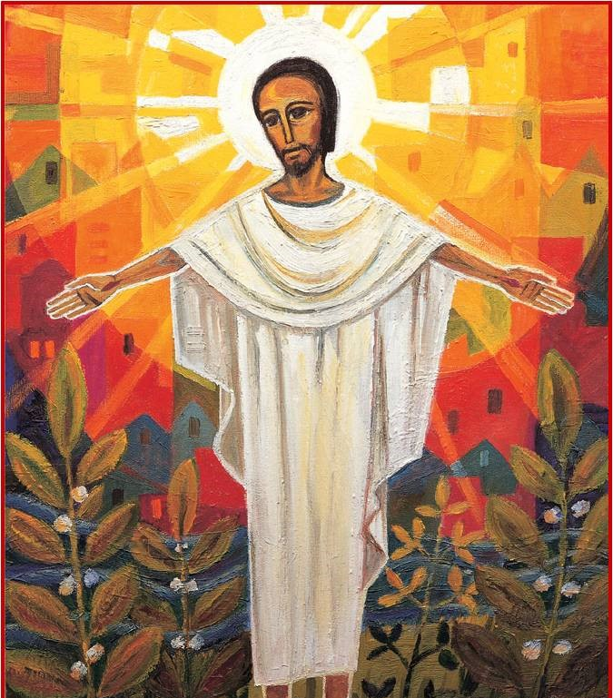
Jesus shares New Life with the World
R-3
S-01
Notes:
Slide 1 Jesus shares New Life with the World
Use this slide as a focussing strategy to introduce the resource topic. Read the title together and invite children to share something they know about how Jesus shares new life with the world.

Slide 2
Learning Intentions
The children will:
1)
identify the signs of new life that remind people of Jesus
2)
recognise Alleluia as a word Christians use at Easter to show joy that Jesus rose.
R-3
S-02
Click the boxes to reveal text.
Notes:
Slide 2 Learning Outcomes
Look at Slide 9 for ideas to celebrate Easter in your class and make arrangements to get what you will need.
Continue to highlight the Easter story at prayer time, Remember to add ‘Alleluia, Alleluia’ to prayer during the 50 days of the Easter season. Have poems, books and bibles with a simple text of the Easter story that children can share with each other. Ask teachers from other classes to let your class visit to share their learning together. If possible take the children to the church to see the Paschal Candle and the bright joyful yellow and white flowers, candles and altar cloths. Children can pick up a lot about the feast and season of Easter from exploring their local church. Help children to understand that this is the greatest feast in the Liturgical Year and it is the event and belief that our faith is based on. Be mindful that this is one of children’s early experiences to learn about the meaning of Easter. You are their spiritual guide and faith witness for your children so this is a good week to let them see how important celebrating Easter is for you and them together.
Read the Easter story at class prayer and recap key ideas from the resources with the children. Let children retell the story with picture prompts.
Keep using the Easter space – the season of Easter lasts for 50 days!
Use the songs in the resource at class prayer during Easter.

Slide 3
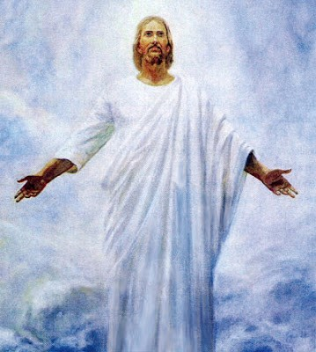
After Jesus rose from the dead he had a different body
Jesus’ new body was like
He could go through doors and
39 days after Easter Sunday Jesus
Jesus is in his new body in heaven
His new body
his old body but a bit different.
just appear in a room.
went back to God his Father in heaven.
with God and all the Saints.
will last forever.
with God and all the Saints.
will last forever.
just appear in a room.
went back to God his Father in heaven.
his old body but a bit different.
R-3
S-03
Click a statement in the lower box to complete the sentence correctly..
Notes:
Slide 3 After Jesus rose from the dead he had a different body
Explain to the children that after Jesus died and rose from the dead his body was different. It was his new risen body that had had to start his new life. He stayed on earth for 40 days in his new body and then he went back to heaven to be with God his Father and that is where he is now.
ANSWERS 1) E, 2) C, 3) D, 4) A, 5) B
As each sentence is completed talk about what it means. FYI After his Resurrection Jesus’ body was transformed and would have appeared as he did at the Transfiguration.

Slide 4
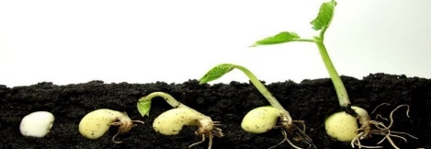
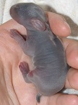
Because Jesus has a new life the world has a new life too
What signs of new life do you see in the world?
I see new life in seeds growing in the earth.
I see new life in monarch butterflies emerging from their chrysalis.
I see new life in chickens hatching from their egg.
I see new life when I hold my new born rabbit.
We have this new life in the world because Jesus rose from the dead
Jesus wants to share this new life with us.
R-3
S-04
Click the picture icons to reveal text.
Click video icons for clips: “Chick hatching”, “Monarch butterfly emerging from chrysalis”
Notes:
Slide 4 Because Jesus has a new life the world has a new life too Read the question in the title and click on each image to make answer appear. Ask children to think of other examples. Adapt Teaching and Learning Experiences 1 & 2
Watch the clips
https://www.youtube.com/watch?v=tof5b1Qs_OE
Chick hatching (1:16 minutes)
Remind children that a chicken has a new life when it comes out of the egg and this reminds us of Jesus coming out of the tomb to his new life.
https://www.youtube.com/watch?v=Gt-5lS9hJFA
Monarch butterfly emerging from chrysalis (2:10 minutes)
Talk with children about how a caterpillar has a new life when it comes out of the chrysalis and changes into a new life as a beautiful butterfly and this reminds us of Jesus coming out of the tomb to his new life.

Slide 5
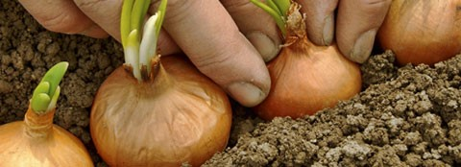
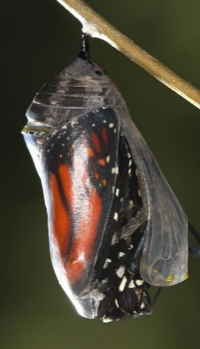
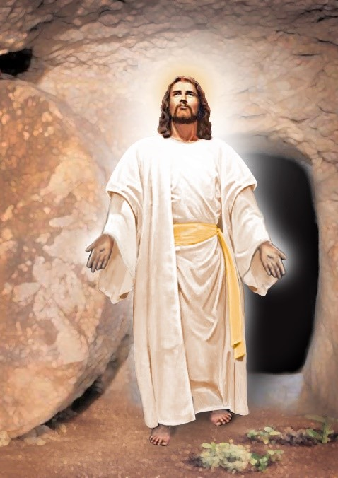
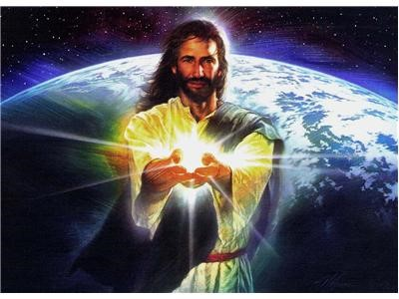
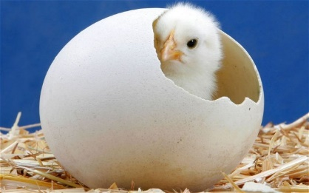
Nature shows us examples of new life which remind us of Jesus’ new life
We watch Monarch Butterflies hatching from the darkness of the chrysalis and their life as a caterpillar into a new life as a butterfly just like Jesus did.
Jesus came from the darkness of the tomb to his new life in the light
We plant bulbs at Easter time because they come out of the darkness of the ground as Jesus came out of the dark tomb into the light.
We have chickens and eggs at Easter because they remind us of Jesus coming out of the darkness of the tomb into his new life.
Jesus brought light and new life into the world when he rose out of the darkness of the tomb.
R-3
S-05
Click the arrows to reveal examples.
Notes:
Slide 5 Nature shows us examples of new life which remind us of Jesus’ new life
Adapt Teaching and Learning Experience 4
Children chose one of the examples on the slide and draw it and write about how it reminds them that Jesus came out of the dark tomb and began his new life. These could be shared with their family whānau. Refer to Sharing our Learning, Slide 12.
Read the text and talk about what it means. Remember these are difficult faith concepts for 5 year olds to grasp – this is the beginning of their understanding and you are sowing the seeds of understanding important faith concepts. Adapt Teaching and Learning Experience 4

Slide 6
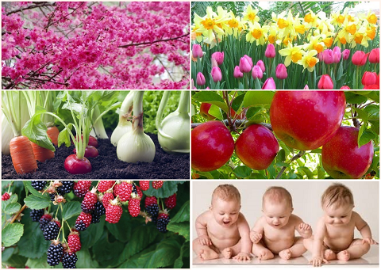
All Living things that grow are signs of the new life Jesus brought into the world when he rose from the dead
For trees blossoming – thank you Jesus for rising from death.
For bulbs flowering – thank you Jesus for rising from death.
For vegetables growing – thank you Jesus for rising from death.
For fruit trees giving fruit – thank you Jesus for rising from death.
For berry bushes laden with fruit – thank you Jesus for rising from death.
Best of all little people growing – just like ME! Thank you Jesus for rising from death.
R-3
S-06
Click the pictures to reveal text.
Click the audio button to play ‘Praise the Lord our God!’
Click the audio button to stop ‘Praise the Lord our God’
Notes:
Slide 6 All Living things that grow are signs of the new life Jesus brought into the world when he rose from the dead Look at each picture and read the text with the children. Ask them for other examples of new life that Jesus brought into the world when he rose from the dead.
Sing using the MP3 ‘Praise the Lord our God’ – make up some actions to go with it.

Slide 7
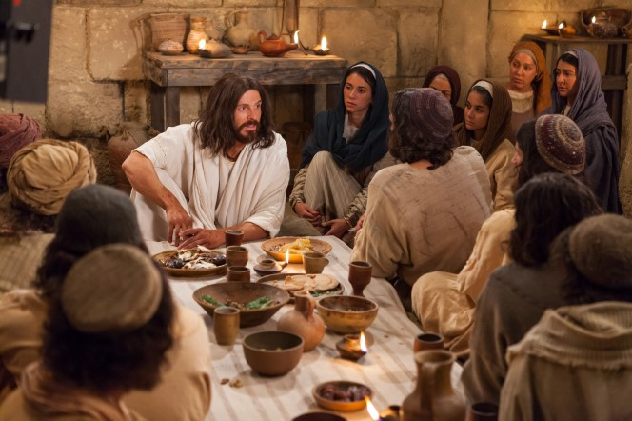
When his friends saw Jesus they knew he was different, but they knew it was him because…
His voice sounded the same
He liked to eat with them as he used to
He had the same marks he had on his feet, hands and side
He talked about a new life that would never end
He reminded them that he had kept his promise that he would rise on the third day.
He told his followers they would rise again too and have new bodies and a new life when they rise on the last day.
He told them he wanted to share his new life with them so they can be with him and he will be with us always too because we are his followers today.
R-3
S-07
Click the red button to follow text with the arrow.
Notes:
Slide 7 When his friends saw Jesus they knew he was different, but they knew it was him because …
Read the title of the slide and talk about it. Explain that this is what happened after Jesus had risen and he was meeting with his friends. Use the pointer to move through the text and explain ideas as you go. Remind children that they are his followers now and so are you.
Explain to children that Jesus promised he would always be with us and that is why we can talk to him and ask him to help us when we are worried or unhappy. Jesus listens to everything we say to him and he helps us to be strong and loving people.

Slide 8
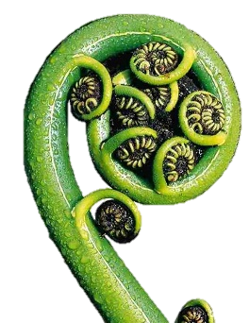
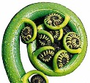
We have a special Aotearoa New Zealand symbol of new life unfurling
Koru and spirals are symbols of new beginnings and growth in Māori culture.
Koru grow on fern trees and their fronds unfurl as they grow showing us they are alive.
As the fronds unfurl their spores or seeds explode out on to the earth to continue the life cycle of the fern tree.
The unfurling fronds show us that, like all living things including people, when we open ourselves up to new things we grow and change and that is God’s plan for us.
R-3
S-08
Click the small koru to reveal text.
Click the audio button to stop ‘Waiata ki Te Atua’
Click the audio button to play ‘Waiata ki Te Atua!’
Notes:
Slide 8 We have a special Aotearoa New Zealand symbol unfurling into a new life Invite children to share their experiences of seeing a koru frond. Ask them to share what it reminds them of.
Let children draw their own fern fronds and display them with a caption that explains how they are a symbol that is unfurling into a new life and Jesus shares this new life with us his Resurrection. Sing using the ‘Waiata ki Te Atua’

Slide 9
Alleluia is a special word we use to show joy at EASTER
ALLELUIA IS A VERY HAPPY WORD TO GIVE PRAISE TO GOD.
ALLELUIA MEANS ‘PRAISE GOD’.
WE SAY THIS WORD AT THE BEGINNING AND THE END OF OUR PRAYERS AT EASTER TIME.
WE PRAISE GOD FOR GIVING US JESUS.
R-3
S-09
Click the Video icon for “Alleluia He is Risen” - Michael Mangan.
Click the audio button to stop ‘Easter Alleluia’
Click the audio button to play ‘Easter Alleluia!’
Notes:
Slide 9 Alleluia is a special word we use to show joy at EASTER
Watch the clip:
https://www.youtube.com/watch?v=Q4bJ8D6lvrk
Alleluia He is Risen Michael Mangan
1:48 minutes
Watch the clip and sing and dance with the song. Make up their own ALLELUIA dance to share. Some yellow streamers may add to the joy!
Adapt Teaching and Learning Experience 6
Make bunting with large letters ALLELUIA JESUS IS RISEN to hang in your classroom.
Children make a poster to take home to share.
Sing using the ‘Easter Alelluia’
Make Easter cookies to share at school and at home.
Ingredients
1 1/2 cups butter, softened
1 cup powdered sugar
1/4 teaspoon salt
1 teaspoon vanilla extract
2 3/4 cups all-purpose flour, sifted
Method
Step 1 Beat butter, sugar, and salt at medium speed with a heavy-duty electric stand mixer until creamy. Add vanilla; beat until well blended. Gradually add flour, beating at low speed until blended. (Dough will be very soft.)
Step 2 Divide dough into 2 equal portions; wrap each with plastic wrap and flatten into a disc. Chill 2 to 24 hours.
Step 3 Preheat oven to 350°. Unwrap 1 dough disc on a well-floured surface. Cover with a large piece of plastic wrap and roll to 1/4-inch thickness; cut into desired shapes with 3 1/2-inch cookie cutters. Place 1 inch apart on ungreased baking sheets. Chill 15 minutes. Repeat procedure with remaining dough disc.
Step 4 Bake at 350° for 14 to 17 minutes or just until edges are lightly browned. Cool on baking sheets 5 minutes. Transfer to wire racks and let cool completely (about 30 minutes). Decorate cookies with simple icing. Let stand 1 hour or until icing is firm.

Slide 10
Check Up
1)
Name 3 signs of new life we can see in the world. (Slides 4,5,6)
2)
How does a chicken or a Monarch butterfly remind us of Jesus rising from the dead? (Slide 5)
3)
Share your koru frond and say why it is a sign of new life. (Slide 8)
4)
How was Jesus’ new body different and how did the disciples know it was him? (Slide 7)
5)
Say what the special joyful Easter word is and sing a song about it. (Slide 9)
6)
Which activity do you think helped you to learn best in this resource?
7)
Questions I would like to ask about the topics in this resource are …
R-3
S-10
Click the boxes to reveal text.
Notes:
Slide 10 Check Up
This formative assessment strategy will help teachers to identify how well the children have achieved the Learning Intentions of the resource.
Teachers can choose how they use the slide in their range of assessment options.
A worksheet of this slide is available for children in Years 5-8 to complete.
The last two items are feed forward for the teacher.
Recording the children’s responses to these items is recommended as it will enable teachers to adjust their learning strategies for future resources and target the areas that need further attention.

Slide 11
Time for Reflection
R-3
S-11
Click the audio button to stop Reflective Music
Click the audio button to play Reflective Music
Notes:
Slide 11 Time for Reflection
The MP3 is played to help create a reflective atmosphere and bring the children to stillness and silence as the teacher invites them to think about the things in nature that remind them about Jesus coming out of the darkness of the tomb and sharing his new life with them. Say thank you to Jesus for doing this.

Slide 12
Sharing our Learning about EASTER with family whānau
Make up your own way of showing and sharing what you have learned and decide who you would like to share it with.
Have a conversation with someone at home who knows about Easter Sunday and plan to go to Mass and do something special to celebrate it.
Make up a play about Jesus rising from the dead and act it out for people at home. You could use the bible stories to help you with the play.
Share your ALLELUIA dance with your family whānau. (Slide 9, R3)
Share the message Jesus gave his friends when he met them after he had risen from the dead.
Share your art works at home: Jesus showing himself to his friend after he rose from the dead (Slide 6, R2). An example in nature that reminds people of Jesus coming out of the darkness of the tomb (Slide 5, R3). Share with your family whānau what you have learned about this.
Look at the image and use it to help you explain what happened on Easter Sunday. Share it with your family whānau. Ask them to tell you what they know about the Easter Sunday story.
Sharing our Learning about EASTER
R-3
S-12
Click the button in the middle to start the slide, click the text side to move through (7 total), click the arrow to start over.
Click worksheet icon for worksheet.
Notes:
Slide 12 Sharing our Learning about EASTER with family whānau
This slide provides some choices for children to show and share what they have learned. Examples could be photographed as evidence of children’s learning.
You may like to put a copy of the Sharing our Learning page in children’s RE Learning Journals. You could talk through the choices using the slide and let children make their choice from their own copy.
Children could work on their choice at school and/or at home and you may like to set a day for sharing. Please let parents and whānau know what you expect them to do with this.
The slide is focussed on Achievement Objective for Year 1 EASTER which is covered in Resources 1, 2, 3.
LEVEL 1 Year1 AO) Children will be able to: recognise the EASTER event.

Slide 13
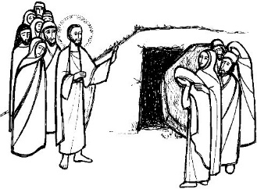
Sharing our Learning about EASTER with family whānau
Name_______________________ Date________________
Share your ALLELUIA dance with your family whānau. (Slide 9, R3)
Make up a play about Jesus rising from the dead and act it out for people at home. You could use the bible stories to help you with the play.
Have a conversation with someone at home who knows about Easter Sunday and plan to go to Mass and do something special to celebrate it.
Make up your own way of showing and sharing what you have learned and decide whom you would like to share it with.
Look at the image and use it to help you explain what happened on Easter Sunday. Share it with your family whānau. Ask them to tell you what they know about the Easter Sunday story.
Share your art works at home: Jesus showing himself to his friend after he rose from the dead (Slide 6, R2). An example in nature that reminds people of Jesus coming out of the darkness of the tomb (Slide 5, R3). Share with your family whānau what you have learned about this.
Share the message Jesus gave his friends when he met them after he had risen from the dead.
R-3
S-12
Worksheet
Click the up arrow to return to the presentation

