Slide 1

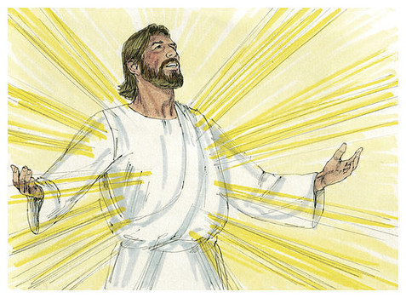
Easter is a Season of Joy because
Jesus Rose from the Dead
R-1
S-01
Notes:
Slide 1 Easter is a Season of Joy because Jesus Rose from the Dead
Use this slide as a focussing strategy to introduce the resource topic. Read the title together and invite children to share something they know about
Jesus’ Resurrection and what that means.

Slide 2

Learning Intentions
The children will:
1)
recognise that Easter is a season of joy because Jesus rose from the dead
2)
identify the feelings expressed by people in the Easter stories and give reasons for them
3)
name ways that followers of Jesus celebrate the joy of Easter today.
R-1
S-02
Click the borders to reveal text
Notes:
Slide 2 Learning Intentions
Read through the Learning Intentions with the class and identify some ideas/questions that might be explored in the resource.
Create a place in the room as an Easter area, maybe a (blanket) cave with a big (pillow) stone and a white towel. Gather stories, images, books, songs, you tube clips, art and craft materials and paper etc. for children to explore Easter. Collect some simple props and costumes children can use to create their own Easter story through drama. Have a selection of articles suitable for an Easter prayer focus and let them set up a new one each day. Remember to add ‘Alleluia, Alleluia’ to prayer during the 50 days of the Easter season. Have poems, books and bibles with a simple text of the Easter story that children can read to each other. Ask teachers from other classes to let your class visit to share their learning together. If possible take the children to the church to see the Paschal Candle and the bright joyful yellow and white flowers, candles and altar cloths. Children can pick up a lot about the feast and season of Easter from exploring their local church. Make children aware that this is the greatest feast in the Liturgical Year and it is the event and belief that our faith is based on. Be mindful that this is one of children’s early experiences to learn about the meaning of Easter. You are their spiritual guide and faith witness for your children so this is a good week to let them see how important celebrating Easter is for you and them together.

Slide 3
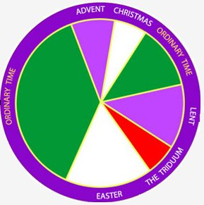
What do you know about the Liturgical Calendar?
What season comes after Holy Week?
What season is before Christmas?
What is the longest time in the year?
What is the shortest time in the year?
Purple is used for which seasons?
White is used for what sort of seasons?
Green is for what time?
The Liturgical Calendar follows the life of?
R-1
S-03
Press the blue button on the bottom left hand corner of the calendar to advance arrow to the next answer.
Notes:
Slide 3 What do you know about the Liturgical Calendar?
Talk about what the Liturgical Calendar is and why we have it. Work through each item on the slide using the pointer button. Answer the questions and draw attention to the colours on the prayer focus and how they match the season of the year in the church.

Slide 4


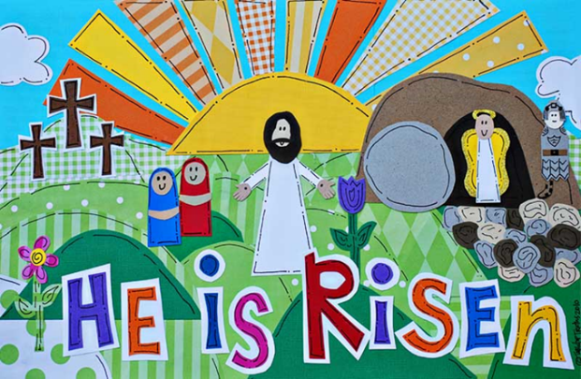
Easter is the most joyful feast and season of the Church’s year because…
We can see signs of the new life in the world when we see baby animals, flowers and plants growing.
Jesus promised his followers that when they die they will be raised like him to a new life in heaven forever.
Jesus is risen from the dead – he is the only person in the whole world ever to do that.
When Jesus rose he had a new life and he brought new life back into all the world.
Jesus told his followers he would rise again after three days and he did.
R-1
S-04
Click the pins on the right to reveal post-it notes. Click the video button to play ‘A Very Special Easter’
Notes:
Slide 4 Easter is the most joyful feast and season of the Church’s year because…
Watch the clip
https://www.youtube.com/watch?v=zY2NH8Wpoog
A Very Special Easter (3:35 minutes)
Read the post it notes and let them generate comments and questions. Children talk about the clip and share something they learned from it.

Slide 5

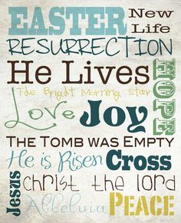
The special ways Christians celebrate Easter
1. On Easter Sunday Christians all over the world
celebrate that Jesus is risen from death as he said he would.
2. They retell the story of the first Easter Sunday
when Jesus came out of the darkness of the tomb.
3. Christians go to their church to celebrate the
new life of Jesus with special prayers and songs at Mass.
4. They light a special candle called the Easter candle
which reminds people that Jesus is the light of the world.
5. In songs and prayers the people say and sing
the joyful Easter word that means ‘praise God’ ALLELUIA.
a) the joyful Easter word that means ‘praise God’ ALLELUIA.
b) when Jesus came out of the darkness of the tomb.
c) which reminds people that Jesus is the light of the world.
d) celebrate that Jesus is risen from death as he
said he would.
e) new life of Jesus with special prayers and songs at Mass.
R-1
S-05
Click a sentence ending from the white box to correctly position it. Click video button to play ‘Why celebrate Easter?’
Click the audio button to stop ‘Alleluia, Alleluia, give thanks to the Risen Lord’
Click the audio button to play ‘Alleluia, Alleluia, give thanks to the Risen Lord’
Notes:
Slide 5 The special ways Christians celebrate Easter
ANSWERS
1)D, 2) B, 3) E, 4) C, 5) A
Read each sentence and talk about what it means and add some ideas of your own to the discussion. Remind children to look for the big Easter Candle in the church and to watch when it is lit at Mass. It is lit for the whole of the Easter season – 50 days.
Make enough copies of the worksheet for each child to complete and add to the RE Learning Journal
https://www.youtube.com/watch?v=gxbB0XCeulw
Why Celebrate Easter? (3:09 minutes)
Sing ‘Alleluia, Alleluia, give thanks to the Risen Lord’ using the MP3

Slide 6
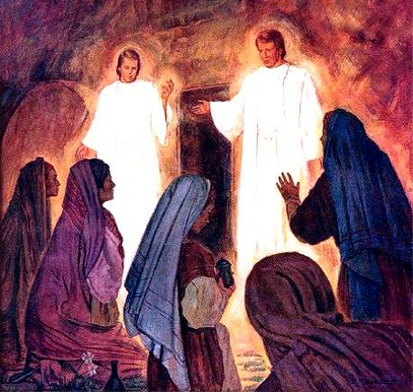
The Story of the Resurrection Matthew 28:1-10
1) Where did the story take place?
2) What day did the story take place?
3) What unusual events took place?
4) What did the angel do that made the women feel better?
5) What happened next in the story
R-1
S-06
Click in a white box to type. Click on video button to play ‘What is Easter?’
Notes:
Slide 6 The Story of the Resurrection Matthew 28:1-10
Read Mathew 28 – text in Teachers Book or Bible.
Teacher records children’s responses to the questions in appropriate box on the screen.
Watch the clip
https://www.youtube.com/watch?v=N6tSgEoZP0k
What is Easter? (4:34 minutes)

Slide 7
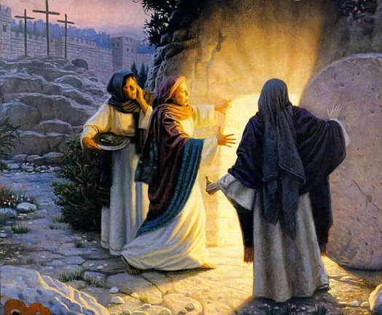
Can you say how the characters in the story felt
when Jesus rose from the dead?
The angel
felt excited to share the good news that Jesus has risen.
The guards
felt so frightened they fainted.
The women
felt frightened and joyful at the same time.
Jesus
felt pleased to see his friends and reassured them as they were frightened.
a) felt pleased to see his friends and reassured them as they were frightened.
b) felt frightened and joyful at the same time.
c) felt excited to share the good news that Jesus has risen.
d) felt so frightened they fainted.
R-1
S-07
Click a sentence ending from the bottom list to correctly position it.
Notes:
Slide 7 Can you say how the characters in the story felt when Jesus rose from the dead?
ANSWERS: 1) C, 2) D, 3) B, 4) A
Read each sentence and say how the characters felt and check it by using the floater. Retell the story and assign characters to each group of children and as their part is read they show their feelings.

Slide 8
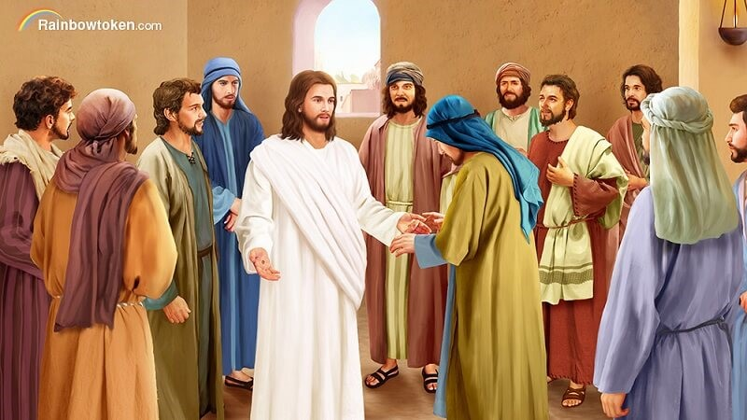
Jesus shows himself to his Disciples Luke 24:36-43
While the disciples were together, Jesus appeared among them and said, “Peace be with you.” The disciples were frightened and thought they were seeing a ghost.
Jesus said, “Can’t you see it is me? Look at my hands and my feet. Touch me and see I am not a ghost.”
When Jesus showed the disciples the marks on his hands and feet they were so happy even though they still wondered if it was really him.
Then Jesus said to them, “Have you got anything I could eat?” They gave him a piece of fish and he ate it. This story was written by St Luke.
R-1
S-08
Click the down-button to move the blind down. Click the video button to play ‘Jesus appears to his disciples’.
Notes:
Slide 8 Jesus shows himself to his Disciples Luke 24: 36-43
Explain that when Jesus appeared to the disciples after his Resurrection he said, “Peace be with you.” because he knew they needed time to get used to him in his new body and they needed him to re-assure them that he was still their friend and teacher.
Why didn’t the disciples recognise Jesus? He was in his new resurrected body and he looked different.
What did they see that proved it was Jesus? The marks in his hands and his feet.
Why was Jesus hungry? He hadn’t eaten since he rose up out of the tomb. He wanted to show the disciples that he still like to do what he used to do with them – share a meal.
Watch the clip
https://www.youtube.com/watch?v=3vyDRZVXc9Y
Jesus appears to his disciples (3:24 minutes)
Discuss the clip and share one new thing you learned from it.

Slide 9
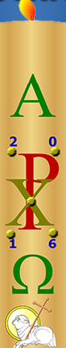
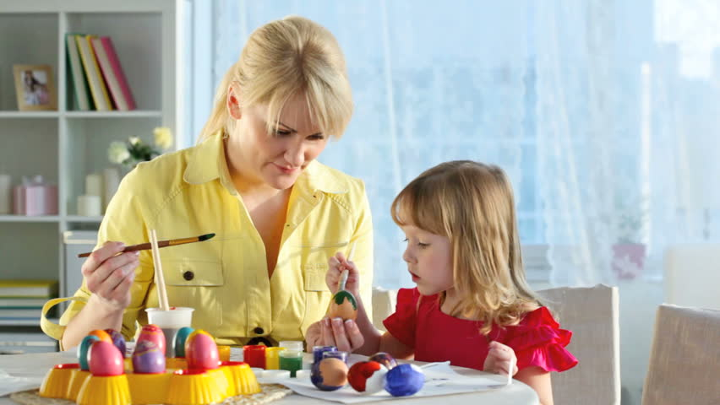
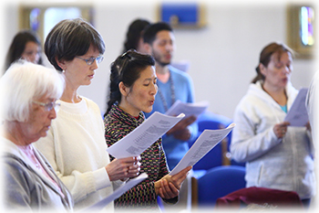
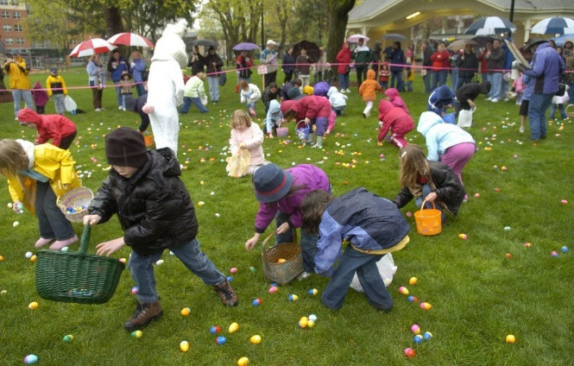
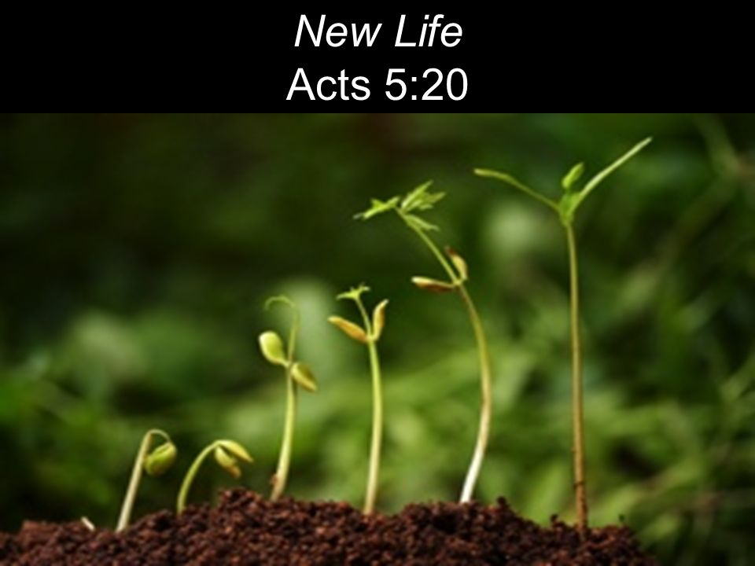
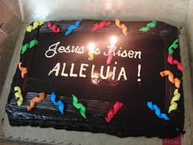
How Jesus’ Followers today Celebrate the joy of Easter
Card 6
We can decorate eggs to help us remember that Jesus rose from death and he brought new life to the world. We can see this new life when baby animals are born and new plants grow. Have you seen a chicken come out of an egg just like Jesus came out of the tomb?
Card 5
Card 4
Families celebrate the joy of Easter by sharing an Easter cake together because Jesus has risen. What special food does your family have to celebrate Easter?
Card 3
Our Church has an Easter Candle which is a symbol of Jesus. We light this candle at Mass, when people are baptised or at Funeral masses when people have died. The Easter Candle is part of the Easter celebrations in our parish. Where is the Easter candle in your church? Notice it next time you go to the church.
Card 2
Children celebrate the joy of Easter Sunday with an Easter egg hunt. Eggs are a symbol of new life so that is why we have them at Easter to celebrate Jesus’ new life.
Tell a partner about an Easter egg hunt you have been to.
They notice the new life in creation that Jesus brought into the world when he rose from the dead.
Where have you seen signs of new life growing?
Christians celebrate the joy of Easter by going to Mass and singing songs of joy which include Alleluia.
Can you sing a joyful Easter song?
Click top card to discard it.
R-1
S-09
Click the audio button to stop ‘Easter Song’
Click the audio button to play ‘Easter Song’
Notes:
Slide 9 How Jesus’ Followers today Celebrate the joy of Easter
Read through the flip cards and answer the questions.
Sing using the MP3 ‘Easter Song’.

Slide 10

Check Up
1)
Why is Easter such a happy season full of joy? (Slide 4)
2)
Name 2 people in the Easter story and say what they felt when they realised Jesus had risen and say why they felt like that. (Slides 6 & 7)
3)
Make a poster to share with their family whānau that illustrates 3 ways the followers of Jesus today celebrate Easter. (Slide 9)
4)
What did Jesus say to his disciples when he appeared to them after his Resurrection to help them not to be afraid? (Slide 8)
5)
Which activity do you think helped you to learn best in this resource?
6)
Questions I would like to ask about the topics in this resource are…
R-1
S-10
Click the borders to reveal text
Notes:
Slide 10 Check Up
This formative assessment strategy will help teachers to identify how well children have achieved the Learning Intentions of the resource.
Teachers can choose how they use the slide in their range of assessment options.
A worksheet of this slide is available for children in Years 5-8 to complete.
The last two items are feed forward for the teacher.
Recording the children’s responses to these items is recommended as it will enable teachers to adjust their learning strategies for future resources and target the areas that need further attention.

Slide 11
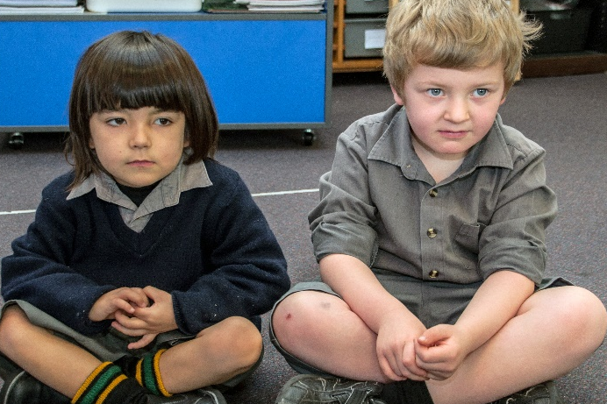
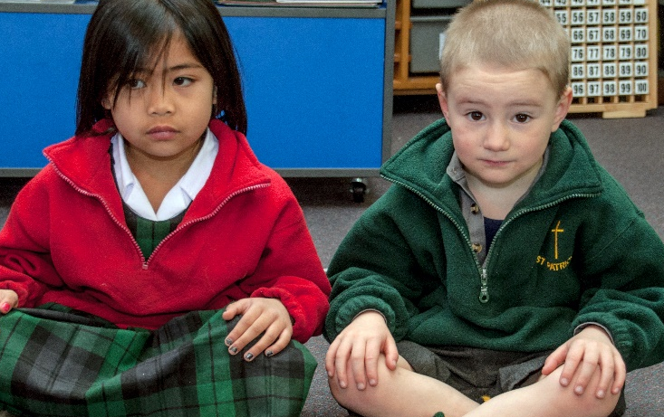

Time for Reflection
R-1
S-11
Click the audio button to stop ‘Reflective Music’
Click the audio button to play ‘Reflective Music’
Notes:
Slide 11 Time for Reflection
The MP3 is played to help create a reflective atmosphere and bring the children to stillness and silence as the teacher invites them to think about how they could help to spread the joy of Easter in their family whānau.

