Slide 1
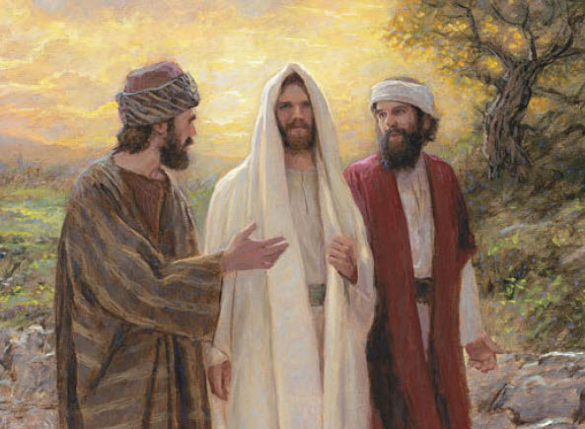
Recognising the Risen Jesus
R-2
S-01
Notes:
Slide 1 Recognising the Risen Jesus
Use this slide as a focussing strategy to introduce the resource topic. Read the title together and invite children to share something they know about how Jesus’ followers recognised Jesus after his Resurrection.

Slide 2
Learning Intentions
The children will:
1)
recall the story of the journey to Emmaus
2)
identify times that children need to recognise the presence of Jesus in their lives.
R-2
S-02
Click the borders to reveal text
Notes:
Slide 2 Learning Intentions
Read through the Learning Intentions with the class and identify some ideas/questions that might be explored in the resource.
Create a place in the room as an Easter area, maybe a (blanket) cave with a big (pillow) stone and a white towel. Gather stories, images, books, songs, you tube clips, art and craft materials and paper etc. for children to explore Easter. Collect some simple props and costumes children can use to create their own Easter story through drama. Have a selection of articles suitable for an Easter prayer focus and let them set up a new one each day. Remember to add ‘Alleluia, Alleluia’ to prayer during the 50 days of the Easter season. Have poems, books and bibles with a simple text of the Easter story that children can read to each other. Ask teachers from other classes to let your class visit to share their learning together. If possible take the children to the church to see the Paschal Candle and the bright joyful yellow and white flowers, candles and altar cloths. Children can pick up a lot about the feast and season of Easter from exploring their local church. Make children aware that this is the greatest feast in the Liturgical Year and it is the event and belief that our faith is based on. Be mindful that this is one of children’s early experiences to learn about the meaning of Easter. You are their spiritual guide and faith witness for your children so this is a good week to let them see how important celebrating Easter is for you and them together.rough the Learning Intentions with the class and identify some ideas/questions that might be explored in the lesson.

Slide 3
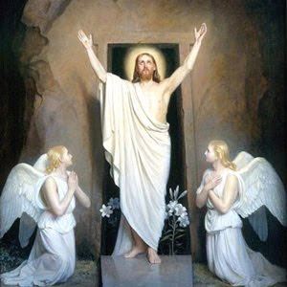
Recapping the Resurrection story
Complete the sentences to tell the story
After Jesus died on the cross he was …
He lay in the tomb for three days then he …
The disciples hid in the room where they had the Last Supper because …
Mary and the women came to the tomb but …
The angel told them that …
They rushed back to …
Jesus appeared among them …
After this Jesus showed himself to the …
R-2
S-03
Click blue button to advance arrow to the next line.
Notes:
Slide 3 Recapping the Resurrection story Let the children share their suggestions to complete the sentence as they retell the Easter story. Invite them to add any further ideas. Use the pointer button to work through them.

Slide 4
Jesus appeared to his disciples in different
places after his Resurrection
The first person Jesus appeared to was Mary Magdalene in the garden near the tomb. She didn’t recognise Jesus until he said to her, “Mary!” and she recognised his voice. He sent her to tell the other disciples to go to Galilee and they would see him there.
Can you name some of the disciples?
Jesus appeared to the disciples several times in the upstairs room and they thought he was a ghost until he said, “Peace be with you.”
Do you think he looks like a ghost?
The two disciples who walked with Jesus on the road to Emmaus did not recognise him until they were having dinner together and he broke the bread like he had done at the Last Supper.
How do you think they felt?
R-2
S-04a
Click each image to reveal text
Notes:
Slide 4a Jesus appeared to his disciples in different places after his Resurrection Read the text related to each picture and answer the questions. Allow time for comments and questions.

Slide 5
Jesus appeared to his disciples in different
places after his Resurrection
Jesus appeared to seven disciples on the sea shore near Lake Tiberias at sunrise one day. Peter was the first to recognise him and he jumped into the water to go and meet Jesus who had made a fire for them and he cooked them breakfast.
Have you ever eaten fish you have caught on the beach like this?
Jesus appeared to a big crowd of people. But not much was written about this in the Bible. What do you think the people would have told their friends about Jesus who had risen?
The last appearance Jesus made to the disciples was on the top of Mount Olivet. Jesus was lifted up and he disappeared from their sight into the clouds. He returned to his Father in heaven. We call this Jesus’ Ascension. Now Jesus lives with God in heaven.
Do you know anyone else who is in heaven with Jesus?
R-2
S-04b
Click each image to reveal text
Notes:
Slide 4b Jesus appeared to his disciples in different places after his Resurrection Read the text related to each picture and answer the questions. Allow time for comments and questions.

Slide 6
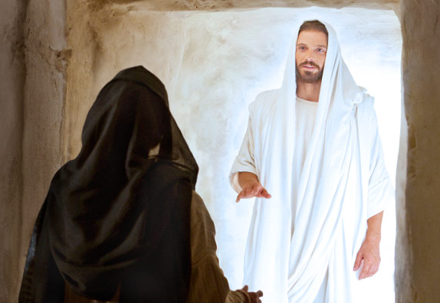
Jesus looked different after the Resurrection
When Jesus was born he had an earthly body like ours with skin and bones. When he died and rose again he had a heavenly body. He still had skin so the disciples would know it was him from the marks on his hands and feet.
He used this time with them to remind them to pass on all he had taught them when he was with them. He told them he was going back to his Father and that he would send his Holy Spirit to help them carry on his work.
His heavenly body was bright shining white and he could pass through doors without opening them. This made the disciples a bit scared of him. When he spoke they recognised his voice and they knew it was Jesus their
teacher and friend.
Jesus was on earth for 40 days after he rose from death and returned to his Father in heaven. He appeared to his friends about 12 times.
R-2
S-05
Click the pins on the left to reveal post-it notes.
Notes:
Slide 5 Jesus looked different after the Resurrection Read each PIN and talk to the children about what the disciples would have been wondering about Jesus when they met him after his Resurrection. If you had been there what would you have been wondering about him? What would have proved to you he really was Jesus?

Slide 7
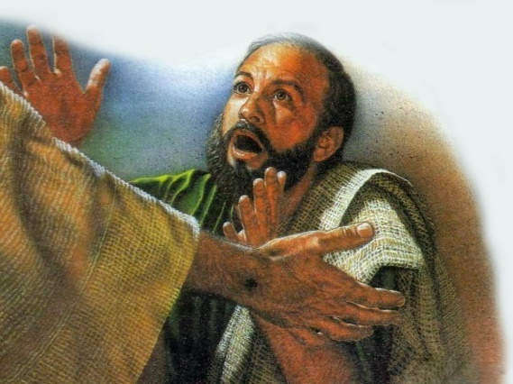
His friends only recognised Jesus by the things he did
1. They recognised Jesus because he used to
always greet them by saying, “Peace be with you.”
2. Jesus always liked to share
a meal with his friends.
3. Jesus had the marks of the nails in his
hands and feet so this helped the disciples to recognise him.
4. He continued to teach them about God and how
he wanted them to carry this work on in the world.
5. He knew all their names and he always
called them by their names.
a) called them by their names.
b) a meal with his friends.
c) he wanted them to carry this work on in the world.
.
d) always greet them by saying, “Peace be with you.”
e) hands and feet so this helped the disciples to recognise him.
R-2
S-06
Click a sentence ending from the white box to correctly position it.
Notes:
Slide 6 His friends only recognised Jesus by the things he did
ANSWERS: 1) D, 2) B, 3) E, 4) C, 5) A
Children read the statement and suggest the correct one to complete each sentence and check it with the word float. Children read each sentence and explain what it means. Have you ever recognised someone not by their face but by something they did?

Slide 8
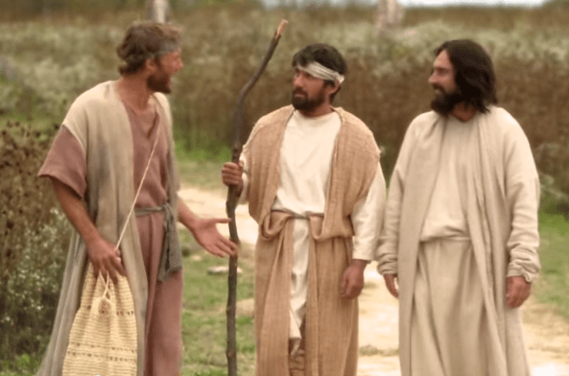
The Road to Emmaus story
The story of the Road to Emmaus is a very well-known story about one of Jesus’ appearances after his Resurrection. It shows how the disciples recognised Jesus when he did something that they had seen him do when they had shared meals with him.
R-2
S-07
Click the video button to play ‘The Road to Emmaus.’
Notes:
Slide 7 The Road to Emmaus story
Explain that after he rose Jesus wanted to spend time with his followers. His risen body was different and it was hard for them to recognise him. He appeared to them lots of times in different places. Read the text on the slide to introduce the clip. You could read the Gospel text as the reading for class prayer (Luke 24:13-33).
Adapt Teaching and Learning Experience 3.
Watch the clip and take time to think about the story. Share a comment or a question, then share something new you learned about this story.
https://www.youtube.com/watch?v=K3L9eXMeV1A
The Road to Emmaus (2:21 minutes)

Slide 9
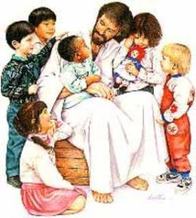
How we recognise that Jesus is with us today
J | P | E | O | P | L | E | T | I | I
E | C | S | P | E | A | K | H | S | N
S | A | E | S | E | R | V | E | H | K
U | R | N | E | E | D | A | Y | A | I
S | E | O | T | H | E | R | S | R | N
R | E | C | O | G | N | I | S | E | D
P | R | E | S | E | N | T | W | W | N
F | O | R | W | H | A | T | H | I | E
O | T | H | E | R | S | W | E | T | S
A | N | D | H | A | V | E | N | H | S
We recognise Jesus is present when people care for others, speak with kindness, share what they have and serve others in need.
R-2
S-08
Click the words in the sentence to reveal its position in the Word Find. Click the worksheet button to go to worksheet
Notes:
Slide 8 How we recognise that Jesus is with us today Find each word in the sentence on the matrix and highlight it in the sentence and in the Word Find. Make a copy of the worksheet for each child to complete and add to their RE Learning Journal. Read the sentence and ask children to share examples when they have done this.

Slide 10
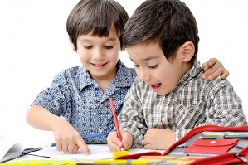
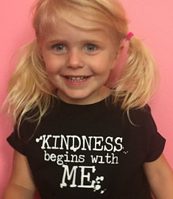
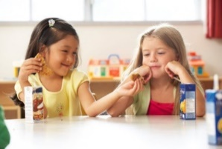
How children of our age carry on Jesus’
work today in the world
We try
We show
We help
We remember
We share
We include
R-2
S-09
Click in the white box and write your text
Notes:
Slide 9 How children of our age carry on Jesus’ work today in the world Children suggest ways they can carry on Jesus’ work and record their ideas in appropriate spaces on the screen. Children read their recorded ideas back.

Slide 11
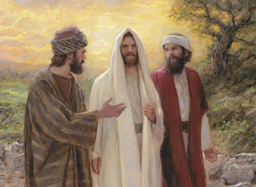
Check Up
1)
Tell a partner the story of the Road to Emmaus. (Slide7)
2)
Name two ways the disciples recognised Jesus after his Resurrection. (Slide 6)
3)
Name 2 times Jesus appeared to his disciples after he had risen. (Slide 4)
4)
How do you recognise Jesus present in your classroom today? (Slide 8)
5)
Name 2 ways children of your age can carry on the work of Jesus in the world today. (Slide 9)
6)
Which activity do you think helped you to learn best in this resource?
7)
Questions I would like to ask about the topics in this resource are …
R-2
S-10
Click the borders to reveal text
Notes:
Slide 10 Check Up
This formative assessment strategy will help teachers to identify how well children have achieved the Learning Intentions of the resource.
Teachers can choose how they use the slide in their range of assessment options.
A worksheet of this slide is available for children in Years 5-8 to complete.
The last two items are feed forward for the teacher.
Recording the children’s responses to these items is recommended as it will enable teachers to adjust their learning strategies for future resources and target the areas that need further attention.

Slide 12
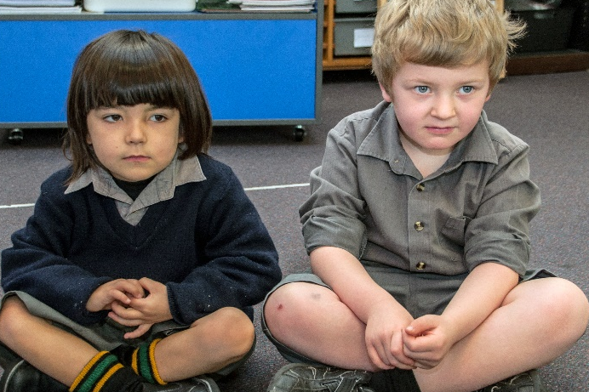
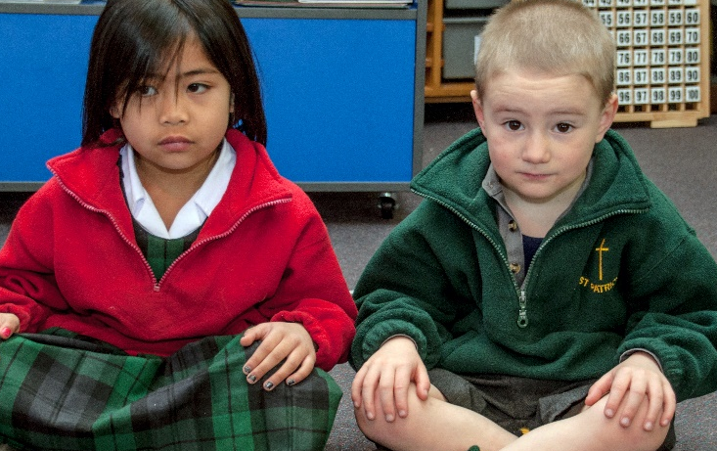
Time for Reflection
R-2
S-11
Click the audio button to stop reflective music
Click the audio button to play reflective music
Notes:
Slide 11 Time for Reflection
The MP3 is played to help create a reflective atmosphere and bring the children to stillness and silence as the teacher invites them to bring into their mind a time when Jesus is present in their life and listen to what Jesus asks you to do to carry on his work at home and at school when he speaks to you in your heart.

Slide 13
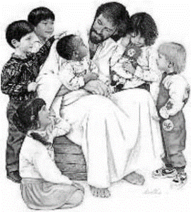
How we recognise that Jesus is with us today
Name_________ Date________
J | P | E | O | P | L | E | T | I | I
E | C | S | P | E | A | K | H | S | N
S | A | E | S | E | R | V | E | H | K
U | R | N | E | E | D | A | Y | A | I
S | E | O | T | H | E | R | S | R | N
R | E | C | O | G | N | I | S | E | D
P | R | E | S | E | N | T | W | W | N
F | O | R | W | H | A | T | H | I | E
O | T | H | E | R | S | W | E | T | S
A | N | D | H | A | V | E | N | H | S
We recognise Jesus is present when people care for others, speak with kindness, share what they have and serve others in need.
R-2
S-08
Worksheet
Click the up arrow to return to the lesson

