Slide 1
God’s People are Easter People
R-3
S-01
Notes:
Slide 1 God’s People are Easter People Use this slide as a focussing strategy to introduce the resource topic. Read the title together and invite children to share something they know about how the friends of Jesus recognised him after he had risen.

Slide 2
Learning Intentions
The children will:
1)
identify ways the friends of Jesus recognised him after he had risen
2)
retell the story about breakfast by the sea
3)
recognise reasons why the followers of Jesus today can be called Easter people.
R-3
S-02
Click the borders to reveal text
Notes:
Slide 2 Learning Intentions Read through the Learning Intentions with the class and identify some ideas/questions that might be explored in the resource. Continue to give attention to the Easter Prayer focus and remember to add ‘Alleluia, Alleluia’ to prayer during the 50 days of the Easter season. Give children time to spend in the Easter space with the poems, books and bibles with the Easter story with a simple text that children can read to each other. Ask teachers from other classes to let your class visit to share their learning together. If possible take the children to the church to see the Paschal Candle and the bright joyful yellow and white flowers, candles and altar cloths. Children can pick up a lot about the feast and season of Easter from exploring their local church. Make children aware that this is the greatest feast in the Liturgical Year and that this event and our belief in it belief is what our faith is based on. This is one of children’s early experiences to learn about the meaning of Easter. You are their spiritual guide and faith witness for your children so this is a good week to let them see how important celebrating Easter is for you and them together.

Slide 3
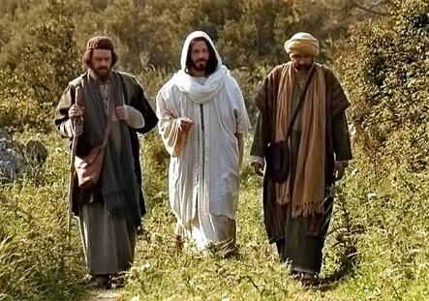
Remembering the Road to Emmaus story and how the disciples recognised Jesus
Who was walking along the road?
Where were they going?
What were they talking about?
Where did they stop and what did they do?
What happened while they were eating together?
What happened next?
R-3
S-03
Click the video button to play ‘The Road to Emmaus’
Notes:
Slide 3 Remembering the Road to Emmaus story and how the disciples recognised Jesus
Adapt Teaching and Learning Experience 1.
Watch the clip
https://www.youtube.com/watch?v=K3L9eXMeV1A
The Road to Emmaus (2:21 minutes)
Suggested responses:
Who was walking along the road – two unnamed disciples of Jesus and a man who was a stranger who joined them.
Where were they going - to the village of Emmaus which was 7 miles from Jerusalem.
What were they talking about - the events of the last week.
Where did they stop and what did they do – outside the village of Emmaus and they asked the stranger to join them for dinner and he agreed.
What happened while they were eating together – the stranger broke blessed and the bread and the disciples realised the man was not a stranger but Jesus and he vanished from their sight.
What happened next – the disciples hurried back to Jerusalem and told the others what happened and as they talked Jesus appeared among them.
Remind children this is a very important story to help them realise Jesus is present with us today in the people who help us, care for us and comfort us when we are anxious or sad. You may not recognise people who are friends of Jesus by the way they look but by what they do and say.
Adapt Teaching and Learning Experience 1.

Slide 4
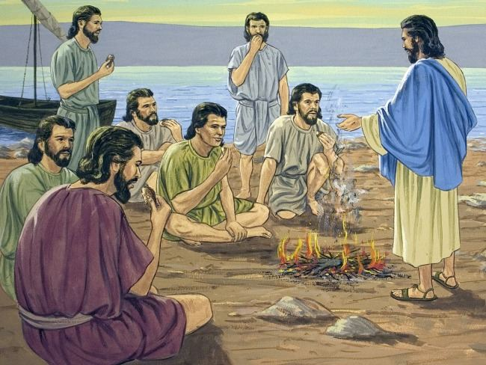
Breakfast by the Sea – another after Easter story
Listen to the story Breakfast by the Sea from the Bible on the clip.
Written by John
Chapter 21 Verses 1-12
What happened in this story that also happened in the Road to Emmaus story? What did Jesus do that helped the disciples to recognise him?
How did the disciples know Jesus was the same person they had known when he lived on earth with them even though he looked different?
How did the disciples feel when they realised it was Jesus who was with them? What did they want to do next?
R-3
S-04
Click the pins on the left to reveal post-it notes. Click the video button to play ‘John Chapter 21’
Notes:
Slide 4 Breakfast by the Sea – another after Easter story
Read John 21:1-12. Use the questions on the PINs to help process the story with the children.
Then watch the clip https://www.youtube.com/watch?v=PftRF2xVDD4
6:51 minutes
NOTE WELL - Stop the clip at 3:02 – the end of this story
Invite children to make a comment or ask a question about the clip.
Adapt Teaching and Learning Experience 3

Slide 5
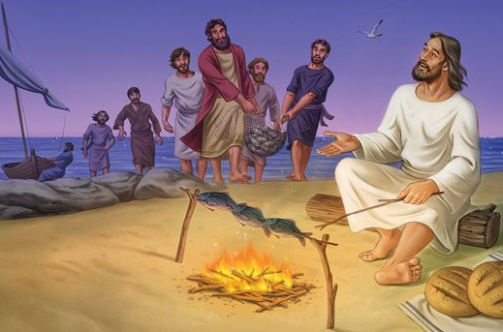
Slowly the disciples believed that …
Jesus truly had risen from the dead.
Jesus was alive even though he looked different.
They knew it was him because he did the things he did before he died.
They remembered he had told them he would die and come back to life and he had kept his promise.
They began to understand some of the things he had spoken about when he was teaching them before he died and rose.
R-3
S-05
Click a circular image to reveal a line of text
Notes:
Slide 5 Slowly the disciples believed that … Read the revealed text and talk about each one and what it means. Ask children to think about a time they have slowly realised something and how good it felt. Share your experience and how just being given a bit more time to work it out was so good and helpful for you – and the disciples if Jesus!

Slide 6
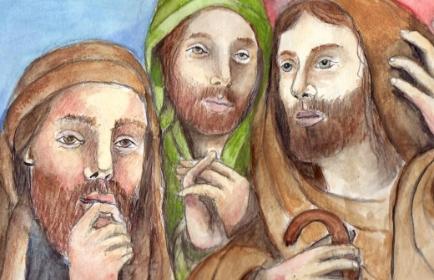
Now the disciples understood in a new way all Jesus had taught them
Look at the disciples’ faces What do you think they are thinking?
R-3
S-06
Click worksheet button to go to worksheet
Notes:
Slide 6 Now the disciples understood in a new way all Jesus had taught them Make copies for each child to write in the thinking balloons and when completed, share what they wrote add to their RE Learning Journals. Ask children to name the disciples.

Slide 7
Jesus taught his disciples important things about God and his Kingdom
Jesus came to earth to teach people about God’s kingdom and how people can help to build it here on earth.
God’s kingdom is already in heaven so people who follow Jesus help to build it here on earth – not with nails and wood but with love and kindness – just like Jesus did.
God’s kingdom will come at the end of time and there will be no more pain or suffering, no more mean words or actions just people who love God and each other.
God’s kingdom will last forever and all people who follow Jesus will be in it when they die. Jesus promised this when he lived on earth and we know he keeps his promises.
Now it is our job to build God’s kingdom in our homes and our school by doing what Jesus did – caring for people, sharing what we have, helping people in need. This is the way we can help to build God’s kingdom on earth as it is in heaven.
R-3
S-07
Click the down-button to move the blind down.
Notes:
Slide 7 Jesus taught his disciples important things about God and his Kingdom
Use the arrow to show the blind reveals and talk about each one. Give each child time to name one way they know that will help to build God’s kingdom in the classroom and in their home. Say the Our Father together and note the part about the kingdom on earth as it is in heaven. This week take time at the end of each day to reflect with the children how you have all done something to build God’s Kingdom of love, peace and joy in their classroom and their school.

Slide 8
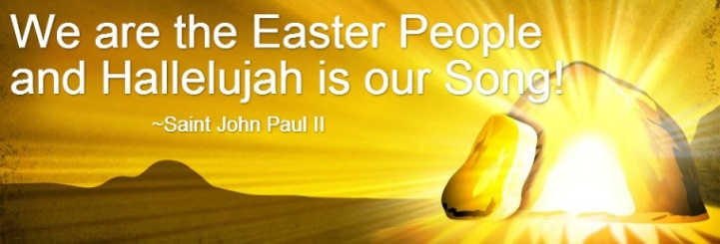
We follow the Risen Jesus – that is why we are the EASTER PEOPLE
P | S | U | N | D | A | Y | I | A | F | A
E | F | I | L | L | E | D | N | D | O | R
O | W | E | T | W | I | T | H | I | R | E
P | I | A | H | O | P | E | W | E | E | B
L | L | R | E | A | S | T | E | R | V | E
E | L | E | J | E | S | U | S | O | E | L
T | H | A | T | W | I | T | H | S | R | I
H | B | H | E | A | V | E | N | E | P | E
A | E | A | S | T | E | R | A | N | D | V
T | J | E | S | U | S | W | H | E | N | E
B | E | C | A | U | S | E | O | N | W | E
We are the Easter people because we believe that Jesus rose on Easter Sunday and we are filled with hope that when we die we will be with Jesus in heaven forever.
R-3
S-08
Click the words in the sentence to reveal its position in the Word Find. Click the worksheet button to go to worksheet
Notes:
Slide 8 We follow the Risen Jesus – that is why we are the EASTER PEOPLE Read the sentence together then find each word in the sentence on the matrix and highlight it in the sentence and in the Word Find worksheet. Talk about what the sentence means. Print each child a copy of the worksheet to complete and add to their RE Learning Journal.

Slide 9
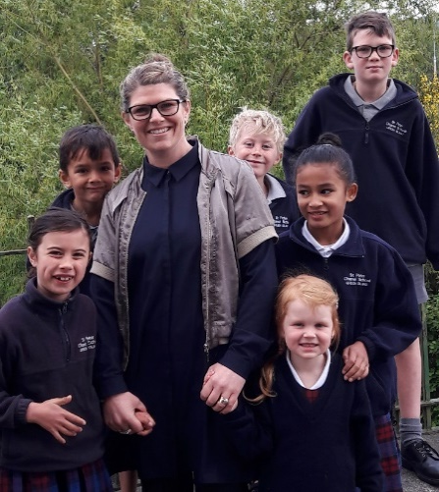
How can we show that we are Easter People?
We show we are Easter people when we …
act like Jesus towards people we meet.
We show we are Easter people when we …
recognise Jesus in people who act like he did.
We show we are Easter people when we …
notice people who need help and offer to help them willingly.
We show we are Easter people when we …
are joyful and sing ALLELUIA songs to show we are happy.
Click each white image to reveal a line of text.
R-3
S-09
Click the audio button to stop ‘We are Easter People’
Click the audio button to play ‘We are Easter People’
Notes:
Slide 9 How can we show that we are Easter People? Children read text and share an example of a time they have shown they are one of the Easter People.
Children make frozen statues of themselves being Easter People. Teacher photographs them and makes a power point to share with families. Add text about the slides so families can share it with their children. Title it - How we show we are EASTER PEOPLE. Make ALLELUIA and JESUS IS RISEN bunting to decorate the classroom. Adapt Teaching and Learning Experiences 5& 6. Sing using the MP3 ‘We are the Easter People.’

Slide 10
Check Up
1)
Name 2 ways Jesus’ disciples recognised Jesus after he had risen. (Slides 3,4,5)
2)
Retell the story of Breakfast by the Sea to a partner. (Slides 4&5)
3)
Can you name one important thing Jesus taught his disciples about
God’s Kingdom? (Slide 7)
4)
What do Easter people believe about Jesus? (Slide 8)
5)
How can we show that we are Easter People? (Slide 9)
6)
Which activity do you think helped you to learn best in this resource?
7)
Questions I would like to ask about the topics in this resource are …
R-3
S-10
Click the borders to reveal text
Notes:
Slide 10 Check Up This formative assessment strategy will help teachers to identify how well children have achieved the Learning Intentions of the resource. Teachers can choose how they use the slide in their range of assessment options. A worksheet of this slide is available for children in Years 5-8 to complete. The last two items are feed forward for the teacher. Recording the children’s responses to these items is recommended as it will enable teachers to adjust their learning strategies for future resources and target the areas that need further attention.

Slide 11
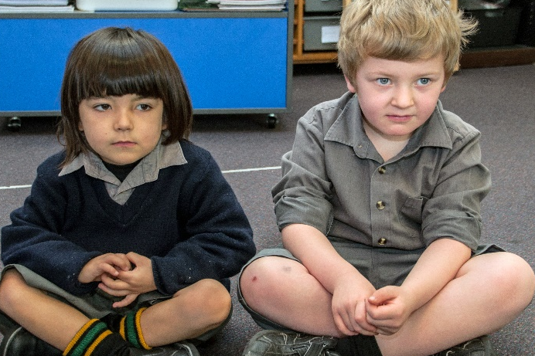
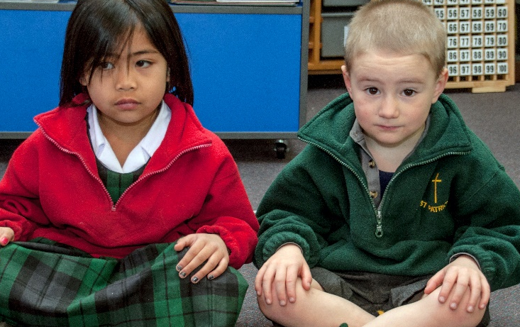
Time for Reflection
R-3
S-11
Click the audio button to stop ‘Reflective Music’
Click the audio button to play ‘Reflective Music’
Notes:
Slide 11 Time for Reflection
The MP3 is played to help create a reflective atmosphere and bring the children to stillness and silence as the teacher invites them to bring in their mind the ways they can show they are Easter People who celebrate Easter because Jesus is risen from the dead.

Slide 12
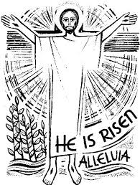
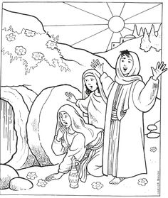
Sharing our Learning about LENT with family whānau, other classes and parish
Talk about, skype or telephone your family to tell them what you have learned about what Easter means and how, when Jesus rose from the dead, he brought new life back into the world. We have Easter eggs because they are a sign of new life.
Ask your teacher to take photographs to share of children in your class showing kindness like Jesus did.
Plan what Easter celebration your family whānau is going to attend in the church where you will be for Easter.
Read the famous story of the Road to Emmaus (Luke 24:13-33) with someone at home and talk about when the disciples recognised Jesus.
Sing Easter songs at home to share the joy of the Easter season.
Share your worksheets R1, Slide 5 and R3 Slides 6&8 with your family whānau and plan some ways you could celebrate the real joy of Easter this year together.
Make a poster or power point to share that what shows how children of your age with their family whānau celebrate the joy of Easter as the followers of Jesus today. (Slide 9, Check up item 4)
Share the ‘How we show we are EASTER PEOPLE’ power point with families. (R3 Slide 9)
Make up your own way of showing and sharing what you have learned and decide who you would like to share it with.
R-3
S-12
Click the worksheet button to go to the worksheet
Notes:
Slide 12 Sharing our Learning about EASTER with family whānau, other classes and parish
This slide provides some choices for children to show and share what they have learned. Examples could be photographed as evidence of children’s learning.
You may like to put a copy of the Sharing our Learning page in children’s RE Learning Journals. You could talk through the choices using the slide and let children make their choice from their own copy.
Children could work on their choice at school and/or at home and you may like to set a day for sharing. Please let parents and whānau know what you expect them to do with this.
The slide is focussed on the Year 2 EASTER Achievement Objective which is covered in Resource 1-3 Year 2 EASTER
AOs 1-2 Children will be able to:
recognise that because Jesus rose from the dead Easter Te Aranga is a season of joy.
relate aspects of the Easter event to their own lives.

Slide 13
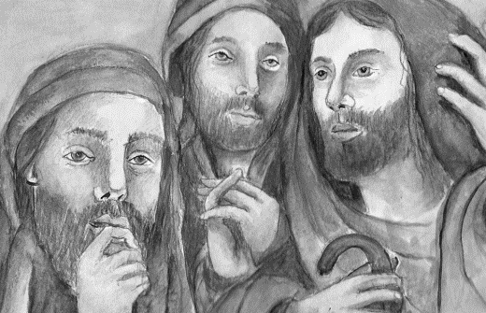
Now the disciples understood in a new way all Jesus had taught them
Name________ Date_______
Look at the disciples’ faces What do you think they are thinking?
R-3
S-06
Worksheet
Click the up arrow to return to the lesson
Notes:
Make copies for each child to write in and when completed add to their RE Learning Journals.

Slide 14
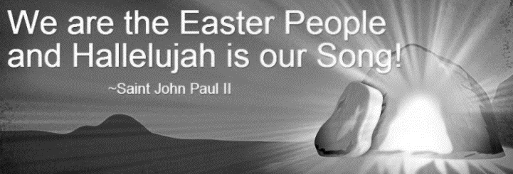
We follow the Risen Jesus – that is why we are the EASTER PEOPLE
P | S | U | N | D | A | Y | I | A | F | A
E | F | I | L | L | E | D | N | D | O | R
O | W | E | T | W | I | T | H | I | R | E
P | I | A | H | O | P | E | W | E | E | B
L | L | R | E | A | S | T | E | R | V | E
E | L | E | J | E | S | U | S | O | E | L
T | H | A | T | W | I | T | H | S | R | I
H | B | H | E | A | V | E | N | E | P | E
A | E | A | S | T | E | R | A | N | D | V
T | J | E | S | U | S | W | H | E | N | E
B | E | C | A | U | S | E | O | N | W | E
Name_________ Date________
We are the Easter people because we believe that Jesus rose on Easter Sunday and we are filled with hope that when we die we will be with Jesus in heaven forever.
R-3
S-08
Worksheet
Click the up arrow to return to the lesson
Notes:
Make copies for each child to write in and when completed add to their RE Learning Journals.

Slide 15
Sharing our Learning about LENT with family whānau, other classes and parish
Talk about, skype or telephone your family to tell them what you have learned about what Easter means and how, when Jesus rose from the dead, he brought new life back into the world. We have Easter eggs because they are a sign of new life.
Ask your teacher to take photographs to share of children in your class showing kindness like Jesus did.
Plan what Easter celebration your family whānau is going to attend in the church where you will be for Easter.
Read the famous story of the Road to Emmaus (Luke 24:13-33) with someone at home and talk about when the disciples recognised Jesus.
Sing Easter songs at home to share the joy of the Easter season.
Share your worksheets R1, Slide 5 and R3 Slides 6&8 with your family whānau and plan some ways you could celebrate the real joy of Easter this year together.
Make a poster or power point to share that shows how children of your age with their family whānau celebrate the joy of Easter as the followers of Jesus today. (Slide 9, Check up item 4)
Share the ‘How we show we are EASTER PEOPLE’ power point with families. (R3 Slide 9)
Make up your own way of showing and sharing what you have learned and decide who you would like to share it with.
R-3
S-12
Worksheet
Click the up arrow to return to the lesson

