Slide 1
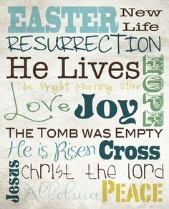
What does the Resurrection mean?
R-1
S-01
Notes:
Slide 1 What does the Resurrection mean? Use this slide as a focussing strategy to introduce the resource topic. Read the title together and invite children to share something they know about what the Resurrection means.

Slide 2
Learning Intentions
The children will…
1)
explain the meaning of the word Resurrection in relation to Jesus
2)
recognise that all people can now have everlasting life because of the Resurrection.
R-1
S-02
Click the boxes to reveal text.
Notes:
Slide 2 Learning Outcomes
Create a place in the room as an Easter area, maybe a (blanket) cave with a big (pillow) stone and a white towel. Gather for children to explore Easter through dramatisation, stories, images, books, songs, you tube clips, art and craft materials and paper etc. Have some simple props and costumes children can use to create their own Easter story drama. Have a selection of articles suitable for an Easter prayer focus and let them set up a new one each day. Remember to add “Alleluia, Alleluia” to prayer during the 50 days of the Easter season. Have poems, books and bibles with the Easter story with a simple text that children can read to each other. Ask teachers from other classes to let your class visit to share their learning together. If possible take the children to the church to see the Paschal Candle and the bright joyful yellow and white flowers, candles and altar cloths. Children can pick up a lot about the feast and season of Easter from exploring their local church. Make children aware that this is the greatest feast in the Liturgical Year and it is the event and belief that our faith is based on. This is one of children’s early experiences to learn about the meaning of Easter. You are their spiritual guide and faith witness for your children so this is a good week to let them see how important celebrating Easter is for you and them together.

Slide 3
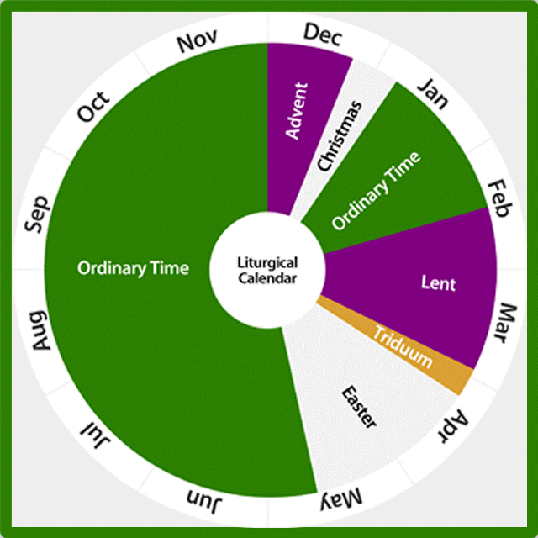
What do you know about the Liturgical Year?
Highlight Yes or No
1) | The Liturgical Calendar marks the feast and seasons in the Church’s year | YES | NO
2) | Ordinary Time is the longest season in the Liturgical Year | YES | NO
3) | Easter is a feast and a season | YES | NO
4) | Advent is the last season of the Liturgical Year | YES | NO
5) | Christmas comes after Lent | YES | NO
6) | Easter is the most important feast and season in the whole year | YES | NO
7) | Easter lasts for 20 days | YES | NO
8) | White, yellow or gold are the colours for the celebrating seasons | YES | NO
9) | Most of Ordinary Time is in spring and summer | YES | NO
10) | The Liturgical Calendar retells and celebrates the life of Jesus each year | YES | NO
R-1
S-03
Click YES or NO for the correct answer.
Click worksheet icon for worksheet.
Notes:
Slide 3 What do you know about the Liturgical Year?
Make a copy of the worksheet for each child to complete and add to their RE Learning Journals. Use the quiz to help children recap what they know about the Liturgical Year.
Check answers. Share worksheet, refer to Sharing our Learning, R3 Slide 12.
Children record their score – quiz could be repeated later.
Answers 1) YES, 2) YES, 3) YES, 4) NO, 5) NO, 6) YES, 7) NO, 8) YES, 9) NO, 10) YES
NO RESPONSES 4) first season, 5) Easter comes after Lent, 7) for 50 days, 9) in winter and autumn. Children record their score – quiz could be repeated later.
Adapt Teaching and Learning Experience 1.

Slide 4
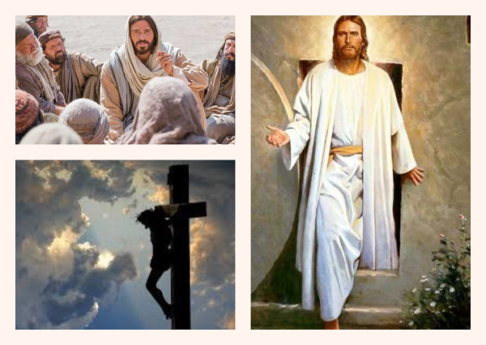
What I know already about Jesus’ life, death and Resurrection
R-1
S-04
Click worksheet icon for worksheet.
Notes:
Slide 4 What I know already about Jesus’ life, death and Resurrection Make a copy of the Mind Map worksheet for each child and give them time to write something they know in some of the spaces. They can leave some for writing in later, as they work through the resource. Complete the mind map at the end of this work. To get started look closely at the images on the slide to get ideas of what happened in Jesus’ life, his death and his Resurrection. Share it with someone at home. Refer to Sharing our Learning, R3 Slide 12.
Note which aspects of the topic has least understanding and decide how you can address this – using older children/RE buddies, reading/telling bible stories, you tube clips, theme work.

Slide 5
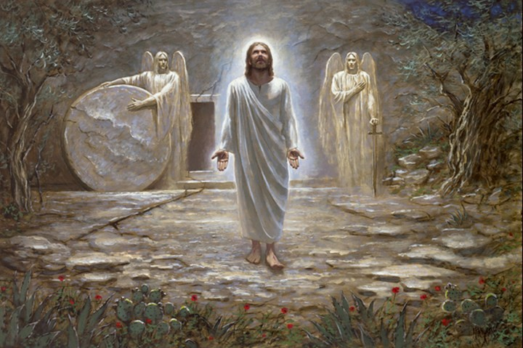
The Resurrection of Jesus
Read the story of the Resurrection Matthew 28:1-10
R-1
S-05
Click video icon for the clip “Alleluia He is Risen”.
Notes:
Slide 5 The Resurrection of Jesus
Look at the picture and give children time to say what they can see and what Jesus is doing. Who else is present?
Explain that the story of Jesus’ Resurrection is in the Bible – show children where it is and read the Resurrection story Matthew 28:1-10. Look closely at the slide image and let children share what they see. Allow time for children’s questions and comments.
Adapt Teaching and Learning Experiences 2 &3.
Sing a response to the story using the clip
https://www.youtube.com/watch?v=Q4bJ8D6lvrk&frags=wn
Alleluia He is Risen Michael Mangan (1:48 minutes)

Slide 6
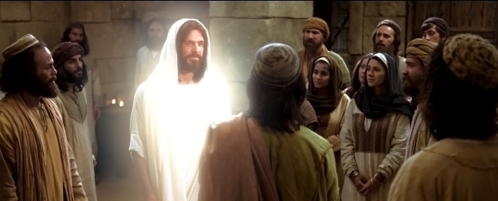
Jesus appeared to his disciples after his Resurrection
The Resurrection was the last event that completed what Jesus had to do before he returned to God in heaven.
Jesus had done all God had asked him to do – he had taught the people about God and his kingdom, he had showed them how to live by the example of his own life.
He had died because of the way he had lived his life. The greatest thing of all he did was he rose and defeated death.
Because of Jesus’ Resurrection, his followers will rise also because this is what he promised would happen. He died to save us from eternal death and gave us eternal life.
Jesus has a new life in heaven with God. We will have this too because we are his followers. We must try to live as he did – helping, loving and caring for people.
R-1
S-06
Click the green arrow to lower blind and the red arrow to raise it.
Click video icon for the clip “Resurrected Jesus Appears to His Disciples”.
Notes:
Slide 6 Jesus appeared to his disciples after his Resurrection Use the text on the blind reveal to recap with children what Jesus had been doing before he died on the cross and rose again. They may be able to add ideas about this. Read each piece of the revealed text and talk about it and ask questions - Did Jesus miss his friends? Look at the picture on the slide and see what is happening? Do you think this is before or after Jesus has risen? How do you know?
Watch the clip
https://www.youtube.com/watch?v=8pzYDDNKJbE
Resurrected Jesus Appears to His Disciples (1:55 Minutes)
Take time for children to respond to what they saw in the clip and make comments or ask questions. Keep a record of their questions to ensure they have been answered and as an indicator of the level of understanding and interest of the children’s thinking – surface or deeper.

Slide 7
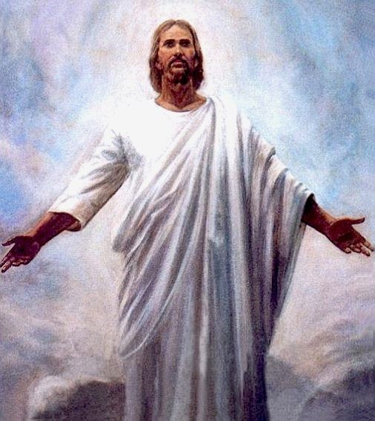
Jesus’ Resurrection is very important because…
Resurrection means being stronger than
Jesus is the only person in the whole world
The best thing is that Jesus promised his
When Jesus rose he had a new body and a new life this is why some of his followers did not recognise him.
Jesus told his disciples he would die and rise again
death and rising up talking and breathing like you are alive.
ever to come back to life after he had died.
followers that they would also rise again after they die.
this is why some of his followers did not
recognise him.
but they didn’t really understand what he meant.
followers that they would also rise again after they die.
but they didn’t really understand what he meant.
death and rising up talking and breathing like you are alive.
this is why some of his followers did not recognise him.
ever to come back to life after he had died.
R-1
S-07
Click options a-e to correctly complete the sentences.
Notes:
Slide 7 Jesus’ Resurrection is very important because… Make enough copies of the Worksheet ‘What does the Resurrection mean?’ See copy after slides & p.32 Teacher’s book. ANSWERS 1) C, 2) E, 3) A, 4) D, 5) B
Encourage children to find the statement that completes the sentence correctly then check them with the floater tool. Let each sentence generate class discussion, questions and comments. Work through the worksheet with the class and use it to consolidate concepts covered in the resource. When it is completed children add it to their RE Learning Journal.

Slide 8
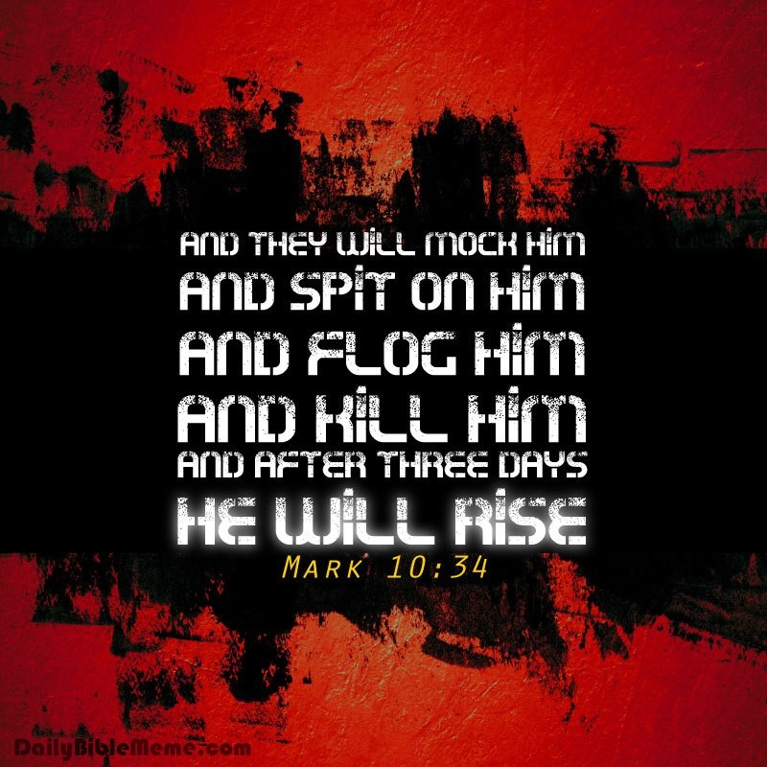
Jesus tried to prepare his followers for what would happen to him
This message had been given by other people in the Old Testament and it was only when it really happened that they remembered it. Although Jesus’ death seemed at first to be the end, when he rose again they remembered his words and realised he had kept his promise.
When Jesus was teaching the people about God and his kingdom he also told them that he wanted them to continue his teaching even when he wasn’t with them anymore.
He told them that he would be mocked, spat on, flogged and killed and after 3 days he would rise again. The disciples heard him say this but they didn’t really understand what he meant.
Jesus’ death was not the end of life because he rose after three days to begin a new life with God which will last forever. He promised that his faithful followers will do the same.
R-1
S-08
Click the pins on the right to reveal post-it notes.
Notes:
Slide 8 Jesus tried to prepare his followers for what would happen to him Read each PIN with the children and talk about how Jesus tried to prepare his followers for what was going to happen to him. He thought this would help them to cope better with what was to come. Do you cope better when you have been prepared for something that is going to happen? Do you know why this is? Share some examples. Make a poster or a power point to show how Jesus tried to prepare his disciples for his death and Resurrection. Share your poster with your family whānau. Refer to Sharing our Learning, R3 Slide 12.

Slide 9
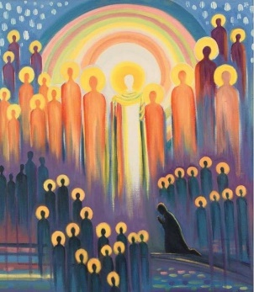
We will share in the everlasting life of the risen Jesus in heaven when we die
Why did Jesus look different after his Resurrection?
What does everlasting life mean?
Everlasting life means life forever more, death has been destroyed because Jesus has risen.
Jesus looked different because he was in his new body as he had begun to live his new life. He began his new life when he returned to God his Father after his Ascension into heaven. He is waiting there for all his faithful followers to come and join him after their death.
What did Jesus say about himself and the Resurrection?
Jesus said “I am the resurrection, and the life. Whoever believes in me, even though they die, they will live forever” John 11:25.
What happened to Jesus’ first followers after his Resurrection?
Who will benefit from Jesus’ promise of everlasting life?
After his Resurrection Jesus’ followers were filled with the Holy Spirit who came to them at Pentecost. They were not frightened of the Jews and Romans any more. They began preaching the messages Jesus had taught them and spreading the good news.
Everyone who believes in Jesus and lives as he did with the help of the Holy Spirit will share in the new and everlasting life of the risen Jesus. They too will have a new resurrected body.
R-1
S-09
Click the candle icons to reveal text.
Click the audio button to play ‘I am the Bread of Life’
Click the audio button to stop ‘I am the Bread of Life’
Notes:
Slide 9 We will share in the everlasting life of the risen Jesus in heaven when we die Work through the questions and answers on the slides and discuss what they mean. What do you think it will be like to live an everlasting life in heaven with God and the people you love?
Sing using the MP3 ‘I am the Bread of Life’.

Slide 10
Check Up
1)
What does Resurrection mean and why is Jesus’ Resurrection so important? (Slide 7)
2)
How did Jesus prepare his first followers for what was going to happen to him? (Slide 8)
3)
What does everlasting life mean? (Slide 9)
4)
Explain the idea that Jesus death was not the end of his life but the beginning of his new life? (Slide 9)
5)
How do Jesus’ followers benefit from his Resurrection? (Slide 9)
6)
Which activity do you think helped you to learn best in this resource?
7)
Questions I would like to ask about the topics in this resource are …
R-1
S-10
Click the boxes to reveal text.
Notes:
Slide 10 Check Up
This formative assessment strategy will help teachers to identify how well the children have achieved the Learning Intentions of the resource.
Teachers can choose how they use the slide in their range of assessment options.
A worksheet of this slide is available for children in Years 5-8 to complete.
The last two items are feed forward for the teacher.
Recording the children’s responses to these items is recommended as it will enable teachers to adjust their learning strategies for future resources and target the areas that need further attention.

Slide 11
Time For Reflection
R-1
S-11
Click the audio button to stop Reflective Music
Click the audio button to play Reflective Music
Notes:
Slide 11 Time for Reflection
The MP3 is played to help create a reflective atmosphere and bring the children to stillness and silence as the teacher invites them to reflect on why the Resurrection is such an important event for all Christians. Thank Jesus for his promise of everlasting new life for us after we die.

Slide 12
What do you know about the Liturgical Year?
Name_________________________ Date_____________
Highlight Yes or No
1) | The Liturgical Calendar marks the feast and seasons in the Church’s year | YES | NO
2) | Ordinary Time is the longest season in the Liturgical Year | YES | NO
3) | Easter is a feast and a season | YES | NO
4) | Advent is the last season of the Liturgical Year | YES | NO
5) | Christmas comes after Lent | YES | NO
6) | Easter is the most important feast and season in the whole year | YES | NO
7) | Easter lasts for 20 days | YES | NO
8) | White, yellow or gold are the colours for the celebrating seasons | YES | NO
9) | Most of Ordinary Time is in spring and summer | YES | NO
10) | The Liturgical Calendar retells and celebrates the life of Jesus each year | YES | NO
How well do you know the Liturgical Year?
My score was __/10
R-1
S-3
Worksheet
Click the up arrow to return to the presentation.
Notes:
Answers 1) YES, 2) YES, 3) YES, 4) NO, 5) NO, 6) YES, 7) NO, 8) YES, 9) NO, 10) YES
NO 4) first season, 5) Easter, 7) 50 days, 9) winter and autumn
Make a copy of the worksheet for each child to complete and add to their RE Learning Journals. Check answers (Share worksheet Sharing our Learning, R3 Slide 12 )

Slide 13
Name_________________________ Date_____________
Jesus’ life, death and Resurrection
R-1
S-4
Worksheet
Click the up arrow to return to the presentation.

