Slide 1
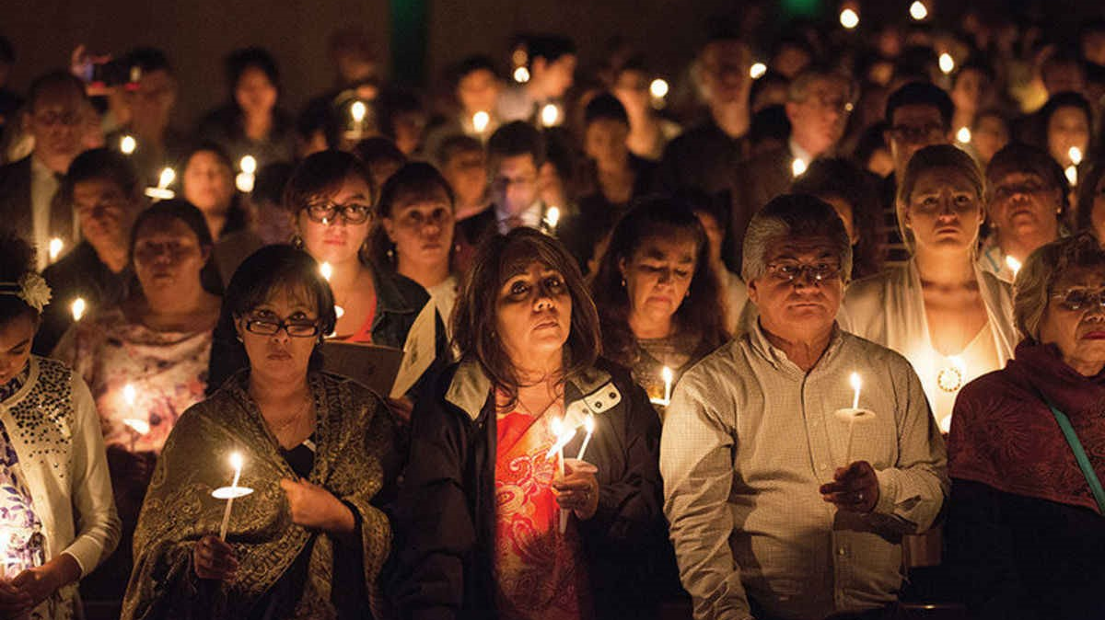
Easter helps Christians to have hope
R-2
S-01
Notes:
Slide 1 Easter helps Christians to have hope
Use this slide as a focussing strategy to introduce the resource topic. Read the title together and invite children to share something they know about …

Slide 2
Learning Intentions
The children will…
1)
recognise that because Jesus rose all people will rise with him
2)
explain how Easter helps Christians to have hope.
R-2
S-02
Click the boxes to reveal text.
Notes:
Slide 2 Learning Outcomes
Continue to give attention to the Easter Prayer focus and remember to add ‘Alleluia, Alleluia’ to prayer during the 50 days of the Easter season. Give children time to spend in the Easter space with the poems, books and bibles with the Easter story with a simple text that children can read to each other. Ask teachers from other classes to let your class visit to share their learning together. If possible take the children to the church to see the Paschal Candle and the bright joyful yellow and white flowers, candles and altar cloths. Children can pick up a lot about the feast and season of Easter from exploring their local church. Make children aware that this is the greatest feast in the Liturgical Year and it the event and belief that our faith is based on. This is one of children’s early experiences to learn about the meaning of Easter and it is foundation of their understanding of this great truth of our faith. You are their spiritual guide and faith witness for your children so this is a good week to let them see how important celebrating Easter is for you and them together. Draw children’s attention to the images – a lot of learning can come from discussion around them.

Slide 3
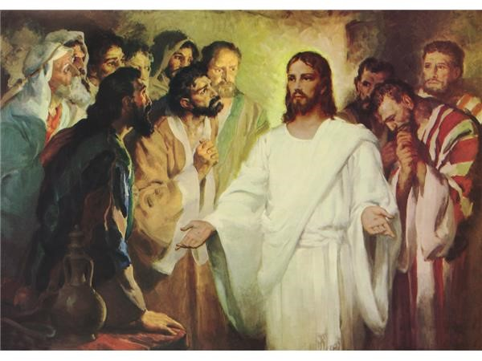
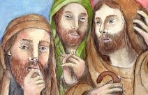
How the disciples of Jesus were feeling after the Resurrection
They felt very lost without him and thought they would never see him again. They were very frightened that the Romans who killed him would come looking for them so they hid in the upper room.
When Jesus rose and came back to them, even though he was different, they began to make sense of what he had taught them. When he did the things he had always done with them, like breaking bread they knew he was with them and this filled them with hope.
Look at the faces of the disciples in the image – what do they tell you about how they were feeling? Can you say why they feel like this?
When Jesus broke bread and was truly present with the first disciples that was the first Eucharist. Now when we are at Eucharist the priest breaks bread and the risen Jesus is truly present with us, giving us hope.
The disciples were ordinary fishermen and they did not understand everything Jesus taught them when he was with them before he died and rose.
R-2
S-03
Click the icons to reveal text.
Notes:
Slide 3 How the disciples of Jesus were feeling after the Resurrection
Read each revealed text and let each one initiate discussion, questions and comments.

Slide 4
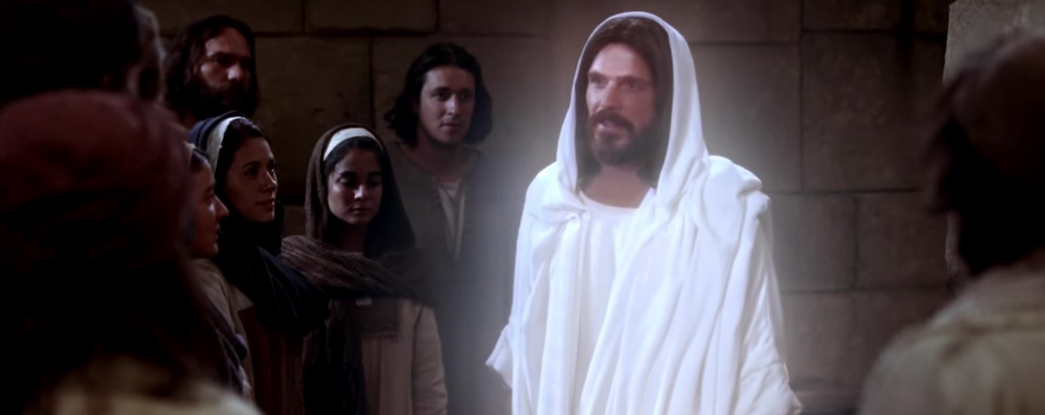
Each time Jesus appeared to the Disciples they understood more fully what he had taught them
When Jesus first appeared to the disciples after his Resurrection they were unsure it was him because …
What proof did Jesus show them that he was the Jesus they had known and loved?
Gradually they came to understand that Jesus was fulfilling some of the predications about him that were in the Bible especially the promise that …
They began to understand that because of Jesus’ Resurrection, all people who follow his ways in their lives will …
Slowly they realised that Jesus was going back to his Father in heaven and they would have to carry …
R-2
S-04
Click the green arrow to lower the blind and the red arrow to raise it.
Notes:
Slide 4 Each time Jesus appeared to the Disciples they understood more fully what he had taught them
Make an art work of Jesus in his earthly body and beside this draw Jesus in his new heavenly body and explain the differences. (Sharing our Learning Slide 12)
Suggested responses
He looked different and they weren’t sure he had truly risen.
Jesus showed them the marks of the nails in his hands and his feet and the mark from the spear in his side. They recognised his voice and he liked to eat with them and teach them.
He would die and after 3 days he would rise again.
We will die and rise again as he did, and have a new life and a heavenly body as he did to live in in heaven forever with God as he does.
The disciples realised that everything Jesus had taught them they were now to pass on to all his followers. They were now the leaders of the Church and they would have to continue to do what he did to build God’s Kingdom here on earth.

Slide 5
What does Christian Hope mean?
Christian hope is a confidence that something will happen because God has promised it will happen.
Christian hope is about the present, that is today and the future, that is what lies ahead of us
Christian hope means that no matter how bad things get, God will never forget his people and will always be with them
People can have little hopes only because Jesus gave them hope of a life with God that is everlasting
Christians share the same hope today that the first followers of Jesus who saw him die and rise had because we trust what Jesus promised.
because God has promised it will happen.
the future, that is what lies ahead of us.
never forget his people and will
always be with them.
Jesus gave them hope of a life with God that is everlasting.
who saw him die and rise had
because we trust what Jesus promised.
who saw him die and rise had because we trust what Jesus promised.
never forget his people and will always be with them.
because God has promised it will happen.
the future, that is what lies ahead of us.
Jesus gave them hope of a life with God that is everlasting.
R-2
S-05
Click the options a-e to correctly complete the sentences.
Notes:
Slide 5 What does Christian Hope mean?
ANSWERS 1) C, 2) D, 3) B, 4) E, 5) A
Children read through the sentences and suggest the correct statements to complete them. Check them out with the floaters.
What helps you to feel hopeful?
Adapt Teaching and Learning Experiences 4 & 5
Make a fridge magnet to use at home with a message such as: HOPE comes from the Resurrection, Our God gives us hope, Kia tūmanako – Let us have hope. (Sharing our Learning, Slide 12, R3)

Slide 6
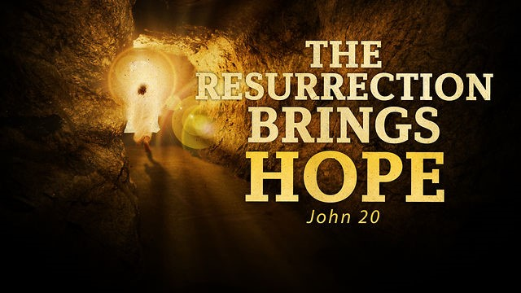
Why does the Resurrection bring Christians great hope?
Because we believe in the Resurrection our hope can be seen in our attitudes and actions and the ways we encourage others to be hopeful especially in hard times.
The Resurrection proved that Jesus, his work and his teachings are true and he was the promised Messiah.
The prayers at Eucharist remind us of the Resurrection hope and this helps to keep our hope alive. Listen for the word HOPE in the prayers at Mass next time you are there.
Our Resurrection hope makes us sure that God will raise us up on the last day through the same Holy Spirit who raised Jesus when Jesus will come again.
Through the Resurrection we are freed forever from fear of dying because Jesus promised our sins would be forgiven and we would be with him in heaven forever and this is what we hope for.
R-2
S-06
Click the pins on the right to reveal post-it notes.
Click the audio button to stop ‘New Hope’
Click the audio button to play ‘New Hope’
Notes:
Slide 6 Why does the Resurrection bring Christians great hope?
Sing using the MP3 ‘New Hope’
Read the post it notes and let them generate questions and comments from the children.
Make a HOPE Acrostic and display them in the school or church foyer under a heading – EASTER is a SEASON of HOPE. Children share these with family whānau.

Slide 7
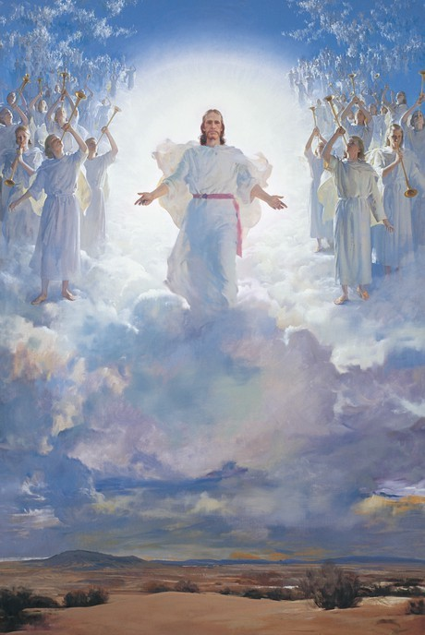
Recapping the outcomes of Jesus’ Resurrection for his followers
In our lives we follow Jesus by our words and actions. Now Jesus’ followers carry on his work with the help of his Holy Spirit who lives in them and who helps them to do what God wants them to do.
Can you name 3 things that God wants you to do each day?
The power of the Holy Spirit that raised Jesus from the dead works, not only to save us, but to help us as we continue to build the Kingdom of God here on earth.
How can children of your age build the Kingdom of God each day?
Forty days after he rose Jesus went back to his Father in his heavenly glory that he gave up when he became human and went to live on earth. Now Jesus is in heaven sitting at the right hand of the Father which is a very special place.
What do you think heavenly glory is like?
When Jesus died his body and soul were separated. His soul went to heaven and his body was laid in the tomb. At his Resurrection, Jesus’ body and soul were re-united. The same thing will happen to us when we die because Jesus promised this would happen.
Can you imagine how wonderful it will be to be in heaven with God in our new bodies that will live forever?
Jesus was sent to earth by God to establish God’s Kingdom of justice, peace and love and by the time he died his work was done but it is not finished.
Whose work is it now to carry on building God’s Kingdom here on earth?
Jesus has his new body and his new life in heaven with God and he talks to God about us and asks God to help us. God helps us by sending his Holy Spirit into people’s hearts.
How has the Holy Spirit helped you recently?
Christians believe that on the last day of the world Jesus will come again and gather people together and take them to share his life in heaven. People who are in their graves will rise up with their new bodies and be taken to heaven to begin their new life with God.
Can you imagine what a happy day that will be?
When Jesus rose from the dead his body and soul were re-united just as it will be when all humans rise in their new body and their soul will be reunited after Jesus has come again in his Second Coming.
Do you know when Jesus is coming again to the earth?
Before his death, Jesus lived in his human body. At his death his body and his spirit separated as it does when all humans die.
Where will our body and soul go when we die?
R-2
S-07
Click the cards to move through (9 total) click the arrow to start over.
Click the audio button to stop ‘All is Well’
Click the audio button to play ‘All is Well’
Notes:
Slide 7 Recapping the outcomes of Jesus’ Resurrection for his followers
Sing using the MP3 – “All is Well”
Some suggested responses.
Where will our body and soul go when we die?
Our body will be buried and our soul will be with God if we have been faithful followers of Jesus.
Do you know when Jesus is coming again to the earth?
No one knows the day Jesus will come again – we call it his Second Coming.
Can you imagine what a happy day that will be?
How has the Holy Spirit helped you recently? – to be kind, to notice people who need help and to help them, to try my hardest, to inspire me to have good ideas.
Whose work is it now to carry on building God’s Kingdom here on earth? It is ours because we are Jesus’ followers today.
Can you imagine how wonderful it will be to be in heaven with God in our new bodies that will live forever? It will be like a wonderful party that goes on forever with all the people we love. The Bible says we can’t imagine what great things God has prepared for those who love God – there might even be a great banquet!
What do you think heavenly glory is like? Loads of Saints, angels and holy people giving praise and thanks to God, endless happiness, joy and fun.
How can children of your age build the Kingdom of God each day? By doing our best to get to know more about God in RE, by doing all we can to help those in need, by using what Jesus did while he was on earth – including people, giving time and talents to help others.
Can you name 3 things that God wants you to do each day? To think of God and pray to God, to take care of God’s creatures and creation, give God thanks and praise for all God has given us, read or listen to God’s word from the bible.

Slide 8
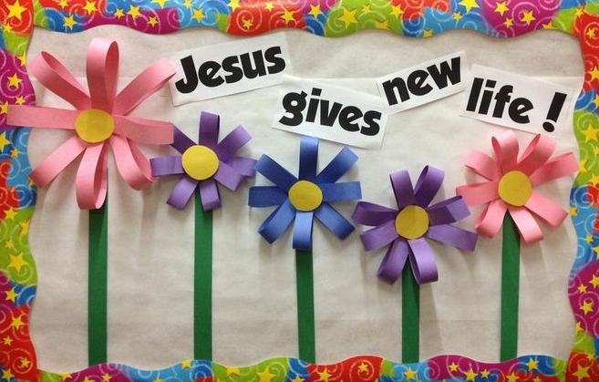
The greatest hope Christians have is to be with God in heaven forever
G | O | D | O | N | H | B | E | S | A | T
Y | R | S | P | E | O | P | L | E | N | H
O | F | E | S | K | P | S | I | E | G | E
P | N | G | A | A | E | H | V | N | E | O
D | L | Z | I | T | H | A | E | N | L | R
L | S | A | N | D | E | R | S | E | S | E
L | I | V | T | H | R | S | H | T | U | H
L | T | R | S | O | U | N | T | H | A | T
I | H | N | A | L | O | U | I | E | R | T
W | E | W | N | Y | B | Y | W | P | U | O
T | O | M | D | R | E | V | E | R | O | F
Our greatest hope is that at the end of our lives we will be taken to heaven to be with God, the Saints, and angels, and holy people forever.
R-2
S-08
Click the words in the sentence to display them on the word-find.
Click the worksheet icon for a worksheet.
Notes:
Slide 8 The greatest hope Christians have is to be with God in heaven forever
Make a copy of the worksheet for each child to complete and share with their family whānau (Sharing our Learning, R2 Slides 8 & 9)
Find each word in the sentence on the matrix and highlight it in the sentence and in the Word Find

Slide 9
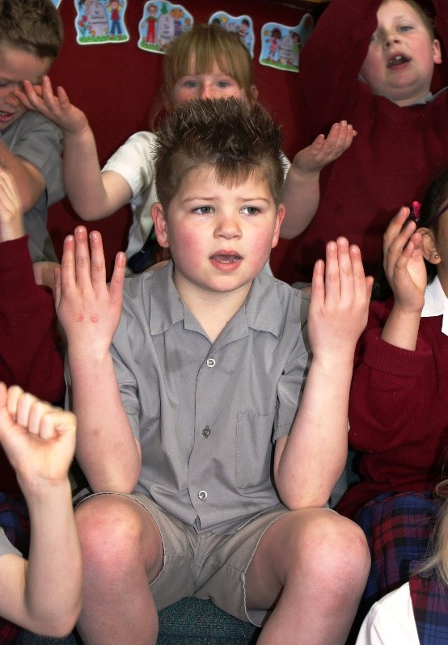
Our songs and prayers are full of hope and praise to God
R-2
S-09
Click the worksheet icon for a worksheet.
Notes:
Slide 9 Our songs and prayers are full of hope and praise to God
Refer to Slide 5 & 6 for ideas for children’s responses

Slide 10
Check Up
1)
3 things I have learned about what Christian hope is … (refer to Slides 5, 6, 8)
2)
Because Jesus rose from the dead we have a new life, a new body and hope for our future – explain what each one means.
3)
The greatest benefit we receive from Jesus’ Resurrection is that we too will … (refer to Slide 7)
4)
Make an art work to illustrate what will happen on the last day of the world. (refer to Slide 7, to be shared in the Sharing our Learning, Slide 12)
5)
Make an art work of Jesus in his earthly body and beside this draw Jesus in his new heavenly body and explain the differences. (Refer to Slide 4)
6)
Can you name something that Jesus passed on to the disciples to do after he had left them and returned to God in heaven. (Refer to Slide 4)
7)
Which activity do you think helped you to learn best in this resource?
8)
Questions I would like to ask about the topics in this resource are …
R-2
S-10
Click the boxes to reveal text.
Notes:
Slide 10 Check Up
This formative assessment strategy will help teachers to identify how well the children have achieved the Learning Intentions of the resource.
Teachers can choose how they use the slide in their range of assessment options.
A worksheet of this slide is available for children in Years 5-8 to complete.
The last two items are feed forward for the teacher.
Recording the children’s responses to these items is recommended as it will enable teachers to adjust their learning strategies for future resources and target the areas that need further attention.

Slide 11
Time For Reflection
R-2
S-11
Click the audio button to stop Reflective Music
Click the audio button to play Reflective Music
Notes:
Slide 11 Time for Reflection
The MP3 is played to help create a reflective atmosphere and bring the children to stillness and silence as the teacher invites them to thank God that they can have hope in their hearts especially when they are having hard times. Tell Jesus they are grateful that he rose from the dead and that they will do their part to help build his Kingdom here on earth.

Slide 12
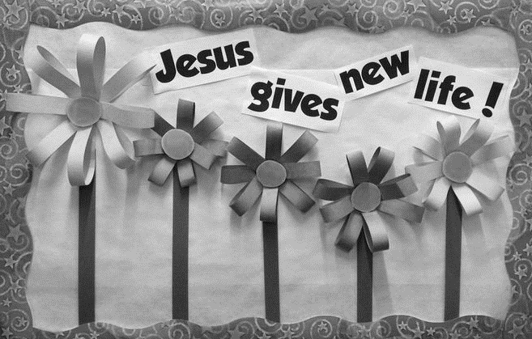
The greatest hope Christians have is to be with God in heaven forever
Name___________________ Date___________
G | O | D | O | N | H | B | E | S | A | T
Y | R | S | P | E | O | P | L | E | N | H
O | F | E | S | K | P | S | I | E | G | E
P | N | G | A | A | E | H | V | N | E | O
D | L | Z | I | T | H | A | E | N | L | R
L | S | A | N | D | E | R | S | E | S | E
L | I | V | T | H | R | S | H | T | U | H
L | T | R | S | O | U | N | T | H | A | T
I | H | N | A | L | O | U | I | E | R | T
W | E | W | N | Y | B | Y | W | P | U | O
T | O | M | D | R | E | V | E | R | O | F
Our greatest hope is that at the end of our lives we will be taken to heaven to be with God the Saints and angels and holy people forever.
Highlight the words in the word-find and in the sentence.
R-2
S-8
Worksheet
Click the up arrow to return to the lesson
Notes:
Make a copy of the worksheet for each children to complete and share with their family whānau (Sharing our Learning, R2 Slides 8 & 9)
Find each word in the sentence on the matrix and highlight it in the sentence and in the Word Find
FOR YEARS 1 & 2 & 3
Use the following text for the Word Find - you will need 120 spaces on the matrix – insert the text vertically, diagonally or horizontally
Our greatest hope is that at the end of their lives we will be taken to heaven to be with God the Saints and angels and holy people forever.

Slide 13
Our songs and prayers are full of hope and praise to God
Name___________________ Date___________
Christian Hope
Looks like
Sounds like
R-2
S-9
Worksheet
Click the up arrow to return to the lesson

