Slide 1
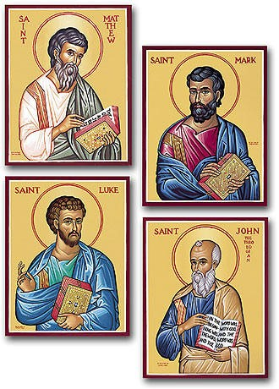
The Easter story by four writers
R-1
S-01
Notes:
Slide 1 The Easter story by four writers
Use this slide as a focussing strategy to introduce the resource topic. Read the title together and invite children to share something they know about the authors of the four gospels. Note the images of Matthew, Mark, Luke and John – they are icons which are usually small paintings from the Eastern Church tradition. Popular icons depict religious people, Jesus and Mary and the Saints. They help people to pray. Look closely at the images of the four writers who are sometimes referred to as the four Evangelists. Notice something about each one and share it.

Slide 2
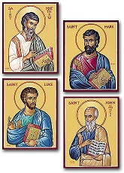
Learning Intentions
The children will…
1)
retell the Easter story
2)
recognise some differences and similarities in the gospel accounts of the Easter story
3)
name the first people to see the risen Jesus.
R-1
S-02
Click the boxes to reveal text.
Notes:
Slide 2 Learning Outcomes
Create an Easter prayer focus with yellow or gold cloths, images of Jesus rising, Easter symbols of candles, chickens, eggs and bulbs in a pot. Draw attention to the change of season and mood of Holy Week. Remember to add ‘Alleluia, Alleluia’ to prayer during the 50 days of the Easter season. Create an Easter space for children to spend time with the poems, books and bibles with the Easter story with a text that children can read to each other. Ask teachers from other classes to let your class visit to share their Easter learning together. If possible, after Easter take the children to the church to see the Paschal Candle and the bright joyful yellow and white flowers, candles and altar cloths. Children can pick up a lot about the feast and season of Easter from exploring their local church. Help children to become aware that this is the greatest feast in the Liturgical Year and it is the event and belief that our faith is based on. Hopefully these resources will increase children’s understanding of the meaning of Easter and how it is foundation of the greatest belief of our faith. You are their spiritual guide and faith witness for your class so this is a good week to let them see how important celebrating Easter is for you and them together. Draw children’s attention to the images on the slides – a lot of learning can come from discussion around them. NB Use the image on the title slide to introduce the children again to the four gospel writers and explain that they were not eye witnesses to the events they wrote about because they knew the stories would be lost as people who knew Jesus died. Imagine being an eyewitness of Jesus’ life!

Slide 3
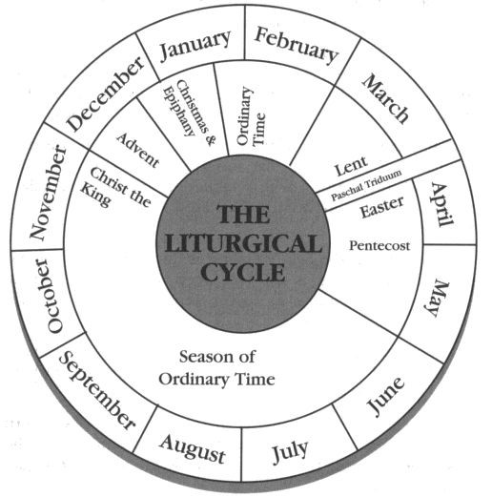
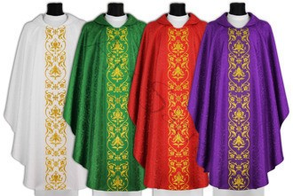
The Liturgical Year
Name the Liturgical colours of the vestments.
Name the colour that is used for each season.
Use the pointer button to point to each season and feast starting with Advent, and name the colour of the feast or season.
Colour the calendar.
Note the season we are in at present _________________
The Liturgical Calendar retells the story of the life of _________.
What is the most important Feast of the Year? __________
When does the Liturgical Year start? __________________
When does the Liturgical Year finish?__________________
What is the longest season of the year?________________
What is your favourite Liturgical feast or season? _________
Click the red button to move the arrow around the calendar.
Click the worksheet icon for a worksheet.
R-1
S-03
Notes:
Slide 3 The Liturgical Year Make a coloured copy of the Liturgical Calendar worksheet for each child to complete. Ask children to explain what a Liturgical Calendar is used for? Whose life are the events focussed on? Use the pointer to look at and name each season of the year up to Easter. Use the pointer to keep children focussed. Follow the items on the screen and give children their worksheets to complete. Use this again during the resource to help children identify the feast and seasons of the Liturgical Year.

Slide 4
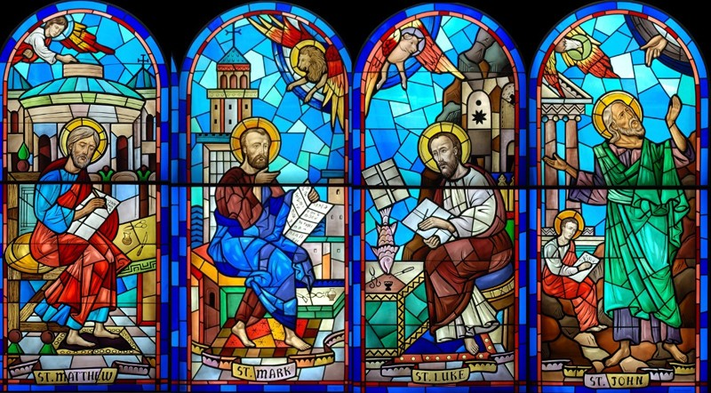
A Profile of the Writers of the 4 Gospels
Matthew’s Profile
Tax collector, wealthy, well educated, could read and write in several languages, including Greek, also knew maths. Spent time with Jesus, heard and likely wrote down some of his sayings. Later wrote about the teachings of Jesus. His gospel stresses that Jesus Christ is the Messiah. Matthew’s gospel written specifically for the Jews. Gospel written in the 80s or 90s of the 1st Century, used Mark’s Gospel as a source.
John’s Profile
John, one of the sons of Zebedee, known as the beloved apostle, best friend of Jesus, gospel probably written last, seems like John had already read the other Gospels before he wrote his own, writes about things the other writers did not include, gospel for members of the Church who already knew things about Jesus, emphasizes Jesus’s divine nature as the Son of God. John is not named the author of this gospel. The Book of Revelation and 3 letters also bear his name.
Mark’s Profile
Full name John Mark, younger than other writers, followed Jesus Christ in his teens, Mother prominent follower, her house in Jerusalem used as a meeting place for other disciples. After the Resurrection, Mark travelled with the Apostle Paul. Accompanied the Apostle Peter to Rome, stayed by him while he was in prison. Mark known as Peter’s interpreter, as a fisherman Peter may not have spoken Greek fluently. Recorded memories of Peter reflect Peter’s interest in spreading the gospel among the Gentiles. Writer of the first Gospel.
Luke’s Profile
A medical doctor, did not know Jesus personally, became a follower after his death, was taught the gospel by Paul, travelled with him, talked with many of the apostles and other eyewitnesses to events in Jesus’ life. Many people Luke knew were still alive and remembered Jesus teaching and performing miracles. In the first few verses of his book, Luke says that he is going to write the things that eyewitnesses and other teachers of the gospel had to say about Jesus. Gospel written around the same time as Matthew using same sources.
Click the image to move through the profiles (4 total).
Click video icon for the clip “Why Do We Have Four Gospels?”
R-1
S-04
Notes:
Slide 4 A Profile of the Writers of the 4 Gospels
Explain the point of focussing on the Gospel writers is that we are going to explore the 4 accounts of the Easter story in the 4 gospels. Knowing something about the writers will help to understand the differences in the accounts.
Read each Profile carefully – explain that a profile is an outline of the most important pieces of information about a person usually in note form. Suggest children could research the Gospel writers further. The quiz on Slide 8 refers to information in the profiles so give children some time to read it and remember it. The information on the clip will supplement the information in the profiles. Watch the clip
https://www.youtube.com/watch?v=ggIXPM8syhI
Why Do We Have Four Gospels? (4:57 minutes)
Answer the question in the clip title – share answers. Name one thing you learned from the clip – write it one a post it note and put it on a poster board with a heading - We Learned this from the clip we watched about why we have 4 Gospels.

Slide 5
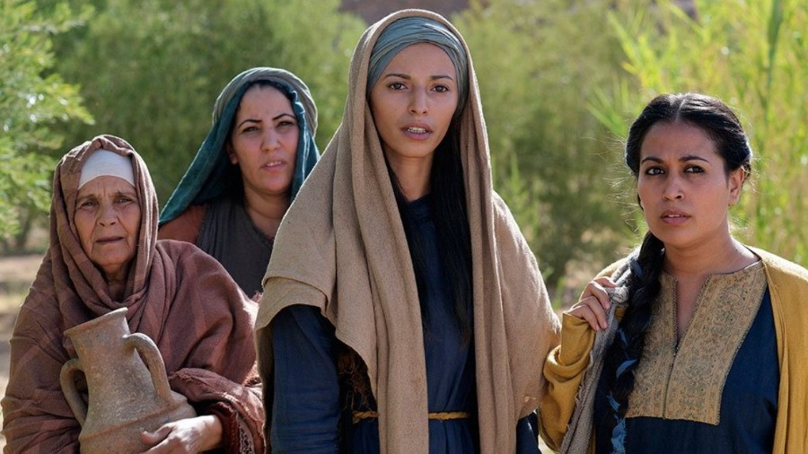
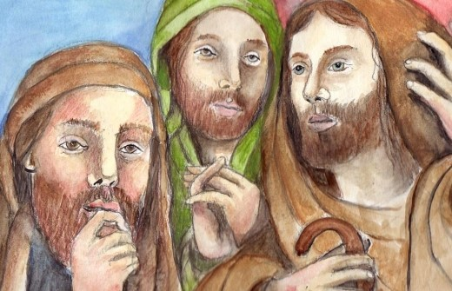
The Reasons for Differences in Gospel Accounts of Events
One thing that helped the gospel writers was that the Jewish people had a tradition of story telling so people were used to repeating stories orally about events and family members – this is a cultural practice in Māori culture also. This meant that there was a good chance that what was passed down was probably true.
The gospel writers had to rely on accounts of the Resurrection that were in some cases many years old. There were some that were based on eye witness accounts of what happened. But we know that stories of any event changes according to the story teller today just as they would have in the first century.
Reading the profiles of the four gospel writers (Slide 4) helps us to understand who they were, and who the audience or readers they would have had in mind were when they were writing their accounts of their gospel. That gives us a reason for some differences before they even start their writing.
Simply put they are: differences in the purposes the authors wrote them for, cultural differences of the time, differences in the sources of the material used and writing style differences.
What is important, and what the gospel writers and Jesus’ disciples could never have imagined is, that this event changed human history forever.
While we recognise the differences in the accounts of the gospel writers, the differences are minor and don’t impact on the basic story of what happened on the first Easter morning when Jesus rose for the dead.
This is why when Jesus treated them with respect it was not what usually happened. Stories such as the woman at the well illustrate this.
Regarding the fact that women were the first to discover the empty tomb was probably seen as being unreliable. The place of women in Jewish culture at that time was not as it in today.
There are some common reasons why there are differences in the stories of the same events in the gospels.
R-1
S-05
Click the cards to move through (9 total).
Notes:
Slide 5 The Reasons for Difference in Gospel Accounts of Events
Read the title questions and share your responses.
Look at their facial expression of the people in the images. Talk about who they are and what is going on in their lives and how they are feeling about it.
Read through each Flip Card and use the text to initiate comment, questions and discussion.

Slide 6
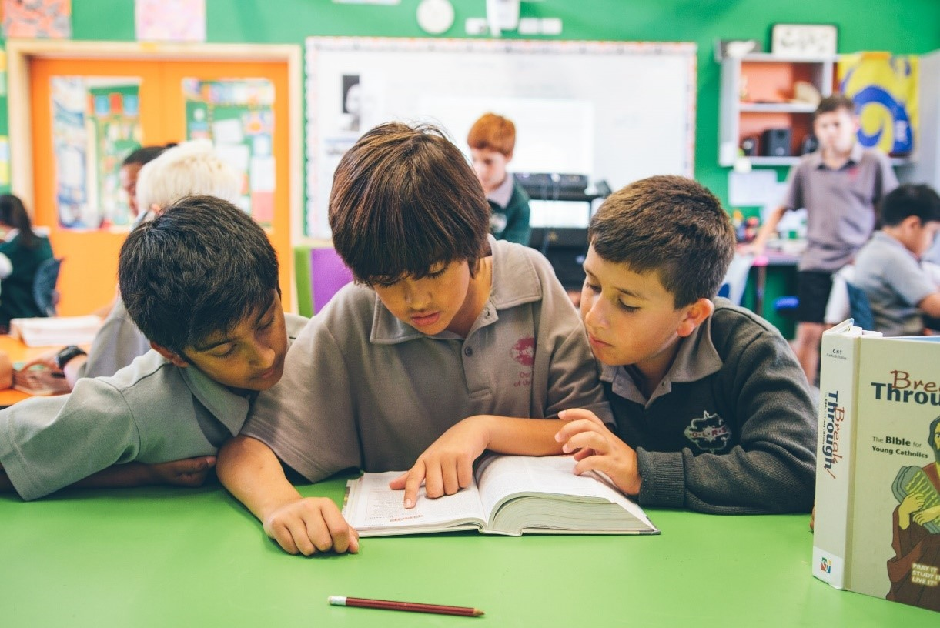
The Four Accounts of the Easter Story
Children get into groups of four with a Bible, a worksheet, and a Scripture reference for one of the four Easter stories.
Matthew 28:1-10, Mark 16:1-8
Luke 24:1-12, John 20:1-18
Before reading the gospel refer to the information on Slide 4 about the writer. Think about this and try to recognise how this has influenced how he has described the event.
The gospel is read and the group works through the worksheet responding to each item. When completed, discuss whether you found any influence of the gospel writer’s personal profile.
Each group shares their responses and identifies the differences and similarities between the four accounts of the Easter story.
Dramatise the story in your groups as it is narrated.
R-1
S-06
Notes:
Slide 6 The Four Accounts of the Easter Story Adapt Teaching and Learning Experience 3. Work through the instructions on the slide. You could share this work with another class and photograph the drama and keep pictures as a resource to use next year. Add some pictures to the school newsletter to share this learning with the community. Print enough copies of the ‘Questions for Gospel Stories’ page for each group to have one to use to guide their discussion.

Slide 7
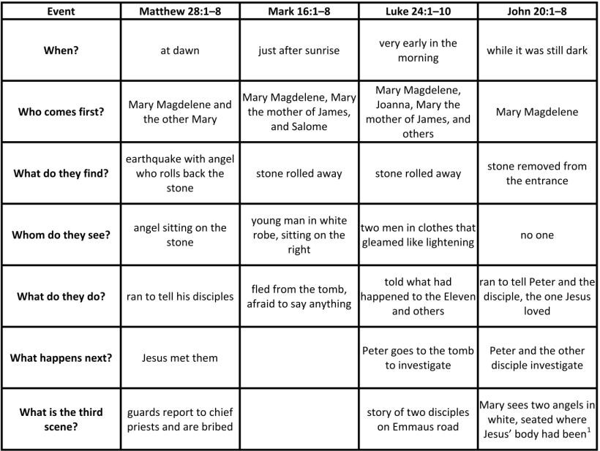
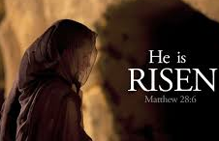
Comparison of the Gospel accounts of the Resurrection of Jesus
Use your worksheet to look closely at each event and trace
across to see what each item is saying.
Can you see any similarities?
What else do you notice?
Share your observations from the Easter story accounts grid in your class and with your family whanau. (Sharing our Learning)
R-1
S-07
Click the worksheet icon for worksheet.
Notes:
Slide 7 Comparison of the Gospel accounts of the Resurrection of Jesus Make a copy of the worksheet for each child to share and add to their RE Learning Journal. Explain how to use the grid and give children time to explore it. Then work through slide instructions and answer the questions.
Items in the quiz on the next slide refer to information on this.

Slide 8
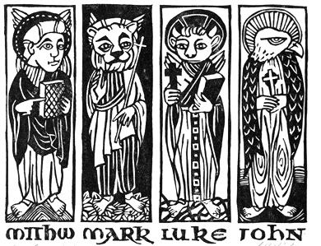
Easter Story Quiz
1) | Which gospel writer names Mary Magdalene as the first person at the tomb?______________ | 11) | Who travelled with Paul and translated for Peter?___________
2) | Who wrote the first gospel?________ | 12) | Who is believed to have written a gospel, 3 Letters and the Book of Revelation?____________
3) | What nationality was Matthew?___________ | 13) | Who had read the other gospels before he wrote his own?___________
4) | Which gospel speaks of two angels at the tomb?_____ | 14) | What century were the gospels written in?__________
5) | How many gospel writers referred to the stone being rolled away?___ | 15) | Whose mother’s house was used as a gathering place for the disciples?____________
6) | Which two gospels were written at the same time based on the same source?____________________ | 16) | Who was a doctor and knew and talked to eye witnesses of Jesus’ life?______________
7) | Who was the beloved disciple and Jesus’ best friend?_____ | 17) | Who followed Jesus as a teenager?__________
8) | Who is the only gospel writer to mention bribing the guards?___________ | 18) | Which gospel writer was called by Jesus to be one of his disciples?____________
9) | Who was the youngest gospel writer and what was his full name?____________ | 19) | Which gospel writer stayed with Peter while he was in prison?_____________
10) | Who was a son of Zebedee?____________ | 20) | Which gospel writer highlighted that Jesus was the Messiah? _____________
R-1
S-08
Click the worksheet icon for worksheet.
Notes:
Slide 8 Easter Story Quiz
Make copies of the quiz worksheet for all children to complete and add to their RE Learning Journal. Identify areas where recapping is needed.
Which gospel writer names Mary Magdalene as the first person at the tomb? All of them
Who wrote the first gospel? Mark
What nationality was Matthew? Jewish
Which gospel speaks of two angels at the tomb? Luke
How many gospel writers referred to the stone being rolled away? 4
Which two gospels were written at the same time based on the same source? Matthew and Luke
Who was the beloved disciple and Jesus’ best friend? John
Who is the only gospel writer to mentions bribing the guards? Matthew
Who was the youngest gospel writer and what was his full name? John Mark
Who was a son of Zebedee? John
Who travelled with Paul and translated for Peter? Mark
Who is believed to have written a gospel, 3 Letters and the Book of Revelation? John
Who had read the other gospels before he wrote his own? John
What century were the gospels written in? 1st Century AD
Whose mother’s house was used as a gathering place for the disciples? Mark
Who was a doctor and knew and talked to eyes witnesses of Jesus’ life? Luke
Who followed Jesus as a teenager? Mark
Which gospel writer was called by Jesus to be one of his disciples? Matthew
Which gospel writer stayed with Peter while he was in prison? Mark
Which gospel writer highlighted that Jesus was the Messiah? Matthew
Make a copy of the worksheet for each child to work on in pencil. When the children have completed their sheet go through each item and mark or add in the answer. Use the quiz as a learning activity to build up children’s religious knowledge rather than a test. It could be repeated orally later in the resource.

Slide 9
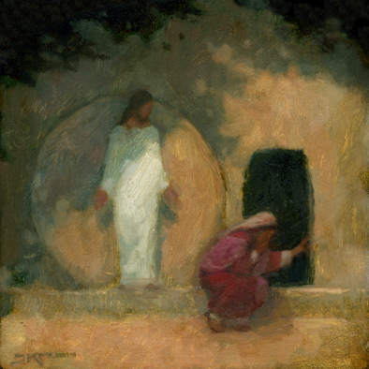
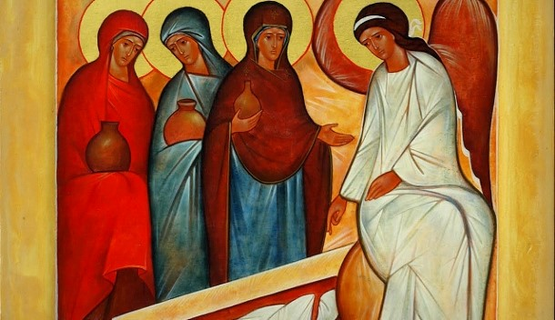
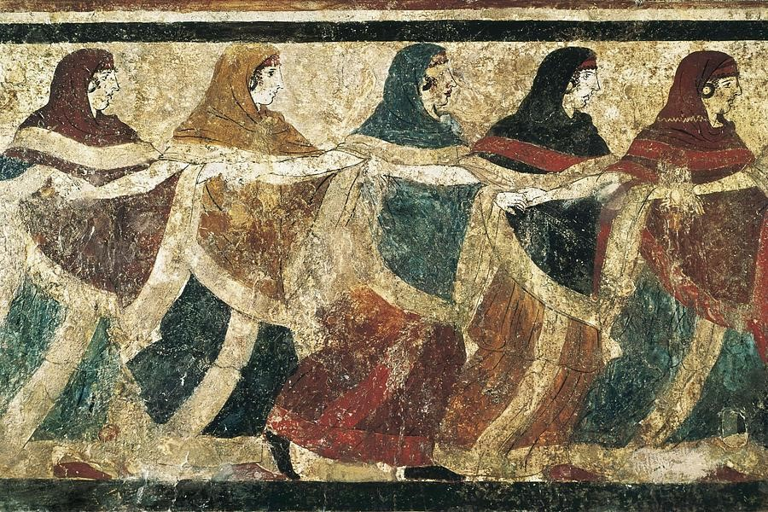
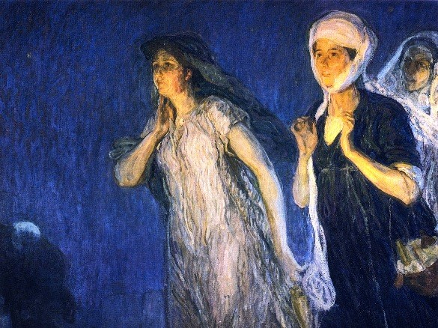
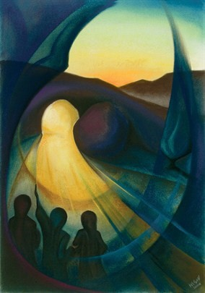
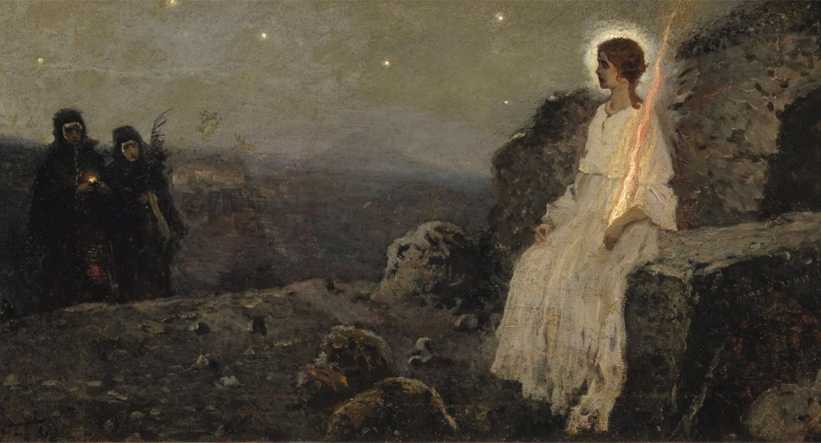
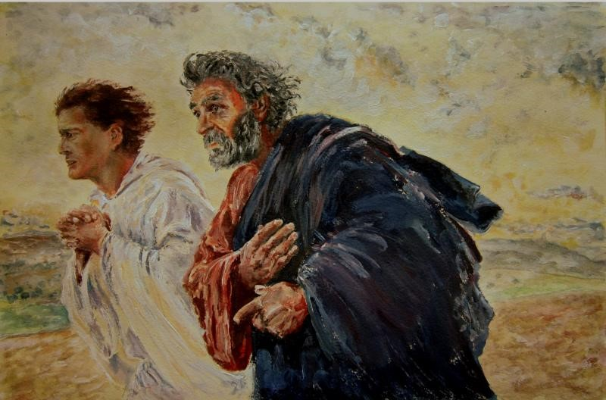
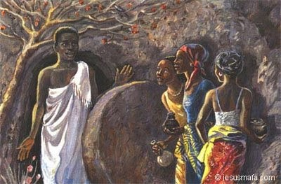
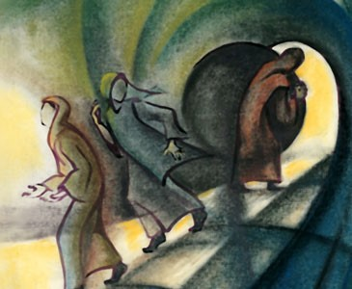
The Women at the Tomb expressed by Artists
Peter and John running to the Tomb - Eugène Burnand
Icon of
Myrrh Bearers
The Tomb of the Dancing Women
- Photograph of Etruscan Fresco
Women at the Tomb
The Women, the Authorities and Jesus’ Body
The Women
at the Tomb
The Three Marys
The Women
at the Tomb
Why weepest thou?
- J. Kirk Richard
Click the red button to look through paintings (9 total).
R-1
S-09
Click the audio button to stop ‘At the Tomb!’
Click the audio button to play ‘At the Tomb!’
Notes:
Slide 9 The Women at the Tomb expressed by Artists This slide shows examples of how artists portray the first people who went to the tomb. Notice how the artists capture the drama of the story. As you view the art works listen to the story (from a different writer every day) and imagine how the women and Peter and Thomas were feeling on this morning when the world changed forever. This could be used for class prayer during the 50 days of the Easter season. Let the children choose their favourite art work and say why it appeals to them. They could write a reflection on it. Unfortunately, most of the images were unnamed.
Children could create their own art work and have a Resurrection Art Exhibition to share with the school and parish community during the 50 days of the Easter Season.
Sing using the MP3 ‘At the Tomb’

Slide 10
Check Up
1)
Name the 4 Gospel writers and share something you know about each of them. (refer to Slide 4)
2)
Explain briefly why there are differences and similarities in the gospel writers’ versions of the Resurrection event. (refer to Slide 5)
3)
In your own words tell a partner the story of the first Easter Sunday when Jesus rose from the dead. (refer to Slide 6)
4)
Reflect on the images of the women and men disciples at the tomb as they discover Jesus has truly risen. Write your own response to the images. (refer to Slide 9)
5)
Which activity do you think helped you to learn best in this resource?
6)
Questions I would like to ask about the topics in this resource are …
R-1
S-10
Click the boxes to reveal text.
Notes:
Slide 10 Check Up
This formative assessment strategy will help teachers to identify how well the children have achieved the Learning Intentions of the resource.
Teachers can choose how they use the slide in their range of assessment options.
A worksheet of this slide is available for children in Years 5-8 to complete.
The last two items are feed forward for the teacher.
Recording the children’s responses to these items is recommended as it will enable teachers to adjust their learning strategies for future resources and target the areas that need further attention.

Slide 11
Time for Reflection
R-1
S-11
Click the audio button to stop Reflective Music
Click the audio button to play Reflective Music
Notes:
Slide 11 Time for Reflection
The MP3 is played to help create a reflective atmosphere and bring the children to stillness and silence as the teacher invites them to reflect on how the stories of the Resurrection were written down over 2000 years ago on the other side of the world and children like them are reading them today as they recall and prepare to celebrate again Jesus’ rising from the dead. How does that make them feel?

Slide 12
The Liturgical Year
Name_________________________ Date____________
Name the Liturgical colours of the vestments.
Name the colour that is used for each season.
Colour the calendar.
Note the season we are in at present _________________
The Liturgical Calendar retells the story of the life of _________.
What is the most important Feast of the Year? __________
When does the Liturgical Year start? __________________
When does the Liturgical Year finish?__________________
What is the longest season of the year?________________
What is your favourite Liturgical feast or season?_________
Worksheet
R-1
S-3
Click the up arrow to return to the lesson

Slide 13
Worksheet
R-1
S-6
Click the up arrow to return to the lesson

Slide 14
Comparison of the Gospel accounts of the Resurrection of Jesus
Name_________________________ Date____________
Look closely at each event and trace across to see what each item is saying.
Can you see any similarities?
What else do you notice?
Share your observations from the Easter story accounts grid in your class and with your family whanau. (Sharing our Learning)
Worksheet
R-1
S-7
Click the up arrow to return to the lesson

Slide 15
Easter Story Quiz
Name_________________________ Date____________
1) | Which gospel writer names Mary Magdalene as the first person at the tomb?________________________________ | 11) | Who travelled with Paul and translated for Peter? ________________________________________________
2) | Who wrote the first gospel?__________________________ | 12) | Who is believed to have written a gospel, 3 Letters and the Book of Revelation?________________________________
3) | What nationality was Matthew?_______________________ | 13) | Who had read the other gospels before he wrote his own?____________________________________________
4) | Which gospel speaks of two angels at the tomb?_________ | 14) | What century were the gospels written in?_______________
5) | How many gospel writers referred to the stone being rolled away?___________________________________________ | 15) | Whose mother’s house was used as a gathering place for the disciples?_____________________________________
6) | Which two gospels were written at the same time based on the same source?__________________________________ | 16) | Who was a doctor and knew and talked to eyes witnesses of Jesus’ life?_______________________________________
7) | Who was the beloved disciple and Jesus’ best friend?_____ | 17) | Who followed Jesus as a teenager?____________________
8) | Who is the only gospel writer to mentions bribing the guards?_________________________________________ | 18) | Which gospel writer was called by Jesus to be one of his disciples?________________________________________
9) | Who was the youngest gospel writer and what was his full name?__________________________________________ | 19) | Which gospel writer stayed with Peter while he was in prison?__________________________________________
10) | Who was a son of Zebedee?_________________________ | 20) | Which gospel writer highlighted that Jesus was the Messiah? ________________________________________________
My total is ____
Worksheet
R-1
S-8
Click the up arrow to return to the lesson
Notes:
Which gospel writer names Mary Magdalene as the first person at the tomb? All of them
Who wrote the first gospel? Mark
What nationality was Matthew? Jewish
Which gospel speaks of two angels at the tomb? Luke
How many gospel writers referred to the stone being rolled away? 4
Which two gospels were written at the same time based on the same source? Matthew and Luke
Who was the beloved disciple and Jesus’ best friend? John
Who is the only gospel writer to mentions bribing the guards? Matthew
Who was the youngest gospel writer and what was his full name? John Mark
Who was a son of Zebedee? John
Who travelled with Paul and translated for Peter? Mark
Who is believed to have written a gospel, 3 Letter and the Book of Revelation? John
Who had read the other gospels before he wrote his own? John
What century were the gospel written in? 1st Century AD
Whose mother’s house was used as a gathering place for the Disciples Mark
Who was a doctor and knew and talked to eyes witnesses of Jesus’ life? Luke
Who followed Jesus as a teenager? Mark
Which gospel writer was called by Jesus to be one of his apostles? Matthew
Which gospel writer stayed with Peter while he was in prison? Mark
Which gospel writer highlighted that Jesus was the Messiah? Matthew

