Slide 1
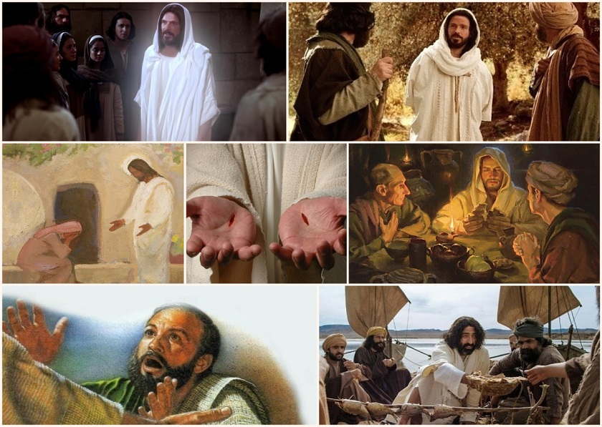
The After Easter Stories
R-2
S-01
Notes:
Slide 1 The After-Easter Stories
Use this slide as a focussing strategy to introduce the resource topic. Read the title together and invite children to share something they know about the stories that happened after Jesus had risen for the dead. What do you think Jesus did in the days after his Resurrection? What do you think the disciples did in the days after the Resurrection? – give reasons for your thinking. Can you name some of the people in the pictures and say when and where these events occurred?

Slide 2
Learning Intentions
The children will…
1)
recognise why the Easer story is so important
2)
retell one of the after-Easter stories
3)
explain why the after-Easter stories are important.
R-2
S-02
Click the boxes to reveal text.
Notes:
Slide 2 Learning Outcomes
Read through the Learning Intentions with the class and identify some ideas/questions that might be explored in the resource.
Continue to add to the Easter Prayer focus with bright yellow cloths and candles to give a sense of the joy and hope of the feast and season. Include some Resurrection images and symbols. Try to convey to the children the change in the mood of the Easter season compared with the sadness of Holy Week.
Remember to add ‘Alleluia, Alleluia’ to prayer during the 50 days of the Easter season. If possible after Easter take the children to the church to see the new Paschal Candle and the other signs of Easter in the church. Invite any children who were at the Easter Vigil Mass to share their experience with the class. Children can pick up a lot about the feast and season of Easter from exploring their local church. Help children to become aware of the importance of the Easter Feast and Season. Remind them that this event and our belief in it is what our faith is based on. Children in Year 4 are starting to grasp the meaning of Easter. You are their spiritual guide and faith witness for your class, so this is a good week to let them see how important celebrating Easter is for you and them together.
Draw children’s attention to the images on the slides – a lot of learning can come from discussion around them.

Slide 3
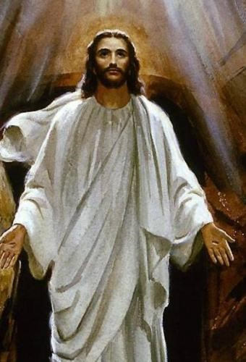
The Easter Story is such an important story for all Christians because …
The Easter story proved that Jesus had really and truly risen from the dead because he had died and he became alive again.
The Easter story helped people to believe that Jesus really was the Messiah sent by God to save them from their hard lives caused by the Romans.
The Easter story meant that what Jesus had been saying about rising after 3 days was true – he had kept his promise to his disciples.
The Easter story helped people to believe that Jesus was God’s son without a doubt.
R-2
S-03
Click the pins on the right to reveal post-it notes.
Notes:
Slide 3 The Easter Story is such an important story for all Christians because …
Read the reasons and talk about what they mean. Close their eyes and see what they can remember about why the Easter story is so important for people who believe in Jesus and try to live their lives as he did – caring and serving others, praying to God, helping people who were sick or had disabilities and teaching others about God.

Slide 4
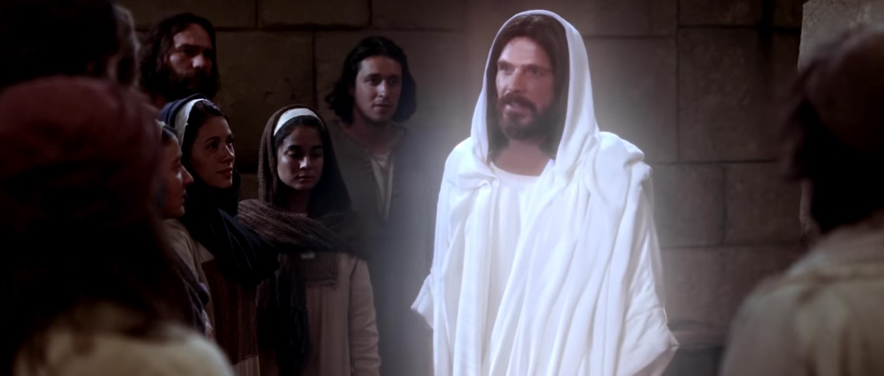
How was Jesus different after his Resurrection?
Jesus looked different because he was in his heavenly body because his earthly body was dead.
Jesus could appear among his followers but did not come through the door.
Jesus had the marks of the nails in his hands and his feet.
Jesus looked different because he was preparing for his new life with God his Father in heaven – this new life started 40 days after he rose and ascended to heaven.
Jesus appeared 12 times to reassure his friends before he left them and returned to God his Father in heaven.
R-2
S-04
Click the green arrow to lower the blind and the red arrow to lift the blind.
Notes:
Slide 4 How was Jesus different after his Resurrection?
Look at Jesus – what is different about him that you can see and why is he like that?
Read the blind reveals and think about what they mean. What do we call the day Jesus went back to heaven to live with his Father? (Ascension Day). In the 40 days between Easter Sunday and the Ascension Jesus spent time with his friends the disciples. He loved being with them and he knew he would miss them when he went to heaven. His disciples were with him when he went back to heaven – they watched him float up into the clouds until they could see him no more. That is why we think of heaven being in the sky. Jesus is still with his Father in heaven but by the power of his Holy Spirit he lives in his followers (that’s us) on earth. The Holy Spirit is Jesus’ spirit who came to live in us at baptism and continues to help us live as Jesus wants us to. Jesus’ spirit gets stronger in us when we receive the Sacrament of Confirmation. Give children time to think about this and ask questions – let their questions lead you to see where their thinking is about how Jesus is in heaven but also on the earth. This is a good time to get this belief clearer for them.

Slide 5
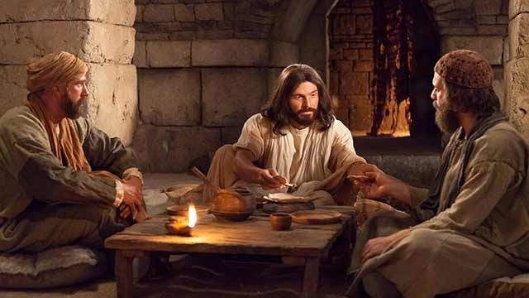
How did Jesus’ followers recognise him after he had risen?
Jesus’ friends were very frightened after the Resurrection because Jesus was not the same as he had been.
But when Jesus appeared to them and said, “Peace be with you” they knew it was him.
When Jesus showed them the marks in his hands and feet and side they knew it was Jesus, their teacher.
When they heard his voice when he spoke with them they recognised it was him as they remembered him.
They recognised him when he blessed and broke the bread during meals and they were certain it Jesus.
Jesus was not the same as he had been.
“Peace be with you.” they knew it was him.
hands and feet and side they knew it was Jesus, their teacher.
them they recognised it was him as they remembered him.
the bread during meals and they were certain it Jesus.
hands and feet and side they knew it was Jesus, their teacher.
them they recognised it was him as they remembered him.
Jesus was not the same as he had been.
the bread during meals and they were certain it Jesus.
“Peace be with you.” they knew it was him.
R-2
S-05
Click options a-c to correctly complete the sentences.
Notes:
Slide 5 How did Jesus’ followers recognise him after he had risen?
ANSWERS 1) C, 2) E, 3) A, 4) B, 5) D
Children choose a statement from the a) to e) list to complete the sentence correctly. They check it with a floater. Read the completed sentences and talk about what they mean. Notice in the picture Jesus is doing one of his favourite things he like to do – share food with his friends – that is what he does with us when we go to Mass – we are his friends on earth. All the friends he had when he was on earth are now in heaven with him. Do you know their names?

Slide 6
The After-Easter Stories
The first person Jesus showed himself to was Mary Magdalene, his friend. He met her in the garden near the tomb and she recognised him when he said her name, “Mary.”
When Jesus came among his friends after the Resurrection he liked to eat with them. He did what he always did at meals with them – he blessed and broke the bread and gave it to them to eat. They remembered the Last Supper.
Jesus knew his disciples were feeling lost without him and scared the soldiers would come for them because they were friends with Jesus. He wanted to reassure them. He had just appeared among them.
Jesus showed his disciples the marks of the nails and they remembered his suffering on the cross and his painful death. But they were so happy now he had risen as he said he would and he was with them again.
One day Jesus went down to the beach to meet the disciples where they were at work fishing as this was their job. He performed a miracle and they caught a lot of fish. Jesus cooked it for them and they shared breakfast on the beach.
One day two of Jesus’ disciples, one of whom was Cleopas, were walking along the road to a village called Emmaus. They were talking about what had been going on when a stranger appeared and walked with them. It was Jesus but they did not recognise him. When they had tea together Jesus blessed and broke the bread and the disciples recognised immediately.
Another day when Jesus appeared to his friends, Thomas was not with them. When he returned, Thomas would not believe Jesus has been with them. He doubted Jesus was alive. It was only when Jesus appeared to them again and he put his fingers in the marks on Jesus’ hands and side that he believed it was really him. He fell on his knees and said “My Lord and my God.”
Start
R-2
S-06
Click start for text then click each text box to move through (7 total). Click video icon for the clip – “Jesus’ Resurrection appearances”.
Notes:
Slide 6 The After-Easter Stories
Watch the clip
https://www.youtube.com/watch?v=evoOaIQwITg
Jesus’ Resurrection Appearances
14:14 Minutes
Don’t be put off by the length of this clip - it gives an excellent recap of the events after Jesus’ death, his burial and Resurrection and most of Jesus appearances after he had risen. It has dialogue and imagery which is most suitable and highly recommended for Yr. 4 children. The clips on slides 7, 8 and 9 are also worth watching to give children a good understanding of these important after-Easter stories. All of the clips can be used to initiate comments and questions about these stories which are sometimes missed when children are on holiday.
Use the images and flip cards on the slide to help children become more familiar with the after-Easter stories – notice how the image is framed as the text about it is read. These could be used in class prayer also. Year 4 children are becoming able to make sense of the sequence of these important stories so it is worth spending time with them.

Slide 7
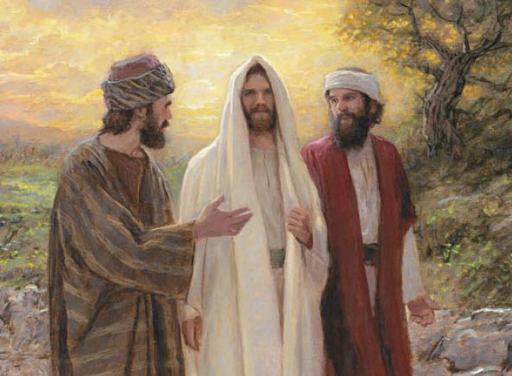
The Road to Emmaus – an after-Easter story
Watch the clip and think about how we recognise Jesus when the priest breaks the bread and shares it with us at Mass.
You can read this story from the Bible in Luke’s gospel 24:13-35 in class prayer this week.
Can you share the other ways the disciples recognised Jesus after he had risen?
R-2
S-07
Click video icon for the clip – “The Road to Emmaus”.
Notes:
Slide 7 The Road to Emmaus – an after-Easter story
Follow the guide on the slide and work through it.
This is a very important story for children as it is useful for them to know when they are learning about recognising Jesus when he broke the bread and how do we recognise Jesus today. So this clip would be worth using especially if the children will be preparing for their first communion this year.
Watch the clip
https://www.youtube.com/watch?v=K3L9eXMeV1A
The Road to Emmaus (2:21 minutes)
This would be a good topic for them to create an art work from and/or dramatise in small groups. All of these strategies help to embed the story in the children’s memory and they can be drawn on later. They can look on the web to research what the village of Emmaus looks like today.

Slide 8
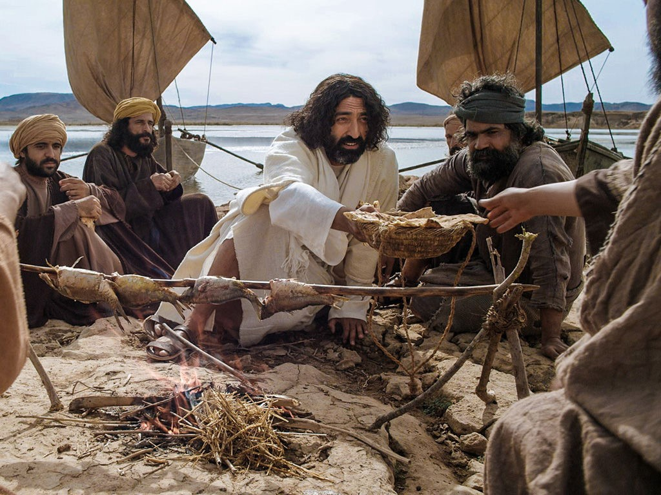
Breakfast by the Sea
The disciples who were at the Sea of Tiberias the day Jesus appeared to them for the 3rd time were: Simon Peter, Thomas, Nathanael, James and John the sons of Zebedee, and two others who are not named.
Do you think when Jesus worked the miracle with the fish he was thinking of another time the disciples might have remembered before his death and Resurrection when he worked a miracle with fish?
Can you remember what happened? Tell a partner the story. Do you think the disciples would have remembered it?
Make a list of the times Jesus showed himself to his disciples and include this one.
R-2
S-08
Click video icon for the clip – “Jesus appears once more to his disciples at Lake Tiberias”.
Notes:
Slide 8 Breakfast by the Sea
This is another important story for children to be familiar with. Work through the items on the slide and help children to engage in deeper thinking as they look beyond the words for deeper meaning. Read the story Luke 24: 13-49 and think about Jesus’s feelings as he knew he would be leaving his friends.
Watch the clip
https://www.youtube.com/watch?v=nA14i1Bshdo
Jesus appears once more to his disciples at Lake Tiberias (2:55 minutes) Share your questions and comments.

Slide 9
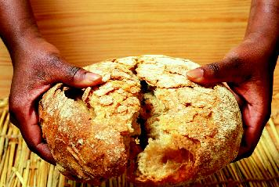
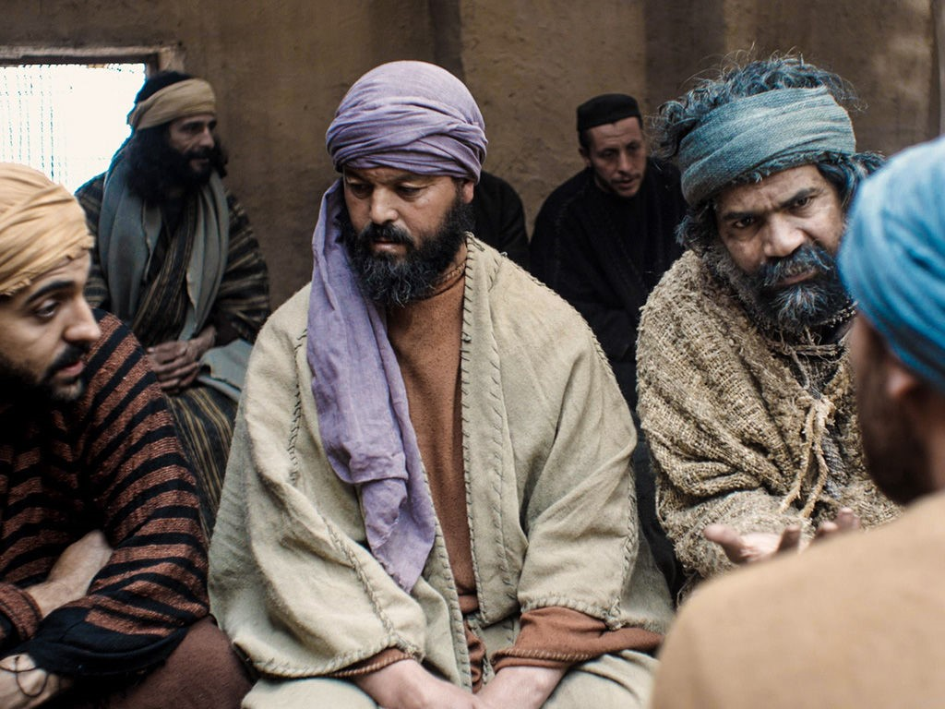
Why are the After Easter Stories Important?
Look at the people in the image and share what it tells you about how the disciples of Jesus were feeling in the days after Jesus had risen.
The stories about what happened during this time showed the disciples were lost without Jesus their friend and teacher.
They are important stories because they are about how we feel during times of change in our lives, and how Jesus is there for us if we can recognise him, to call on to reassure us just as the disciples did.
The stories are about the disciples but they are also about us. They help us to think about how we recognise Jesus in our lives when simple things remind us that he is present with us always.
R-2
S-09
Click the icons to reveal text.
Notes:
Slide 9 Why are the After-Easter Stories Important?
Follow the icons and text they reveal on the slide and when this is completed share your thoughts about why these stories are important for Christians to know and relate to their lives. We have had uncertain times in our lives too – we understand how this affects you. We can help others through these times and that is living as a follower of Jesus today. This is how we can take the messages from the stories of Jesus’ life and let them help us to grow closer to him.
Refer to Slide 5 & 6 for ideas for children’s responses.

Slide 10
Check Up
1)
Name 3 reasons why the Easter story is so important. (refer to Slide 3)
2)
Jesus was different after his Resurrection because he … (refer to Slide 4)
3)
Write 3 sentences to describe 3 ways the disciples were able to recognise Jesus after his Resurrection. (refer to Slide 5)
4)
Choose one after-Easter story and write it your own words describing what happened and how the disciples recognised Jesus. (refer to Slide 6)
5)
Give 3 reasons why the after-Easter stories are important. (refer to Slide 9)
6)
Which activity do you think helped you to learn best in this resource?
7)
Questions I would like to ask about the topics in this resource are …
R-2
S-10
Click the boxes to reveal text.
Notes:
Slide 10 Check Up
This formative assessment strategy will help teachers to identify how well the children have achieved the Learning Intentions of the resource.
Teachers can choose how they use the slide in their range of assessment options.
A worksheet of this slide is available for children in Years 5-8 to complete.
The last two items are feed forward for the teacher.
Recording the children’s responses to these items is recommended as it will enable teachers to adjust their learning strategies for future resources and target the areas that need further attention.

Slide 11
Time for Reflection
R-2
S-11
Click the audio button to stop Reflective Music
Click the audio button to play Reflective Music
Notes:
Slide 11 Time for Reflection
The MP3 is played to help create a reflective atmosphere and bring the children to stillness and silence as the teacher invites them to reflect on how the stories of the Resurrection were written down over 2000 years ago on the other side of the world and children like them are reading them today as the recall and prepare to celebrate again Jesus’ rising from the dead. How does that make them feel?

