Slide 1
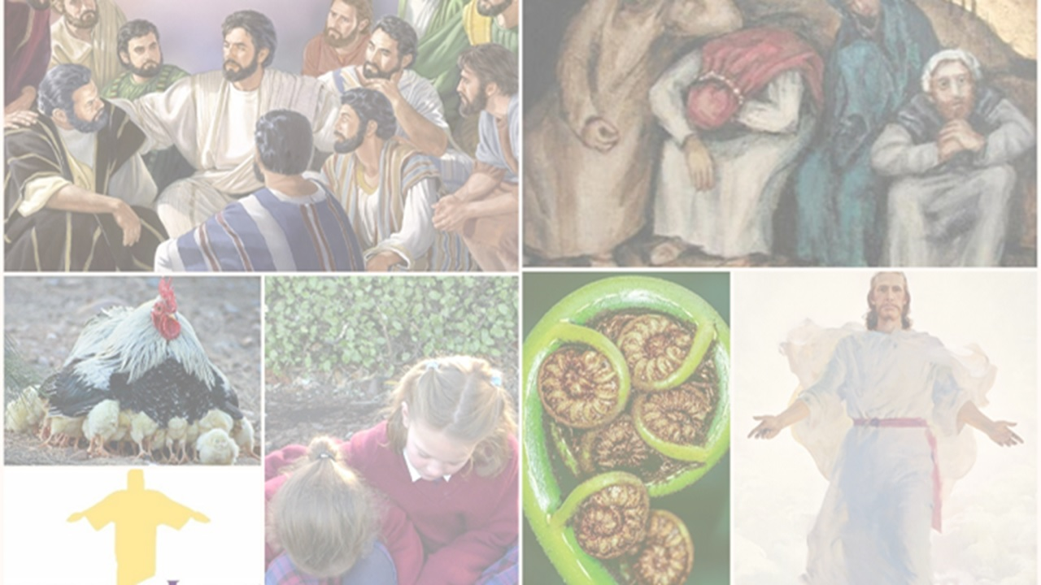
What Easter -Te Aranga means to Believers today
R-3
S-01
Notes:
Slide 1 What Easter - Te Aranga means to Believers today
Use this slide as a focussing strategy to introduce the resource topic. Read the title together and invite children to share something they know about what Easter means for believers today.

Slide 2
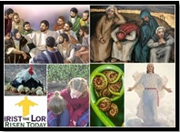
Learning Intentions
The children will…
1)
retell the story of one of the disciples after the Resurrection
2)
identify what Jesus’ Resurrection means for believers today.
R-3
S-02
Click the boxes to reveal text.
Notes:
Slide 2 Learning Outcomes
Continue to give attention to the Easter Prayer focus and remember to add ‘’Alleluia Alleluia’’ and the Sign of Peace during class prayer over the 50 days of the Easter season. Keep reading the after -Easter stories at prayer time. If possible take the children to the church to see the new Paschal Candle after Easter. Help children to become aware that Easter is the greatest feast in the Liturgical Year and it is the event and belief that our faith is based on. You as their teacher are their spiritual guide and faith witness for your children so this is a good week to let them see how important celebrating Easter is for you and them together. Draw children’s attention to the images – a lot of learning can come from discussion around them.

Slide 3
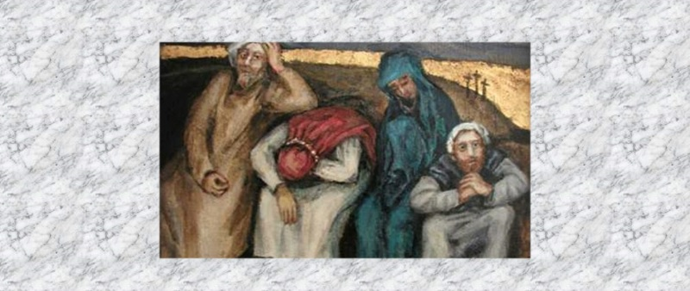
Jesus’ Disciples took time to get used to the risen Jesus
Jesus’ disciples were filled with joy that Jesus had risen as he promised and although he looked different, he was back talking, eating and spending time with them.
Peter raced to the tomb when Mary told him Jesus had risen. Since then he had spent as much time as he could with Jesus and professed 3 times how much he loved him – to make up for the 3 times he had denied him.
Mary Magdalene, who was the first to speak with Jesus after his Resurrection, gradually came to believe that Jesus, her greatest friend was risen to life again and she treasured the time she spent listening to him knowing he was leaving soon.
Cleopas cannot believe he walked with him on the road to Emmaus and didn’t even recognise Jesus – but then he did have a new heavenly body. When he did something as familiar as blessing and breaking bread with them he recognised his friend and his heart burned inside him.
Thomas was not going to be as easily deceived as the others. He needed proof it was his friend Jesus who supposedly had risen from the dead. Forget his promises just let me see the evidence – and there he was, right in front of him, holding out his hands and showing him his side. How could he ever have doubted this man, his friend?
R-3
S-03
Click the green arrow to lower the blind and the red arrow to lift the blind.
Notes:
Slide 3 Jesus’ Disciples took time to get used to the risen Jesus
Read the slide title and think about why did the disciples take time to get used to the risen Jesus?
Read the blind revealed text and comment on each item.
Can you remember what was going on when Peter denied knowing Jesus? How do you think Peter felt when he saw him for the first time after he rose?
What do you think Mary was feeling when she realised Jesus really was risen from the dead?
Why do you think Cleopas’ heart burned within him when Jesus was speaking to him at the table in the inn in the village of Emmaus? What caused the burning in his heart?
Do you know people like Thomas who need proof of something before they will believe it?
What an interesting collection of friends Jesus had – do you agree?
Adapt Teaching and Learning Experience 2.

Slide 4
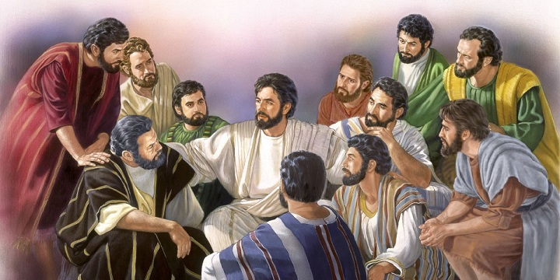
What did the Resurrection mean for Jesus’ first Disciples?
Jesus had brought new life back to the world and because of this, all creation was renewed and in keeping with the natural seasons and cycles of life, this would renew the face of the earth – all because Jesus has risen.
As the days passed with Jesus appearing to them to reassure them that all he had taught and promised them was true. The disciples’ hope in him grew stronger and they trusted him because he truly was God’s son.
The disciples came to understand that everything had changed because of Jesus’ Resurrection. People would share in his risen life in a new risen body in heaven without end.
Everything that was shattered by his death now seemed together again and life with Jesus around was getting back to what it used to be – or so they thought!
Jesus had risen as he promised – so the disciples became confident that he would keep all his other promises.
Jesus looked different and was different. He talked about a new life in a new body in heaven with his Father forever and how it would be the same at end of their lives.
Jesus said by his death and Resurrection there would be no more death forever because everyone would rise as he did and those who had lived faithful lives would live a new life in heaven for all eternity.
Restart
R-3
S-04
Click the captions to reveal picture (7 total), click ‘Restart’ to start over.
Notes:
Slide 4 What did the Resurrection mean for Jesus’ first Disciples?
Share your responses to the question in the title.
Read the text and watch the image be revealed. Who are these people? Can you name them?
Can you imagine what your new risen body might look like?
Remember your earthly body died at the end of your life. That is why when you rise on the last day of the world you will need your heavenly body to go to heaven

Slide 5
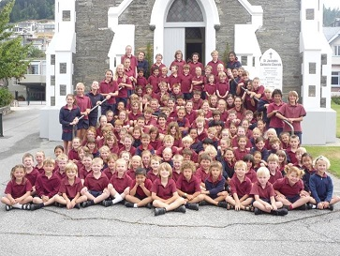
What Jesus’ Resurrection means for Believers today
Because Jesus was raised by God through the power of the Holy Spirit we believe he truly is the Son of God.
Through Jesus’ Resurrection all people became his sisters and brothers and Jesus is our Tuakana older brother.
Now we are God’s adopted sons and daughters and we belong to God’s family whānau.
Through Jesus, people can share in God’s grace which is God’s way of reaching out to the world and being present in it.
Jesus lives in the hearts of all believers so they can have hope they too will rise as Jesus did.
We are Easter people who have hope that after death we will have a new eternal life with God in heaven.
Holy Spirit we believe he truly is the Son of God.
sisters and brothers and Jesus is our Tuakana older brother.
we belong to God’s family whānau.
way of reaching out to the world and being
present in it.
have hope they too will rise as Jesus did.
we will have a new eternal life with God in heaven.
we belong to God’s family whānau.
have hope they too will rise as Jesus did.
Holy Spirit we believe he truly is the Son of God.
we will have a new eternal life with God in heaven.
sisters and brothers and Jesus is our Tuakana older brother.
way of reaching out to the world and being present in it.
R-3
S-05
Click options a-c to correctly complete the sentences.
Notes:
Slide 5 What Jesus’ Resurrection means for Believers today
ANSWERS 1) C, 2) E, 3) A, 4) F,5) B, 6) D
Children read the numbered statements and match them with a lettered statement to complete the sentence correctly. Read the completed sentences and discuss their meaning and encourage children to make a comment or ask a question. What does it mean that Jesus lives in our hearts so that we can have hope that we too will rise as Jesus did?

Slide 6
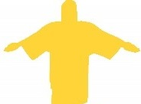
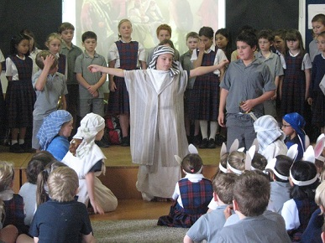
Jesus’ Resurrection has brought hope to his disciples today because …
hope is a confidence that something will happen because God has promised it will happen.
hope is about the present, that is today, and the future, that is what lies ahead of us.
hope means that no matter how bad things get, God will never forget his people and will always be with them.
People can have little hopes only because Jesus gave them hope of a life with God that is everlasting.
Christians share the same hope today that the first followers of Jesus who saw him die and rise had because we trust what Jesus promised.
R-3
S-06
Click the icons to reveal text.
Notes:
Slide 6 Jesus’ Resurrection has brought hope to his disciples today because …
Children share their ideas about hope means. Then work through the icon revealed text and talk about what they mean. What is a little hope? - we hope it will be fine for sports day What is a big hope? – we hope that after we die we will be with God in heaven forever.

Slide 7
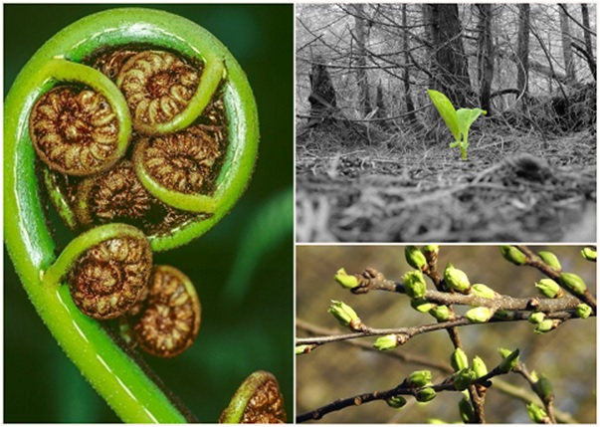
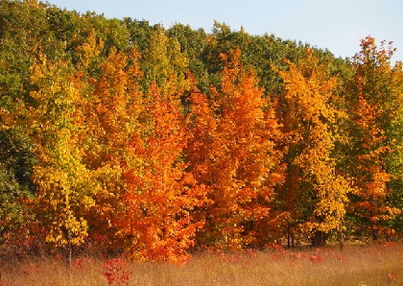
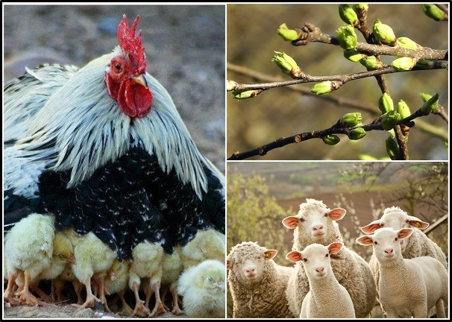
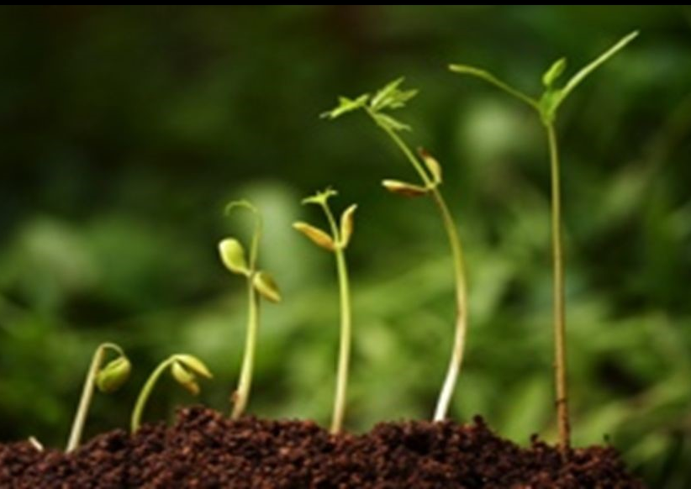
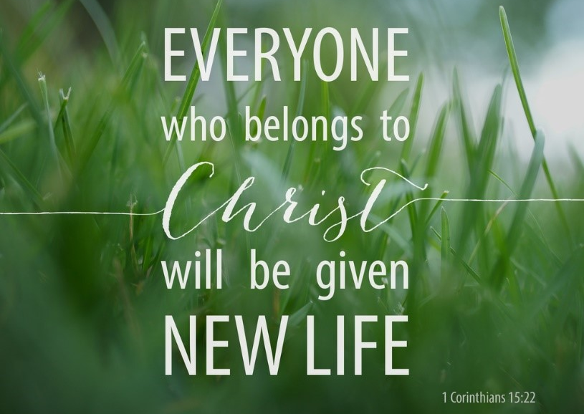
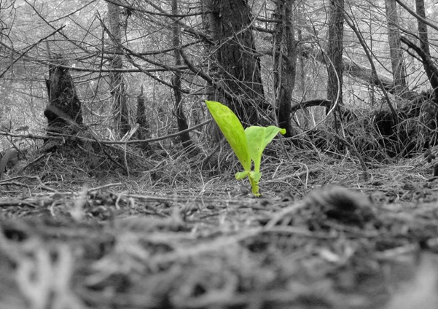
Through Jesus’ Resurrection new life has come into the world
This hope we have comes from what happened to Jesus – he died to his old life then rose to a new life and we will do the same – we will die at the end of our life and rise because Jesus promised we would – and Jesus keeps his promises.
We have the dying part of the cycle at Easter in our part of the world but we know that from the dying the new life will come – we see signs of buds on trees and shoots coming out of the ground and this gives us hope.
Nature follows this pattern or cycle of life - from sleeping to waking, from life to death then to a new life. The dead leaves and plants become compost which feeds the plants giving them new life and growth.
When we clear away the dead plants in the garden we see signs of new green shoots. From death we can see new life shooting up – this is what happened to Jesus.
In our country Aotearoa Easter is in the season of Autumn. Autumn is a season for dying as plants come to the end of their life cycle. Plants die off or sleep under the ground until they ‘rise again’ when spring comes.
In the Northern Hemisphere Easter occurs in the season of spring when signs of new life are everywhere the world is waking up, after a long winter – blossoms, flowers, lambs, chickens.
We look around us and see signs of death that reminds us of the death of Jesus. But we know Jesus died so he could rise again – that is the cycle life follows – dying then rising. Without Jesus’ death there would be no Resurrection
R-3
S-07
Click the cards to move through (7 total).
Notes:
Slide 7 Through Jesus’ Resurrection new life has come into the world
What do you think it means when we say Jesus brought new life into the world? Read the Flip Cards and explain what it means that new life has come into the world. Read them again and say one them you have learned about this

Slide 8
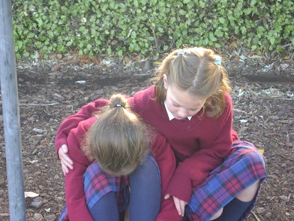
For children who follow Jesus today Easter means carrying on his work building God’s Kingdom of justice, peace and love on earth
We build God’s Kingdom in our school when we support each other and care for children when they are upset.
Standing up for fair play when we are playing sport and giving people encouragement and no put downs.
Respecting children and adults especially our teachers and showing appreciation for all they do for us.
Speaking up for those who are vulnerable and need an advocate when they are in trouble.
Praying every day for Pope Francis that he will continue to lead our Church in ways that promote the values of the Kingdom of God on earth – JUSTICE, PEACE and LOVE.
Click the icons to reveal text.
R-3
S-08
Click the audio button to play ‘Easter People’
Click the audio button to stop ‘Easter People’
Notes:
Slide 8 For children who follow Jesus today Easter means carrying on his work building God’s Kingdom of justice, peace and love on earth How could we see the Kingdom of God in your classroom if we came to visit?
Read through the ideas with children and make a classroom list and each child make a personal list of how they are doing their bit to build the Kingdom of God wherever they are. The personal list can be added to their RE Learning Journal and referred to regularly.
Justice means fairness. Peace means calmness and gentleness. Love means kindness and serving others in need. How do you live these out as a follower of Jesus today?
Enjoy the song with the children.
Sing using the MP3 ‘Easter People’.

Slide 9
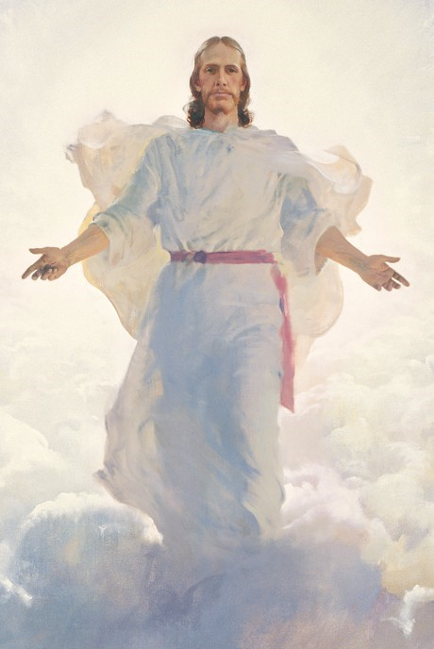
Jesus has promised that on the Last Day of the world he will gather all of God’s people into God’s life forever in heaven
When he was on earth Jesus promised us that he would come again in glory to gather all people who have lived as his followers on earth, to be in heaven with him and with God forever. Talk about when the last day of the world might be.
The graves of the dead will be opened and they shall be raised as Jesus was, and given a new heavenly body, as he was, to live their new life with God. What do you think your new heavenly body will be like?
This will be a time of great joy and celebration when all people and all creation will give glory and praise and thanks to God for all his goodness to us. Our life on earth now as we know it will be over and our new life will begin – this is what we have hoped for as Christians. What do you think your new life in heaven will be like?
Jesus will judge the living and the dead on how they have lived while they were on earth. The Kingdom of God that good people have helped to build on earth will be completed. You know how to do this so keep it up!
Click the pins on the right to reveal post-it notes.
R-3
S-09
Click the audio button to stop ‘All is Well’
Click the audio button to play ‘All is Well’
Notes:
Slide 9 Jesus has promised that on the Last Day of the world he will gather all of God’s people into God’s life forever in heaven
Read each Post it note and discuss the yellow text.
Listen to the words of the song carefully using the MP3 ‘All is well’. Play it often so the children can learn it and sing it. It reinforces the learning in these resources.
Children could create an art work to share with their family whānau of ‘The Last Day of the World when Jesus Comes again’.(Sharing our Learning)

Slide 10
Check Up
1)
Choose one of the disciples who was with Jesus after he rose and write a paragraph telling what it was like. Start by saying what your name is. (refer to Slides 3 & 4).
2)
What does the Resurrection mean for believers in Jesus today? (refer to Slides 5 & 6)
3)
Make a poster that illustrates the ways that Jesus’ Resurrection has brought new life into the world. (refer to Slide 7 to be used in Sharing our Learning)
4)
Make a list of what is going to happen on the last day of the world when Jesus will come to judge the living and the dead and Jesus will take us all to heaven forever. (refer to Slide 9, use your art work to help you).
5)
Make a stick drawing to Illustrate 5 ways children of your age help to build God’s kingdom of justice, peace and love here on earth. (refer to Slide 8, add illustration to Sharing our Learning)
6)
Which activity do you think helped you to learn best in this resource?
7)
Questions I would like to ask about the topics in this resource are …
R-3
S-10
Click the boxes to reveal text.
Notes:
Slide 10 Check Up
This formative assessment strategy will help teachers to identify how well children have achieved the Learning Intentions of the resource.
Teachers can choose how they use the slide in their range of assessment options.
A worksheet of this slide is available for children in Years 5-8 to complete.
The last two items are feed forward for the teacher.
Recording the children’s responses to these items is recommended as it will enable teachers to adjust their learning strategies for future resources and target the areas that need further attention.

Slide 11
Time for Reflection
R-3
S-11
Click the audio button to stop Reflective Music
Click the audio button to play Reflective Music
Notes:
Slide 11 Time for Reflection
The MP3 is played to help create a reflective atmosphere and bring the children to stillness and silence as the teacher invites them to on what it would be like to hear Jesus say to you, “Peace be with you.” Remember his words when you are feeling troubled or frightened.

Slide 12
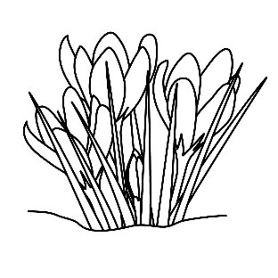
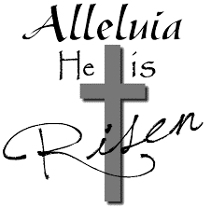
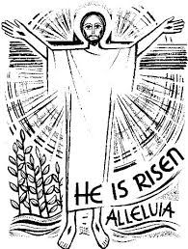
Sharing our Learning about Easter with family whānau
Sharing our Learning about
Easter
Use the Liturgical Year Calendar to illustrate what you have learned about the Liturgical Year and what you know about the feast and season of Easter. (refer to R1 Slide 3)
Arrange an ‘Easter the Greatest Feast of the Year’ celebration for your school.
Share your observations from the Easter story accounts grid with your class and with your family whānau. (refer to R1 Slide 8)
Make a stick drawing to Illustrate 5 ways children of your age help to build God’s kingdom of justice, peace and love here on earth and share this at home or with a younger class. (refer to R3 Slide 8)
Create your own Resurrection art work as part of a Resurrection Art Exhibition to share with the school and parish community. (refer to R1 Slide 9)
Share your Easter Quiz with someone at home. (refer to R1 Slide 8)
Make a poster that illustrates the ways that Jesus’ Resurrection had brought new life into the world (refer to R 3 Slide 7)
Create an art work to share with your family whānau of ‘The Last Day of the World when Jesus Comes again’.(refer to R3 Slide 9)
Make up your own way of showing and sharing what you have learned and decide whom you would like to share it with.
Click the star to start slide, click the sign with text to move through (9 total).
Click worksheet icon for a worksheet.
R-3
S-12
Notes:
Slide 12 Sharing our Learning about EASTER with family whānau
This slide provides some choices for children to show and share what they have learned. Examples could be photographed as evidence of children’s learning.
You may like to put a copy of the Sharing our Learning page in children’s RE Learning Journals. You could talk through the choices using the slide and let children make their choice from their own copy.
Children could work on their choice at school and/or at home and you may like to set a day for sharing. Please let parents and whānau know what you expect them to do with this.
The slide is focussed on Year 4 Easter Achievement Objective which is covered in Lessons 1-3
AO Yr. 4 - Children will be able to: develop an understanding of the stories of the Easter event.

Slide 13
Sharing our Learning about Easter with family whānau
Name_________________________ Date____________
Use the Liturgical Year Calendar to illustrate what you have learned about the Liturgical Year and what you know about the feast and season of Easter. (refer to R1 Slide 3).
Arrange an ‘Easter the Greatest Feast of the Year’ celebration for your school and parish.
Share your observations from the Easter story accounts grid with your class and with your family whanau. (refer to R1 Slide 8)
Make a stick drawing to Illustrate 5 ways children of your age help to build God’s kingdom of justice, peace and love here on earth and share this at home or with a younger class. (refer to R3 Slide 8)
Create your own Resurrection art work as part of a Resurrection Art Exhibition to share with the school and parish community. (refer to R1 Slide 9)
Share you Easter Quiz with someone at home. (refer to R1 Slide 8)
Make a poster that illustrates the ways that Jesus’ Resurrection has brought new life into the world. (refer to R 3 Slide 7)
Create an art work to share with your family whānau of ‘The Last Day of the World when Jesus Comes again’. (refer to R3 Slide 9)
Make up your own way of showing and sharing what you have learned and decide whom you would like to share it with.
Worksheet
R-3
S-12
Click the up arrow to return to the lesson

