Slide 1

Easter is the greatest Feast in the
Liturgical Year Te Tau me ona Ritenga Tapu
R-1
S-01
Notes:
Slide 1 Easter is the greatest Feast in the Liturgical Year Te Tau me ona Ritenga Tapu
Use this slide as a focussing strategy to introduce the resource topic. Read the title together and invite children to share something they know about the Feast of Easter and what it means for Christians.

Slide 2

Learning Intentions
The children will:
1)
recognise the importance of the feast of Easter
for Christians
2)
identify how Christians show the joy of Easter
in their Easter liturgies
3)
explain the meaning of the Easter candle
used throughout the Easter season.
R-1
S-02
Click in each caption space to reveal text
Notes:
Slide 2 Learning Outcomes
Read through the Learning Intentions with the class and identify some ideas/questions that might be explored in the resource. Create an Easter prayer focus with yellow or gold cloths, images of Jesus rising, Easter symbols of candles, chickens, eggs and bulbs in a pot. Draw attention to the change of season and mood of Holy Week. Remember to add ‘Alleluia, Alleluia’ to prayer during the 50 days of the Easter season. Create an Easter space for children to spend time with the poems, books and bibles with the Easter story with a text that children can read to each other. Ask teachers from other classes to let your class visit to share their Easter learning together. If possible, take the children to the church to see the Paschal Candle and the bright joyful yellow and white flowers, candles and altar cloths. Children can pick up a lot about the feast and season of Easter from exploring their local church. Make children aware that this is the greatest feast in the Liturgical Year and it the event and belief that our faith is based on. Hopefully these resources will increase children’s understanding of the meaning of Easter and how it is the foundation of this great truth of our faith. You are their spiritual guide and faith witness for your children so this is a good week to let them see how important celebrating Easter is for you and them together. Draw children’s attention to the images on the slides – a lot of learning can come from discussion around them.
Watch the clip which puts Easter in its historical context and helps children to understand what a big moment in history the Resurrection of Jesus was and how it changed the world – from this moment on people could hope and believe the promise Jesus made that from this event onwards death was not the end of life. The new life Jesus had when he rose he passed on to all who believe in him. From the Resurrection we all have a new heavenly life after death with God forever. This is what Christians believe will happen after death all because Jesus’ Resurrection defeated death so it was no more.

Slide 3

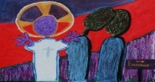
The Feast of Easter is the Feast of Jesus’ Resurrection
– the Pinnacle of all the Feasts of the Church’s Liturgical Year
We believe that Christ rose from the dead and overcame noa, the power of sin and death.
We believe that Jesus promised all people who have
believed in him will not remain dead but they will be
resurrected as he was to a new eternal life with God.
We believe that death is not the end of life - there is a new life after death for all who put their faith in Jesus and believe in God. It is a new heavenly life which will be lived in a new heavenly body and it will never die.
We believe that Jesus will come again to the earth in glory on the last day of the world. The graves of those who have died will open and he will gather up all who have believed in him and they will leave their earthly bodies behind.
Then he will take them in their new heavenly bodies to their new heavenly life with God forever.
We believe that we follow Jesus Christ who established the first Christian community now known as Christianity. Every other religion was founded by men or prophets whose end was the grave – Jesus is risen and sits now at the right hand of God his Father in heaven. His Holy Spirit lives in the hearts of his followers who carry on his work in the world.
We believe that Jesus’ Resurrection brought new life back into the world and we see this all around us in the natural world as the seasons change and plants and animals die and rise to a new life.
R-1
S-03
Click an image to reveal text. Click the video button to play the video EASTER: History and Culture
Notes:
Slide 3 The Feast of Easter is the Feast of Jesus’ Resurrection – the Pinnacle of all the Feasts of the Church’s Liturgical Year
In Year 5 children are beginning to develop a deeper understanding of what Catholic believe about Easter and its meaning and significance.
Watch the clip
https://www.youtube.com/watch?v=fSxQUdK7NRY
EASTER: History and Culture (9:09 minutes)
Give children time to comment and ask questions about the clip before reviewing the Learning Intentions. Take note of their questions as they may be answered as you work through these 2 resources.
Read through the text on the slide and use it to initiate conversations about what we believe about Easter.

Slide 4
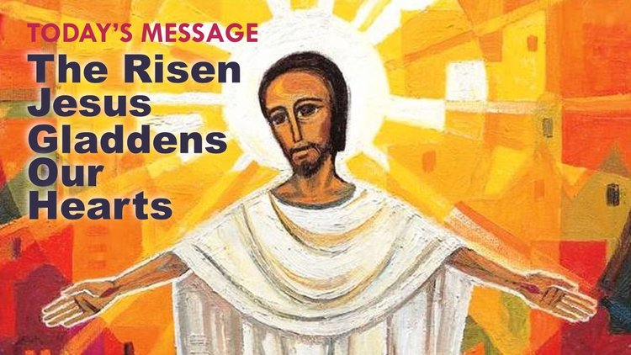
Why is the Feast of Easter such a joyful Feast?
Jesus’ death looked like he was defeated and all
he had done was in vain – his life was over.
His disciples were terrified they thought they were next to
be put to death so they hid in the upper room for 3 days.
On the third day everything changed, Jesus did as he had
promised – he rose from his grave and showed himself to them.
Can you imagine their joy at seeing him even though he
looked different it was him, he had the marks in his hands and feet.
promised – he rose from his grave and showed himself to them.
he had done was in vain – his life was over.
be put to death so they hid in the upper room for 3 days.
looked different it was him, he had the marks in his hands and feet.
R-1
S-04A
Click on a sentence from the list at the bottom or click an empty text box to match the sentences.
Notes:
Slide 4A Why is the Feast of Easter such a joyful Feast?
Read and talk about the words on the image.
ANSWERS 1=2ND line, 2=3rd line, 3=1st line, 4=4th line.
Choose the statement from the lower set to correctly complete the sentence then check it with the floater.
Make an Acrostic poem for the word EASTER to display at school and share at home. (Sharing our Learning, Slide 12)

Slide 5
Why is the Feast of Easter such a joyful Feast?
The disciples fear vanished, Jesus appeared to them and
ate with them as he used to and their hearts burned within them.
They knew now his Resurrection would change everything
and they set out to carry on his work to build God’s kingdom on earth.
2000 + years later our hearts burn and are filled with joy as we
celebrate this happy, holy, joy filled day with our community.
celebrate this happy, holy, joy filled day with our community.
ate with them as he used to and their hearts burned within them.
and they set out to carry on his work to build God’s kingdom on earth.
R-1
S-04B
Click on a sentence from the list at the bottom or click an empty text box to match the sentences.
Notes:
Slide 4B Why is the Feast of Easter such a joyful Feast?
ANSWERS 5=2nd line, 6=3rd line, 7=1st line.
Choose the statement from the lower set to correctly complete the sentence then check it with the floater.
Make an Acrostic poem for the word EASTER to display ay school and share at home. (Sharing our Learning, Slide 12)

Slide 6


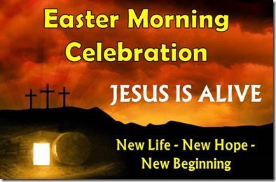

How Christians celebrate the joy of Easter in their Liturgies
The joy of Easter is captured in the liturgies the Church celebrates on Saturday at the Easter Vigil and in the Mass on Easter Sunday morning. The first sign of joy is the colour of the priest’s vestments, the altar and lectern cloths and the flowers.
The Gospels tell the wonderful stories about Jesus’ appearances to his disciples. These stories have the last things he wanted to teach them before he goes back to his Father in heaven. He does this on Ascension Day which is 40 days after he rose on Easter Sunday.
The new Easter Candle stands in the sanctuary where it can be seen by everyone. It is lit at the beginning of Mass and is a symbol of the risen Jesus standing among his disciples who are filled with the joy of his Resurrection.
The music is bright and the hymns are joyful and along with the prayers, they are filled with ‘Alleluias’ to praise the Lord. The joy people feel is expressed in song and prayers of praise that Jesus has risen.
R-1
S-05
Click the pins on the right to reveal post-it notes.
Click the audio button to stop ‘Celtic Alleluia’
Click the audio button to play ‘Celtic Alleluia’
Notes:
Slide 5 How Christians celebrate the joy of Easter in their Liturgies
Read the PINs and give children time to have conversations about them.
Sing using the MP3 ‘Celtic Alleluia’.
Encourage the children to talk with their families about celebrating Easter by attending one of the special Liturgies where they are celebrating Easter.
Adapt Teaching and Learning Experiences 3 & 4.

Slide 7
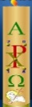
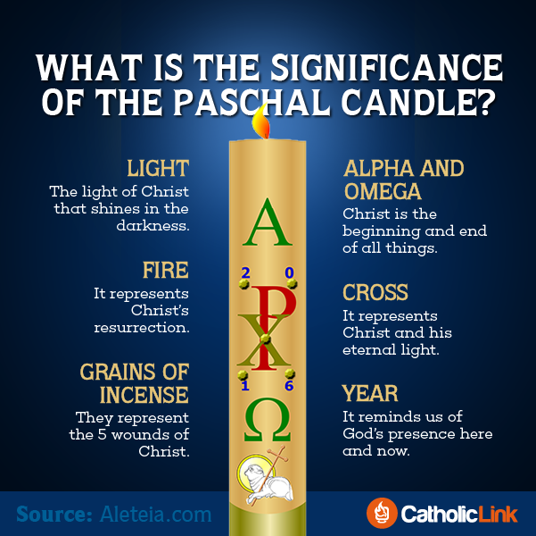
The Easter Candle …
is the symbol of the risen Christ standing among us
is lit at every Mass and at Baptisms and Funerals and in the Easter season which
lasts for 50 days from Easter Sunday until Pentecost Sunday
has Alpha and Omega on it and these are the first and last letters of the Greek alphabet to show that Christ is the beginning and the end of all time
is a sign of hope for all people and it brings light into the darkness
Make a sketch of the Easter Candle to share with your family whānau
R-1
S-06
Click on the candles on the left to reveal text
Notes:
Slide 6 The Easter Candle …
Adapt Teaching and Learning Experience 2.
Read each item and talk about how each candle is handmade for each parish church. Research who makes the candle for their local parish church. You may like to involve the priest in this discussion preferably with the candle to illustrate what is being said.
Make a copy of the worksheet ‘Easter is the Greatest Feast in the Church’s Liturgical Year’ from Teacher’s Book, page 37, for each child to complete and add to their RE Learning Journal. Point the candle out to the children when next you go to the church.

Slide 8
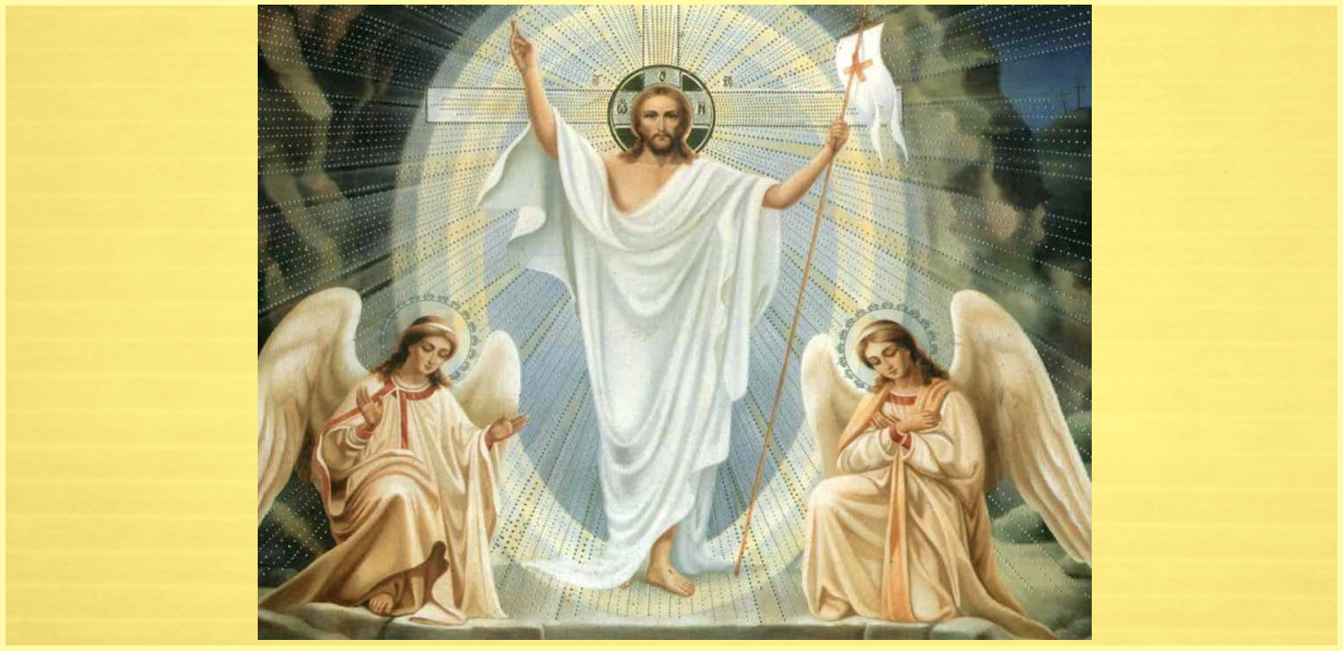
What Jesus’ Resurrection brought about
and made clear for Christians
The Resurrection was clear proof that Jesus was not just another human being but he was divine, both God and man – human. Believing in the Resurrection means believing all that Jesus taught his first followers. Share examples.
God’s love for us has no limits, our purpose here on earth is to love and serve God and one another, forgiveness is more powerful than revenge, we believe these, and many other teachings of Jesus are true. Name some.
Jesus’ Resurrection: frees us from our slavery to sin, death and evil, ensures us that we too will one day have our own Resurrection because Jesus promised this, enabled him to give the Holy Spirit to his people. What else did Jesus promise?
Jesus’ Resurrection guarantees that God will one day transform all creation and this will be the beginning of a new era in human history. We will share in this new creation in a heavenly life with a heavenly body with God forever. Imagine this!
R-1
S-07
Click the down-button to move the blind down.
Notes:
Slide 7 What Jesus’ Resurrection brought about and made clear for Christians
Look closely at the image and share what it tells you about Jesus’ Resurrection – does it illustrate why we talk about his glorious Resurrection? Read through each text block. Give children time to think about each one and share their ideas about what they mean. These are important core beliefs about the Resurrection. Encourage them to ask questions and summarise their thinking by making, ‘So this means …’ statements and record them in the RE Learning Journal. Children share their responses to the highlighted text.

Slide 9

What has Jesus promised for those
who have put their faith in him?
Share your ideas about what you imagine God has prepared for those who love God.
R-1
S08
Click in the white box and write your text
Notes:
Slide 8 What has Jesus promised for those who have put their faith in him?
Record the ideas children share about what God has prepared in heaven for those who love God. Children may like to compose a rap or a mural to share their ideas with others. Look at the next Slide 9 for some more ideas that could be helpful before you start.

Slide 10
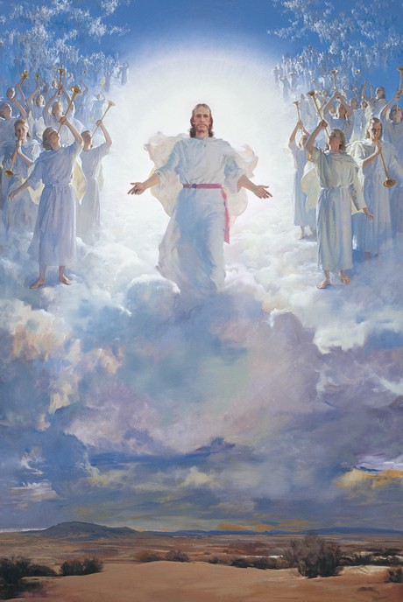
What will happen at the end of the world
for those who trust in God
8.
Now his Holy Spirit is with us guiding us and helping us to make good choices as we strive to do our bit to build his Kingdom here on earth so we can enjoy the joy of heaven he has prepared for us at the end of time.
7.
If this were not so, I would tell you plainly. When everything is ready, I will come and get you, so that you will always be with me where I am.’’ Jesus wants to be with us always.
6.
Some words Jesus spoke about this time are recorded in John’s Gospel 14:1-4. “Don’t be troubled. You trust in God, now trust in me. There are many rooms in my Father’s house and I am going to prepare a place for you.
5.
The Book of Revelation has some descriptions of what this time will be like. There has been much speculation about what these end times will be like, some of which have no Scriptural basis. Talk to someone you know about this.
4.
Evil, sin, suffering and death will be destroyed. The old heaven and old earth will pass away and God will be with his people. God will wipe away every tear and there will be no more weeping or mourning because the old order has passed away and God’s Kingdom will finally be established.
3.
Jesus will come in his glory for his final judgement of the living and the dead. Everyone including those still living and those who are already dead will be judged on the deeds they did while they lived on earth.
2.
When Jesus comes the graves of those who have died already will open and the dead will be raised up leaving their natural earthly bodies behind and the righteous will receive their spiritual heavenly bodies.
1.
No one knows the day the world will end. Jesus tells many stories about being ready for it. We do know that it will be the day of Jesus’ Second Coming to the world and Jesus tells us to prepare and “Repent and turn to God.” (Acts 3:19)
R-1
S-09
Click top card to discard it.
Click the audio button to play ‘All is Well’
Click the audio button to stop ‘All is Well’
Notes:
Slide 9 What will happen at the end of the world for those who trust in God?
Listen to the song, ‘All is Well’ and note what the words are saying.
Read each Flip Card and encourage children to listen carefully to the text and make comments and questions as you work through them. When this is done create an art work to capture your impression of what the last day of the world will be like.
Share it with your family whānau and let it generate conversations about this topic at home. Refer to Sharing our Learning slide.

Slide 11

Check Up
1)
Name 3 key beliefs Catholics have about the Resurrection of Jesus. (refer to Slide 3)
2)
Write 3 reasons why Easter is a feast and season of joy.
(refer to Slide 4)
3)
Draw and label 5 aspects of the Easter liturgies that express the joy of Easter. (refer to Slide 5)
4)
Use your sketch of the Easter Candle to share all you know about it. Say where you have seen one in a church during the Easter season. (refer to Slide 6)
R-1
S-10A
Click in each caption space to reveal text.
Notes:
Slide 10A Check Up
This formative assessment strategy will help teachers to identify how well children have achieved the Learning Intentions of the resource.
Teachers can choose how they use the slide in their range of assessment options.
A worksheet of this slide is available for children in Years 5-8 to complete.
The last two items are feed forward for the teacher.
Recording the children’s responses to these items is recommended as it will enable teachers to adjust their learning strategies for future resources and target the areas that need further attention.

Slide 12
Check Up
5)
Write 3 outcomes of Jesus’ Resurrection
that Christians believe. (Slide 7)
6)
Make a list of 5 things that will happen on the last day of the world when Jesus comes again. (refer to Slide 9)
7)
Which activity do you think helped you to learn best in this resource?
8)
Questions I would like to ask about the topics in this resource are …
R-1
S-10B
Click in each caption space to reveal text. Click on the worksheet button to go to the worksheet
Notes:
Slide 10B Check Up
Children use the worksheet and respond to each item. This can be added to their RE Learning Journal. Note what areas may need more attention and use strategies including peer tutoring to help with this.

Slide 13
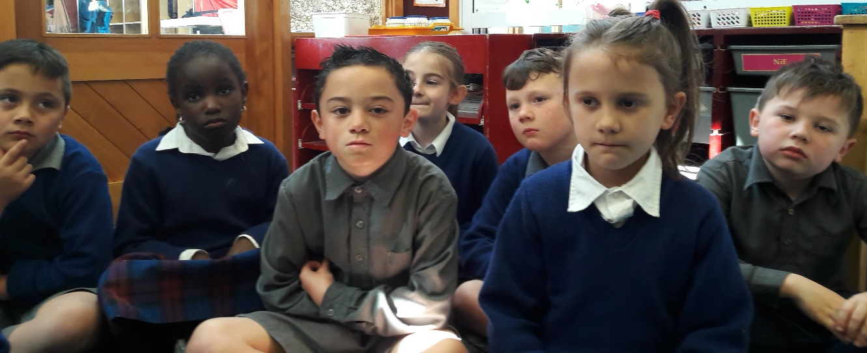

Time for Reflection
R-1
S-11
Click the audio button to stop reflective music
Click the audio button to play reflective music
Notes:
Slide 11 Time for Reflection
The MP3 is played to help create a reflective atmosphere and bring the children to stillness and silence as the teacher invites them to reflect on what Jesus has told them about what will happen at the end of the world and what he has prepared for those who love him and how good it would be to share it with him.

Slide 14
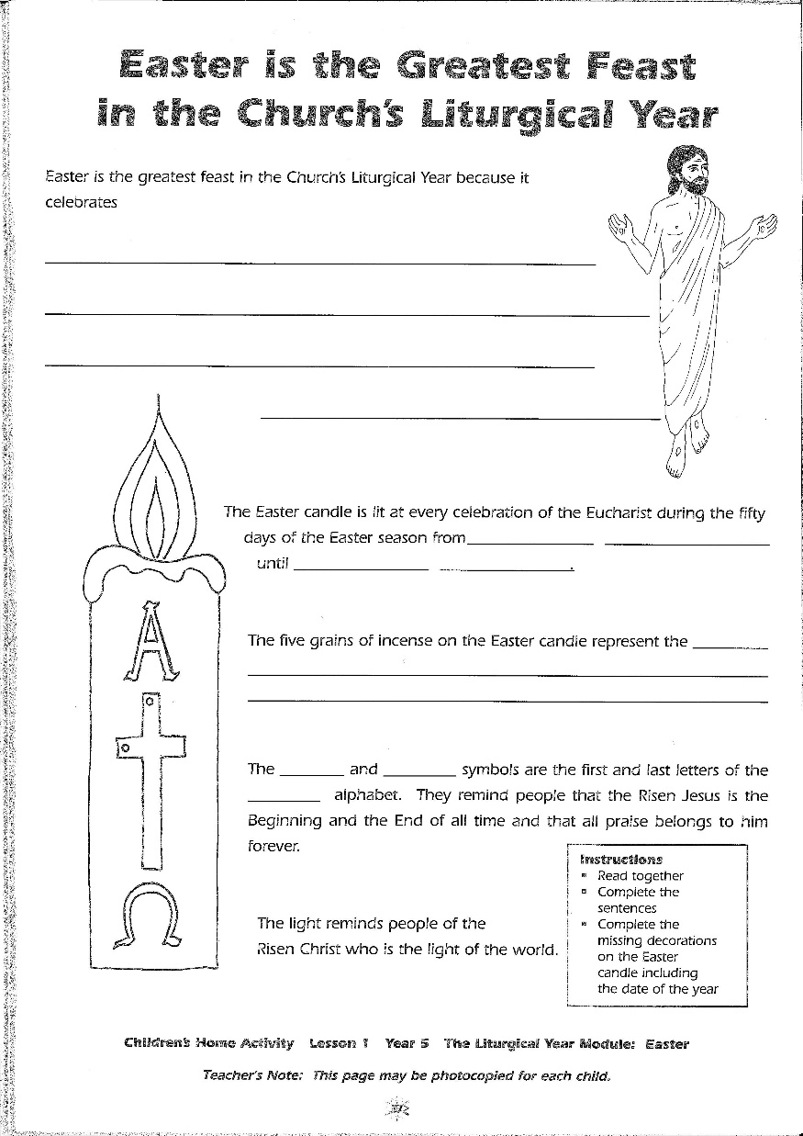
Notes:
This Worksheet relates to Slide 6.

Slide 15
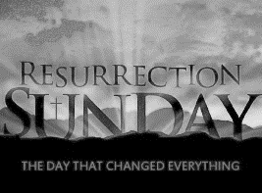
Check Up
1)
Name 3 key beliefs Catholics have about the Resurrection of Jesus. (refer to Slide 3)
2)
Write 3 reasons why Easter is a feast and season of joy. (refer to Slide 4)
3)
Draw and label 5 aspects of the Easter liturgies that express the joy of Easter. (refer to Slide 5)
4)
Use your sketch of the Easter Candle to share all you know about it. Say where you have seen one in a church
during the Easter season. (refer to Slide 6)
5)
Write 3 outcomes of Jesus’ Resurrection that Christians believe. (Slide 7)
6)
Make a list of 5 things that will happen on the last day of the world when Jesus comes again. (refer to Slide 9)
7)
Which activity do you think helped you to learn best in this resource?
Name:_______________
8)
Date:____________
Questions I would like to ask about the topics in this resource are …
R-1
S-10
Worksheet
Click the up arrow to return to the presentation
Notes:
This Worksheet relates to slides 10A and 10B.

