Slide 1
Meeting the Risen Jesus Today
R-2
S-01
Notes:
Slide 1 Meeting the Risen Jesus Today
Use this slide as a focussing strategy to introduce the resource topic. Read the title together and invite children to share something they know about how Christians today meet the risen Jesus in their lives and in the Eucharist.

Slide 2
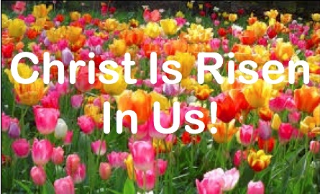
Learning Intentions
The children will:
1)
identify how Christians today meet the Risen Jesus in the celebration of the Eucharist.
R-2
S-02
Notes:
Slide 2 Learning Outcomes
Read through the Learning Intentions with the class and identify some ideas/questions that might be explored in the resource.
Create an Easter Prayer focus with bright yellow cloths and candles to give a sense of the joy and hope of the feast and season. Include some Resurrection images and symbols. Try to convey to the children the change in the mood of the Easter season compared with the sadness of Holy Week.
Remember to add ‘Alleluia, Alleluia’ to prayer during the 50 days of the Easter season. If possible take the children to the church to see the Paschal Candle and the bright joyful yellow and white flowers, candles and altar cloths. Children can pick up a lot about the feast and season of Easter from exploring their local church. Make children aware that this is the greatest feast in the Liturgical Year and that this event and our belief in it belief is what our faith is based on. This is one of children’s early experiences to learn about the meaning of Easter. You are their spiritual guide and faith witness for your children so this is a good week to let them see how important celebrating Easter is for you and them together.

Slide 3
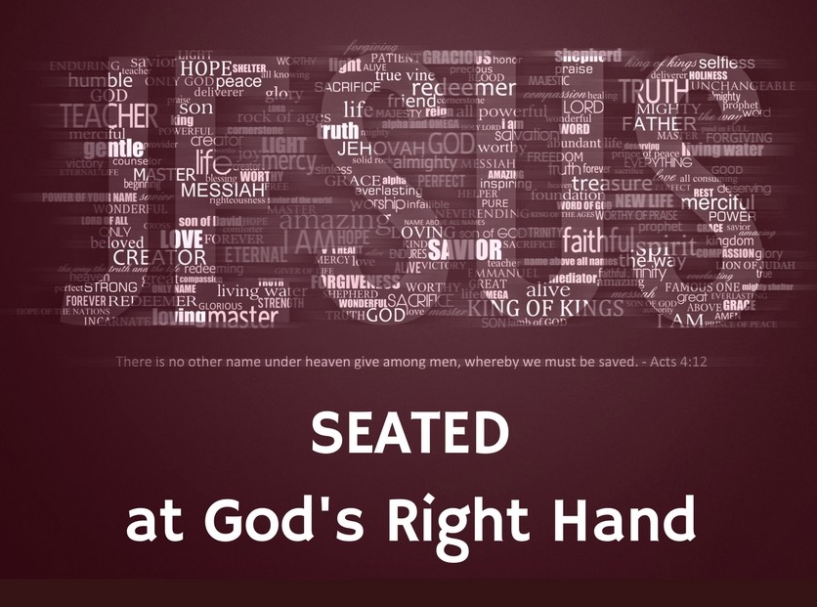
Where is Jesus today?
Jesus is in heaven in his heavenly body with God his Father.
Q1 Can you name someone else in his family and friends who are there with him?
Jesus speaks to God about people on earth.
Q2 What do you think he says about us?
Jesus shares in God’s glory and power.
Q3 What does God’s glory mean?
He will be there - until he comes again in glory to judge the living and the dead.
Q4 Where do you hear these words?
Jesus’ Spirit lives in the heart of his followers and they carry on the work he started to build the Kingdom of God on earth.
Q5 How do you, as one of Jesus’ followers today, help to build God’s Kingdom where you live today?
R-2
S-03
Click a line of text to reveal a question.
Notes:
Slide 3 Where is Jesus today?
A1 Can you name others in his family and friends who are there with him? His mother Mary, his father Joseph, his cousin John the Baptist, his aunt Elizabeth and his uncle Zechariah. His best friends John and Mary, his apostles, his friends Mary, Martha and Lazarus, all the people he healed and many millions more.
A2 What do you think he says about us? That he is pleased with us and how we are trying to build his kingdom of love, peace and justice here on earth today. He likes the ways we care for and serve others. He says he forgives us when we forget to be kind and unselfish and he reminds us that he will always forgive us if we are sorry and try not to sin again. He loves to see us enjoying our lives and helping others to enjoy theirs too and spreading his message to others.
A3 What does God’s glory mean?
God’s glory is God’s beauty, greatness, supreme strength, distinctness, perfection, apartness, constancy that will never fade, power, light, authority, honour, manifold (many) attributes, worth.
Giving God glory is honouring the beauty of God’s Spirit and Character. God shares this glory with his only Son, Jesus as he sits at his right side in heaven. When we give God glory we are acknowledging all of what we mean by the words we have mentioned. Even though we can never give God glory to match his greatness, God accepts our humble attempts.
A4 Where do you hear these words?
We hear them when we proclaim the Apostles Creed or the Nicene Creed usually at Mass. The Creed names the important beliefs of our faith that we live by. It is good for children of your age to join with the community as they proclaim what Catholics believe in God’s presence at Mass.
A5 How do you as one of Jesus’ followers today help to build God’s Kingdom where you live today?
By offering to help, by including others, by caring for those in need, by showing gratitude for what I have, by being a good friend, by sharing the fruits of the Spirit of the risen Jesus with people I meet.

Slide 4
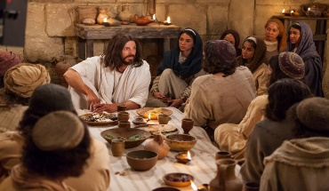
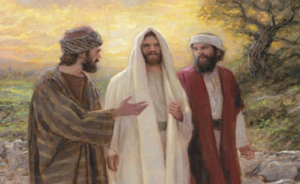
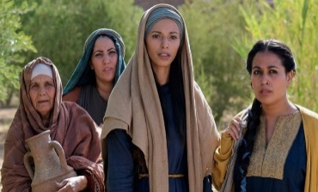
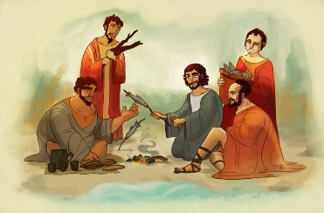
When the Disciples meet the Risen Jesus, how do they recognise him?
He came to the supper room to share a meal with them. What did he do that showed them he was still their friend and teacher?
He shared a meal with them and he showed them the marks in his hands and feet. John 20:19-23
Two disciples met Jesus on the road to Emmaus. They thought he was a stranger and they asked him to stay and share a meal with them. They recognised him when he did what?
He broke the bread like he did at the Last Supper. Luke 24:13-35
The women met Jesus on the way back from the tomb. They didn’t recognise him until he did what?
He spoke to them and they recognised his voice. John 20:1-18
The disciples had been out fishing all night and had caught nothing. Jesus appeared but they did not recognise him until he performed a miracle.
Then their nets were full and they recognised him and he cooked breakfast for them. John 21: 1-14. These were the ways people recognised the risen Jesus in the days soon after his Resurrection.
R-2
S-04
Click an image to reveal more text.
Notes:
Slide 4 When the Disciples meet the Risen Jesus, how do they recognise him?
Children read the black text and think about answers to the questions.
Click the image for some ideas for responses on the yellow text to appear.
Read the Easter Sunday story according to John 20:1-18.
Adapt the Teaching and Learning Experiences 2 & 3.
Use the Meditation process with after Easter stories especially those featured and referenced in Slide 4

Slide 5
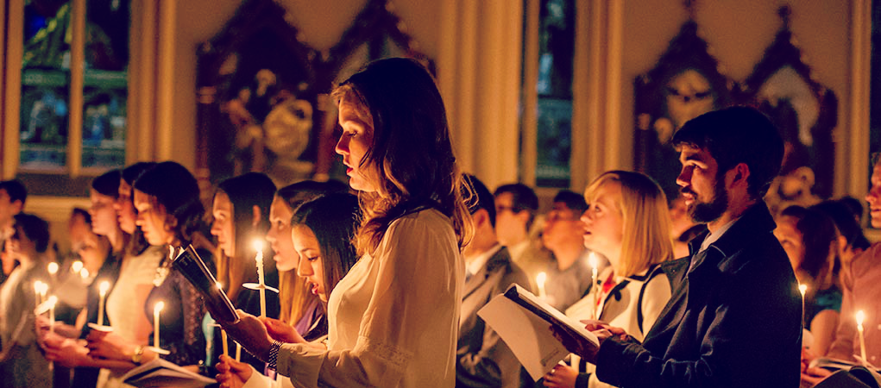
We meet the Risen Jesus today through his presence in the Eucharist in the People Gathered
The risen Jesus is present wherever and whenever the Eucharist is celebrated. He is with his followers just as he was at the Last Supper the night before he died.
Strengthened by his body and blood, his Word and his Spirit his followers go out into the world and spread his message of kindness and service to others as they build his Kingdom in their homes, their schools and their communities.
At the Easter Vigil the people hold candles lit from the Easter Candle as a symbol of Jesus the Light of the World. By his Resurrection Jesus brought light and hope back into the world of darkness.
Now the risen Jesus is present in the hearts of the people who are his disciples today. His Spirit is in their hearts and they come to replenish their faith and hope in him with their community at Eucharist.
R-2
S-05
Click the pins on the right to reveal post-it notes.
Notes:
Slide 5 We meet the Risen Jesus today through his presence in the Eucharist in the People Gathered
Children read each PIN and share ideas about what they mean. Use these ideas as conversation starters about how the risen Jesus is present in the world today through the faith and actions of his followers.
Adapt Teaching and Learning Experience 1

Slide 6
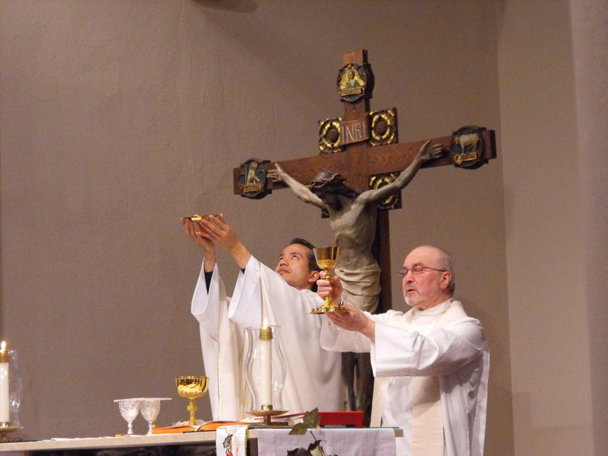
We meet the Risen Jesus present in the Eucharist in the Priest
The risen Jesus is in the priest as he leads the
community through the celebration of the Eucharist.
The risen Jesus is present when the
priest leads the celebrations of the Sacraments.
The risen Jesus is present with the priest
when he offers pastoral care to people in his parish.
Through the priest the risen Jesus
offers God’s forgiveness in the Sacrament of Penance.
The Spirit of the risen Jesus inspires the priest
to share the message of the gospel in his community.
when he offers pastoral care to people in his parish.
community through the celebration of the Eucharist.
offers God’s forgiveness in the Sacrament of Penance.
priest leads the celebrations of the Sacraments.
to share the message of the gospel in his community.
R-2
S-06
Click on a sentence from the list at the bottom or click an empty text box to match the sentences.
Notes:
Slide 6 We meet the Risen Jesus present in the Eucharist in the Priest
ANSWERS: 1=2nd sentence, 2=4th sentence, 3=1st sentence, 4=3rd sentence, 5=5th sentence.
Children select the statement to complete the sentence correctly. Then they check it with the floater. When the sentences are complete they discuss their meaning.

Slide 7
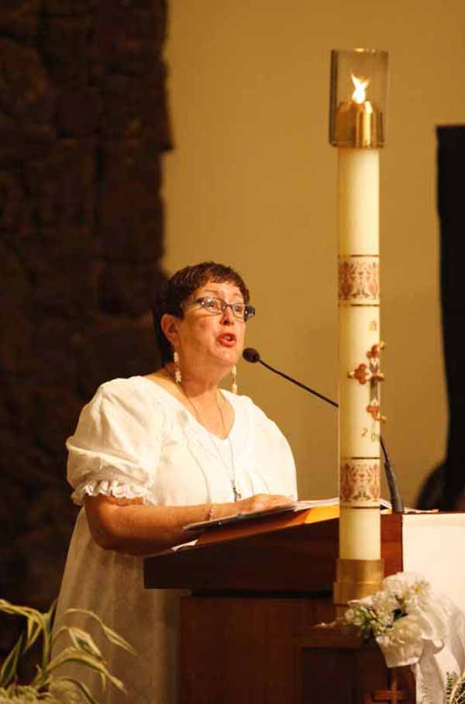
We meet the Risen Jesus present in the Word of God
Complete the sentences:
The risen Lord is present when the Word of God is …
The Spirit of the risen Jesus enables the reader to …
When the people hear the Word they reflect on what …
The followers of the risen Jesus listen to his Word and …
The Word helps the risen Jesus to be present in the hearts of the ...
R-2
S-07
Notes:
Slide 7 We meet the Risen Jesus present in the Word of God
Children read the sentences and suggest suitable endings e.g.
-proclaimed during the Liturgy of the Word in the Eucharist.
-bring the Word alive for the people listening.
-the message is for them and their lives.
-let its message help to shape their lives.
-the people. They listen to the Readings so they can go out and share their message in the world.

Slide 8
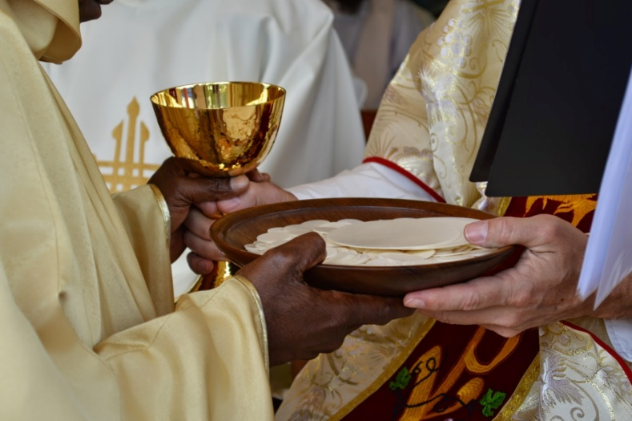
In the Eucharist we meet the Risen Jesus present in the consecrated bread and wine that is his Body and Blood
Write a question for the answer:
Q1) ______________________________________________________________
A1) The risen Jesus is present in the Eucharist in the bread that is his Body.
Q2) ______________________________________________________________
A2) In the Eucharist we receive the wine that is the risen Jesus’ Blood.
Q3) ______________________________________________________________
A3) The risen Jesus is present in the Church with us just as he was with his disciples.
Q4) ______________________________________________________________
A4) We recognise the risen Jesus in the Eucharist just as his friends did at Emmaus.
Q5) ______________________________________________________________
A5) In the bread and wine that is his Body and Blood the risen Jesus strengthens us.
R-2
S-08
Click on the worksheet button to go to the worksheet
Notes:
Slide 8 In the Eucharist we meet the Risen Jesus present in the consecrated bread and wine that is his Body and Blood
Children read the answer and write an appropriate question. Make copies of the worksheet for each child to complete and add to their RE Learning Journal.

Slide 9
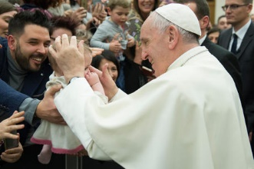
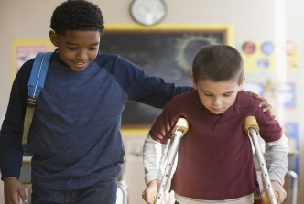
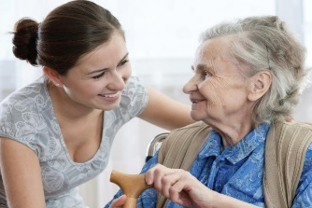
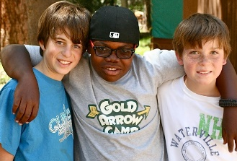
We meet the Risen Jesus through his Spirit present in People in the World
The Spirit of the risen Jesus lives in the hearts of his followers. They are carrying on the work he did while he lived on earth by showing the love Jesus showed for children. How can you see the Spirit of the risen Jesus in Pope Francis’ actions?
The Spirit of the risen Jesus is the Spirit of kindness. People who show kindness to others who are struggling are doing what Jesus did to build his Kingdom of love, peace and justice here on earth as it is in heaven.
How can you see the Spirit of the risen Jesus in the big boy’s actions?
The Spirit of the risen Jesus lives in people who show care to people who are vulnerable. Vulnerable people are who Jesus was most drawn to – the sick, the weak, the disabled and the excluded. People who comfort these people are true followers of Jesus.
How can you see the Spirit of the risen Jesus in the young woman’s actions?
The Spirit of the risen Jesus lives in the heart of children who see children of their own age struggling to fit in. Inviting them to join your group, accepting them as they are and looking out for them are ways Jesus wants his followers to act.
How can you see the Spirit of the risen Jesus in the hearts of the boys?
R-2
S-09
Click an image to reveal text.
Notes:
Slide 9 We meet the Risen Jesus through his Spirit present in People in the World
Explain to children that Jesus is not in the world now in a physical body because he has returned to heaven to be with God his Father. But Jesus sent his Spirit to the earth at the first Pentecost and people receive it through the Sacraments of Baptism and Confirmation. This is how the Spirit lives in the hearts and lives of people now. These people continue the work Jesus started to build God’s Kingdom of the love, peace and justice. It is the words and actions of these people that are some of the signs of the Spirit of the risen Jesus in the world now. People also meet the risen Jesus in the Eucharist as covered in Slides 5,6,7, 8.

Slide 10
Check Up
1)
Write 3 sentences explaining where Jesus is now. (refer to Slide 3)
2)
Name 3 ways the disciples recognised Jesus when he had risen. (refer to Slide 4)
3)
Name the 4 ways the risen Jesus is present in the Eucharist. (refer to Slides 5,6, 7,8).
R-2
S-10A
Notes:
Slide 10A Check Up
This formative assessment strategy will help teachers to identify how well children have achieved the Learning Intentions of the resource. Teachers can choose how they use the slide in their range of assessment options. A worksheet of this slide is available for children in Years 5-8 to complete.The last two items are feed forward for the teacher. Recording the children’s responses to these items is recommended as it will enable teachers to adjust their learning strategies for future resources and target the areas that need further attention.

Slide 11
Check Up
4)
Write 2 examples of how we see the Spirit of the risen Jesus in the world today.
5)
Which activity do you think helped you to learn best in this resource?
6)
Questions I would like to ask about the topics in this resource are …
R-2
S-10B
Click on the worksheet button to go to the worksheet
Notes:
Slide 10B Check Up

Slide 12
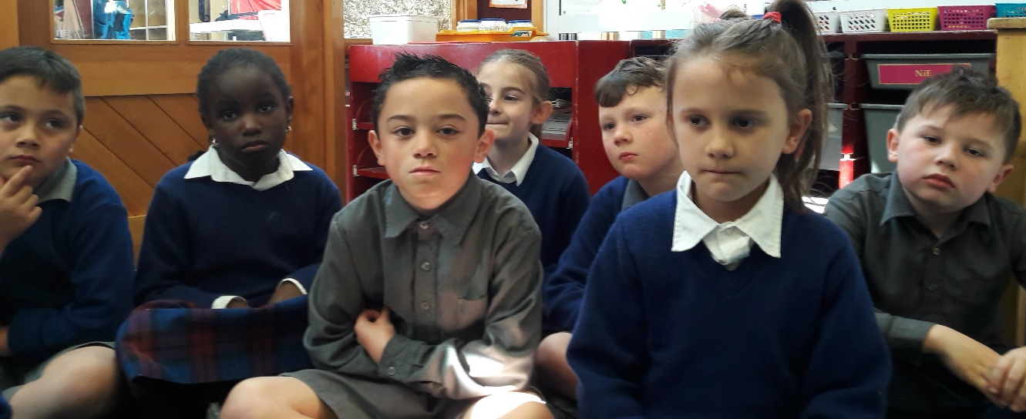
Time for Reflection
R-2
S-11
Click the audio button to stop reflective music
Click the audio button to play reflective music
Notes:
Slide 11 Time for Reflection
The MP3 is played to help create a reflective atmosphere and bring the children to stillness and silence as the teacher invites them to recall all the ways they recognise the Spirit of the risen Jesus in people around them and how they make him present by their words and actions.

Slide 13
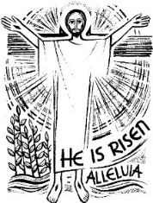
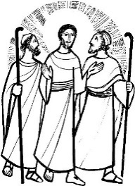
Sharing our Learning about EASTER with family whānau
Take a younger child to the church to show them the Easter Candle and explain to them how it reminds us that Jesus is the light of the world. (refer to R1, Slide 6)
Create an art work to share that captures your impression of what the last day of the world will be like. (refer to R1, Slide 9)
Make a power point about what you have learned about the importance of Easter and what Catholics believe about the Resurrection to share with your family whānau. Add speaker notes for the slides that explain what each slide is about. (refer to R1, Slide 3)
Share your Acrostic poem for the word EASTER. (refer to R1, Slide 4)
R-2
S-12A
Notes:
Slide 12A Sharing our Learning about EASTER with family whānau
This slide provides some choices for children to show and share what they have learned. Examples could be photographed as evidence of children’s learning.
You may like to put a copy of the Sharing our Learning page in children’s RE Learning Journals. You could talk through the choices using the slide and let children make their choice from their own copy.
Children could work on their choice at school and/or at home and you may like to set a day for sharing. Please let parents and whānau know what you expect them to do with this.
The slide is focussed on the 1 Achievement Objective which is covered in the 2 Year 5 resources.
AO1) Children will be able to: develop an understanding of the Easter Sunday liturgy and how people can meet the Risen Jesus today.

Slide 14
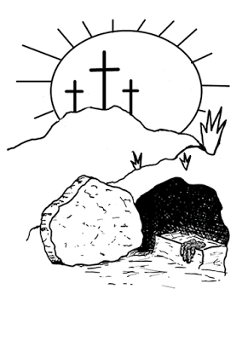
Sharing our Learning about EASTER with family whānau
Make a sketch of the Easter Candle to share with your family whānau. (refer to R1 Slide 6)
Encourage your family to attend Mass on Easter Saturday night or Easter Sunday morning. Refer to your parish bulletin. Invite other family whānau to join you. Share what you have learned about the Feast and season of Easter.
Name the symbols on the Easter Candle. (refer to R1 Slide 6)
Share your worksheet (refer to Slide 8) with a family member and talk about how the risen
Jesus is in the world today.
Make up your own way of showing and sharing what you have learned and decide whom you would like to share it with.
R-2
S-12B
Click on the worksheet button to go to the worksheet
Notes:
Slide 12B Sharing our Learning about EASTER with family whānau

Slide 15
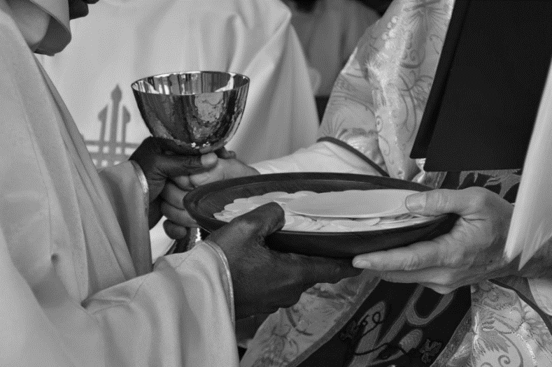
In the Eucharist we meet the Risen Jesus present in the consecrated bread and wine that is his body and blood
Write a question for the answer:
Q1) ______________________________________________________________
A1) The risen Jesus is present in the Eucharist in the bread that is his body.
Q2) ______________________________________________________________
A2) In the Eucharist we receive the wine that is the risen Jesus’ blood.
Q3) ______________________________________________________________
A3) The risen Jesus is present in the Church with us just as he was with his disciples.
Q4) ______________________________________________________________
A4) We recognise the risen Jesus in the Eucharist just as his friends did at Emmaus.
Q5) ______________________________________________________________
A5) In the bread and wine that is his body and blood the risen Jesus strengthens us.
Name:_______________
Date:____________
R-2
S-08
Worksheet
Click the up arrow to return to the presentation
Notes:
This Worksheet relates to slide 8.

Slide 16
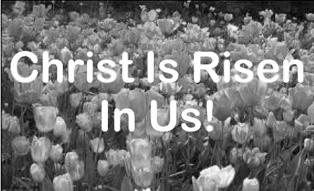
Check Up
1)
Write 3 sentences explaining where Jesus is now. (refer to Slide 3)
2)
Name 3 ways the disciples recognised Jesus when he had risen. (refer to Slide 4)
3)
Name the 4 ways the risen Jesus is present in the Eucharist. (refer to Slides 5,6, 7,8).
4)
Write 2 examples of how we see the Spirit of the risen Jesus in the world today.
Name:_______________
5)
Which activity do you think helped you to learn best in this resource?
Date:____________
6)
Questions I would like to ask about the topics in this resource are …
R-2
S-10
Worksheet
Click the up arrow to return to the presentation
Notes:
This Worksheet relates to slides 10A and 10B.

Slide 17
Sharing our Learning about EASTER with family whānau
Take a younger child to the church to show them the Easter Candle and explain to them how it reminds us that Jesus is the light of the world. (refer to R1, Slide 6)
Create an art work to share that captures your impression of what the last day of the world will be like. (refer to R1, Slide 9)
Make a power point about what you have learned about the importance of Easter and what Catholics believe about the Resurrection to share with your family whānau. Add speaker notes for the slides that explain what each slide is about. (refer to R1, Slide 3)
Share your Acrostic poem for the word EASTER. (refer to R1 Slide 4)
Make a sketch of the Easter Candle to share with your family whānau. (refer to R1 Slide 6)
Encourage your family to attend Mass on Easter Saturday night or Easter Sunday morning. Refer to your parish bulletin. Invite other family whānau to join you. Share what you have learned about the Feast and season of Easter.
Name the symbols on the Easter Candle. (refer to R1 Slide 6)
Share your worksheet (refer to Slide 8) with a family member and talk about how the risen Jesus is in the world today.
Make up your own way of showing and sharing what you have learned and decide whom you would like to share it with.
Name:____________________________
Date:____________
R-2
S-12
Worksheet
Click the up arrow to return to the presentation
Notes:
This Worksheet relates to slides 12A and 12B.

