Slide 1
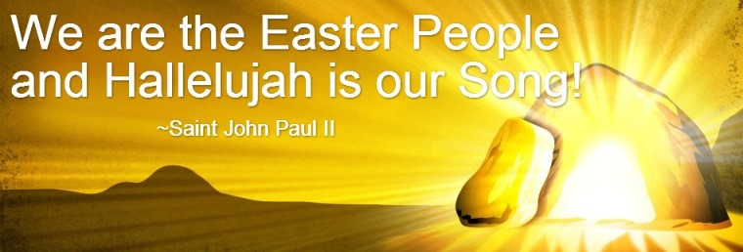
The Season of Easter
R-1
S-01
Notes:
Slide 1 The Season of Easter
Use this slide as a focussing strategy to introduce the resource topic. Read the title together and invite children to share something they know about the Season of Easter.

Slide 2
Learning Intentions
The children will:
explain the significance of the Resurrection – Te Aranga of Jesus for Christians
1)
identify three ways the joy of Easter is expressed in the celebration of the Eucharist.
2)
R-1
S-02
Click the box to reveal the Learning Intention
Notes:
Slide 2 Learning Outcomes
Recap the concepts with the children that were covered in HOLY WEEK Resource 2 before beginning this Resource.
Create an Easter Prayer focus with bright yellow cloths and candles to give a sense of the joy and hope of the feast and season. Include some Resurrection images and symbols. Try to convey to the children the change in the mood of the Easter season compared with the sadness of Holy Week. Read the after- Easter stories at prayer time – these are very important stories for the students to become familiar with to get a sense of what life was like for the apostles and the risen Jesus. Include Luke 24:13-35, The road to Emmaus, John 20: 19-31, 21: 1-19 Jesus appears to various people.
Children could create some Easter bunting to decorate the classroom with Easter words, symbols and images. It could be a great artwork theme. It can last for 50 days until Pentecost.
Explain to the children that a vigil is held at night. It is a time of waiting and praying and being with others. Vigils are sometimes held before funerals or before special feasts to prepare for the time of celebration. The most solemn of these is the Easter Vigil which is the most beautiful liturgy in the Catholic Church. It focusses around beautiful symbols and music along with ancient rituals as we await anticipating the joy of Easter and the celebration of Jesus’ Resurrection. The atmosphere in the church is different: the holy water fonts are drained, all the lights are out, the tabernacle is empty, the Paschal Candle symbolising Christ is prepared. The service begins outside the church. Ask the children to find out the times and places the Easter Vigil will be celebrated where they will be at Easter.

Slide 3
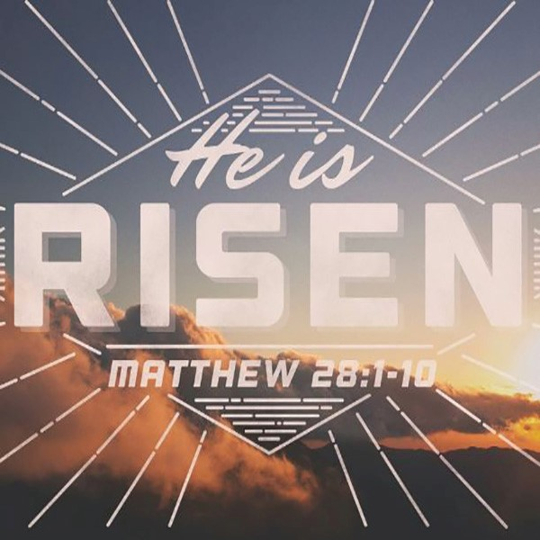
Exploring the Scripture Account of Easter
The Resurrection of Jesus According to Matthew 28:1-10
28 After the sabbath, as the first day of the week was dawning, Mary Magdalene and the other Mary went to see the tomb. ² And suddenly there was a great earthquake; for an angel of the Lord, descending from heaven, came and rolled back the stone and sat on it. ³ His appearance was like lightning, and his clothing white as snow. ⁴ For fear of him the guards shook and became like dead men. ⁵ But the angel said to the women, “Do not be afraid; I know that you are looking for Jesus who was crucified. ⁶ He is not here; for he has been raised, as he said. Come, see the place where he lay. ⁷ Then go quickly and tell his disciples, ‘He has been raised from the dead, and indeed he is going ahead of you to Galilee; there you will see him.’ This is my message for you.” ⁸ So they left the tomb quickly with fear and great joy and ran to tell his disciples. ⁹ Suddenly Jesus met them and said, “Greetings!” And they came to him, took hold of his feet, and worshiped him. ¹⁰ Then Jesus said to them, “Do not be afraid; go and tell my brothers to go to Galilee; there they will see me.”
Press the button to advance through the lines
Click the image to Reveal Matthew 28:1-10
R-1
S-03
Click the worksheet button to go to the worksheet
Notes:
Slide 3 Exploring the Scripture Account of Easter
The Easter story is a very important story for the disciples of Jesus to know and understand. You may like to use it as the focus for drama, writing or art work that could be displayed in the school or church foyer throughout the Easter season. Children could include scripture verses such as, “He is risen, he is not here,” or, “We are the Easter People and ALLELUIA is our Song”. You might also make Acrostics using ALLELUIA, HE IS RISEN, COME SEE, GO TELL
Make a copy of the worksheet for each child to complete and add to their RE Learning Journals. Children in pairs read the Matthew 28:1-10 from their worksheet, then work through each item and complete it. Use the items to generate discussion about the place of women in this story and the pattern of discipleship that it follows – come, see, go, tell (28:6-7) – this pattern is still used for disciples today. Watch for it in other gospel stories.

Slide 4
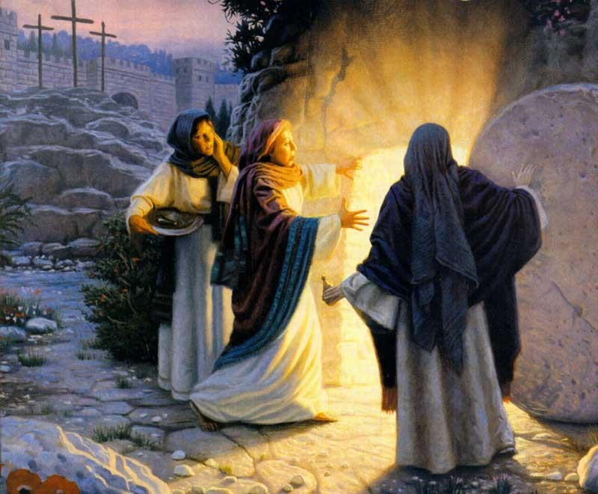
What does the Resurrection mean for Christians?
When Jesus returns to earth at his Second Coming, he will physically raise all those who have died and give them back the bodies they lost at death. These will be the same bodies people had in earthly their life but they will not die and they will be transformed into a glorified state, no suffering and pain, and able to do many of the amazing things Jesus could do with his glorified body.
3/3
Christians believe that the Resurrection is proof that God who created life has the power to restore life and that Jesus is his one true son.
Because of his Resurrection Christians, have hope that because Jesus conquered his own death, he will keep the promises he made to do the same for his followers.
2/3
Christians believe that because of the Resurrection, Jesus shares his risen life with his believers and that when they die they too will be raised to share in eternal life in heaven with God.
Christians celebrate Christ’s rising from the dead because it overcame noa the power of sin and death and made it possible for all people to be saved.
For Christians, Christ’s Resurrection guarantees that the bodies of those who believe in Christ will not remain dead but will be resurrected to eternal life.
1/3
Press the button to advance through the lines
R-1
S-04
Click the picture to reveal the pages
Notes:
Slide 4 What does the Resurrection mean for Christians?
Let the text help to open a discussion about the effect Jesus’ Resurrection had, not only on his apostles and disciples of the 1st century but for all those who have followed Jesus since. After the discussion let children name what the greatest effect of Jesus’ Resurrection is in their lives as believers and followers of Jesus – is it that when they die they will be in heaven with God and those they love forever, is it that they live with hope that Jesus will keep his promises, is it that after his Second Coming their resurrected body will feel no pain and will their glorified body be as Jesus’ body after the Resurrection? Recall what he could do after his Resurrection when he appeared to the disciples.

Slide 5
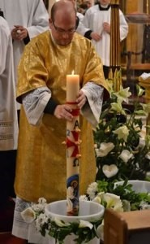
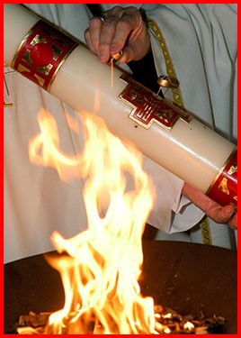
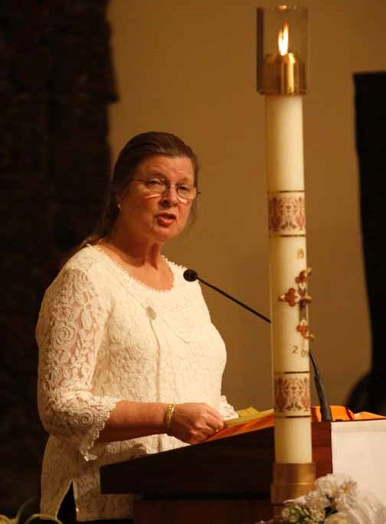
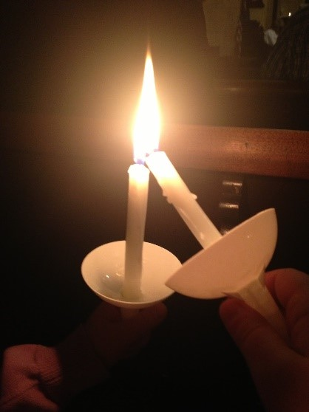
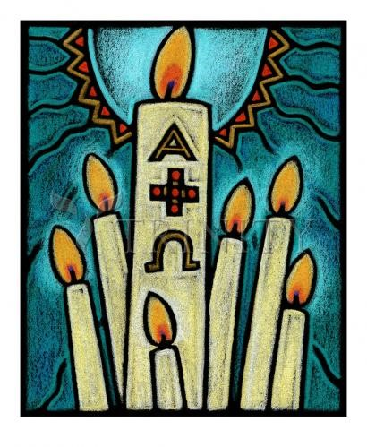
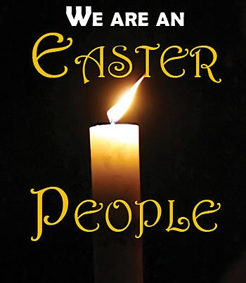
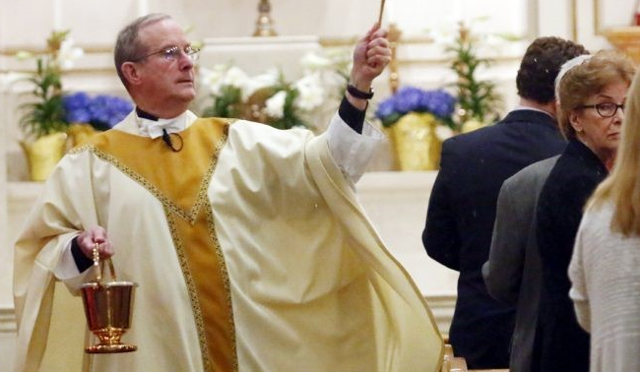
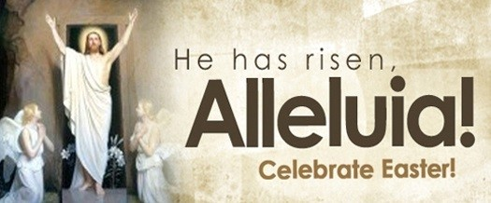
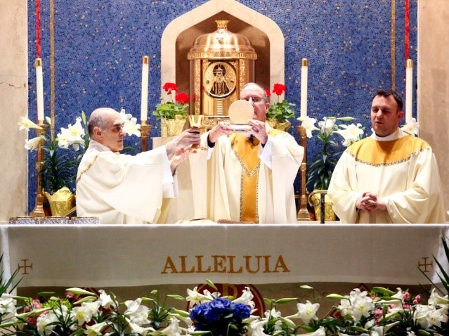
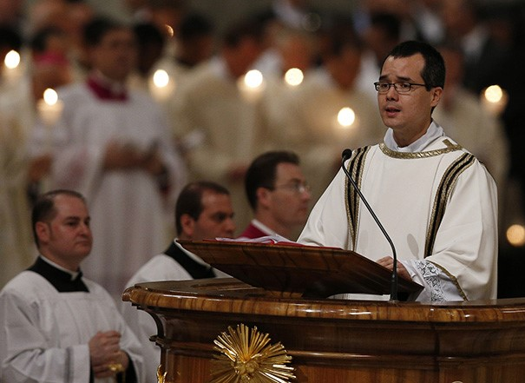
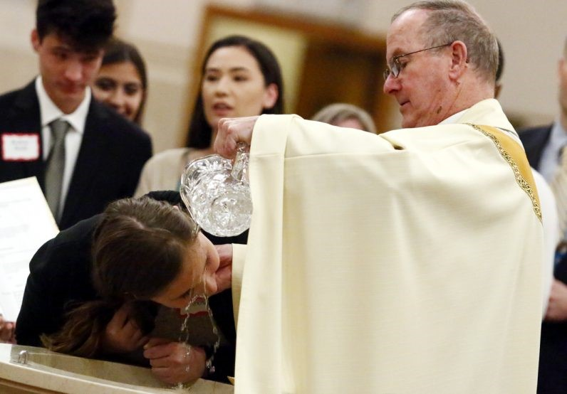
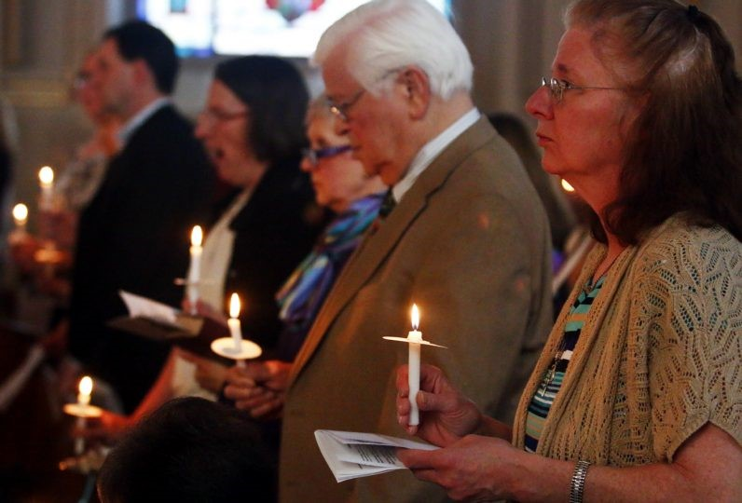
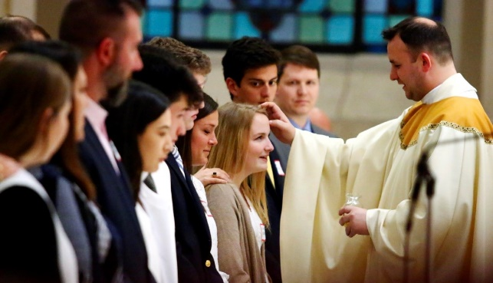
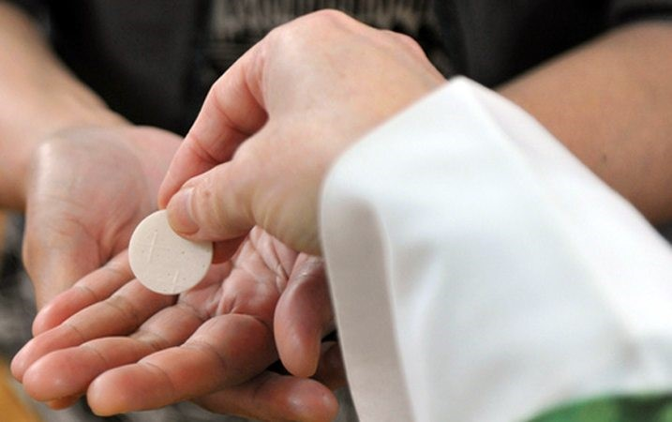
How the Church Celebrates the Resurrection in the Eucharist at the Easter Vigil and throughout the Easter Season
The word ‘Alleluia’ means Praise the Lord. This word is included in the liturgy during the 50 days of the Easter season. It expresses the joy that the community feels because Jesus has conquered death and lives again and we as his followers are given the same privilege.
14/16
The people’s candles are lit from the Easter candle and the light from their candles is passed throughout the church symbolising how people share the Christ Light with others by the way they care for them.
4/16
The Eucharist continues as the community celebrates the first Mass of Easter Day and the beginning of the celebrations of the fifty days of the Easter season which ends on Pentecost Sunday.
13/16
The Easter Candle is the symbol of the Risen Christ and the Light of Christ that he brought into a world darkened by sin. The candle is lit from the Easter fire.
3/16
The Easter Fire is a symbol of warmth and the source of light.
The Liturgy begins with the blessing of this fire and the lighting of the Paschal Candle from the fire.
2/16
The priest sprinkles the people with the new Easter water as he blesses them.
8/16
How the Church Celebrates the Resurrection in the Eucharist throughout Easter
As followers of the risen Jesus we celebrate his Resurrection every Sunday at Eucharist when we say, “Christ has died, Christ is risen, Christ will come again.” We remember every day we are an Easter people who live in the hope of our own resurrection as Jesus promised us.
16/16
Symbols of fire, light, word, water and Sacrament are woven throughout the Easter Vigil Eucharist on Holy Saturday night. They bring deeper meaning to the 4 parts of the liturgy and enrich the expressions of joy that the feast and season of Easter celebrates.
1/16
The Sacrament of the Eucharist completes the process of Initiation into the membership of the Catholic Church. It is the spiritual food we eat to grow closer to God through Jesus.
12/16
The new Easter water is blessed in the font using the Easter Candle which is plunged into the font 3 times. Lilies are used to decorate the church during the Easter season as they are a symbol of the Resurrection. Legend tells that after the Resurrection, lilies sprang up and bloomed in the Garden of Gethsemane where Jesus had prayed before he was crucified.
7/16
The Liturgy of the Word can include up to seven readings, five from the Old Testament and two from the New Testament. They tell the story of God’s saving power throughout human history and lead up to the last reading which is the gospel story of the Resurrection.
6/16
The Easter Vigil which expresses the joy of Easter comes to an end with the solemn Easter Blessing which sends people forth into the world to celebrate the Risen Jesus. The gold and white vestments the priests wear remind us that Easter is the feast and season of the greatest joy and celebration in the whole Liturgical Year.
15/16
Then the newly baptised are anointed as the bishop or priest lays his hands on their heads and seals them with the holy oil of chrism as they receive the Sacrament of Confirmation
11/16
The new Easter water is used to baptise the new members of the Church as they are welcomed through the Sacrament of Baptism.
10/16
The music in the liturgy is joyful, especially the Exsultet which is an ancient hymn in praise of God’s saving work in human history. The words express the great joy of the Resurrection of Christ. It is the Church’s most glorious hymn. At this time bells are rung to add to the Easter joy.
5/16
The people renew their Baptismal Promises.
The community stands and renews their baptismal promises together.
9/16
Click the cards to flip the pages
R-1
S-05
Click the audio button to play ‘Easter Alleluia’
Click the audio button to stop ‘Easter Alleluia’
Click the video button to play ‘The Exsultet’
Notes:
Slide 5 How the Church Celebrates the Resurrection in the Eucharist at the Easter Vigil and throughout the Easter Season
Watch the clip when Flip Card 5 appears
https://www.youtube.com/watch?v=VVlOGED_avw
The Exsultet - St John's Abbey, 2011 Easter Vigil 11:07 Minutes
The image is not the best but the voice and diction of the monk singing is wonderful. Let the children listen to a few minutes of it up to, ‘This is the night’. You might also use it in prayer this week.
Sing using the MP3 at the end of the Flip Cards.
‘Easter Alleluia’
Explain as you read the flip cards and share ideas the reasons for the importance of the Easter Vigil as the most important and memorable celebration in the whole Liturgical Year. Explain the importance of symbols in helping people to understand and imagine what a momentous event it was in the history of humanity. Remind children that every Sunday is another Easter Sunday when we recall again in the words, symbols and rituals of the Mass that Jesus rose from the dead and the affect that it has had on our lives as his followers today.
Adapt Teaching and Learning Experience 4.

Slide 6
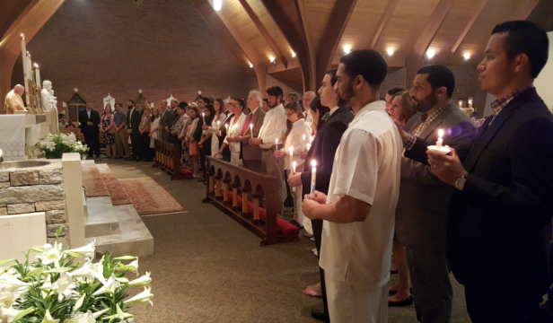
The Resurrection is the great
feast of hope for Christians
made to them of life forever with God after death.
The hope that Christians have is based on the promises Jesus
It is through the power of the Holy Spirit
that Christians are able to place their hope for everlasting life in Jesus.
Our hope as the followers of Jesus today
is based on what he taught people while he lived on earth.
If Jesus was not resurrected from the dead
then we have no hope that we will be either.
Christian hope is a belief in a sure reality of the real event
of Christ’s Resurrection and his promise of eternal life with him.
Jesus promised to share his risen life with those who love him
it is Christians’ belief in this that is the foundation of their hope and joy.
is based on what he taught people while he lived on earth.
B) then we have no hope that we will be either.
C) made to them of life forever with God after death.
D) it is Christians’ belief in this that is the foundation of their hope and joy.
E) of Christ’s Resurrection and his promise of eternal life with him.
F) that Christians are able to place their hope for everlasting life in Jesus.
R-1
S-06
Click the text at the bottom to reveal the complete statements
Notes:
Slide 6 The Resurrection is the great feast of hope for Christians
Read the first part of the sentence and then ask children to find the correct statement to complete it. Listen to the suggestions and check each one with the floating tool.
ANSWERS
1) C, 2) F, 3) A, 4) B, 5) E, 6) D

Slide 7
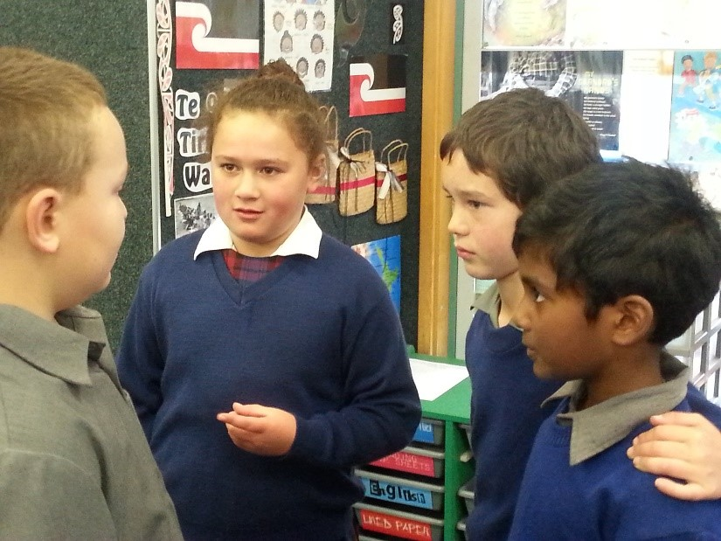
Recognising how we share in Jesus’ Death and Resurrection in our lives each day
Every day we have experiences that cause us pain – they are like little deaths. These are often followed by little resurrections when we are able to rise up, strengthened to overcome what caused our hurt or disappointment and start a new stronger life.
Reflect on your own life and identify times when you have been hurt, disappointed, excluded, put down, criticised, bullied, overlooked or ignored.
Reflect on experiences you have had of being raised up from these painful experiences. How did these resurrection experiences happen? What or who gave you the strength to rise up and carry on? How do you give others strength to rise up to a new way of being themselves, a new way of speaking up for themselves and expressing what they stand for – a new life? This is how we share in Jesus’ death and Resurrection on earth today as we look forward to eternal life with him in heaven.
Look at the image and create a story around this death and resurrection situation to share.
R-1
S-07
Press the button to advance through the lines
Notes:
Slide 7 Recognising how we share in Jesus’ Death and Resurrection in our lives each day
It is important to help the children recognise the pattern in nature and in life of dying and rising – death and resurrection. Take time to look at the school gardens at the moment to notice the dying and rising of nature all around. You could discuss the dying moments in everyday life and focus on showing children how to recognise them and deal with them. Help them to see they can be part of other children’s rising experiences. Helping them to be more aware of this is part of nurturing their spiritual lives. As their spiritual guide they will notice how you help to raise people up. Explain when this happens it is a tiny sample of what their Resurrection will be like when they will rise with Jesus and all their family and friends when Jesus comes again. Help them to understand the Resurrection is happening now through the help of the Holy Spirit in our lives each day.

Slide 8
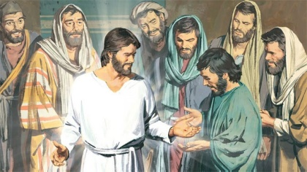
Thinking about the Meaning and the
Effects of the Resurrection of Jesus
Write a question for each answer
Q1 _____________________________________________________________
A1 The Paschal Mystery is that Christ had to suffer and die to save us from sin and death and to rise with him to a new and glorious life.
Q2 _____________________________________________________________
A2 If there was no Resurrection, there would have been no gospels and no Church because there would be no faith in Jesus.
Q3 _____________________________________________________________
A3 After his Resurrection Jesus had a completely resurrected body – we will have the same when we are resurrected after Christ comes a second time.
Q4 _____________________________________________________________
A4 The empty tomb, the Resurrection stories in the 4 gospels which were told by the apostles and their eye witness accounts of being with the risen Jesus.
Q5 _____________________________________________________________
A5 Jesus’ appearances after his Resurrection transformed the disciples from beaten, discouraged men who were afraid for their lives, to fearless preachers most of whom died, rather than deny their faith in the risen Jesus.
R-1
S-08
Click the worksheet button to go to the worksheet
Notes:
Slide 8 Thinking about the Meaning and the Effects of the Resurrection of Jesus
Read the answers and think about a question to match them. Children can work with a partner trying out each other’s questions and checking if they match the answer.

Slide 9
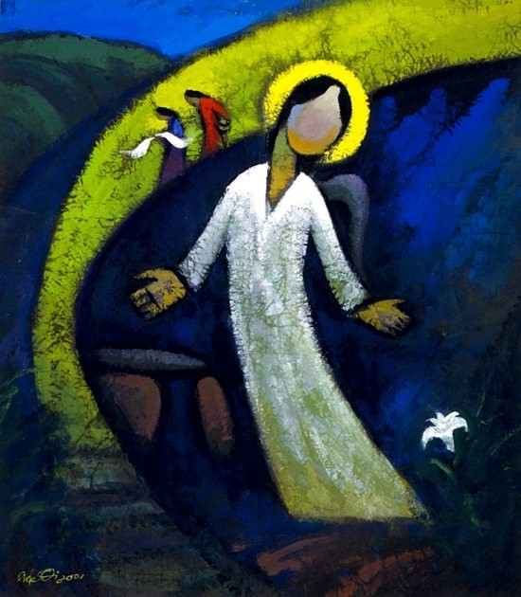
Summarising the meaning of the Resurrection and the difference it makes to my life.
The Resurrection of Jesus Christ
R-1
S-09
Click the worksheet button to go to the worksheet
Notes:
Slide 9 Summarising the meaning of the Resurrection and the difference it makes to my life.
Brainstorm all ideas that children have thought about and discussed in this resource. Make copies of the worksheet for children to complete. When they have been completed the children share what they have in each column and add further important ideas they hear. Note the WONDERINGS on the whiteboard and deal with some each day. Seek help if you need to – you could ask your parish priest to come and help.

Slide 10
Check up
Read the account of the Resurrection story again. Who were the first people to learn that Jesus had risen? Write how this happened and what it tells us about Jesus. (Slide 3)
1)
2)
Make a list of 5 reasons why the Resurrection is so important for Christians. (Slide 4)
3)
Describe 4 different ways the Easter Vigil expresses the joy of the Resurrection. Name 3 symbols that do this also. (Slide 5)
4)
Explain why Easter is the feast of hope. (Slide 6)
5)
Write a reflection about how we experience Jesus’ death and Resurrection in
our lives each day. (Slide 7)
6)
Which activity do you think helped you to learn best in this resource?
7)
Questions I would like to ask about the topics in this resource are …
R-1
S-10
Click the worksheet button to go to the worksheet
Notes:
Slide 10 Check Up
This formative assessment strategy will help teachers to identify how well children have achieved the Learning Intentions of the resource.
Teachers can choose how they use the slide to assess each item.
A worksheet of this slide is available as an option for children to complete.
The last two items are feed forward for the teacher.
Recording the children’s responses to these items is recommended as it will enable teachers to adjust their learning strategies for future resources and target the areas that need further attention.

Slide 11
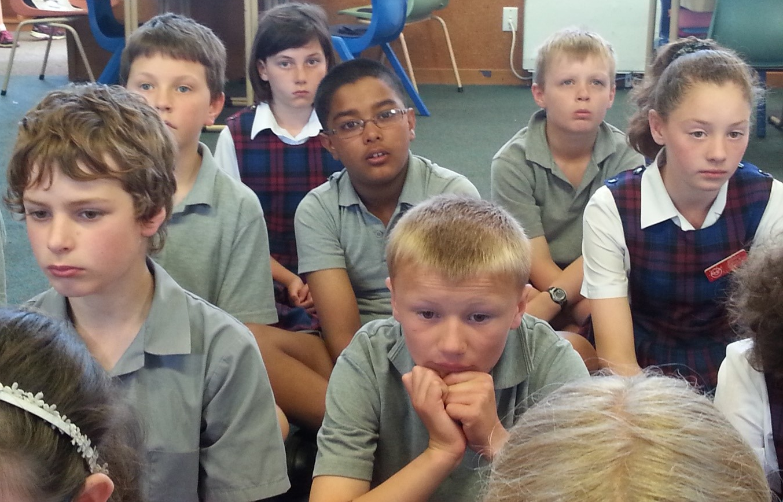
Time for Reflection
R-1
S-11
Click the audio button to stop Reflective Music
Click the audio button to play Reflective Music
Click the audio button to play reflective music
Notes:
Slide 11 Time for Reflection
The MP3 is played to help create a reflective atmosphere and bring the children to stillness and silence as the teacher invites them to reflect on the death and Resurrection experiences they have had recently. Talk to Jesus about them and ask him to help them to rise up after them to a new and stronger way of being. Remember because of Jesus’ Resurrection they can hope for a new way of being- here on earth and in heaven forever.

Slide 12
Exploring the Scripture Account of Easter
Name:____________________________
Date:____________
Write a response to each of the following
1) The time and day of the Resurrection
2) The first people to hear the news of the Resurrection
3) What proof did the angel show them that Jesus was not in the tomb?
4) Describe the angel of the Lord
5) The guards’ response to the angel of the Lord
6) The women’s response to the angel of the Lord
7) The angel’s instructions to the women
8) How did Jesus suddenly appear to them?
9) The women’s reaction to seeing Jesus
10) The disciples’ response to the women’s message
R-1
S-03
Worksheet
Click the up arrow to return to the presentation

Slide 13
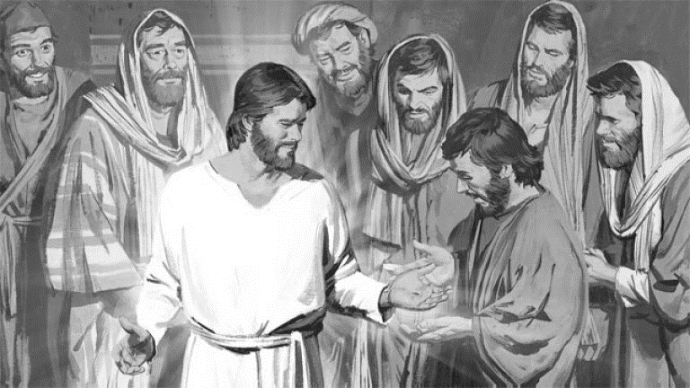
Thinking about the Meaning and the
Effects of the Resurrection of Jesus
Name:
Write a question for each answer
Date:
Q1 _____________________________________________________________
A1 The Paschal Mystery is that Christ had to suffer and die to save us from sin and death and to rise with him to a new and glorious life.
Q2 _____________________________________________________________
A2 If there was no Resurrection, there would have been no gospels and no Church because there would be no faith in Jesus.
Q3 _____________________________________________________________
A3 After his Resurrection Jesus had a completely resurrected body – we will have the same when we are resurrected after Christ comes a second time.
Q4 _____________________________________________________________
A4 The empty tomb, the Resurrection stories in the 4 gospels which were told by the apostles and their eye witness accounts of being with the risen Jesus.
Q5 _____________________________________________________________
A5 Jesus’ appearances after his Resurrection transformed the disciples from beaten, discouraged men who were afraid for their lives, to fearless preachers most of whom died, rather than deny their faith in the risen Jesus.
R-1
S-08
Worksheet
Click the up arrow to return to the presentation
Notes:
Read the answers and think about a question to match them. Children can work with a partner trying out each other’s questions and checking if they match the answer.

Slide 14
Name:____________________________
Date:____________
Topic: The Resurrection of Jesus Christ
What do I KNOW? | What do I WONDER? | What have I LEARNT?
R-1
S-09
Worksheet
Click the up arrow to return to the presentation

Slide 15
Check up
Name:____________________________
Date:____________
1) Read the account of the Resurrection story again. Who were the first people to learn that Jesus had risen? Write how this happened and what it tells us about Jesus. (Slide 3)
2) Make a list of 5 reasons why the Resurrection is so important for Christians. (Slide 4)
3) Describe 4 different ways the Easter Vigil expresses the joy of the Resurrection. Name 3 symbols that do this also. (Slide 5)
4) Explain why Easter is the feast of hope. (Slide 6)
5) Write a reflection about how we experience Jesus’ death and Resurrection in our lives each day. (Slide 7)
6) Which activity do you think helped you to learn best in this resource?
7) Questions I would like to ask about the topics in this resource are …
R-1
S-10
Worksheet
Click the up arrow to return to the presentation

