Slide 1
The Easter Vigil
R-1
S-01
Notes:
Slide 1 The Easter Vigil
Use this slide as a focussing strategy to introduce the resource topic. Read the title together and invite students to share something they know about the Easter Vigil which is the celebration of Jesus’ Resurrection in the parish community.

Slide 2
Learning Intentions
The students will:
1)
recognise how the Easter Vigil is celebrated in the parishes
2)
identify the four parts of the Easter Vigil.
R-1
S-02
Click the borders to reveal the text.
Notes:
Slide 2 Learning Intentions
Create an Easter Prayer focus with bright yellow cloths and candles to give a sense of the joy and hope of the feast and season. Include some Resurrection images and symbols. Try to convey to the students the change in the mood of the Easter season compared with the sadness of Holy Week. Read the after- Easter stories at prayer time – these are very important stories for the students to become familiar with to get a sense of what life was like for the disciples and the risen Jesus.
Include
Luke 24:13-35, The road to Emmaus
John 20: 19-31, Jesus appears to various people, 21: 1-19 Breakfast by the sea
Children could create some Easter bunting to decorate the classroom with Easter words, symbols and images. It could be a great artwork theme. It can last for 50 days until Pentecost.
Explain to the children that a vigil is held at night. It is a time of waiting and praying and being with others. Vigils are sometimes held before funerals or before special feasts to prepare for the time of celebration. The most solemn of these is the Easter Vigil which is the most beautiful liturgy in the Catholic Church. It focusses around beautiful symbols and music along with ancient rituals as we wait in anticipation of the joy of Easter and the celebration of Jesus’ Resurrection. The atmosphere in the church is different: the holy water fonts are drained, all the lights are out, the tabernacle is empty, the new Paschal Candle symbolising Christ is prepared. The service begins outside the church. Ask the children to find out the times and places the Easter Vigil will be celebrated where they will be at Easter.

Slide 3
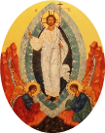
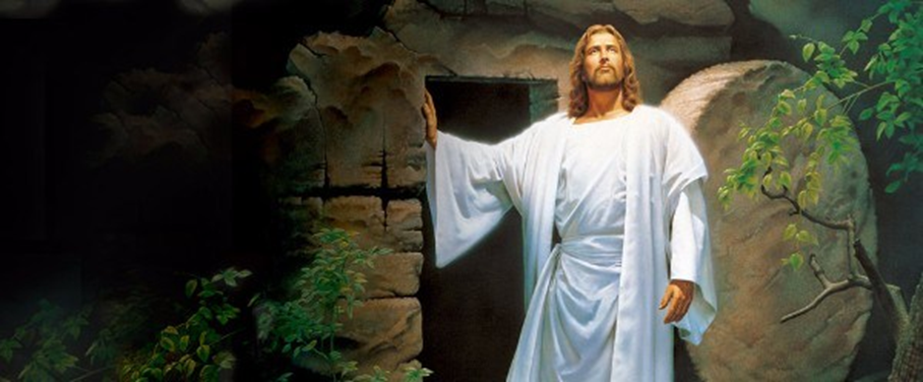
Easter is the Feast of Jesus’ Resurrection - the most important Feast of the Church’s Liturgical Year because …
… it celebrates Christ’s rising from the dead and overcoming noa the power of sin and death and accomplishing the salvation of all people.
… it guarantees that the bodies of those who believe in Christ will not remain dead but will be resurrected to eternal life.
… it proves that God who created life has the power to restore life.
… it validates that Jesus was who he claimed to be – God’s own son.
Jesus conquered his own death and he promises the same for his followers.
… every other religion was founded by men or prophets whose end was the grave – Jesus is risen and sits at the right hand of God his Father and will come again in glory on the last day.
X
1
2
3
4
5
… every other religion was founded by men or prophets whose end was the grave – Jesus is risen and sits at the right hand of God his Father and will come again in glory on the last day.
Jesus conquered his own death and he promises the same for his followers.
… it validates that Jesus was who he claimed to be – God’s own son.
… it proves that God who created life has the power to restore life.
… it guarantees that the bodies of those who believe in Christ will not remain dead but will be resurrected to eternal life.
… it celebrates Christ’s rising from the dead and overcoming noa the power of sin and death and accomplishing the salvation of all people.
6
R-1
S-03
Click the icons on the left to display the reasons. Click the large image to see a summary.
Notes:
Slide 3 Easter is the Feast of Jesus’ Resurrection - the most important Feast of the Church’s Liturgical Year because …
Use the text to initiate conversations about the meaning of each item. Explain to the children that the Jewish calendar counts each new day starting at sun down an ending at sundown the next day. Jesus rose on the ‘third day’ some time early on Sunday morning. According to ancient tradition this night before the Resurrection is one of vigil - of watching and waiting in anticipation of the Resurrection and then culminating in great joy and celebration because Jesus is risen from the dead.

Slide 4
On Easter Saturday Evening the community gathers in their parish church to celebrate the Easter Vigil
The celebration of the Easter Vigil helps Catholics to recall and deepen their belief about what the Resurrection of Jesus means in their lives.
When Jesus rose from the dead he had a new body and a new and glorious life that will never end. This is a mystery we cannot fully understand.
Because of his love for people, Jesus’ Resurrection means that all people will be raised with him from the dead to share in his new and glorious life with God, as brothers and sisters of Christ.
This is why we have Easter eggs because eggs are a sign of new life. The power of Jesus’ love aroha given in his life and death frees people from all sin.
It is these beliefs about the Resurrection that make it the most important event in human history and in the life of the People of God and the major celebration in the life of the Church every Liturgical Year.
R-1
S-04
Click the down-button to move the blind down.
Notes:
Slide 4 On Easter Saturday Evening the community gathers in their parish church to celebrate the Easter Vigil
What is going on in this picture and what is it part of?
Name the central belief Christians have about Jesus? (Died and rose from death.) Can you name 3 advantages Jesus’ followers are given because Jesus rose from the dead? (Raised to eternal life with God, brought new life into the world, proves Jesus is God’s son and he keeps his promises.) What does the power of Jesus’ love given in his life and death do for people? (Frees them from sin). Because Jesus did not seek revenge on those who put him to death, he destroyed evil, and good will triumph over evil in the end and God’s kingdom will reign on earth as it is in heaven. Where have you heard those words before? – in the Our Father, the prayer Jesus taught us. Take time to talk about this, so children can grow in understanding of these important Christian beliefs.

Slide 5
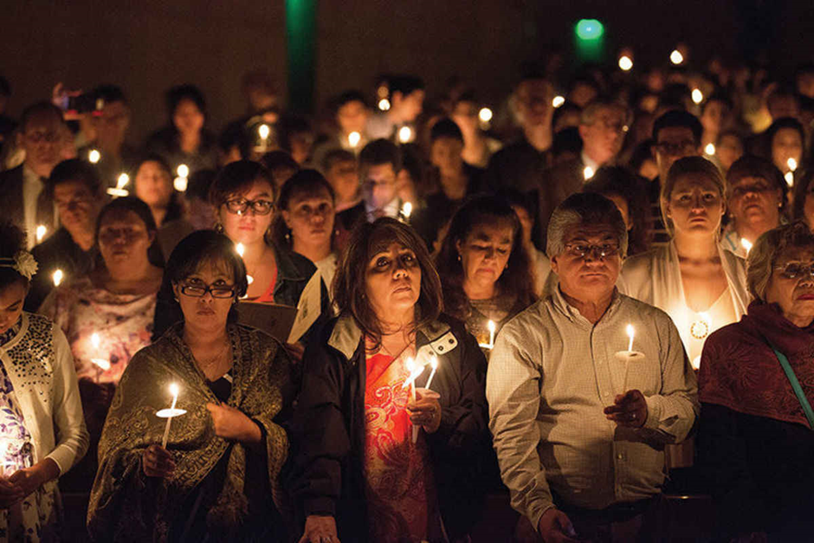
The Church Celebrates the Resurrection of Jesus
The Liturgy of the Word recaps from the beginning of creation all that God has done for his people down through the ages. It heightens the expectation of the climax of God’s greatness and goodness when it is proclaimed in the Gospel story of the Resurrection of Jesus.
The Easter Vigil is celebrated in every parish usually during the evening on Holy Saturday. It begins in the expectation and excitement of Jesus’ Resurrection. It is a long ceremony divided into 4 parts.
The Liturgy of Baptism gives the community the opportunity to welcome new people into the Church and to renew their own baptismal promises. The Liturgy of the Eucharist is celebrated bringing the people together as they proclaim their faith – Christ has died, alleluia. Christ is risen, alleluia. Christ will come again, alleluia.
The church is decorated with yellow, gold and white to create a sense of celebration in the community. White flowers, often lilies, bells, music, the Easter fire, tapers, candles especially the large Paschal Candle, incense, beautiful altar cloths and priest’s vestments all contribute to the beauty and joy of the occasion.
Click the pins on the right to reveal post-it notes.
Click the video button to watch “Catholic – Easter Vigil.
R-1
S-05
Notes:
Slide 5 The Church Celebrates the Resurrection of Jesus
The children work in 4 groups each taking one PIN and they read and discuss it and present it to the rest of the class.
https://www.youtube.com/watch?v=gO5romstsQY
Catholic - Easter Vigil (5:41 Minutes)
The clip may be helpful - some parts are dated – Teacher needs to pre-view.
Please explain to children
Alleluia or Hallelujah comes from a Hebrew phrase which means “Praise the Lord!” 'Hallel' is the Hebrew word for 'praise', and 'Yah' is the short form of 'Yahweh’ - the old Jewish name for God. Alleluia is added to prayers during the Easter season and should be part of class prayer to remind people this is a season of great joy.
Remind children that attending the Easter Vigil is the preferred way to celebrate Easter and to get a sense of this great event. If this is not possible, Mass on Sunday morning is a great alternative.

Slide 6
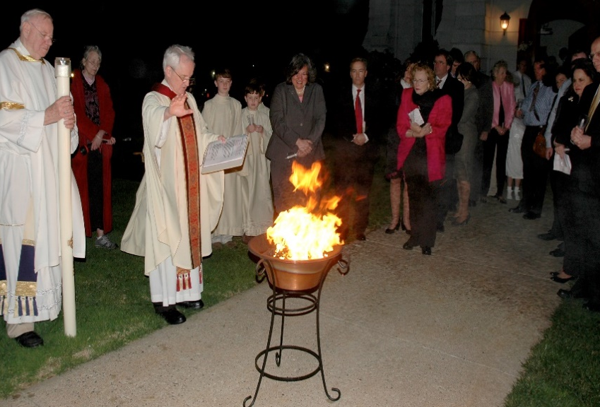
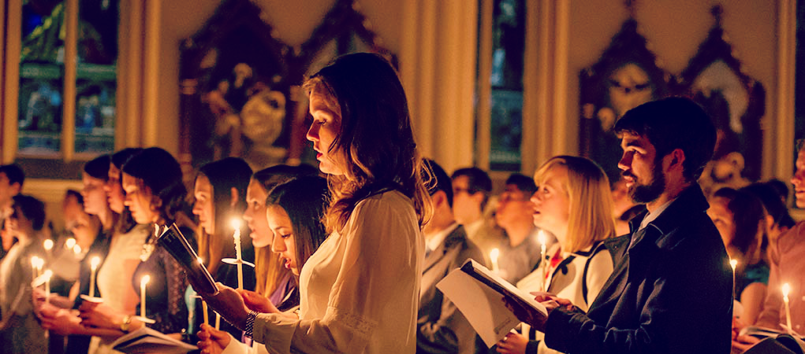
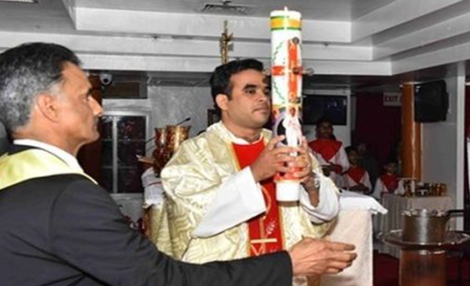
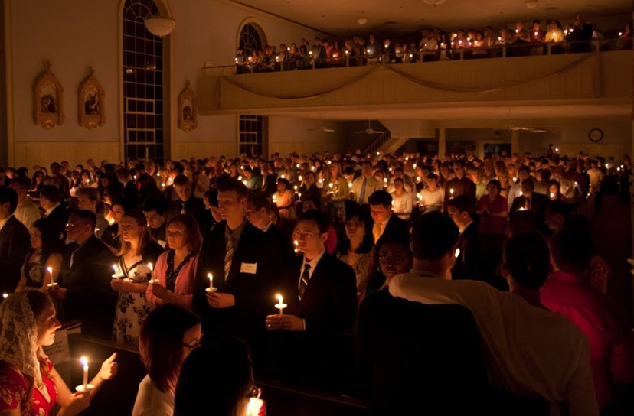
The Service of Light
The Exsultet is an ancient hymn of praise for God’s saving work in human history especially in the Resurrection of Christ. This is the Church’s most glorious hymn and it announces the dignity and meaning of the mystery of Easter.
The Passing of the Easter Candle Light around the community. The smaller candles held by the community are lit from the Paschal Candle as they make their way into the Church, symbolising the new life each of us receives from Christ. Just as the church brightens as the light of Christ spreads from person to person, so too is the world transformed when we spread the light of Christ in it. The Easter candle is placed in the stand while the Exsultet is sung.
The Procession of the Paschal Candle. The Paschal Candle, representing the light of Christ rising from the tomb, is then brought into the darkened church. The priest raises the candle high for all to see as he moves into the church singing, “Christ our Light” and the people respond singing, “Thanks be to God.” This is done 3 times as the priest moves through the people towards the altar.
The Preparation of the Easter Candle. The priest cuts a cross shape into the candle, then adds the Greek letters - A for Alpha, beginning, and O for Omega, end, and the numbers to signify the coming year. Last of all he adds 5 grains of incense in the form of a cross representing Jesus’ wounds on the cross saying:
1
2
The Easter Fire is usually lit outside the doors of the church. The Liturgy begins with the blessing of this Paschal fire and the lighting of the Paschal Candle from the fire. Paschal is a Latin word meaning “Easter.”
5
3
4
Click the panels in sequence to reveal the image and an explanation.
Click the video button to watch “The Exsultet – St. John’s Abbey, 2011 Easter Vigil”.
R-1
S-06
Notes:
Slide 6 The Service of Light
The Service of Light is the first part of the Easter Vigil. Click on card 1 and read an explanation of this part of the liturgy. Click card 2 – the Preparation and lighting of the new Easter Candle – read an explanation of this. Click card 3 and read the text. Click card 4 and read the text about the passing of the light from the Easter Candle around the community gathered. The Service of light part of the Vigil come to a conclusion with the singing of the Exsultet – read the notes below.
Watch the clip
https://www.youtube.com/watch?v=VVlOGED_avw
The Exsultet - St John's Abbey, 2011 Easter Vigil (11:07 Minutes) The excellent voice and diction of the monk on this clip of the Exsultet will give the children a sense of this very old and solemn prayer prayed at the Easter Vigil. Because the image is blurry you might just let the children listen to some of it especially up until the ‘This is the night …’ This refers to the night we celebrate the greatest event in human history.

Slide 7
The Liturgy of the Word
The Liturgy of the Word can include up to seven readings, five from the Old Testament and two from the New Testament and each is followed with a sung psalm. Each of the readings relates to another stage of salvation history, that is the history of God’s saving work among his people. It reaches the highest point in salvation history with the proclamation of the Gospel relating the story of the Resurrection.
R-1
S-07
Notes:
Slide 7 The Liturgy of the Word
The 2nd part of the Vigil is the Liturgy of the Word.
Children read the text on the slide in pairs and answer the questions.
How many readings are read at the Easter Vigil? What do they tell the story of? What is the highest point of the Liturgy of the Word?
What else is part of the Liturgy of the Word? (The Prayers of Intercession for the Church and the World - the same in all churches.)

Slide 8
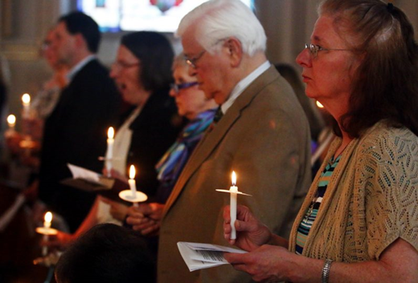
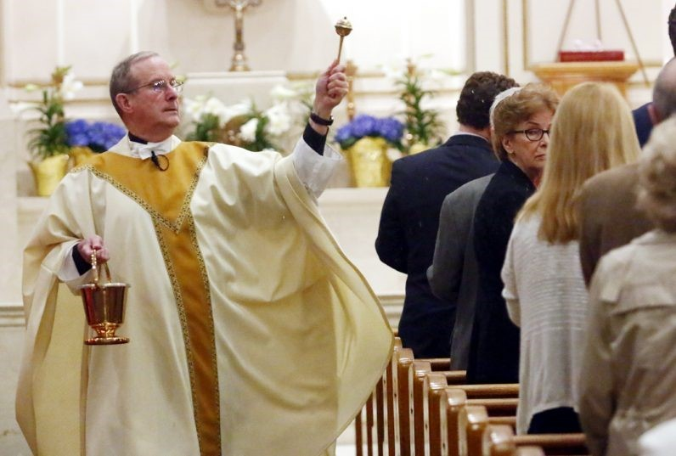
The Baptismal Liturgy
Immediately following the blessing of the new holy Easter water it is sprinkled on the community as the priest blesses them.
The Renewal of the Baptismal Promises The community stands and renews their baptismal promises together.
The Blessing of the Baptismal Water by the priest in the font leads into the Baptismal Liturgy.
R-1
S-08
Click the buttons on the left to learn about the Baptismal Liturgy
Notes:
Slide 8 The Baptismal Liturgy
The Baptismal Liturgy begins with the priest using the new Paschal Candle to bless the new Easter water. Then, with the new water, he blesses the community and then he baptises people who have been preparing to become members of the Church – the Catechumens. As this happens the Paschal Candle stands beside the baptism font as a symbol of Christ.

Slide 9
The Rites of Initiation at the Easter Vigil
The Sacrament of the Eucharist completes the process of Initiation into the membership of the Catholic Church. It is the spiritual food we eat to grow closer to God through Jesus. It helps us to become stronger as his followers to live his way and carry on his mission to build his kingdom here on earth. Remember receiving holy communion regularly helps us to follow our personal call to holiness.
Then the newly baptised are anointed as the bishop or priest lays his hands on their head and seals them with the holy oil of chrism while saying, “Be sealed with the gift of the Holy Spirit.” This sacred gesture used during the Sacrament of Confirmation brings people through all generations into the grace and power of the first Pentecost. Their sponsor stands beside them as a sign of the support they offer them along the ways of their new faith journey.
Now is the time when people who have been preparing to become part of the Church (catechumens) and part of the body of Christ through the Sacrament of Baptism. The priest baptises them with the newly blessed Easter water saying, “I baptise you in the name of the Father, and of the Son and of the Holy Spirit.” Baptism marks people with a spiritual character for the rest of our lives which stays with us until we meet God face to face.
R-1
S-09
Click the buttons on the left to learn about the Rites of Initiation at the Easter Vigil
Notes:
Slide 9 The Rites of Initiation at the Easter Vigil
One person reads the text and the class joins in when the words of Baptism are said.
The Baptism is followed by the Sacrament of Confirmation when the Holy Spirit received at Baptism is strengthened within them as they go out into the world as children of God, new followers of Jesus and members of his Church. What can you say about the effects of the Sacrament of Baptism?

Slide 10
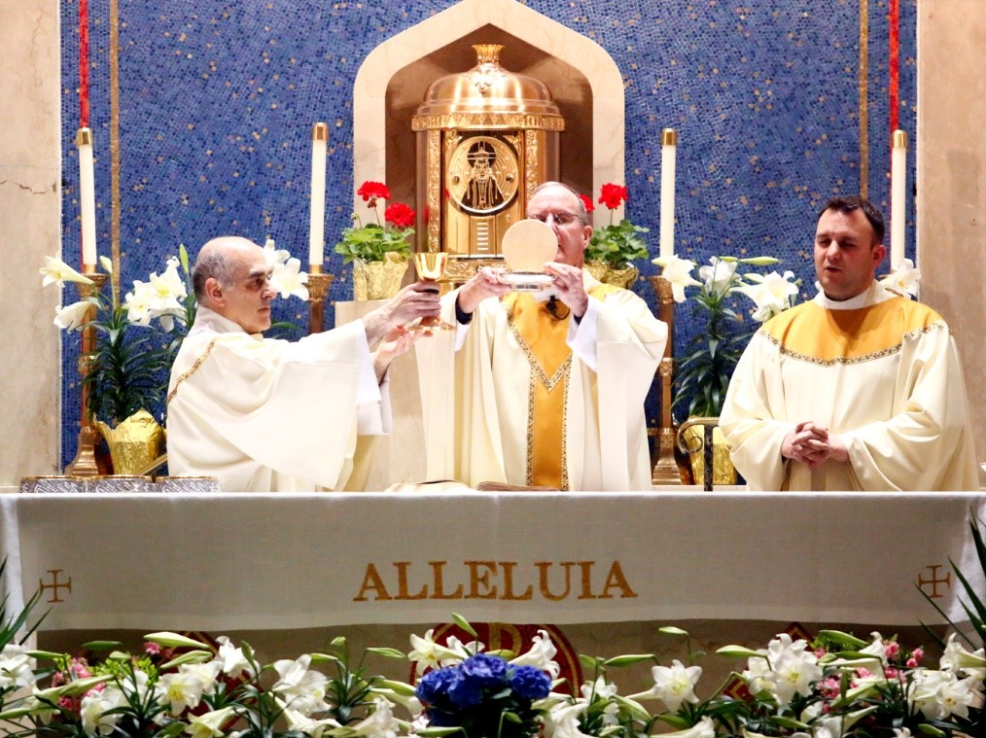
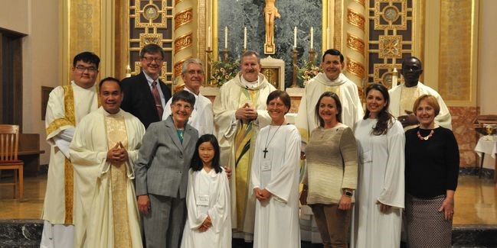
The Liturgy of the Eucharist
The Concluding Rites include a solemn blessing and Alleluia and these bring this long and beautiful celebration to a close. People leave together to go and continue to rejoice that Jesus is risen.
Concluding
Rites
As the Mass comes to an end the new members of the Church are presented to the community and welcomed into their parish community.
The Liturgy of the Eucharist follows the Baptismal Rite and it continues in its usual pattern. The newly baptised people receive their first communion along with the whole community. This is the first Mass of Easter Day and the beginning of the celebrations of the fifty days of the Easter season which ends on Pentecost Sunday.
R-1
S-10
Click the buttons on the left to learn about the Rites of Initiation at the Easter Vigil
Notes:
Slide 10 The Liturgy of the Eucharist
Read the text and tell a partner what happens in the fourth part of the Easter Vigil – the Liturgy of the Eucharist. What is the same and what is different about this celebration of the Eucharist?
There are newly baptised people receiving their first communion.
The Eucharist has been preceded by 3 special liturgical rituals that only happen once a year. It is the first Mass of the Feast and Season of Easter that last 50 days. Can you name the 4 parts of the Easter Vigil?

Slide 11
Check up
1)
Name 3 reasons why Easter is the most important feast and season of the Liturgical Year. (Slide 3)
2)
Name the 4 parts of the Easter Vigil and put them in order and write something you know about each part. (Slides 5, 6,7,8,9,10)
3)
What makes the Liturgy of the Word special at the Easter Vigil Mass? (Slide 7)
4)
Make a flow chart to show the process of Initiation used during the Easter Vigil by which people become members of the Catholic Church. (Slide 9)
5)
Name 4 examples the community participate in special ways in the Easter Vigil Mass. (Slides 6,8,10)
6)
Which activity do you think helped you to learn best in this resource?
7)
Questions I would like to ask about the topics in this resource are …
Click in each caption space to reveal text
Click on the worksheet button to go to the worksheet.
R-1
S-11
Notes:
Slide 11 Check Up
This formative assessment strategy will help teachers to identify how well students have achieved the Learning Intentions of the resource.
Teachers can choose how they use the slide in their range of assessment options.
A worksheet of this slide is available for students in Years 5-8 to complete.
The last two items are feed forward for the teacher.
Recording the students’ responses to these items is recommended as it will enable teachers to adjust their learning strategies for future resources and target the areas that need further attention.

Slide 12
Time for Reflection
R-1
S-12
Click the audio button to stop reflective music
Click the audio button to play reflective music
Notes:
Slide 12 Time for Reflection
The MP3 is played to help create a reflective atmosphere and bring the students to stillness and silence as the teacher invites them to reflect on the reasons why Easter is the greatest feast in the whole Liturgical Year and how Jesus’ Resurrection is the most remarkable event in all human history – he is the only person ever to have risen from the dead. Ask yourself – how will I celebrate this amazing event this year?

Slide 13
Check up
Name:____________________________
Date:____________
Name 3 reasons why Easter is the most important feast and season of the Liturgical Year. (Slide 3)
2. Name the 4 parts of the Easter Vigil and put them in order and write something you know about each part. (Slides 5, 6,7,8,9,10)
3. What makes the Liturgy of the Word special at the Easter Vigil Mass? (Slide 7)
Make a flow chart to show the process of Initiation used during the Easter Vigil by which people become members of the Catholic Church. (Slide 9)
5. Name 4 examples the community participate in special ways in the Easter Vigil Mass. (Slides 6,8,10)
6. Which activity do you think helped you to learn best in this resource?
7. Questions I would like to ask about the topics in this resource are...
R-1
S-11
Worksheet
Click the up arrow to return to the lesson

