Slide 1
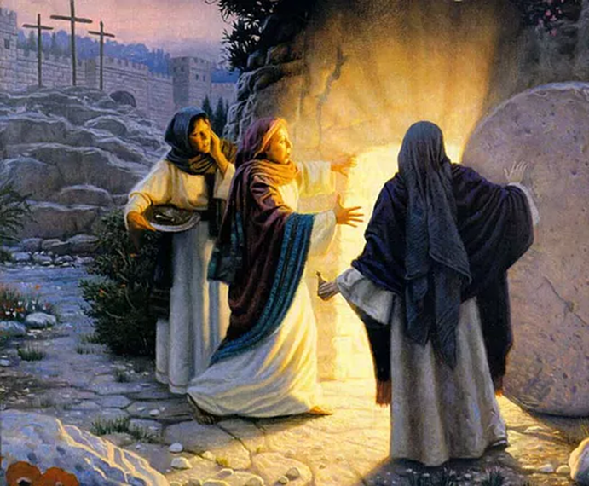
Easter - Te Aranga
R-1
S-01
Notes:
Slide 1 Easter - Te Aranga
Use this slide as a focussing strategy to introduce the resource topic. Read the title together and invite students to share something they know about the Feast of Easter. Look closely at the Image and make a statement about what is happening and what part of the Easter story it is about. There are a number of Easter clips in this resource. You may decide not to use them all.

Slide 2
Learning Intentions
The students will:
1)
identify the gifts taonga people receive through the Resurrection of Christ
2)
identify ways various cultures celebrate the meaning of Easter and explain how the custom relates to the significance of Christ’s Resurrection Te Aranga.
R-1
S-02
Click the borders to reveal the text.
Notes:
Slide 2 Learning Intentions
Create an Easter Prayer focus with bright yellow cloths and candles to give a sense of the joy and hope of the feast and season. Include some Resurrection images and symbols. Try to convey to the students the change in the mood of the Easter season compared with the sadness of Holy Week. Read the after- Easter stories at prayer time – these are very important stories for the students to become familiar with to get a sense of what life was like for the apostles and the risen Jesus. Include Luke 34:13-35, The road to Emmaus, John 20: 19-31, 21: 1-19 Jesus appears to various people.
Children could create some Easter bunting to decorate the classroom with Easter words, symbols and images. It could be a great artwork theme. It can last for 50 days until Pentecost. Remember the mood change from Holy Week to Easter and try to capture this in your prayer focus, readings, songs and prayers.
Explain to the children the greatest liturgy of the whole year is the Easter Vigil Mass on Easter Saturday night. A vigil is usually held at night and it is a time of waiting and praying and being with others. Vigils are sometimes held before funerals or before special feasts to prepare for the time of celebration. The most solemn of these is the Easter Vigil which is the most beautiful liturgy in the Catholic Church. It focusses around beautiful symbols, music, readings from Scripture, celebration of Sacraments along with ancient rituals as we await anticipating the joy of Easter and the celebration of Jesus’ Resurrection. The atmosphere in the church is different as the Vigil is prepared for: the holy water fonts are drained, all the lights are out, the tabernacle is empty, the Paschal Candle symbolizing Christ is prepared. The service begins outside the church. Ask the children to find out the times and places the Easter Vigil will be celebrated where they will be at Easter.

Slide 3
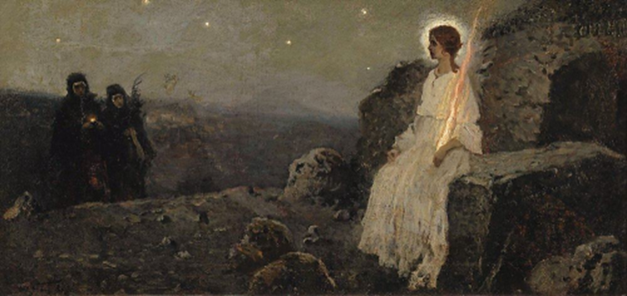
The Resurrection Event according to John
Read John 20:1-10
Record the words and actions of the characters in the story. Add some words from your imagination that were spoken.
Mary Magdalene
Words
Actions
John
Words
Actions
Simon Peter
Words
Actions
R-1
S-03
Click the worksheet button to go to the Worksheet.
Notes:
Slide 3 The Resurrection Event according to John Make a copy of the Worksheet for each student to complete and add to their RE Learning Journals. Read the Resurrection story according to John. Give the children time to think and talk about the story. Note that Mary is the only person who speaks in the story so children can imagine what the apostles said from their actions. Children complete their worksheet and add it to their RE Learning Journal. Then working in small groups using some of the dialogue they have written on their worksheets, they present the story using human statues which hold their stance and move slowly on the spot as they share the story with their class.
Note: For Jewish people Saturday is their Sabbath day and each day began at sunset until the following sunset. Sunday is the first day of the week.

Slide 4
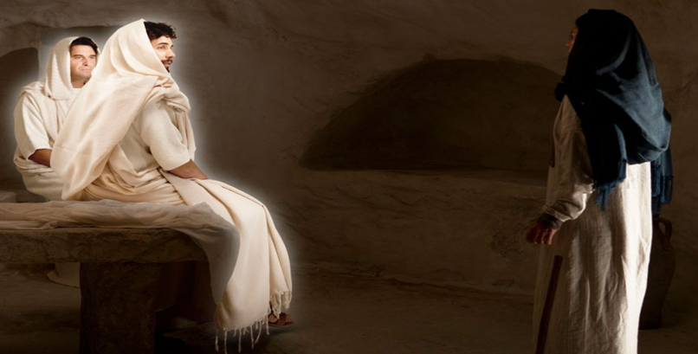
What happened next in the Resurrection story?
Continue to read John 20:11-23 then complete these statements
“Woman why are you weeping?” said the ______________
“They have taken away my Lord.” said ________________
“Whom are you looking for?” said ___________________
“Mary.” “Rabbouni.” said ____________ and ___________
“Do not hold on to me.” said _______________________
“I am ascending to my Father and my God.” said ________
“I have seen the Lord.” said _______________
“Peace be with you. As the Father has sent me so I send you.” said ___________
“Receive the Holy Spirit. If you forgive sins they are forgiven, if you retain them they are retained.” said __________
Watch the clip and in your groups then dramatise this incident and present it to your class.
R-1
S-04
Click the video button to watch “John 20:19-23”.
Notes:
Slide 4 What happened next in the Resurrection story? Work through each statement and refer to the Scripture reading if necessary. Draw students’ attention to the words in the last bullet point. They are very important as they record the moment when the apostles were given the power to forgive sins. This was the moment when the Sacrament of Penance/Reconciliation was established and was passed down through the apostles who were the first bishops who passed it to priests as part of their ordination to priesthood when they receive the Sacrament of Holy Orders. This power has been passed down through the centuries through the bishops to the priests we have today who through the power of the Holy Spirit forgive our sins.
Watch the clip
https://www.youtube.com/watch?v=ePspzvGfDkE
John 20:19-23 (1:20 minutes)
Encourage children to respond to the clip. What do you think the disciples were most afraid of in the time following Jesus’ Resurrection? What caused this fear? What helped them to overcome it?

Slide 5
Easter is the Feast of Jesus’ Resurrection - the most important Feast of the Church’s Liturgical Year because …
it celebrates Christ’s rising from the dead and overcoming noa the power of sin and death and accomplished the salvation of all people.
it guarantees that the bodies of those who believe in Christ will not remain dead but will be resurrected to eternal life.
it proves that God who created life has the power to restore life.
it validates that Jesus was who he claimed to be – God’s own son.
Jesus conquered his own death and he promises the same for his followers.
every other religion was founded by men or prophets whose end was the grave – Jesus is risen and sits at the right hand of God his Father and will come again in glory on the last day.
Click the down-button to move the blind down.
Click the video button to watch “Easter Sunday”.
R-1
S-05
Notes:
Slide 5 Easter is the Feast of Jesus’ Resurrection - the most important Feast of the Church’s Liturgical Year because …
Read and discuss each blind reveal. Children share their explanation in their own words with a partner.
This clip recaps the Feast of Easter and puts it in its context which is good for the children to appreciate.
Watch the clip
https://www.youtube.com/watch?v=0HY9PM9sWhw
Easter Sunday 3:27 minutes
Give students time to discuss the reasons why Easter is the pinnacle of the Christian Liturgical Year and help them to be able to explain this in their own words.

Slide 6
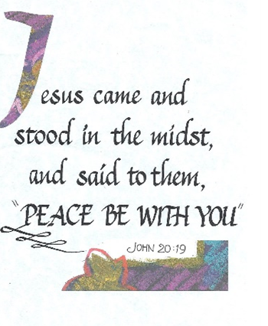
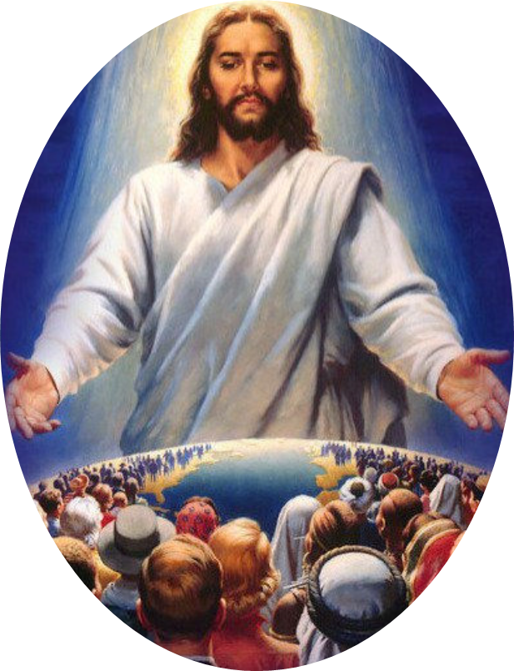
Through his Resurrection Jesus passed on gifts to his followers for all time
Many of these gifts have PEACE at their centre.
Remember that after his Resurrection the greeting and gift Jesus gave his apostles was PEACE – can you explain why?
Make a list of all the gifts that have PEACE at their centre in your RE book.
When your list is completed check using the screen examples.
Use the 20 initial letters to help you guess the names of the gifts that come wrapped in the gift of PEACE.
f
orgiveness
m
ercy
l
ove
t
apu
a
cceptance
h
ope
f
reedom
m
ana
c
ompassion
m
anaaki
k
indness
j
oy
t
olerance
c
ourage
g
entleness
c
are
e
ncouragement
p
atience
g
oodness
a
roha
Click on the blue letters to reveal the complete word.
Click the video button to watch “Jesus Easter Video”.
R-1
S-06
Click the audio button to stop ‘My People’
Click the audio button to play ‘My People’
Notes:
Slide 6 Through his Resurrection Jesus passed on gifts to his followers for all time
Children work through the points on the slide and see how many peace centred words they can suggest and check on the slide.
Watch the clip
https://www.youtube.com/watch?v=GhPTLMS1-TE
Jesus Easter Video (3:52 minutes)
The clip recaps the events leading up to Jesus death and Resurrection. This could be used during class prayer. Remind students after all Jesus had suffered – betrayal, denial, cruelty, injustice, rejection, humiliation he did not seek darkness, vengeance or retribution instead he came full of forgiveness, light and love and his first greeting to those he met was PEACE. Invite children to suggest reasons why the disciples would be in need of the gift of PEACE.
forgiveness mercy love tapu acceptance
hope freedom mana compassion manaaki
kindness joy tolerance courage gentleness
care encouragement patience goodness aroha
Sing using the MP3 ‘He is Risen Tell the Story’

Slide 7
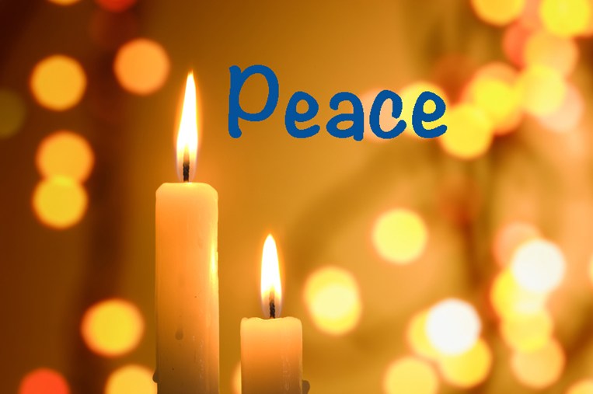
The significance of the Easter Candle
The Easter Candle is an important symbol in the Easter vigil …
The ritual of sharing the light taken from the Easter Candle …
The Easter Candle is a sign of hope for all believers that they …
The Paschal Candle is the first to be lit from the new …
The priest leads the procession into the Church holding the Candle chanting …
The Candle is lit during the Easter season and during baptisms and funerals …
… as it represents Christ who brought light back into the world darkened by sin.
… reminds people that Jesus sheds his peaceful light on all humanity.
… too, after their death will rise to live with Christ forever in heaven.
… Easter fire that represents Christ rising from the darkness of the tomb.
… 3 times, “The Light of Christ.” and the people respond, “Thanks be to God.”
… when it is placed by the casket to signify the hope of the Resurrection
a )
Easter fire that represents Christ rising from the darkness of the tomb.
b )
3 times, “The Light of Christ.” and the people respond, “Thanks be to God.”
c )
reminds people that Jesus sheds his peaceful light on all humanity.
d )
when it is placed by the casket to signify the hope of the Resurrection.
e )
too, after their death will rise to live with Christ forever in heaven.
f )
as it represents Christ who brought light back into the world darkened by sin.
R-1
S-07
Click the end-parts to complete the sentences.
Notes:
Slide 7 The significance of the Easter candle
Select a statement from the a) to f) list to complete the sentence correctly. Check it with the floater and read each one and discuss its meaning.
Read and discuss the meaning of each statement. Check it with the floaters.
ANSWERS 1) f, 2) c, 3) e, 4) a, 5) b ,6) d Adapt Teaching and Learning Experience 3
If the Church is close visit it with the children after Easter so they can see where it is, what it symbolises, how it was featured during the Easter Vigil and what the symbols mean.

Slide 8
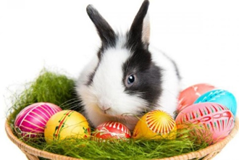
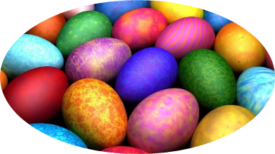
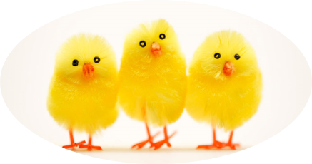
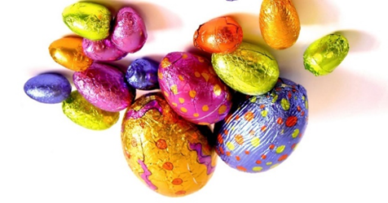
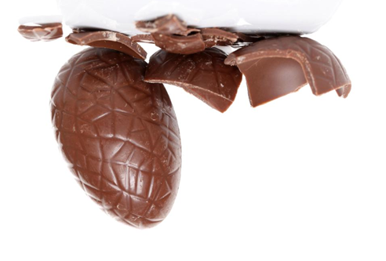
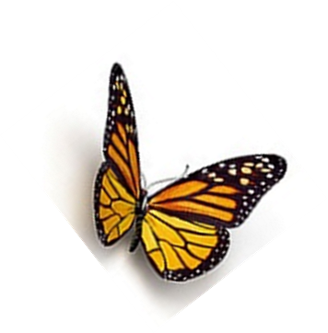
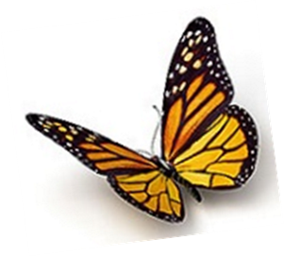
The Symbols of Easter
Within Christianity, the butterfly symbolises the Resurrection of Christ and his believers. It can be seen around Easter celebrations and sometimes at Christian funerals. The caterpillar disappears into a cocoon, appearing dead, just as Christ was laid in the tomb after the crucifixion. Later, it emerges, having transformed into something more beautiful and powerful. Christ overcame death and was raised to a new life, just as his followers will be.
Baby chicks and eggs symbolise new life, joy and hope. Eggs have been a symbol of spring since ancient times. An egg also is a symbol of the rock tomb out of which Christ emerged when he arose again. The chick, hatching out of the egg, symbolises new life or re-birth.
Easter Eggs are also a symbol that were seen as a symbol of re-birth and rejuvenation that happens in spring. In later years, Christians recognised eggs as an Easter symbol, by attaching them to the Resurrection, or re-birth of Christ.
The Easter Bunny dates back to the Teutonic deity Eostra who was the goddess of spring and fertility. Feasts were held in her honour on the Vernal Equinox which is one of 2 moments in the year when the Sun is exactly above the Equator and day and night are of equal length. Eostra’s symbol was the rabbit because of the animal’s high reproduction rate. Her earthly symbol was the Rabbit, and given how quickly rabbits produce ‘offspring’, you can see the connection.
R-1
S-08
Click the symbols on the left to information.
Notes:
Slide 8 The Symbols of Easter Remind children that Easter in Aotearoa is not in spring but in autumn. What is happening around Easter in the Southern Hemisphere is opposite to the Northern Hemisphere. As the earth in the Northern Hemisphere is waking after a long hibernation time during autumn and winter, in the Southern Hemisphere the earth is beginning a ‘dying’ time as Jesus did in the tomb. Jesus had to die before he could rise and bring new life back into the world. Invite children who have experienced Easter in the Northern Hemisphere to describe how what is happening in the natural world reflects the new life of Easter.

Slide 9
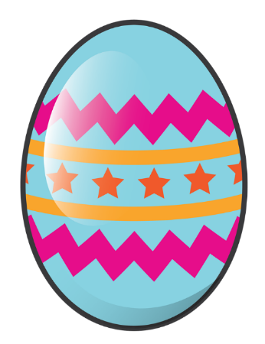
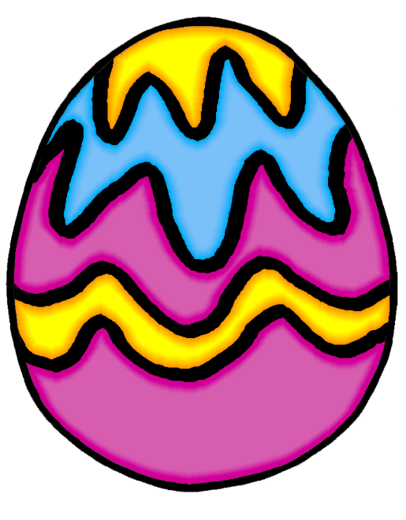
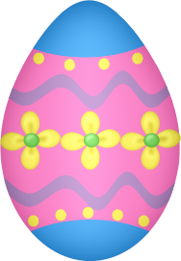
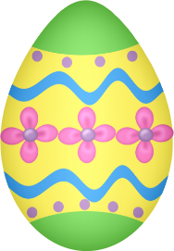
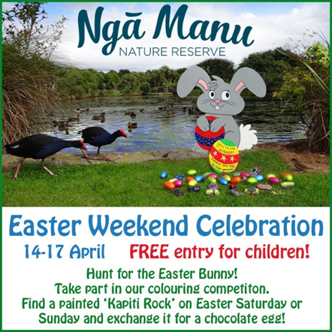
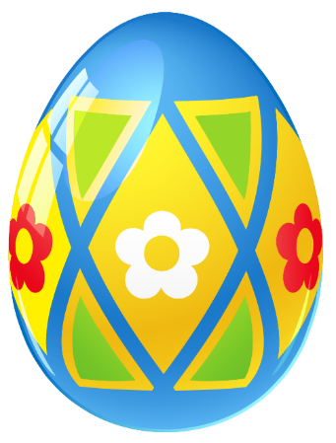
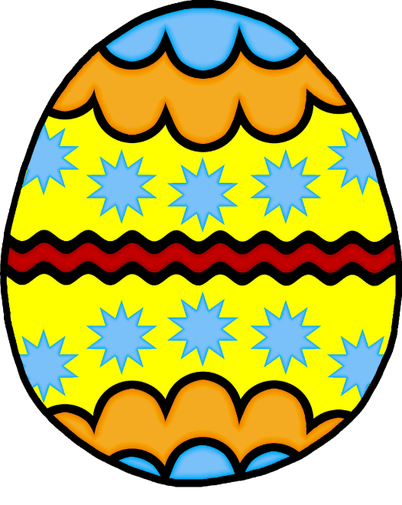
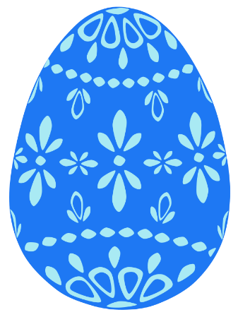
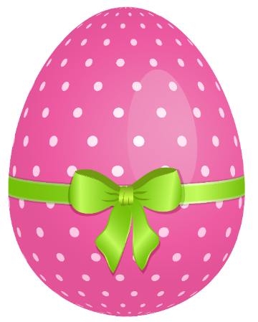
Celebrating Easter in Aotearoa
-9-
Many families arrange an Easter Egg Hunt for children on Easter Sunday. Make a list of instructions and rules for your family’s Easter Egg Hunt this year so that everyone gets a fair share.
Share an experience you have had of participating in an Easter Egg Hunt.
-8-
Hot Cross Buns are a favourite Easter food in New Zealand. Some families enjoy painting or dyeing hard boiled eggs to celebrate Easter Sunday. Can you suggest some other symbols or customs your family uses to celebrate Easter that relate to the Resurrection event?
-7-
Easter time is also
harvest time in New Zealand. In both cities and country towns there are shows and markets to add to the enjoyment of visitors. There are stalls full of food that has been harvested into jams and pickles as well as honey and wine which is popular as people stock up for the cold days and nights ahead. If you had to make a law about respecting the reason for the Easter holidays what would you include
in it?
-6-
The long Easter weekend is a popular time for school and family re-unions, sports’ tournaments and family weddings. It is also a popular time for friends getting together for shopping and dining out before winter sets in. What restrictions, if any do you think should be put on social gatherings on Good Friday and Easter Sunday and give your reasons?
-5-
Most retail stores are closed
on Good Friday and
Easter Sunday and it is illegal
for them to be open on these religious days. This is beginning to change as the increasing number of tourists and holiday makers who are traveling around the country at this time need to be catered for. Special licenses to open on these days are becoming more common.
Discuss with a partner whether you agree or disagree that shops and entertainment places should be open on Good Friday and Easter Sunday?
-4-
The left-overs of the dead trees and plants decompose and become compost which feed the earth and generate new life. The months vary about when the growth time of the year is but the life cycle is the same.
Where do you see this process happening during autumn where you live?
-3-
The Easter symbols of
new birth and new life of the Northern Hemisphere are displayed in shops selling Easter confectionery and cards. These symbols are explained in the context of the life cycle of all living natural and human creatures. They have a beginning or, a life, a death and a Resurrection and the cycle is continuous. Can you use an example to tell a story to explain the cycle of birth, life, death and Resurrection?
-2-
All Christian communities celebrate the Sacred Triduum in their churches over the 3 days and because of what is explained above, in popular holiday places there are often increased numbers of people who come to participate in the celebrations. This means many people celebrate the Easter ceremonies in parishes outside their homes. Where do you celebrate the Easter liturgies usually?
-1-
Easter weekend in Aotearoa is the last long weekend before the winter. Many families take advantage of this to go to their holiday house before the cold winter days begin and the roads can be dangerous to travel on. The holiday house is usually prepared to be locked up for the winter until the warmth of spring returns in September. What does your family do over the Easter weekend?
R-1
S-09
Click top card to discard it.
Notes:
Slide 9 Celebrating Easter in Aotearoa
Invite children to share 3 ways they celebrate Easter. Read the flip cards through and discuss and respond to the questions. Notice how many of the ANZ customs have a religious connection. Make a summary statement about the influence of religion on how people in ANZ celebrate a religious festival. What does this say about the place of religion in our country? Use this as the subject of a class debate. Half the class can be on the affirmative the other negative. Remind children they need evidence and examples to back up their argument. It’s a good way to get children thinking about this issue and generate discussion about it in their families over the Easter break. Plan to have the debate during the week after they return to school. Invite an adjudicator to judge the teams and summarise the results and the arguments and add it to the school and parish newsletters.

Slide 10
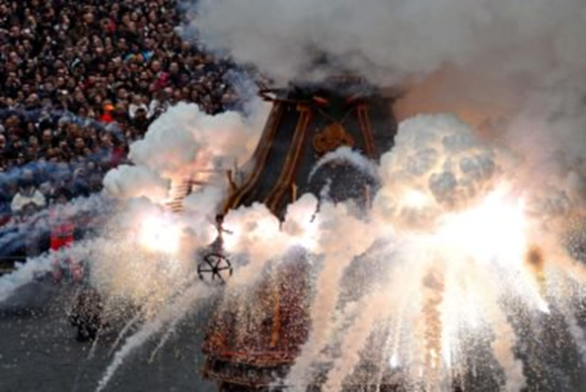
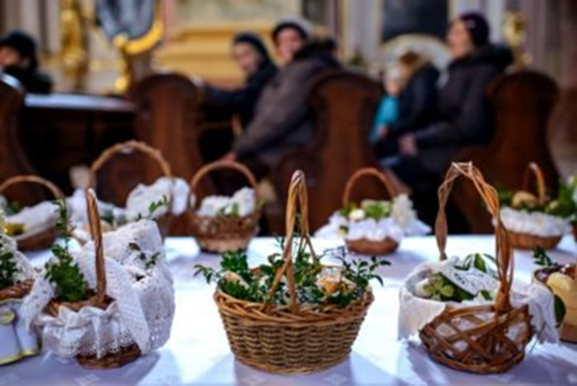
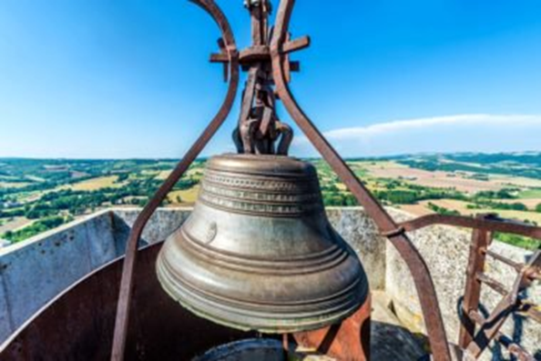
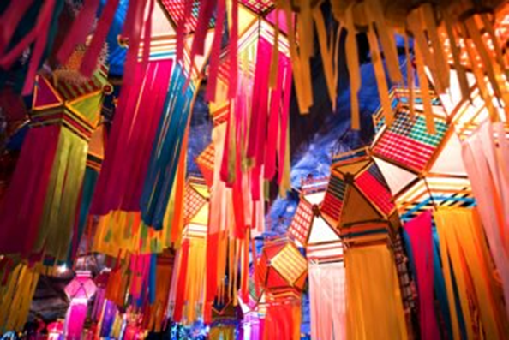
Easter Customs in other Cultures and Countries
In France French children don’t get treats from the Easter bunny; they get them from the Easter bells. According to Catholic teaching, no church bells can ring between Holy Thursday and the Easter Vigil, on account of the solemnity of the days around Jesus’s death. Eventually, a legend evolved that said the church bells weren’t rung because they grew wings and flew to Rome to be blessed by the Pope. Then they returned on Easter day with chocolate and presents for the children.
In Italy on Pasqua ‘Easter’ in Italian, residents of Florence celebrate a 350-year-old tradition called Scoppio del carro, which means “explosion of the cart.” A centuries-old cart is loaded with fireworks and pulled by decorated oxen to the front of the Cathedral of Saint Mary of the Flower referred to as the Duomo, where spectators watch the fireworks go off to celebrate Christ’s Resurrection.
In India even though Christians make up only 2.5 percent of India’s population, they still have elaborate Easter festivities, especially in the north eastern states. The western India state of Goa celebrates with carnivals, including street plays, songs, and dances. People exchange chocolates, flowers, and colourful lanterns as gifts.
In Poland the day before Easter, families prepare a “blessing basket.” It is filled with coloured eggs, sausages, bread, and other important food and taken to church to be blessed. In Polish culture, Lent isn’t over until a priest blesses this basket.
R-1
S-10
Click the small images to reveal the text.
Notes:
Slide 10 Easter Customs in other Cultures and Countries
Adapt Teaching and Learning Experience 4
Read and discuss the customs and how they relate to the real meaning of Easter. Invite children from other cultures to share their Easter customs and celebrations.

Slide 11
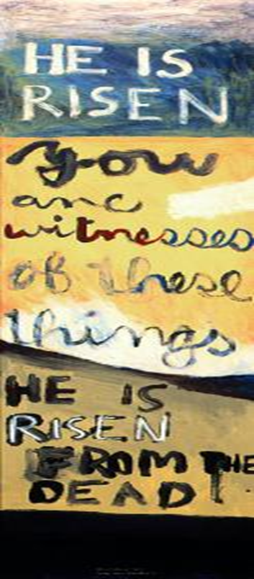
Aotearoa New Zealand Artist, Colin McCahon’s Resurrection Triptych
- 1 -
Colin McCahon is a New Zealand artist who was born in 1919 in Timaru, though he spent most of his early years in Dunedin. He loved attending local exhibitions at the Dunedin Art Gallery with his family. Colin McCahon attended Saturday morning art classes and when he was 14 he was convinced he wanted to be an artist.
- 2 -
As a young adult he went to a College of Art in Dunedin. In the summer he would cycle to Nelson for casual work. These long journeys through the landscape of the South Island became for him a profound source of inspiration that echoed throughout his art career.
- 3 -
Although he claimed to be of no particular religion, many of MaCahon’s works have religious themes, words, symbols and biblical figures as illustrated on this panel. In this painting he used enamel paint on hardboard.
- 4 -
In 1959 McCahon painted the “You Are Witnesses”. It is a long vertical panel – like a prophetic scroll with a message from a human messenger. The panel has three sections, maybe in keeping with the three days Christ was in the tomb. The painting is also referred to as a triptych which is an art work with 3 sections.
- 5 -
The top section appears to be a misty landscape where the capitalised words HE IS RISEN in white, rise from the land as if they are alive. These words are from Matthew 28.6 where an angel speaks to a woman in the garden, which is represented in the green background. Christ’s Resurrection is like a sunrise in a misty morning landscape, signalling the dawn of a new age.
- 6 -
The words “HE IS RISEN” are repeated like a refrain in the lower portion. The additional phrase, “FROM THE DEAD” reinforces the miracle of the event. The black patch at the bottom suggests the finality of death, but from the gloom comes light… with the word RISEN outlined so it almost appears 3D.
- 7 -
It is possible to recognise a resurrection visually in the painting from the lowest to the uppermost portion, from the dark tomb to the mystery of the supernatural light in the central portion to the defiance of the white letters standing on the earth in the top portion.
- 8 -
The middle section squarely addresses the viewer with the bolded word YOU. YOU are witnesses of these things. These words come from Luke 24:48.
The artist’s choice of the title of the painting –
“You are witnesses,” emphasise their importance.
- 9 -
We were not spectators at Christ’s Resurrection but we are Christ’s followers today who continue to be witnesses to his life, death and Resurrection by the way we live our lives and carry on his mission in the world.
Top
Middle
Bottom
R-1
S-11
Click the top card to discard it
Notes:
Slide 11 Aotearoa New Zealand Artist, Colin McCahon’s Resurrection Triptyc
Read through the flip cards and discuss the life and works of Colin McCahon an amazing New Zealand artist who lived among ordinary people. Watch out for his artworks in galleries especially the ones with religious themes. Have a conversation with someone you know who is interested in art and find out more about him. Find a picture of Colin and put a face to the name. Perhaps there is an undiscovered Colin McCahon in your class?
Children may like to select a quote from one of the Resurrection accounts and create their own triptyc. They could be displayed in the church foyer to share with parishioners during the fifty days of the Easter season.

Slide 12
Check up
1)
Name and describe 3 of the gifts people receive through Christ’s Resurrection. (Slide 3)
2)
Create an image of an Easter Candle with the correct symbols and words and make a list of 5 facts that you could share with your family including what it symbolises and why it is significant. (Slide 7)
3)
Make a poster of 5 different Easter symbols and a short explanation about them to share with younger children at home or at school. Make a display of them in the school or church foyer. (Slide 8)
4)
Describe 3 Easter customs in Aotearoa and 2 from other countries and explain how each relates to the Resurrection of Jesus. Illustrate these and share them with your family. (Slides 9 &10)
5)
Share 5 things you learned about Colin McCahon and research to find out more about his work and see more examples of his religious art works.
6)
Which activity do you think helped you to learn best in this resource?
7)
Questions I would like to ask about the topics in this resource are …
Click in each caption space to reveal text
Click on the worksheet button to go to the worksheet.
R-1
S-12
Notes:
Slide 12 Check Up
This formative assessment strategy will help teachers to identify how well students have achieved the Learning Intentions of the resource.
Teachers can choose how they use the slide in their range of assessment options.
A worksheet of this slide is available for students in Years 5-8 to complete.
The last two items are feed forward for the teacher.
Recording the students’ responses to these items is recommended as it will enable teachers to adjust their learning strategies for future resources and target the areas that need further attention.

Slide 13
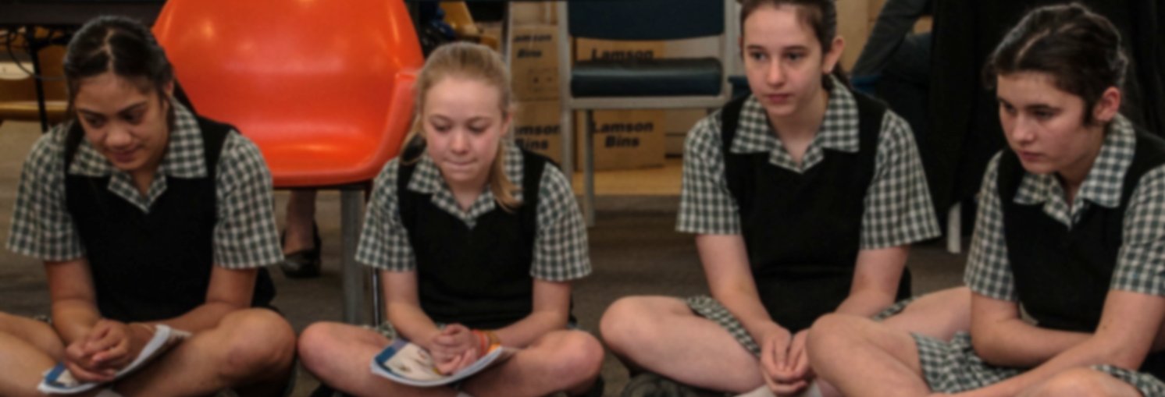
Time for Reflection
R-1
S-13
Click the audio button to stop reflective music
Click the audio button to play reflective music
Notes:
Slide 13 Time for Reflection
The MP3 is played to help create a reflective atmosphere and bring the students to stillness and silence as the teacher invites them to reflect on the reasons why Easter is the greatest feast in the whole year and how Jesus’ Resurrection is the most remarkable event in all human history – he is the only person ever to have risen from the dead. Ask yourself – how will I celebrate this amazing event this year?

Slide 14
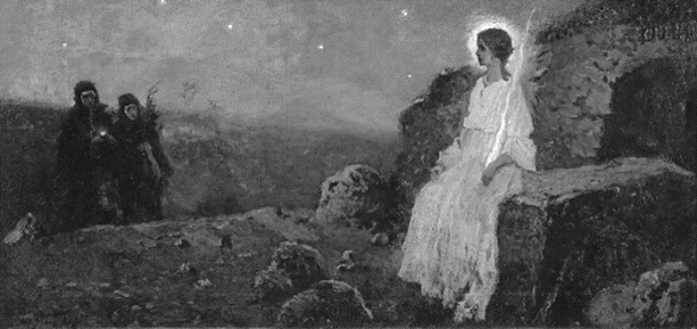
The Resurrection Event according to John
Read John 20:1-10
Record the words and actions of the characters in the story. Add some words from your imagination that were spoken.
Mary Magdalene
Words
Actions
John
Words
Actions
Simon Peter
Words
Actions
Name:____________________
Date:____________
R-1
S-03
Click the up arrow to return to the lesson
.

Slide 15
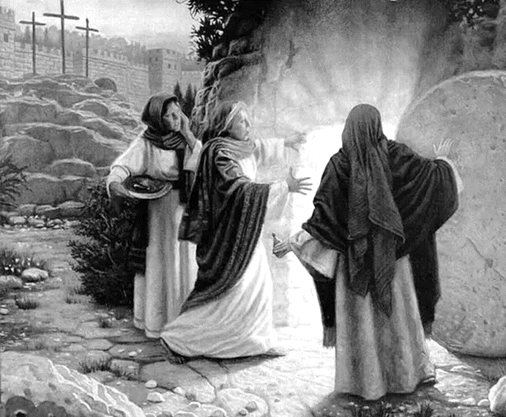
Check up
Name:____________________________
Date:____________
1. Name and describe 3 of the gifts people receive through Christ’s Resurrection. (Slide 3)
2. Create an image of an Easter Candle with the correct symbols and words and make a list of 5 facts that you could share with your family including what it symbolises and why it is significant. (Slide 7)
3. Make a poster of 5 different Easter symbols and a short explanation about them to share with younger children at home or at school. Make a display of them in the school or church foyer. (Slide 8)
4. Describe 3 Easter customs in Aotearoa and 2 from other countries and explain how each relates to the Resurrection of Jesus. Illustrate these and share them with your family. (Slides 9 & 10)
5. Share 5 things you learned about Colin McCahon and research to find out more about his work and see more examples of his religious art works.
6. Which activity do you think helped you to learn best in this resource?
7. Questions I would like to ask about the topics in this resource are...
R-1
S-12
Worksheet
Click the up arrow to return to the lesson

