Slide 1
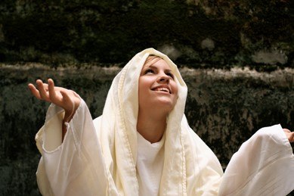
Mary’s song of praise
L-2
S-01
Notes:
Use this slide as a focussing strategy to introduce the lesson topic. Read the title together and invite children to share something they know about how Mary thanked God for choosing her out of all the women in the world to be the mother of his son, Jesus.

Slide 2
Learning Intentions
The children will:
1)
recognise that Mary thanked God with a song of praise for choosing her to be the mother of his son Jesus.
2)
recall parts of Mary’s song of praise.
L-2
S-02
Click the boxes to reveal text.
Notes:
Read through the Learning Intentions with the class and identify some ideas/questions that might be explored in the lesson.

Slide 3
Preparing for a new baby
Get things a new baby needs like a name, a bed, clothes, some toys and books.
What other ways do you know that people prepare for a baby?
How did Mary and Joseph prepare for their new baby?
Talk about what the baby might be like and how they will love and care for her or him.
Ask God to help their baby to be healthy and happy.
L-2
S-03
Click the pins on the right to reveal post-it notes.
Notes:
Adapt Teaching and Learning Experience 1
Invite children to share how people prepare for a new baby in their family.
What are the people doing in the picture?
Read each post it note and ask children to respond to each one.

Slide 4
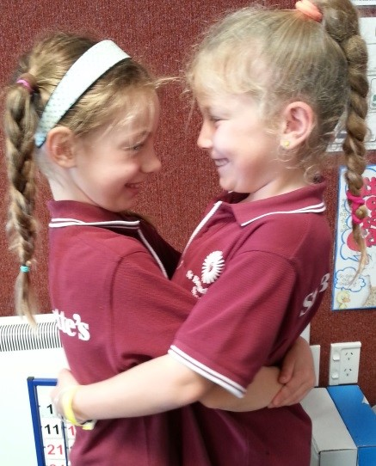
When we are chosen to do something special we are filled with joy
How do you feel when you are chosen to do something special in your class?
What do you do when you are chosen to do something special?
X
L-2
S-04
Click the ‘i’ button to reveal information
Notes:
Notice the children in the picture – what do you think has happened?
Press the I button and read and answer the questions.
Children share experiences about when they have been chosen to do something special.

Slide 5
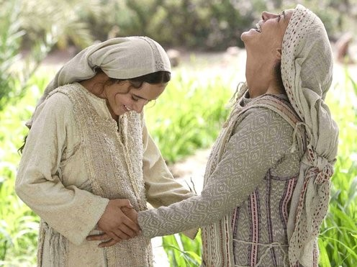
What did Mary do when she was chosen by God to be the mother of Jesus?
Elizabeth was so pleased to see her, and greeted her with a loud cry of joy saying, “Mary, you are the most blessed among all women because your baby is God’s own son. How can it be that you have come to visit me?”
Mary sang a song of praise to God for choosing her to be the mother of God’s only son.
This story was written in the Bible by St. Luke in Chapter 1.
When the angel came to tell Mary that God had chosen her to be the mother of his son, Jesus, Mary said, “Yes, I will do what God asks me to do”.
Then Mary set out to see her cousin Elizabeth who was also having a baby. Mary had to walk to a town in the hill country until she came to Elizabeth’s house.
L-2
S-05
Press the button to advance through the lines (there are 2 pages)
Notes:
Adapt Teaching and Learning Experience 2
Read the story to answer the question in the title.
Use the green button to guide your reading with the red arrow.
What did Mary do when she was chosen by God to be the mother of his son, Jesus?
How did she feel about this? How do you know? How do you think her cousin Elizabeth felt? Get a clue from the picture.

Slide 6
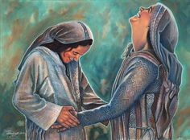
What was Mary’s song of joy about?
Watch, listen and remember what Mary’s song of joy was about.
L-2
S-06
Click the video button to play a video
Notes:
Watch the clip ‘The annunciation and the visitation’. 5:01 minutes
Turn down the sound and retell the story with the children.
https://www.youtube.com/watch?v=o_b-woAaK1s
Adapt Teaching and Learning Experience 4

Slide 7
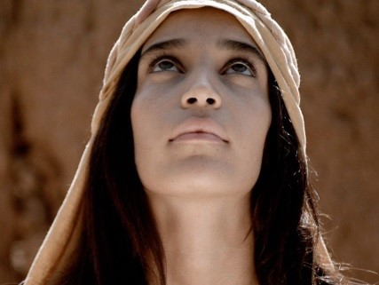
Mary’s heart was filled with joy and happiness
Mary’s heart was so filled
Mary often sang her song
Mary praised God because
Mary knew God had done
God had chosen her to be the mother of his son.
great things for her and God’s name was holy. while she waited for Jesus to be born.
with joy and happiness it made her sing.
L-2
S-7A
Drawing Tool
Match the statements on the left with the ones on the right using the drawing tool.
Click worksheet icon for worksheet.
Notes:
Read statements on left and children suggest the matching statement on the right. Check them out using next slide by clicking on numbers.
Answers 1)- d, 2) -c, 3)-a, 4) – b.
Children complete worksheet by drawing lines to link correct statements.

Slide 8
Mary’s heart was filled with joy and happiness
1
Mary’s heart was so filled
Mary often sang her song
Mary praised God because
Mary knew God had done
2
3
4
a)
God had chosen her to be the mother of his son.
c)
while she waited for Jesus to be born.
b)
great things for her and God’s name was holy.
d)
with joy and happiness it made her sing.
L-2
S-7B
Click the purple numbered buttons on the left to reveal the correct statement match.
Click the audio button to stop ‘My Spirit sings’
Click the audio button to play ‘My Spirit sings
Notes:
Children check their worksheets.
Sing using the MP3 ‘My Spirit sings’

Slide 9
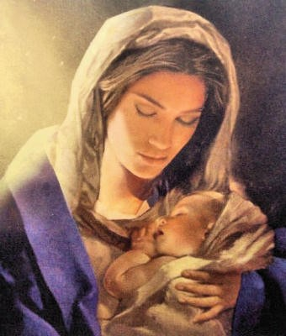
We honour Mary because she is the mother of Jesus who is God’s son
We pray Mary’s special prayer to honour her.
I can pray this with my family.
We honour Mary when we sing to her.
Hail Mary, full of grace,
the Lord is with you.
Blessed are you among women,
and blessed is the fruit of your womb, Jesus.
Holy Mary, Mother of God,
pray for us sinners, now and at the hour of our death.
Amen.
Press the button to advance through the lines
L-2
S-08
Click the audio button to stop ‘Te Waiata a Maria’
Click the audio button to play ‘Te Waiata a Maria’
Notes:
Adapt Teaching and Learning Experience 8
Talk about what ‘honouring’ someone means and why we honour Mary.
Use red button to point to each line as the Hail Mary is prayed.
Sing using the MP3 ‘Te Waiata a Maria’

Slide 10
Check Up
1)
How did Mary give thanks to God for choosing her to be Jesus’ mother?
2)
Tell a partner the story about Mary going to visit her cousin Elizabeth.
3)
Which activity do you think helped you to learn best in this lesson?
4)
Questions I would like to ask about the topics in this lesson are…
L-2
S-09
Click each caption space to reveal text
Notes:
This formative assessment strategy will help teachers to identify how well the children have achieved the Learning Intentions of the lesson.
Teachers can choose how they use the slide in their range of assessment options.
A worksheet of this slide is available for children in Years 5-8 to complete.
The last two items are feed forward for the teacher.
Recording the children’s responses to these items is recommended as it will enable teachers to adjust their learning strategies for future lessons and target the areas that need further attention.

Slide 11
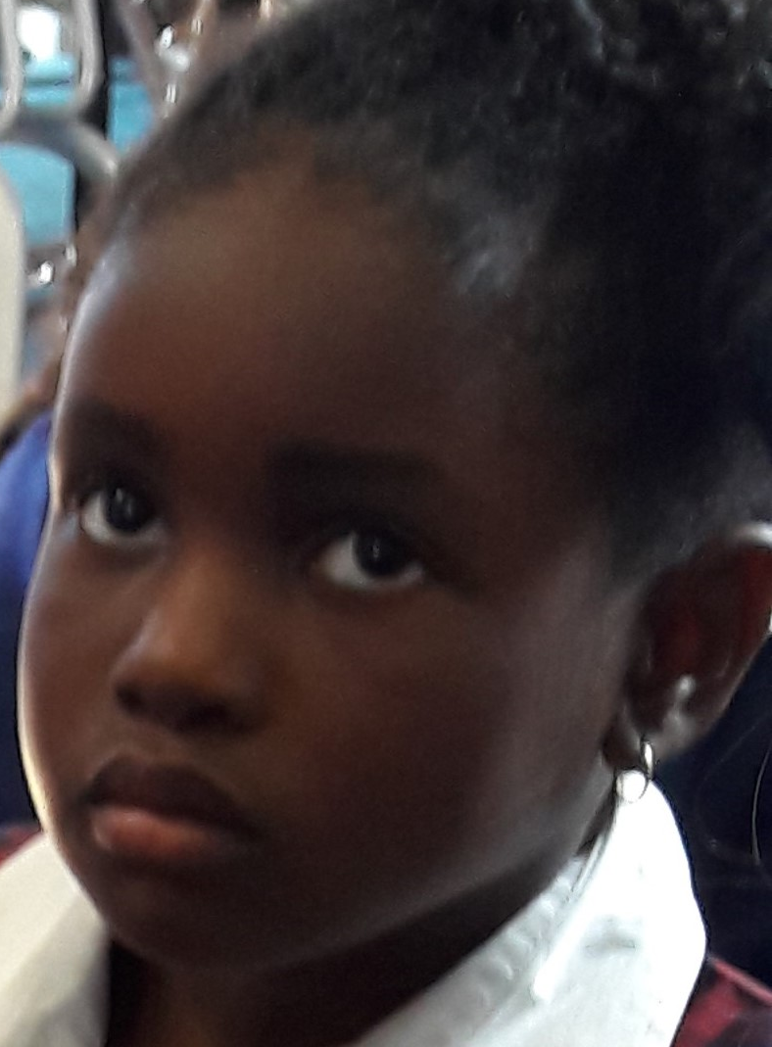
Time for Reflection
L-2
S-10
Click the audio button to stop Reflective Music
Click the audio button to play Reflective Music
Notes:
The MP3 is played to help create a reflective atmosphere and bring the children to stillness and silence as the teacher invites them to imagine Mary’s great joy as she is getting ready to bring God’s only son into the world – the baby that people had been waiting for, for thousands of years.

Slide 12
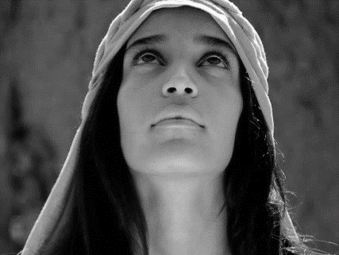
Mary’s heart was filled with joy and happiness
Name___________________________ Date_______________
Mary’s heart was so filled
Mary often sang her song
Mary praised God because
Mary knew God had done
God had chosen her to be the mother of his son.
great things for her and God’s name was holy. while she waited for Jesus to be born.
with joy and happiness it made her sing.
L-2
S-7
Worksheet
Click the up arrow to return to the lesson
Notes:
This worksheet relates to slide 7

Slide 13
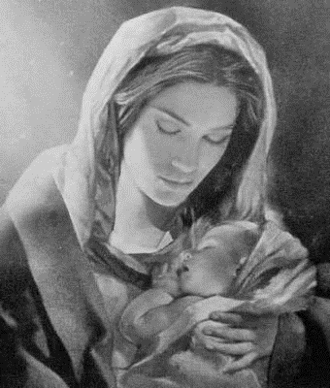
We honour Mary because she is the mother of Jesus who is God’s son
Name___________________________ Date_______________
We pray Mary’s special prayer to honour her
I can pray this with my family.
We honour Mary when we sing to her.
Hail Mary, full of grace,
the Lord is with you.
Blessed are you among women,
and blessed is the fruit of your womb, Jesus.
Holy Mary, Mother of God,
pray for us sinners, now and at the hour of our death.
Amen.
L-2
S-8
Worksheet
Click the up arrow to return to the lesson
Notes:
This worksheet relates to slide 8

