Slide 1
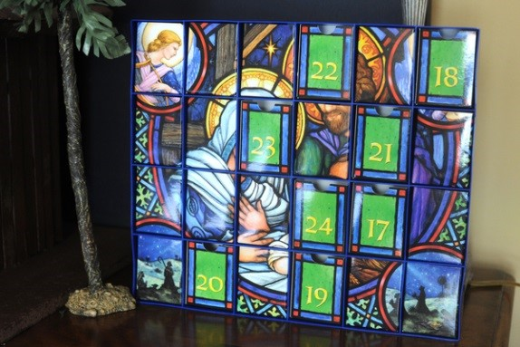
Advent is a time for families whānau to prepare for Christmas
L-3
S-01
Notes:
Use this slide as a focussing strategy to introduce the lesson topic. Read the title together and invite children to share something they know about what their family whānau did to prepare when they were waiting for their new baby to be born.

Slide 2
Learning Intentions
The children will:
1)
identify ways that a family whānau can prepare for the birth of Jesus
L-3
S-02
Click the box to reveal text.
Notes:
Read through the Learning Intentions with the class and identify some ideas/questions that might be explored in the lesson.

Slide 3
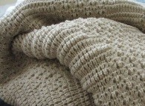
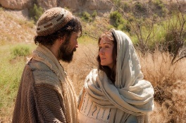
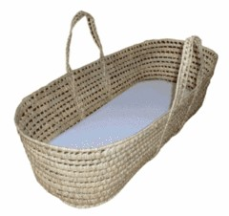
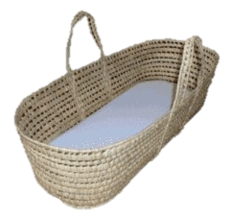
Mary and Joseph prepared for the coming of Jesus
Mary made a
to keep baby Jesus warm.
Joseph made a
for Jesus to sleep in.
Before Jesus was born
talked and prayed that they would be good parents.
They bought a
to take Jesus on long journeys with them.
L-3
S-03
Click an image from the box or an empty space to correctly position an image in the sentence.
Notes:
Use this slide to revise what Mary and Joseph did to prepare for Jesus.
Children complete the worksheet.
Answers: 1- blanket, 2- crib, 3- Mary and Joseph, 4- basket.

Slide 4
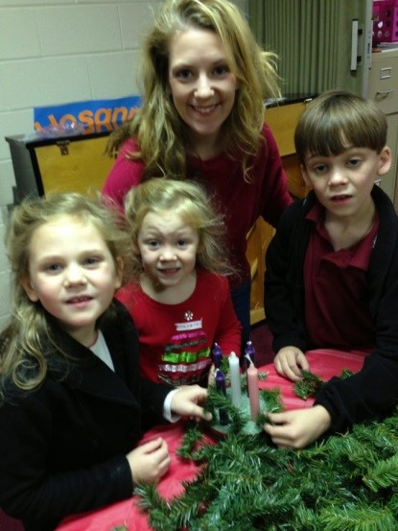
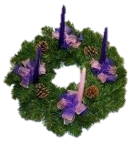
Family whānau prepare during Advent for Jesus to come
We decorate our homes with things that remind us that Jesus is coming.
We make an Advent wreath with four candles to remind us that we have 4 weeks to prepare for Jesus to be born.
We light the candles to show us which week we are up to.
When all the candles are lit the light is brightest and it is time for Jesus to be born.
L-3
S-04
Click the wreaths to reveal text
Notes:
Children talk about ways their family whānau prepare for Jesus to come.
Children use the Advent wreath on the worksheet to help them to explain what they know about it and how it helps people to remember that Jesus is coming and all of God’s people are waiting for him.

Slide 5
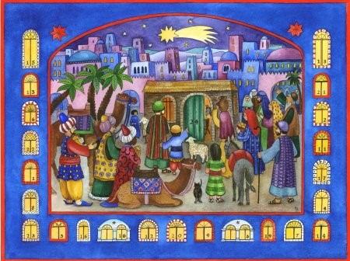
We open the windows on our Advent Calendar as we wait for Jesus to be born
Advent Calendars are about helping us to prepare for Jesus to be born.
Each day we open a new door to remind us we are getting nearer to Jesus’ birth.
When we open the door we ask Jesus to come into our hearts at Christmas.
When Jesus is in our hearts he helps us to be kind and loving to others.
L-3
S-05
Click the stars to reveal text
Notes:
Adapt Teaching and Learning Experience 5
Read the revealed captions and talk about how useful Advent Calendars are to help people remember to prepare for Jesus by being a helpful and kind person.
Notice the picture on the calendar.

Slide 6
What we can do to prepare our hearts to welcome Jesus
As Christmas gets closer we prepare our hearts for Jesus to come.
We can try to be kind and helpful to show Jesus we want to make him welcome.
‘Come Lord Jesus, Come and be born in our hearts, Come and be born in our lives’.
We open our hearts to Jesus by saying ‘Come Lord Jesus come, haere mai e Hehu’.
We can say this very old prayer in our hearts and only Jesus can hear it.
L-3
S-06
Click the pins on the right to reveal post-it notes.
Notes:
Read the title and listen to children’s ideas.
Children read each post it note and talk about it with a partner.
How can you tell that people are preparing their hearts to welcome Jesus?

Slide 7
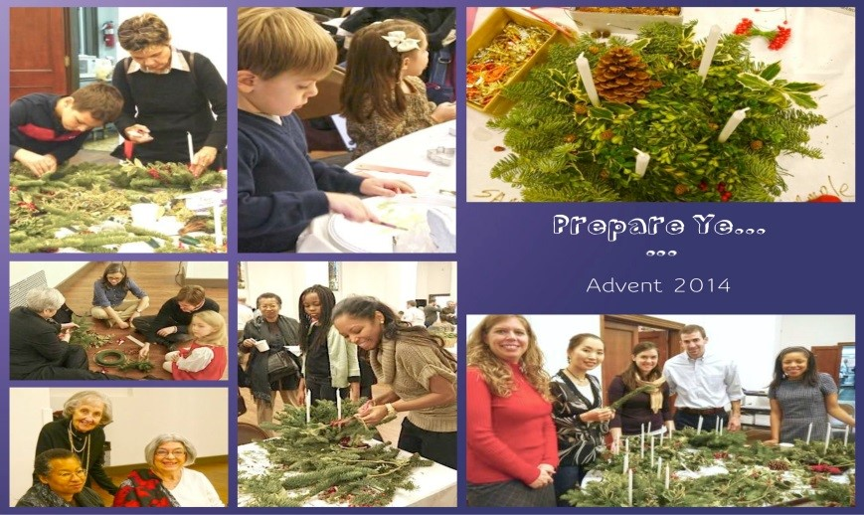
Children can help their family whānau prepare for Christmas
Children can help prepare their hearts for Christmas
Helping to get special things ready at home
Reminding each other that it is Jesus’ birthday
Families can pray in their hearts to Jesus
by helping when they are asked to.
is another way of preparing for Christmas.
that people are getting ready for.
so he knows they want to welcome him on his birthday.
a) that people are getting ready for.
b) by helping when they are asked to.
c) so he knows they want to welcome him on his birthday.
d) is another way of preparing for Christmas.
L-3
S-07
Click text from the list or an empty space to correctly position a word in the sentence.
Click the audio button to stop ‘Mo Te Awenti’
Click the audio button to play ‘Mo Te Awenti’
Notes:
Notice what the people are doing in the picture.
Read numbered statements and children work out the matching statement below them. Check them out by clicking on the statements below or in the white spaces. Read each statement when it is completed. How do you help at home to prepare for Christmas?
Answer 1) - b, 2) – d, 3) – a, 4) – c
Sing using the MP3 ‘Mo Te Aweneti’

Slide 8
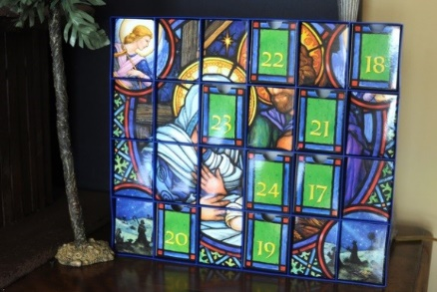
Check Up
1)
Tell a partner one way a family whānau can prepare for the birth of Jesus.
2)
Share your Advent Wreath worksheet with your family whānau and say how it helps people to prepare for the birth of Jesus.
3)
Pray the old ‘Come Lord Jesus’ prayer and share it with your family whānau.
4)
Explain how the Advent Calendar works and why it is good to use during Advent.
5)
Which activity do you think helped you to learn best in this lesson?
6)
Questions I would like to ask about the topics in this lesson are…
L-3
S-08
Click in each caption space to reveal text
Notes:
This formative assessment strategy will help teachers to identify how well the children have achieved the Learning Intentions of the lesson.
Teachers can choose how they use the slide in their range of assessment options.
A worksheet of this slide is available for children in Years 5- 8 to complete.
The last two items are feed forward for the teacher.
Recording the children’s responses to these items is recommended as it will enable teachers to adjust their learning strategies for future lessons and target the areas that need further attention.

Slide 9
Time for Reflection
L-3
S-09
Click the audio button to stop Reflective Music
Click the audio button to play Reflective Music
Notes:
The MP3 is played to help create a reflective atmosphere and bring the children to stillness and silence as the teacher invites them to ask Jesus to help your family whānau prepare for Christmas by talking gently to each other and offering to help others at home so everyone can enjoy a peaceful Christmas.

Slide 10
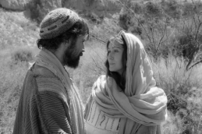
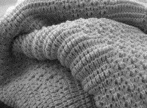
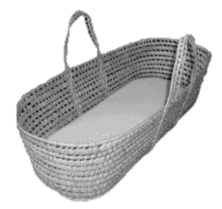
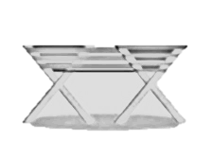
Mary and Joseph prepared for the coming of Jesus
Name___________________________ Date_______________
Mary made a
Joseph made a
Before Jesus was born
They bought a
to keep baby Jesus warm.
for Jesus to sleep in.
talked and prayed that they would be good parents.
to take Jesus on long journeys with them.
L-3
S-3
Worksheet
Click the up arrow to return to the lesson
Notes:
This worksheet relates to slide 3

Slide 11
Family whānau prepare during Advent for Jesus to come
Name___________________________ Date_______________
Colour 3 candles purple and one pink and light one for each week of Advent.
Colour the wreath green, the circle is like God’s love for us, it has no beginning and no end.
L-3
S-4
Worksheet
Click the up arrow to return to the lesson
Notes:
This worksheet relates to slide 4

