Slide 1
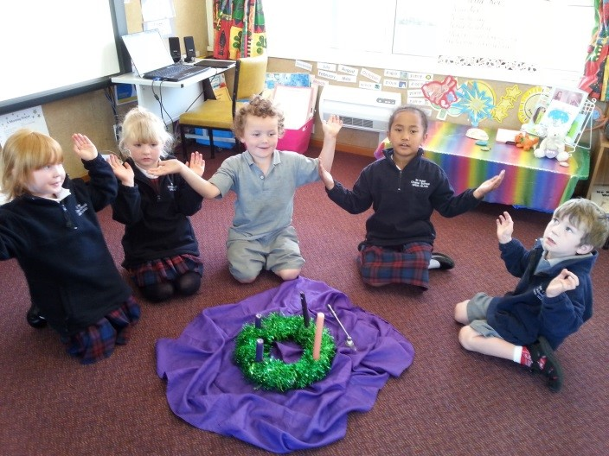
Advent is celebrated in our school and our parish
L-4
S-02
Notes:
Use this slide as a focussing strategy to introduce the lesson topic. Read the title together and invite children to share something they know about how their school and parish or pastoral area celebrates the season of Advent.

Slide 2
Learning Intentions
The children will:
1)
identify ways that the school and the parish will prepare for Jesus’ birth.
L-4
S-02
Click the box to reveal text.
Notes:
Read through the Learning Intentions with the class and identify some ideas/questions that might be explored in the lesson.

Slide 3
In our school each class has an Advent Wreath
This is what we know about the Advent Wreath…
L-4
S-03
Click in the white box and write your text
Notes:
Adapt Teaching and Learning Experience 1
Children share what they know about the Advent wreath.
This can be recorded on the slide.

Slide 4
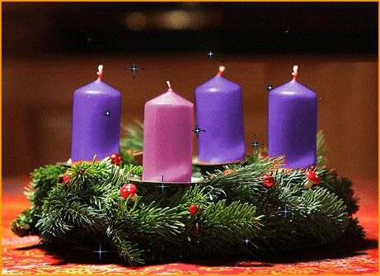
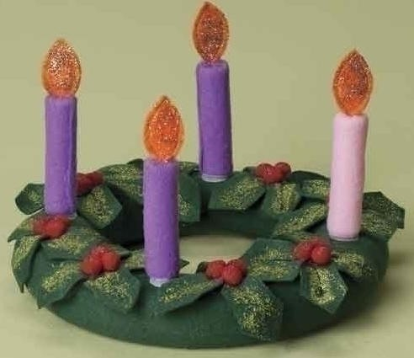
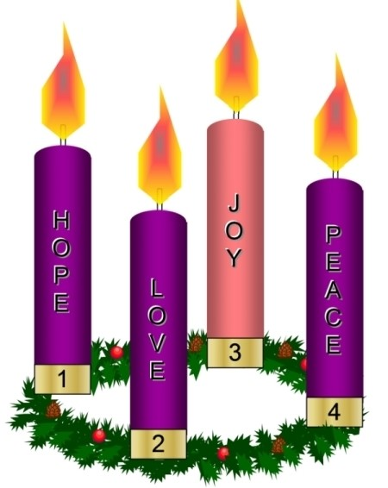
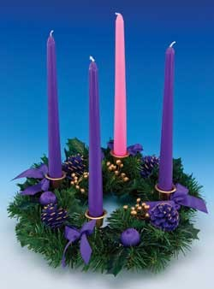
Why do we have an Advent wreath?
Each week we wait we light another candle on the Advent wreath to show us that the birth of Jesus is getting closer.
When we light the pink candle how much longer do we have to wait?
The Advent wreath helps us to measure the time of waiting for Jesus to come.
How long do we wait for Jesus in Advent?
The purple candles remind us that we are in a waiting time and the pink candle is the joy candle that shows us we have just one more week to wait for Jesus.
What happens when the waiting time is over?
When Advent is finished Christmas comes because on Christmas day we celebrate that Jesus is born.
Why don’t we light the Advent wreath on Christmas day?
L-4
S-04
Click on images to reveal text.
Notes:
Use the revealed text for each image to extend children’s knowledge and answer the question in the title.
Children answer the purple questions and say which Advent wreath is their favourite and why. Children explain why an Advent wreath is useful to use.

Slide 5
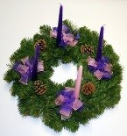
The Advent Wreath song
Light the Advent candle one.
Now the waiting has begun
We have started on our way
Time to think of Christmas Day.
Light the Advent candle three
Think of heavenly harmony
Angels singing “Peace on Earth”
At the Blessed Saviour’s birth. Chorus
Chorus:
Candle, candle burning bright
Shining in the warm summer night
Candle, candle burning bright
Fill our hearts with Christmas light.
Light the Advent candle four
Think of joy forever more
Christchild in a stable born
Gift of love that Christmas morn. Chorus
Light the advent candle two
Think of humble shepherds who
Filled with wonder at the sight
Of the Child on Christmas night. Chorus
Light the Christmas candles now
Sing of donkey, sheep and cow
Birthday candles for the King
Let the Alleluias ring.
Chorus
L-4
S-05
Click the worksheet button for worksheet.
Click the red button to move between verses and chorus.
Click the audio button to stop ‘Advent Song’
Click the audio button to play ‘Advent Song’
Notes:
Sing using the MP3 ‘Advent Song’
Use the red button to point to the words in each verse and the chorus.

Slide 6
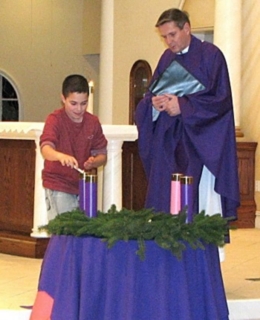
We have signs of Advent in our parish
Notice what the boy is doing.
Notice what colour the cloth is.
Notice what colour the priest is wearing.
What happens next?
Look at the picture.
What signs of Advent can you see?
We have signs of Advent in our Church
to remind the people in the parish
that it is the Advent season when we
get ready for Jesus’ birth.
Where was this picture taken?
What is happening?
Have you got something like this
in your church? Go and look!
L-4
S-06
Click the pins on the right to reveal post-it notes.
Notes:
Note the Advent wreath and the purple vestments the priest is wearing – purple is the colour for Advent.
Read and respond to each post it note.
Children share about the Advent wreath in their church.

Slide 7
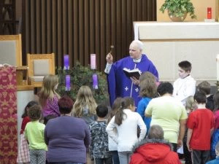
We bring our family Advent Wreaths to school and our priest blesses them
Father blesses the wreaths to make them holy.
We keep them on our meal tables at home.
We light them when we eat together.
We remember that Jesus is coming soon and we are getting ready for him.
L-4
S-07
Click the images to reveal text
Notes:
Children talk about what is going on in the picture.
Read each reveal statement and ask WHY after each one. Children respond.

Slide 8
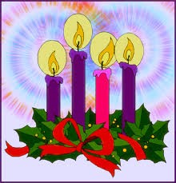
What happens during Advent?
In Advent children at school
Mothers are busy
Teachers are helping children
Priests are wearing
People are getting their hearts
Children are opening the doors
We are using our Advent wreath
People are praying in their
are learning about what the season of Advent means.
getting ready for Christmas with their family whānau.
to learn about Advent wreaths to light at prayer time.
purple vestments to remind people we are in a waiting season.
ready for the peace Jesus brings at Christmas.
of their Advent calendars that remind them Jesus is near.
to measure the time until Jesus is born at Christmas.
hearts to be more loving because Jesus will be here soon.
ready for the peace Jesus brings at Christmas.
getting ready for Christmas with their family whānau.
of their Advent calendars that remind them Jesus is near.
are learning about what the season of Advent means.
to measure the time until Jesus is born at Christmas.
purple vestments to remind people we are in a waiting season.
to learn about Advent wreaths to light at prayer time.
hearts to be more loving because Jesus will be here soon.
L-4
S-08
Click a line from the list or an empty space to correctly position a line.
Notes:
Read numbered statements and children work out the matching statement below them. Check them out by clicking on the statements below or in the white spaces. Read each statement when it is completed.
The children close their eyes and say one thing they know that happens during Advent.
Answers a) - 5, b) – 2, c) - 6, d) – 1, e) – 7, f) – 4, g) – 3, h) – 8,

Slide 9
We are getting our hearts ready to welcome Jesus
L-4
S-09
Click in the word balloon to type text
Notes:
Teacher records ways children say they are preparing their hearts to welcome Jesus. Read the speech bubbles.
Return to Slide 5 for words for ‘Advent Song’

Slide 10
Check Up
1)
Here are 2 ways our school prepares for Advent…
2)
We know it’s Advent in our parish when we…
3)
I can sing an Advent song about the Advent Wreath – listen
4)
I can sing this song at home to share my learning when we light our Advent Wreath.
5)
Which activity do you think helped you to learn best in this lesson?
6)
Questions I would like to ask about the topics in this lesson are…
L-4
S-10
Click in each caption space to reveal text
Notes:
This formative assessment strategy will help teachers to identify how well the children have achieved the Learning Intentions of the lesson.
Teachers can choose how they use the slide in their range of assessment options.
A worksheet of this slide is available students in Year 5-8 to complete.
The last two items are feed forward for the teacher.
Recording the children’s responses to these items is recommended as it will enable teachers to adjust their learning strategies for future lessons and target the areas that need further attention.

Slide 11
Time for Reflection
L-4
S-11
Click the audio button to stop Reflective Music
Click the audio button to play Reflective Music
Notes:
The MP3 is played to help create a reflective atmosphere and bring the young people to stillness and silence as the teacher invites them to remind themselves that Advent isn’t very long and soon it will be Christmas and time to welcome Jesus into their hearts. Whisper to Jesus that you are waiting for him to come into your heart and to help you to be filled with Christmas joy.

Slide 12
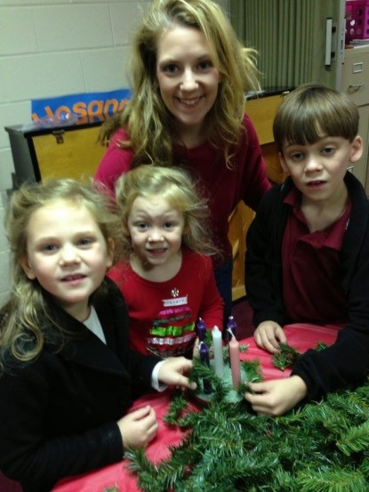
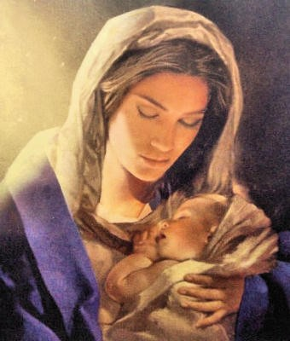
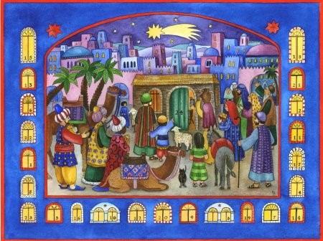
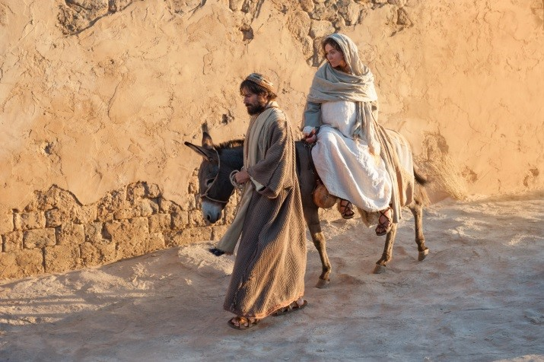
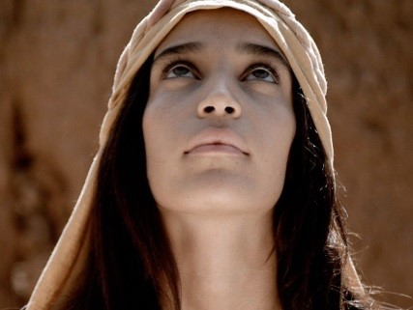
Sharing our Learning about ADVENT with family whānau
Tell someone the story about God sending the angel Gabriel to Mary to ask her to be the mother of his son, Jesus.
Sing an ADVENT song for your mother that you have learned and ask her to tell you how she got ready for her new baby.
Buy an Advent Calendar and share what you have learned about Advent as you open a new door each day. Talk about ADVENT is a waiting time and a getting ready time for Jesus to be born.
Purple is the colour for ADVENT.
Remember to get a calendar that is about Jesus and ADVENT and CHRISTMAS!
Make up your own way of showing and sharing what you have learned and decide with whom you would like to share it.
Ask an older member of your family to help you.
When the wreath is made put it on your table and each day light the candles - 1 for each week during ADVENT to help you and your family measure the time till when Jesus is born at Christmas.
Sing the ADVENT song as you light the candles. Take home your worksheet with the words for your family whānau to share.
Use your worksheets to help you share what you have learned about how Mary and Joseph got ready for Jesus to be born.
Draw a picture about when Mary went to visit her cousin Elizabeth and they helped each other because they were both having a baby.
Talk to your family about making an ADVENT Wreath.
Share with them what you need and make a plan to get –
a circle base (from the florist), or make one with wire, some ever- greenery, pins, 3 purple candles and 1 pink candle.
L-4
S-12
Click arrow to go through options (8 total). Click worksheet icon for worksheet.
Notes:
This slide provides some choices for children to show and share what they have learned. Examples could be photographed as evidence of children’s learning.
You may like to put a copy of the Sharing our Learning page in children’s RE Learning Journals. You could talk through the choices using the slide and let children make their choice from their own copy.
Children could work on their choice at school and/or at home and you may like to set a day for sharing. Please let parents and whānau know what you expect them to do with this.
The slide is focussed on the ADVENT Achievement Objective for Year 1 which is covered in Lessons 1-4
ADVENT Year 1 AO) Children will be able to recognise that Advent is a time to get ready for the birth of Jesus.

Slide 13
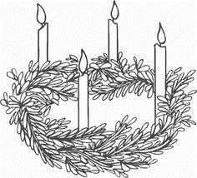
The Advent Wreath song
Name___________________________ Date_______________
L-4
S-5
Worksheet
Click the up arrow to return to the lesson
Notes:
This worksheet relates to slide 5

Slide 14
Sharing our Learning about ADVENT with family whānau
Name___________________________ Date_______________
Use your worksheets to help you share what you have learned about how Mary and Joseph got ready for Jesus to be born.
Sing an ADVENT song for your mother that you have learned and ask her to tell you how she got ready for her new baby.
Tell someone the story about God sending the angel Gabriel to Mary to ask her to be the mother of his son, Jesus.
Draw a picture about when Mary went to visit her cousin Elizabeth and they helped each other because they were both having a baby.
Talk to your family about making an ADVENT Wreath. Share with them what you need and make a plan to get – a circle base (from the florist), or make one with wire, some ever- greenery, pins, 3 purple candles and 1 pink candle.
Ask an older member of your family to help you. When the wreath is made put it on your table and each day light the candles - 1 for each week during ADVENT to help you and your family measure the time till when Jesus is born at Christmas. Sing the ADVENT song as you light the candles. Take home your worksheet with the words for your family whānau to share.
Buy an Advent Calendar and share what you have learned about Advent as you open a new door each day. Talk about how ADVENT is a waiting time and a getting ready time for Jesus to be born. Purple is the colour for ADVENT. Remember to get a calendar that is about Jesus and ADVENT and CHRISTMAS!
Make up your own way of showing and sharing what you have learned and decide with whom you would like to share it.
L-4
S-12
Worksheet
Click the up arrow to return to the lesson
Notes:
This worksheet relates to slide 12

