Slide 1
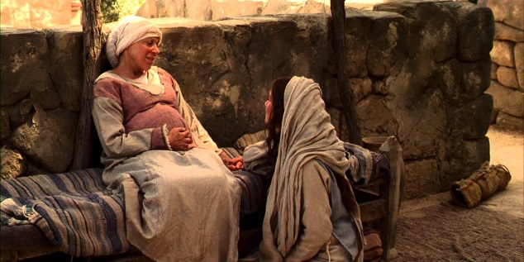
Waiting with others
L-2
S-01
Notes:
Use this slide as a focussing strategy to introduce the lesson topic. Read the title together and invite children to share something they know about waiting with others for something special to happen.

Slide 2
Learning Intentions
The children will:
1)
recall how Mary shared her waiting time with Elizabeth
2)
name ways people can share times of waiting with family whānau and friends
L-2
S-02
Click the borders to reveal text
Notes:
Read through the Learning Intentions with the class and identify some ideas/questions that might be explored in the lesson.

Slide 3
We remember the first people who waited for Jesus to be born, his parents – Mary and Joseph
Mary lived in Nazareth.
She was engaged to Joseph.
She was chosen by God to
be the mother of his son, Jesus.
Joseph was a carpenter.
He loved Mary and they
were going to be married.
Joseph was Jesus’ foster father.
L-2
S-03
Click on images to reveal a line of text
Notes:
Adapt Teaching and Learning Experiences 1,2,3,4
Read the text that matched the images and talk about it.
How would Mary and Joseph be feeling as they waited for their new baby?

Slide 4
We remember Joachim and Anne – Jesus’ grandparents
Mary’s parents were Joachim and Anne and they loved their daughter very much.
They were looking forward to becoming grandparents to her son, Jesus.
They supported Mary and helped her to get ready for the baby to be born.
They waited patiently, wondering what their grandson would be like.
Click the down-button to move the blind down,
click the up-button (appears at bottom) to move the blind to the top.
L-2
S-04
Notes:
Children could ask their grandparents how they were feeling as they waited for their new grandchildren to be born.
Read each sentence and imagine what Joachim and Anne would be talking about in the days before Jesus’ birth.

Slide 5
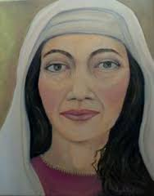
We remember Elizabeth - Mary’s cousin
Elizabeth, Mary’s cousin, was married to Zechariah and they had no children.
This was at the same time Mary was waiting for her baby.
Mary’s baby was Jesus and Elizabeth’s baby was John the Baptist.
The Angel Gabriel came to tell Zechariah that Elizabeth was going to have a baby.
Mary and Elizabeth waited together for their babies to be born.
L-2
S-05
Click the pins on the right to reveal post-it notes.
Notes:
Adapt Teaching and Learning Experiences 6 &7 .
Read the story of the Visitation Luke 1: 39- 56.
Read each post it and imagine what sort of person Elizabeth was.
Why do you think she was a good person for Mary to wait with?

Slide 6
People share times of waiting with others – Mary and Elizabeth waited together
Why did Mary go to visit Elizabeth?
What do you think they talked about?
What did they do while they were waiting together?
Why is it good for people to share waiting times with others?
X
L-2
S-06
Click on video button to go to video clip. Click the I-button to reveal information
Notes:
Watch the clip The Visitation 5:06 minutes
https://www.youtube.com/watch?v=3WLF3cwXfGc
Answer the questions on the pop up.
Make up a question of your own.

Slide 7
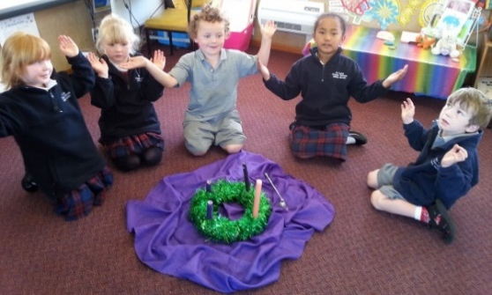
What are you doing as you wait for Jesus to be born?
While I am waiting for Jesus I
talk to him in my heart and tell him I am waiting for him to come.
In Advent I try to help
because Advent is a very busy season of the year.
In my family we
talk about getting ready for Jesus to be born at Christmas.
In my class
we are learning about the people who waited for Jesus to be born.
At prayer time we like to
use our Advent wreath to help us prepare for Jesus.
use our Advent wreath to help us prepare for Jesus.
because Advent is a very busy season of the year.
we are learning about the people who waited for Jesus to be born.
talk to him in my heart and tell him I am waiting for him to come.
talk about getting ready for Jesus to be born at Christmas.
L-2
S-07
Click a sentence in the white box to reveal its position.
Click the audio button to stop ‘The whole world is waiting for love’
Click the audio button to play ‘The whole world is waiting for love’
Notes:
Read the title and think about it as children read each statement and suggest the correct conclusion to it in the white box. Click on the option to check each one out.
Sing using the MP3 ‘The whole world is waiting for love’

Slide 8
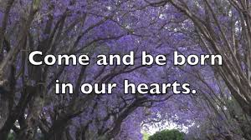
Why do we recall Jesus’ birthday?
When we wait and prepare for the day Jesus was born, our hearts are ready to welcome him and he is present for us in a new way.
That is why we pray ‘Come Lord Jesus, come and be born in our hearts.’
It does not mean Jesus is born again. It means his presence is stronger in our lives and hearts because we remember the day of his birth.
The day Jesus was born is the day we recall that he is
God’s son, Emmanuel – God with us.
By remembering the day Jesus was born it makes the special day present again in our lives.
L-2
S-08
Click top card to discard it
Notes:
Read each flip card and talk about what it means.
When all are read ask the children the question in the title.

Slide 9
Check Up
1)
Name the people who waited for Jesus to be born.
2)
What did Mary do while she waited for Jesus to be born?
3)
Why is it good for us to prepare for Jesus to be born?
4)
Which activity do you think helped you to learn best in this lesson?
5)
Questions I would like to ask about the topics in this lesson are …
L-2
S-09
Click the borders to reveal text
Notes:
This formative assessment strategy will help teachers to identify how well students have achieved the Learning Intentions of the lesson.
Teachers can choose how they use the slide to assess each item.
A worksheet of this slide is available as an option for children to complete.
The last two items are feed forward for the teacher.
Recording the children’s responses to these items is recommended as it will enable teachers to adjust their learning strategies for future lessons and target the areas that need further attention.

Slide 10
Time for Reflection
L-2
S-10
Click the audio button to stop reflective music
Click the audio button to play reflective music
Notes:
The MP3 is played to help create a reflective atmosphere and bring the children to stillness and silence as the teacher invites them to talk to Jesus in their hearts and tell him they are waiting to welcome into their life on his birthday.

