Slide 1
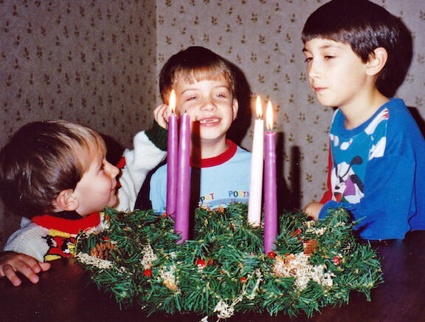
Advent is a time for family whānau to prepare for Christmas
L-3
S-01
Notes:
Use this slide as a focussing strategy to introduce the lesson topic. Read the title together and invite children to share something they know about the symbols that belong to the waiting time of Advent.

Slide 2
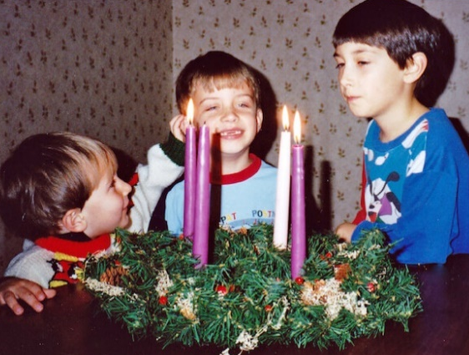
Learning Intentions
The children will:
1)
recognise that people need to wait patiently in Advent
2)
identify symbols of Advent that belong to the waiting time
L-3
S-02
Click the borders to reveal text
Notes:
Read through the Learning Intentions with the class and identify some ideas/questions that might be explored in the lesson.

Slide 3
Waiting on the outside and preparing on the inside
Inside preparing by
Talking to Jesus about waiting for him
Remembering we are preparing for Jesus’ birth
Having a quiet moment with Jesus
Keeping our hearts open to receive Jesus in a new way
Outside waiting
We light the Advent candles
We notice signs of Advent
We see the purple colour
We sing Advent songs
L-3
S-03
Click on image to reveal text
Notes:
Explain to children the difference between waiting and getting ready on the outside using candles, colours and songs to remind us that we are waiting for Jesus to be born and waiting on the inside in our hearts for Jesus.
Read and talk about the bullet points on both reveals and decide how we can remind each other to prepare for Jesus in our hearts.

Slide 4
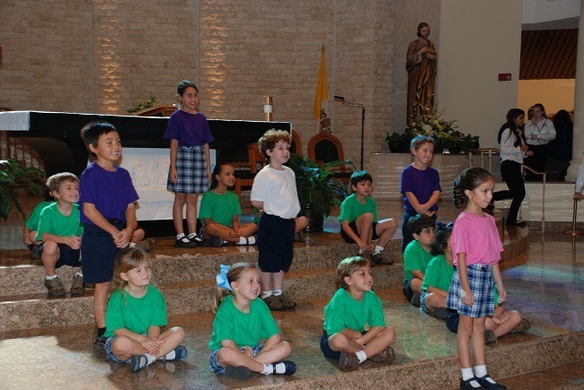
Keeping focussed on Advent
SEE - What do you see in the way the children are sitting?
How are they doing this?
THINK – How do you think doing this keeps the children thinking about Advent?
Why is it important to keep focussed on waiting for Jesus to come?
WONDER - Do you wonder what happens if you celebrate Christmas early?
Why is celebrating early not the best idea?
Read the story ‘Early Birthday’ to find out.
L-3
S-04
Notes:
Use the SEE, THINK, WONDER strategy to help children stay focussed on Advent. Replicate in the class how the children are sitting in the image in the slide in the Advent wreath formation and use this to remind children about Advent.
Read the story ‘Early Birthday’ on the Teacher Resource p16 or on the lesson home page and make copies of the Teacher Resource The Advent Wreath p17 for children to colour and share with their family whanau.

Slide 5
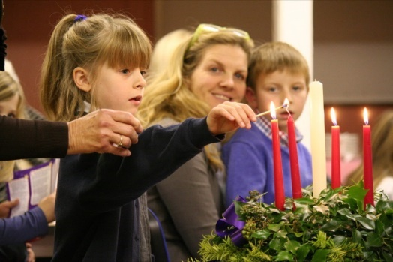
Patiently waiting in Advent prepares us for a great Christmas celebration
We use the 4 weeks of Advent to help us to get our hearts ready to give Jesus a special welcome when the time is right for this.
We need to remind each other to put special Christmas treats away until Christmas comes and Advent is ended.
In Advent we use the wreath and the candles to help us wait patiently and prepare for Jesus to come.
We need to use the right time to prepare for Jesus and this will help us to celebrate well at Christmas.
L-3
S-05
Click the pins on the right to reveal post-it notes.
Notes:
Read each post it note and talk about what it is saying.
Explain to children that when we prepare well for something it always works out better. Children share experiences of this at home and at school.
Talk at home about waiting patiently for Jesus to be born

Slide 6
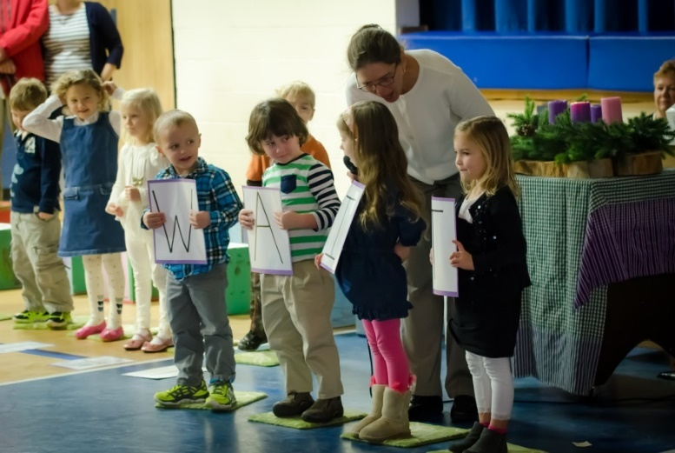
Enjoying Advent symbols and colours before Christmas
B | E | C | A | U | S | E | W | H | Y
R | P | A | T | I | E | N | T | L | Y
E | R | E | A | D | Y | U | H | G | C
M | J | E | S | U | S | S | A | E | O
I | W | E | I | S | V | E | T | T | L
N | A | F | C | K | N | B | M | T | O
D | I | O | O | Y | I | S | D | I | U
S | T | R | M | T | I | T | A | N | R
A | D | V | E | N | T | I | V | G | T
P | U | R | P | L | E | N | L | E | O
Purple
is
a
getting
ready
Colour.
That
is
why
we
use
it
in
Advent
because
it
reminds
us
to
wait
patiently
for
Jesus
to
come
Click on a word in the sentence to reveal its position on the word find. Click on worksheet button to go to worksheet
L-3
S-06
Click the audio button to stop ‘Advent song’
Click the audio button to play ‘Advent song’
Notes:
Read the sentence
Find each word in the sentence beside the matrix and highlight it there and in the Word Find. Children complete the worksheet and check it on the screen.
Sing using the MP3 ‘Advent song.’
Remind your family about the colour and symbols of Advent and how you are preparing at home for Jesus to come.

Slide 7
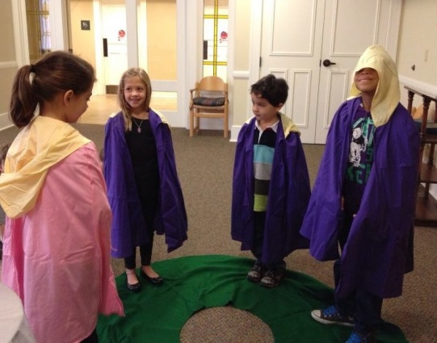
An Advent Quiz
L-3
S-07
Click on worksheet button to go to worksheet
Notes:
Look closely at the image and explain what the children are doing.
Children complete the worksheet and mark it together.
Children share 3 things they have learnt about the Advent season.
Answers
1) YES, 2) NO, 3) YES, 4) NO, 5) YES, 6) YES, 7) NO, 8) YES, 9) NO, 10) YES,

Slide 8
Check Up
1)
Tell a partner what helps you to wait patiently during Advent.
2)
Why is it important to keep Advent things for the Advent season?
3)
How does the Advent wreath or the Advent Calendar help you to wait patiently during Advent?
4)
Complete the sentences-
On the Advent wreath the purple candles mean…
The pink candle means ...
The green wreath means…
5)
Which activity do you think helped you to learn best in this lesson?
6)
Questions I would like to ask about the topics in this lesson are …
L-3
S-08
Click the borders to reveal text
Notes:
This formative assessment strategy will help teachers to identify how well children have achieved the Learning Intentions of the lesson.
Teachers can choose how they use the slide in their range of assessment options.
A worksheet of this slide is available for children in Years 5-8 to complete.
The last two items are feed forward for the teacher.
Recording the children’s responses to these items is recommended as it will enable teachers to adjust their learning strategies for future lessons and target the areas that need further attention.

Slide 9
Time for Reflection
L-3
S-09
Click the audio button to stop reflective music
Click the audio button to play reflective music
Notes:
The MP3 is played to help create a reflective atmosphere and bring the children to stillness and silence as the teacher invites them to recall talking about preparing their heart for Jesus’ coming (see Slide 3)- by talking to Jesus, having a quiet time with Jesus and keeping their hearts open to meet Jesus in a new way in Advent.

Slide 10
Sharing our Learning about ADVENT with family whānau
Make a poster to help you explain that Advent is a waiting time, telling how you feel about waiting, showing what it feels like to have to wait, and explaining who we are waiting for and what waiting patiently means.
Make up some plays to tell the bible stories about Mary and Joseph waiting and Mary and Elizabeth waiting. In the plays say why people like to wait with others rather than on their own. You could use the bible stories to help you with the plays.
Talk to someone who knows about waiting in your family and ask them to share some tips about how to make waiting easier. Explain to them why you are learning about waiting at the moment.
Share the Advent Quiz with someone and share your scores.
Have a conversation with someone who doesn’t know what the Advent wreath or calendar is and explain to them what they mean and how to use them.
Make up your own way of showing and sharing what you have learned and decide with whom you would like to share it.
L-3
S-10
Click on worksheet button to go to worksheet
Notes:
This slide provides some choices for children to show and share what they have learned. Examples could be photographed as evidence of children’s learning. You may like to put a copy of the Sharing our Learning page in children’s RE Learning Journals. You could talk through the choices using the slide and let children make their choice from their own copy.
Children could work on their choice at school and/or at home and you may like to set a day for sharing. Please let parents and whānau know what you expect them to do with this.
The slide is focussed on Achievement Objective for Year 2 Advent which is covered in Lessons 1,2,3
Year AO) Children will be able to: identify aspects of waiting, and relate these to the Advent season.

Slide 11
Sharing our Learning about ADVENT with family whānau - WORKSHEET
Make a poster to help you explain that Advent is a waiting time, telling how you feel about waiting, showing what it feels like to have to wait, and explaining who we are waiting for and what waiting patiently means.
Make up some plays to tell the bible stories about Mary and Joseph waiting and Mary and Elizabeth waiting. In the plays say why people like to wait with others rather than on their own. You could use the bible stories to help you with the plays.
Talk to someone who knows about waiting in your family and ask them to share some tips about how to make waiting easier. Explain to them why you are learning about waiting at the moment.
Share the Advent Quiz with someone and share your scores.
Have a conversation with someone who doesn’t know what the Advent wreath or calendar is and explain to them what they mean and how to use them.
Make up your own way of showing and sharing what you have learned and decide with whom you would like to share it.
L-3
S-10
Worksheet
Click the up arrow to return to the presentation
Notes:
This worksheet relates to slide 10

Slide 12
Enjoying Advent symbols and colours before Christmas - WORKSHEET
B | E | C | A | U | S | E | W | H | Y
R | P | A | T | I | E | N | T | L | Y
E | R | E | A | D | Y | U | H | G | C
M | J | E | S | U | S | S | A | E | O
I | W | E | I | S | V | E | T | T | L
N | A | F | C | K | N | B | M | T | O
D | I | O | O | Y | I | S | D | I | U
S | T | R | M | T | I | T | A | N | R
A | D | V | E | N | T | I | V | G | T
P | U | R | P | L | E | N | L | E | O
Name_________ Date________
Purple
is
a
getting
ready
Colour,
That
is
why
we
use
it
in
Advent
because
it
reminds
us
to
wait
patiently
for
Jesus
to
come
L-3
S-06
Worksheet
Click the up arrow to return to the presentation
Notes:
This worksheet relates to slide 6

Slide 13
OUR ADVENT QUIZ
Name _______________________________ Date ____________
Reading the stories about Mary, Joseph and Elizabeth in Advent is helpful for us. YES/ NO
The Advent wreath has 6 yellow candles. YES/ NO
An Advent Calendar is a useful way to count off the days in Advent. YES/ NO
Advent lasts 6 weeks and most of it is in December. YES/ NO
At Christmas we wait like Mary and Joseph waited for Jesus to be born. YES/ NO
Advent is a time to talk to Jesus in our hearts and thank him for coming. YES/ NO
The pink candle on the wreath reminds us that Christmas is here. YES/ NO
We put Christmas treats away in Advent until it is Christmas Day. YES/ NO
Advent comes after Easter on the Liturgical Calendar. YES/ NO
Advent is a time to prepare, not a time to celebrate . YES/ NO
How is your score?
10 Excellent 9-7 Very good 6-4 Good
Below 4 – find a friend to help you learn more about ADVENT
L-3
S-07
Worksheet
Click the up arrow to return to the presentation
Notes:
This worksheet relates to slide 7

