Slide 1

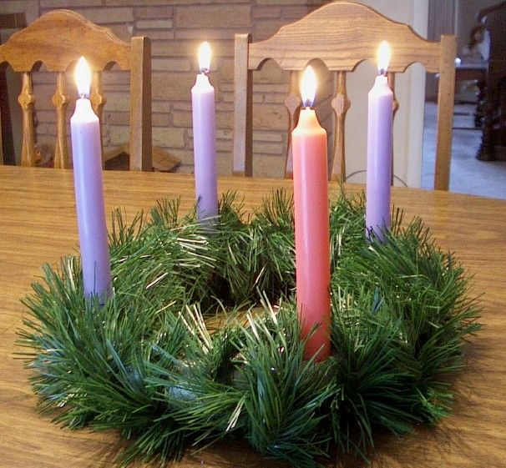
The Advent Wreath
L-1
S-01
Notes:
Slide 1 The Advent Wreath
Use this slide as a focussing strategy to introduce the lesson topic. Read the title together and invite children to share something they know about the Advent Wreath and how it is used to mark the weeks in the season of Advent.

Slide 2

Learning Intentions
The children will:
1)
identify the main symbols of the Advent Wreath
2)
explain the traditional meaning of the symbols
L-1
S-02
Click the rectangles to reveal the text
Notes:
Slide 2 Learning Intentions
Read through the Learning Intentions with the class and identify some ideas/questions that might be explored in the lesson.

Slide 3
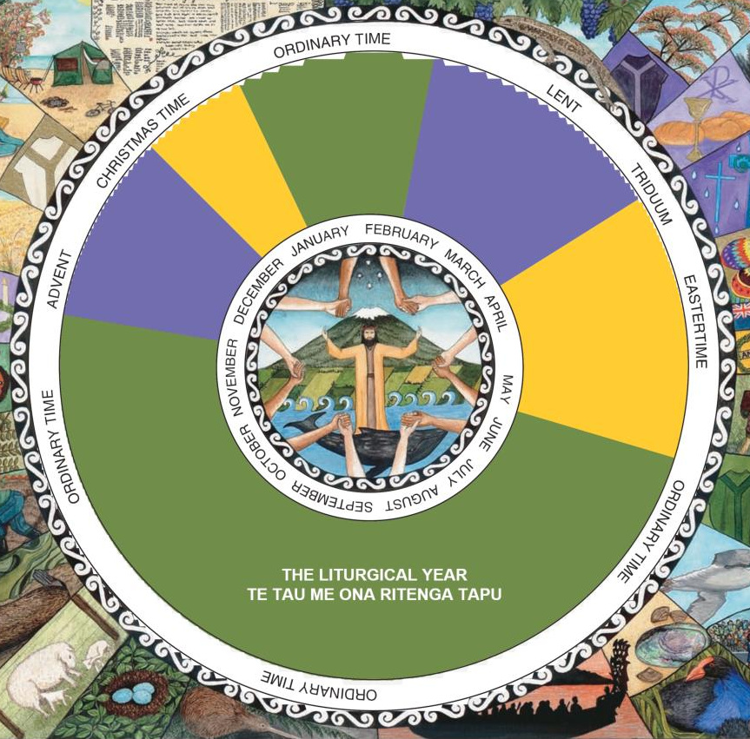
The Season of Advent
On the Liturgical Calendar Advent
is coloured
purple
Advent is a season for getting
ready for
Christmas
The other getting ready season is
Lent
A getting ready season is a
Penitential season
The time before Advent is called
Ordinary Time
Christmas
purple
Lent
Ordinary Time
Penitential season
Click in the empty text box to complete the sentence
L-1
S-03
Notes:
Slide 3 The Season of Advent
Children share what they know about the Season of Advent and suggest the correct word to complete the cloze activity. Use the floaters to check. Answers
1. Purple 2. Christmas 3. Lent 4. Penitential Season 5. Ordinary Time

Slide 4


The Advent Wreath is an important
tradition for Christians
The Advent Wreath comes from a different part of the world that we call the Northern Hemisphere which has opposite seasons to us. We have Christmas in summer and they have Christmas in winter.
Winter is a very cold season in the northern hemisphere and there is often deep snow. The days are short and dark with no sunshine around Christmas time. Have you seen Christmas cards showing pictures of snow falling and Christmas stockings hung by the fireplace with a fire burning?
The trees are bare except for the fir and pine trees because they are evergreen trees which stay green and fresh all year. People light candles to brighten up the darkness and the candle light cheers them up and gives them hope that spring will come soon.
People used the small branches of the evergreen trees to make a wreath and they added the candles which became a sign that Jesus comes to us like light in the darkness bringing us hope and reminding us of God’s love and life.
The evergreen leaves became a sign of God’s gift of everlasting life which is God’s promise of hope to all Christians. The circle is like God’s everlasting love that has no beginning and no end.
Press the green button to advance through the lines
L-1
S-04
Click the audio button to stop ‘Mo te Aweneti’
Click the audio button to play ‘Mo te Aweneti
Notes:
Slide 4 The Advent Wreath is an important tradition for Christians
Adapt Teaching and Learning Experience 2 & 3.
Use candles to reveal text and read each one through using the pointer. Children talk about the meaning of the text in each and ask questions and make comments. Children who have experienced Advent in the northern hemisphere share what it is like with the class.
Sing using the MP3 ‘Mo te Aweneti’

Slide 5
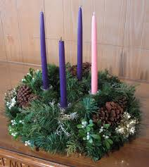
The Candles on the Advent Wreath
The other three candles are purple to remind us that Advent is a penitential time to prepare our hearts for Jesus to come into at Christmas.
The pink or rose candle is the joy candle because we have almost reached the joy of Christmas.
As each new candle is lit for each new week in Advent the light gets brighter because Jesus’ coming is getting closer.
The four candles on the wreath, one for each week of Advent, remind us that Jesus, the light of the world, is coming.
L-1
S-05
Click top card to discard it
Notes:
Slide 5 The candles on the Advent Wreath
Children share what they know about the candles on the Advent Wreath.
Use the flip cards to find out more about the candles and how they are used.

Slide 6

The Christ Candle
Some people put a white candle in the middle of the wreath – this is the Christ
Candle
The Christ Candle is lit on Christmas day
It reminds people to keep Christ at the
centre of Christmas.
The Advent Wreath is a Christian tradition
that helps people to open their hearts to
welcome Jesus into their lives in a new way.
Families usually bless their wreaths
before they use it. Usually the wreath is
on the meal table and the candles are
lit during the family meal and the family
prays when the meal is finished.
L-1
S-06
Press the green button to advance through the lines
Notes:
Slide 6 The Christ Candle
Identify the Christ Candle – the white one in the centre reminds us that Christ is at the centre of Christmas.
Children share what they know about this candle and what it symbolises.
Use the pointer to share the information about the Christ Candle.
*Explain that the circle shape of the wreath is like God’s love that has not beginning and no end.
*The evergreen leaves are everlasting and they remind people that they live in hope that they will live forever with God. Green is the colour of hope. *The purple ribbon reminds us to turn back to living God’s ways of love and kindness.
*Explain that the four candles, one for each week of Advent, remind people that Jesus who is the light of the world is coming. *As each candle is lit the light gets brighter.
*The pink or rose candle is lit in the third week as a sign of joy that Jesus is coming very soon.

Slide 7

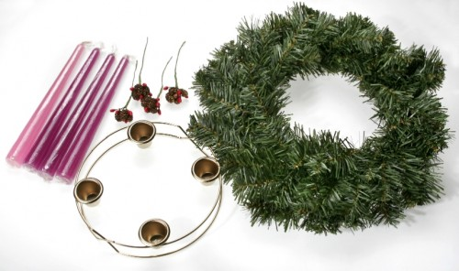
How to make an Advent wreath
Step 1 Get the circular base for the wreath
Step 2 Collect some small evergreen branches and attach them to the base
Step 3 Get the candles - 3 purple, 1 pink candle and a white Christ candle
Step 4 Attach the candles securely
Step 5 Place the wreath on your table to light at meal time when an adult is there.
Step 6 Pray the Advent blessing together and sing the Advent song
L-1
S-07
Click the worksheet button to go to the worksheet
Notes:
7 How to make an Advent Wreath
Children work through the directions step by step.
Children take their worksheet home to help make a family Advent Wreath.
You may like to arrange a blessing for family Advent Wreaths on the Friday before the 1st Sunday of Advent and encourage families to bring their wreaths. Classroom Advent Wreaths could be blessed at the same time.
The worksheet could be shared with other classes to help them make their class Advent Wreath.

Slide 8
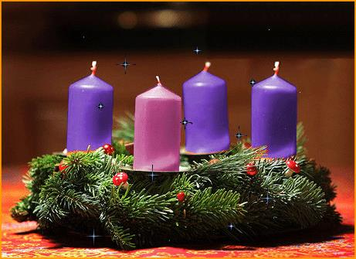
Advent Family Prayer
Blessed
be our God,
Who sent Jesus his Son
to be the Light of the world,
to spread the light of his love
among all people.
As we light the candles of this wreath
may its growing brightness
remind us that Jesus is near.
While we prepare to celebrate his birth,
open our hearts as we wait, saying,
Come Lord Jesus, come and fill us with joy
and the gentle peace that only you can bring.
AMEN
L-1
S-08
Press the green button to advance through the lines
Click the worksheet button to go to the worksheet
Notes:
Slide 8 Advent Family Prayer
Use the pointer to read through the Advent Family Prayer.
This can be used during class morning prayer each day in Advent around the wreath.
Children take home a copy on their worksheet to pray at home.
It could be added to the school weekly newsletter for families to pray.

Slide 9
Advent Song
Light the Advent candle one.
Now the waiting has begun
We have started on our way
Time to think of Christmas Day.
Chorus:
Candle, candle burning bright
Shining in the warm summer night
Candle, candle burning bright
Fill our hearts with Christmas light.
Light the advent candle two
Think of humble shepherds who
Filled with wonder at the sight
Of the Child on Christmas night.
Chorus
Light the Advent candle three
Think of heavenly harmony
Angels singing “Peace on Earth”
At the Blessed Saviour’s birth.
Chorus
Light the Advent candle four
Think of joy forever more
Christ child in a stable born
Gift of love that Christmas morn.
Chorus
Light the Christmas candles now
Sing of donkey, sheep and cow
Birthday candles for the King
Let the Alleluias ring.
Chorus
Click the audio button to stop ‘Advent song’
Click the audio button to play ‘Advent song’
Press the green button to advance through the lines
L-1
S-09
Click the worksheet button to go to the worksheet
Notes:
Slide 9 Advent Song
Use the pointer as the Advent song is sung
Sing using the MP3 ‘ The Advent Song’
Children can share the song with their family during Advent using their worksheet.
Encourage children to pray and sing during Advent around their family wreath to prepare for Jesus to come closer to their family as they prepare for his coming at Christmas.

Slide 10
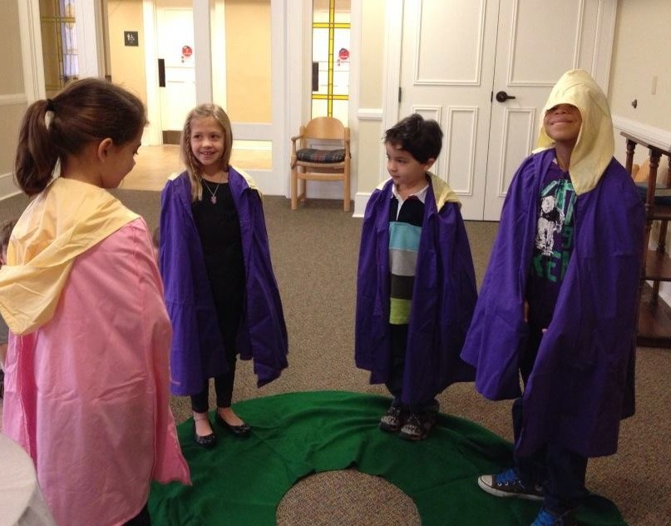
Make yourselves into a living
Advent Wreath
You will need:
A long piece of green material on the
floor in a wreath shape
3 purple capes, 1 pink cape, I white cape
5 yellow hats or hoods
Children wearing capes and hats or hoods stand as if they are candles on the wreath.
Children decide which Sunday they are.
As each verse of the Advent song is sung children put their hat or hood on to represent the flame.
L-1
S-10
Click the audio button to stop ‘Advent song’
Click the audio button to play ‘Advent song’
Notes:
Slide 10 Make yourselves into a living Advent Wreath
Look at the image on the slide.
Children follow the directions on the slide to make themselves into an Advent Wreath. The materials used for this could be shared around classes during Advent and at school prayer times.
Sing using the MP3 ‘ The Advent Song’
Send home copies of the Children’s Home Activity on p13 or on lesson home page to be completed.

Slide 11
Check Up
1)
Name the symbols of the Advent wreath and explain what they mean.
2)
Tell a partner how to make an Advent wreath.
3)
Which activity do you think helped you to learn best in this lesson?
4)
Questions I would like to ask about the topics in this lesson are …
L-1
S-11
Click in each caption space to reveal text
Notes:
Slide 11 Check Up
This formative assessment strategy will help teachers to identify how well children have achieved the Learning Intentions of the lesson.
Teachers can choose how they use the slide in their range of assessment options.
A worksheet of this slide is available for children in Years 5-8 to complete.
The last two items are feed forward for the teacher.
Recording the children’s responses to these items is recommended as it will enable teachers to adjust their learning strategies for future lessons and target the areas that need further attention.

Slide 12


Time for Reflection
Click the audio button to stop reflective music
L-1
S-12
Click the audio button to play reflective music
Notes:
Slide 12 Time for Reflection
The MP3 is played to help create a reflective atmosphere and bring the children to stillness and silence as the teacher invites them to reflect on the meaning of the symbols in the Advent Wreath and how it helps people to remember the season of Advent and how it lets people see that as the candle light increases that Jesus truly is the light of the world.
Original Children’s Activities available on lesson home page

Slide 13

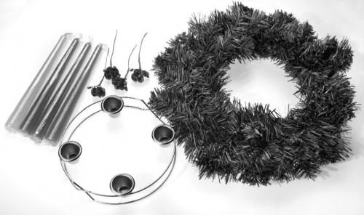
Name:
Date:
How to make an Advent wreath
Step 1 Get the circular base for the wreath
Step 2 Collect some small evergreen branches and attach them to the base
Step 3 Get the candles - 3 purple, 1 pink candle and a white Christ candle
Step 4 Attach the candles securely
Step 5 Place the wreath on your table to light at meal time when an adult is there.
Step 6 Pray the Advent blessing together and sing the Advent song
L-1
S-07
Worksheet
Click the up arrow to return to the lesson
Notes:
(6) Copy worksheet template
Some slides will be used as worksheets by the students.
A copy worksheet is a black & white version of the colour slide which is here, for reference purpose, called the original.
(please refer to the worksheet template on how to create a worksheet).
Tip: create the worksheet immediately after you have created the original slide and place it at the end of the presentation before configuring the worksheet button.
If a slide is designated to be a worksheet, it should have the Worksheet button positioned on the bottom right.
The exact position depends on the buttons that are available on the slide (refer to General Information section for the position of buttons).
If the Worksheet button is the only button on the slide, the position of the button on this template is correct.
Configuring the Worksheet button.
The following procedure can be used to configure the worksheet button:
Right-click the button and chose: “Edit Hyperlink”;
On the Mouse click tab chose: “Hyperlink to:”;
From the drop down chose: “slide”;
Pick the correct slide number of the worksheet slide:
The worksheet slide should be position at the end of the presentation (if there is more than 1 worksheet, place them in order of appearance);
Don’t worry if you add slides between the original and the worksheet, the worksheet button will automatically be updated to point to the correct slide;
Don’t forget to have the document button on the worksheet slide pointing to this original slide.
Next to the content specified in Anne’s instructions this worksheet must have the following objects: Identification field, back button, tool instructions and worksheet indication.
For configuration information on these objects please refer to the General Information and Structure sections.
Adjust the tool instruction to match the purpose of the slide.

Slide 14

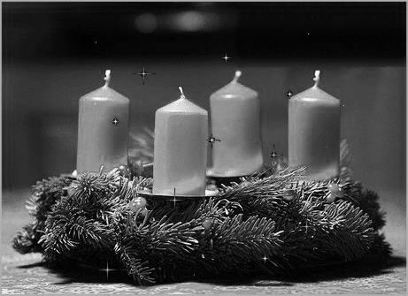
Advent Family Prayer
Blessed
be our God,
Who sent Jesus his Son
to be the Light of the world,
to spread the light of his love
among all people.
As we light the candles of this wreath
May its growing brightness
remind us that Jesus is near.
While we prepare to celebrate his birth.
Open our hearts as we wait, saying
Come Lord Jesus, come and fill us with joy
and the gentle peace that only you can bring.
AMEN
L-1
S-08
Worksheet
Click the up arrow to return to the lesson
Notes:
(22) Multiple line pointer template
In this template, an arrow will point to a certain when the button at the bottom-right of the slide is clicked.
This template is useful when a prayer or poem needs to be recited in class. The teacher can advance the arrow when each line is vocalised.
Two sections are chosen to allow for two stanza poems/prayers or a single stanza poem/prayer in two languages.
Please note that in case of a single poem/prayer in two languages, the languages are sequential.
The number of lines in a stanza can be increased by adding lines, buttons and animation at the bottom.
If lines in a stanza are to be deleted, it is best to delete them from the bottom and remove the corresponding buttons and animation.
A compete stanza can be added by copy/paste of one of the two existing ones.
When deleting a complete stanza, the bottom one (button/line 5 to 9) can best be chosen.
After clicking the forward or back button and moving back to this slide, the text will be reset to the initial position so that the animation can be repeated.

Slide 15
Advent Song
Light the Advent candle one.
Now the waiting has begun
We have started on our way
Time to think of Christmas Day.
Chorus:
Candle, candle burning bright
Shining in the warm summer night
Candle, candle burning bright
Fill our hearts with Christmas light.
Light the advent candle two
Think of humble shepherds who
Filled with wonder at the sight
Of the Child on Christmas night.
Chorus
Light the Advent candle three
Think of heavenly harmony
Angels singing “Peace on Earth”
At the Blessed Saviour’s birth.
Chorus
Light the Advent candle four
Think of joy forever more
Christ child in a stable born
Gift of love that Christmas morn.
Chorus
Light the Christmas candles now
Sing of donkey, sheep and cow
Birthday candles for the King
Let the Alleluias ring.
Chorus
L-1
S-09
Worksheet
Click the up arrow to return to the lesson
Notes:
(22) Multiple line pointer template
In this template, an arrow will point to a certain when the button at the bottom-right of the slide is clicked.
This template is useful when a prayer or poem needs to be recited in class. The teacher can advance the arrow when each line is vocalised.
Two sections are chosen to allow for two stanza poems/prayers or a single stanza poem/prayer in two languages.
Please note that in case of a single poem/prayer in two languages, the languages are sequential.
The number of lines in a stanza can be increased by adding lines, buttons and animation at the bottom.
If lines in a stanza are to be deleted, it is best to delete them from the bottom and remove the corresponding buttons and animation.
A compete stanza can be added by copy/paste of one of the two existing ones.
When deleting a complete stanza, the bottom one (button/line 5 to 9) can best be chosen.
After clicking the forward or back button and moving back to this slide, the text will be reset to the initial position so that the animation can be repeated.

