Slide 1

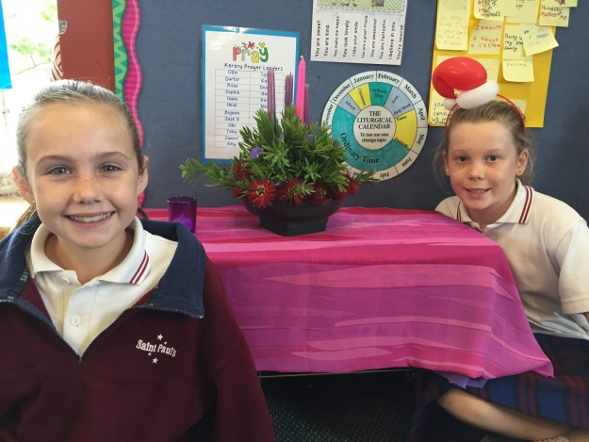
The Advent Wreath in
Aotearoa New Zealand
L-2
S-01
Notes:
Slide 1 The Advent Wreath in Aotearoa New Zealand
Use this slide as a focussing strategy to introduce the lesson topic. Read the title together and invite children to share something they know about the Advent Wreath in Aotearoa New Zealand.

Slide 2

Learning Intentions
The children will:
1)
recognise that the traditional symbols of the Advent wreath can be adapted to the place and season they are being used in
2)
recognise that the Advent wreath can remind people of the coming of Jesus into the world
3)
recall the words of Isaiah 9:2
L-2
S-02
Click the rectangles to reveal the text
Notes:
Slide 2 Learning Intentions
Read through the Learning Intentions with the class and identify some ideas/questions that might be explored in the lesson.
The children will:
1. recognise that the traditional symbols of the Advent wreath can be adapted to the place and season they are being used in
2. recognise that the Advent wreath can remind people of the coming of Jesus into the world
3. recall the words of Isaiah 9:2

Slide 3
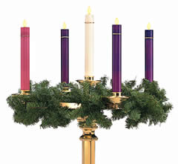
What the Advent Wreath means for people who celebrate Advent during winter
Complete the sentences
Small branches of evergreen trees are used because …
The light the candles bring is important because …
Celebrating Advent in the winter helps people to feel ...
What do you prefer – Advent in summer or winter?
Give the reasons for your answers.
L-2
S-03
Click the worksheet button to go to the worksheet
Notes:
Slide 3 What the Advent Wreath means for people who celebrate Advent during winter
Take time to think about what the Advent Wreath would be like for people in places where it is winter. Share responses. Children suggest words to complete the sentences, answer the question and give reasons for their answers. Children record their own answers on their worksheet.

Slide 4
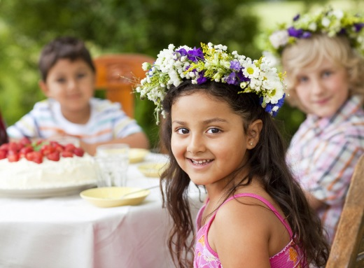
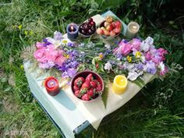
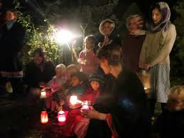
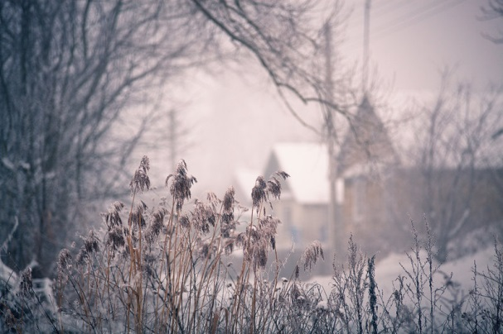
Compare what Advent is like in winter and in summer
Notice the people, the weather, the candles, the flowers, the food
How are these things telling something about celebrations in Advent?
How does the weather change what you can use for Advent symbols?
Share an experience you have had celebrating Advent in winter.
X
Look at the pictures and make a statement about a summer Advent picture compared with a winter Advent picture.
L-2
S-04
Click the I-button to reveal information
Notes:
Slide 4 Compare what Advent is like in winter and in summer
Children look at the images and use the pop up to help them make statements about Advent in summer and in winter and note the differences.
Share responses to the questions.

Slide 5

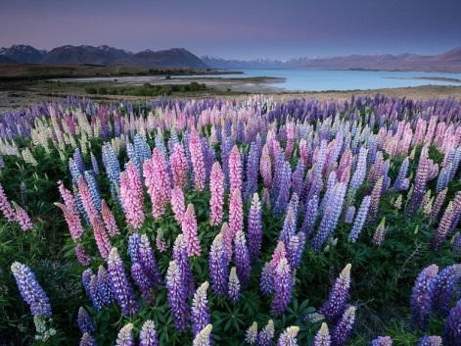
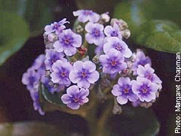
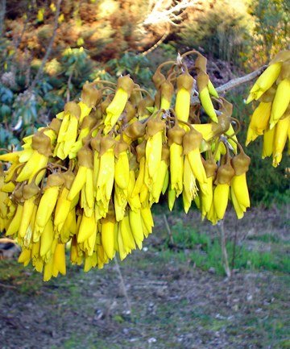
Celebrating Advent in summer
What do the summer flowers and the bright sun
remind us of in Advent?
The purple and pink lupins remind us of the candles on the Advent Wreath.
The purple African violet reminds us that purple is the colour of the preparation or penitential seasons on our Liturgical Calendar.
The kowhai flowers remind us of the light of Christ who is coming soon to be born again in our lives.
Click the images to reveal the sentences
L-4
S-05A
Click the audio button to stop ‘Shine, Shine Your Light’
Click the audio button to play ‘Shine, Shine Your Light’
Notes:
Slide 5 A Celebrating Advent in summer
Children name flowers and say what they bring to mind about Advent. Read the revealed text and talk about it. Children suggest other Advent flowers, trees or birds that say something about Advent.
Sing using the MP3 ‘Shine, Shine Your Light’ .

Slide 6
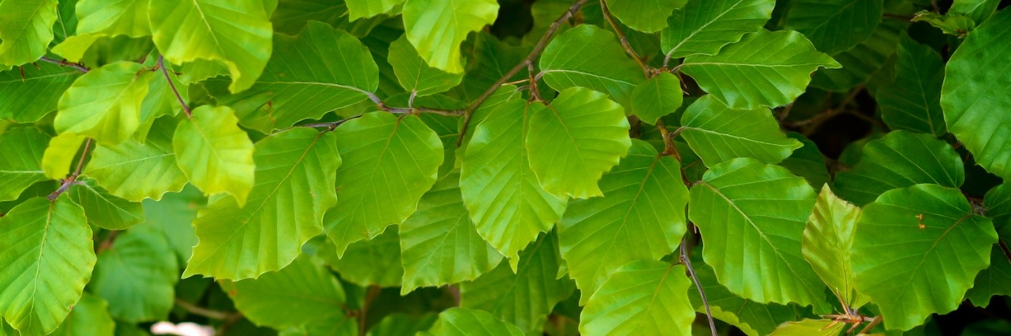
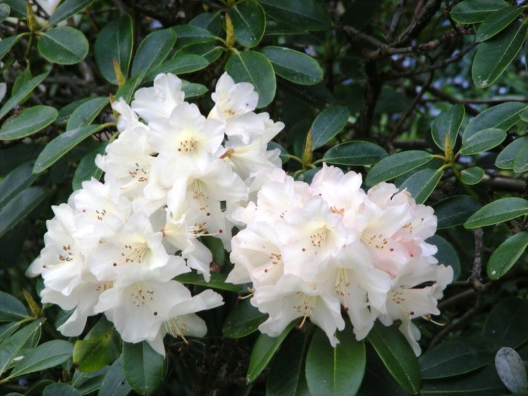
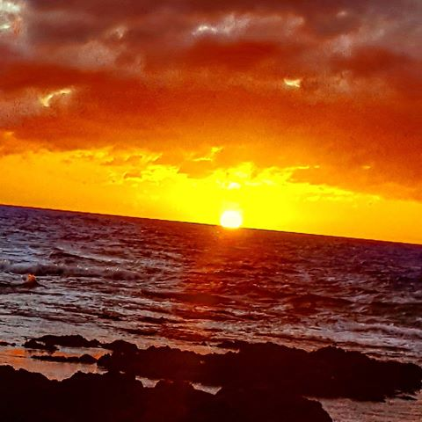
Celebrating Advent in summer
What do the summer flowers and the bright sun
remind us of in Advent?
The green leaves on the plants remind us this is a time of hope because green is the colour of hope.
The white rhododendron reminds us of the Christ candle that we put in the centre of our Advent wreath to tell us that Christ is at the centre of Christmas.
The bright summer sun reminds us of the light and warmth that Jesus brings into our lives.
L-4
S-05B
Click the images to reveal the sentences
Click the audio button to stop ‘Shine, Shine Your Light’
Click the audio button to play ‘Shine, Shine Your Light’
Notes:
Slide 5 B Celebrating Advent in summer
Children name flowers and say what they bring to mind about Advent.
Read the revealed text and talk about it.
Children suggest other Advent flowers, trees or birds that say something about Advent. Adapt Teaching and Learning Experience 2
Sing using the MP3 ‘Shine, Shine Your Light’

Slide 7
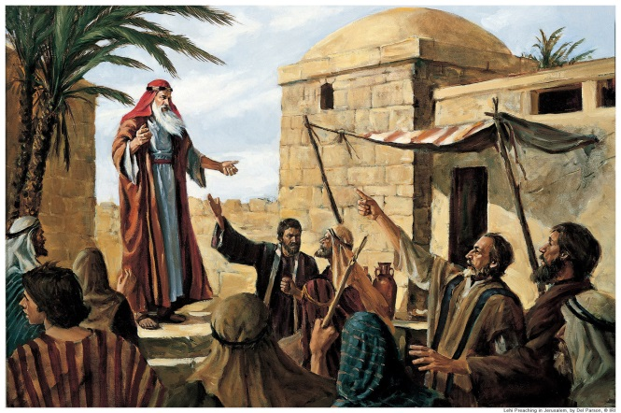
The people of the Old Testament waited for hundreds of years for Jesus,
the Messiah, to come
The people’s lives were very hard and they were tired of waiting for the Messiah to come and save them.
Sample text line that is displayed on the blind.
God sent people called prophets to remind them to be patient and God would keep his promise.
The people rejected the prophets and were not faithful to God because they had lost hope.
They felt as though they were in darkness and were waiting for the light to come.
L-2
S-06
Click the down-button to move the blind down.
Notes:
Slide 6 The people of the Old Testament waited for hundreds of years for Jesus, the Messiah, to come
Use the blind to reveal what was going on and how the people felt.
Children name some prophets and what they did to remind the people about God’s promise. How do think the people felt when the Messiah was born?

Slide 8
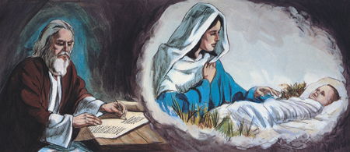

Isaiah was a prophet and a writer
Isaiah lived in Jerusalem 800 years before Jesus was born. He tried to help the people prepare for the coming of the Messiah.
He saw how frustrated the people were and he
tried to bring them hope.
L-2
S-07A
Click the circle images to reveal a text line
Notes:
Slide 7 A Isaiah was a prophet and a writer
Read the story of Isaiah’s life using the reveals in Slides 7A & 7B.
Prophets are people who talk about what could happen in the future and try to help the people prepare for it.
Isaiah predicted that Jesus would be born and he would be God’s son.

Slide 9
Isaiah was a prophet and a writer
He is the author of part of the book of Isaiah in the Old Testament in the Bible.
He predicted the birth of Jesus as the Messiah
who would bring peace to the people.
L-2
S-07B
Click the circle images to reveal a text line
Notes:
Slide 7 B Isaiah was a prophet and a writer
Isaiah could see and hear how miserable the people felt.
He could see it was like they were in darkness and could not come into the light. They had lost hope of a better life that the Messiah was going to bring.

Slide 10
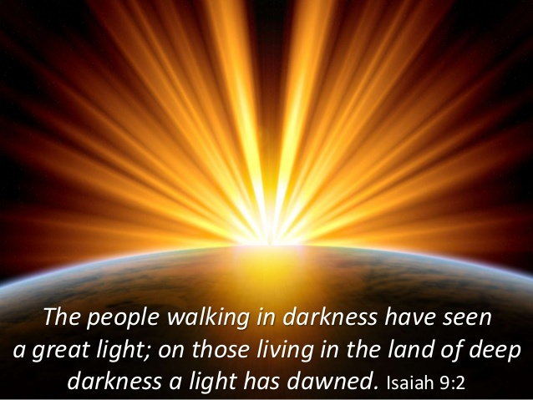
Isaiah wrote these famous words
Who do you think the light was?
How do you think this made the people feel?
What would it be like to live with nothing to hope for or look forward to?
Who changed this for the people?
Can you learn these words by heart?
X
L-2
S-08
Click the I-button to reveal information
Notes:
Slide 8 Isaiah wrote these famous words
Read the words on the image.
Read and share responses to the 5 questions on the pop up.

Slide 11
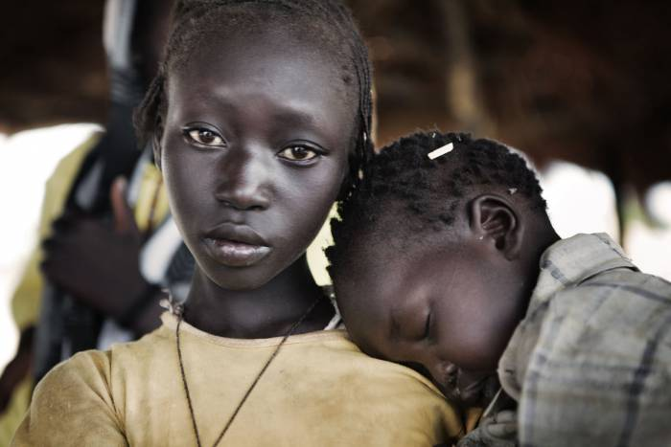
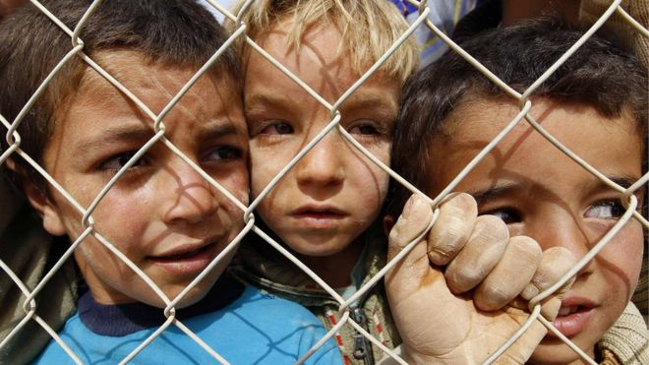
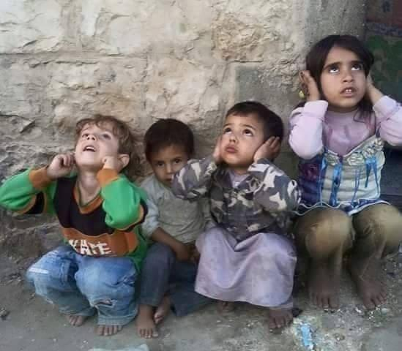
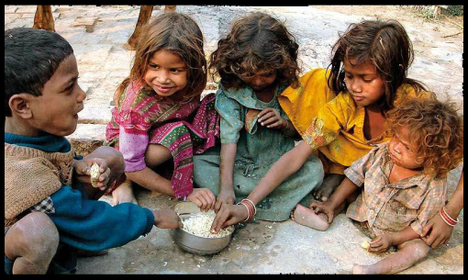
In the world today Jesus needs to come
into the darkness of children who have lost their families
into the darkness of children who live in refugee camps
into the darkness of children
who live where there is war
into the darkness of children who are hungry
L-2
S-09A
Notes:
Slide 9 A In the world today Jesus needs to come …
Children think about places where life is very hard and the people are like those in Old Testament time before Jesus came. These people are in darkness.
Read the caption for each image and look at the children’s faces and say how they are feeling. Name all the reasons these children are living in darkness – how can they be brought back into the light to keep hoping life will get better for them? What can people here do to help that happen?

Slide 12
In the world today Jesus needs to come
H | E | L | P | T | G | I | S | Y | C
C | O | M | E | O | R | N | U | O | H
D | A | R | K | N | E | S | S | U | I
H | C | T | H | E | A | T | E | O | L
O | A | O | F | B | T | H | J | T | D
W | N | C | N | A | C | E | A | N | R
E | E | D | W | O | R | L | D | I | E
V | H | O | F | J | E | S | U | S | N
I | T | S | E | E | Y | E | H | T | O
L | I | G | H | T | Y | N | A | M | S
Isaiah said “The people in darkness have seen a great light” – it was the light of Jesus coming into the world to save people
Find the words below
How can you help Jesus to come into the darkness of the world many children live in so they can see the great light of Jesus
L-2
S-09B
Click each word to reveal the position in the wordfind
Click the worksheet button to go to the worksheet
Notes:
Slide 9 B In the world today Jesus needs to come …
Read the sentence starting with ‘How’ beside the word find.
Find each word in the sentence beside the matrix on the screen and on your worksheet highlight it in the sentence and in the Word Find
Children add worksheets to their RE Learning Journals as evidence of their learning

Slide 13



Celebrating Advent in summer
The sunshine gets hotter and brighter and our days are long and light.
During Advent in our country we have flowers and trees that bloom because the sun is bright and warm.
What is happening here is the opposite to what is happening in the northern hemisphere.
L-2
S-10A
Click the pins on the right to reveal post-it notes
Notes:
Slide 10 A Celebrating Advent in summer
Use the post it notes to explain what it is like celebrating Advent in summer.
Children share what they know about what is happening in the northern hemisphere.

Slide 14
Celebrating Advent in summer
Celebrating Advent in summer
They remind us that it was Jesus who brought us into his light and warmth and gave us hope.
The symbols that remind us that Jesus is coming are different but they make sense to us.
L-2
S-10B
Click the pins on the right to reveal post-it notes
Notes:
Slide 10 B Celebrating Advent in summer
Use the post it notes to explain what it is like celebrating Advent in summer.
What symbols here remind people that Jesus is coming?
Use the Teacher resource p.15 in the Teacher’s book or on the lesson home page to prepare an Advent liturgy for your class to share.

Slide 15

The Advent Wreath reminds us that we are preparing for …
n
ews
It is who must pass on the good of Jesus to others.
p
eople
s
hare
J
esus’
It is people who must the warmth and light of love and aroha.
s
peak
a
ct
People show Jesus’ aroha by the way they and towards
o
thers.
Double click on a letter to reveal a word
L-2
S-11A
Click the audio button to stop ‘Shine, Shine Your Light’
Click the audio button to play ‘Shine, Shine Your Light’
Notes:
Slide 11 A The Advent Wreath reminds us that we are preparing for …
Children guess the words using the initial sounds to complete the sentences. Double click to check.
ANSWERS: 1 people, 2 news, 3 share, 4 Jesus’, 5 speak, 6 act, 7 others
Sing using the MP3 ‘Shine, Shine Your Light’.

Slide 16
The Advent Wreath reminds us that we are preparing for …
essiah
Jesus is the who came to set people and give them
M
f
ree
h
ope.
ring
l
ove
l
ight
Think about how you can Jesus’ and into the
b
w
orld.
Double click on a letter to reveal a word
L-2
S-11B
Click the audio button to stop ‘Shine, Shine Your Light’
Click the audio button to play ‘Shine, Shine Your Light’
Notes:
Slide 11 B The Advent Wreath reminds us that we are preparing for …
Children guess the words using the initial sounds to complete the sentences. Double click to check.
ANSWERS: 1 Messiah, 2 free, 3 hope, 4 bring, 5 love, 6 light, 7 world.
Sing using the MP3 ‘Shine, Shine Your Light’.

Slide 17
Check Up
1)
Name 3 Advent symbols that can be used in
Aotearoa New Zealand.
2)
How can the Advent Wreath help people to remember that this is a season to prepare for the coming if Jesus?
3)
Tell a partner the words of Isaiah on Slide 8 and what Isaiah’s message was?
4)
Explain what ‘living in darkness’ means and give an example of this.
5)
Which activity do you think helped you to learn best in this lesson?
6)
Questions I would like to ask about the topics in
this lesson are …
L-2
S-12
Click in each caption space to reveal text
Notes:
Slide 12 Check Up
This formative assessment strategy will help teachers to identify how well children have achieved the Learning Intentions of the lesson.
Teachers can choose how they use the slide in their range of assessment options.
A worksheet of this slide is available for children in Years 5-8 to complete.
The last two items are feed forward for the teacher.
Recording the children’s responses to these items is recommended as it will enable teachers to adjust their learning strategies for future lessons and target the areas that need further attention.
Check up:
1. Name 3 Advent symbols that can be used in Aotearoa New Zealand.
2. How can the Advent Wreath help people to remember that this is a season to prepare for the coming if Jesus?
3. Tell a partner the words of Isaiah on Slide 8 and what Isaiah’s message was?
4. Explain what ‘living in darkness’ means and give an example of this.
5. Which activity do you think helped you to learn best in this lesson?
6. Questions I would like to ask about the topics in this lesson are …

Slide 18
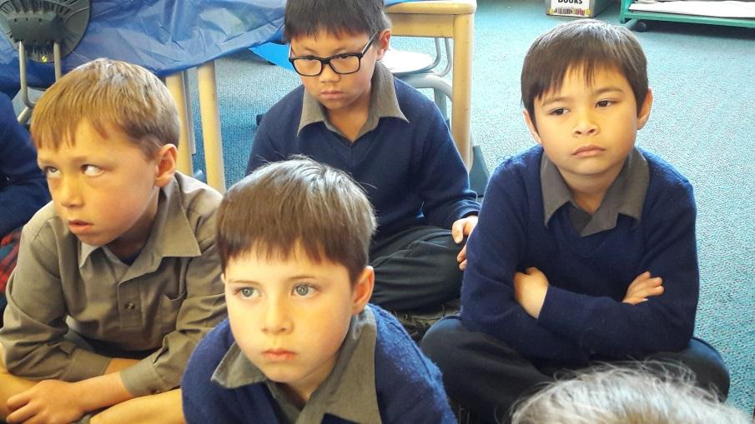

Time for Reflection
L-2
S-13
Click the audio button to stop reflective music
Click the audio button to play reflective music
Notes:
Slide 13 Time for Reflection
The MP3 is played to help create a reflective atmosphere and bring the children to stillness and silence as the teacher invites them to imagine how they can bring light into people’s lives that are in darkness and by their kind actions and gentle words
Original Children’s Activities available on lesson home page

Slide 19

Sharing our Learning about ADVENT with family whānau
Use an Advent wreath to explain to someone how the symbols remind people to prepare for the coming of Jesus at Christmas.
Draw pictures or find old Christmas cards that show the contrast between Christmas in the northern hemisphere and Christmas in the southern hemisphere. Explain the difference in the seasons and how this affects the Advent symbols.
Share your worksheet for Slide 9 and explain 2 meanings for ‘darkness’. Cut out some pictures from the newspaper or magazines of people in ‘darkness’ who are waiting for Jesus to come and bring his light of hope and love to them.
Draw or make an Advent wreath using symbols from Aotearoa New Zealand and explain why you have chosen them and what they mean and what they are reminders of.
Make a postcard with the words of Isaiah on it to share. Show someone where you can find the book of Isaiah in the Old Testament in the Bible.
Make up your own way of showing and sharing what you have learned and decide who you would like to share it with.
L-2
S-14
Click the worksheet button to go to the worksheet
Notes:
Slide 14 SHARING OUR LEARNING with family whānau
This slide provides some choices for children to show and share what they have learned. Examples could be photographed as evidence of children’s learning.
You may like to put a copy of the Sharing our Learning page in children’s RE Learning Journals. You could talk through the choices using the slide and let children make their choice from their own copy.
Children could work on their choice at school and/or at home and you may like to set a day for sharing. Please let parents and whānau know what you expect them to do with this.
The slide is focussed on the ADVENT Achievement Objective for Year 3 which is covered in Lessons 1-2
Year 3 ADVENT AO Children will be able to: explain the meaning of the symbols of the Advent Wreath.
Children will be able to: recognise the Advent Wreath as a symbol of the season.

Slide 20
What the Advent Wreath means for people who celebrate Advent during winter
Complete the sentences
Small branches of evergreen trees are used because …
The light the candles bring are important because …
Celebrating Advent in the winter helps people to feel ...
What do you prefer – Advent in summer or winter?
Name:
Date:
Give the reasons for your answers
L-2
S-03
Worksheet
Click the up arrow to return to the lesson
Notes:
(6) Copy worksheet template
Some slides will be used as worksheets by the students.
A copy worksheet is a black & white version of the colour slide which is here, for reference purpose, called the original.
(please refer to the worksheet template on how to create a worksheet).
Tip: create the worksheet immediately after you have created the original slide and place it at the end of the presentation before configuring the worksheet button.
If a slide is designated to be a worksheet, it should have the Worksheet button positioned on the bottom right.
The exact position depends on the buttons that are available on the slide (refer to General Information section for the position of buttons).
If the Worksheet button is the only button on the slide, the position of the button on this template is correct.
Configuring the Worksheet button.
The following procedure can be used to configure the worksheet button:
Right-click the button and chose: “Edit Hyperlink”;
On the Mouse click tab chose: “Hyperlink to:”;
From the drop down chose: “slide”;
Pick the correct slide number of the worksheet slide:
The worksheet slide should be position at the end of the presentation (if there is more than 1 worksheet, place them in order of appearance);
Don’t worry if you add slides between the original and the worksheet, the worksheet button will automatically be updated to point to the correct slide;
Don’t forget to have the document button on the worksheet slide pointing to this original slide.
Next to the content specified in Anne’s instructions this worksheet must have the following objects: Identification field, back button, tool instructions and worksheet indication.
For configuration information on these objects please refer to the General Information and Structure sections.
Adjust the tool instruction to match the purpose of the slide.

Slide 21
In the world today Jesus needs to come
H | E | L | P | T | G | I | S | Y | C
C | O | M | E | O | R | N | U | O | H
D | A | R | K | N | E | S | S | U | I
H | C | T | H | E | A | T | E | O | L
O | A | O | F | B | T | H | J | T | D
W | N | C | N | A | C | E | A | N | R
E | E | D | W | O | R | L | D | I | E
V | H | O | F | J | E | S | U | S | N
I | T | S | E | E | Y | E | H | T | O
L | I | G | H | T | Y | N | A | M | S
Isaiah said “The people in darkness have seen a great light” – it was the light of Jesus coming into the world to save people
Find the words below
How can you help Jesus to come into the darkness of the world many children live in so they can see the great light of Jesus
Name:
L-2
S-09B
Worksheet
Click the up arrow to return to the lesson
Date:
Notes:
(37) Specific worksheet Template
A specific worksheet is designed and created by the designer related to a particular slide according to Anne’s instructions. Specific worksheets are usually one offs.
Instructions on how to do this are given below.
Next to the content specified in Anne’s instructions this worksheet must have the following objects: Identification field, back button, tool instructions and worksheet indication.
For configuration information on these objects please refer to the General Information and Structure sections.
Creating a worksheet from an existing slide.
The following procedure can be used to create a worksheet:
Make a copy of the slide that needs to be converted to worksheet:
Select the slide in the Slides/Outline panel, right click it and use the copy/paste or duplicate slide option to create a copy;
Paste or drag the slide to the end of the presentation;
Remove the background of the slide. The slides background should be white;
Remove any objects that are not required or add object according to Anne’s instructions;
Remove any colour (background, border of text) from the objects;
Convert images to black & white:
The easiest way to do this is to use: Right-click the image and chose: Format Picture/Picture Colour then set the saturation to 0%;
If the slide has images (for design/decoration purpose) then create a thumbnail of the main image on the slide with the following seize: Height=86 mm, Width=64 mm;
Move this thumbnail to the following position on the slide: Horizontal=185 mm, Vertical=12 mm;
Copy the Identification field, back button and worksheet indication from this template and paste them on the worksheet;
Configure the back button to point to the original (colour) slide:
Right-click the button and chose: “Edit Hyperlink” and on the Mouse click tab chose: “Hyperlink to:” and from the drop down chose: “slide” the pick the correct slide number of the original slide;
Don’t forget to have the document button on the original slide pointing to this worksheet slide.

Slide 22
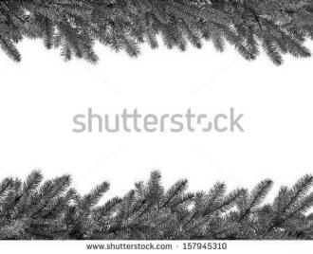
Sharing our Learning about ADVENT with family whānau
Use an Advent wreath to explain to someone how the symbols remind people to prepare for the coming of Jesus at Christmas.
Draw pictures or find old Christmas cards that show the contrast between Christmas in the northern hemisphere and Christmas in the southern hemisphere. Explain the difference in the seasons and how this affects the Advent symbols.
Share your worksheet for Slide 9 and explain 2 meanings for ‘darkness’. Cut out some pictures from the newspaper or magazines of people in ‘darkness’ who are waiting for Jesus to come and bring his light of hope and love to them.
Draw or make an Advent wreath using symbols from Aotearoa New Zealand and explain why you have chosen them and what they mean and what they are reminders of.
Make a postcard with the words of Isaiah on it to share. Show someone where you can find the book of Isaiah in the Old Testament in the Bible.
Make up your own way of showing and sharing what you have learned and decide who you would like to share it with.
Name:
Date:
L-2
S-14
Worksheet
Click the up arrow to return to the lesson
Notes:
Worksheets
A worksheet is an activity page that relates to a specific slide in the lessons and is worked on by children to consolidate their learning.
Navigation between the lesson slides and worksheets should be by means of the worksheet button:
Clicking the worksheet button on the slide that has the worksheet will navigate to the relevant worksheet (which is positioned at the back of the lesson). Clicking the back button on the worksheet will return to the next slide in the lesson sequence (example: slide 7 has a worksheet; clicking the worksheet button on slide 7 will navigate to the worksheet; clicking the back button on the worksheet will navigate to slide 8).
If the slides has two worksheets, the first worksheet should contain a forward button which will navigate to the second worksheet and the second worksheet should contain the back button to return to the next slide in the lesson sequence.
The ‘electronic’ version of the worksheet is displayed on screen and the teacher will use it to focus the children’s attention on the screen during the instruction part of the lesson and record their ideas etc.
Usually the worksheets will be printed by the teacher (actually a PDF version of the worksheet will be printed and not the slide) as a hand-out for the children/students.
They will complete the activity on the page recalling what they discussed as a class and adding their own ideas.
As worksheets are usually printed it is important to keep the amount and areas of dark coloured objects and/or images to a minimum in order to save printer-toner. A good way to do this is to reduce these items on the worksheet or delete the colour of the objects altogether (if allowed/feasible from a design point of view). Images should always be converted to B&W and reduced in size.
There are three types of worksheets:
Copy worksheet - Tool (6)
A copy worksheet is a black & white version of a particular slide in the presentation that will be used in hardcopy form by the students/children to reinforce and extend their learning.
Specific worksheet - Tool (37)
A specific worksheet is designed and created by the designer related to a particular slide according to Anne’s instructions. Specific worksheets are usually one offs.
Standard worksheet (e.g. Tool WS1)
A standard worksheet is a worksheet that is contained in this Master Template and is found in the back of the pack as last slides (marked as WS).
The format of the standard worksheet is set and it only inherits some information (i.e. title, text) from the actual slide.
Please make sure that the routing to and from the slide to which the worksheet is related is set accordingly.
Next to the black & white content of the slide it represents, a worksheet must have the following objects: Identification field, back button and worksheet indication.
Identification field and back button
For a description of these buttons, please refer to the ‘Other buttons’ slides in the general information section.
Worksheet Indication
This is a textbox positioned in the left bottom corner of the slide as per the information specified on this slide. The textbox will be positioned over the drawing tools which are not supposed to be used on this slide.
Once the design of the slide and related worksheet is finished, a pdf version of the worksheet (only) should be created (see below on how to create a PDF).
The PDF file(s) of the worksheet(s) must be delivered together with your PPT version of the lesson.
Creating a PDF version of the worksheet
There are three ways to create a PDF version of a slide which differ depending on the whether or not PowerPoint has access to the PDF creator (e.g. Acrobat) or if you have a PDF creator installed on your computer.
1) The PDF program can be accessed from within PPT:
Save your PPT lesson;
Launch the PDF program from within PPT;
Select ‘create PDF’;
The following steps largely depend on the brand/type of PDF program installed but:
Usually the program now allows selecting a single slide from the presentation at some point in the process (look for e.g. options, preferences, etc.);
If that is possible, select the particular worksheet slide and follow the steps of the program to create a PDF file of the worksheet.
2) Standalone PDF program installed on your PC (no access from within PPT):
Save your PPT lesson;
Open the PPT lesson in the PDF program;
Usually the PDF program allows you to generate a PDF from only a single page of the opened file (your PPT lesson);
Find the page number of the worksheet that you want to use to generate the PDF;
Look in/for ‘Options’, ‘Preferences” or something similar for a setting to print a specific page;
Follow the remaining steps to create a PDF of the worksheet;
If your program does not have an option to create a PDF from a single page, do the following:
Open the lesson in PPT (if it is not already open);
Delete all slides except for the worksheet that you want to create a PDF for;
IMPORTANT: Save this file as a PPT presentation with A DIFFERENT NAME;
Open this file in your PDF program and create a PDF (should be the worksheet only).
3) You don’t have a PDF program installed on your computer:
You can make use of one of the many ‘on-line’ PDF generators on the Internet;
Usually you will NOT have the option to create a PDF from a single page/slide of you PPT lesson so do the following to isolate the worksheet slide:
Open the lesson in PPT (if it is not already open);
Delete all slides except for the worksheet that you want to create a PDF for;
IMPORTANT: Save this file as a PPT presentation with A DIFFERENT NAME;
Use this file for your ‘on-line” PDF conversion.
Unfortunately the steps and flow of the ‘on-line’ PDF programs are manifold and quite different from each other so there is no point to explain one here;
However, the interfaces are usually quite user-friendly so you should find your way around;
If all does not work out for you, please let us know and we will find a way to create the PDF.

