Slide 1
Preparing the way for the coming of Jesus
L-1
S-01
Notes:
Use this slide as a focussing strategy to introduce the lesson topic. Read the title together and invite children to share something they know about the people who prepared the way for Jesus to come and how they did this.
Identify some words related to Advent and the coming of Jesus in the wordle.

Slide 2
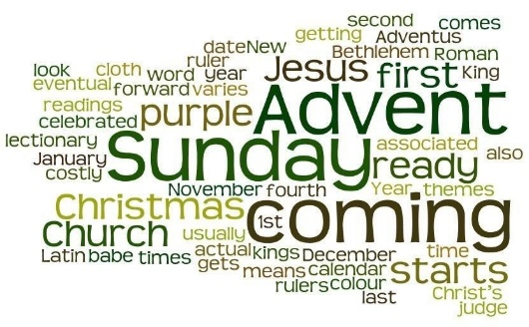
Learning Intentions
The children will:
1)
identify the people who were part of the whakapapa of Jesus and who prepared the way for his coming.
2)
locate in the Bible the story of John the Baptist Mark 1:1-11.
3)
retell the story of John the Baptist and how he prepared the way for the coming of Jesus.
L-1
S-02
Click the boxes to reveal text.
Notes:
Read through the Learning Intentions with the class and identify some ideas/questions that might be explored in the lesson.

Slide 3
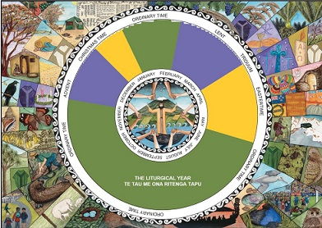
The Liturgical Calendar
Locate the season of Advent on the calendar.
What seasons come before and after it?
What sort of season is Advent?
Tell a partner 3 things you know about the season of Advent.
Colour the seasons on the Liturgical Year Calendar on the worksheet.
X
L-1
S-03
Click the ‘i’ button to reveal information
Notes:
Adapt Teaching and Learning Experience 1.
Use the directions on the pop up to focus children’s thinking.
Children use the worksheet to record their responses.

Slide 4
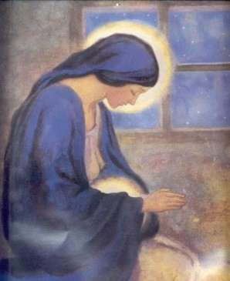
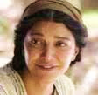
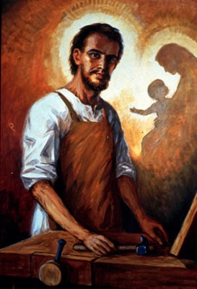
People in Jesus’ whānau who prepared for his coming
Mary was called by God and she prepared to become the mother of God’s son, Jesus.
What preparations would Mary have made?
Elizabeth, Mary’s cousin, was also having a baby who grew up to be John the Baptist. Elizabeth helped Mary to prepare for the coming of Jesus.
What preparations would Elizabeth have made?
Joseph was the man Mary was engaged to when God asked her to be the mother of his son. Joseph cared for Mary and together they prepared for the birth of Jesus.
What preparations would Joseph have made?
Click the images to reveal text.
L-1
S-04
Click the audio button to stop ‘Prepare the Way’
Click the audio button to play ‘Prepare the Way’
Notes:
Name the people in the images.
Use the revealed statements and questions to focus children’s thinking about who and how they prepared for Jesus’ coming.
Sing using the MP3 ‘Prepare the Way’

Slide 5
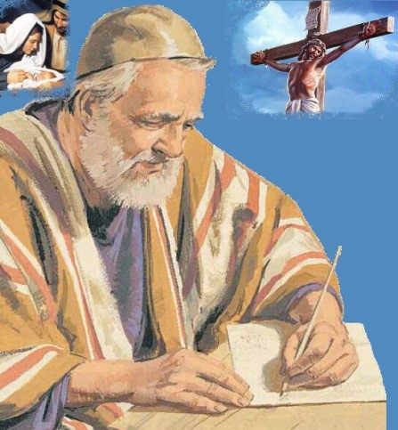
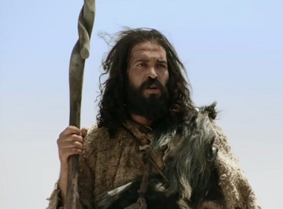
For thousands of years the prophets prepared the people to accept the new Messiah
Isaiah was one of the Old Testament prophets who was called by God to tell the people to turn back to God. He tried to prepare the people for the coming of the Messiah. The Messiah was promised by God to restore their friendship with God.
He was doing this 800 years before Jesus was born. Many things he spoke about came true.
John the Baptist was the last prophet. He knew Jesus was the Messiah who was promised by God to come and save the people from the hard times they were living in. He preached to the people to get ready, to change their lives as the Messiah was very near. Some believed him and others didn’t.
John was part of Jesus’ family tree, Jesus’ whakapapa.
L-1
S-05
Click the images to reveal text, click buttons under images to move arrows.
Click audio button for MP3 ‘Prepare the way’
Notes:
Read the introductory information about Isaiah and John the Baptist on the slide using the pointer. Both prophets are important characters in Scripture who played a big part in preparing people for the coming of Jesus.
Read the Story of John the Baptist in the Teacher’s book, page 14.
Work through the worksheet and use the questions to extend children’s knowledge and interest about John the Baptist. Children respond to the questions on the worksheet and they may like to do their own research on Isaiah and John to share.
Sing using the MP3 ‘Prepare the way’

Slide 6
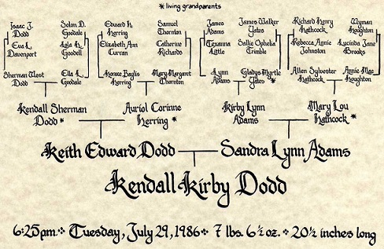
Our Family Tree
It is important to keep the memory of our ancestors tupuna close to us because they are the reason we are here in this land and they are often the reason we have faith in God because they have passed this belief down to us.
Family trees are useful for keeping a written record of our family history whakapapa. They remind us of our ancestors tupuna who have come before us and prepared the way for us to make our lives here in Aotearoa New Zealand.
Family whānau members have pictures of older family members tupuna and they tell stories about them to keep their memory alive. That is why the photographs of the tupuna are hung in a marae so they can continue to be part of the lives of their descendants.
Sometimes our family tell us we have a likeness to one of our ancestors or we have the same gifts as they had such as singing or playing cricket. They might say we remind them of one of the old uncles or aunts because we have their hair or eyes. Sometimes people are called after people in their whakapapa.
We may know what ship, waka or plane they travelled on to get here, which country they came from, what sort of work they did and where they settled to make their new life. Family trees help us to get to know who we are and where we belong.
L-2
S-06
Click the pins on the right to reveal post-it notes.
Notes:
Invite children to share what they know about their family tree whakapapa. Notice on the image of the family tree the name of the baby for whom it was made and whom she is called after (her two grandmothers.)
Invite children to ask their family whānau what connections they have with their ancestors – are there any likenesses, similarity of gifts or features or names. Do they have a copy of their family tree? Maybe there are stories that have been handed down that could be shared as examples. Read each Post it note carefully and encourage children to share knowledge and experiences they have had about their ancestors, family trees and whakapapa.
Adapt Teaching and Learning Experience 2

Slide 7
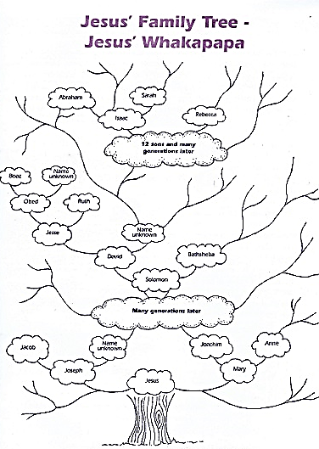
Jesus’ Family Tree – Jesus’ Whakapapa
Read Matthew 1:1-16 –
Discuss what it is saying about Jesus’ ancestors
Jesus was a Jew and like Māori, the ancestors tupuna in their whakapapa family tree are very important to them and are still present to them in a different way.
Jesus’ ancestors who played important roles in preparing the people for his coming have been researched for many years and much is known about them. We are familiar with Jesus’ grandparents (except for Joseph’s father) and close family members and the important roles they played in preparing themselves and the wider community especially John the Baptist for Jesus to come.
Some of Jesus’ tupuna helped to prepare the way for Jesus to come and the chapters that trace this information in Matthew and Luke’s gospel are read during Advent each year to make it clear that Jesus’ most important ancestor is God. God is Jesus’ true father.
Jesus’ family knew their whakapapa and some of it is recorded in the Bible. The people in each generation were named along with whose son or daughter they were and they could go back many generations describing who their ancestors were and where they fitted into the family tree. Some of these people are included in the Jesse Tree.
Click the top page to reveal the next one (there are 4).
L-1
S-07
Click the audio button to stop ‘Mo te Aweneti’
Click the audio button to play ‘Mo te Aweneti’
Notes:
Adapt Teaching and Learning Experience 3
Share the information on the slide using red pointer.
Refer to Jesus’ Family Tree on the Teacher Resource, page 13 and help children to recognise people’s names and what they did that they have heard Scripture stories about.
Sing using the MP3 Mo Te Aweneti’

Slide 8
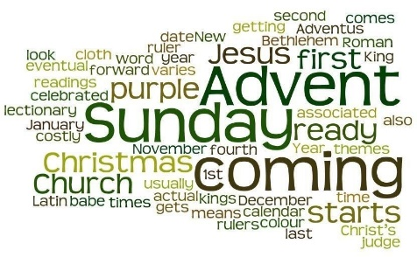
Check Up
1)
Name three people who are members of Jesus’ whakapapa and say how they prepared for his coming
2)
Show a partner the story of John the Baptist in Mark 1:1-11 and share what you have learned about him. Imagine what Jesus and John talked about when they were together.
3)
Retell John’s story about what he did to prepare people for the coming of Jesus.
4)
Which activity do you think helped you to learn best in this lesson?
5)
Questions I would like to ask about the topics in this lesson are…
L-1
S-08
Click in each caption space to reveal text
Notes:
This formative assessment strategy will help teachers to identify how well the children have achieved the Learning Intentions of the lesson.
Teachers can choose how they use the slide in their range of assessment options.
A worksheet of this slide is available for students in Years 5-8 to complete.
The last two items are feed forward for the teacher.
Recording the children’s responses to these items is recommended as it will enable teachers to adjust their learning strategies for future lessons and target the areas that need further attention.

Slide 9
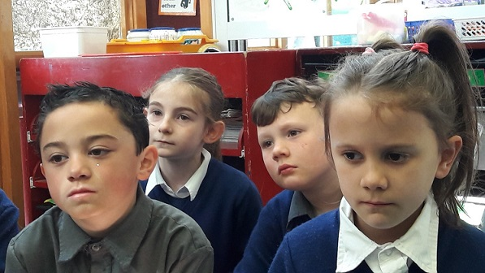
Time for Reflection
L-1
S-09
Click the audio button to stop Reflective Music
Click the audio button to play Reflective Music
Notes:
The MP3 is played to help create a reflective atmosphere and bring the children to stillness and silence as the teacher invites them to imagine what it would have been like for the people in Jesus’ whakapapa who waited and prepared for him to be born as the Messiah that God had promised to send to save people from sin, sadness, death and pain.

Slide 10
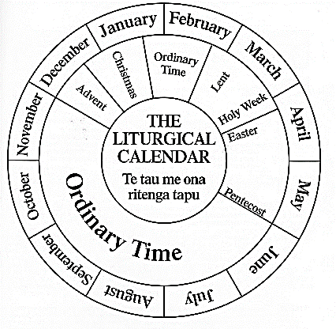
The Liturgical Calendar
Name___________________________ Date_______________
Locate the season of Advent on the calendar
What seasons come before and after it?
What sort of season is Advent?
Tell a partner 3 things you know about the season of Advent.
Colour the seasons on the Liturgical Year Calendar on the worksheet.
L-1
S-3
Worksheet
Click the up arrow to return to the lesson
Notes:
This worksheet relates to slide 3

Slide 11
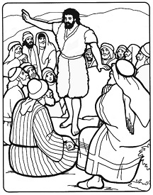
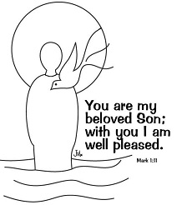
John the Baptist who prepared the way for the coming of Jesus
Name___________________________ Date_______________
PART 1 What do you know John the Baptist’s family whānau?
What relation was John the Baptist to Jesus? ___
Who was John’s mother? ___
What was the age difference between Jesus and John? ___
What do you think they did together as boys growing up? ____
What was John’s father’s name? ____
How did Elizabeth help Mary to prepare for Jesus’ birth? ____
What relation was Mary to Elizabeth? _____
What special role did God call John to do? ­____
Where did John go to live alone? ____
What was John’s message to the people? ­­­­____
PART 2 What do you know about John’s work?
What name did John become known by? ­­­____
What work did John do? _____
Who was John talking about when he said “I am not fit to untie his sandals” _____
What did John do to the people who followed him? ____
Where did John do his work? ____
Whose voice did John hear when he baptised Jesus? ____
What was the dove that was present a sign of? _____
Who did John’s followers leave him to follow? _____
Who do these first followers of Jesus become? _____
What happened to John the Baptist? ____
PART 1
wisdom, motherhood, baby care and prayer
6 months
younger cousin
a prophet
a cousin
prepare the way of the Lord
the desert
played, talked, had fun
Elizabeth
Zechariah
PART 2
around the River Jordan
The Spirit
baptised them
Jesus
preached to prepare people for the Messiah
John the baptizer
the first apostles
beheaded on Herod’s orders
God’s
Jesus, his cousin, the Messiah
L-1
S-5
Worksheet
Click the up arrow to return to the lesson
Notes:
This worksheet relates to slide 5
Read the story on the Teacher Resource p14 or on the lesson the home page and write the number of the correct words to complete the sentence in the space.
Use answer sheet below to mark children’s responses

Slide 12
John the Baptist who prepared the way for the coming of Jesus
Answer sheet
PART 1 What do you know John the Baptist’s family whānau?
What relation was John the Baptist to Jesus? _5_
Who was John’s mother? _9_
What was the age difference between Jesus and John? _2_
What do you think they did together as boys growing up? _8_
What was John’s father’s name? _10_
How did Elizabeth help Mary to prepare for Jesus’ birth? _1_
What relation was Mary to Elizabeth? _3_
What special role did God call John to do? _­4_
Where did John go to live alone? _7_
What was John’s message to the people? _­­­6_
PART 2 What do you know about John’s work?
What name did John become known by? _6_
What work did John do? _5_
Who was John talking about when he said “I am not fit to untie his sandals”? _10_
What did John do to the people who followed him? _3_
Where did John do his work? _1_
Whose voice did John hear when he baptised Jesus? _9_
What was the dove that was present a sign of? _2_
Who did John’s followers leave him to follow? _4_
Who do these first followers of Jesus become? _7_
What happened to John the Baptist? _8_
PART 1
wisdom, motherhood, baby care and prayer
6 months
younger cousin
a prophet
a cousin
prepare the way of the Lord
the desert
played, talked, had fun
Elizabeth
Zechariah
PART 2
around the River Jordan
The Spirit
baptised them
Jesus
preached to prepare people for the Messiah
John the baptizer
the first apostles
beheaded on Herod’s orders
God’s
Jesus, his cousin, the Messiah
L-1
S-5
Worksheet
Click the up arrow to return to the lesson
Notes:
This answer sheet relates to slide 5

