Slide 1
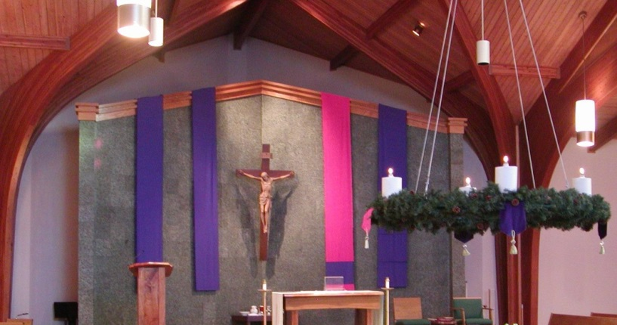
The Meaning of Advent
L-1
S-01
Notes:
Use this slide as a focussing strategy to introduce the lesson topic.
Read the title together and invite children to share something they know about what Advent means.

Slide 2

Learning Intentions
The children will:
1)
identify symbols used in churches to show it is the season of Advent.
2)
identify how during Advent people can prepare themselves for the celebration of Christmas.
3)
recognise that the Jesse Tree tells the story of the people who prepared for the coming of the Messiah.
L-1
S-02
Click in each caption space to reveal text
Notes:
Read through the Learning Intentions with the class and identify some ideas/questions that might be explored in the lesson.

Slide 3
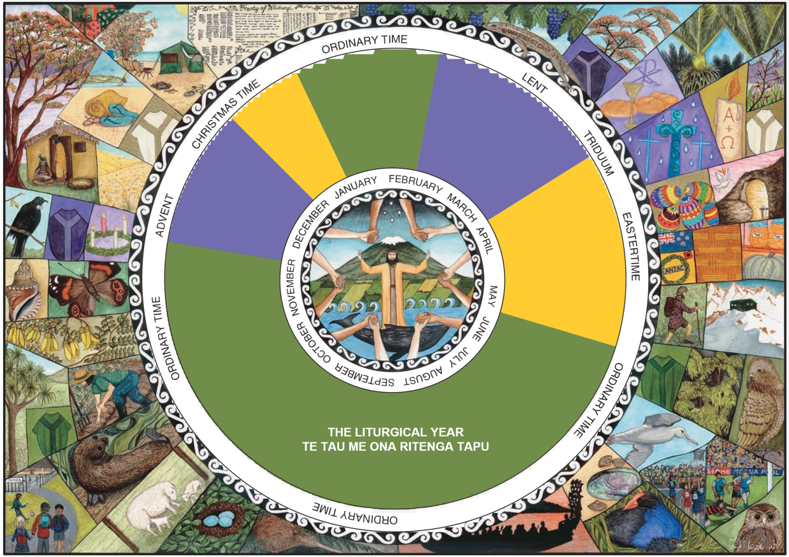
The Liturgical Calendar
The Liturgical Calendar is the way the Church recalls and retells
the stories of Jesus’ life throughout the year.
L-1
S-03A
Notes:
Adapt Teaching and Learning Experience 1. Each child shares one thing they know about the Liturgical Year.

Slide 4
The Liturgical Calendar
Look at the Liturgical Calendar and complete the sentences below
In the Liturgical Year we are coming to the end of …
Ordinary Time
We are moving into the season of ...
Advent
Advent is a season to prepare for the great feast of …
Christmas
We use the colour purple to show this is a …
penitential season
The other penitential season is …
Lent
The feast that Lent prepares us for is …
Easter
Christmas
Easter
Advent
Ordinary Time
Lent
penitential season
L-1
S-03B
Click on a word from the list at the bottom or click an empty text box to match the sentences.
Notes:
Adapt Teaching and Learning Experience 1. Children name the word to complete the cloze activity and check it out using the floaters.

Slide 5
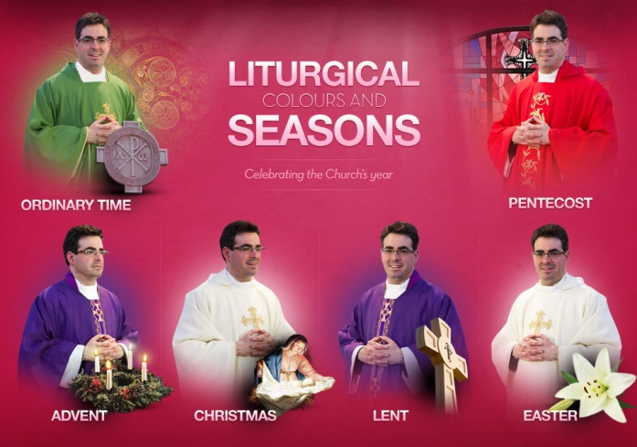
The colour of the priest’s vestments
reflect the Liturgical Season
The colour of these things remind people to think about the season they are in.
Are there other things of the same colour, e.g. flowers, symbols?
Notice the colour of the church decorations on the altar and the lectern.
Think about what season the colour is reflecting.
Next time you go to Mass notice the colour of the priest’s vestments.
L-1
S-04
Click top card to discard it
Notes:
Look closely at the picture and notice the colour of the priests’ vestments in the Liturgical Seasons.
Read and discuss the flips cards. Note the symbols for the season also. Can you suggest some other symbols for the seasons.
Add these to your Liturgical Calendar.

Slide 6

How could you tell which Liturgical Season is being celebrated in this church?
Imagine you are at Mass in this church
– name what you can see and hear that would
tell you which liturgical season it is:
L-1
S-05
Click in the white box and write your text
Notes:
Record the children’s ideas by typing in the white space.
Include banners, Advent wreath, priest’s vestments, Advent hymns – O Come O Come Emmanuel, Advent Scripture readings and prayers.

Slide 7

What children of your age can do in
Advent to prepare your ‘inside selves’
to celebrate Christmas
Take time each day to really reflect on the meaning of Advent
- coming - and remember whose coming it is that we are preparing for.
When you see the colour purple let it remind you it is Advent – Jesus is coming.
Before you go to sleep each night think about how you could focus more on the coming of Jesus and let him into your life so you and he can become friends.
Try just talking to him – that’s a great way to grow a friendship.
Advent is a very busy time in families. Decide on something you can do that would make things easier at home for your family.
L-1
S-06A
Click on images to reveal a text line
Notes:
What do we mean when we talk about our ‘inside selves’?
Share ideas about the importance of preparing for events and how it helps in the celebration of them.
Read each text reveal and share ideas about them.

Slide 8
What children of your age can do in
Advent to prepare your ‘inside selves’
to celebrate Christmas
Talk at home about what the season of Advent means and make an effort to go to Mass together to make it more meaningful.
Make an Advent wreath, light it each evening at meal time, reflect together on your day and take a moment to appreciate Jesus present with you. As you light each candle on the wreath remember it represents thousands of years that people waited for Jesus the Messiah, the Prince of Peace. Give each other a sign of peace.
L-1
S-06B
Click on images to reveal a text line
Notes:
Adapt Teaching and Learning Experience 3. Remind each other that children of your age can initiate things that can help your whole family to celebrate Advent more fully especially when everyone is very busy. Think of one thing you could do for your family this Advent.

Slide 9
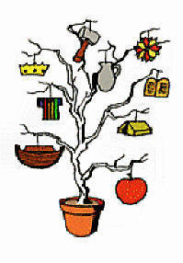
Using a tree with symbols in Advent
helps people to prepare for the coming of Jesus
J | B | C | R | E | A | T | I | O | N | T | T | A | F
E | I | L | C | R | J | H | R | H | R | H | E | B | R
S | B | O | S | T | R | E | E | E | E | E | L | O | O
S | L | V | P | T | S | E | S | L | E | L | L | U | M
E | E | E | P | E | O | P | R | E | P | A | R | E | D
T | N | J | E | B | O | R | F | I | N | S | T | S | S
H | T | O | E | T | E | P | I | O | C | W | H | O | T
E | H | T | O | S | T | R | L | E | R | O | T | S | O
A | B | O | U | T | U | O | S | E | S | M | M | T | R
A | N | C | H | R | I | S | T | M | A | S | T | E | Y
A Jesse tree helps to tell the Bible stories about the people who prepared for Jesus to come, from creation to the Christmas Story.
L-1
S-07
Click the words in the text box to reveal the position in the puzzle. Click on the worksheet button to go to the worksheet.
Notes:
Read the sentence and then find each word on the matrix and highlight it in the sentence and in the Word Find.
Note the symbols on the tree and say what they represent. Children can add worksheets to their RE Learning Journals as evidence of their learning.

Slide 10
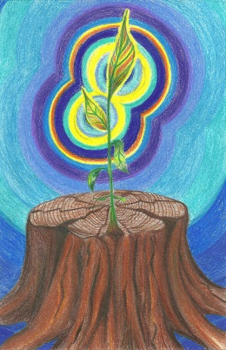
The Jesse Tree
Write a question for the answer
Q1:
A1: The Jesse Tree is a kind of Advent Calendar which is used to mark off the days leading up to Christmas by hanging a symbol of a Bible story to show we
are getting closer to Christmas.
Q2:
A2: The first Jesse Tree was used long ago when many people could not read or write to teach them the stories from the Bible. They were on stained glass windows or banners in churches .
Q3:
A3: The name ‘Jesse’ comes from Jesse, the father of the great King David
in the Old Testament.
L-1
S-08A
Click the video button to play a video
Notes:
Explain that the Jesse Tree helps people to learn more about the people who prepared for Jesus the Messiah to come over many thousands of years. Children read and think about each answer and then make up a question that would match it.
Watch the clip ‘The Jesse Tree’ book 4.03 minutes https://www.youtube.com/watch?v=GOt5J5xPBL8

Slide 11

The Jesse Tree
Write a question for the answer
Q4:
A4: The prophet Isaiah said, “ A shoot will come from the stump of Jesse,
from its roots a branch will bear fruit”(Isaiah 11:1).
Q5:
A5: A branch is a sign of new life and new beginnings. Jesus was a descendant of King David and Christians believe that Jesus is the new branch.
A Jesse Tree helps prepare people for his coming.
L-1
S-08B
Click on the worksheet button to go to the worksheet
Click the audio button to stop ‘Promise chain’
Click the audio button to play ‘Promise chain’
Notes:
Discuss the clip and how it explains the meaning of the Jesse tree.
Notice the image and relate it to Answers 4 & 5.

Slide 12
Check Up
1)
Share 5 facts about the season of Advent including where it comes in the Liturgical Year and what sort of season it is.
2)
Write 3 tips you could give to a friend about using Advent to prepare your ‘inside selves’ to let
Jesus become your friend and a bigger part of your life.
L-1
S-09A
Click in each caption space to reveal text
Notes:
This formative assessment strategy will help teachers to identify how well students have achieved the Learning Intentions of the lesson.
Teachers can choose how they use the slide to assess each item.
A worksheet of this slide is available as an option for children in Years 5-8 to complete. The last two items are feed forward for the teacher.
Recording the children’s responses to these items is recommended as it will enable teachers to adjust their learning strategies for future lessons and target the areas that need further attention.

Slide 13
Check Up
3)
Explain what the Jesse Tree is and how it is useful during Advent.
4)
Which activity do you think helped you to learn best in this lesson?
5)
Questions I would like to ask about the topics in this lesson are …
L-1
S-09B
Click on the worksheet button to go to the worksheet
Notes:
Make a copy for each child of the WORKSHEET if you plan to use it as part of your assessment.

Slide 14
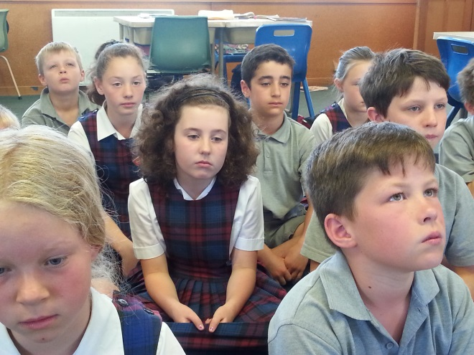

Time for Reflection
L-1
S-10
Click the audio button to stop reflective music
Click the audio button to play reflective music
Notes:
The MP3 is played to help create a reflective atmosphere and bring the children to stillness and silence as the teacher invites them to reflect on the season of Advent and how it is a good time to let Jesus into your life by just spending time talking to him just as would do with a friend.
Original Children’s Activities available on lesson home page.

Slide 15
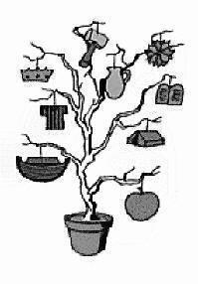
Using a tree with symbols in Advent
helps people to prepare for the coming of Jesus
Name:____________________________
Date:____________
J | B | C | R | E | A | T | I | O | N | T | T | A | F
E | I | L | C | R | J | H | R | H | R | H | E | B | R
S | B | O | S | T | R | E | E | E | E | E | L | O | O
S | L | V | P | T | S | E | S | L | E | L | L | U | M
E | E | E | P | E | O | P | R | E | P | A | R | E | D
T | N | J | E | B | O | R | F | I | N | S | T | S | S
H | T | O | E | T | E | P | I | O | C | W | H | O | T
E | H | T | O | S | T | R | L | E | R | O | T | S | O
A | B | O | U | T | U | O | S | E | S | M | M | T | R
A | N | C | H | R | I | S | T | M | A | S | T | E | Y
A Jesse tree helps to tell the Bible stories about the people who prepared for Jesus to come from creation to the Christmas Story
L-1
S-07
Worksheet
Click the up arrow to return to the presentation
Notes:
This worksheet relates to slide 7.

Slide 16
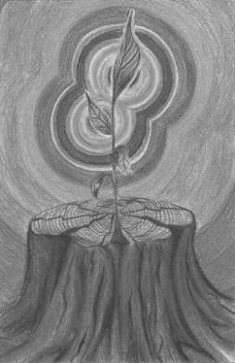
The Jesse Tree
Name:____________________________
Date:____________
Write a question for the answer
Q1:
A1: The Jesse Tree is a kind of Advent Calendar which is used to mark off the days leading up to Christmas by
hanging a symbol of a Bible story to show we are getting closer to Christmas.
Q2:
A2: The first Jesse Tree was used long ago when many people could not read or write to teach them the stories
from the Bible. They were on stained glass windows or banners in churches.
Q3:
A3: The name ‘Jesse’ comes from Jesse, the father of the great King David in the Old Testament.
Q4:
A4: The prophet Isaiah said, “ A shoot will come from the stump of Jesse, from its roots a branch will bear fruit” (Isaiah 11:1).
Q5:
A5: A branch is a sign of new life and new beginnings. Jesus was a descendent of King David and Christians believe that
Jesus is the new branch. A Jesse Tree helps prepare people for his coming.
L-1
S-08
Worksheet
Click the up arrow to return to the presentation
Notes:
This worksheet relates to slide 8.

Slide 17
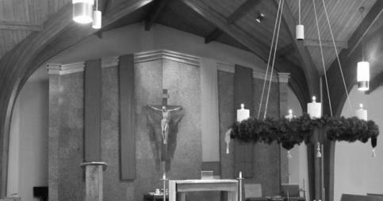
Check Up
Name:____________________________
Date:____________
1)
Share 5 facts about the season of Advent including where it comes in the Liturgical Year and what sort of season it is.
2)
Write 3 tips you could give to a friend about using Advent to prepare your ‘inside selves’ to let Jesus become your friend and a bigger part of your life.
3)
Explain what the Jesse Tree is and how it is useful during Advent.
4)
Which activity do you think helped you to learn best in this lesson?
5)
Questions I would like to ask about the topics in this lesson are …
L-1
S-09
Worksheet
Click the up arrow to return to the presentation
Notes:
This worksheet relates to slide 9.

