Slide 1
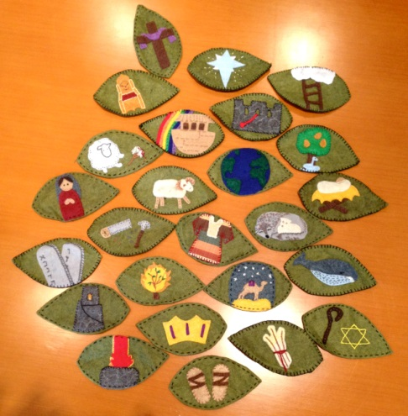
The Jesse Tree
L-2
S-01
Notes:
Use this slide as a focussing strategy to introduce the lesson topic. Read the title together and invite children to share something they know about the Jesse Tree. Ask children to look at the image and identify a symbol and name the person it relates to in the Old Testament. Retell their story.

Slide 2
Learning Intentions
The children will:
1)
relate the story of one of the people represented on the Jesse Tree
L-2
S-02
Notes:
Read through the Learning Intentions with the class and identify some ideas/questions that might be explored in the lesson.

Slide 3
The symbols on the Jesse Tree
The Jesse Tree is Jesus’ Family Tree
Sample text line that is displayed on the blind
First sentence that wraps at the end of the textbox and thus spreads out over two lines
Second sentence covering one line only
Third sentence that wraps at the end of the textbox and thus spreads out over two lines
Fourth sentence covering one line only
Fifth sentence that wraps at the end of the textbox and thus spreads out over two lines
Sixth sentence covering one line only
It traces his ancestors back to when God first promised to send a Messiah to save the world after the first sin
This is recorded in the Creation story
It took thousands of years to pass between God’s promise and the coming of the Messiah
The symbols on the Jesse Tree represent the people who waited for the Messiah to come
Can you imagine what it would be like to wait for something for your whole life that doesn’t come?
L-2
S-03
Click the down-button to move the blind down, Click the up-button (appears at bottom) to move the blind to the top.
Notes:
Adapt Teaching and Learning Experiences 1 & 2.
Read each blind reveal and when this is completed pull the blind up and ask children to repeat something they learned about the Jesse Tree.
Repeat the activity and see if the children can recall every statement. Children ask questions related to the Jesse tree and its symbols.

Slide 4
The effects of the first sin – why people needed a saviour
In the beginning God’s relationship with humans and all creation was perfect. Everything lived together in perfect harmony that we know as original holiness and justice.
This first sin damaged the relationship between God and humans and brought sin, sickness, suffering, death and loss of friendship with God into the world.
Humans damaged this relationship and that is when the first and original sin came into the world.
L-2
S-04A
Click the pins on the right to reveal post-it notes.
Notes:
Explain that understanding how the first time people damaged their relationship with God was just as God had created the world for people to enjoy it. The story of Adam and Eve is the Christian creation story that helps people to understand how people came to need a saviour to rebuild their friendship with God. God had not planned for this to happen Read the post it notes and talk about what original holiness and original sin mean.

Slide 5
The effects of the first sin – why people needed a saviour
But our forgiving God so loved humanity that God made a promise to restore their relationship by sending a Messiah, a saviour who would be his son, Jesus .
Jesus would undo the effects of sin and save people from death and restore them to life forever with God. The people waited for thousands of years for this promise to be fulfilled by Jesus.
L-2
S-04B
Click the pins on the right to reveal post-it notes.
Notes:
Continue to read the post it notes and talk about in the state of God’s original holiness there was no pain, sickness, sadness, failure, sinfulness, hopelessness disappointment only happiness and loving joy and all of this was destroyed when original or first sin entered the world – this is what Jesus the Messiah came to restore by winning back God’s love and favour. Think about a time when you have damaged your relationship with your parents and you let them down. What did you do to restore your relationship with them? How did you make up for the pain you had caused them?

Slide 6
The people who waited and prepared for the Messiah to come and save them
Adam and Eve waited and prepared Genesis - 3:1-7 Their symbol – an apple. Unhappiness came into the world when people damaged their friendship with God. God found a way to restore the original blessing and friendship with all people through his Son Jesus. People waited for this to happen.
Noah and his family waited and prepared Genesis - 9:12 Their symbol – the Ark and the Rainbow. God saved Noah and his family from a great flood.
The rainbow is the sign of God’s promise never to destroy the earth with water.
Abraham and Sarah waited and prepared Genesis - 17:1-8, 15-16 Their symbol –the stars in the night sky. God promised them they would have children as many as the stars in the night sky. (Genesis - 15:15). Through them God would bless all the families of the earth.
Joseph waited and prepared Genesis - Chapters 37, 41, 42ff His symbol – Joseph’s coat of many colours. Joseph’s father gave him a coat of many colours which made his brothers jealous. They sold him as a slave and he was taken to Egypt. Joseph was favoured by the Pharaoh the ruler of Egypt who gave him power. Joseph saved his brothers from starvation during a great famine.
L-2
S-05A
Click an icon to reveal text
Notes:
The people in the Old Testament knew God had promised to send someone who could make up for what the people had done- a Messiah who would put things right. But they would have to wait. They didn’t know how long but it was for thousands of years. Read and talk about some of the famous people who waited that we know about from their stories in the Bible. Before you click guess from their symbol who they are and share what you know about them. While they were waiting people lost hope and began turning away from God. God sent people known as prophets to call them back to living good lives in keeping with God’s laws. Many would not listen.

Slide 7
The people who waited and prepared for the Messiah to come and save them
Moses waited and prepared Exodus - 14:21-31. His symbol – the Ten Commandments.
Moses led God’s chosen people out of slavery in Egypt. On the long journey God gave Moses the 10 Commandments to guide them in the way they were to live.
Joseph waited and prepared Matthew - 1:18-22 . His symbol – a set of carpenter’s tools. God chose Joseph to be the foster father of Jesus. Joseph was a descendant of King David.
Mary waited and prepared Luke - 1:26-34. Her symbol – the lily.
God chose Mary to be the mother of Jesus, his son the Messiah who would come to save the world who had been awaited by millions of people for many thousands of years.
Jesus Christ, long awaited Messiah came to save all people Luke - 2:1-20. His symbol – the Chi Rho (pronounced "KEE-roe") can be viewed as the first Christian cross.
The saviour of the world for whom millions of people for thousands of years had waited, came into the world as a tiny baby in a stable watched by sheep and oxen as he slept in their feed box.
L-2
S-05B
Click an icon to reveal text
Notes:
Adapt Teaching and Learning Experiences 2&3. Read each Scripture reference and share ideas about how the characters in them prepared for the Messiah’s coming. Children could complete the Original Children’s activity on p16 of the Teacher’s book or on the Lesson home page.

Slide 8
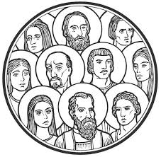
Imagine what the people said when after all their waiting Jesus finally came
Write what the holy people in the image would have said when they realised Jesus truly was the long awaited Messiah promised by God.
Click in the word balloons to type text
Click the worksheet button to go to the worksheet
L-2
S-06
Notes:
Read the title and the text on the slide.
Children record their ideas on their worksheets. They could give some people a name.

Slide 9
What did the long expected Saviour do for all people?
Jesus led people away from sin and led them to respect God’s law. He taught them how to forgive and be forgiven.
Jesus would help people cope with pain and suffering.
Jesus overcame death. It would no longer last forever. Now it became the beginning of a new life forever with God in heaven.
Through Jesus’ example and teaching the people could live together again in peace and harmony.
Jesus made it possible for people to be restored to friendship with God and grow in their relationship with God.
L-2
S-07
Click top card to discard it
Notes:
Read and discuss the ideas on each flip card. These ideas help children to understand why Jesus is such an important person in Christians lives and as his followers we carry on the work he started by helping to build God’s kingdom here on earth as members of his Church. Ask children to complete the sentence - Jesus truly is the savoir of the world because he …

Slide 10
Check Up
1)
Explain why God promised to send a Messiah to save the people.
2)
Name 3 effects of sin when it first came into the world.
3)
What did Jesus do to restore people’s relationship with God?
4)
Describe how using the Jesse Tree is a meaningful Advent activity.
L-2
S-08A
Click in each caption space to reveal text
Notes:
This formative assessment strategy will help teachers to identify how well students have achieved the Learning Intentions of the lesson.
Teachers can choose how they use the slide to assess each item.
A worksheet of this slide is available as an option for students to complete.
The last two items are feed forward for the teacher.
Recording the students’ responses to these items is recommended as it will enable teachers to adjust their learning strategies for future lessons and target the areas that need further attention.

Slide 11
Check Up
5)
Retell a story of a person/people whose symbol/s can be included on the Jesse Tree and explain how she/he/they prepared for the coming of the Messiah God had promised.
6)
Which activity do you think helped you to learn best in this lesson?
7)
Questions I would like to ask about the topics in this lesson are …
L-2
S-08B
Click the worksheet button to go to the worksheet
Notes:
Children could work in groups using their worksheets to share their responses to selected items and record them to share with the class including items 6 & 7. Remind children this is an important lesson in the RE programme that will help them to understand why we call Jesus our Saviour.

Slide 12
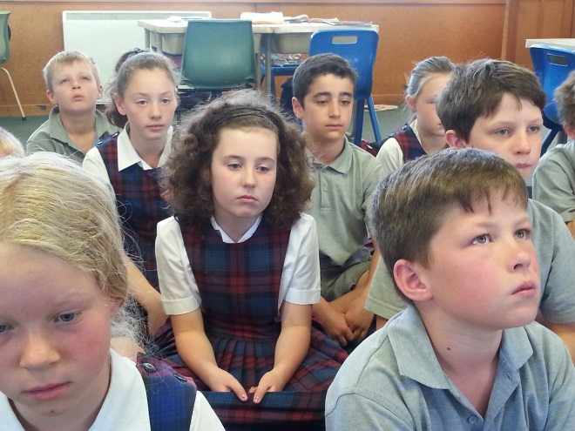
Time for Reflection
L-2
S-09
Click the audio button to stop reflective music
Click the audio button to play reflective music
Notes:
The MP3 is played to help create a reflective atmosphere and bring the children to stillness and silence as the teacher invites them to imagine what it must have been like for generations of people who waited for God to fulfil his promise to send the Messiah. Keep this in mind as you wait and prepare for Jesus this Christmas.
Original Children’s Activities available on lesson home page.

Slide 13
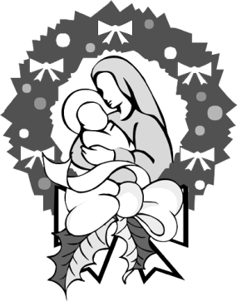
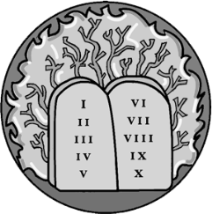
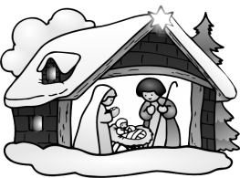
Make a Jesse Tree for your class. Write explanations of its meaning and use. Add some extra people and symbols – research suitable examples. Share this with children in other classrooms during Advent.
Make a power point to explain the purpose of the Jesse Tree as calendar to mark progress through Advent by adding a new symbol each day and to remind people about the significant people who waited for Jesus. Share it with your family whānau or a younger class.
Have a conversation with someone in your family whānau or parish about when sin came into the world and what effect it had. Talk about how because God loved people so much God forgave them for disrupting their relationship with God. Explain how God wanted to repair the relationship and that is why God promised to send a Messiah to put things right. Make a list of the good effects this had on people.
Create artworks of Jesse Tree symbols and display them in the foyer of your school or parish church. Add simple stories about them and include their reference from the Scripture. Invite groups of children to come to the exhibition and you can explain to them that all of these people waited for Jesus to come and in Advent we remember all those who waited and that is why we have a Jesse Tree.
L-2
S-10A
Notes:
This slide provides some choices for children to show and share what they have learned. Examples could be photographed as evidence of children’s learning.
You may like to put a copy of the Sharing our Learning page in children’s RE Learning Journals. You could talk through the choices using the slide and let children make their choice from their own copy.
Children could work on their choice at school and/or at home and you may like to set a day for sharing. Please let parents and whānau know what you expect them to do with this.
The slide is focussed on Year 5 Achievement Objective which is covered in Lessons 1-2.
ADVENT Year 5 AO) Children will be able to: develop an understanding of the significance of the Jesse Tree in relation to the meaning of Advent.

Slide 14
Make a card for a family member with a Jesse Tree on it and give it to someone in your family whānau. Write a short explanation of what a Jesse Tree is.
Prepare a presentation for assembly outlining the meaning and purpose of Advent and illustrate this with examples of Advent Calendars, Advent Wreaths, A Jesse Tree and other ways people can use Advent as a time to prepare for Christmas. Include Advent songs.
Make up a game using an image of Jesus in a manger (or use a model of this) to pass around a circle while children count down until the Year 0 when Jesus was born. This will help children get a sense of how long people waited for him to come. Decide what year you will start. Make a list of instructions about how to play it and share it with other older classes.
Prepare a reflective time to share with older classes about ways children of around your age can prepare for Jesus to come by inviting him to become a bigger part of your life. Use music and symbols and create an atmosphere of quiet prayerfulness and mindfulness. Refer to Slide 6 Lesson 1 for the flavour of ideas you could include.
Make up your own way of showing and sharing what you have learned and decide with whom you would like to share it.
L-2
S-10B
Click the worksheet button to go to the worksheet
Notes:
Children discuss how they can share their learning at home, at school and in their parish or pastoral area.

Slide 15
Imagine what the people said when after all their waiting Jesus finally came
Write what the holy people in the image would have said when they realised Jesus truly was the long awaited Messiah promised by God.
Name:____________________________
Date:____________
L-2
S-06
Worksheet
Click the up arrow to return to the presentation
Notes:
This worksheet relates to slide 6.

Slide 16
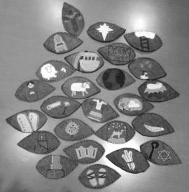
Check Up
1)
Explain why God promised to send a Messiah to save the people.
2)
Name 3 effects of sin when it first came into the world.
3)
What did Jesus do to restore people’s relationship with God?
4)
Describe how using the Jesse Tree is a meaningful Advent activity.
5)
Retell a story of a person/people whose symbol/s can be included on the Jesse Tree and explain how she/he/they prepared for the coming of the Messiah God had promised.
6)
Which activity do you think helped you to learn best in this lesson?
7)
Questions I would like to ask about the topics in this lesson are …
Name:____________________________
Date:____________
L-2
S-08
Worksheet
Click the up arrow to return to the presentation
Notes:
This worksheet relates to slide 8.

Slide 17
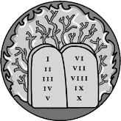
Make a Jesse Tree for your class. Write explanations of its meaning and use. Add some extra people and symbols – research suitable examples. Share this with children in other classrooms during Advent.
Make a power point to explain the purpose of the Jesse Tree as calendar to mark progress through Advent by adding a new symbol each day and to remind people about the significant people who waited for Jesus. Share it with your family whānau or a younger class.
Have a conversation with someone in your family whānau or parish about when sin came into the world and what effect it had. Talk about how because God loved people so much God forgave them for disrupting their relationship with God. Explain how God wanted to repair the relationship and that is why God promised to send a Messiah to put things right. Make a list of the good effects this had on people.
Create artworks of Jesse Tree symbols and display them in the foyer of your school or parish church. Add simple stories about them and include their reference from the Scripture. Invite groups of children to come to the exhibition and you can explain to them that all of these people waited for Jesus to come and in Advent we remember all those who waited and that is why we have a Jesse Tree.
Make a card for a family member with a Jesse Tree on it and give it to someone in your family whānau. Write a short explanation of what a Jesse Tree is.
Prepare a presentation for assembly outlining the meaning and purpose of Advent and illustrate this with examples of Advent Calendars, Advent Wreaths, A Jesse Tree and other ways people can use Advent as a time to prepare for Christmas. Include Advent songs.
Make up a game using an image of Jesus in a manger (or use a model of this) to pass around a circle while children count down until the Year 0 when Jesus was born. This will help children get a sense of how long people waited for him to come. Decide what year you will start. Make a list of instructions about how to play it and share it with other older classes.
Prepare a reflective time to share with older classes about ways children of around your age can prepare for Jesus to come by inviting him to become a bigger part of your life. Use music and symbols and create an atmosphere of quiet prayerfulness and mindfulness. Refer to Slide 6 Lesson 1 for the flavour of ideas you could include.
Make up your own way of showing and sharing what you have learned and decide with whom you would like to share it.
L-2
S-10
Worksheet
Name:____________________
Date:____________
Click the up arrow to return to the presentation
Notes:
This worksheet relates to slide 10.

