Slide 1
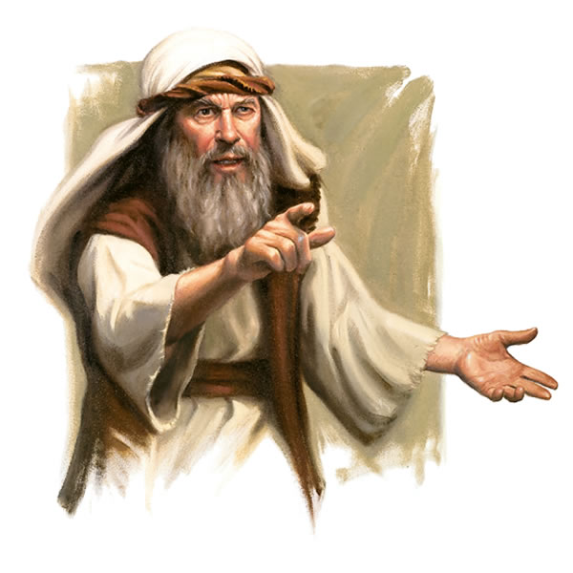
The People of Advent
L-1
S-01

Slide 2
Learning Intentions
The children will:
1)
recognise that the Advent reading from Isaiah helps people hope for the Messiah and remind them to prepare for his coming.
L-1
S-02
Click the boxes to reveal the learning intentions

Slide 3
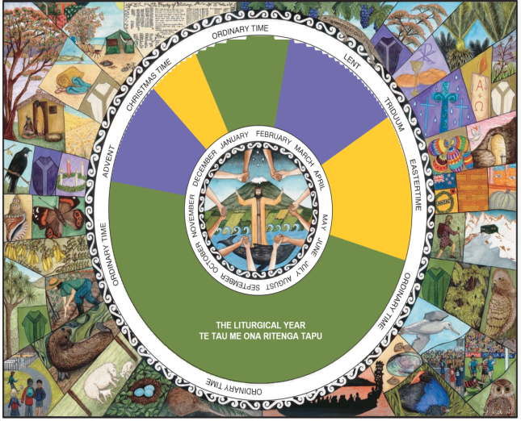
Rapid recap on the Liturgical Year
The penitential or preparations seasons of the Liturgical Year are
The Liturgical Year begins each year on
The most important feast in the Liturgical Year is
The colour you would see featuring in church decorations during Ordinary Time is
In the homily, the hymns and the Scripture readings for Advent, the theme is
The Sunday Scripture readings are set out in a
The Liturgical Cycle of the Catholic Church is shared with
The season of Lent begins on
Ordinary Time lasts for 34 weeks is
The Liturgical feasts and seasons are celebrated by
1
Advent and Lent
1
2
the first Sunday of Advent
2
3
Easter the day of Jesus Christ’s resurrection
3
4
4
green, the colour of hope
5
5
repentance, fasting, prayer and giving to the poor
6
three year cycle – Years A,B,C
6
7
other Christian churches with a few exceptions
7
8
Ash Wednesday and lasts 6 weeks ending on Holy Saturday, the Saturday before Easter
8
9
spread over 2 blocks, after Easter and after the Epiphany
9
10
people in the liturgical celebrations in Church communities
10
a)
three year cycle – Years A,B,C
f)
Advent and Lent
b)
Easter the day of Jesus Christ’s resurrection
g)
repentance, fasting, prayer and giving to the poor
c)
other Christian churches with a few exceptions
h)
people in the liturgical celebrations in Church communities
d)
green, the colour of hope
I)
spread over 2 blocks, after Easter and after the Epiphany
J)
the first Sunday of Advent
E)
Ash Wednesday and lasts 6 weeks ending on Holy Saturday, the Saturday before Easter
Click the green buttons on the left to reveal the correct statement match
Click the worksheet button to go to the worksheet
L-1
S-03
Notes:
Answers
1F, 2J, 3B, 4D,5G, 6A, 7C, 8E, 9I, 10H

Slide 4
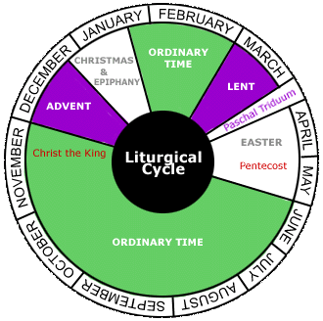
The Sunday Readings
for the season of Advent
The Sunday Readings are set out in a 3 year cycle Years A, B, C.
This is in keeping with Advent as a season of preparation through repentance, prayer and giving to the poor.
During the 4 Sundays of Advent when the community gathers for Eucharist the readings focus on some of the people who prepared for the first coming of the Messiah. One of these is the prophet Isaiah.
In Years A and B the first readings on the Sundays of Advent come from the Prophet Isaiah because he tried to prepare the people for the first coming of the Messiah.
L-1
S-04
Click the book icons on the left to reveal the statements

Slide 5
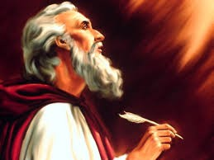
Isaiah whose name means – God is salvation
Isaiah is regarded as one of the greatest prophets in the Bible which meant he was one of God’s spokesmen. He lived in Jerusalem 800 years before Jesus was born.
There are many references in the New Testament telling how Jesus brought about Isaiah’s prophecy.
Isaiah’s prophecies were also about the coming of the Messiah, Jesus. His prophetic ministry lasted 40 years and was fulfilled in Jesus.
Isaiah’s prophecies challenged the people to trust in God, give up their sinful way of life and warned them of destruction if they did not return to God and establish God’s ways on earth.
Isaiah, according to Jewish tradition was of royal descent which would have given him access to share his prophecies with the kings of Judah in Jerusalem.
L-1
S-05
Click the pins on the right to reveal post-it notes.

Slide 6
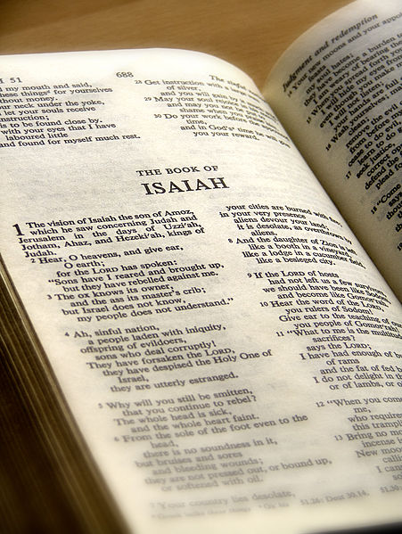
Year A Advent first readings are
from the book of Isaiah
What are we doing as the followers of Jesus the Messiah to bring about his kingdom of love aroha, peace rangimarie and tika justice here and now?
What can we do to bring hope to people around us especially to those without hope? 6/6
Reflect on how Isaiah’s prophecies helped Old Testament people to prepare for and recognise the Messiah who would bring about a kingdom or reign of love, peace and justice.
How do Isaiah’s messages fit the situation in the world today? How are they still true for us? 4/6
We can ask ourselves the question this Advent – how are we preparing for the Messiah to come into and influence our lives this Christmas?
5/6
A sign of these things will be a young woman giving birth to a son who shall be named Emmanuel – God with us.
Explain how, when, where and by whom this prophecy of Isaiah was fulfilled.
3/6
He predicts a time when men will make their weapons into tools for growing food and war will cease, when all animals will become tame and live in harmony. Children will play with snakes and no harm will come to them and the people who are blind, deaf and lame will be healed. 2/6
Isaiah’s prophecies were recorded in a book in the Old Testament where we can read, that despite the sinfulness of the world around him, Isaiah looks forward with hope to a time when all creation will learn to live God’s ways of justice tika and peace rangimarie.
1/6
L-1
S-06
Click top card to discard it

Slide 7
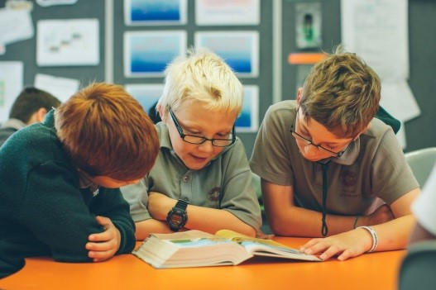
Looking closely at Isaiah’s messages
in the Advent readings
In groups read one of the Isaiah readings from the Teacher Resource.
Discuss what Isaiah is saying and how this reading helps to remind people who hear it at Mass to prepare for the birth of Jesus.
Decide if his prophecy has already been fulfilled or has yet to be.
Choose a context in today’s world and apply your reading to a situation you know about.
If God called you today to be a prophet as he called Isaiah, what would your message to the people in the Middle East or another conflict area be? Make your message into a rap.
X
L-1
S-07
Click the information button to reveal the pop up
Notes:
Access the readings on the Teacher Resource from the Teacher’s Book p. 12 or the lesson home page

Slide 8
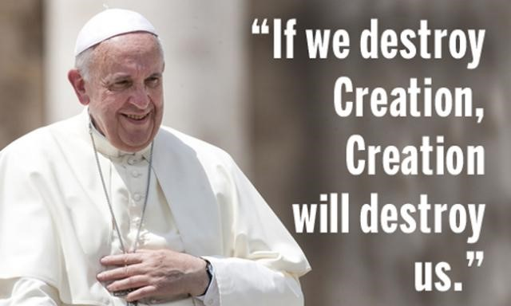
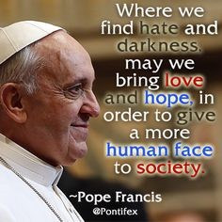
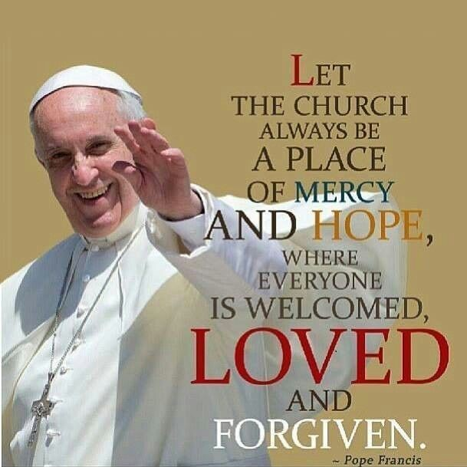
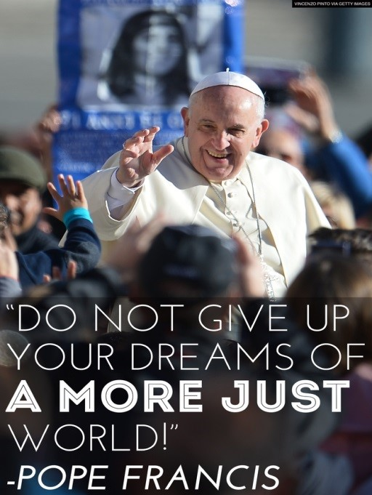
Listen to our prophetic Pope who reminds us,
as Isaiah did, to turn back to God
Learn one quote from Pope Francis by heart and share it with people during Advent.
Do something to make your home and school more hopeful places this Advent season.
L-1
S-08

Slide 9
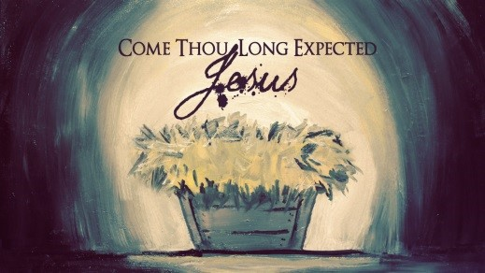
Expressing Advent themes in art works for your school to make Advent present
Choose one of the following themes, or find a theme in your Isaiah reading or make up your own.
O come O come Emmanuel.
Come and be born in our hearts.
Come O long awaited Jesus.
Come and save our broken world.
Come Lord Jesus.
Come and bring your peace and tika.
We are waiting for you.
We await your coming Jesus.
Come and restore harmony to all creation.
L-1
S-09
Click the buttons to reveal themes

Slide 10
Check up
Recall a message from the readings of Isaiah, explain its meaning and how it reminds you to use the Advent season to be a hopeful person as you await the birth of Jesus at Christmas.
1)
2)
Make a cartoon showing Isaiah, use his words and show how his messages apply to a situation in the world today.
3)
Write a brief description of Isaiah and the time he lived in and explain why preaching a message of hope was so challenging for him.
4)
Which activity do you think helped you to learn best in this lesson?
5)
Questions I would like to ask about the topics in this lesson are …
L-1
S-10
Click the worksheet button to go to the worksheet

Slide 11
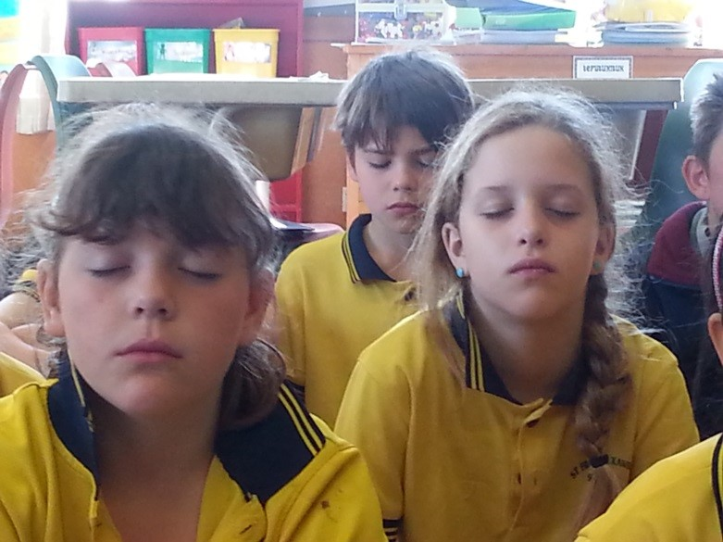
Time for Reflection
L-1
S-11
Click the audio button to stop reflective music
Click the audio button to play reflective music

Slide 12
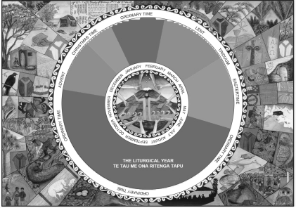
Rapid recap on the Liturgical Year
Rapid recap on the Liturgical Year
Name:____________________________
Date:____________
The penitential or preparations seasons of the Liturgical Year are
The Liturgical Year begins each year on
The most important feast in the Liturgical Year is
The colour you would see featuring in church decorations during Ordinary Time is
In the homily, the hymns and the Scripture readings for Advent, the theme is
The Sunday Scripture readings are set out in a
The Liturgical Cycle of the Catholic Church is shared with
The season of Lent begins on
Ordinary Time lasts for 34 weeks is
The Liturgical feasts and seasons are celebrated by
1
a)
three year cycle – Years A,B,C
2
b)
Easter the day of Jesus Christ’s resurrection
3
c)
other Christian churches with a few exceptions
4
d)
green, the colour of hope
5
e)
Ash Wednesday and lasts 6 weeks ending on
Holy Saturday, the Saturday before Easter
6
f)
Advent and Lent
7
g)
repentance, fasting, prayer and giving to the poor
8
h)
people in the liturgical celebrations in Church communities
9
I)
spread over 2 blocks, after Easter and after the Epiphany
10
J)
the first Sunday of Advent
Fill in the square with the letter that completes the sentence
1
2
3
4
5
6
7
8
9
10
L-1
S-03
L-1
S-03
Worksheet
Click the up arrow to return to the lesson

Slide 13
Check up
Name:____________________________
Date:____________
1) Recall a message from the readings of Isaiah, explain its meaning and how it reminds you to use the Advent season to be a hopeful person as you await the birth of Jesus at Christmas.
2) Make a cartoon showing Isaiah, use his words and show how his messages apply to a situation in the world today.
3) Write a brief description of Isaiah and the time he lived in and explain why preaching a message of hope was so challenging for him.
4) Which activity do you think helped you to learn best in this lesson?
5) Questions I would like to ask about the topics in this lesson are …
L-1
S-10
Worksheet
Click the up arrow to return to the presentation

