Slide 1
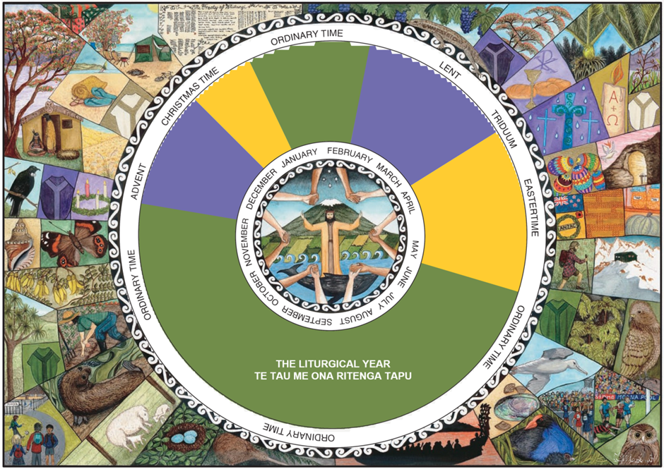
Aotearoa New Zealand symbols of Advent
L-2
S-01
Notes:
Slide 1 Aotearoa New Zealand symbols of Advent
Use this slide as a focussing strategy to introduce the lesson topic. Read the title together and invite students to share something they know about the symbols and events that are part of life in Aotearoa New Zealand during Advent.

Slide 2
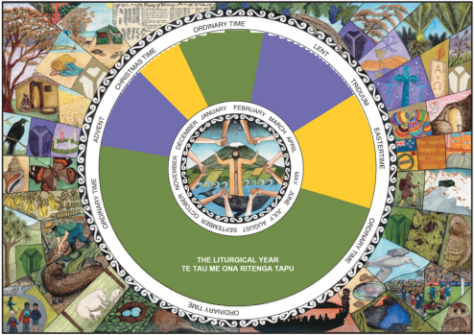
Learning Outcomes
The Students will:
1)
  identify what is happening in nature and life in Aotearoa New Zealand during December when
  the Church celebrates Advent
2)
  explain how these symbols could remind Christians about the meaning of Advent
L-2
S-02
Click the borders to reveal text
Notes:
Slide 2 Learning Outcomes
Read through the Learning Intentions with the class and identify some ideas/questions that might be explored in the lesson.

Slide 3
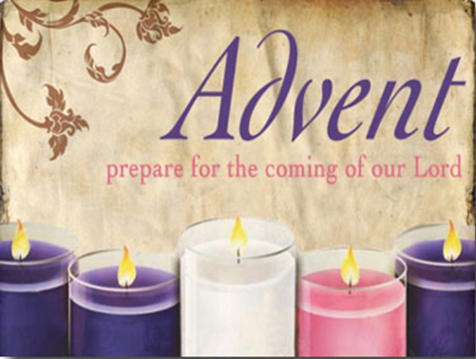
Rapid recap of what Advent is
Complete the sentences
L-2
S-03
Click in the white box and write your text
Notes:
Slide 3 Rapid recap of what Advent is
Ideas to include: bring these ideas into the discussion for the next slide also
Symbols of Jesus bringing light into the darkness.
Jesus sharing the warmth of his love and friendship.
The brightness of the sun brings forth growth and beauty as Jesus does.
The colour purple reminds us Advent is a time to get ready for Jesus’ birth.
The joyful anticipation of Jesus’ coming matches the joy of the coming of summer and a time of rest.
Jesus brings hope tūmanako and opportunities that unfold in people’s lives.
Daylight saving starts before Advent and people look forward to the coming of Christ, the Sun of Justice, coming to save people from their weakness and lack of love aroha and peace rangimarie and mercy.
Jesus’ coming lights the way for people to live in friendship with God and each other.
The end of the working year brings the joy of the coming holidays with time for families to get together and share good times building and renewing their relationships.
Remind students that adapting new and old symbols in a different cultural setting is an example of ‘inculturation’ which is a concept covered in the Holy Spirit Strand Lesson 4 Year 8.

Slide 4


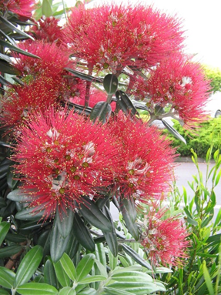
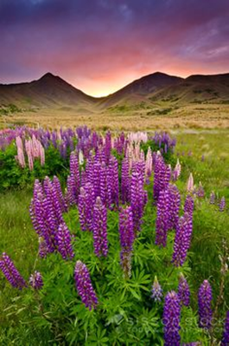

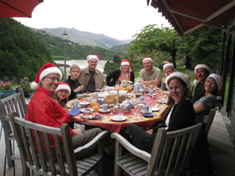
Making meaning of the Advent symbols in the summer
Jesus brings hope tūmanako and opportunities that unfold in people’s lives
The brightness of the sun brings forth growth and beauty as Jesus does
The colour purple reminds us Advent is a time to prepare for Jesus’ birth
Daylight saving and Advent are not too far apart and people look forward to the coming of Christ, the Sun of Justice, coming to save people from their weakness and lack of love aroha and peace rangimarie.
Jesus’ coming lights the way for people to welcome him and renew their friendship with God and each other
The end of the working year brings the joy of the coming holidays with time for families to get together and share good times and build and renew their relationships.
Click the images to reveal text.
Click on the worksheet button to go to the worksheet
L-2
S-04
Notes:
Slide 4 Making meaning of the Advent symbols in the summer
Adapt Teaching and Learning Experience 1
Read each reveal and share comments about how these images are part of your experience of Advent.
Complete the worksheet as a record of your learning.
This worksheet will be used again in CHRISTMAS Lesson 1 Slide 3

Slide 5

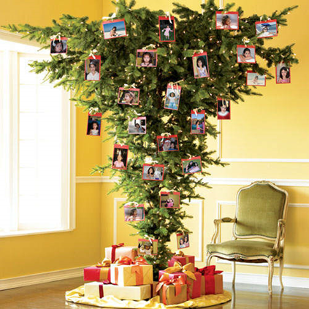
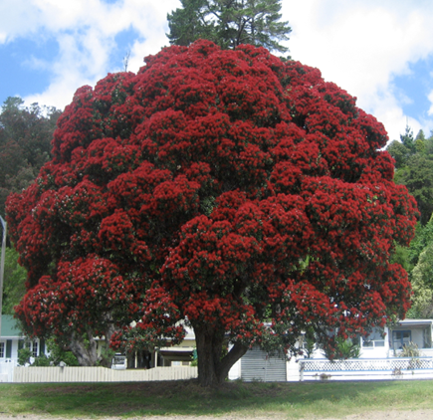
An upside down Christmas
L-2
S-05
Click the audio button to play ‘New Zealand Carol’
Click the audio button to stop ‘New Zealand Carol’
Notes:
Slide 5 An upside down Christmas
Sing using the MP3 ‘An upside down Christmas’
Explain why Christmas in Aotearoa New Zealand is called an upside down Christmas
Discuss the advantages and disadvantages of celebrating Advent and Christmas here.
Sing using the MP3 ‘An upside down Christmas’
Carol our Christmas, an upside down Christmas;
Snow is not falling the trees are not bare.
Carol the summer, and welcome the Christ Child,
Warm in our sunshine and sweetness of air.
Sing of the gold and the green and the sparkle,
Water and river and lure of the beach.
Sing in the happiness of open spaces,
Sing a nativity summer can reach!
Shepherds and musterers move over the hillsides,
Finding, not angels, but sheep to be shorn,
Wise one's make journeys whatever the season
Searching for signs of the truth to be born.
Right side up Christmas belongs to the universe
Made in the moment a woman gives birth;
Hope is the Jesus gift, love is the offering,
Everywhere, anywhere, here on the earth.

Slide 6
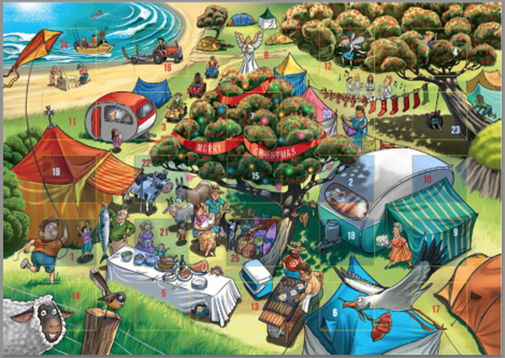
Aotearoa New Zealand Advent Calendar
Look at this example of an Aotearoa New Zealand Advent Calendar
Share your experiences of Advent and
share an example of what might be
behind the Advent doors
Identify a symbol of Advent and
explain what it symbolises
Remember that Advent is a time for
mucking in and helping in
the Christmas preparations.
Write an Advent Psalm that looks
forward to Christ’s coming in Aotearoa New Zealand
L-2
S-06
Click the audio button to play ‘New Zealand Carol’
Click the audio button to stop ‘New Zealand Carol’
Notes:
Slide 6 Aotearoa New Zealand Advent Calendar
Respond to each item on the screen.
Psalm activity see Teacher’s book page 15 or Lesson home page
Sing using the MP3 New Zealand Carol – ‘Kauri, Flax and Rata Trees’

Slide 7
Advent is a time to recognise the attitudes we need to have as we prepare for Christmas so that ..
Our hearts and minds will be open and happy to receive the love and peace of Jesus as we recognise the signs of his coming in the beauty of summer around us.
With an attitude of awareness
We will be aware of the particular busyness of others as they bring the school and working year to a close.
With an attitude of helpfulness
We could offer to help at home to care for others and notice what needs to be done and do it.
With an attitude of willingness
L-2
S-07A
Click the icons to reveal a text line
Notes:
Slide 7A Advent is a time to recognise the attitudes we need to have as we prepare for Christmas so that …
Read each reveal and take time to reflect on the attitude for each one.

Slide 8
Advent is a time to recognise the attitudes we need to have as we prepare for Christmas so that ..
We will take time to reflect on the true meaning of Christmas and the impact of the life of the baby who was born on our own lives.
With an attitude of being a true follower of Jesus
We could remind ourselves each day to notice something that helps us to be conscious of the gifts God has given us, especially Jesus.
With an attitude of prayerfulness and openness to encountering God in the world
We will enjoy the excitement and hype that is part of the lead up to Christmas while keeping in mind what we can do to share the peace and love of Jesus with the people around us, so they encounter his presence more clearly in their lives.
With an attitude of unselfish sharing of the peace and love of the season.
L-2
S-07B
Click the icons to reveal a text line
Notes:
Slide 7B Advent is a time to recognise the attitudes we need to have as we prepare for Christmas so that ..
Read each reveal and take time to reflect on the attitude for each one.

Slide 9

Check up
1)
Advent is a season that is sometimes not celebrated well because …
2)
Name some Aotearoa New Zealand Advent symbols that make the season of Advent meaningful and holy.
3)
Write one tip to share that will help people to keep their minds and hearts focussed on preparing for Jesus to be born in a new way
into their lives.
4)
Which activity do you think helped you to learn best in this lesson?
5)
Questions I would like to ask about the topics in this lesson are …
Click in each caption space to reveal text
Click on the worksheet button to go to the worksheet.
L-2
S-08
Notes:
Slide 8 Check Up
This formative assessment strategy will help teachers to identify how well students have achieved the Learning Intentions of the lesson.
Teachers can choose how they use the slide in their range of assessment options.
A worksheet of this slide is available for students in Years 5-8 to complete.
The last two items are feed forward for the teacher.
Recording the students’ responses to these items is recommended as it will enable teachers to adjust their learning strategies for future lessons and target the areas that need further attention.

Slide 10

Time for Reflection
L-2
S-09
Click the audio button to stop reflective music
Click the audio button to play reflective music
Notes:
Slide 9 Time for Reflection
The MP3 is played to help create a reflective atmosphere and bring the young people to stillness and silence as the teacher invites them to notice how nature during the season of Advent in Aotearoa reveals the true meaning of Advent. Try to take time in the busyness to spend some time each night to think of something you could do to help someone at this time. Choose a different person each night.

Slide 11
Sharing our Learning about ADVENT
Make a poster or a power point to explain what Christians are preparing for during Advent. Include an explanation of the Liturgical Calendar, the significance of the colours and symbols and things that people can do to prepare their hearts to be open to encountering Jesus in a new way at Christmas. Share this with a younger class or at Children’s Liturgy in your parish.
Have a conversation with someone in your family whānau about the reason we have a time of preparation for Christmas. Talk about how being prepared for something helps you to do it better and mean more. Share what you have learned about the season of Advent and what you and your family whānau could do to use the season of Advent to help Christmas have a deeper meaning.
Take responsibility for creating some Advent symbols for your family to use as a focus for family prayer and conversations in which you could explain what an ‘upside down Christmas’ means.
Demonstrate that what you have learned about preparing for the coming of the Prince of Peace has inspired you to offer to do things e.g. to help around the house and look after younger family members during Advent to make it easier for others to deal with what needs to be done.
L-2
S-10
Click on the worksheet button to go to the worksheet
Notes:
Slide 10 Sharing our Learning about ADVENT
This slide provides some choices for students to show and share what they have learned. Examples could be photographed as evidence of students’ learning.
You may like to put a copy of the Sharing our Learning page in students’ RE Learning Journals. You could talk through the choices using the slide and let students make their choice from their own copy.
Students could work on their choice at school and/or at home and you may like to set a day for sharing. Please let parents and whānau know what you expect them to do with this.
The slide is focussed on the Yr 7 ADVENT Achievement Objective which is covered in Lessons 1 & 2
Yr 7 AO) Students will be able to: identify symbols of Aotearoa New Zealand are identified with the message of ADVENT.

Slide 12
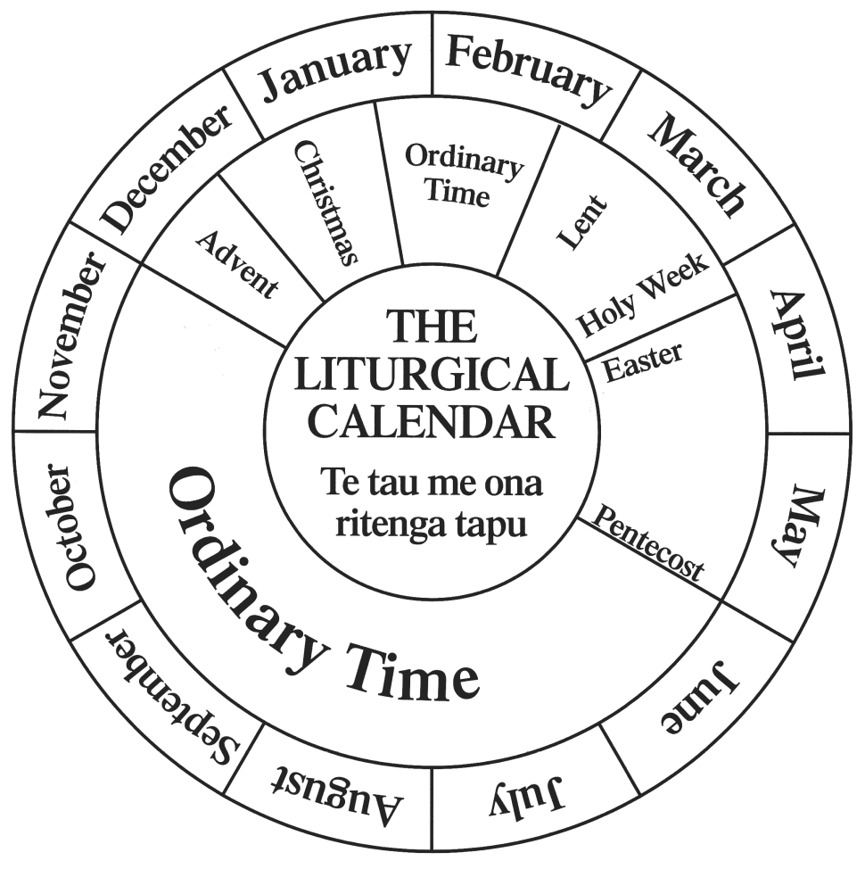
ADVENT and CHRISTMAS in AOTEAROA NEW ZEALAND
Name: _______________
Date: _________
Colour the season of Advent on the calendar
Mark the date of the 1st Sunday of Advent on the calendar.
Mark the Feast of Christmas.
Add NZ symbols for Advent near the season.
You can refer to the symbols on the slide and add some of your own
Keep the calendar to use in the other lessons in the Liturgical Year.
L-2
S-04
Worksheet
Click on the worksheet button to go to the worksheet
Click the up arrow to return to the lesson
Notes:
Slide 4 ADVENT and CHRISTMAS in AOTEAROA NEW ZEALAND WORKSHEET
This worksheet relates to slide 4

Slide 13
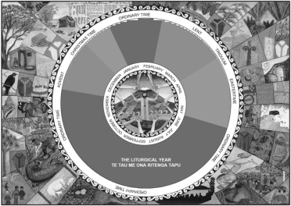
Check up
Name: _______________
Date: _________
1)
Advent is a season that is sometimes not celebrated well because …
2)
Name some Aotearoa New Zealand Advent symbols that make the season of Advent meaningful and holy.
3)
Write one tip to share that will help people to keep their minds and hearts focussed on preparing for Jesus to be born in a new way
into their lives.
4)
Which activity do you think helped you to learn best in this lesson?
5)
Questions I would like to ask about the topics in this lesson are …
Click in each caption space to reveal text
Click on the worksheet button to go to the worksheet.
L-2
S-08
Worksheet
Click on the worksheet button to go to the worksheet
Click the up arrow to return to the lesson
Notes:
Slide 8 Check Up WORKSHEET
This worksheet relates to slide 8

Slide 14

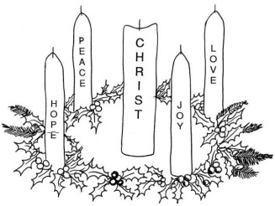

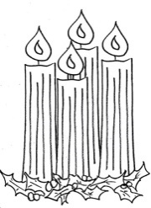
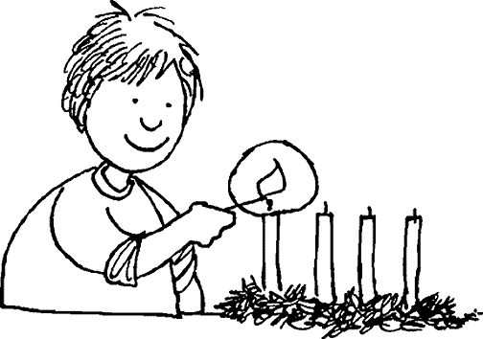
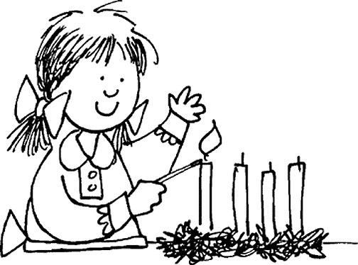
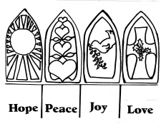

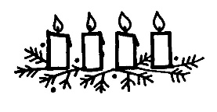
Sharing our Learning about ADVENT
Name: _______________
Date: _________
Make a poster or a power point to explain what Christians are preparing for during Advent. Include an explanation of the Liturgical Calendar, the significance of the colours and symbols and things that people can do to prepare their hearts to be open to encountering Jesus in a new way at Christmas. Share this with a younger class or at Children’s Liturgy in your parish.
Have a conversation with someone in your family whānau about the reason we have a time of preparation for Christmas. Talk about how being prepared for something helps you to do it better and mean more. Share what you have learned about the season of Advent and what you and your family whānau could do to use the season of Advent to help Christmas have a deeper meaning.
Take responsibility for creating some Advent symbols for your family to use as a focus for family prayer and conversations in which you could explain what an ‘upside down Christmas’ means.
Demonstrate that what you have learned about preparing for the coming of the Prince of Peace has inspired you to offer to do things e.g. to help around the house and look after younger family members during Advent to make it easier for others to deal with what needs to be done.
L-2
S-10
Worksheet
Click the up arrow to return to the lesson
Notes:
Slide 10 Sharing our Learning about ADVENT WORKSHEET
This worksheet relates to slide 10

