Slide 1
Advent – Preparing for the coming of Christ
L-1
S-01
Notes:
Slide 1 Advent – Preparing for the coming of Christ
Use this slide as a focussing strategy to introduce the lesson topic. Read the title together and invite students to share something they know about Christ’s first coming into human history, how he comes in the world now and his second coming at the end of time.

Slide 2
Learning Outcomes
The students will:
1)
recognise that Advent is a time when people prepare to celebrate Christ’s coming as a real event in history
2)
identify how Christ comes in the Church now through the celebration of every liturgy
3)
explain how people can strive to grow more like Christ Te Karaiti
L-1
S-02
Click the borders to reveal text
Notes:
Slide 2 Learning Outcomes
Read through the Learning Intentions with the class and identify some ideas/questions that might be explored in the lesson.

Slide 3
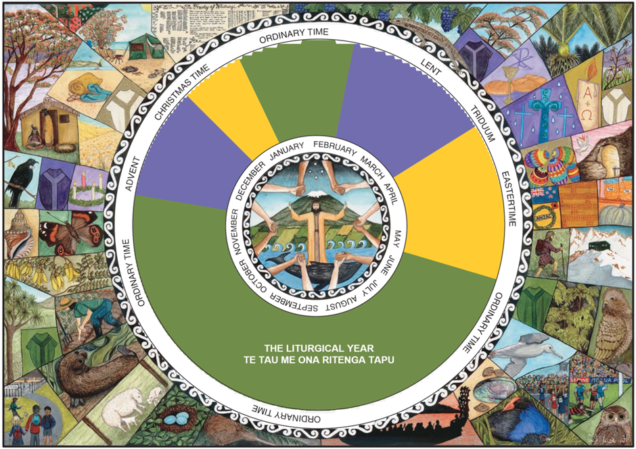
The Season of Advent – a time for conversion and preparation
Look closely at the images nearest to Advent on the Calendar and explain how they relate to the season
Explain what the colour purple represents in Catholic culture.
What is meant by 'Advent is a season of conversion’ – conversion to what?
What is Advent encouraging people to prepare themselves for?
X
L-1
S-03
Click the I-button to reveal information
Notes:
Slide 3 The Season of Advent – a time for conversion and preparation
Use the items on the pop up to focus students’ attention on Advent.
Purple is a penitential colour that reminds people of their need to recognise when they have failed to love, to seek forgiveness and to change the attitudes that cause their sinful behaviour. This is what conversion is a change of heart and mind to see and do things as Christ did – this is what it means to be Christian. Advent is the season to prepare to celebrate that Christ has come in history and we can welcome on his birthday and be more aware of his presence in our lives.

Slide 4
Understanding Christ’s coming in history and how he comes today
During Advent the Church invites people to prepare to celebrate with joy not only the first coming of Jesus into the world but also to examine how they are living their lives and to make changes that will let their hearts be more open and aware of Christ’s presence among his people today as they grow closer to him.
For today’s Christians, Christ’s coming is not just something that happened long ago. Christ comes into people’s lives today through their participation in liturgical celebrations which bring them healing and strength so they can grow more like him in tika, pono and aroha.
Jesus’ life is recorded in the New Testament according to the faith and experience of his first followers. It tells how Jesus came to teach people about God and to establish the kingdom or reign of God `on earth as it is in heaven.’
Christ’s coming was a real event in history. He lived in 1st century Palestine and there are references to his life in historical records of this time. You can research the writing of historians such as Tacitus and Josephus for more information about this.
Advent means ‘coming’ and this is understood in several ways. Christ has already come into the world.
Advent means ‘coming’ and this is understood in several ways. Christ has already come into the world.
Christ’s coming was a real event in history. He lived in 1st century Palestine and there are references to his life in historical records of this time. You can research the writing of historians such as Tacitus and Josephus for more information about this.
Jesus’ life is recorded in the New Testament according to the faith and experience of his first followers. It tells how Jesus came to teach people about God and to establish the kingdom or reign of God ‘on earth as it is in heaven.’
For today’s Christians, Christ’s coming is not just something that happened long ago. Christ comes into people’s lives today through their participation in liturgical celebrations which bring them healing and strength so they can grow more like him in tika, pono and aroha.
L-1
S-04
Click top right card to flip the page
Notes:
Slide 4 Understanding Christ’s coming in history and how he comes today
Adapt Teaching and Learning Experience 2.
Read each page in the flip book and encourage comments and questions.

Slide 5
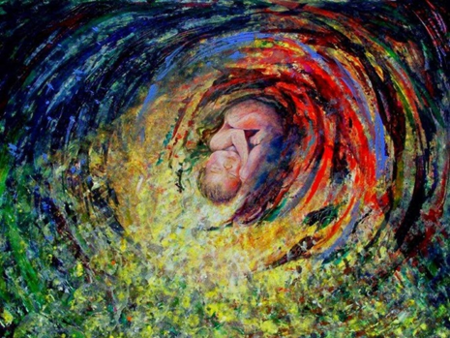
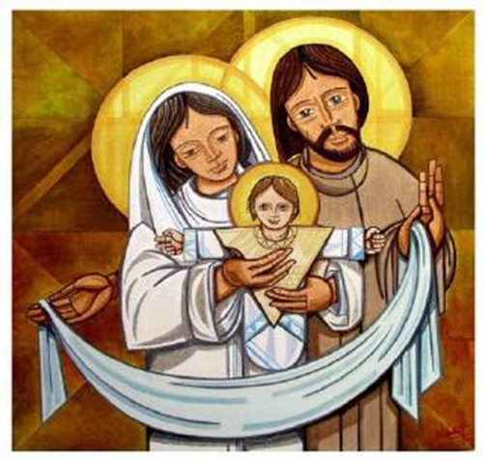
Jesus Christ’s birth is an event in history WHEN, WHERE, WHY?
L-1
S-05
Click on the worksheet button to go to the worksheet
Notes:
Slide 5 Jesus Christ’s birth is an event in history - WHEN, WHERE, WHY?
Students record their responses to the questions in each column of the worksheet. When completed students share their responses with the class.
Adapt Teaching and Learning Experience 3

Slide 6
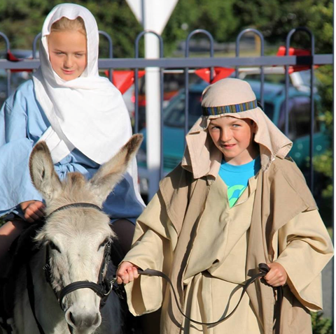
The message of Advent
Advent is a time for conversion which means a complete turning around and change in your attitudes and actions.
When you take part in liturgy or liturgical drama how does it help you to become more aware of what Jesus was really like?
Jesus is present in liturgies in different ways and his presence comes to people and strengthens them to turn away from sin like cheating, lying and meanness so they can grow more like him.
Conversion is not usually a one-off experience but the beginning of a life-long process. Why would this be? Do you know of someone who had a one-off conversion experience?
How do you think liturgy or re-enacting events in the life of Jesus help people’s conversion to change their attitudes and actions?
L-1
S-06
Click the pins on the right to reveal post-it notes.
Notes:
Slide 6 Christ comes to people today through the liturgy to help them grow more like him
The next 6 slides are an adaption of the Teacher Resource on p13 in the Teacher’s book or the Lesson home page.
Share each slide with the class before starting the drama work and use the image on the slide and the directions on the worksheet to assist the students to generate ideas for their work.
A suggestion is to photograph the images that the young people create as they work through Slides 7 – 12. The photographs could be used as part of the Sharing our Learning at the end of the lesson - see Slide 10 Lesson 2. They may also be useful in the lessons in the Sacrament Strand.
St Paul had a one –off conversion experience on the road to Damascus. (See Acts 9:1-19)

Slide 7
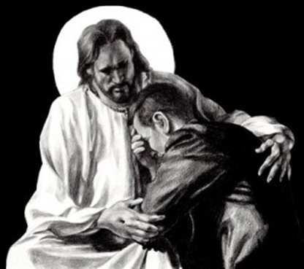
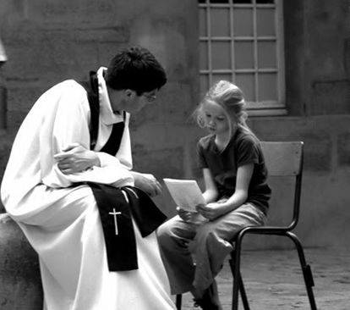
Each day through the Sacrament of Penance people get the strength to change their attitudes and actions
Create a drama to show how Christ comes to people when they celebrate the Sacrament of Penance Hohou Rongo and invites them to grow closer to him.
Show how through the action of the priest who represents Jesus, people can experience healing reconciliation with God, who gives them mana to strengthen them to live as Jesus lived.
L-1
S-07
Click on the worksheet button to go to the worksheet
Notes:
Slide 7 Each day through the Sacrament of Penance people get the strength to change their attitudes and actions
Invite students to reflect on the awareness of their attitudes and actions that are not based on love, their need for forgiveness and conversion and how the Sacrament of Penance helps to bring this about.
Use the image on the slide and the directions on the worksheet to assist the students to express how people experience Christ alive in the world through forgiveness and conversion in the Sacrament of Penance.

Slide 8
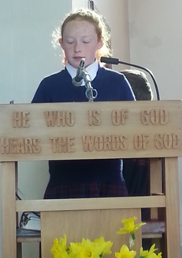
Every day Christ comes to people when the Word of God Te Kupu a Te Ariki is proclaimed in liturgical celebrations
Create a tableau to show how Christ comes to people when the Word of God is proclaimed in liturgical celebrations then move slowly to …
Show how God’s word encourages people to live as Jesus did with love and compassion aroha, peace rangimarie, forgiveness hohou rongo and justice tika.
L-1
S-08
Click on the worksheet button to go to the worksheet
Notes:
Slide 8 Every day Christ comes to people when the Word of God Te Kupu a Te Ariki is proclaimed in liturgical celebrations
Use the image on the slide and the directions on the worksheet to assist the students to express how people experience Christ alive in the world through the proclamation of his word bringing people healing and strength so they can grow more like him and through this develop a deeper relationship with God.

Slide 9
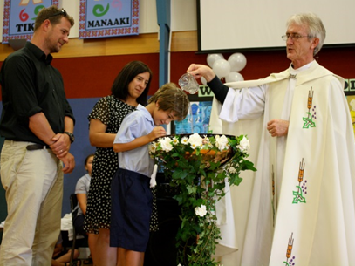
Today through the Sacrament of Baptism Christ comes to people and they become members of his family in the Church
Re-enact a celebration of the Sacrament of Baptism and show how through this Sacrament people die to sin by being baptised with water and rise to live the new life of Christ. (You may like to use a narrator in your re-enactment).
Capture how people are strengthened by the Holy Spirit Te Wairua Tapu when they are anointed with the oil of chrism and how this deepens their friendship with God.
L-1
S-09
Click on the worksheet button to go to the worksheet
Notes:
Slide 9 Today through the Sacrament of Baptism Christ comes to people and they become members of his family in the Church
Use the image on the slide and the directions on the worksheet to assist the students to express how people experience Christ alive in the world in the Sacrament of Baptism when the Holy Spirit becomes present through the symbols of water and the oil of chrism and people become members of Christ’s family in the Church.

Slide 10
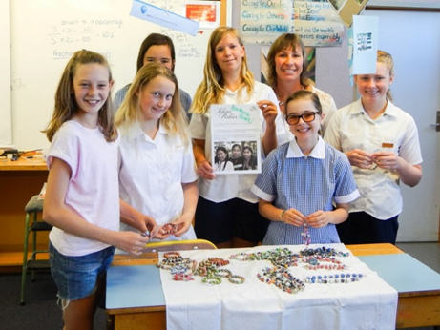
Christ comes to people today through the Christian community Te Whānau a Te Karaiti
Using human statues show how people meet the risen Christ in different ways in one another and how they are strengthened in faith whakapono through the Christ-like actions of others.
L-1
S-10
Click on the worksheet button to go to the worksheet
Notes:
Slide 10 Christ comes to people today through the Christian community Te Whānau a Te Karaiti
Use the image on the slide and the directions on the worksheet to assist the students to express how people experience Christ alive in the world through
The Christian community in one another and are strengthened and encouraged by the faith and loving actions of others.

Slide 11
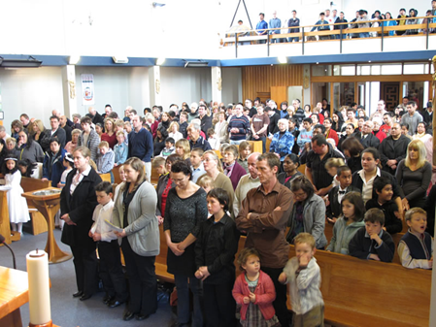
Christ comes into people’s lives now in our time as they celebrate the Eucharist
Use mime to show how Christ comes to people today when they celebrate Eucharist.
Show how people recognise Jesus in the breaking of the bread and are strengthened by him through the bread of life te taro o te ora to go out and live lives of service, aroha and manaakitanga.
L-1
S-11
Click on the worksheet button to go to the worksheet
Notes:
Slide 11 Christ comes into people’s lives now in our time as they celebrate the Eucharist
Use the image on the slide and the directions on the worksheet to assist the students to express how people experience Christ alive in the world now when they recognise Jesus in the breaking of the bread and are strengthened by him to go out and live lives of service and aroha when they receive him.

Slide 12
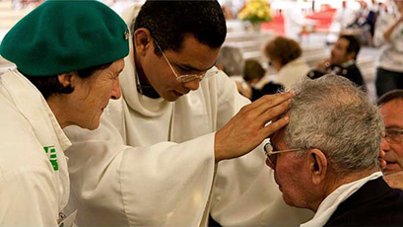
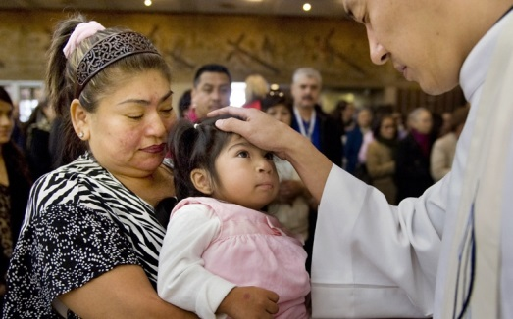
Christ comes to people now and gives healing and comfort to them when they celebrate the Sacrament of the Anointing
Show how through the laying on of hands and the anointing with oil people meet the risen Christ and are strengthened by his peace rangimarie and healing love aroha to accept what will be, and grow
closer to him.
Use human statues to illustrate what happens at the celebration of the Anointing of the Sick.
L-1
S-12
Click on the worksheet button to go to the worksheet
Notes:
Slide 12 Christ comes to people now and gives healing and comfort to them when they celebrate the Sacrament of the Anointing
Use the image on the slide and the directions on the worksheet to assist the students to express how people experience Christ alive in the world now through the laying on of hands and the anointing with oil in the Sacrament of anointing. Christ comes to people and brings them healing, strength, peace and acceptance of what will be.

Slide 13
Check up
1)
Explain the difference between Jesus’ coming as an event in history and Christ coming into people’s lives today.
2)
Advent is a season for conversion which means …
3)
An example of conversion in young people’s lives is …
4)
Give 3 examples of how Christ comes into people’s lives now when liturgy is celebrated.
5)
What advice could you give someone of your age to help them grow more like Christ especially in Advent?
6)
Which activity do you think helped you to learn best in this lesson?
7)
Questions I would like to ask about the topics in this lesson are …
Click in each caption space to reveal text
Click on the worksheet button to go to the worksheet.
L-1
S-13
Notes:
Slide 13 Check Up
This formative assessment strategy will help teachers to identify how well students have achieved the Learning Intentions of the lesson.
Teachers can choose how they use the slide in their range of assessment options.
A worksheet of this slide is available for students in Years 5-8 to complete.
The last two items are feed forward for the teacher.
Recording the students’ responses to these items is recommended as it will enable teachers to adjust their learning strategies for future lessons and target the areas that need further attention.

Slide 14
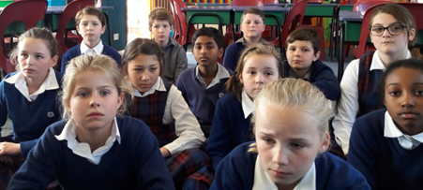
Time for Reflection
L-1
S-14
Click the audio button to stop reflective music
Click the audio button to play reflective music
Notes:
Slide 13 Check Up
This formative assessment strategy will help teachers to identify how well students have achieved the Learning Intentions of the lesson.
Teachers can choose how they use the slide in their range of assessment options.
A worksheet of this slide is available for students in Years 5-8 to complete.
The last two items are feed forward for the teacher.
Recording the students’ responses to these items is recommended as it will enable teachers to adjust their learning strategies for future lessons and target the areas that need further attention.

Slide 15
Name____________________
Date__________
Jesus Christ’s birth – WHEN, WHERE, WHY?
What do I KNOW? | What do I WONDER? | What have I LEARNT?
L-1
S-05
Worksheet
Click the up arrow to return to the lesson
Notes:
Slide 5 Jesus Christ’s birth – WHEN, WHERE, WHY WORKSHEET
This worksheet relates to slide 5

Slide 16
Each day through the Sacrament of Penance people get the strength to change their attitudes and actions
Name____________________
Date__________
Create a drama to show how Christ comes to people when they celebrate the Sacrament of Penance Hohou Rongo and invites them to grow closer to him.
Show how through the action of the priest who represents Jesus, people can experience healing, reconciliation with God who gives them mana to strengthen them to live as Jesus lived.
L-1
S-07
Worksheet
Click the up arrow to return to the lesson
Notes:
Slide 7 Each day through the Sacrament of Penance people get the strength to change their attitudes and actions WORKSHEET
This worksheet relates to slide 7

Slide 17
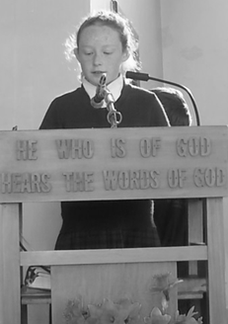
Every day Christ comes to people when the Word of God Te Kupu a Te Ariki is proclaimed in liturgical celebrations
Name____________________
Date__________
Create a tableau to show how Christ comes to people when the Word of God is proclaimed in liturgical celebrations then move slowly to …
Show how God’s word encourages people to live as Jesus did with love and compassion aroha, peace rangimarie, forgiveness hohou rongo and justice tika.
L-1
S-08
Worksheet
Click the up arrow to return to the lesson
Notes:
Slide 8 Every day Christ comes to people when the Word of God Te Kupu a Te Ariki is proclaimed in liturgical celebrations> WORKSHEET
This worksheet relates to slide 8

Slide 18
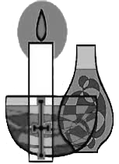
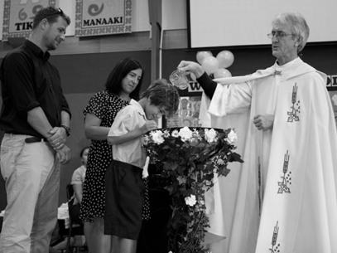
Today through the Sacrament of Baptism Christ comes to people and they become members of his family in the Church
Name____________________
Date__________
Re-enact a celebration of the Sacrament of Baptism and show how through this Sacrament people die to sin by being baptised with water and rise to live the new life of Christ. (You may like to use a narrator in your re-enactment).
Capture how people are strengthened by the Holy Spirit Te Wairua Tapu when they are anointed with the oil of chrism and how this deepens their friendship with God.
L-1
S-09
Worksheet
Click the up arrow to return to the lesson
Notes:
Slide 9 Today through the Sacrament of Baptism Christ comes to people and they become members of his family in the Church WORKSHEET
This worksheet relates to slide 9

Slide 19
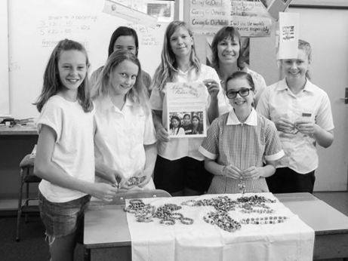
Christ comes to people today through the Christian community Te Whānau a Te Karaiti
Name____________________
Date__________
Using human statues show how people meet the risen Christ in different ways in one another and how they are strengthened in faith whakapono through the Christ-like actions of others.
L-1
S-10
Worksheet
Click the up arrow to return to the lesson
Notes:
Slide 10 Christ comes to people today through the Christian community Te Whānau a Te Karaiti WORKSHEET
This worksheet relates to slide 10

Slide 20
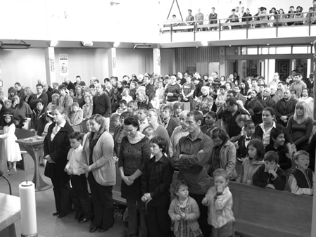
Christ comes into people’s lives now in our time as they celebrate the Eucharist
Name____________________
Date__________
Use mime to show how Christ comes to people today when they celebrate Eucharist.
Show how people recognise Jesus in the breaking of the bread and are strengthened by him through the bread of life te taro o te ora to go out and live lives of service, aroha and manaakitanga.
L-1
S-11
Worksheet
Click the up arrow to return to the lesson
Notes:
Slide 11 Christ comes into people’s lives now in our time as they celebrate the Eucharist WORKSHEET
This worksheet relates to slide 11

Slide 21
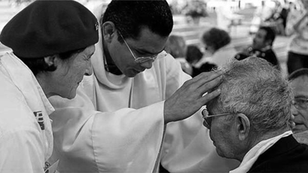
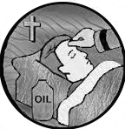
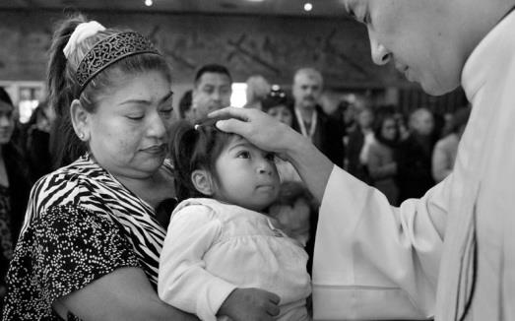
Christ comes to people now and gives healing and comfort to them when they celebrate the Sacrament of the Anointing
Name____________________
Date__________
Show how through the laying on of hands and the anointing with oil people meet the risen Christ and are strengthened by his peace rangimarie and healing love aroha to accept what will be and grow
closer to him.
Use human statues to illustrate what happens at the celebration of the Anointing of the Sick.
L-1
S-12
Worksheet
Click the up arrow to return to the lesson
Notes:
Slide 12 Christ comes to people now and gives healing and comfort to them when they celebrate the Sacrament of the Anointing WORKSHEET
This worksheet relates to slide 12

Slide 22
Check up
Name____________________
Date__________
1)
Explain the difference between Jesus’ coming as an event in history and Christ coming into people’s lives today.
2)
Advent is a season for conversion which means …
3)
An example of conversion in young people’s lives is …
4)
Give 3 examples of how Christ comes into people’s lives now when liturgy is celebrated.
5)
What advice could you give someone of your age to help them grow more like Christ especially in Advent?
6)
Which activity do you think helped you to learn best in this lesson?
7)
Questions I would like to ask about the topics in this lesson are …
L-1
S-13
Worksheet
Click the up arrow to return to the lesson
Notes:
Slide 13 Check up WORKSHEET
This worksheet relates to slide 13

