Slide 1
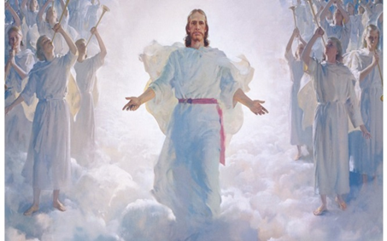
Advent – Preparing for Christ to come again
L-2
S-01
Notes:
Slide 1 Advent – Preparing for Christ to come again
Use this slide as a focussing strategy to introduce the lesson topic. Read the title together and invite students to share something they know about Christ’s second coming and how Christians can live in preparation for it.

Slide 2
Learning Outcomes
The students will:
1)
recognise that Advent is a time of preparing for Christ’s Second Coming
2)
explain how some of the Old Testament readings for Advent describe the fullness of God’s Kingdom or reign of God Te Tino Rangatiratanga
3)
explain how Christians can live in preparation for Christ’s Second Coming.
L-2
S-02
Click the borders to reveal text
Notes:
Slide 2 Learning Outcomes
Read through the Learning Intentions with the class and identify some ideas/questions that might be explored in the lesson.

Slide 3
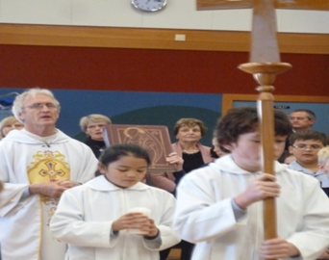
Advent is a time to recall the first coming of Jesus and to recognise how he comes now
What do you recall about the first coming of Jesus into the world?
What do you know about the ways Jesus is in our world now?
What do you know about when Jesus will come into the world again at his Second Coming?
X
L-2
S-03
Click the I-button to reveal information
Notes:
Slide 3 Advent is a time to recall the first coming of Jesus and to recognise how he comes now
Adapt Teaching and Learning Experience 1
Discuss with students the 3 themes of Advent –1) preparing for the historical event of the birth of Jesus, 2) preparing to meet the Christ in Liturgical celebrations now, 3) preparing to meet Christ at his second coming when he comes to bring about the fullness of the Kingdom of God.
Use the questions on the pop up to stimulate students’ thinking.

Slide 4
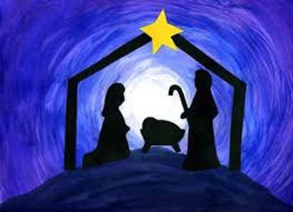
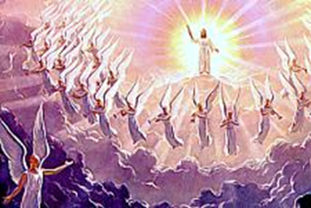
Advent reminds people that Christ’s first and second coming are linked
Christ’s first and second coming...
Jesus first came into the world to build God’s...
Christ’s second coming will...
Now the Church continues to help build God’s reign...
The Church waits in hope for Jesus to...
...are inseparably linked
...kingdom of justice, peace and love
...complete God’s kingdom that Jesus came to establish
...on earth through its loving service to others
...come again at the end of time and fulfil God’s kingdom
A) ...complete God’s kingdom that Jesus came to establish
B) ...are inseparably linked
C) ...come again at the end of time and fulfil God’s kingdom
D) …kingdom of justice, peace and love
E) ...on earth through its loving service to others
L-2
S-04
Click a sentence-end or an empty space to correctly connect the parts.
Notes:
Slide 4 Advent reminds people that Christ’s first and second coming are linked
Discuss each statement with students and let them suggest the correct statement from A to E to complete the sentence. Use the floaters to check. Students explain the connection between Christ’s first and second coming.
Answers 1) B, 2) D, 3) A, 4) E, 5) C Adapt Teaching and Learning Experience 1

Slide 5
The prophets of the Old Testament called the people to conversion and to prepare for the coming of the fullness of God’s Kingdom Te Tino Rangatiratanga
What do you know about the role Jesus played in establishing God’s kingdom and bringing it to its completion?
What part did the Old Testament prophets play in Jesus’ coming to establish God’s kingdom?
Write a question or an answer
Q1: _____________________________________________________________________________
A1: The Old Testament prophets preached to the people that Christ would come again to bring God’s kingdom that he started to completion, but as it was not known when this would happen, the people needed to stay alert, turn away from sin and be ready for Christ to come.
Q2: _____________________________________________________________________________
A2: The messages of the prophets that described God’s kingdom filled the people with hope that they could live in peace, harmony and forgiveness forever with God.
L-2
S-05A
Notes:
Slide 5A The prophets of the Old Testament called the people to conversion and to prepare for the coming of the fullness of God’s Kingdom Te Tino Rangatiratanga
Use the readings on the Teacher Resource, Teacher’s book p14 or on the Lesson home page, for class prayer during Advent and draw the students’ attention to how the prophets describe the fullness of God’s Kingdom after Christ’s Second Coming.
Adapt Teaching and Learning Experience 2
Continued on the next slide

Slide 6
The prophets of the Old Testament called the people to conversion and to prepare for the coming of the fullness of God’s Kingdom Te Tino Rangatiratanga
Write a question or an answer
Q3: Why did the prophets talk to the people about conversion and remind them to change their ways?
A3: _____________________________________________________________________________ _____________________________________________________________________________
Q4: Why do the Scripture readings in Advent include the readings from the Old Testament prophets?
A4: _____________________________________________________________________________ _____________________________________________________________________________
Q5: _____________________________________________________________________________
A5: Before God’s kingdom comes there will be a day of judgement when all people will be judged on how they lived on earth and only those who lived according to God’s law will enter God’s kingdom.
Q6: _____________________________________________________________________________
A6: Advent is the time set aside in the Church’s year for people to reflect on how they are living and put things right in their lives so they will be ready for Christ’s Second Coming and the enjoyment of being in God’s kingdom forever.
L-2
S-05B
Click on the worksheet button to go to the worksheet
Notes:
Slide 5B The prophets of the Old Testament called the people to conversion and to prepare for the coming of the fullness of God’s Kingdom Te Tino Rangatiratanga
Work through the Q&As on Slides 5A & 5B and record them on worksheets.
Use the readings on the Teacher Resource for class prayer during Advent and draw the students’ attention to how the prophets describe the fullness of God’s Kingdom after Christ’s Second Coming.
Adapt Teaching and Learning Experience 2

Slide 7
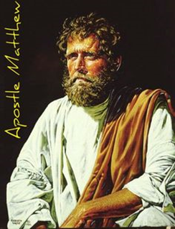
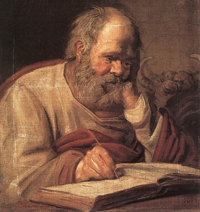
How the New Testament writers describe Christ’s Second Coming
St Matthew records Jesus’ words in his gospel
St Luke records Jesus’ words in his gospel
“The sun will be darkened and the moon will not give its light; the stars will fall from heaven and the power of heaven will be shaken. Then the sign of the Son of Man will appear In heaven and the tribes of the earth will mourn and they will see the Son of Man coming in the clouds of heaven with power and great glory. And he will send out his angels with a loud trumpet call and they will gather his elect from the four winds.”
“There will be signs in the sun, the moon and the stars and on the earth distress among nations confused by the roaring of the sea and the waves. People will faint from
fear and foreboding of what is coming upon the world, for the powers of heaven will be shaken. Then they will see the Son of Man coming in a cloud with power and great glory. Now when these things begin to take place, stand up and raise your heads because your redemption is drawing near.”
Matthew 24:29-31
Luke 21:25-28
L-2
S-06A
Click on the images to reveal text
Notes:
Slide 6A How the New Testament writers describe Christ’s Second Coming
Read what Matthew and Luke wrote in their gospels about Christ’s second coming.
Going on what these gospels tell us what the day of Christ’s second coming will be like. Discuss this in groups.

Slide 8
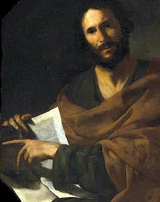
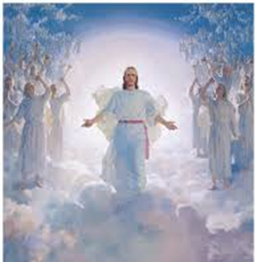
How the New Testament writers describe Christ’s Second Coming
St John writes in the Book of Revelation
St Luke writes in Acts at the end of the story of the Ascension
”Behold, he is coming with the clouds and every eye will see him, everyone who pierced him; and all tribes of the earth will wail on account of him. So it is to be. Amen.”
They said, “Men of Galilee, why do you stand looking up toward heaven? This Jesus, who has been taken up from you into heaven, will come in the same way as you saw him go into heaven.”
Revelation 1:7
Acts 1:11
Think about this statement
When Christ returns it will not be an isolated event, it will not be a secret event, but instead, it will be a loud and public event.
Click on the images to reveal text.
Click the worksheet button to go to the worksheet.
L-2
S-06B
Notes:
Slide 6B How the New Testament writers describe Christ’s Second Coming
Read what John wrote in the Book of Revelation and Luke’s description in the
Acts. Each student makes a statement to describe Christ’s second coming.
Respond to the statement below the images

Slide 9
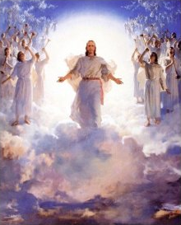
What people can do now to prepare for Christ’s Second Coming
Take time each day during Advent to recall Jesus’ first coming and how he is here with us now especially in our goodness to one another and when we celebrate liturgy at school or with the parish.
Imagine if you knew the day of Christ’s Second Coming is close – what would you do differently? Ask yourself - what ways can I say I have helped to bring about God’s kingdom of justice, peace and love?
Set aside some time for prayer – try to be still and silent, talk to God, listen to God and notice what comes to the surface in your mind. Wonder to yourself why this is on top of your thoughts?
Go for a walk and think about what sort of person you are growing into – ask yourself what you are proud of and what you would like to change – make a plan to do this and remember it will take time.
Click the pins on the right to reveal post-it notes.
L-2
S-07
Click the audio button to play ‘Watch Out! Watch Up!’
Click the audio button to stop ‘Watch out! Watch Up!’
Notes:
Slide 7 What people can do now to prepare for Christ’s Second Coming
Read the slide title and think about this idea. Then read post it note in pairs and think about how you can remind yourself about preparing for Christ’s second coming. Keep in mind some ideas to help you do this especially in Advent as this is the season the Church sets aside for people to focus on this.
Adapt Teaching and Learning Experience 5
Sing using the MP3 ‘Watch Out, Wake Up’

Slide 10
Check up
1)
The connection between Christ’s first and second coming is.
2)
Write a description or create an illustration of what you think Christ’s second coming will be like.
3)
Name some examples of what people can do to use Advent as a season for conversion and preparation for Jesus’ coming.
4)
What can young people of your age do to prepare for Christ’s second coming?
5)
Which activity do you think helped you to learn best in this lesson?
6)
Questions I would like to ask about the topics in this lesson are...
Click in each caption space to reveal text
Click on the worksheet button to go to the worksheet.
L-2
S-08
Notes:
Slide 8 Check Up
This formative assessment strategy will help teachers to identify how well students have achieved the Learning Intentions of the lesson.
Teachers can choose how they use the slide in their range of assessment options.
A worksheet of this slide is available for students in Years 5-8 to complete.
The last two items are feed forward for the teacher.
Recording the students’ responses to these items is recommended as it will enable teachers to adjust their learning strategies for future lessons and target the areas that need further attention.

Slide 11
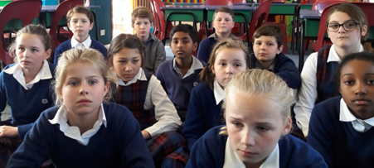
Time for Reflection
L-2
S-09
Click the audio button to stop reflective music
Click the audio button to play reflective music
Notes:
Slide 9 Time for Reflection
The MP3 is played to help create a reflective atmosphere and bring the young people to stillness and silence as the teacher invites them to reflect on how well they are living their life, what will happen at the end of time when Christ will come again as the Scripture tells and to use Advent to recognise any selfish attitudes and behaviours that they may need to turn away from.

Slide 12
Sharing our Learning about ADVENT with family whānau
Create a Power Point using the photographs of the dramatic presentations from Slide 7-12 and create a reflective liturgy to increase people’s awareness of how Jesus comes to people now through the words, images, music and symbols that are part of a liturgy. Use the power point as part of an Advent liturgy to share with your school. Include links to Christ’s first and second coming.
Imagine someone has asked you what the links are between Christ’s coming at Christmas as an historical event, how Christ comes into our lives now and Christ’s second coming at the end of time. Make a tryptic and use it to explain how these are all part of the same connection. Share your tryptic with people at home and at school and say how this connects to celebrating the season of Advent.
Set up a small group discussion to share how people experience Christ’s coming now through celebrating the liturgy. Invite people to share experiences of liturgies where they have been aware of Christ’s presence in the celebration in different ways. Remind people that this is how Christ comes into the world every day. Retell the story of Christ’s first and second coming.
L-2
S-10A
Notes:
Slide 10A Sharing our Learning about ADVENT with family whānau
This slide provides some choices for children to show and share what they have learned. Examples could be photographed as evidence of children’s learning.
You may like to put a copy of the Sharing our Learning page in children’s RE Learning Journals. You could talk through the choices using the slide and let children make their choice from their own copy.
Children could work on their choice at school and/or at home and you may like to set a day for sharing. Please let parents and whānau know what you expect them to do with this.
The slide is focussed on Year 8 Achievement Objective which is covered in Lessons 1-2
ADVENT Year 8 AO Children will be able to: develop an understanding of Christ’s coming as a real event in history, as Christ’s coming now in the Church through the liturgy to help people grow in his likeness and that Christ will come again in the Second Coming.
Continued on the next slide

Slide 13
Sharing our Learning about ADVENT with family whānau
Make a publicity flyer to draw people’s attention to the purpose of the season of Advent. Point out the importance of this time for conversion – to recognise things in your life that need to change. Suggest some ideas to help people change any negative attitudes they have. Include images of the symbols for Advent on the flyer and suggest people use them to keep them focussed on using the 4 weeks to prepare well for the coming of Christ. Distribute the flyers to people who can use them.
Create art works of Christ’s second coming to display in the school or church foyer. Include the Scripture references: Matthew 24:29-31, Luke 21:25-28, Revelation 1:7, Acts 1:11
Compose a rap to share about using the season of Advent to grow more like Jesus – suggestions: reflecting on what needs ‘conversion’ – turning away from sin in your life, responding positively to requests for help at home and at school, opening your heart to Jesus so your friendship with him grows as Christmas approaches, taking part in liturgies that mark the season.
Make up your own way of showing and sharing what you have learned and decide with whom you would like to share it.
L-2
S-10B
Click on the worksheet button to go to the worksheet
Notes:
Slide 10B Sharing our Learning about ADVENT with family whanau
This slide provides some choices for children to show and share what they have learned. Examples could be photographed as evidence of children’s learning.
You may like to put a copy of the Sharing our Learning page in children’s RE Learning Journals. You could talk through the choices using the slide and let children make their choice from their own copy.
Children could work on their choice at school and/or at home and you may like to set a day for sharing. Please let parents and whānau know what you expect them to do with this.
The slide is focussed on Year 8 Achievement Objective which is covered in Lessons 1-2
Year 8 AO Children will be able to: develop an understanding of Christ’s coming as a real event in history, as Christ’s coming now in the Church through the liturgy to help people grow in his likeness and that Christ will come again in the Second Coming.

Slide 14
The prophets of the Old Testament called the people to conversion and to prepare for the coming of the fullness of God’s Kingdom Te Tino Rangatiratanga
Name____________________
Date__________
Write a question or an answer
Write a question or an answer
Q1: ____________________________________________________________________
A1: The Old Testament prophets preached to the people that Christ would come again to bring God’s kingdom that he started to completion, but as it was not known when this would happen, the people needed to stay alert, turn away from sin and be ready for Christ to come.
Q2: ___________________________________________________________________________________________
A2: The messages of the prophets that described God’s kingdom filled the people with hope that they could live in peace, harmony and forgiveness forever with God.
Q3: Why did the prophets talk to the people about conversion and remind them to change their ways?
A3: _____________________________________________________________________________________________ _____________________________________________________________________________________________
Q4: Why do the Scripture readings in Advent include the readings from the Old Testament prophets?
A4: _____________________________________________________________________________________________ _____________________________________________________________________________________________
Q5: _____________________________________________________________________________________________
A5: Before God’s kingdom comes there will be a day of judgement, when all people will be judged on how they lived on earth and only those who lived according to God’s law will enter God’s kingdom.
Q6: _____________________________________________________________________________________________
A6: Advent is the time set aside in the Church’s year for people to reflect on how they are living and put things right in their lives so they will be ready for Christ’s Second Coming and the enjoyment of being in God’s kingdom forever.
L-2
S-05
Worksheet
Click on the worksheet button to go to the worksheet
Click the up arrow to return to the lesson
Notes:
Slide 5 The prophets of the Old Testament called the people to conversion and to prepare for the coming of the fullness of God’s Kingdom Te Tino Rangatiratanga WORKSHEET
This worksheet relates to slide 5A & B

Slide 15
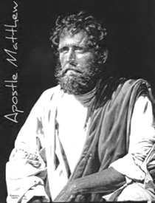
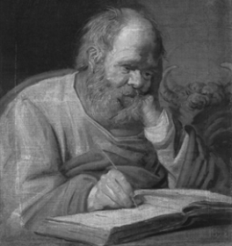
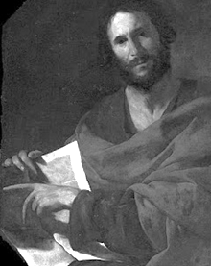
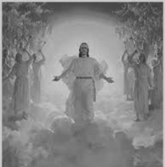
How the New Testament writers describe Christ’s Second Coming
Name__________________
Date__________
St Matthew records Jesus’ words in his gospel
“The sun will be darkened and the moon will not give its light; the stars will fall from heaven and the power of heaven will be shaken. Then the sign of the Son of Man will appear In heaven and the tribes of the earth will mourn and they will see the Son of Man coming in the clouds of heaven with power and great glory. And he will send out his angels with a loud trumpet call and they will gather his elect from the four winds.”
St Luke records Jesus’ words
in his gospel
St John writes in the Book of Revelation
“There will be signs in the sun, the moon and the stars and on the earth distress among nations confused by the roaring of the sea and the waves. People will faint from fear and foreboding of what is coming upon the world, for the powers of heaven will be shaken. Then they will see the Son of Man coming in a cloud with power and great glory. Now when these things will begin to take place, stand up and raise your heads because your redemption is drawing near.”
”Behold, he is coming with the clouds and every eye will see him, everyone who pierced him; and all tribes of the earth will wail on account of him. So it is to be. Amen.”
Matthew 24:29-31
Revelation 1:7
St Luke writes in Acts at the end of the story of the Ascension
Luke 21:25-28
They said, “Men of Galilee, why do you stand looking up toward heaven? This Jesus, who has been taken up from you into heaven, will come in the same way as you saw him go into heaven.”
Read each description from the Scripture writers of the Christ’s Second Coming then:
Name the ideas about the Second Coming that are common to all of the writers?
Describe in your own words what you think Christ’s Second Coming will be like?
Reflect on Christ’s Second Coming during Advent and record this in an art work.
Acts 1:11
L-2
S-06
Worksheet
Click the up arrow to return to the lesson
Notes:
Slide 6 How the New Testament writers describe Christ’s Second Coming WORKSHEET
This worksheet relates to slide 6A & B

Slide 16
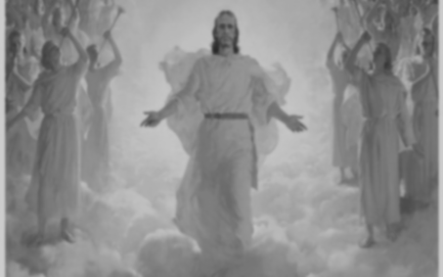
Check up
Name__________________
Date__________
1)
The connection between Christ’s first and second coming is...
2)
Write a description or create an illustration of what you think Christ’s second coming will be like
3)
Write a description or create an illustration of what you think Christ’s second coming will be like
4)
What can young people of your age do to prepare for Christ’s second coming?
5)
Which activity do you think helped you to learn best in this lesson?
6)
Questions I would like to ask about the topics in this lesson are...
L-2
S-08
Worksheet
Click the up arrow to return to the lesson
Notes:
Slide 8 Check up WORKSHEET
This worksheet relates to slide 8

Slide 17
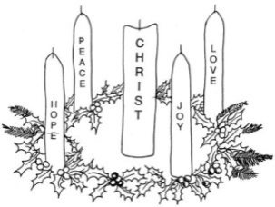
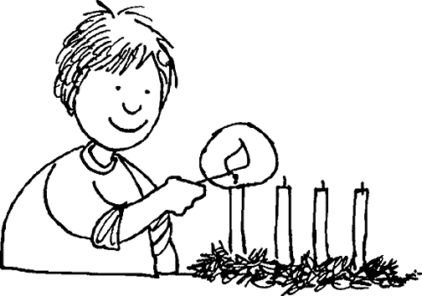
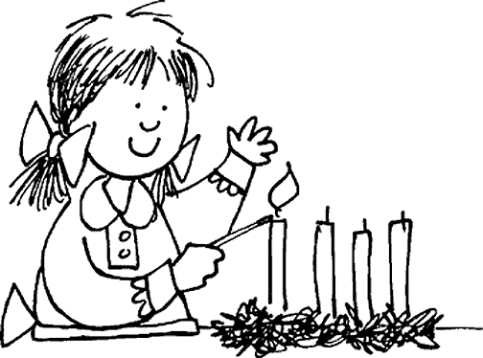
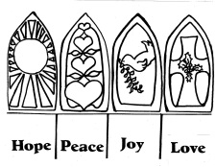
Sharing our Learning about ADVENT with family whānau
Create a Power Point using the photographs of the dramatic presentations from Slide 7-12 and create a reflective liturgy to increase people’s awareness of how Jesus comes to people now through the words, images, music and symbols that are part of a liturgy. Use the power point as part of an Advent liturgy to share with your school. Include links to Christ’s first and second coming.
Imagine someone has asked you what the links are between Christ’s coming at Christmas as an historical event, how Christ comes into our lives now and Christ’s second coming at the end of time. Make a tryptic and use it to explain how these are all part of the same connection. Share your tryptic with people at home and at school and say how this connects to celebrating the season of Advent.
Set up a small group discussion to share how people experience Christ’s coming now through celebrating the liturgy. Invite people to share experiences of liturgies where they have been aware of Christ’s presence in the celebration in different ways. Remind people that this is how Christ comes into the world every day. Retell the story of Christ’s first and second coming.
L-2
S-10A
Worksheet
Notes:
Slide 10A Sharing our Learning about ADVENT with family whānau WORKSHEET
This worksheet relates to slide 10A

Slide 18
Sharing our Learning about ADVENT with family whānau
Make a publicity flyer to draw people’s attention to the purpose of the season of Advent. Point out the importance of this time for conversion – to recognise things in your life that needs to change. Suggest some ideas to help people change any negative attitudes they have. Include images of the symbols for Advent on the flyer and suggest people use them to keep them focussed on using the 4 weeks to prepare well for the coming of Christ. Distribute the flyers to people who can use them.
Create art works of Christ’s second coming to display in the school or church foyer. Include the Scripture references: Matthew 24:29-31, Luke 21:25-28, Revelation 1:7, Acts 1:11
Compose a rap to share about using the season of Advent to grow more like Jesus – suggestions: reflecting on what needs ‘conversion’ – turning away from sin in your life, responding positively to requests for help at home and at school, opening your heart to Jesus so your friendship with him grows as Christmas approaches, taking part in liturgies that mark the season.
Make up your own way of showing and sharing what you have learned and decide who you would like to share it with.
L-2
S-10B
Worksheet
Click on the worksheet button to go to the worksheet
Notes:
Slide 10B Sharing our Learning about ADVENT with family whānau WORKSHEET
This worksheet relates to slide 10B

