Slide 1
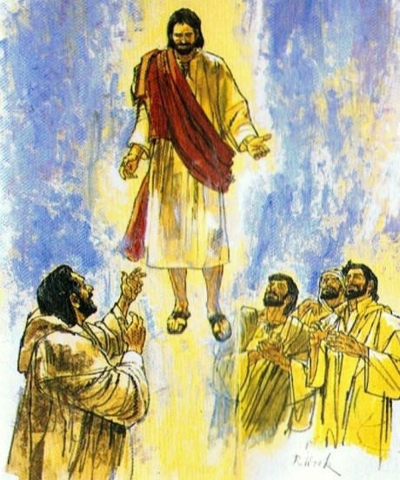
Jesus returns to his Father in Heaven
R-1
S-01
Notes:
Use this slide as a focussing strategy to introduce the resource topic. Read the title together and invite children to share something they know about when Jesus returned to God his Father in heaven.
Retell the Ascension story from the Bible during class prayer this week.

Slide 2
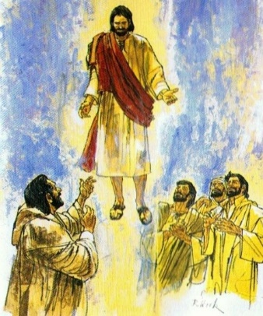
Learning Intentions
The children will…
1)
recognise that Ascension is the name of the feast day which celebrates the return of Jesus to heaven
2)
recognise the story of Jesus’ return to his Father in heaven
R-1
S-02
Click the boxes to reveal text.
Notes:
Read through the Learning Intentions with the class and identify some ideas/questions that might be explored in the resource.

Slide 3
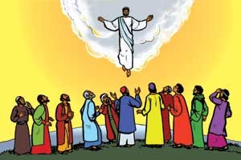
What does the word Ascension mean?
The word ascension means ‘going up’.
Jesus went up to heaven to be at home with God his Father.
We call this Ascension Day because Jesus went up into the clouds.
R-1
S-03
Click the arrows to reveal text.
Notes:
Read the revealed text and make a caption for Ascension and add it to the wall glossary.
Adapt Teaching and Learning Experiences 1,2, 3 & 4.
Can you think of other things that go up to heaven?

Slide 4
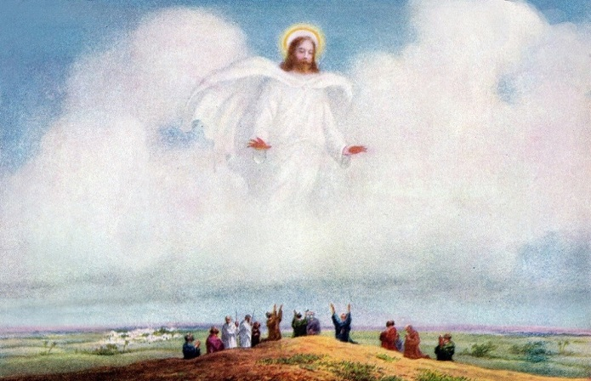
Jesus returns to his Father in Heaven
How do you think Jesus’ friends felt when Jesus disappeared into the clouds?
What are you curious about in this story?
What do you think might have happened when Jesus arrived in heaven?
Show the children the Bible and read the Ascension story to the class.
R-1
S-04
Click the video icon for a video.
Notes:
Explain to children that Ascension Day is another important feast that Christians celebrate in the Liturgical Year. Note where it comes and highlight it on the class Liturgical Calendar and what season it comes at the end of.
Watch the clip: https://www.youtube.com/watch?v=RD0LNtc1UE4
Ascension of Jesus Christ 1:30 minutes
Watch the clip without the sound and use simple language to tell the story. Discuss the clip and answer the questions. Watch the clip again with the sound and show children the story in the Bible.
Adapt Teaching and Learning Experience 5

Slide 5
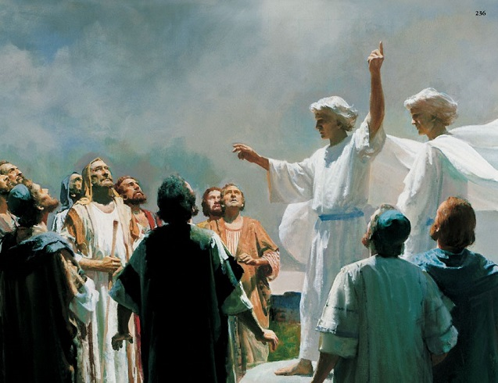
Thinking about the Ascension story
R-1
S-05
Click the speech bubbles to record ideas.
Notes:
Teacher types what the apostles said and what the angels said in the word balloons
When Jesus went up to heaven
What did the apostles say?
What did the angels say?
What did God say?
What would you have said to Jesus if you had been there?

Slide 6
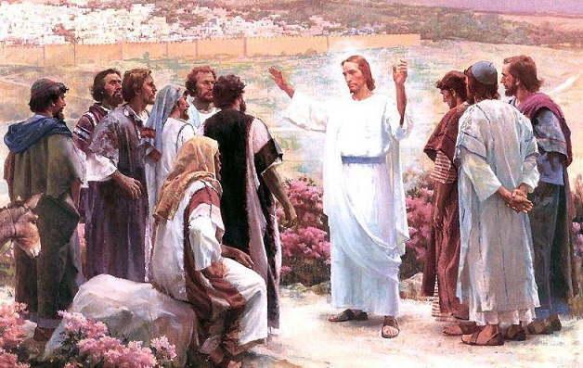
What message did Jesus give his apostles before he ascended into heaven?
We cannot see Jesus anymore but we know he still shares his life and love with us.
Jesus told his apostles to carry on his work teaching people about God.
Next time you are outside look up at the clouds and remember the story of Jesus’ Ascension.
Jesus told them to share their love with people just as he had done.
We celebrate the day Jesus ascended to heaven to be with his Father.
R-1
S-06
Click the pins on the right to reveal post-it notes.
Notes:
Read each Post it Note together.
When there are clouds in the sky take the children outside to remember that Jesus went up into the clouds when he went back to heaven to be with God his Father - that is why we imagine heaven is above the clouds in the sky.

Slide 7
Check Up
1)
Tell a partner the story about Jesus returning to his Father in heaven.
2)
Share what you think God and Jesus said to each other when Jesus ascended to heaven.
3)
Draw a picture of the Ascension story and share it with someone at home.
4)
Which activity do you think helped you to learn best in this resource?
5)
Questions I would like to ask about the topics in this resource are…
R-1
S-07
Click the boxes to reveal text.
Notes:
This formative assessment strategy will help teachers to identify how well the children have achieved the Learning Intentions of the resource.
Teachers can choose how they use the slide in their range of assessment options.
A worksheet of this slide is available for children in Years 5-8 to complete.
The last two items are feed forward for the teacher.
Recording the children’s responses to these items is recommended as it will enable teachers to adjust their learning strategies for future resources and target the areas that need further attention.

Slide 8
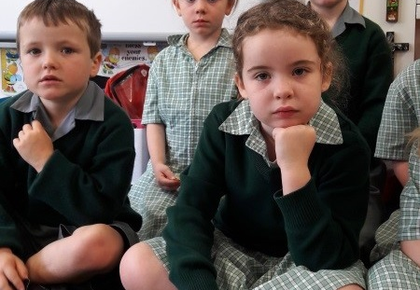
Time for Reflection
R-1
S-08
Click the audio button to stop reflective music
Click the audio button to play reflective music
Notes:
The MP3 is played to help create a reflective atmosphere and bring the children to stillness and silence as the teacher invites them to remember what if feels like when they come home after being away a long time. Imagine how Jesus felt when he returned to heaven and saw God his Father.

