Slide 1
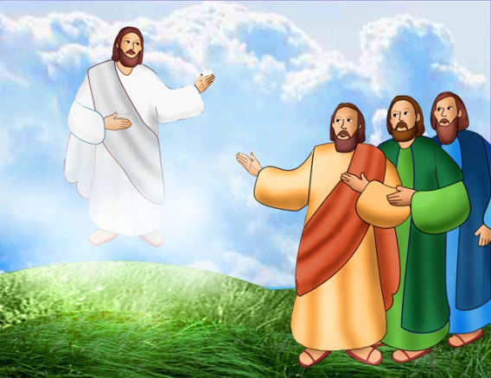
The Church Celebrates Jesus’ Return to Heaven
R-1
S-01
Notes:
Use this slide as a focussing strategy to introduce the resource topic. Read the title together and invite children to share something they know about the Ascension when Jesus returned to God his Father in heaven.
Read the Ascension story in class prayer this week.

Slide 2
Learning Intentions
The children will:
1)
identify a picture of Jesus in glory
2)
demonstrate a celebratory action when singing Psalm 47
R-1
S-02
Click the borders to reveal text
Notes:
Read through the Learning Intentions with the class and identify some ideas/questions that might be explored in the resource.

Slide 3
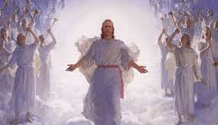
Jesus ascended in glory to his home in heaven
Why does Jesus call heaven home?
Who is waiting for Jesus in heaven?
Can you imagine what ascending in glory to heaven looks like?
Why didn’t Jesus stay on earth with his friends?
R-1
S-03
Click the pins on the right to reveal post-it notes.
Notes:
Revise with children that Ascension Day is another important feast in the Liturgical Year.
Note where it comes and highlight it on the class Liturgical Calendar and what season it comes at the end of.
Responses to questions
We cannot imagine how wonderful and beautiful the glory of heaven is. There could be beautiful music, angels and all the people we love there to welcome us as. Jesus told us heaven is much more wonderful and beautiful than anything on earth and his is getting it ready for us to enjoy.
Jesus called heaven home because God his Father and Mary his mother live there. Heaven is his home because that’s where he belongs and when we die it will be our home too.
All of Jesus’ family and friends were waiting for Jesus in heaven and his work on earth was finished.
Jesus didn’t stay on earth with his friends because he had to go back to heaven so he could be with God and send his Holy Spirit down to live forever in good people on earth.

Slide 4
Jesus’ work on earth was done so he could return to heaven
Jesus taught the people about God his Father and how much God loves all people.
Jesus showed people how to be good friends and help each other.
Jesus healed people with actions and kind words.
Jesus told people that saying sorry and starting again is very important.
Jesus encouraged people to live like God wants them to.
Tell the story of the Ascension around the class circle.
Can you say what work Jesus did while he was on earth?
Who carries on Jesus’ work now?
R-1
S-04
Click the handle to move the blind down. Click the video button to play the video
Notes:
Follow the directions on the slide.
Adapt Teaching and Learning Experience 2.
Read and discuss the blind reveals about what Jesus did while he was on earth and answer the last question. Give examples of how children your age carry on the work of Jesus.
Watch the clip
https://www.youtube.com/watch?v=4qBbr1D-OlU
Beloved Master Jesus’ Ascension 2:56 minutes

Slide 5
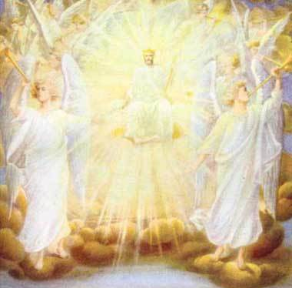
Why is Ascension Day such a very happy day?
Jesus returned to be with God and all the saints and angels.
How can you show that you are happy and full of joy?
Psalm 47
[Sung to the tune of Frère Jacques]
All you peoples x 2
Clap your hands x 2
Shout to God with loud songs x 2
Songs of joy x 2
All you peoples x 2
Sing your praise x 2
For the Lord is awesome x 2
King of all x 2
Press the green button to advance through the lines.
R-1
S-05
Click the audio button to stop ‘Psalm 47’
Click the audio button to play ‘Psalm 47’
Notes:
Children respond to the question in the slide title.
Sing using the MP3 ‘Psalm 47’ – words on slide.
Adapt Teaching and Learning Experiences 4 & 5.

Slide 6
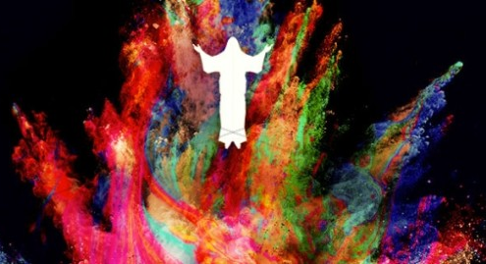
Prepare an Ascension Day Procession
You could:
Make an Ascension Day banner to lead the procession
Blow up balloons to carry and write WELCOME HOME JESUS on them
Have a band and dance and sing celebration songs like Psalm 47
Dress up as angels to welcome Jesus home - have a throne for Jesus to sit on
Invite others to join in and share the celebration
Take some photos to share with your family whānau
Add some ideas of your own.
R-1
S-06
Notes:
Adapt Teaching and Learning Experience 7.
Use ideas suggested on the slide.

Slide 7
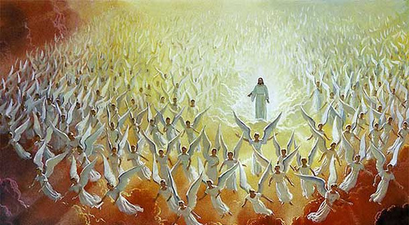
What do you think Jesus in glory in heaven looks like?
Create your own art works and display them in an
Ascension Exhibition
to share with your school and your parish.
R-1
S-07
Notes:
Use a variety of media and photograph the children’s art works to use as a teaching resource for next year.

Slide 8
Check Up
1)
Tell a friend the story of the Ascension of Jesus into heaven.
2)
Give 2 reasons why Jesus went back to heaven?
3)
Demonstrate something you can do to celebrate Ascension Day.
4)
Which activity do you think helped you to learn best in this resource?
5)
Questions I would like to ask about the topics in this resource are …
R-1
S-08
Click the borders to reveal text
Notes:
This formative assessment strategy will help teachers to identify how well children have achieved the Learning Intentions of the lesson.
Teachers can choose how they use the slide in their range of assessment options.
A worksheet of this slide is available for children in Years 5-8 to complete.
The last two items are feed forward for the teacher.
Recording the children’s responses to these items is recommended as it will enable teachers to adjust their learning strategies for future lessons and target the areas that need further attention.

Slide 9
Time for Reflection
R-1
S-09
Click the audio button to stop reflective music
Click the audio button to play reflective music
Notes:
The MP3 is played to help create a reflective atmosphere and bring the children to stillness and silence as the teacher invites them to imagine what it was like in heaven when Jesus returned there. Whisper a prayer to Jesus to tell him how good it is to know him and learn about him and be his friend.

