Slide 1
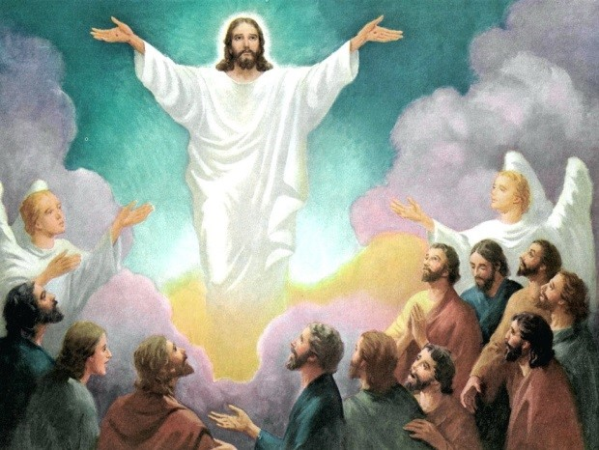
Telling the Good News Te Rongo Pai
R-1
S-01
Notes:
Use this slide as a focussing strategy to introduce the resource topic. Read the title together and invite children to share something they know about the message Jesus gave to the apostles as he ascended into heaven to be with his Father. Use the Ascension story in class prayer this week and ask children to talk with their families about examples of good and bad news in their families, in Aotearoa and in the world at present.

Slide 2
Learning Intentions
The children will…
1)
identify Ascension as the time when Jesus sent his disciples to bring the Good News of the Gospel to all creation
2)
give examples of ‘good news’ for people
3)
give examples of ‘good news’ for the planet.
R-1
S-02
Click the boxes to reveal text.
Notes:
Read through the Learning Intentions with the class and identify some ideas/questions that might be explored in the resource.

Slide 3
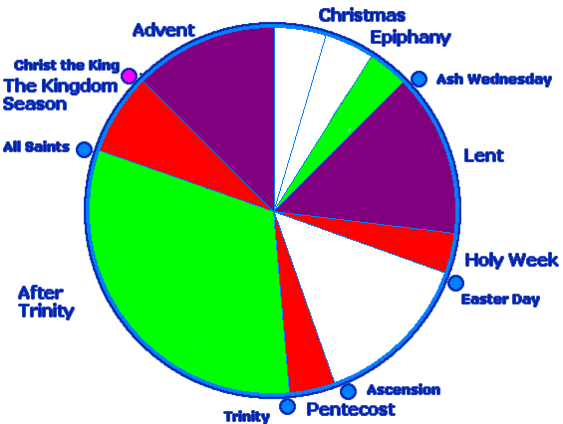
The Feast of the Ascension in the Liturgical Year
Complete the sentences
Ascension day is a major feast that is celebrated on the 7th…
The Ascension event comes one week before...
Jesus had to return to heaven so that…
The story of Jesus returning to his Father can be found in the Bible in…
Just before he ascended into heaven Jesus told his disciples to…
R-1
S-03
Click the worksheet icon to open worksheet.
Notes:
Look closely at the feasts and seasons in the Liturgical Year and say something about each one. Complete the worksheet – refer to responses below. Add to RE Learning Journals for future reference.
1) The 7th Sunday of Easter.
2) Pentecost.
3) He could send his Spirit to be present in the world with his followers.
4) Acts 1:6-11 and in Mark 16:15-20.
5) Go out into the world and bring the Good News to all creation.

Slide 4
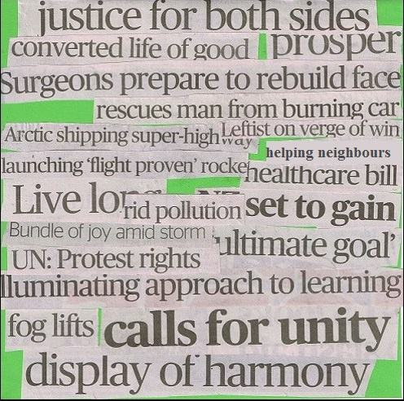
What is Good News?
Read the good news headlines choose one and explain how it is good news and in what way it is good news for people and creation.
Is ‘good’ news always good for everyone?
Share examples and explain.
Is good news just about getting more?
Share examples of good news for children of your age today in Aotearoa New Zealand.
X
R-1
S-04
Click the ‘i-button’ to reveal information.
Notes:
Explain that when we talk about ‘good news’ we mean anything that helps people to live with love, care, and forgiveness as Jesus lived. Good news spreads ‘good’ positive attitudes and actions that continue goodness remembering that all goodness and love comes from God. God shares love and goodness with people so they can share it with others ‘in all nations’.
Take time to read the headlines on the image and discuss their meaning and how they are ‘good news’. Work through the pop up items to increase children’s understanding about what is good news.

Slide 5
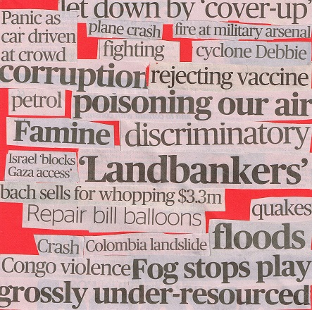
What is Bad News?
Is bad news for people bad news for the planet also? Share examples and explain.
What are the common outcomes of bad news for people?
What are the common factors in bad news for people?
Share bad news headlines, choose one and explain why and for whom it is bad.
Could bad news ever be good for some people?
Reset
R-1
S-05
Click the ‘cards’ to move through, click ‘reset’ to start over.
Notes:
Follow the directions on the flip cards and use them to deepen understanding of the causes and effects of bad news.
Ask children what causes ‘bad news’.
What can children of your age do when bad things happen?
What would Jesus want you to do when you hear bad news?

Slide 6
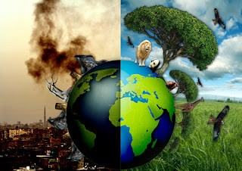
Good and bad news for the planet
In groups list the top 5 pieces of good news and the top 5 pieces of bad news for the planet
R-1
S-06
Click the worksheet icon to open worksheet.
Notes:
Adapt Teaching and Learning Experience 4.
Children complete worksheet and add it to RE Learning Journals.
Children share their lists and select best examples of both.
Children decide on how they could present their learning as the ‘Good News’ Jesus commanded, not just to his apostles but to all his followers including children of their age, to proclaim to the whole world and to all of creation.
Children research what Pope Francis says in ‘Laudato Si’ about care of the planet and include that in their presentation.

Slide 7
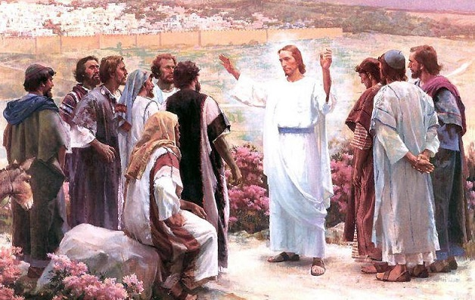
The last message Jesus gave his disciples while he was on earth
1
Jesus prepared his disciples to go and
We are the disciples of Jesus who
It is through the power of the Holy Spirit
The Good News brings people hope
The Good News for creation means taking
2
3
4
5
a)
during hard times in their lives.
b)
care of every part of it.
c)
share his message of love with the world.
d)
that people bring the Good News to others today.
e)
have to spread the Good News with all creation today.
R-1
S-07
Click buttons 1-5 to complete the sentences.
Click the video icon for a video and the worksheet icon to open worksheet.
Notes:
Complete worksheet by reading the statements and drawing lines to match them.
Draw Jesus speaking to his disciples for the last time and write what Jesus is saying to them. Check the statement match using the floater on the slide.
Answers 1-c, 2-e, 3-d, 4- a, 5- b
Adapt Teaching and Learning Experience 3.
https://www.youtube.com/watch?v=cdyxHQi1-Kw
The Great Commission 47 seconds

Slide 8

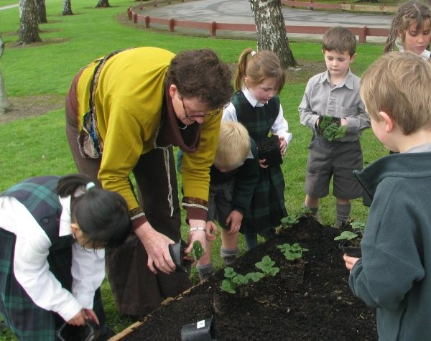

Caring for creation is spreading the Good News Te Rongo Pai
Why do you think Jesus said the ‘whole of creation’?
What do you think he was meaning?
Take care of God’s creation. But above all take care of people in need.
-Pope Francis
All creatures are to be respected. All must be cherished with love and respect. For all of us as living creatures are dependent on one another.
-Pope Francis
We are called to care for creation not only as responsible citizens, but also as followers of Jesus.
-Pope Francis
We must protect creation for it is a gift God has given us. It is God’s present to us. We are the guardians of creation.
-Pope Francis
R-1
S-08
Click the pins on the right to reveal post-it notes.
Notes:
Read and respond to each Post it Note.
1) Jesus wants us to think of creation as God sees it – everything is interconnected. Therefore people need to think about how they treat not only people but the earth and all living things.
Read Pope Francis’ words on each Post it Note, think about what they mean, share your ideas and give examples to illustrate them.
What group does Pope Frances want people to care for first – give a reason for this.
How can children of your age do this?
Adapt Teaching and Learning Experience 5.

Slide 9
Check Up
1)
What were Jesus’ last words to his disciples and what did he want them to do?
2)
How do you carry out Jesus’ last words as one of his disciples today?
3)
Name 3 pieces of good news for people.
4)
Name 3 actions that people of your age can do that are good news for the planet, the earth our home.
5)
Share 2 examples about how you share the good news.
6)
Which activity do you think helped you to learn best in this resource?
7)
Questions I would like to ask about the topics in this resource are…
R-1
S-09
Click the boxes to reveal text.
Notes:
This formative assessment strategy will help teachers to identify how well the children have achieved the Learning Intentions of the resource.
Teachers can choose how they use the slide in their range of assessment options.
A worksheet of this slide is available for children in Years 5-8 to complete.
The last two items are feed forward for the teacher.
Recording the children’s responses to these items is recommended as it will enable teachers to adjust their learning strategies for future resources and target the areas that need further attention.

Slide 10

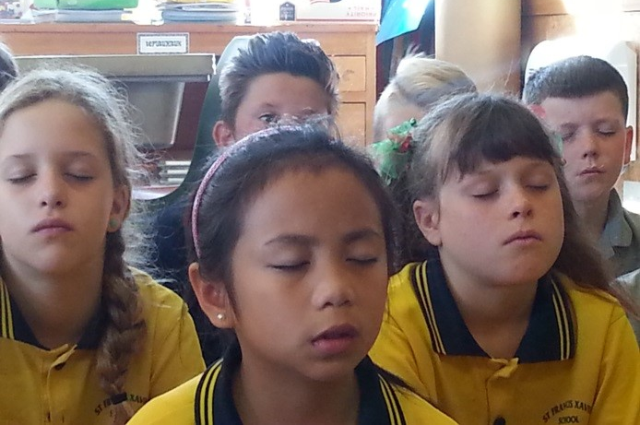


Time for Reflection
R-1
S-10
Click the audio button to stop reflective music
Click the audio button to play reflective music
Notes:
The MP3 is played to help create a reflective atmosphere and bring the children to stillness and silence as the teacher invites them to reflect on how they are putting Jesus’ last command to share the ‘good news’ into action at home with their families and at school in their class and community. Talk to Jesus about this in your heart.

Slide 11
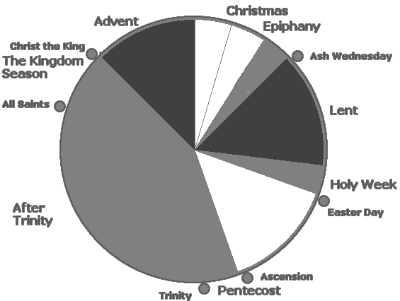
The Feast of the Ascension in the Liturgical Year
Name___________________________ Date_______________
Complete the sentences
Ascension day is a major feast that is celebrated on the 7th…
______________________________________
The Ascension event comes one week before...
______________________________________
Jesus had to return to heaven so that…
______________________________________
The story of Jesus returning to his Father can be found in the Bible in…
______________________________________
Just before he ascended into heaven Jesus told his disciples to…
______________________________________
R-1
S-03
Worksheet
Click the up arrow to return to the lesson
Notes:
1) The 7th Sunday of Easter.
2) Pentecost.
3) He could send his Spirit to be present in the world with his followers.
4) Acts 1:6-11 and in Mark 16:15-20.
5) Go out into the world and bring the Good News to all creation.

Slide 12
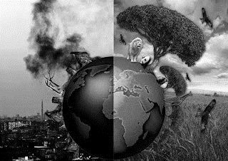
Good and bad news for the planet
Name___________________________ Date_______________
Good news for the planet | Bad news for the planet
1) 2) 3) 4) 5) | 1) 2) 3) 4) 5)
R-1
S-06
Worksheet
Click the up arrow to return to the lesson

Slide 13
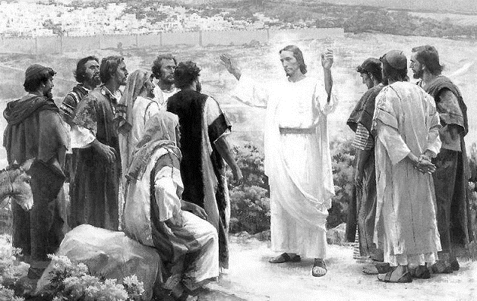
The last message Jesus gave his disciples while he was on earth
Name___________________________ Date_______________
1) Jesus prepared his disciples to go and | during hard times in their lives.
2) We are the disciples of Jesus who | care of every part of it.
3) It is through the power of the Holy Spirit | share his message of love with the world.
4) The Good News brings people hope | that people bring the Good News to others today.
5) The Good News for creation means taking | have to spread the Good News with all creation today.
In this frame draw Jesus speaking to his disciples for the last time.
R-1
S-07
Worksheet
Click the up arrow to return to the lesson
Notes:
Answers 1-3, 2-5, 3-4, 4- 1, 5- 2

