Slide 1
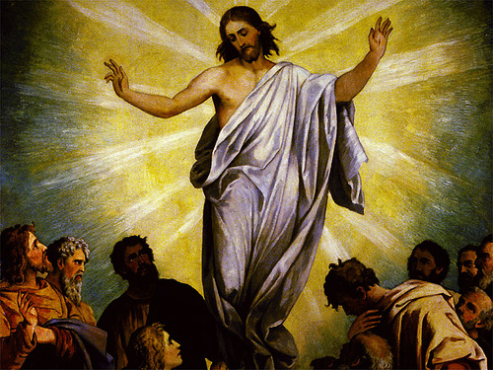
The Feast of the Ascension
R-1
S-01

Slide 2
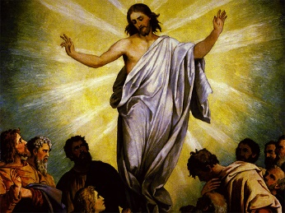
Learning Intentions
The children will:
1)
recognise that the Feast of the Ascension celebrates Jesus’ return to Heaven in glory
2)
identify that the Ascension shows Jesus is Lord and God of all the universe and is with people for all time
R-1
S-02
Click in each caption space to reveal text
Notes:
Read through the Learning Intentions with the class and identify some ideas/questions that might be explored in the resource.

Slide 3
What colours are used on celebration feast days in the Church?
What 2 colours can be used as celebration colours for feasts and seasons?
Name the 2 celebration seasons in the Church’s Year.
Name the feast that celebrates Jesus returning to his Father in heaven.
Explain where the feast fits on the Liturgical Calendar.
Why is the Ascension such a joyful feast?
X
R-1
S-03
Click the I-button to reveal information
Notes:
Adapt Teaching and Learning Experience 1
Remind children that the Ascension is celebrated in Aotearoa New Zealand on the 7th Sunday of Easter.

Slide 4
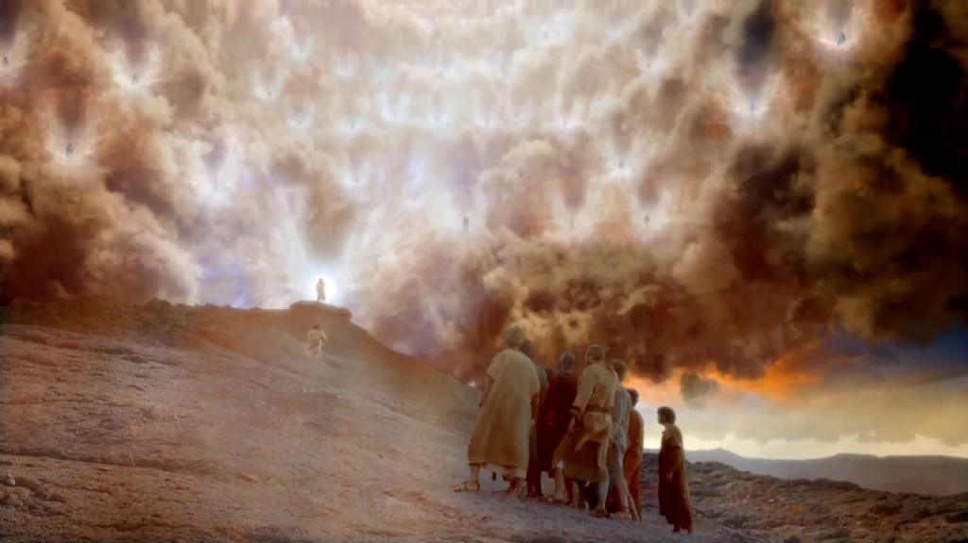
Share what you recall about the feast of the Ascension
What prayer do we say at Mass that mentions Jesus ascended into heaven?
What does Jesus’ Ascension mean for us?
Why does the feast of the Ascension celebrate Jesus leaving his home and friends?
Why did Jesus have to ascend to heaven?
Read Acts 1:1-11
R-1
S-04
Click the pins on the right to reveal post-it notes.
Notes:
Adapt Teaching and Learning Experience 2
Acts 1:1-11 is the first reading during the Mass on Ascension day.
Post it responses
In the Apostles Creed we pray – Jesus ascended into Heaven and is seated at the right hand of the Father
While Jesus was on earth he was present like all humans in the time and place he was living in. After the Ascension he became the present to all of heaven and earth.
Jesus had to physically leave the earth so he could enter the glory of heaven and go to be with God. It also meant he would send the Holy Spirit into the world.
By his Ascension Jesus made it possible for all good people to enter into God’s glory forever when they die.

Slide 5
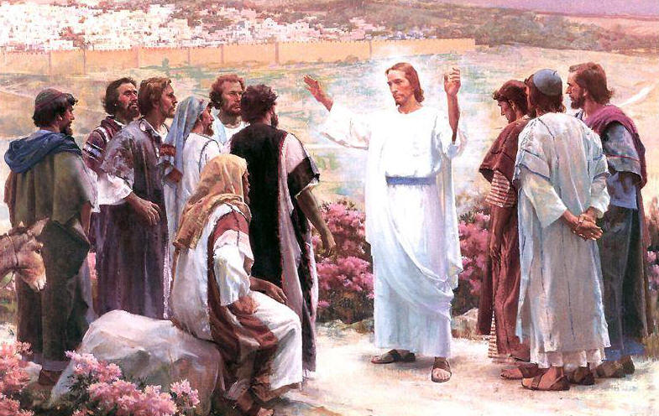
Jesus gave a parting message to his followers
Read Matthew 28:16-20 - this is the gospel that is read on Ascension day.
Listen for Jesus’ parting message to his followers.
Reflect on it as you hear his words, whisper it to yourself and hold it in your heart.
R-1
S-05
Click the video button to play a video
Notes:
Watch the clip Risen - Ascension scene 2:20 minutes
https://www.youtube.com/watch?v=cF2lK-MAicY

Slide 6
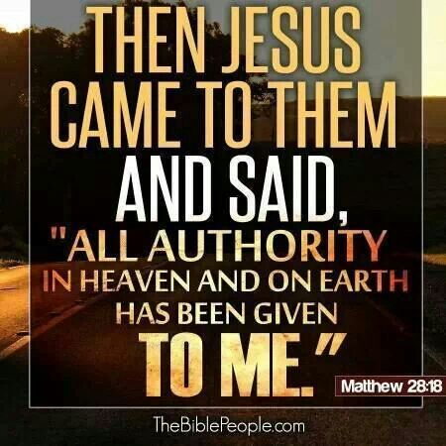
What happened when Jesus returned to God his Father in heaven?
Imagine what this scene will look like and create an art work to share in an Ascension Art Exhibition – make a power point of the artworks to share with your school and parish on Ascension Day.
Christians celebrate the joy and hope of this promise together at Eucharist on the Feast of the Ascension.
All believers in Jesus may enter into the glory of heaven and live in God’s loving presence at the end of their lives on earth.
All people who believe in Jesus can share in what has happened to Jesus.
When Jesus lived on earth he was in one country – Israel. Now he is Lord of all heaven and earth he is present everywhere.
Jesus is Lord and God - the ruler of the whole universe.
Because Jesus is God’s Son, he has inherited all power and authority Mana in heaven and on earth from God.
Sing ‘Praise God with Trumpets’
R-1
S-06
Click the audio button to stop ‘Praise God with Trumpets’
Click top card to discard it.
Click the audio button to play ‘Praise God with Trumpets’
Notes:
Sing using the MP3 ‘Praise God with Trumpets’ .

Slide 7
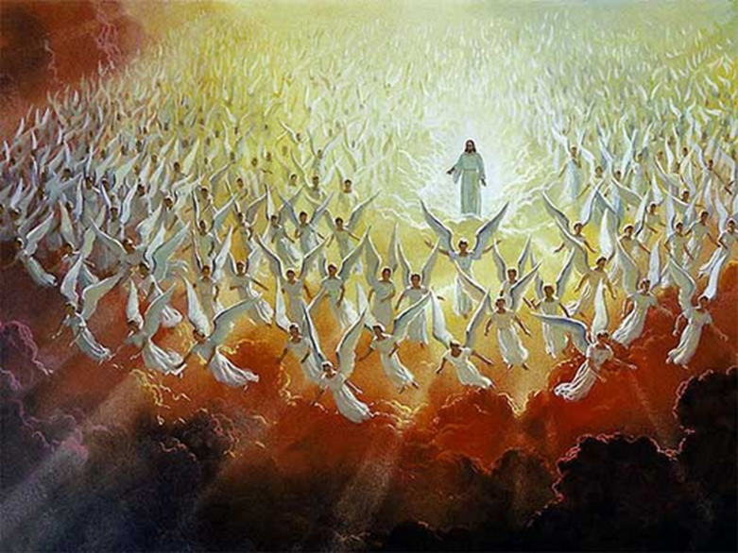
Jesus returned to heaven to prepare a place for all those who follow him on earth
Before Jesus ascended to heaven
he promised he would be with his followers always.
When Jesus ascended to heaven in glory he made
it possible for all good people to do the same.
Because Jesus is Lord and God of the whole universe
he is present everywhere.
he is present everywhere.
he promised he would be with his followers always.
it possible for all good people to do the same.
R-1
S-07A
Click on a sentence from the list at the bottom or click an empty text box to complete the sentences.
Notes:
ANSWERS
– F, 2) – B, 3) – E, 4) – A, 5) – C, 6) D
Adapt Teaching and Learning Experience 6

Slide 8
Jesus returned to heaven to prepare a place for all those who follow him on earth
Jesus’ last words give people hope that they too
will enter the glory of God’s presence forever.
Jesus ascended to God after
he had completed the work God sent him to do on earth.
Jesus fulfilled his promise to be with people always
by sending his Spirit on all his followers at Pentecost.
by sending his Spirit on all his followers at Pentecost.
will enter the glory of God’s presence forever.
he had completed the work God sent him to do on earth.
R-1
S-07B
Click on a sentence from the list at the bottom or click an empty text box to complete the sentences.
Notes:
ANSWERS
– F, 2) – B, 3) – E, 4) – A, 5) – C, 6) D
Adapt Teaching and Learning Experience 6

Slide 9
Check Up
1)
The Ascension is a feast of great celebration for us because …
2)
What do Jesus’ last words mean to you as one of his followers?
3)
How do you experience Jesus present everywhere on the earth?
4)
How would you explain to someone the importance of the feast of Jesus’ Ascension?
R-1
S-08A
Click in each caption space to reveal text
Notes:
This formative assessment strategy will help teachers to identify how well students have achieved the Learning Intentions of the lesson.
Teachers can choose how they use the slide to assess each item.
A worksheet of this slide is available as an option for students to complete.
The last two items are feed forward for the teacher.
Recording the students’ responses to these items is recommended as it will enable teachers to adjust their learning strategies for future lessons and target the areas that need further attention.

Slide 10
Check Up
5)
What difference does the Ascension event make to your relationship with Jesus?
6)
Which activity do you think helped you to learn best in this lesson?
7)
Questions I would like to ask about the topics in this resource are …
R-1
S-08B
Click the worksheet button to go to the worksheet
Notes:
Children could work in groups using their worksheets to share their responses to selected items and record them to share with the class including items 6 & 7. Remind children this is an important lesson in the RE programme that will help them to understand why we call Jesus our Saviour.

Slide 11
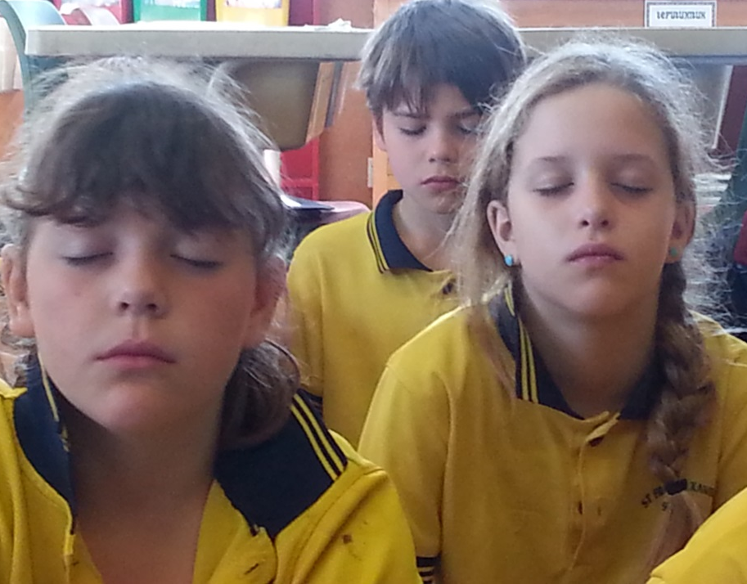
Time for Reflection
R-1
S-09
Click the audio button to stop reflective music
Click the audio button to play reflective music
Notes:
The MP3 is played to help create a reflective atmosphere and bring the children to stillness and silence as the teacher invites them to reflect on the meaning of Jesus’ promise to all his followers – to be with them always, to the end of time. Remember this promise when life is hard – tell Jesus you believe his promise and talk to him about what is troubling you. Listen for his response.

Slide 12
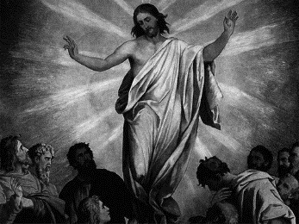
Check Up
Name:____________________________
Date:____________
1)
The Ascension is a feast of great celebration for us because …
2)
What do Jesus’ last words mean to you as one of his followers?
3)
How do you experience Jesus present everywhere on the earth?
4)
What difference does the Ascension event make to your relationship with Jesus?
5)
How would you explain to someone the importance of the feast of Jesus’ Ascension?
6)
Which activity do you think helped you to learn best in this lesson?
7)
Questions I would like to ask about the topics in this lesson are …
R-1
S-08
Worksheet
Click the up arrow to return to the presentation
Notes:
This worksheet relates to slide 9.

