Slide 1
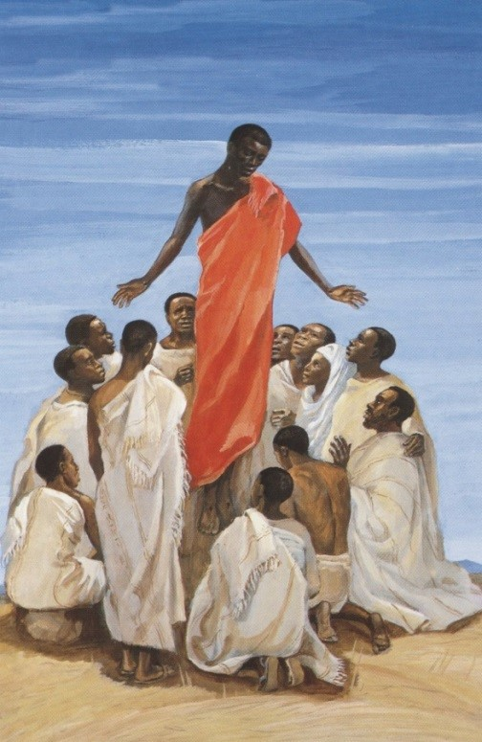
The Feast of the Ascension
R-1
S-01
Notes:
Slide 1 The Feast of Ascension
Use this slide as a focussing strategy to introduce the resource topic. Read the title together and invite children to share something they know about the Feast of the Ascension when Jesus returned to his Father in heaven.
Use the Ascension story in Acts 1:1-11 or John 14:1-3 in class prayer this week.

Slide 2
Learning Intentions
The children will:
1)
recognise that Jesus promised to prepare a place for people in Heaven
identify the hope that the Feast of the Ascension gives to those who believe in Jesus
2)
R-1
S-02
Click the box to reveal the Learning Intention
Notes:
Slide 2 Learning Outcomes
Read through the Learning Intentions with the class and identify some ideas/questions that might be explored in the resource.
Look closely at the Ascension image and share what you notice.
Remind children about how different cultures portray images of events differently.
This image shows Jesus ascending into heaven as portrayed by an African artist.
We call this inculturation – which means expressing ideas and images within different cultures. Imagine how Maori, Indian, Filipino, Pacifika or Chinese artists might paint or draw this event.
Share your ideas about the value of incultured art works.

Slide 3
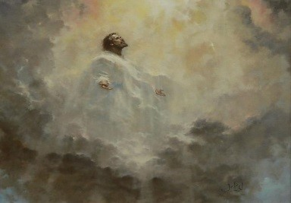
Rapid Recap of what we know
about Jesus’ Ascension
The Ascension of Jesus
R-1
S-03
Notes:
Slide 3 Rapid Recap of what we know about Jesus’ Ascension
Remind children that the Ascension is celebrated in Aotearoa New Zealand on the 7th Sunday of Easter.
Print off a copy of the Mind Map for each child to record something they know about the Ascension in each shape.
When Mind Maps are completed children share what they know.
Invite children to ask questions and record these for the class to see and keep them in focus as you work through the slides.

Slide 4
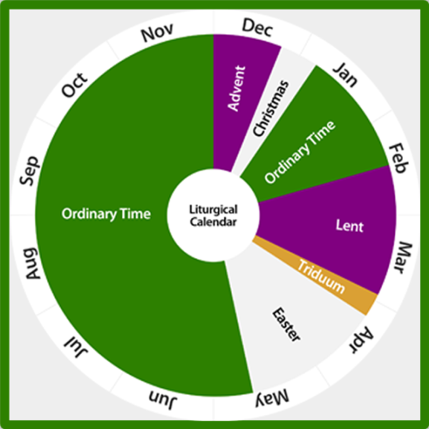
The Feast of the Ascension in the Liturgical Year
Look closely at the Liturgical Calendar and describe where you think the Ascension fits?
What season is the Ascension part of?
What major feast follows the Ascension?
What colours indicate celebrations on the Liturgical Calendar?
If you didn’t have a Liturgical Calendar where could you see the Liturgical colours?
X
R-1
S-04
Click the I-button to reveal information
Notes:
Slide 4 The Feast of the Ascension in the Liturgical Year
Responses
The Ascension comes at the end of the Easter season.
The Ascension is part of the Easter Season.
Pentecost follows the Ascension.
White, yellow or gold are celebration colours on Liturgical Calendars.
The covers on the altar, the lectern, and banners show the colour of the season.

Slide 5
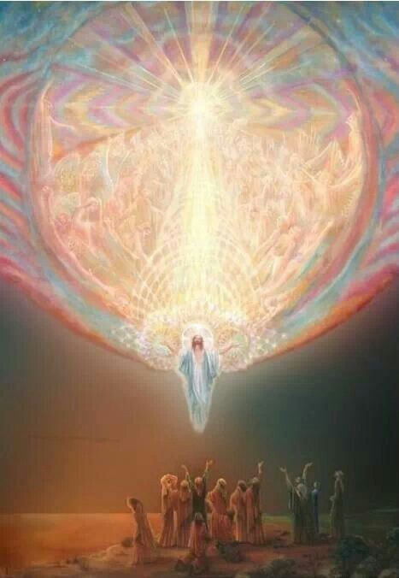
Putting Jesus’ Ascension in the
context of his last weeks on earth
Jesus entered Jerusalem
on a donkey 50 days before Ascension day.
On Thursday of the week that followed Palm Sunday
Jesus had his last meal with his apostles.
The day after his last supper Jesus
was put to death on a cross on Calvary hill.
Jesus lay in a
tomb for 3 days and then God raised him up.
After his resurrection Jesus showed himself
to his friends and some did not recognise him.
He spent time with his apostles and
told them he was going to return to his Father.
50 days after Palm Sunday Jesus
was taken by God to share his glory in heaven.
Because Jesus entered heaven in glory he
made it possible for his followers to do the same.
tomb for 3 days and then God raised him up.
E) to his friends and some did not recognise him.
B) Jesus had his last meal with his apostles.
F) made it possible for his followers to do the same.
C) was taken by God to share his glory in heaven.
G) was put to death on a cross on Calvary hill.
D) on a donkey 50 days before Ascension day.
H) told them he was going to return to his Father.
Click the video button to play a video
R-1
S-05
Click the statements at the bottom to reveal the correct statement match
Notes:
Slide 5 Putting Jesus’ Ascension in the context of his last weeks on earth
ANSWERS 1 – D, 2) – B, 3) – G, 4) – A, 5) – E, 6) – H, 7) – C, 8) - F
Use the word float to help children get the sequence of events leading up to the Ascension clear.
Make a list of the days and events for children to record.
Repeat the exercise orally until children are confident with it.
Watch the clip and give class time to ask questions and make comments about it.
Beloved Master Jesus Ascension 2:56 minutes
https://www.youtube.com/watch?v=4qBbr1D-OlU

Slide 6
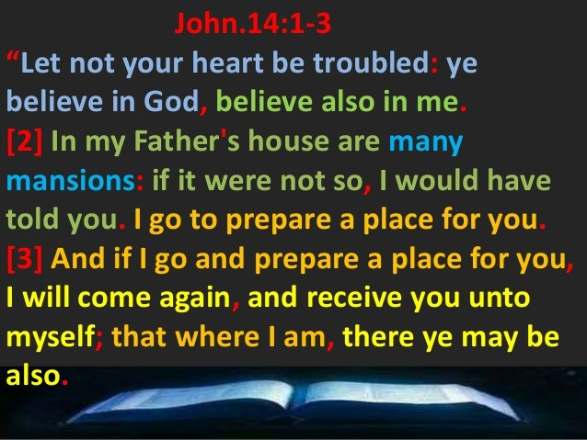
This Promise of Jesus fills Christians with hope
Read the passage from St. John’s Gospel.
Think about when this event happened, what Jesus is saying and why he might be saying it.
What is Jesus saying in Verse 1? What is the most important part of this message? Why?
What do you think Jesus is telling the apostles in Verse 2? Why do you think he said this? Where is his Father’s house?
What is Jesus preparing the apostles for in Verse 3? Share what tells you this.
What does this short passage tell us about the sort of person Jesus is and his relationship with his friends, including us?
Click the picture to advance the pointer
R-1
S-06
Click the audio button to stop ‘Sing a new Song’
Click the audio button to play ‘Sing a new Song’
Notes:
Slide 6 This Promise of Jesus fills Christians with hope
Adapt Teaching and Learning Experiences 4 & 5.
Read the gospel text on the image.
Use the pointer to work through the questions beside the text.
Encourage children to learn the verse that means most to them by heart and write it in their RE Learning Journal.
Sing ‘Sing a new Song’

Slide 7
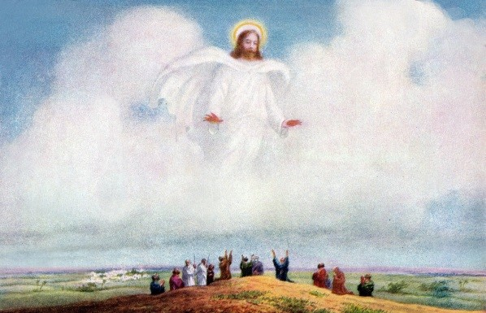
Why the Ascension of Jesus is such
an important event for his followers
The Ascension is followed one week later with the celebration of Pentecost when Jesus keeps his promise by sending his Holy Spirit to be with his followers.
The feast of the Ascension reminds Christians that it is through Jesus that we will live forever with God in heaven.
The promises Jesus made just before he ascended to his Father filled his followers with hope that they will enter the glory and presence of God when they die.
Jesus is now our Lord and God and ruler of all of creation. His presence is not limited to any one place but he is present everywhere.
When he ascended to his Father, God gave Jesus power and authority over all the universe.
It is because Jesus ascended into heaven and made a promise to his followers that he would prepare a place for them there in his Father’s house also.
We cannot enter heaven and share eternal life with God by ourselves.
On our own we cannot share in God’s life, God’s Tapu and Mana because we are human and God is divine.
R-1
S-07
Click top card to reveal others
Click the reset button to restart
Notes:
Slide 7 Why the Ascension of Jesus is such an important event for his followers
Read each flip card and talk about what it means.
How is it possible for humans to enter heaven?
What did God give Jesus when he ascended to heaven?
What difference did Jesus’ Ascension make to him?
What effect did the promises Jesus made before he ascended have on his followers?
What happens one week after the Ascension?

Slide 8
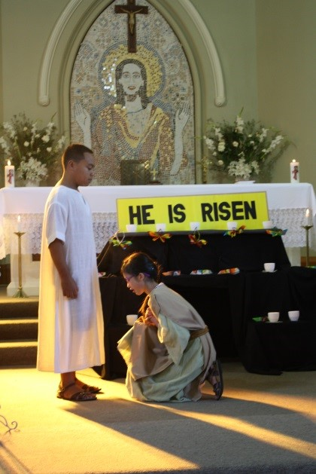
Check up
1)
Why is the Ascension a feast of hope for all Christians?
Create an art work that illustrates 5 major events in Jesus’ life that happened in the 50 days before his Ascension and share this with your school and parish.
Name each event and put them in sequence.
2)
3)
Give 3 reasons why Jesus ascended to God his Father.
4)
Which activity do you think helped you to learn best in this resource?
5)
Questions I would like to ask about the topics in this resource are …
R-1
S-08
Click the worksheet button to go to the worksheet
Notes:
Slide 8 Check Up
This formative assessment strategy will help teachers to identify how well children have achieved the Learning Intentions of the resource.
Teachers can choose how they use the slide in their range of assessment options.
A worksheet of this slide is available for children in Years 5-8 to complete.
The last two items are feed forward for the teacher.
Recording the children’s responses to these items is recommended as it will enable teachers to adjust their learning strategies for future resources and target the areas that need further attention.

Slide 9
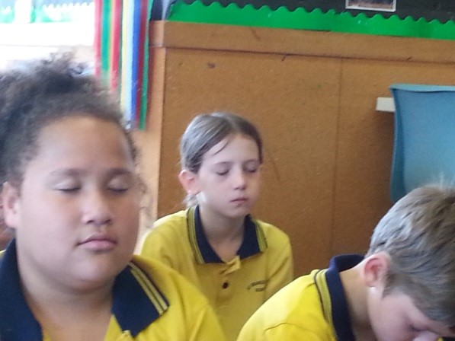
Time for Reflection
R-1
S-09
Click the audio button to stop reflective music
Click the audio button to play reflective music
Click the audio button to play reflective music
Notes:
Slide 9 Time for Reflection
The MP3 is played to help create a reflective atmosphere and bring the children to stillness and silence as the teacher invites them to reflect on the difference to their lives that Jesus made by his Ascension. Thank Jesus for the hope he has given you that you will one day be happy with him forever in heaven.

Slide 10
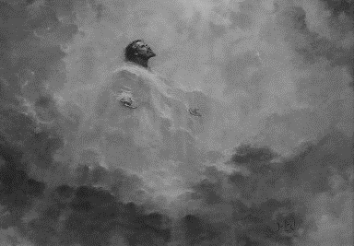
Rapid Recap of what we know
about Jesus’ Ascension
The Ascension of Jesus
Worksheet
R-1
S-03
Click the up arrow to return to the presentation

Slide 11
Check up
Name:____________________________
Date:____________
1) Why is the Ascension a feast of hope for all Christians?
2) Create an art work that illustrates 5 major events in Jesus’ life that happened in the 50 days before his Ascension and share this with your school and parish.
Name each event and put them in sequence.
3) Give 3 reasons why Jesus ascended to God his Father.
4) Which activity do you think helped you to learn best in this resource?
5) Questions I would like to ask about the topics in this resource are …
R-1
S-08
Worksheet
Click the up arrow to return to the presentation

