Slide 1
The Ascension
R-1
S-01
Notes:
Slide 1 The Ascension
Use this slide as a focussing strategy to introduce the resource topic. Read the title together and invite the class to share something they know about the meaning of Jesus’ Ascension when he entered into his glory and his last message to his disciples and those who would follow them.
Use the Scripture accounts of the Ascension in class prayer this week.

Slide 2
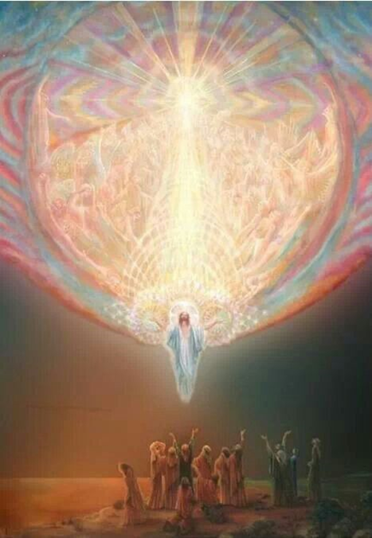
Learning Intentions
The students will:
1)
recognise that before his Ascension Jesus commissioned his disciples to continue his mission on earth
2)
recognise that by returning to Heaven Jesus has entered into his glory and had been given all power- te Tino mana in heaven and on earth.
R-1
S-02
Click the borders to reveal text
Notes:
Slide 2 Learning Intentions
Read through the Learning Intentions with the class and identify some ideas/questions that might be explored in the resource.

Slide 3
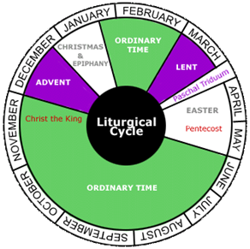
Ascension Day in the Liturgical Year in Aotearoa New Zealand
The feast of the Ascension celebrates Jesus’ return to the glory of heaven. He was lifted up and taken out of sight by a cloud - a cloud was recognised as a sign of God so this means he was really returning to God.
Ascension day in Aotearoa New Zealand is celebrated on the 7th Sunday of the Easter Season. The Ascension is an important feast in the Easter season.
Before Jesus returned to heaven he passed on his mission to his apostles to go out and make disciples of all nations so that the work he had started would be continued.
The work Jesus did was confined to the people of Israel but he wanted his disciples to go beyond Israel and out into the whole world so that all people of every race and country could become his disciples.
Jesus promised to send his Spirit into his disciples to guide and strengthen them in their mission to spread the good news Jesus had taught them.
R-1
S-03
Click on the icons to reveal text
Notes:
Slide 3 Ascension Day in the Liturgical Year in Aotearoa New Zealand
Adapt Teaching and Learning Experiences 1&2
Read, reveal and discuss the text in each item them ask the following questions.
What is the connection between the Ascension and Easter?
Name 3 aspects of the work Jesus started while he lived on earth.
What is meant by Jesus has entered into his glory and has been given all power in heaven and earth.

Slide 4
Jesus promised to send the Holy Spirit Te Wairua Tapu to strengthen the disciples
1
The apostles are to be the witnesses throughout Judea and
Do you think New Zealand could
At the name of Jesus every knee should bend
When Jesus ascended into heaven all power and authority
St Paul says, “God has exalted Jesus on high
It is through the Holy Spirit that
2
3
4
5
6
a)
every tongue confess that Jesus Christ is Lord.
d)
Jesus is with his followers for all time just as he promised.
b)
in heaven and earth was given to him.
e)
and given him a name above all other names”.
c)
be described as the ends of the earth?
f)
Samaria and to the ends of the earth.
Click the buttons on the left to reveal the correct statement match
R-1
S-04
Click the audio button to stop ‘For the Kingdom’
Click the audio button to play ‘For the Kingdom’
Notes:
Slide 4 Jesus promised to send the Holy Spirit Te Wairua Tapu to strengthen the disciples
Read Mark 16:15-20
Students read each item and suggest the statement that would complete it.
ANSWERS 1)-F, 2)-C, 3)-A, 4)-B, 5)-E, 6)-D
Sing using the MP3 ‘For the Kingdom’

Slide 5
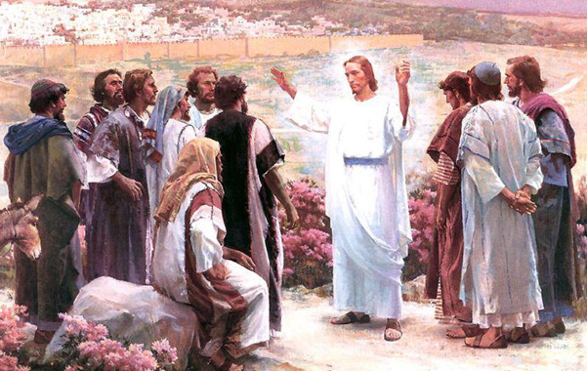
The Great Commissioning and Jesus’ Ascension
Read Mark 16:15-20 - Answer the questions
This event in Mark’s gospel has two parts – can you name them?
What significance does this story have for the followers of Jesus today?
How are you being a witness to knowing and following Jesus?
What places do you understand to be ‘the ends of the earth’ today and who has taken the good news there?
Can you imagine what the apostles think of the ways the gospel is shared now in the 21st century?
Press the button to advance through the lines
Click the video button to play the video
R-1
S-05
Notes:
Slide 5 The Great Commissioning and Jesus’ Ascension
Adapt Teaching and Learning Experience 3
Use the pointer to work through the discussion items.
Watch the clip
The Great Commission 2:39 minutes
https://www.youtube.com/watch?v=RD0LNtc1UE4om/watch?v=ONROQBrbZU8
Encourage the students to comment on the clip and ask questions.
Students share what they know about how and who brought the gospel to Aotearoa New Zealand and how the gospel is spread today throughout our country.

Slide 6
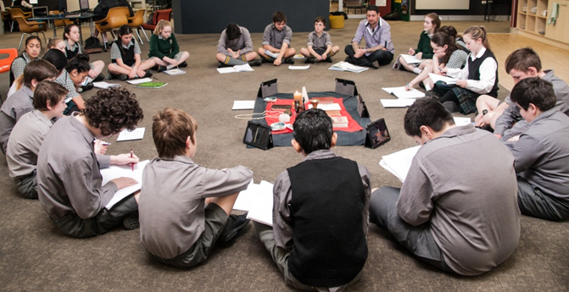
You will be my witnesses in …
R-1
S-06
Click the worksheet button to go to the worksheet
Notes:
Slide 6 You will be my witnesses in …
Students complete their worksheets and share them with other classes and family. Add them to their RE Journals.
Adapt Teaching and Learning Experience 4
Set up groups to debate the statement - It is easier for people in the 21st Century to spread the Good News and follow Jesus than it was in the 1st Century.

Slide 7
God gave Jesus a name above all other names
Jesus, by his death on the cross, won God’s favour back for people because they sin and turn away from God and this is why God raised Jesus up to rule with all power and authority over the whole universe. We acknowledge Jesus’ power and glory when we sing ‘He is Lord’.
This will be when Jesus will come again to the earth and God’s kingdom will be completed and every man, woman and child who ever lived in this world will acknowledge that Jesus truly is Lord and will believe in him.
God has exalted Jesus and given him a name that is above every other name. God’s plan is that one day every single person will bow their knee and every single tongue will confess that Jesus Christ is Lord.
That is the way it works in God’s kingdom. If you want to be the first, you don’t put yourselves there. You need to be the servant of others if you want to be the greatest in God’s kingdom.
When Jesus lived on earth, he did not exalt himself and expect others to serve him. He did the opposite and served others because he was humble. Because of this God raised his Son up to the highest place of importance after his Ascension into heaven.
Therefore God has highly exalted him and bestowed on him the name that is above every name, so that at the name of Jesus every knee should bow, in heaven and on earth and under the earth, and every tongue confess that Jesus Christ is Lord, to the glory of God the Father. Philippians 2:9-11
Click top card to discard it
Click the video button to play the video
R-1
S-07
Notes:
Slide 7 God gave Jesus a name above all other names
Use the flip cards to deepen students’ understanding of what the Kingdom of God is like. Encourage students to name how the Kingdom of God works and how this is different from most other earthly kingdoms.
Read the Philippians excerpt and explain that Jesus’ name is holy and should always be used with respect and reverence.
Adapt Teaching and Learning Experience 5.
Watch the clip and sing
Song ‘He is Lord’ From Philippians 2:22 minutes
https://www.youtube.com/watch?v=GD2lfIam7mQ

Slide 8
Check up
1)
Make a comic strip of the story of the Ascension and include Jesus’ words and actions and imagine what the apostles said. Share this with a younger child.
2)
Make a timeline of the major events in Jesus’ life from Palm Sunday until Pentecost and say what happened at each event.
3)
Explain why God exalted Jesus after he returned to heaven and how God did this.
4)
What is God’s plan for all human beings at the end of time?
5)
Which activity do you think helped you to learn best in this resource?
6)
Questions I would like to ask about the topics in this resource are …
Click in each caption space to reveal text
Click on the worksheet button to go to the worksheet.
R-1
S-08
Notes:
Slide 8 Check Up
This formative assessment strategy will help teachers to identify how well children have achieved the Learning Intentions of the resource.
Teachers can choose how they use the slide in their range of assessment options.
A worksheet of this slide is available for children in Years 5-8 to complete.
The last two items are feed forward for the teacher.
Recording the children’s responses to these items is recommended as it will enable teachers to adjust their learning strategies for future resources and target the areas that need further attention.

Slide 9
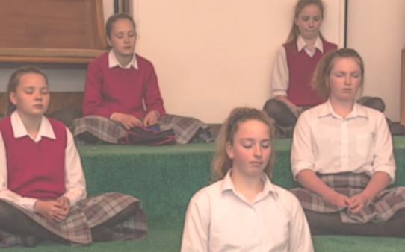
Time for Reflection
R-1
S-09
Click the audio button to stop reflective music
Click the audio button to play reflective music
Notes:
Slide 9 Time for Reflection
The MP3 is played to help create a reflective atmosphere and bring the young people to stillness and silence as the teacher invites them to reflect on the people who have helped them to know and love Jesus and live as his follower. Send them a message to tell them you are grateful for this.

Slide 10
You will be my witnesses in – Time to recall and reflect on your faith journey
Write your responses and give some examples
Who was the first person or ‘witness’ who helped you get to know God?
By whom, and how have you been supported to become a more active and mature follower of Jesus?
Who are the ‘witnesses’ who have had the greatest impact on you as you have grown in your discipleship?
How could you be recognised as a witness to and follower of Jesus by the sort of person you are and by the way you are living?
How would you describe the most effective ‘witnesses’ to Jesus’ messages of love, service, kindness and compassion and what would you say to them if you met them?
Answer
Name: _______________
Date: _________
R-1
S-06
Worksheet
Click on the worksheet button to go to the worksheet
Click the up arrow to return to the lesson

Slide 11
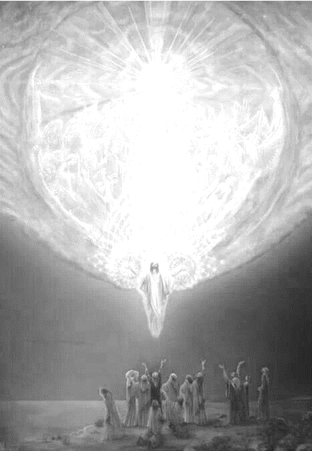
Check up
Name:____________________________
Date:____________
Make a comic strip of the story of the Ascension and include Jesus’ words and actions and imagine what the apostles said. Share this with a younger child.
Make a timeline of the major events in Jesus’ life from Palm Sunday until Pentecost and say what happened at each event.
Explain why God exalted Jesus after he returned to heaven and how God did this.
What is God’s plan for all human beings at the end of time?
Which activity do you think helped you to learn best in this resource?
Questions I would like to ask about the topics in this resource are …
R-1
S-08
Worksheet
Click the up arrow to return to the lesson

