Slide 1
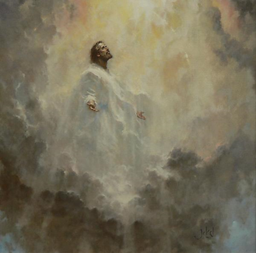
The Feast of the Ascension
R-1
S-01
Notes:
Slide 1 The Feast of the Ascension
Use this slide as a focussing strategy to introduce the resource topic. Read the title together and invite students to share something they know about what the Church celebrates on the feast of the Ascension.
Use the Scripture accounts of the Ascension in class prayer this week.

Slide 2
Learning Intentions
The students will:
1)
explain what the Church celebrates on the Feast of the Ascension
2)
recognise that the Feast of the Ascension gives people hope tūmanako that through the Holy Spirit Te Wairua Tapu they too may share in a heavenly destiny
R-1
S-02
Click the borders to reveal text
Notes:
Slide 2 Learning Intentions
Read through the Learning Intentions with the class and identify some ideas/questions that might be explored in the resource.

Slide 3
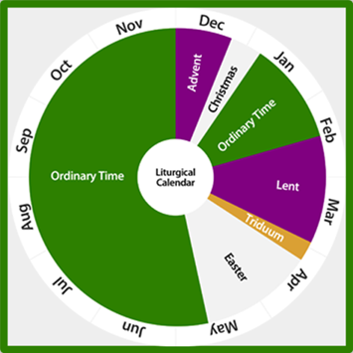
The Liturgical Year
Add the Ascension to your Liturgical Calendar.
Describe where the Ascension comes in the Liturgical Year.
Why is the Ascension in the Easter season?
What is the connection between the Ascension and Pentecost?
Why is the Ascension a significant feast for the followers of Jesus?
X
R-1
S-03
Click the I-button to reveal information
Notes:
Slide 3 The Liturgical Year
Use items on the pop up to initiate discussion.
Let the worksheet generate further discussion that will lead into the next major feast to be celebrated. Students complete and share their worksheets and add them to their RE Learning Journal.

Slide 4
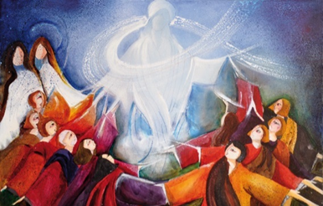
Adding to the Meaning of the Ascension Event
Jesus’ Ascension symbolized Jesus’ exaltation by God and he became recognised as the one ‘with whom the Father was well pleased’. He was received into heaven with great honour and given a name above all other names. Jesus glorified his Father on earth and now his Father glorifies him in heaven.
Jesus now works for all people responding to their prayer and comforting them in their struggles. He is their king and he will establish his kingdom of justice, peace and mercy.
Jesus’ Ascension makes us aware that the ascended Jesus is our mediator, he has secured our forgiveness and reconciliation with God.
Jesus’ Ascension was something he spoke about while on earth and that he had been sent by the Father and that he would return to the Father – this came about through his Ascension.
Jesus’ Ascension reminds us that at present Jesus is in heaven where, in the Scriptures, he is frequently pictured at the right hand of the Father in a position of great honour, glory, power and authority.
Jesus’ Ascension signalled the end of his ministry on earth.
R-1
S-04
Click the top card to discard it
Notes:
Slide 4 Adding to the Meaning of the Ascension Event
Work through each of the flip cards and ask children to share new key ideas in their group. When completed children can record their new learning about the Ascension in their RE Learning Journal.
The image of the Ascension is by an Italian woman artist called Maddalena Franguelli.

Slide 5
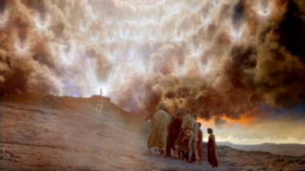
The Five Accounts in Scripture of the Ascension Story
R-1
S-05
Click the worksheet button to go to the worksheet
Notes:
Slide 5 The Five Accounts in Scripture of the Ascension Story
Adapt Teaching and Learning Experience 2
Follow the direction on the worksheet. Ascension story references:
Matthew 28:16-20, Mark 16:15-20, Luke 24: 46-53, John 14:1-3, Acts 1:1-11
Students complete the worksheet and share their responses to compare accounts noting the similarities and differences in each. Students comment on the Scripture of the Ascension account they preferred and give reasons.

Slide 6
The Chapel of the Ascension marks the place today
The first construction built on this place was a rotunda open to the sky and surrounded by porticos and arches. It was appropriate given that the sky was significant for those present at the original event being commemorated.
The Chapel of the Ascension (Hebrew: קפלת העלייה‎)‎ is a shrine located on the Mount of Olives, in the At-Tur district of Jerusalem consisting first of a Christian church and monastery and an Islamic mosque.
Share what other holy places in Israel you know about where signs of Jesus’ life there can still be seen.
The present Chapel is under Islamic jurisdiction and unfortunately the open roof has been filled in much to the disappointment of pilgrims who visit the Chapel to gaze upwards and recapture a sense of Jesus’ Ascension.
The Chapel is located on a site Christians traditionally believe to be the earthly spot where Jesus ascended into Heaven forty days after his resurrection. It houses a slab of stone believed to contain one of his footprints.
Click the pins on the right to reveal post-it notes.
Click the video button to play the video
R-1
S-06
Notes:
Slide 6 The Chapel of the Ascension marks the place today
Use this slide to make students aware that the place of Jesus’ Ascension is now a place of pilgrimage in Israel.
Read the Post it notes to increase students understanding of
Watch the clip
The Chapel of the Ascension on the Mount of Olives 2:02 minutes
https://www.youtube.com/watch?v=CvoNO-L-PfU
Encourage students to do further research about holy places in Israel. Set up a display place for these in the classroom.

Slide 7
What Christians celebrate on the feast of the Ascension
We celebrate the success of Jesus’ work on earth and that he accomplished all he had come to do and he had glorified his Father.
We celebrate the event that marked the return of Jesus’ heavenly glory which had been veiled during his time on earth, except for a brief exception at the Transfiguration.
We celebrate that it was because Jesus ascended it became possible for us to enter into our place in heaven which he prepared for us and this gives us reason to hope that through the Holy Spirit we will be with him in heaven when we die.
We celebrate that Jesus’ Ascension set the pattern for his Second Coming when he comes to set up God’s kingdom – we pray for this in the Our Father. He will come back in his physical body in the clouds just as he left – the angels at the Ascension told the apostles this.
Click the icons to reveal text and image
R-1
S-07
Click the audio button to stop ‘Till the end of Time’
Click the audio button to play ‘Till the end of Time’
Notes:
Slide 7 What Christians celebrate on the feast of the Ascension
Students share what Christians celebrate on the feast of the Ascension. Use the revealed text to deepen their understanding about this.
Recall what happened at the Transfiguration and explain how this illustrated what Jesus’ heavenly glory looks like. Include in class prayer this week – prayers of thanks to Jesus for making it possible for people to hope that they through the help of the Holy Spirit will, when they die be with him in heaven forever.
Share ideas about what will happen at Jesus’ second coming at the end of time.
Sing using the MP3 ‘Till the end of Time’.

Slide 8
Check up
1)
Name 3 things the Church celebrates on the feast of the Ascension.
2)
How does the Ascension help followers of Jesus today to have hope that they will share in his glory forever in heaven when they die?
3)
Explain why the Ascension story appears at the end of the gospels and the beginning of the Acts of the Apostles.
4)
Name 5 things the gospel accounts of the Ascension tell about the event.
5)
Which activity do you think helped you to learn best in this resource?
6)
Questions I would like to ask about the topics in this resource are …
Click in each caption space to reveal text
Click on the worksheet button to go to the worksheet.
R-1
S-08
Notes:
Slide 8 Check Up
This formative assessment strategy will help teachers to identify how well students have achieved the Learning Intentions of the resource.
Teachers can choose how they use the slide in their range of assessment options.
A worksheet of this slide is available for students in Years 5-8 to complete.
The last two items are feed forward for the teacher.
Recording the students’ responses to these items is recommended as it will enable teachers to adjust their learning strategies for future resources and target the areas that need further attention.

Slide 9
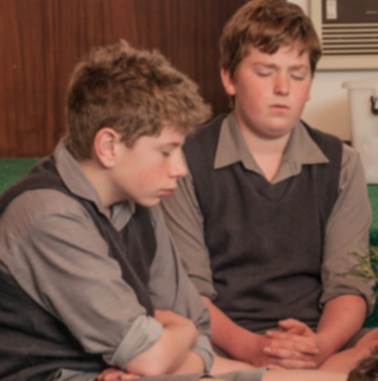
Time for Reflection
R-1
S-09
Click the audio button to stop reflective music
Click the audio button to play reflective music
Notes:
Slide 9 Time for Reflection
The MP3 is played to help create a reflective atmosphere and bring the young people to stillness and silence as the teacher invites them to reflect on Jesus ascending to heaven and how this made it possible for all humans, when they die, to enter into heaven and the presence of God forever

Slide 10
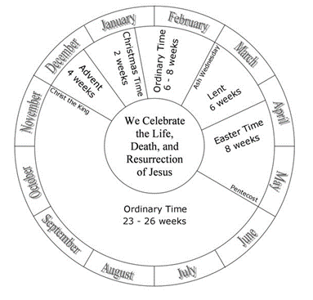
The Liturgical Year
Complete the sentences in your RE books
What season takes up most of the Liturgical Year? Why do you think this is?
Colour the seasons in their Liturgical colours and draw a chasuble vestment beside it to match.
Beside each season draw a small symbol that illustrates what the season is about.
Write a simple explanation to describe what the Liturgical Year is to a younger child.
Name your favourite season or feast and give reasons for your choice.
In an empty church, how would you know what season of the Liturgical Year it is?
Name: _______________
Date: _________
R-1
S-03
Worksheet
Click the up arrow to return to the lesson

Slide 11
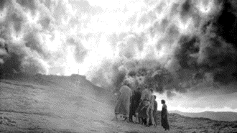
The Five Accounts in Scripture of the Ascension Story
Break into 5 groups and each group reads one account of the story – see references below.
Matthew 28:16-20 - Mark 16: 15-20 - Luke 24:46-53 - John 14:1-3 - Acts 1:1-11
Mark the reference and read the story in your group and record your responses on the worksheet.
What did Jesus ask the apostles to do?
What did Jesus promise the apostles?
How did the apostles react when Jesus left them?
Other things you noted in the story.
Share your responses with other groups and record any new details from other versions that are not included in yours.
Note 3 new facts you have learned about the Ascension story
1)
2)
3)
Share these with the rest of the class.
Name: _______________
Date: _________
R-1
S-05
Worksheet
Click the up arrow to return to the lesson

Slide 12
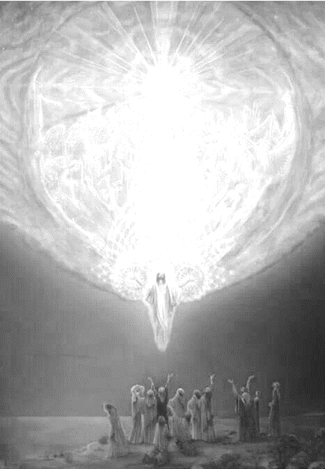
Check up
Name:____________________________
Date:____________
Name 3 things the Church celebrates on the feast of the Ascension.
How does the Ascension help followers of Jesus today to have hope that they will share in his glory forever in heaven when they die?
Explain why the Ascension story appears at the end of the gospels and the beginning of the Acts of the Apostles.
Name 5 things the gospel accounts of the Ascension tell about the event.
Which activity do you think helped you to learn best in this resource?
Questions I would like to ask about the topics in this resource are …
R-1
S-08
Worksheet
Click the up arrow to return to the lesson

