Slide 1
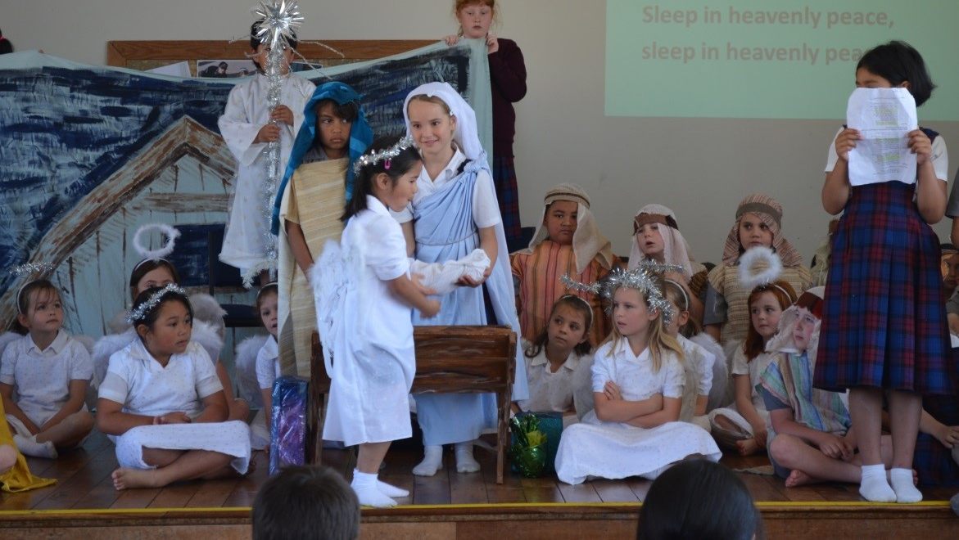
The Birth of Jesus
L-1
S-01
Notes:
Use this slide as a focussing strategy to introduce the lesson topic. Read the title together and invite children to share something they know about the birth of Jesus.

Slide 2
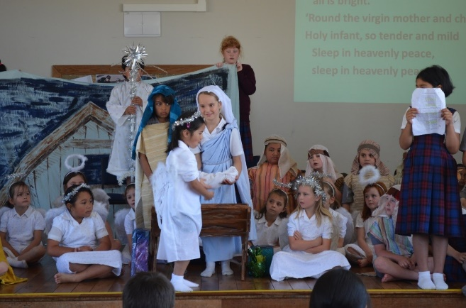
Learning Intentions
The children will:
1)
recall the story of the birth of Jesus.
2)
name ways people in the story responded to the birth of Jesus.
3)
name the day people celebrate the birth of Jesus.
L-1
S-02
Click the boxes to reveal text.
Notes:
Read through the Learning Intentions with the class and identify some ideas/questions that might be explored in the lesson.

Slide 3
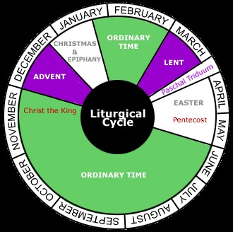
The end of Advent brings us to the feast of Christmas
Advent is the s
Advent comes after O
Advent is before C
Christmas comes after A
Christmas is the feast of J
The colours for Christmas are w
eason for getting ready
rdinary Time
hristmas
dvent
esus’ birth
hite, yellow or gold.
Ordinary time
Christmas
white, yellow or gold
season for getting ready
Advent
Jesus’ birth
L-1
S-03
Click words from the list or an empty space to correctly position words.
Notes:
Adapt Teaching and Learning Experience 1
Children use the initial sound as a clue to the correct words to complete the sentence. Use the floaters to check.
Children can complete the worksheet and add it to their RE Learning Journal.
Answers
1) season for getting ready, 2) Ordinary Time, 3) Christmas, 4) Advent, 5) Jesus’ birth, 6) white, yellow or gold

Slide 4
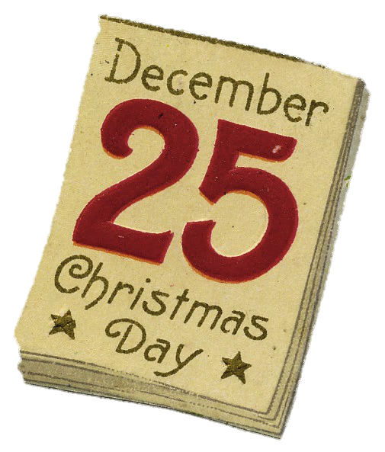
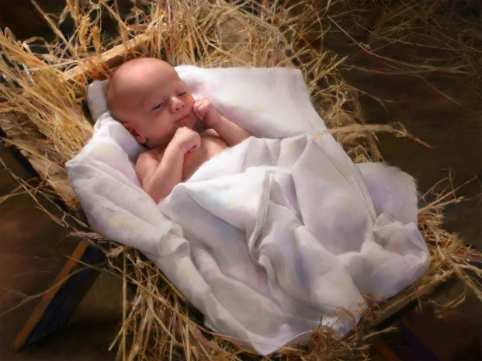
What day is Jesus’ birthday?
Jesus’ birthday is December 25.
This is a very special day in the year.
We call it Christmas Day.
L-1
S-04
Click the boxes to reveal text.
Notes:
Adapt Teaching and Learning Experiences 1&2
Children read the captions then share their own birthday with the class and say why it is a special day.

Slide 5

What do we say to Jesus on his birthday?
L-1
S-05
Click the video button to play a video
Notes:
Ask children why we wish ‘happy birthday’ to people on their birthday?
Watch the clip
Song ‘Happy birthday Jesus’ 2:40 minutes – words included
https://www.youtube.com/watch?v=XMJn-xINwsU

Slide 6
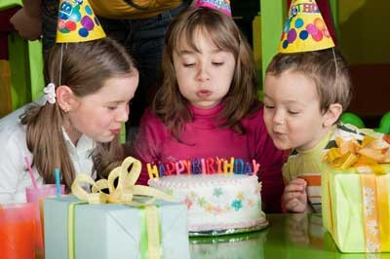
Everyone has a birthday
What do you know about the day you were born?
Who were the first people to know about your birth?
What do people say to you on your birthday?
Who do you think wished Jesus ‘happy birthday’ the day he was born?
L-1
S-06
Click arrows to reveal text
Notes:
Read the reveal questions and share answers.
Can you remember what makes your 5th birthday very special?
Refer to information on the completed Home Activity page (p. 20 in Teacher’s Book or on the lesson home page).

Slide 7
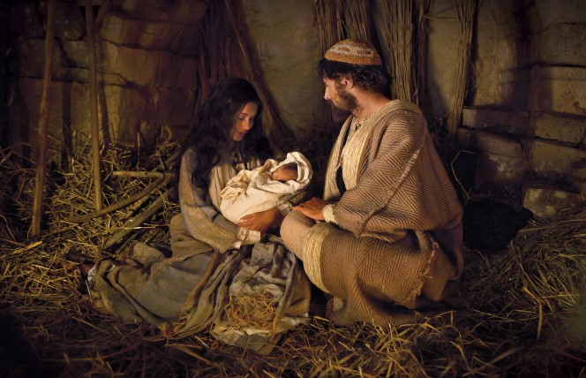
The Christmas Story begins when Jesus was born
L-1
S-07
Notes:
Adapt Teaching and Learning Experiences 4, 5,6
Text below to be read as the children look at the image:
About the time Jesus was to be born the emperor ordered that all the people were to go back to their own towns to be counted. Joseph went with Mary from the town of Nazareth in Galilee to Bethlehem in Judea. While they were there the time came for the baby to be born. There was no place for them to stay so the inn keeper let them stay in his stable with the sheep and cattle. Jesus was born there and Mary wrapped him in swaddling clothes and laid him in the manger on the soft hay.

Slide 8
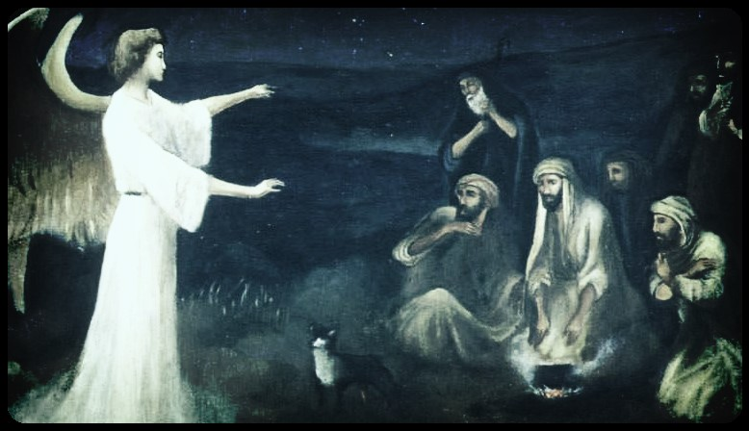
Mary, Joseph and Jesus had some visitors
L-1
S-08
Notes:
Text below to be read as the children look at the image:
In the countryside near Bethlehem there were shepherds watching over their sheep at night. Suddenly an angel, a messenger from God came and stood in front of them and they were very frightened. The angel said, “Do not be frightened, for I am bringing you good news of great joy to share with all people. Today a saviour has been born in the city of Bethlehem. He is the messiah sent by God to save you. You will find the baby wrapped in swaddling clothes and lying in a manger. All of a sudden there was a huge crowd of angels praising God and singing, “Glory to God in the highest heaven and on earth peace to all people of good will.”

Slide 9
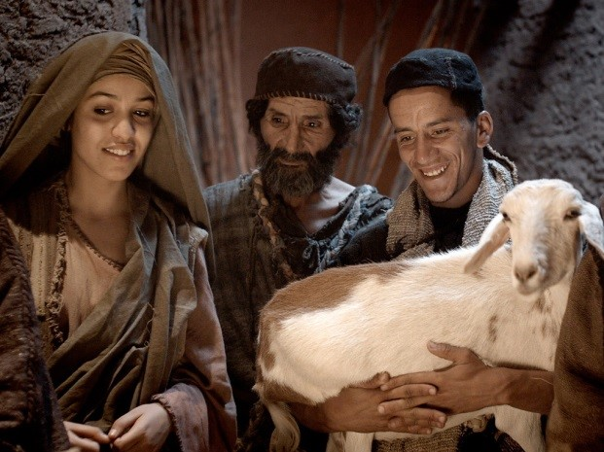
The shepherds go to find the baby who was Jesus, God’s son, born in the stable
L-1
S-09
Notes:
Text below to be read as the children look at the image:
When the angels left to return to heaven the shepherds said “Let us go now to Bethlehem and see what has happened that the angels told us about.” So they hurried over the hills to the stable and found Mary and Joseph and the child lying in the manger. They told people what the angel had said about the baby and everyone was amazed. Mary remembered their words and thought about them in her heart. The shepherds returned to their fields glorifying and praising God for all they had seen and heard.
This is the story of the birth of Jesus adapted from the story St Luke wrote down. Chapter 2: 1-20

Slide 10
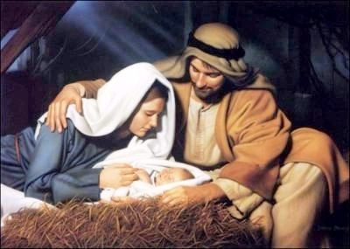
What Mary and Joseph did when Jesus was born
Mary wrapped Jesus in swaddling
Joseph looked after Mary and
Mary placed Jesus in
Joseph made a bed for Jesus
Mary cuddled Jesus and
clothes to keep him warm.
cared for her with love.
the manger to sleep on the soft hay.
using the animal feeding box.
whispered to him how much she loved him.
using the animal feeding box.
cared for her with love.
whispered to him how much she loved him.
clothes to keep him warm.
the manger to sleep on the soft hay.
L-1
S-10
Click a line from the list or an empty space to correctly position a line.
Notes:
Adapt Teaching and Learning Experience 7
Children read the title and respond to it by finding the correct statement to complete the sentences.
Check them with the floaters.
ANSWERS: 1-d, 2-b, 3-e, 4-a, 5-c

Slide 11
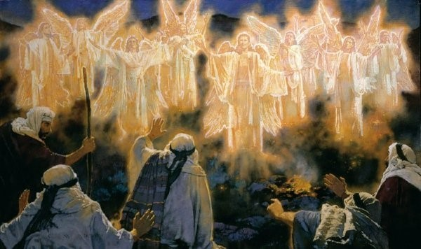

What the angels did when Jesus was born
The angels came from God in heaven with a message.
They brought the shepherds the good news of Jesus’ birth.
Then they sang a song of praise and joy to God.
What do you think the angels told God about Jesus’ birth?
L-1
S-11
Click bottom of cards to move through them and click arrow to return the cards
Notes:
Adapt Teaching and Learning Experience 7
Children read the title and respond to it by reading the text on the flip cards.

Slide 12

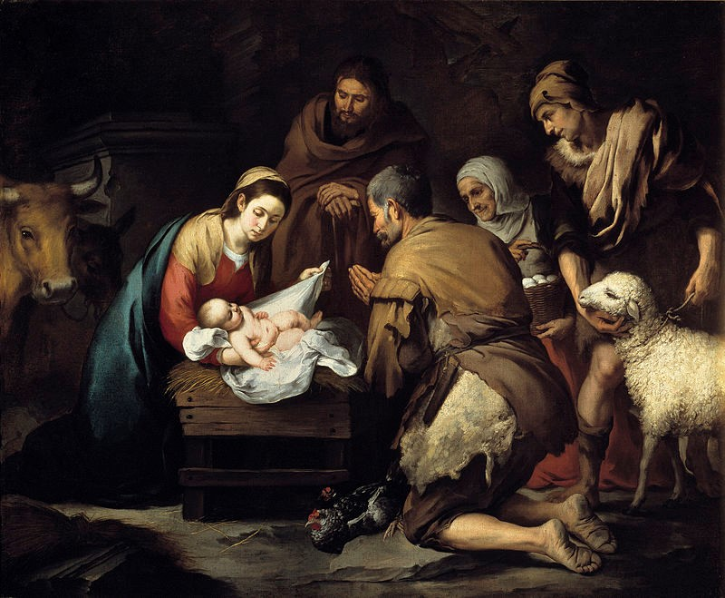
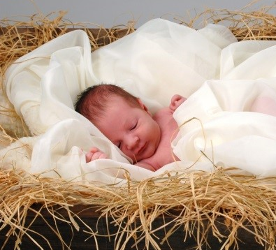

What the shepherds did when Jesus was born
The shepherds listened to the angels’ message.
They were the first people to hear the good news of Jesus’ birth.
They were the first people to hear the good news of Jesus’ birth.
The shepherds listened to the angels’ message.
They hurried to the stable to see Mary and Joseph and their baby.
They adored him because they knew he was the saviour of the world.
They spread the news of Jesus’ birth to everyone they met.
What do you think the shepherds said to Jesus when they saw him?
What do you think the shepherds said to Jesus when they saw him?
They spread the news of Jesus’ birth to everyone they met.
They adored him because they knew he was the saviour of the world.
They hurried to the stable to see Mary and Joseph and their baby.
L-1
S-12
Click bottom of cards to flip through.
Click the audio button to play ‘The Stars danced’
Click the audio button to stop ‘The Stars danced’
Notes:
Adapt Teaching and Learning Experiences 7, 10,11
Children read the title and respond to it by reading the flip book.
Sing using the MP3 ‘The stars danced’

Slide 13

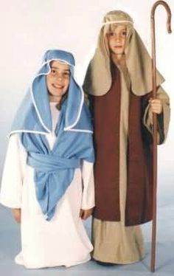
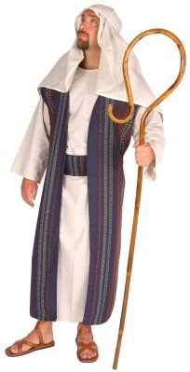
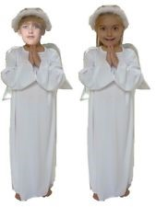
Every Christmas children act out the Christmas story
Which character in the story would you like to be?
I would like to be Mary because…
I would like to be Joseph because…
I would like to be a shepherd because...
I would like to be an angel because…
L-1
S-13
Click characters to display text
Notes:
Children think about the characters in the Christmas story and use the reveals to decide on what character they would like to be and share the reasons for their choice.

Slide 14

Check Up
1)
Tell the Christmas story around your class circle.
2)
Choose one character or group in the story and share what they did when Jesus was born.
3)
Christian people who follow Jesus celebrate his birth on…
4)
Which activity do you think helped you to learn best in this lesson?
5)
Questions I would like to ask about the topics in this lesson are…
L-1
S-14
Click in each caption space to reveal text
Notes:
This formative assessment strategy will help teachers to identify how well the children have achieved the Learning Intentions of the lesson.
Teachers can choose how they use the slide in their range of assessment options.
A worksheet of this slide is available for children in Years 5-8 to complete.
The last two items are feed forward for the teacher.
Recording the children’s responses to these items is recommended as it will enable teachers to adjust their learning strategies for future lessons and target the areas that need further attention.

Slide 15

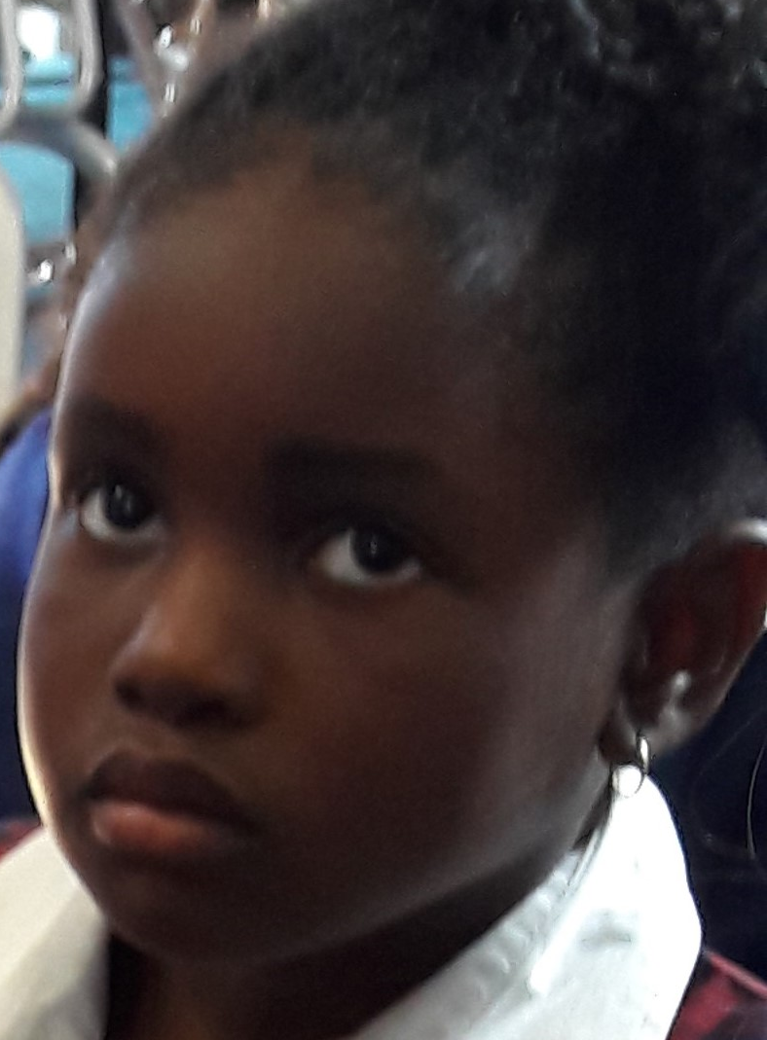

Time for Reflection
L-1
S-15
Click the audio button to stop Reflective Music
Click the audio button to play Reflective Music
Notes:
The MP3 is played to help create a reflective atmosphere and bring the children to stillness and silence as the teacher invites them to remember that Jesus was such a special baby because he was God’s only son and God gave him as a gift to the world. Whisper ‘thank you’ to Jesus in your heart for being born into the world so we can get to know him and follow him.

Slide 16
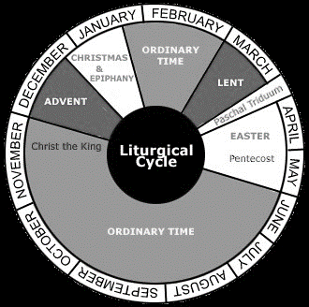
The end of Advent brings us to the feast of Christmas
Name___________________________ Date_______________
Advent is the s
Advent comes after O
Advent is before C
Christmas comes after A
Christmas is the feast of J
The colours for Christmas are w
Ordinary Time
season for getting ready
Christmas
Advent
white, yellow or gold
Jesus’ birth
L-1
S-3
Worksheet
Click the up arrow to return to the lesson
Notes:
This worksheet relates to slide 3
Answers
1) season for getting ready, 2) Ordinary Time, 3) Christmas, 4) Advent, 5) Jesus’ birth, 6) white, yellow or gold

